Slide 1
Agile S/W Process Model
SCRUM

Slide 2
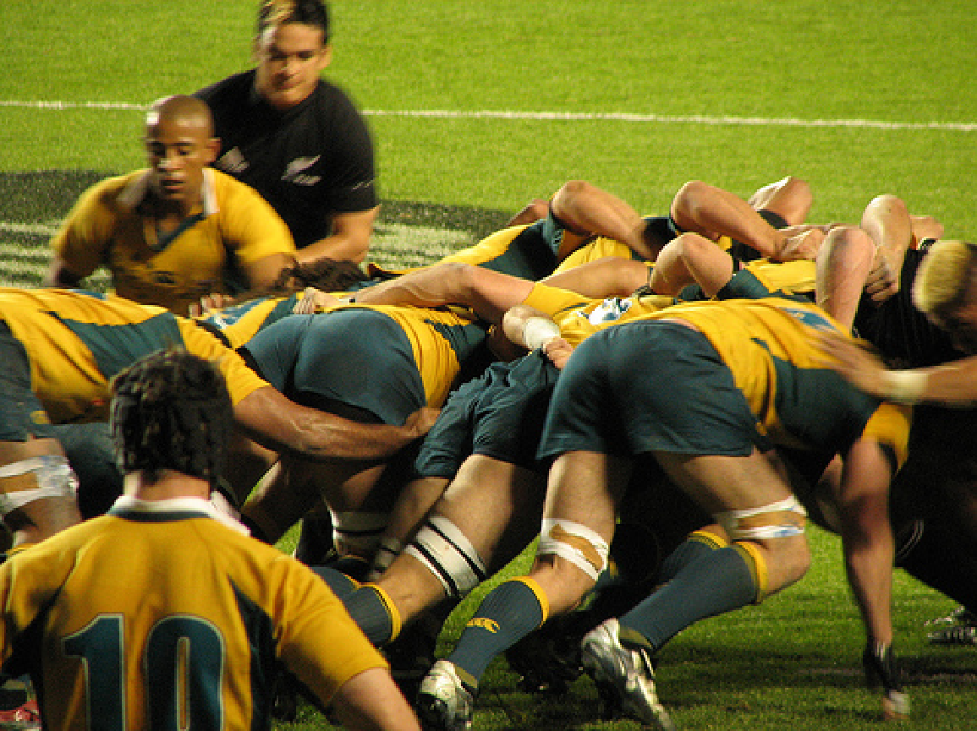
Scrum
Not an acronym – derived from observing a rugby scrum
Iterative software development process
Empirically controlled (rather than rigid, plan-based)
Focuses on maximizing business value
Constant improvement and priority/risk driven

Slide 3
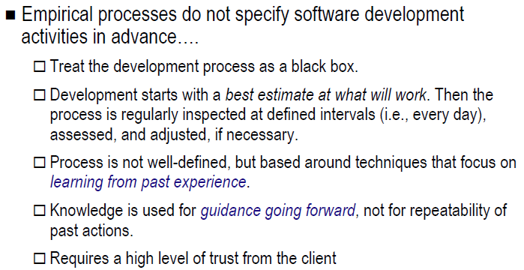
Scrum is an empirical process

Slide 4
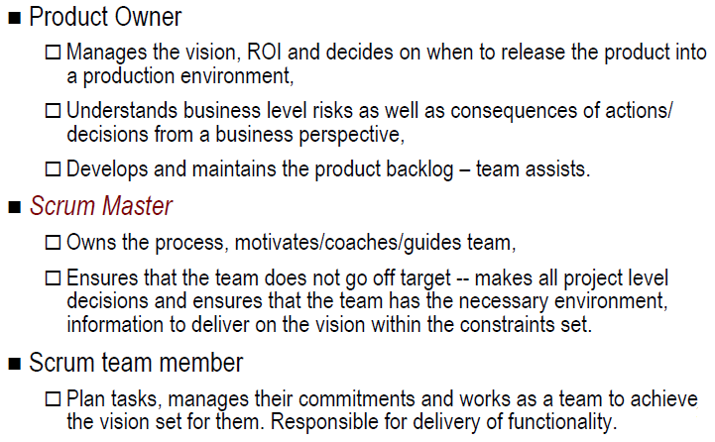
Roles in Scrum

Slide 5
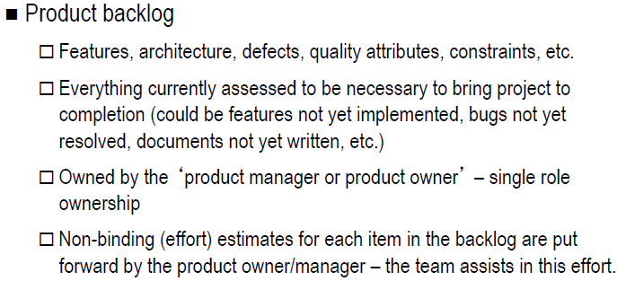
Product Backlog

Slide 6
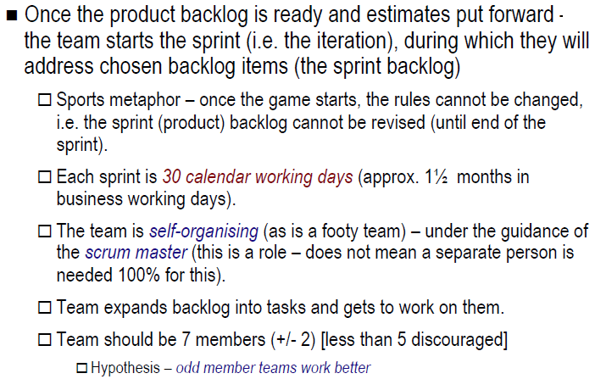
Scrum Team and Sprinting

Slide 7
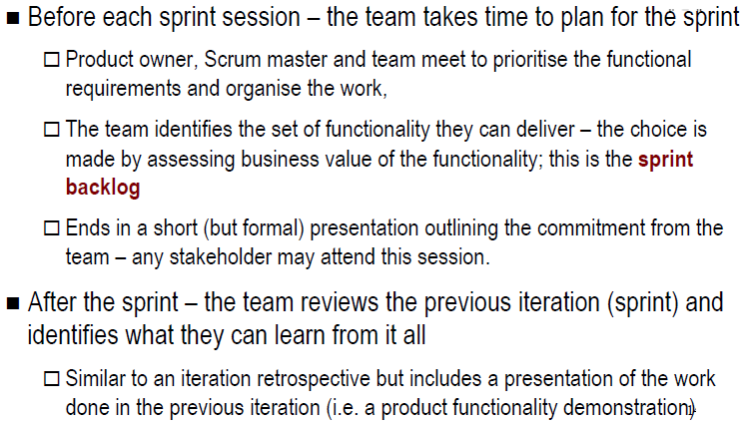
Sprint – Before and After

Slide 8
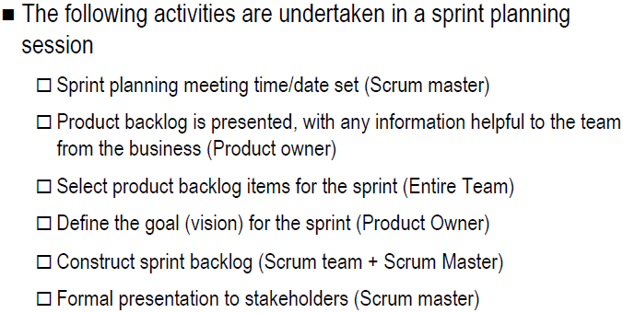
Sprint Planning

Slide 9
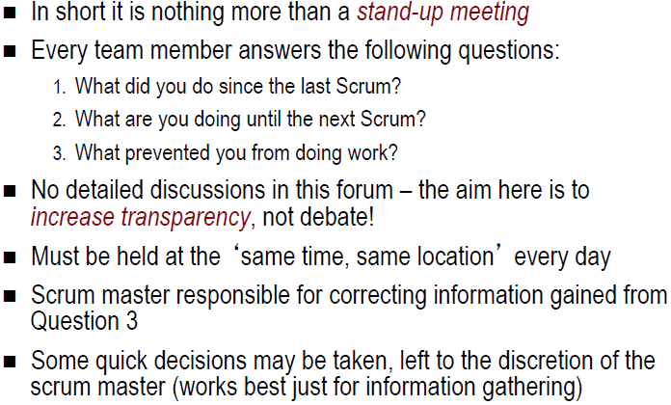
Daily Scrum

Slide 10
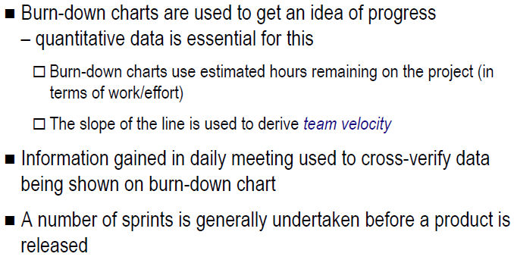
Managing Sprints

Slide 11
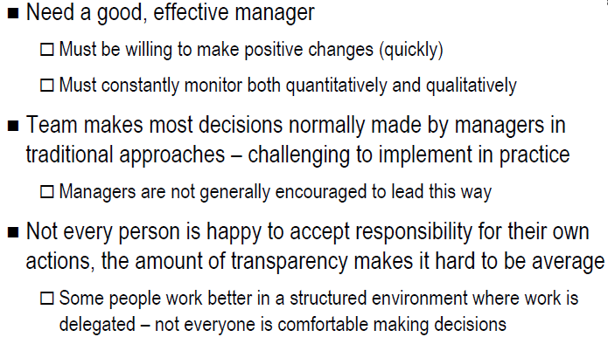
Challenges when using Scrum

Slide 12
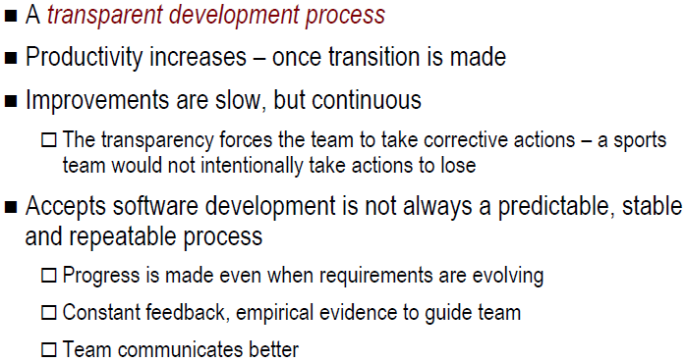
Benefits of Scrum

Slide 13
User Story
In Scrum projects, the Product Backlog is a list of user stories.
These User Stories are prioritized and taken into the Sprint Backlog in the Sprint Planning Meeting.
User Story is narrated from user perspective regarding what he wants to have rather that what system can do for him.

Slide 14
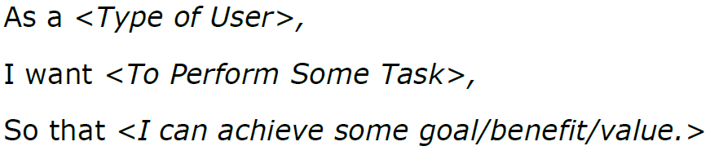
The User Story Structure

Slide 15
User Story: Import Gmail Contacts
As a registered user,
I want to automatically follow all of my Gmail contacts that have twitter accounts,
So that I can easily be able to follow my friends' tweets.

Slide 16
From User Story to Tasks
Add a new Import Contacts page
Add a new Gmail authentication screen
Add a service to get contacts from Gmail
Add a Twitter authentication screen
Modify the contact class to accommodate Gmail specific data
Modify the contacts data schema
Save contacts to the database

Slide 17
Roles
Key Artifacts
Key Meetings
Development Process
Product Backlog
List of requirements & issues
Owned by Product Owner
Anybody can add to it
Only Product Owner prioritizes
Sprint Planning Meeting
Hosted by ScrumMaster; ½-1 day
In: Product Backlog, existing pro­duct, business & technology conditions
1. Select highest priority items in Product Backlog; declare Sprint Goal
2. Team turns selected items into Sprint Backlog
Out: Sprint Goal, Sprint Backlog
Product Backlog
Increment
PO
Product Owner: Set priorities
Sprint Backlog
List of tasks
Owned by team
Only team modifies it
Sprint: 30 days each
Sprint Planning Meeting
SM
Sprint Goal
Burn Down Chart
Shows estimated vs actual effort of the scrum tasks
Shows the work remaining
Daily Scrum
Hosted by ScrumMaster
Attended by all
Same time every day
Answer: 1) What did you do yesterday? 2) What will you do today? 3) What’s in your way?
Team updates Sprint Backlog; ScrumMaster updates Blocks List
ScrumMaster: Manage process, re­­move blocks
Sprint Backlog
Daily Scrum
Blocks List
Sprint Goal
One-sentence summary
Declared by Product Owner
Accepted by team
Daily Work
Product
T
Team: Develop product
Blocks List
List of blocks & unmade decisions
Owned by ScrumMaster
Updated daily
Increment’
Sprint Review Meeting
Hosted by ScrumMaster
Attended by all
Informal, 4-hour, informational
Team demos Increment
All discuss
Hold retrospective
Announce next Sprint Planning Meeting
Sprint Review Meeting
SH
Increment
Version of the product
Shippable functionality (tested, documented, etc.)
Product Backlog’
Stakeholders: observe & advise

