Slide 1
Software Engineering
Lecture 5
(Software Architectural Pattern)

Slide 2
SW Architectural Design

Slide 3
High Level Design
Software Components (e.g. classes / packages / namespaces)
Where to put each software component
How they interact to solve the business requirements
Roles and Responsibilities of each software component

Slide 4
What is Software Architecture?
High level description of the overall system:
The top-level structure of subsystems.
The role and interaction of these subsystems.
Grouping of classes to:
Improve Cohesion.
Reduce Coupling.
Cohesion:
Set of “things” that work well together.
Coupling:
Inter-Dependency between two entities.

Slide 5
Cohesion (= Intra-dependency)
Intra-dependencies of the components in a software unit (e.g. class, method, module)
Want Strong cohesion
Meaning that “separating” these components apart to different units will cause issues
Weak cohesion
Those components can be easily separated into different units without causing problems
Refactoring (weak cohesion 🡪 stronger cohesion)

Slide 6
Coupling (= Inter-dependency)
Inter-dependencies of different software units (e.g. class, method, module)
Want Loose coupling
Meaning that the units do not depend on others very much
So replacing one unit with “a compatible one” will not cause issues
Strong coupling
Those units “depend” on each other so much that replacing one with “a compatible one” will cause troubles due to some dependencies
Refactoring (strong coupling 🡪 loose coupling)

Slide 7
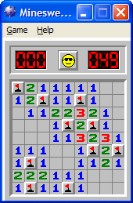
Software Architecture: Example
Take the minesweeper game as an example, and identify the high level components:
Display:
Showing the game graphically.
Application Logic:
Determining the flags, numbers.
Checking whether there are more mines, etc.
Record Storage:
Storing high scores, setting, etc.

Slide 8
Minesweeper: System One
public void ClickOnSquare( ){ if (square == bomb) {
gameState = dead
show dead icon
write high score to file
}
else if (square == number){
open neighboring squares mark squares as opened
display new board
}
}
………..// some other code
}
Bad Cohesion:
Display functions all over the place.
Application logic buried under other operations.
Storage function not clearly separated.
Low Coupling:
Since there is only one class, there is no inter-dependency!

Slide 9
Minesweeper: System Two
class MSGUI { Minesweeper msApp; MSStorage msStore;
public void mouseClickOnSquare( ){ msApp.openSquare(..);
board = msApp.getCurrentBoard(..); show(board);
}
public void menuExitClick( ) { score = msApp.getHighScore( ); msStore.writeHighScore(score);
}
}
class Minesweeper {
MSStorage msStore;
public void openSquare(position){ if (square == bomb)
gameState = dead;
else if (square == number){
open neighboring squares mark squares as opened;
}
}
public Board getCurrentBoard() {
..
}
public void saveCurrentBoard() { msStore.writeBoard(..);
}
}
class MSStorage {
public void writeHighScore(..){ } public void writeBoard(..) { }
}
Notes:
‹#›

Slide 10
Minesweeper: System Two
Cohesion:
Each class groups logically similar functionality together:
Class MSGUI: user interface, input/output to screen;
Class Minesweeper: computation and logic;
Class MSStorage: file operations.
Coupling:
Some interdependencies. Can be improved.
Observe that MSGUI uses MSStorage directly.
Hence, if we substitute another user interface, the high score saving functionality needs to be recorded.

Slide 11
Minesweeper: System Three
class MSGUI {
Minesweeper msApp;
// MSStorage msStore;
.. .. ..
public void menuExitClick( ) {
msApp.closingDown( );
}
}
class Minesweeper {
MSStorage msStore;
.. .. ..
public void closingDown() {
msStore.writehighScore(..)
}
public void saveCurrentBoard() {
}
}
Not needed
class MSStorage {
public void writeHighScore(..){ }
public void writeBoard(..){ }
}

Slide 12
Minesweeper: System Three
Coupling:
Reduced. MSGUI depends on Minesweeper only.
Minesweeper depends on MSStorage only.
Low coupling enables easy maintenance, e.g.:
Changing MSGUI to MSTextUI would not affect the main application at all.
Can swap in another storage class, e.g., database storage, by providing the same methods.

Slide 13
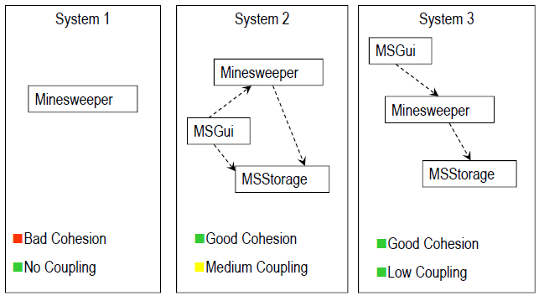
Minesweeper: Systems Comparison

Slide 14
Minesweeper: Observations
Trade off between cohesion and coupling:
Improving cohesion usually implies worse (higher) coupling and vice versa.
The three categories of functionality are quite widely applicable:
User Interface.
Main Application Logic.
Storage (Persistency).
These observations help shaping Software Architecture:
splitting a system into sub-systems.

Slide 15
The Layered Architecture
One of the oldest idea in Software Engineering.
Split into three separate layers:
Presentation Layer
User Interface.
Application Layer
The underlying logic.
Implements the functionality of system.
Storage Layer
Deals with data storage: files, database, etc.
The layers are higher level abstraction:
Each may contain several classes, or several packages (group of classes).

Slide 16
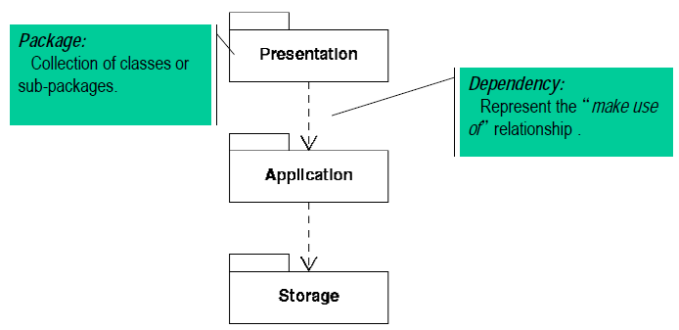
UML Package Diagram

Slide 17
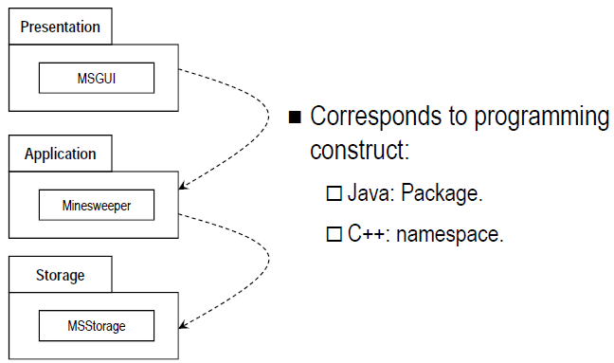
Minesweeper: Package Diagram

Slide 18
Design Pattern
Well known patterns
Model View Controller (MVC)
Facade pattern

Slide 19
Model-View-Controller
Model – data model
View – presentation of the model
Controller – controls the flow / interactions of the view and model

Slide 20
Model-View-Controller
The model-view-controller (MVC) design pattern specifies that an application consist of a data model, presentation information, and control information.
The pattern requires that each of these be separated into different objects.

Slide 21
Model-View-Controller
The model (for example, the data information) contains only the pure application data; it contains no logic describing how to present the data to a user.
The view (for example, the presentation information) presents the model's data to the user. The view knows how to access the model's data, but it does not know what this data means or what the user can do to manipulate it.
Finally, the controller (for example, the control information) exists between the view and the model. It listens to events triggered by the view and executes the appropriate reaction to these events. In most cases, the reaction is to call a method on the model.

Slide 22
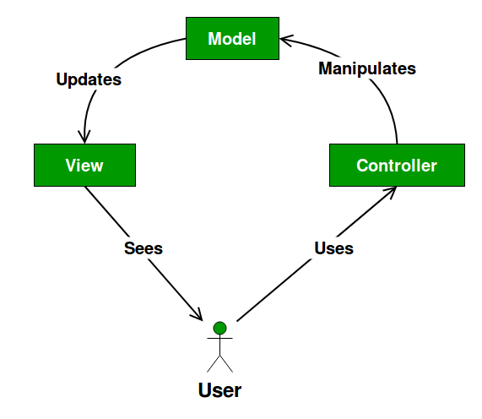
Model-View-Controller

Slide 23
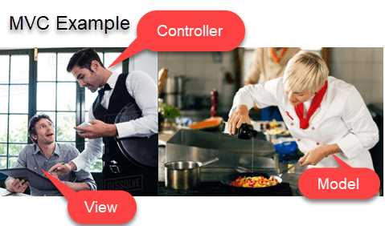

Model-View-Controller

Slide 24
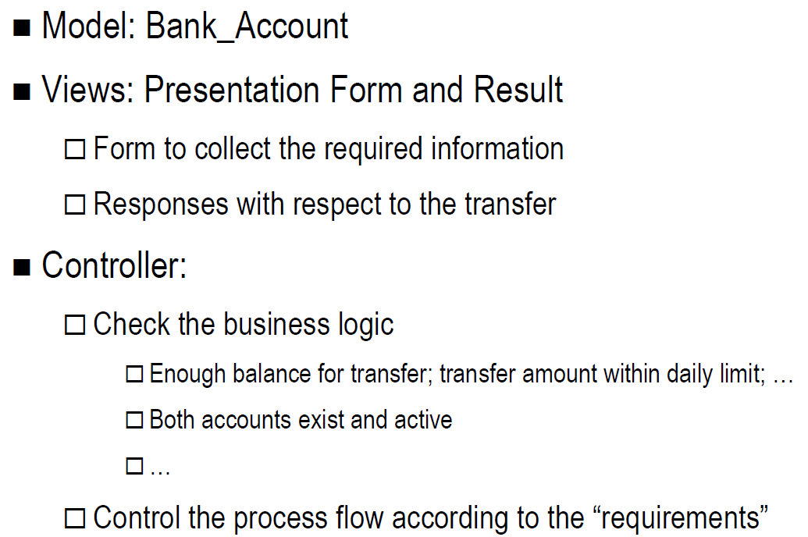
MVC – Example – Balance Transfer

Slide 25
Layered Architecture: Advantages
Layers aim to insulate a system from the effects of change.
For example, user interfaces often change:
but the application layer does not use the presentation layer.
so changes to system should be restricted to presentation layer classes.
Similarly, details of persistent data storage are separated from the application logic.

Slide 26
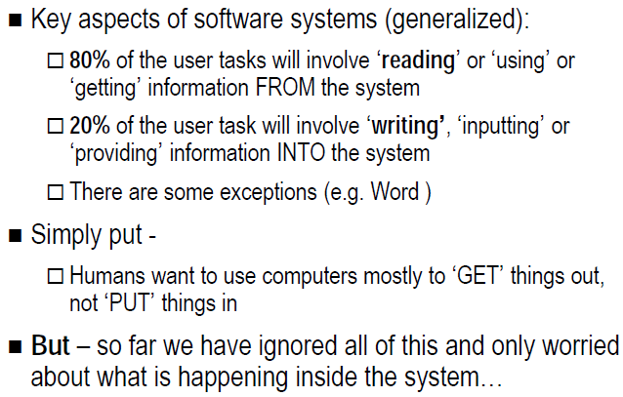
Software is interesting …..

Slide 27
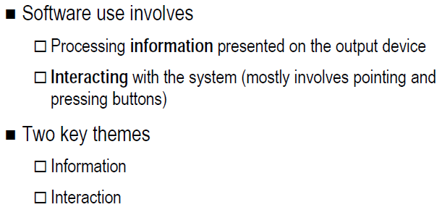
Software is unique…

Slide 28
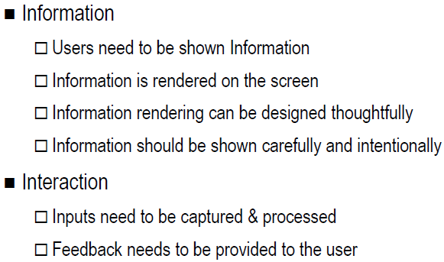
Two key themes

Slide 29
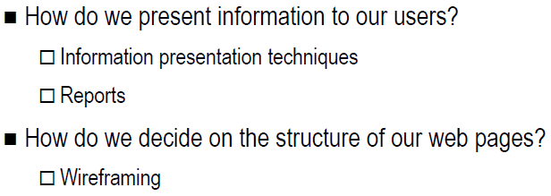
Interface design – Wireframing

Slide 30
Wireframing
Basic visual guide used in web design to suggest the structure of a website and relationships between its pages
A Wireframe is a illustration of the layout of fundamental elements in an interface.
Because of this, wireframes are often completed before any artwork is developed. When completed correctly they will provide a visual reference upon which to structure each page

Slide 31
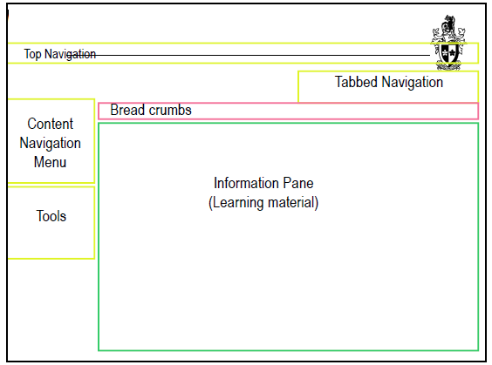
Wire framing - Bare bones

Slide 32
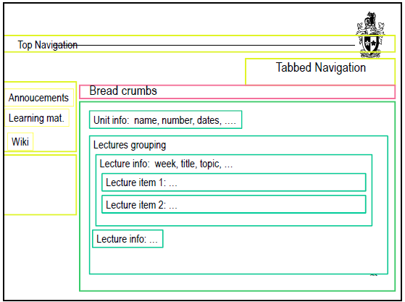
Wire framing – Fleshing out items

Slide 33
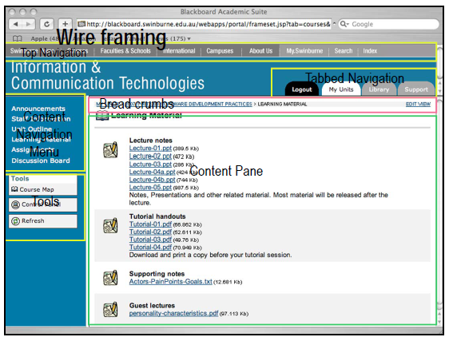

Slide 34
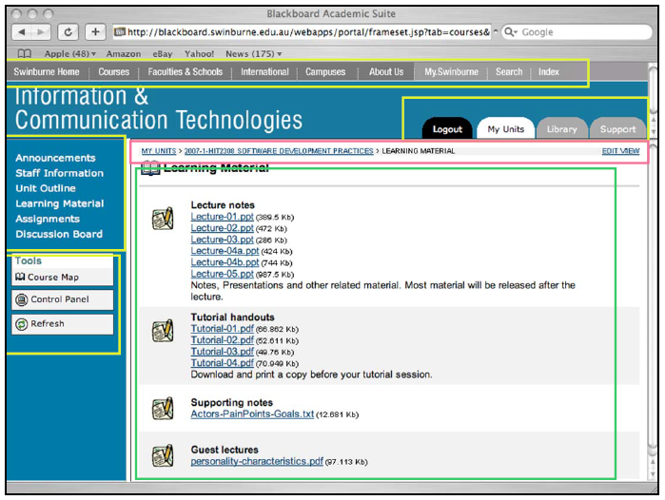

Slide 35
