Slide 1
Software Engineering
Lecture 6
(Design Principle)

Slide 2
Working on legacy code
Re-reading code multiple times to get to the part you need to change.
Hard to understand what a method does.
Spending a lot of time to fix a minor bug.
You spend more time reading than writing code.

Slide 3
Principles of Software Engineering
By the definition, software engineering is known as a systematic and procedural approach to software development.
There are some basic principles governing good software engineering, of which three popular ones are described below:
DRY (“Don’t Repeat Yourself”)
KISS (“Keep It Short and Simple/Stupid”)
SOLID design principles

Slide 4
Principles of Software Engineering DRY (“Don’t Repeat Yourself”)
The “Don’t Repeat Yourself” (or “Duplication Is Evil”) principle tells us that
Every software engineer should aim to reduce repetition of information or methods within their work in order to avoid redundancy.
Therefore, it’s recommended to segregate the entire system of consideration into fragments.
Dividing the code into smaller segments can help manage the code and use a single segment at any point, by calling, whenever required.
DRY Benefits
Less code is good: It saves time and effort, is easy to maintain, and also reduces the chances of bugs.

Slide 5
Principles of Software Engineering KISS (“Keep It Short and Simple/Stupid”)
The “Keep It Short and Simple/Stupid” principle reminds us that
All software or applications design and deployment should be done as simple as possible with least complexities and clear to understand development procedures.
This principle ensures that the source code is made easy to debug (whenever required) and future maintenance by any other operations and maintenance software engineer becomes easier.
Each method should only solve one small problem, not many use cases.
After all, programming languages are for humans to understand.
KISS Benefits
It will not only be easier to read and maintain, but it can help find bugs a lot faster.

Slide 6
Working on a startup product
In charge of the development process
Constantly adding new features
No formal process
Very dynamic environment, no time to worry about code structure
What is like to go back to your code after 2 years?

Slide 7
The purpose of SOLID design principles
To make the code more maintainable.
To make it easier to quickly extend the system with new functionality without breaking the existing ones.
To make the code easier to read and understand, thus spend less time figuring out what it does and more time actually developing the solution.
Introduced by Robert Martin (Uncle Bob), named by Michael Feathers.

Slide 8
The purpose of SOLID design principles
In general, SOLID helps us manage code complexity. It leads to more maintainable and extensible code. Even with big change requests, it's easier to update the code.
SOLID is really a guideline and not a rule.

Slide 9
SOLID design principles
The SOLID Principles are five principles of Object-Oriented class design.
They are a set of rules and best practices to follow while designing a class structure.
These five principles help us understand the need for certain design patterns and software architecture in general.
It becomes easier for you to develop software that can be managed easily. The other features of using S.O.L.I.D are:
It avoids code smells.
Quickly refractor code.
Can do adaptive or agile software development.

Slide 10
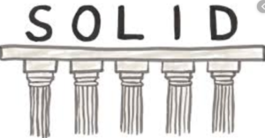
What is the meaning of S.O.L.I.D?
Following the SOLID acronym, they are:
The Single Responsibility Principle
The Open-Closed Principle
The Liskov Substitution Principle
The Interface Segregation Principle
The Dependency Inversion Principle

Slide 11
Single Responsibility Principle (SRP)
A class should have one, and only one, reason to change.
A class should only be responsible for one thing.
There’s a place for everything is in its place.
Find one reason to change and take everything else out of the class.
Very precise names for many small classes > generic names for large classes.

Slide 12
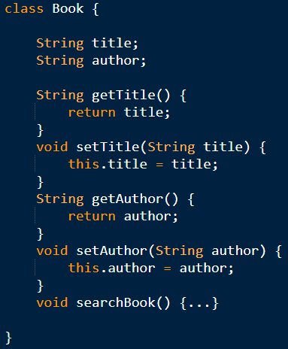
Single Responsibility Principle (SRP)
This code violates the SRP, as the Book class has two responsibilities. First, it sets the data related to the books (title and author). Second, it searches for the book in the inventory.
The setter methods change the Book object, which might cause problems when we want to search the same book in the inventory.
To apply the Single Responsibility Principle, we need to decouple the two responsibilities

Slide 13
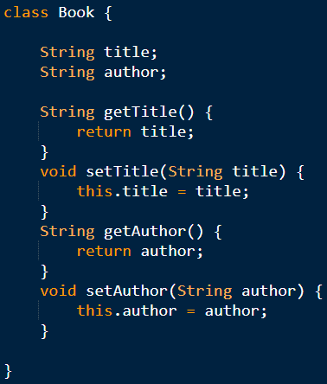
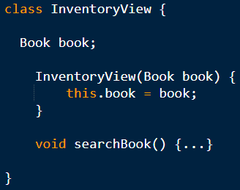
Single Responsibility Principle (SRP)
Before refactoring
After refactoring
In the refactored code, the Book class will only be responsible for getting and setting the data of the Book object.
InventoryView class is only responsible for checking/searching the inventory.

Slide 14
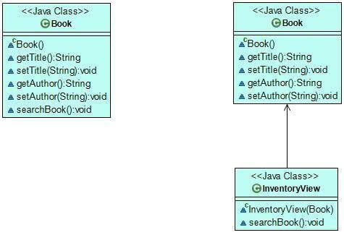
Single Responsibility Principle (SRP)
On the UML diagram below, we can see how the architecture changed after we refactored the code following the Single Responsibility Principle. We split the initial Book class that had two responsibilities into two classes, each having its own single responsibility.
After refactoring
Before refactoring

Slide 15
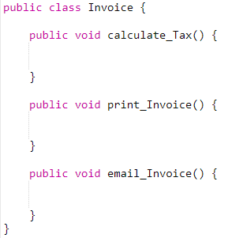

Slide 16
Single Responsibility Principle (SRP)
When SRP is followed, testing is easier. With a single responsibility, the class will have fewer test cases.
Less functionality also means less dependencies to other modules or classes.
It leads to better code organization since smaller and well-purposed classes are easier to search.

Slide 17
Open/Closed Principle
The Open/Closed Principle states that classes, modules, microservices, and other code units should be open for extension but closed for modification.
So, we should be able to extend the existing code using OOP features like inheritance via subclasses and interfaces. However, we should never modify classes, interfaces, and other code units that already exist (especially if those codes are in production already), as it can lead to unexpected behavior.
If we add a new feature by extending our code rather than modifying it, it will minimize the risk of failure as much as possible. Besides, we also don’t have to unit test existing functionalities.

Slide 18
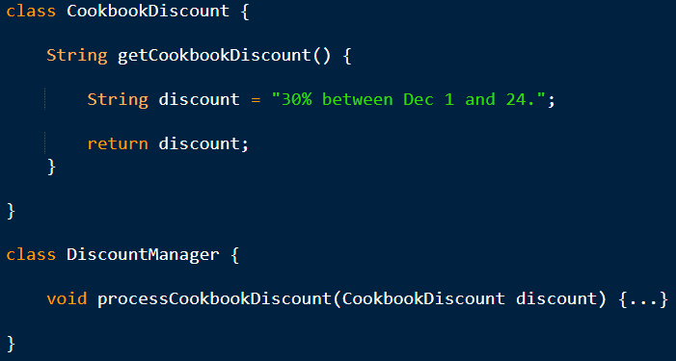
Open/Closed Principle
CookbookDiscount to hold the details of the discount.
DiscountManager to apply the discount to the price.

Slide 19
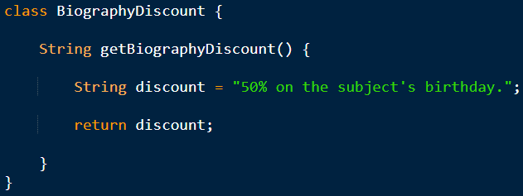
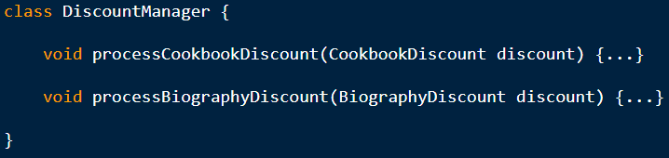
Open/Closed Principle
To add the new feature, for example, every biography with a 50% discount on the subject’s birthday, we create a new BiographyDiscount class.
To process the new type of discount, we need to add the new functionality to the DiscountManager class, too
However, as we changed existing functionality, we violated the Open/Closed Principle.

Slide 20
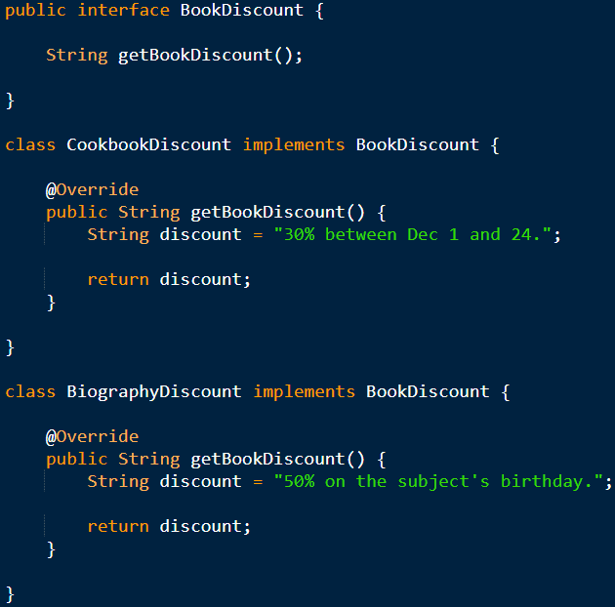
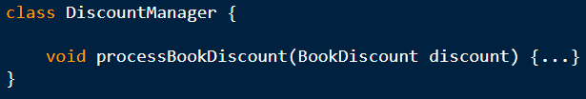
Open/Closed Principle
We need to refactor the code by adding an extra layer of abstraction that represents all types of discounts.
Let’s create a new interface called BookDiscount that the CookbookDiscount and BiographyDiscount classes will implement.
Now, DiscountManager can refer to the BookDiscount interface instead of the concrete classes.
Notes:
Now, DiscountManager can refer to the BookDiscount interface instead of the concrete classes.
When the processBookDiscount() method is called, we can pass both CookbookDiscount and BiographyDiscount as an argument, as both are the implementation of the BookDiscount interface.
‹#›

Slide 21
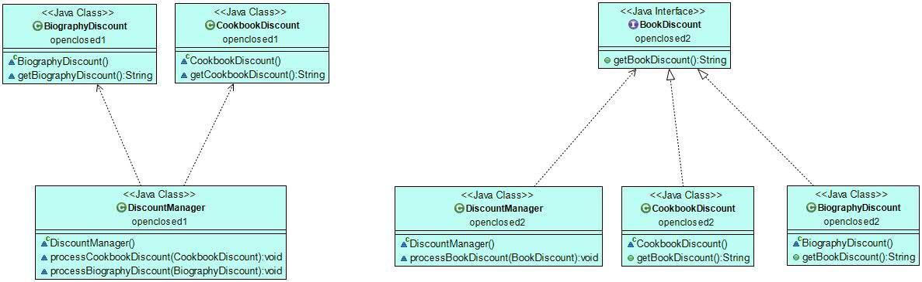
Open/Closed Principle
Before refactoring
After refactoring

Slide 22
Open/Closed Principle
An entity should be open for extension but closed for modification.
Extend functionality by adding new code instead of changing the existing code.
Separate the behaviors, so the system can easily be extended, but never broken.
Goal: get a point where you can never break the core of your system.

Slide 23
Open/Closed Principle
What this means in essence is that you should design your classes and modules with possible future updates in mind, so they should have a generic design that you won't need to change the class itself in order to extend their behavior.
You can add more fields or methods, but in such a way that you don't need to rewrite old methods, delete old fields and modify the old code in order to make it work again. Thinking ahead will help you write stable code, before and after an update of requirements.

Slide 24
Liskov Substitution Principle
“In a computer program, if S is a subtype of T, then objects of type T may be replaced with objects of type S (i.e., objects of type S may substitute objects of type T) without altering any of the desirable properties of that program (correctness, task performed, etc.).”
In layman’s terms, it states that an object of a superclass should be replaceable by objects of its subclasses without causing issues in the application.
We can implement the Liskov Substitution Principle by paying attention to the correct inheritance hierarchy.
Notes:
So, a child class should never change the characteristics of its parent class (such as the argument list and return types).
‹#›

Slide 25
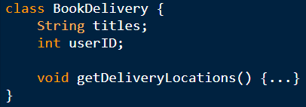
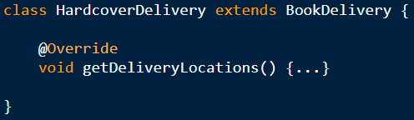
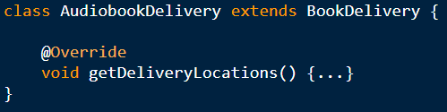
Liskov Substitution Principle
A BookDelivery class that informs customers about the number of locations where they can collect their order.
The store also sells fancy hardcovers they only want to deliver to their high street shops.
Later, the store asks us to create delivery functionalities for audiobooks, too.
Can't be implemented
Notes:
‹#›

Slide 26
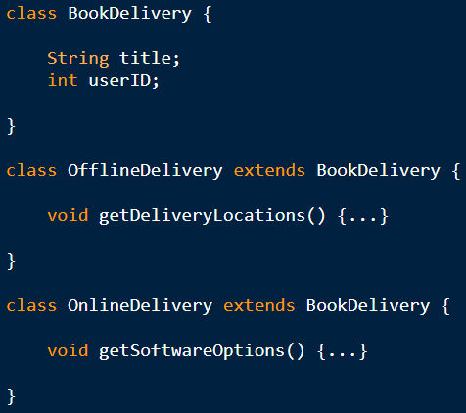
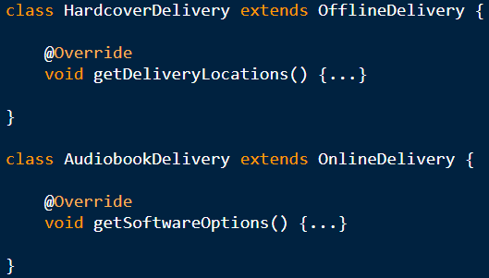
Liskov Substitution Principle
To solve the problem, we need to fix the inheritance hierarchy by adding an extra layer that better differentiates book delivery types.
After refactoring
Notes:
‹#›

Slide 27
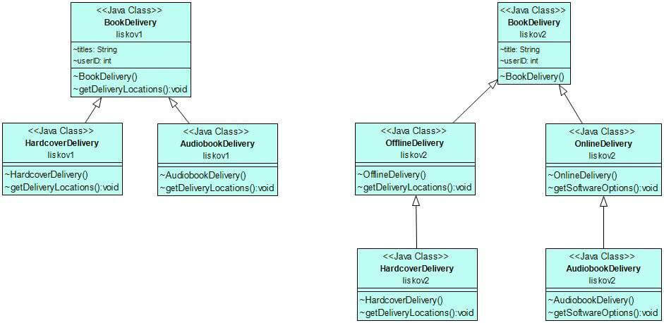
Liskov Substitution Principle
Before refactoring
After refactoring

Slide 28
Liskov Substitution Principle
Any derived class should be able to substitute its parent class without the consumer knowing it.
Every class that implements an interface, must be able to substitute any reference throughout the code that implements that same interface.
Every part of the code should get the expected result no matter what instance of a class you send to it, given it implements the same interface.

Slide 29
Interface Segregation Principle
Classes (that implement interfaces) should not be forced to depend on methods they don’t use. In other words, interfaces shouldn’t include too many functionalities.
The violation of Interface Segregation Principle harms code readability and forces programmers to write dummy methods that do nothing.
In a well-designed application, we should avoid interface pollution (also called fat interfaces). The solution is to create smaller interfaces that can be implemented more flexibly.

Slide 30
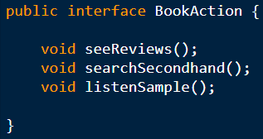
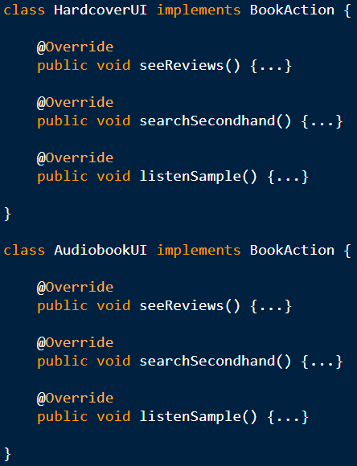
Interface Segregation Principle
Let’s add some user actions to our online bookstore so that customers can interact with the content before making a purchase. To do so, we create an interface called BookAction with three methods: seeReviews(), searchSecondHand(), and listenSample().
Then, we create two classes: HardcoverUI and an AudiobookUI that implement the BookAction interface with their own functionalities:
Both HardcoverUI and an AudiobookUI depend on methods they don’t use, so Interface Segregation Principle is violated. Hardcover books can’t be listened to, so the HardcoverUI class doesn’t need the listenSample() method. Similarly, audiobooks don’t have second-hand copies, so the AudiobookUI class doesn’t need it, either.
Thus, BookAction is a polluted interface that we need to segregate.

Slide 31
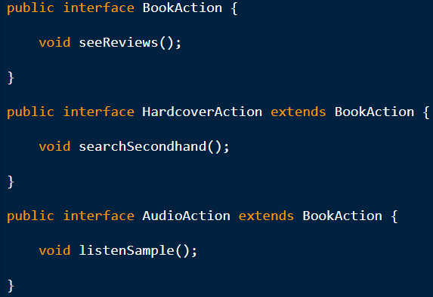
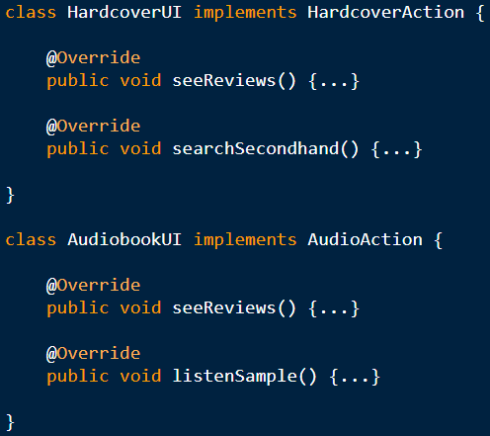
Interface Segregation Principle
Solution is to extend BookAction interface with two more specific sub-interfaces: HardcoverAction and AudioAction.
Now, the HardcoverUI class can implement the HardcoverAction interface and the AudiobookUI class can implement the AudioAction interface.
This way, both classes can implement the seeReviews() method of the BookAction super-interface. However, HardcoverUI doesn’t have to implement the irrelevant listenSample() method and AudioUI doesn’t have to implement searchSecondhand(), either.

Slide 32
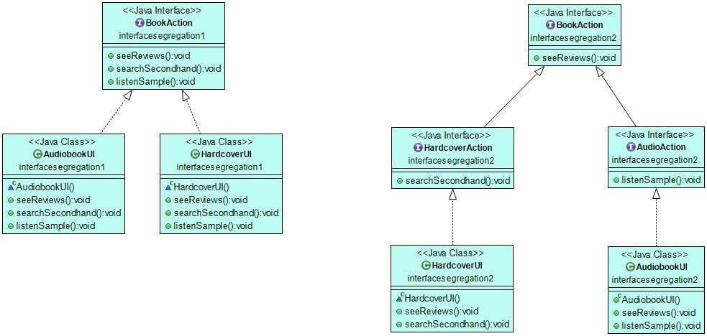
Interface Segregation Principle
Before refactoring
After refactoring

Slide 33
Interface Segregation Principle
A client should never be forced to depend on methods it doesn’t use.
Or, a client should never depend on anything more than the method it’s calling.
Changing one method in a class shouldn’t affect classes that don’t depend on it.
Replace fat interfaces with many small, specific interfaces

Slide 34
Interface Segregation Principle
The Interface Segregation Principle (ISP) states that the client should never be forced to depend on an interface they aren't using in its entirety. This means that an interface should have a minimum set of methods necessary for the functionality it ensures, and should be limited to only one functionality.

Slide 35
Dependency Inversion Principle
The goal of the Dependency Inversion Principle is to avoid tightly coupled code, as it easily breaks the application. The principle states that:
“High-level modules should not depend on low-level modules. Both should depend on abstractions.”
“Abstractions should not depend on details. Details should depend on abstractions.”
In other words, we need to decouple high-level and low-level classes. High-level classes usually encapsulate complex logic while low-level classes include data or utilities. Typically, most people would want to make high-level classes depend on low-level classes. However, according to the Dependency Inversion Principle, we need to invert the dependency. Otherwise, when the low-level class is replaced, the high-level class will be affected, too.
As a solution, you need to create an abstract layer for low-level classes, so that high-level classes can depend on abstraction rather than concrete implementations.
Dependency Inversion Principle is a specific combination of the Open/Closed and Liskov Substitution Principles.

Slide 36
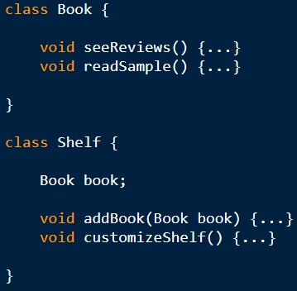
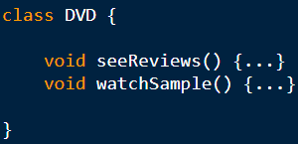
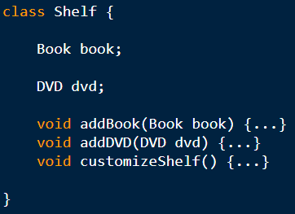
Dependency Inversion Principle
Now, the book store requires to add a new feature that enables customers to put their favorite books on a shelf.
To implement the new functionality, we create a lower-level Book class and a higher-level Shelf class.
Next, the store requires to enable customers to add DVDs to their shelves, too.
To fulfill the demand, we create a new DVD class:
and modify the Shelf class so that it can accept DVDs, too.
This clearly breaks the Open/Closed Principle
Notes:
The Book class will allow users to see reviews and read a sample of each book they store on their shelves.
The Shelf class will let them add a book to their shelf and customize the shelf.
‹#›

Slide 37
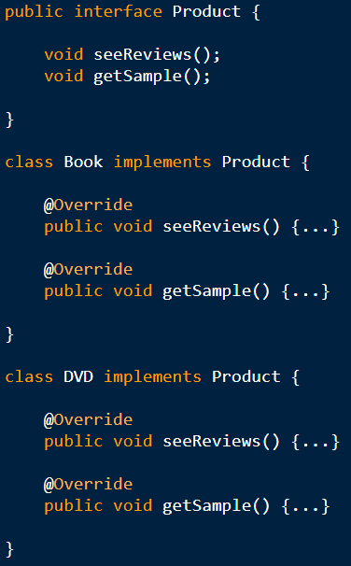
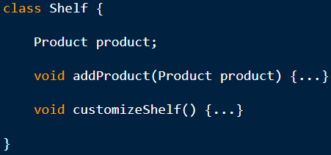
Dependency Inversion Principle
The solution is to create an abstraction layer for the lower-level classes (Book and DVD) by introducing the Product interface that both classes will implement.
Now, Shelf can reference the Product interface instead of its implementations (Book and DVD).
The above code also follows the Liskov Substitution Principle, as the Product type can be substituted with both of its subtypes (Book and DVD) without breaking the program. At the same time, it also implemented the Dependency Inversion Principle, as in the refactored code, high-level classes don’t depend on low-level classes, either.

Slide 38
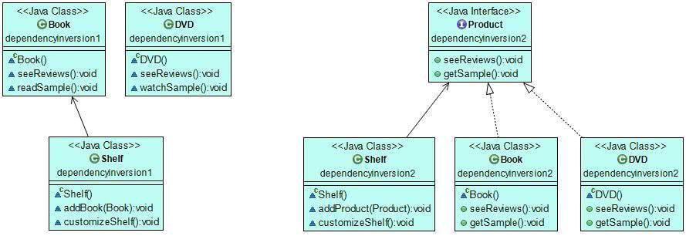
Dependency Inversion Principle
Before refactoring
After refactoring

Slide 39
Dependency Inversion Principle
Never depend on anything concrete, only depend on abstractions.
High level modules should not depend on low level modules. They should depend on abstractions.
Able to change an implementation easily without altering the high level code.

Slide 40
Dependency Inversion Principle
If Dependency Inversion is not implemented in the code, we run the risk of:
Damaging the higher level code that uses the lower level classes.
Requiring too much time and effort to change the higher level code when a change occurs in the lower level classes.
Producing less-reusable code.

Slide 41
Dependency Inversion Principle
According to the Dependency Inversion Principle (DIP), high-level and low-level modules should be decoupled in such a way that changing (or even replacing) low-level modules doesn't require (much) rework of high-level modules. Given that, both low-level and high-level modules shouldn't depend on each other, but rather they should depend on abstractions, such as interfaces.
Another important thing DIP states is:
Abstractions should not depend on details. Details (concrete implementations) should depend on abstractions.
This principle is important because it decouples modules, making the system less complex, easier to maintain and update, easier to test, and more reusable. I can't stress enough how much of a game changer this is, especially for unit testing and reusability. If the code is written generically enough, it can easily find application in another project, while code that's too specific and interdependent with other modules of the original project will be hard to decouple from it.

Slide 42

Don’t get trapped by SOLID
SOLID design principles are principles, not rules.
Always use common sense when applying SOLID.
Avoid over-fragmenting your code for the sake of SRP of SOLID.
Don’t try to achieve SOLID, use SOLID to achieve maintainability.

