Slide 1
Software Engineering (CSE 403)
Lecture 7
(Design Patterns)

Slide 2
What is Design Patterns
Design patterns are typical solutions to commonly occurring problems in software design.
They are like pre-made blueprints that you can customize to solve a recurring design problem in your code.
A design pattern isn't a finished design that can be transformed directly into code.
It is a description or template for how to solve a problem that can be used in many different situations.

Slide 3
Design Patterns
Patterns deal with
Application and system design
Abstractions on top of code
Speed up the development process by providing tested, proven development paradigms.
Relationships between classes and other collaborators
Problems that have been already solved
Patterns are not concerned with
Algorithms
Specific implementations or classes

Slide 4
Design Patterns
The idea was picked up by four authors: Erich Gamma, John Vlissides, Ralph Johnson, and Richard Helm.
In 1995, they published Design Patterns: Elements of Reusable Object-Oriented Software, in which they applied the concept of design patterns to programming.
The book featured 23 patterns solving various problems of object-oriented design and became a best-seller very quickly.
Due to its lengthy name, people started to call it “the book by the gang of four” which was soon shortened to simply “the GOF book”.

Slide 5
Design Patterns (Category)
Creational patterns provide object creation mechanisms that increase flexibility and reuse of existing code.
Structural patterns explain how to assemble objects and classes into larger structures, while keeping the structures flexible and efficient.
Behavioral patterns take care of effective communication and the assignment of responsibilities between objects.

Slide 6
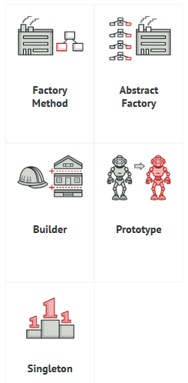
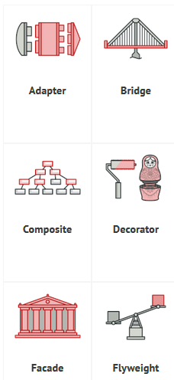
Creational patterns
Structural patterns

Slide 7
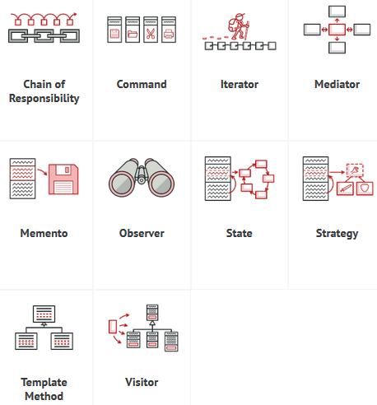
Behavioral patterns

Slide 8
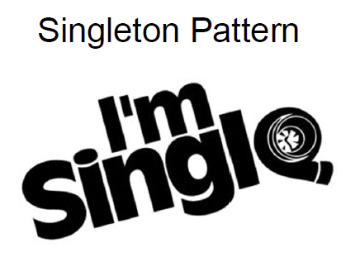
Singleton Pattern

Slide 9
Singleton Pattern
Intent
A creational design pattern that ensures only one instantation (of the class) is created and avoids creating multiple instances of the same object.
Provides a global access point to this instance.
Problem
Application needs one, and only one, instance of an object. Additionally, lazy initialization and global access are necessary.

Slide 10
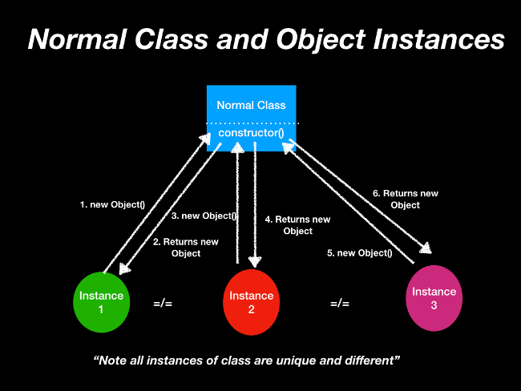
Singleton Pattern

Slide 11
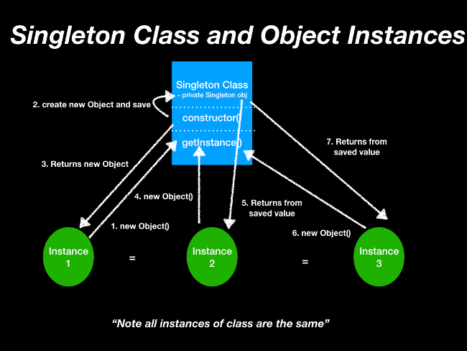
Singleton Pattern

Slide 12
Singleton Pattern
The Singleton pattern solves two problems at the same time, violating the Single Responsibility Principle:
Ensure that a class has just a single instance. Why would anyone want to control how many instances a class has? The most common reason for this is to control access to some shared resource—for example, a database or a file.
Here’s how it works:
imagine that you created an object, but after a while decided to create a new one. Instead of receiving a fresh object, you’ll get the one you already created.
Note that this behavior is impossible to implement with a regular constructor since a constructor call must always return a new object by design.

Slide 13
Singleton Pattern
2. Provide a global access point to that instance. Remember those global variables that are used to store some essential objects? While they’re very handy, they’re also very unsafe since any code can potentially overwrite the contents of those variables and crash the app.
Just like a global variable, the Singleton pattern lets you access some object from anywhere in the program. However, it also protects that instance from being overwritten by other code.

Slide 14
Singleton Pattern
All implementations of the Singleton have these two steps in common:
Make the default constructor private, to prevent other objects from using the new operator with the Singleton class.
Create a static creation method that acts as a constructor. Under the hood, this method calls the private constructor to create an object and saves it in a static field. All following calls to this method return the cached object.

Slide 15
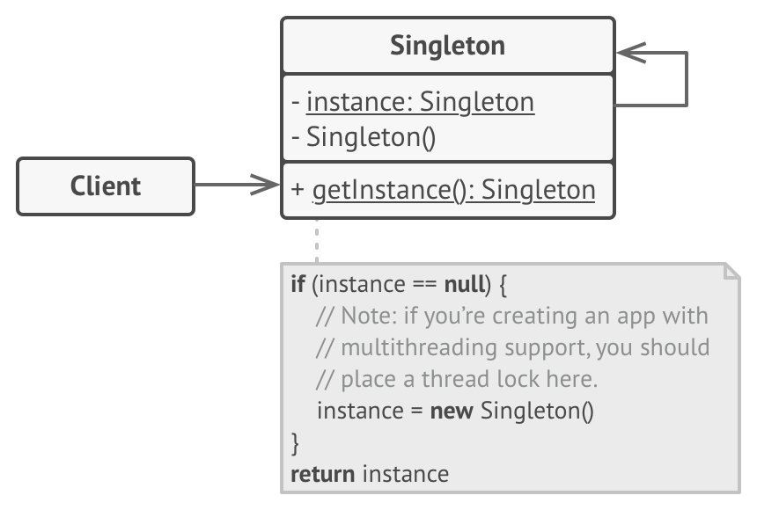
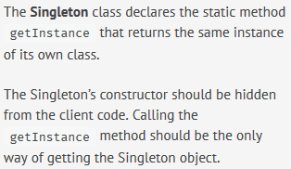
Singleton Pattern (Structure)

Slide 16
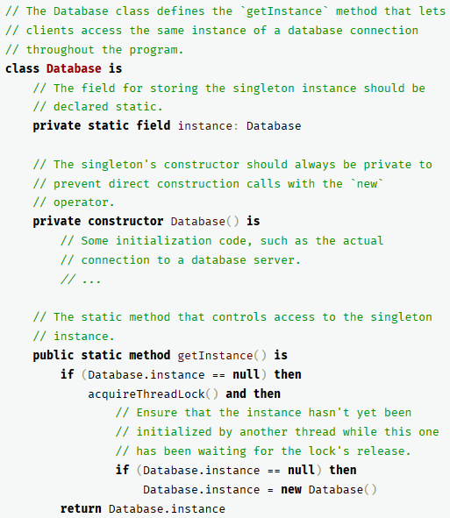
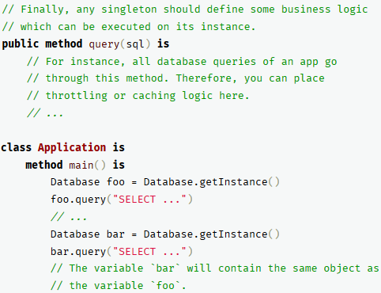
Singleton Pattern
Notes:
‹#›

Slide 17
Applicability
Use the Singleton pattern when a class in your program should have just a single instance available to all clients; for example, a single database object shared by different parts of the program.
Use the Singleton pattern when you need stricter control over global variables.
Notes:
1. The Singleton pattern disables all other means of creating objects of a class except for the special creation method. This method either creates a new object or returns an existing one if it has already been created.
2. Unlike global variables, the Singleton pattern guarantees that there’s just one instance of a class. Nothing, except for the Singleton class itself, can replace the cached instance.
‹#›

Slide 18
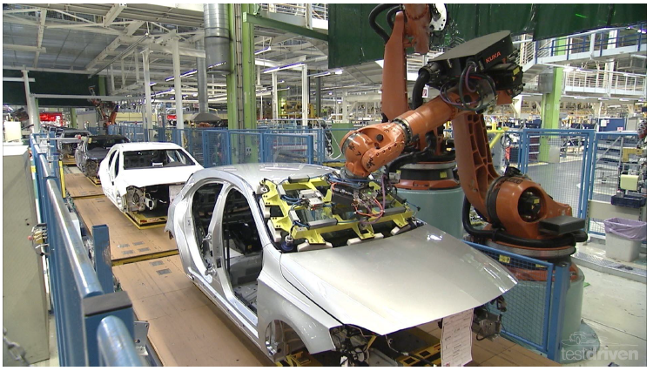
Factory Patterns

Slide 19
Factory Patterns
Intent
Define an interface for creating an object, but let subclasses decide which class to instantiate. Factory Method lets a class defer instantiation to subclasses.
Defining a "virtual" constructor.
The new operator considered harmful.

Slide 20
Factory Patterns
Problem
A framework needs to standardize the architectural model for a range of applications, but allow for individual applications to define their own domain objects and provide for their instantiation.

Slide 21
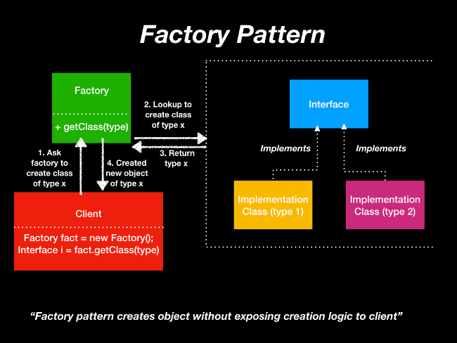
Factory Patterns
Notes:
Instead of the client directly calling the object creation, the client asks the factory class for a certain object, type x. Based on the type, the factory pattern decides which object to create and to return.
‹#›

Slide 22
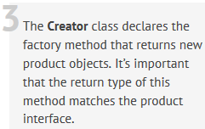
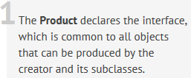
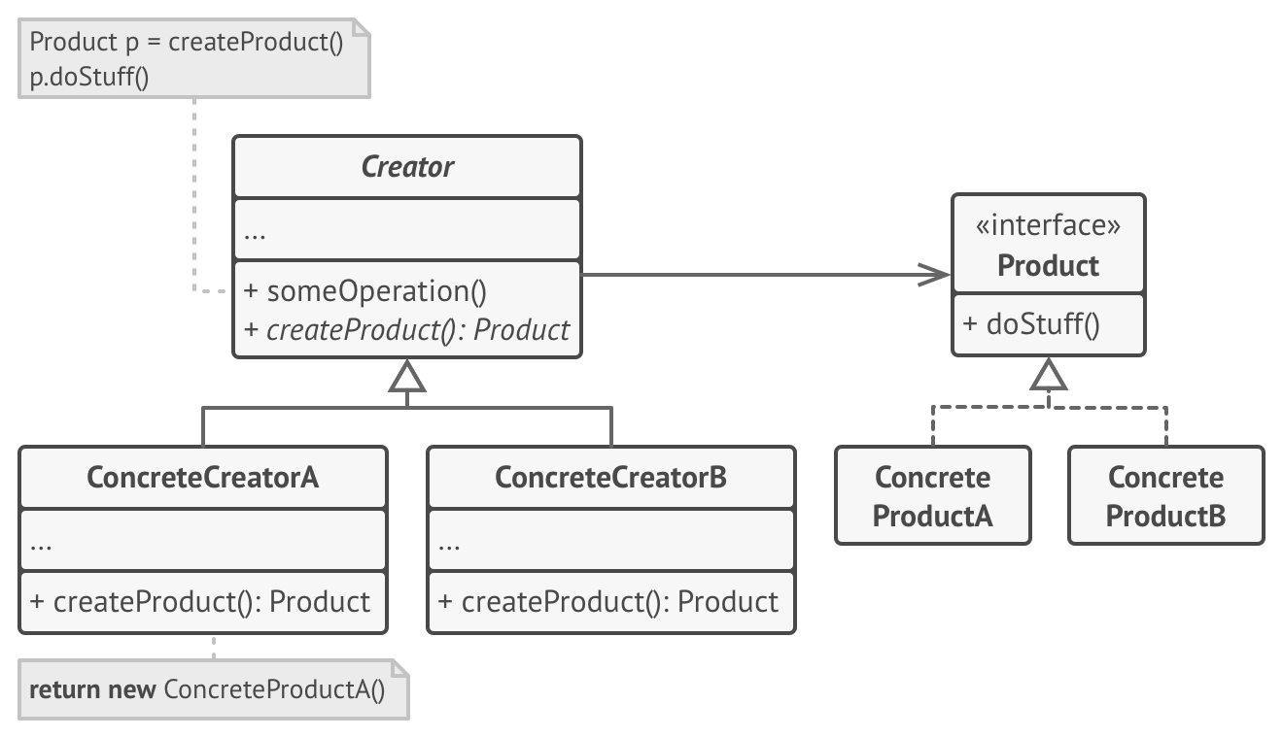


Factory Patterns
Notes:
‹#›

Slide 23
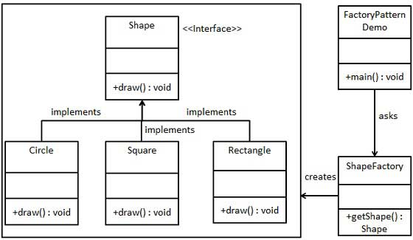
Factory Patterns
Notes:
FactoryPatternDemo, our demo class will use ShapeFactory to get a Shape object. It will pass information (CIRCLE / RECTANGLE / SQUARE) to ShapeFactory to get the type of object it needs.
‹#›

Slide 24
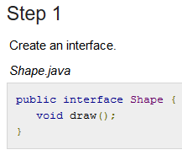
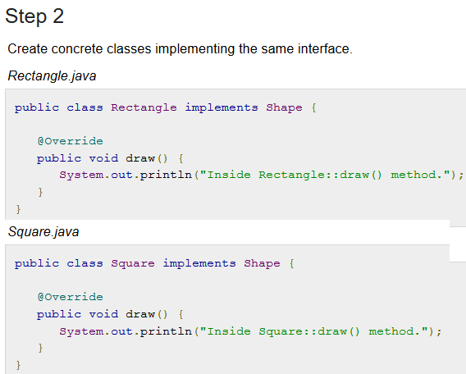
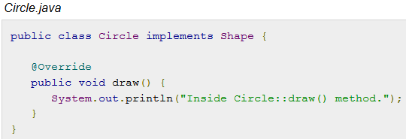
Notes:
‹#›

Slide 25
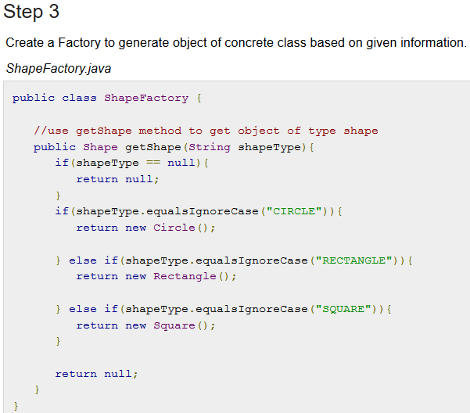

Slide 26
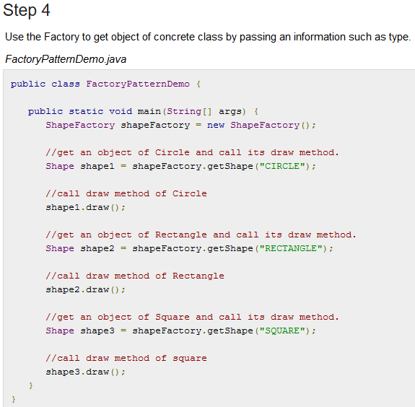
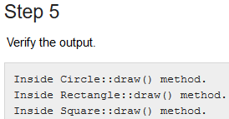

Slide 27
Applicability
Use the Factory Method when you don’t know beforehand the exact types and dependencies of the objects your code should work with.
Use the Factory Method when you want to provide users of your library or framework with a way to extend its internal components.
Use the Factory Method when you want to save system resources by reusing existing objects instead of rebuilding them each time.
Notes:
- The Factory Method separates product construction code from the code that actually uses the product. Therefore it’s easier to extend the product construction code independently from the rest of the code.
For example, to add a new product type to the app, you’ll only need to create a new creator subclass and override the factory method in it.
‹#›

Slide 28

Observer Pattern
Also known as: Event-Subscriber, ­Listener

Slide 29
Observer Pattern
Intent
Define a one-to-many dependency between objects so that when one object changes state, all its dependents are notified and updated automatically.
Encapsulate the core (or common or engine) components in a Subject abstraction, and the variable (or optional or user interface) components in an Observer hierarchy.
Notes:
Also
‹#›

Slide 30
Observer Pattern
For the sake of simplicity, think about what happens when you follow someone on Twitter. You are essentially asking Twitter to send you (the observer) tweet updates of the person (the subject) you followed.
The pattern consists of two actors:
the observer who is interested in the updates and
the subject who generates the updates.

Slide 31
Observer Pattern
Problem
Imagine that you have two types of objects: a Customer and a Store. The customer is very interested in a particular brand of product (say, it’s a new model of the iPhone) which should become available in the store very soon.
The customer could visit the store every day and check product availability. But while the product is still en route, most of these trips would be pointless.

Slide 32
Observer Pattern
On the other hand, the store could send tons of emails (which might be considered spam) to all customers each time a new product becomes available.
This would save some customers from endless trips to the store.
At the same time, it’d upset other customers who aren’t interested in new products.
It looks like we’ve got a conflict. Either the customer wastes time checking product availability or the store wastes resources notifying the wrong customers.

Slide 33
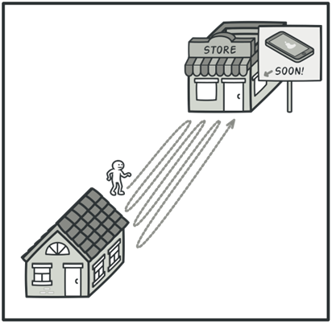
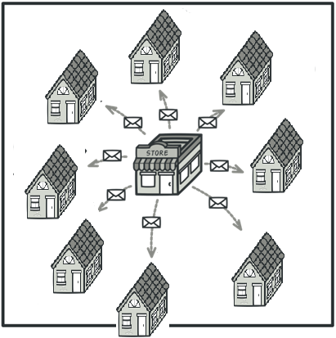
Observer Pattern
Visiting the store vs. sending spam

Slide 34
Observer Pattern
Solution
The object that has some interesting state is often called subject, but since it’s also going to notify other objects about the changes to its state, we’ll call it publisher. All other objects that want to track changes to the publisher’s state are called subscribers.
The Observer pattern suggests that you add a subscription mechanism to the publisher class so individual objects can subscribe to or unsubscribe from a stream of events coming from that publisher.

Slide 35
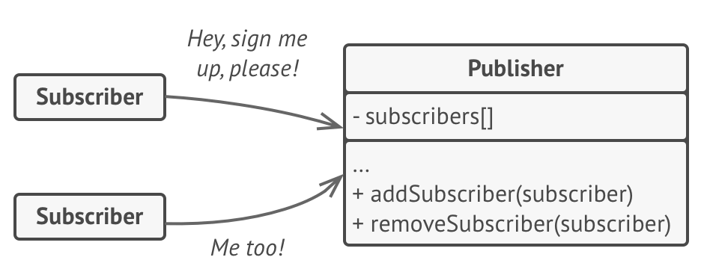
Observer Pattern
A subscription mechanism lets individual objects subscribe to event notifications.
Now, whenever an important event happens to the publisher, it goes over its subscribers and calls the specific notification method on their objects.
Notes:
‹#›

Slide 36
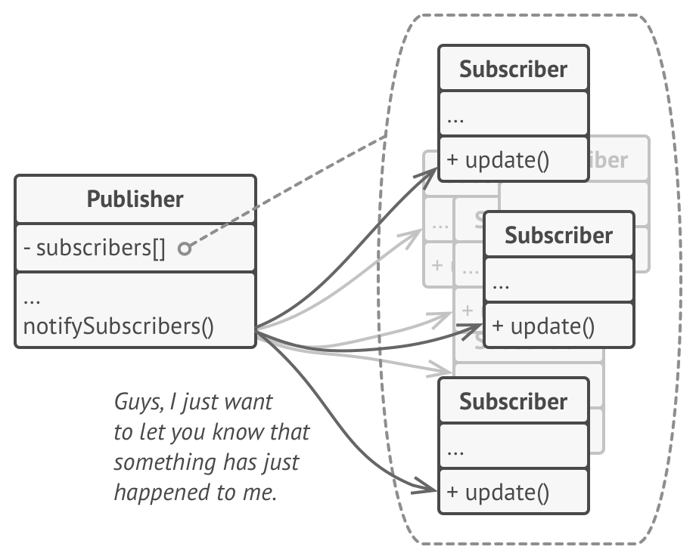
Observer Pattern
Real apps might have dozens of different subscriber classes that are interested in tracking events of the same publisher class.
You wouldn’t want to couple the publisher to all of those classes. Besides, you might not even know about some of them beforehand if your publisher class is supposed to be used by other people.
That’s why it’s crucial that all subscribers implement the same interface and that the publisher communicates with them only via that interface.
This interface should declare the notification method along with a set of parameters that the publisher can use to pass some contextual data along with the notification.

Slide 37
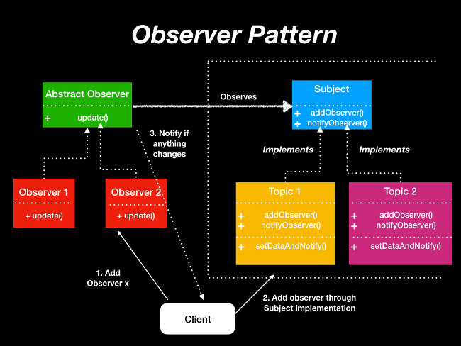
Observer Pattern

Slide 38
Applicability
Use the Observer pattern when changes to the state of one object may require changing other objects, and the actual set of objects is unknown beforehand or changes dynamically.
Use the pattern when some objects in your app must observe others, but only for a limited time or in specific cases.

Slide 39
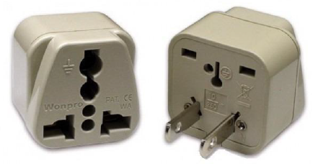
Adapter Pattern

Slide 40
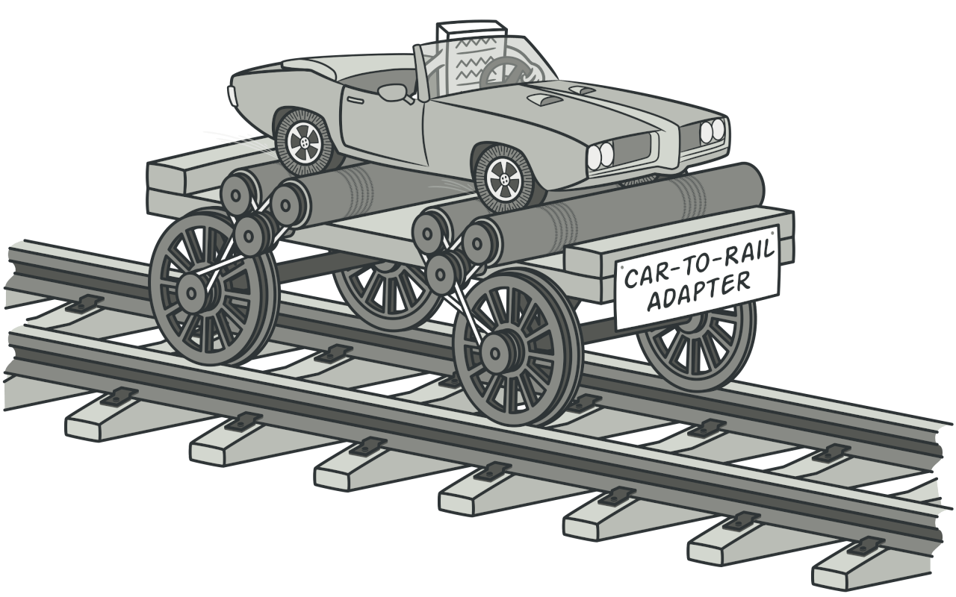
Adapter Pattern
Intent
Convert the interface of a class into another interface clients expect. Adapter lets classes work together that couldn't otherwise because of incompatible interfaces.
Wrap an existing class with a new interface.
Impedance match an old component to a new system

Slide 41
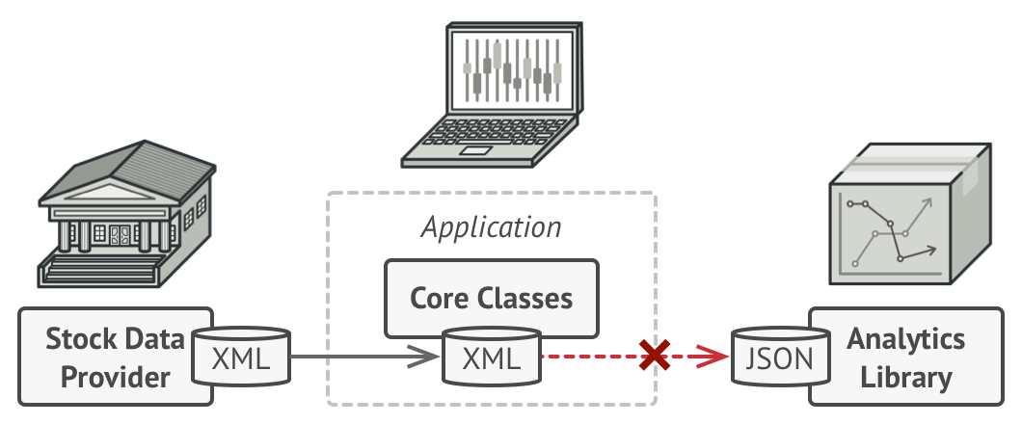
Adapter Pattern
Problem
Imagine that you’re creating a stock market monitoring app. The app downloads the stock data from multiple sources in XML format and then displays nice-looking charts and diagrams for the user.
At some point, you decide to improve the app by integrating a smart 3rd-party analytics library. But there’s a catch: the analytics library only works with data in JSON format.
You could change the library to work with XML. However, this might break some existing code that relies on the library. And worse, you might not have access to the library’s source code in the first place, making this approach impossible.

Slide 42
Adapter Pattern
Solution
You can create an adapter. This is a special object that converts the interface of one object so that another object can understand it.
An adapter wraps one of the objects to hide the complexity of conversion happening behind the scenes. The wrapped object isn’t even aware of the adapter. For example, you can wrap an object that operates in meters and kilometers with an adapter that converts all of the data to imperial units such as feet and miles.

Slide 43
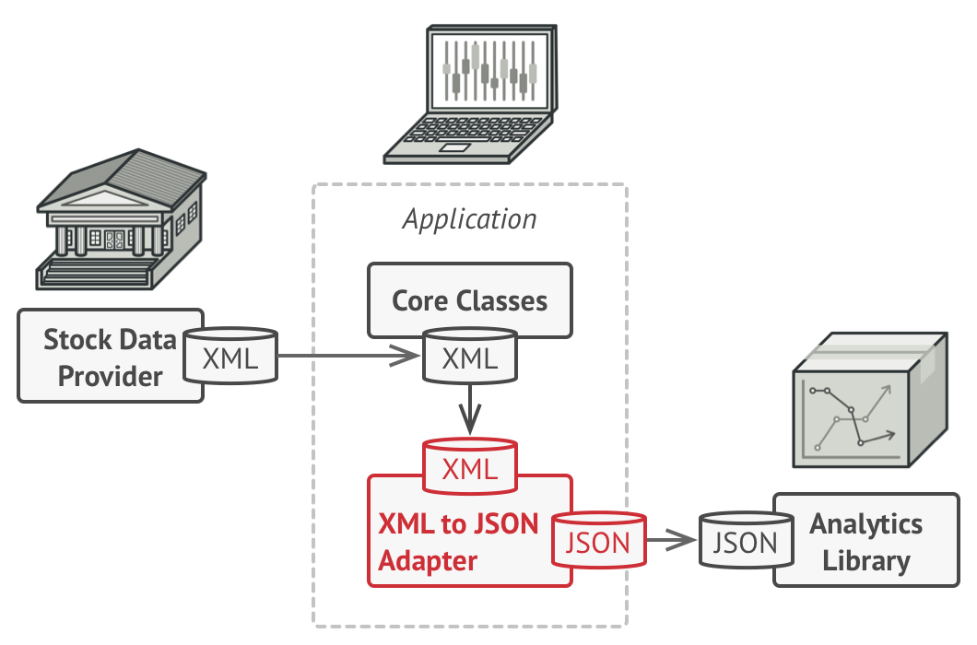
Adapter Pattern
Adapters can not only convert data into various formats but can also help objects with different interfaces collaborate. Here’s how it works:
The adapter gets an interface, compatible with one of the existing objects.
Using this interface, the existing object can safely call the adapter’s methods.
Upon receiving a call, the adapter passes the request to the second object, but in a format and order that the second object expects.
Notes:
Sometimes it’s even possible to create a two-way adapter that can convert the calls in both directions.
- Let’s get back to our stock market app. To solve the dilemma of incompatible formats, you can create XML-to-JSON adapters for every class of the analytics library that your code works with directly. Then you adjust your code to communicate with the library only via these adapters. When an adapter receives a call, it translates the incoming XML data into a JSON structure and passes the call to the appropriate methods of a wrapped analytics object.
‹#›

Slide 44
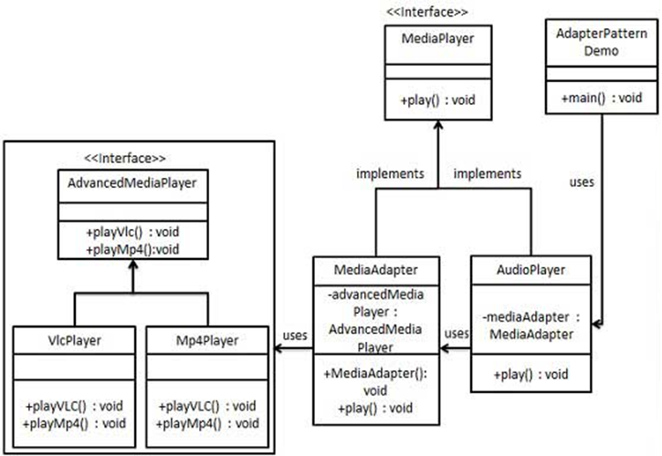
Adapter Pattern
Notes:
We have a MediaPlayer interface and a concrete class AudioPlayer implementing the MediaPlayer interface. AudioPlayer can play mp3 format audio files by default.
We are having another interface AdvancedMediaPlayer and concrete classes implementing the AdvancedMediaPlayer interface. These classes can play vlc and mp4 format files.
We want to make AudioPlayer to play other formats as well. To attain this, we have created an adapter class MediaAdapter which implements the MediaPlayer interface and uses AdvancedMediaPlayer objects to play the required format.
AudioPlayer uses the adapter class MediaAdapter passing it the desired audio type without knowing the actual class which can play the desired format. AdapterPatternDemo, our demo class will use AudioPlayer class to play various formats.
‹#›

Slide 45
Applicability
Use the Adapter class when you want to use some existing class, but its interface isn’t compatible with the rest of your code.
Use the pattern when you want to reuse several existing subclasses that lack some common functionality that can’t be added to the superclass.
Notes:
- The Adapter pattern lets you create a middle-layer class that serves as a translator between your code and a legacy class, a 3rd-party class or any other class with a weird interface.
‹#›

Slide 46
Façade Pattern
Intent
Provide a unified interface to a set of interfaces in a subsystem. Facade defines a higher-level interface that makes the subsystem easier to use.
Wrap a complicated subsystem with a simpler interface.
Problem
A segment of the client community needs a simplified interface to the overall functionality of a complex subsystem.

Slide 47
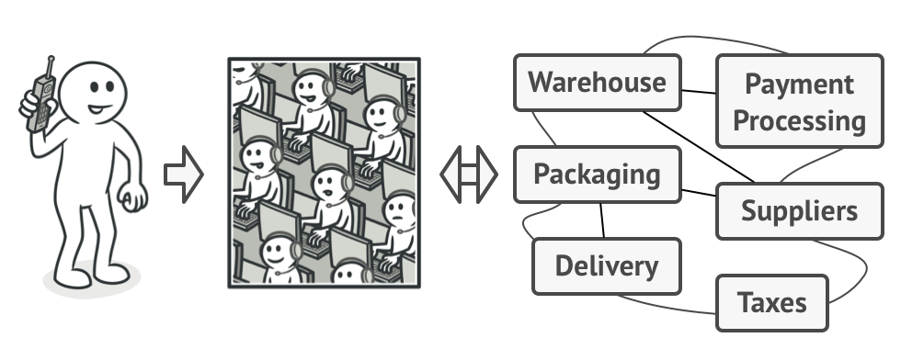
Façade Pattern
When you call a shop to place a phone order, an operator is your facade to all services and departments of the shop. The operator provides you with a simple voice interface to the ordering system, payment gateways, and various delivery services.

Slide 48
Façade Pattern
Facade discusses encapsulating a complex subsystem within a single interface object. This reduces the learning curve necessary to successfully leverage the subsystem.
It also promotes decoupling the subsystem from its potentially many clients.
On the other hand, if the Facade is the only access point for the subsystem, it will limit the features and flexibility that "power users" may need.

Slide 49
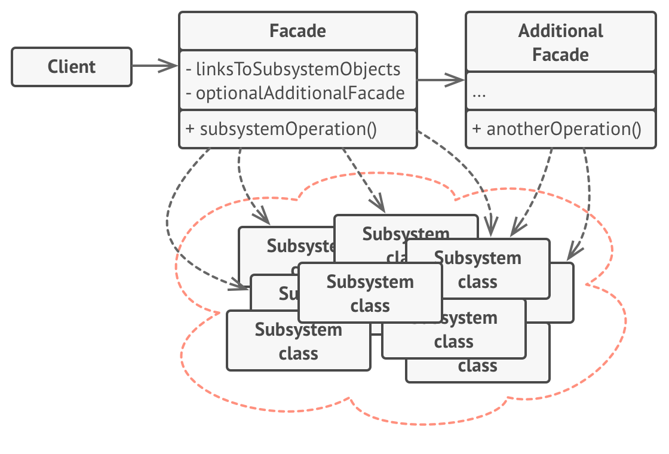
Façade Pattern

Slide 50
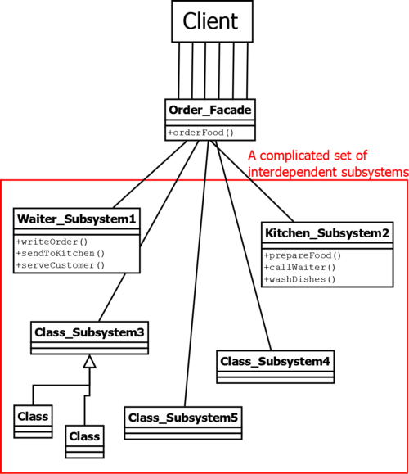
Façade Pattern

Slide 51
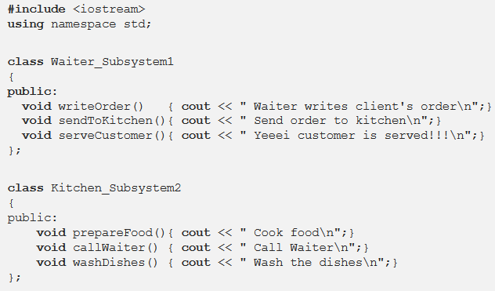
Façade Pattern

Slide 52
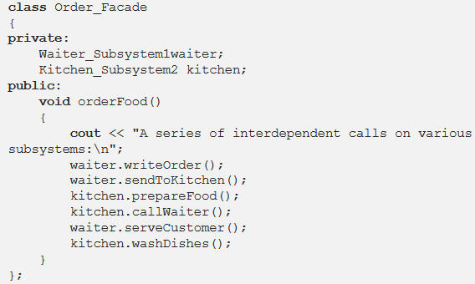
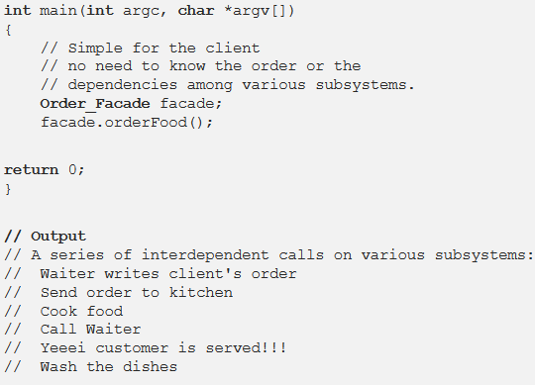
Façade Pattern

Slide 53
Applicability
Use the Facade pattern when you need to have a limited but straightforward interface to a complex subsystem.
Use the Facade when you want to structure a subsystem into layers.

