Slide 1
Software Engineering (CSE 403)
Lecture 9
(Black Box Testing)

Slide 2
Unit Testing

Slide 3
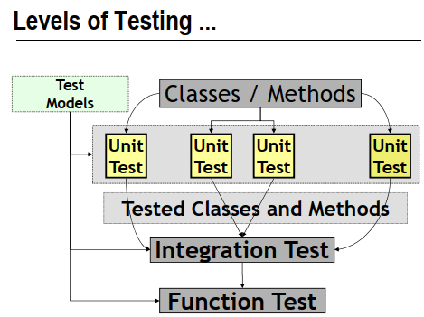

Slide 4
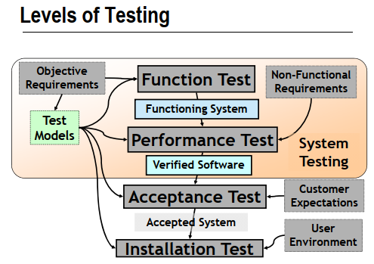

Slide 5
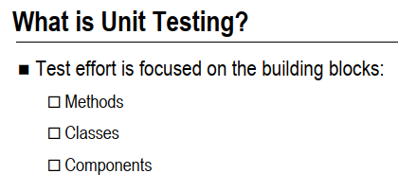

Slide 6
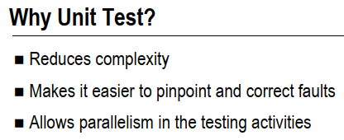

Slide 7
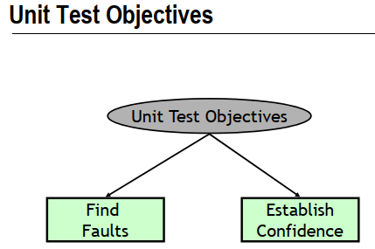

Slide 8
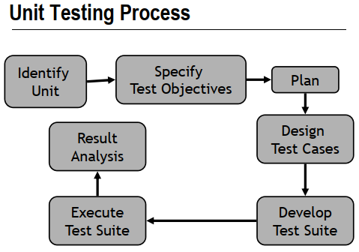

Slide 9
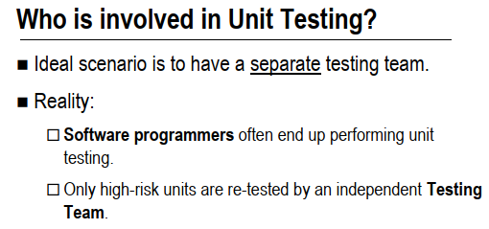

Slide 10
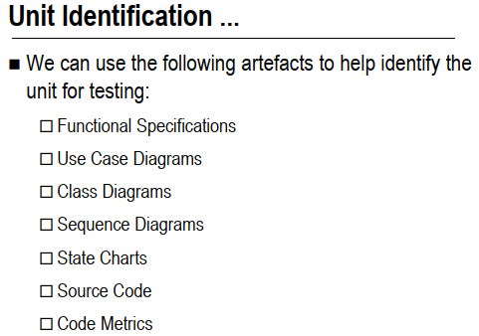

Slide 11
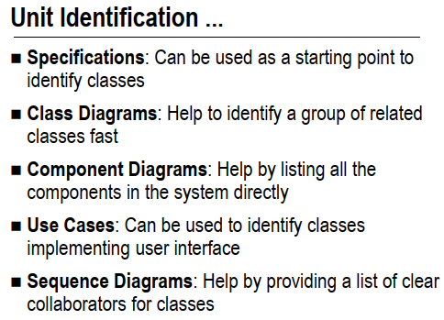

Slide 12
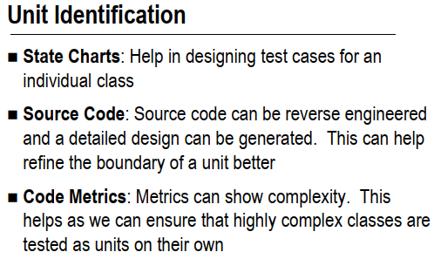

Slide 13
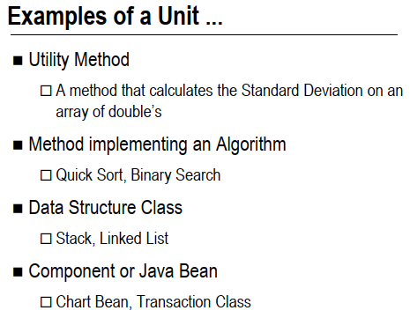

Slide 14
Overview of This Lecture
Test Case Design
White Box
Control Flow Graph
Cyclomatic Complexity
Basic Path Testing
Black Box
Equivalence Classes
Boundary Value Analysis
Notes:
‹#›

Slide 15
Test Case Design: Revision
White box testing:
Knowing the internal workings of a component;
Test cases exercise specific sets of condition, loops, etc.
Black box testing:
Knowing the specified function a component has been designed for;
Tests conducted at the interface of the component.
Notes:
‹#›

Slide 16
Black Box Testing
Notes:
‹#›

Slide 17
Black Box Testing: Introduction
Test Engineers have no access to the source code or documentation of internal working.
The “Black Box” can be:
A single unit.
A subsystem.
The whole system.
Tests are based on:
Specification of the “Black Box”.
Providing inputs to the “Black Box” and inspect the outputs.
Inputs
Component Under Test
Outputs
Notes:
‹#›

Slide 18
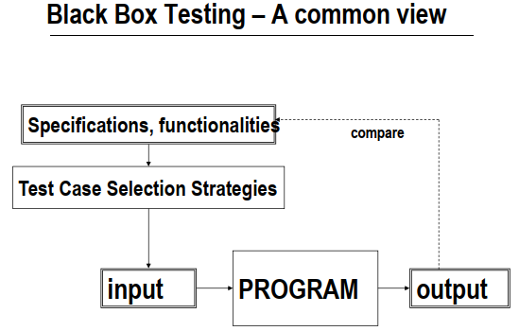

Slide 19
Test Case Design
Two techniques will be covered for the black box testing in this course:
Equivalence Partition;
Boundary Value Analysis.
Notes:
‹#›

Slide 20
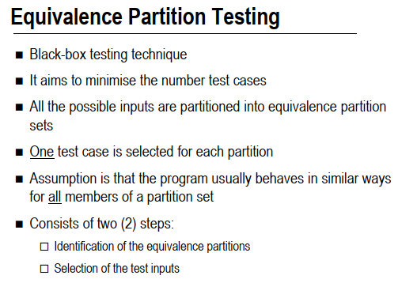

Slide 21
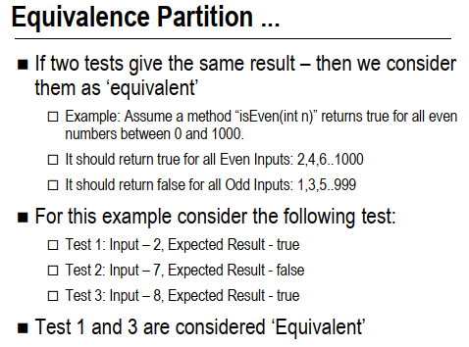

Slide 22
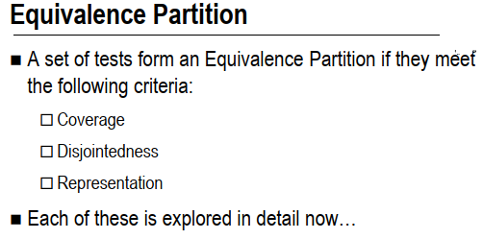

Slide 23
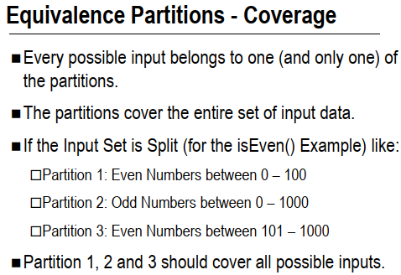

Slide 24
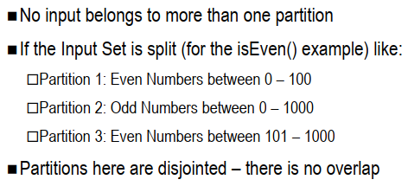
Equivalence Partitions - Disjointedness

Slide 25
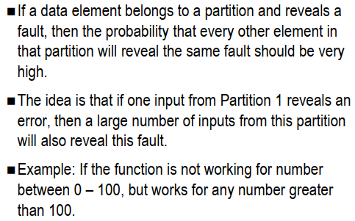
Equivalence Partitions - Representation

Slide 26
Equivalence Partition: Introduction
To ensure the correct behavior of a “black box”, both valid and invalid cases need to be tested.
Example:
Given the method below:
boolean isValidMonth(int m)
Functionality: check m is [1..12]
Output: - true if m is 1 to 12 - false otherwise
Is there a better way to test other than testing all integer values [-2³¹, …, 2³¹-1] ?
Notes:
‹#›

Slide 27
Equivalence Partition
Experience shows that exhaustive testing is not feasible or necessary:
Impractical for most methods.
An error in the code would have caused the same failure for many input values:
There is no reason why a value will be treated differently from others.
E.g., if value 240 fails the testing, it is likely that 241 is likely to fail the test too.
A better way of choosing test cases is needed.
Notes:
‹#›

Slide 28
Equivalence Partition
Observations:
For a method, it is common to have a number of inputs that produce similar outcomes.
Testing one of the inputs should be as good as exhaustively testing all of them.
So, pick only a few test cases from each “category” of input that produce the same output.
1, 5, 9, 11, 12
isValidMonth( int m )
TRUE
All inputs here produce TRUE.
Notes:
‹#›

Slide 29
Equivalence Partition: Definition
Partition input data into equivalence classes.
Data in each equivalence class:
Likely to be treated equally by a reasonable algorithm.
Produce same output state, i.e., valid/invalid.
Derive test data for each class.
Input Test Data
Component
Result
Notes:
‹#›

Slide 30
Example (isValidMonth)
For the isValidMonth example:
Input value [1 … 12] should get a similar treatment.
Input values lesser than 1, larger than 12 are two other groups.
Three partitions:
[ -∞ ... 0 ] should produce an invalid result
[ 1 … 12 ] should produce a valid result
[ 13 … ∞ ] should produce an invalid result
Pick one value from each partition as test case:
E.g., {-12, 5, 15}
Reduce the number of test cases significantly.
Notes:
‹#›

Slide 31
Common Partitions
If the component specifies an input range, [ X … Y ].
Three partitions:
-∞ ... <X
X ... Y
>Y … ∞
Invalid
Valid
Invalid
If the component specifies a single value, [ X ].
Three partitions:
-∞ ... <X
X
>X … ∞
Invalid
Valid
Invalid
Notes:
‹#›

Slide 32
Common Partitions
If the component specifies member(s) of a set:
E.g., The traffic light color = {Green, Yellow, Red}; Vehicles have to stop moving when the traffic light is Red.
Two partitions:
Invalid
Valid
If the component specifies a boolean value.
Two partitions:
Invalid
Valid
Notes:
‹#›

Slide 33
Combination of Equivalence Classes
Number of test cases can grow very large when there are multiple parameters.
Example:
Check a phone number with the following format:
(XXX) XXX – XXXX
In addition:
Area Core Present: Boolean value [ True or False ]
Area Code: 3-digit number [200 … 999] except 911
Prefix: 3-digit number not beginning with 0 or 1
Suffix: 4-digit number
Area Code (optional)
Prefix
Suffix
Notes:
‹#›

Slide 34
Example (cont)
Area Core Present: Boolean value [ True or False ]
Two Classes:
[True], [False]
Area Code: 3-digit number [200 … 999] except 911
Five Classes:
[-∞ …199], [200 … 910], [911], [912 … 999], [1000 … ∞]
Prefix: 3-digit number not beginning with 0 or 1
Three Classes:
[-∞ … 199], [200 … 999], [1000 … ∞ ]
Suffix: 4-digit number
Three Classes:
[-∞ … -1], [0000 … 9999], [10000 … ∞ ]
Notes:
‹#›

Slide 35
Example (cont)
A thorough testing would require us to test all combinations of the equivalence classes for each parameter.
Hence, the total equivalence classes for the example should be the multiplication of equivalence classes for each input:
2 x 5 x 3 x 3 = 90 classes = 90 test cases (!)
For critical systems, all combinations should be tested to ensure a correct behavior.
A less stringent testing strategy can be used for normal systems.
Notes:
‹#›

Slide 36
Reduction of Test Cases
A reasonable approach to reduce the test cases is as follows:
At least one test for each equivalence class for each parameter:
Different equivalence class should be chosen for each parameter in each test to minimize the number of cases.
Test all combinations (if possible) where a parameter may affect each other.
A few other random combinations.
Notes:
‹#›

Slide 37
Example
As the Area Code has the most classes (i.e., 5), five test cases can be defined which simultaneously try out difference equivalence classes for each parameter:
Test Case | Area Code Present | Area Code | Prefix | Suffix
1 | False | [-∞ …199] | [-∞ … 199] | [-∞ … -1]
2 | True | [200 … 910] | [200 … 999] | [0000 … 9999]
3 | True | [911] | [1000 … ∞ ] | [10000 … ∞ ]
4 | True | [912 … 999] | [200 … 999] | [0000 … 9999]
5 | True | [1000 … ∞] | [1000 … ∞ ] | [10000 … ∞ ]
E.g., Actual Test Case Data: (True, 934, 222, 4321)
Notes:
‹#›

Slide 38
Example (cont)
In this example, Area Code Present affects the interpretation of Area Code, so all combinations between these two parameters should be tested.
2 x 5 = 10 test cases.
Five combinations have already been tested in the previous test cases, five more would be needed.
Not counting extra random combinations, this strategy reduces the number of test cases to only 10.
Notes:
‹#›

Slide 39
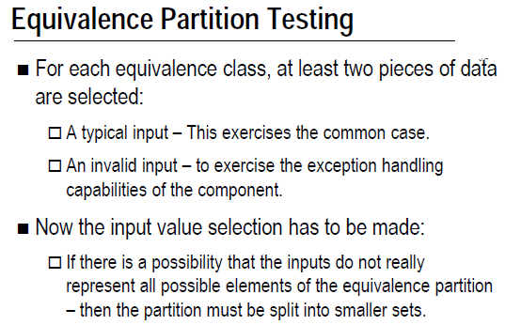

Slide 40
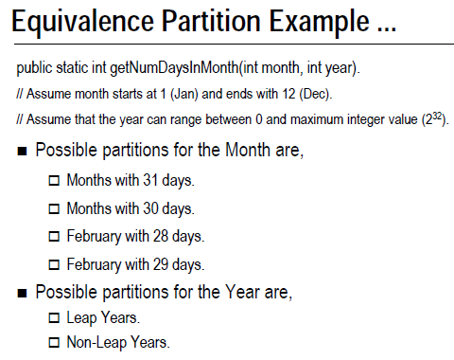

Slide 41
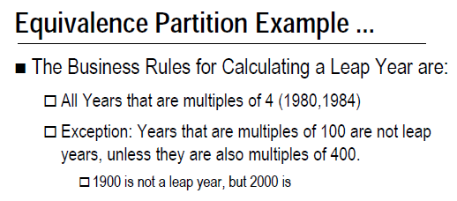

Slide 42
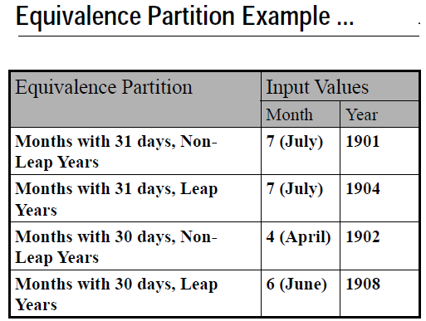

Slide 43
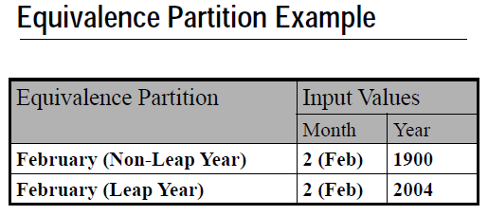

Slide 44
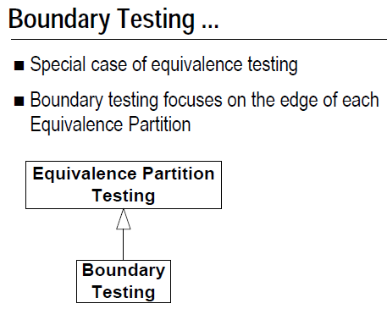

Slide 45
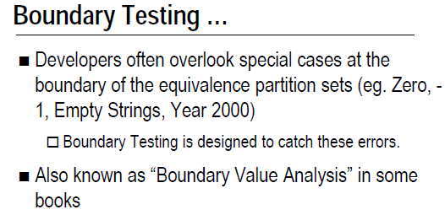

Slide 46
Boundary Value Analysis: Introduction
It has been found that most errors are caught at the boundary of the equivalence classes.
Not surprising, as the end points of the boundary are usually used in the code for checking:
E.g., checking K is in range [ X … Y ):
Easy to make mistake on the comparison.
if (K >= X && K <= Y)
...
Hence, when choosing test data using equivalence classes, boundary values should be used.
Nicely complement the Equivalence Class Testing.
Notes:
‹#›

Slide 47
Using Boundary Value Analysis
If the component specifies a range, [ X … Y ]
Four values should be tested:
Valid: X and Y
Invalid: Just below X (e.g., X – 1)
Invalid: Just above Y (e.g., Y + 1)
E.g., [1 … 12]
Test Data: {0, 1, 12, 13}
Similar for open interval (X … Y), i.e., X and Y not inclusive.
Four values should be tested:
Invalid: X and Y
Valid: Just above X (e.g., X + 1)
Valid: Just below Y (e.g., Y - 1)
E.g., (100 … 200)
Test Data: {100, 101, 199, 200}
Notes:
‹#›

Slide 48
Using Boundary Value Analysis
If the component specifies a number of values:
Define test data using [ min value … max value]:
Valid: min, max
Invalid: Just below min (e.g., min – 1)
Invalid: Just above max (e.g., max + 1)
E.g., values = {2, 4, 6, 8} → [2 … 8]
Test Data: {1, 2, 8, 9}
If a data structure has prescribed boundaries:
define test data to exercise the data structure at those boundaries.
E.g.,
String: Empty String, String with 1 character
Array : Empty Array, Array with 1 element, Full Array
Boundary value analysis is not applicable for data with no meaningful boundary, e.g., the set color {Red, Green, Yellow}.
Notes:
‹#›

Slide 49
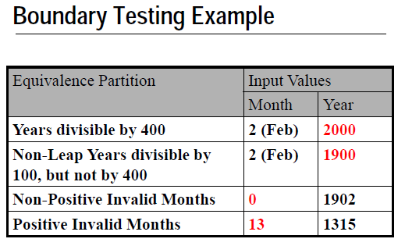

Slide 50
Example
Apply the Black Box Equivalence Partitioning test selection technique to the following question:
(Q1) “Write a small fragment of code that will find the largest number in an array of integers”
You will need to supply as many tests as there are equivalence partitions.

Slide 51
Sample Answer of Q1
Purpose: Equivalence Partition | Input(s) | Environment | Expected output(s)
Array of size greater than 1: all same number | 1, 1, 1, 1, 1 | Array of size 5 | 1
All positive, different and in order | 1, 2, 3, 4, 5 | Array of size 5 | 5
All positive, different and descending order | 5, 4, 3, 2, 1 | Array of size 5 | 5
All positive, different and in random order | 1, 2, 5, 4, 3 | Array of size 5 | 5
All negative and different | -1, -2, -3, -4, -5 | Array of size 5 | -1
All 0 | 0, 0, 0 | Array of size 3 | 0
Array of size 1 | 5 | Array of size 1 | 5
Array of size 0 |  | Array of size 0? | Error?
Non-numbers | 1, t, 5, h | Array of size 4 | Error

Slide 52
Functionality Testing
Previous examples have mostly numerical parameters and simplistic functionality, where it is easy to see how Equivalence Class Testing and Boundary Value Analysis can be applied.
The following example is to illustrate how functionality testing of a method can be accomplished by the black box testing techniques discussed.
This requires the method to be well specified:
The Precondition, Postcondition and Invariant should be available.
The Invariant: A property that is preserved by the method, i.e., true before and after the execution of method.
Notes:
‹#›

Slide 53
Functionality Testing
For a well specified method (or component).
Use the Precondition:
Define Equivalence Classes.
Apply Boundary Value Analysis if possible to choose test data from the equivalence classes.
Use the Postcondition and the Invariant:
Derive expected results.
Notes:
‹#›

Slide 54
Example (Searching)
boolean Search( List aList, int key)
Precondition:
-aList has at least one element
Postcondition: - true if key is in the aList - false if key is not in aList
Notes:
‹#›

Slide 55
Equivalence Classes
Sequence with a single value:
key found.
key not found.
Sequence of multi values:
key found:
First element in sequence.
Last element in sequence.
“Middle” element in sequence.
key not found.
Notes:
‹#›

Slide 56
Test Data
Test Case | aList | Key | Expected Result
1 | [ 123 ] | 123 | True
2 | [ 123 ] | 456 | False
3 | [ 1, 6, 3, -4, 5 ] | 1 | True
4 | [ 1, 6, 3, -4, 5 ] | 5 | True
5 | [ 1, 6, 3, -4, 5 ] | 3 | True
6 | [ 1, 6, 3, -4, 5 ] | 123 | False
Notes:
‹#›

Slide 57
Example (Stack – Push Method)
void push (Object obj) throws FullStackException
Precondition:
- ! full()
Postconditions:
- if !full() on entry then
top() == obj && size() == old size() + 1
else throw FullStackException
Invariant:
- size() >= 0 && size() <= capacity()
Common methods in the Stack class:
full(), top(), size(), capacity()
Notes:
‹#›

Slide 58
Test Data
Precondition: stack is not full (i.e., boolean).
Two equivalence classes can be defined.
Valid Case: Stack is not full.
Input: a non-full stack, an object obj
Expected result:
top() == obj
size() == old size() + 1
0 <= size() <= capacity()
Invalid Case: Stack is full.
Input: a full stack, an object obj
Expected result:
FullStackException is thrown
0 <= size() <= capacity()
Notes:
‹#›

