Slide 1
Metrics for Classification

Slide 2
Classification models predict class and/or probability
Classification model outcomes:
HARD: Class prediction (e.g. whether a patient has a disease or not)
SOFT: Probability of being a given class
Not all classification models have a meaningful definition of probability
Some have a pseudo-probability (e.g. tree models and SVMs) – generally costly for SVM
We judge our models based on the class and probability predictions they make
Sometimes we care only about the class predictions, other times we use probabilities as inputs into other downstream models

Slide 3
The most naive metric:
Accuracy
What percent did we get right?

Slide 4
Accuracy is % of observations classified correctly
Accuracy for any classification model is defined as:
Observations Correctly Classified
All Observations

Slide 5
Accuracy is % of observations classified correctly
Accuracy: (observations correctly classified / all observations)
Accuracy is useful as a first heuristic, but it has shortcomings
Student exercise
Is 95 percent accuracy a good score?
Can you name some shortcomings of accuracy as a metric? Think about cases where we’re trying to predict highly imbalanced classes.

Slide 6
Accuracy Example
Say we’re trying to predict whether a patient has a disease
In our sample, 99.5% of patients do not have the disease
What naive model could we use to get high accuracy?

Slide 7
Accuracy Example
Say we’re trying to predict whether a patient has a disease
In our sample, 99.5% of patients do not have the disease
What naive model could we use to get high accuracy?
If we naively predict “no disease” for every observation, we get 99.5% accuracy!

Slide 8
Accuracy Example
Say we’re trying to predict whether a patient has a disease
In our sample, 99.5% of patients do not have the disease
What naive model could we use to get high accuracy?
If we naively predict “no disease” for every observation, we get 99.5% accuracy!
So... maybe we should look at other metrics as well

Slide 9
Demystifying the confusion matrix

Slide 10
A confusion matrix is accuracy by class
Predicted
 | # days it was sunny | # days it rained
# days it was sunny | 75 | 5
# days it rained | 10 | 25
Actual

Slide 11
A confusion matrix is accuracy by class
Predicted
 | # days it was sunny | # days it rained
# days it was sunny | 75 | 5
# days it rained | 10 | 25
Actual
A confusion matrix is used to detail the performance of a classification model.

Slide 12
A confusion matrix is accuracy by class
Predicted
 | Negative class (0) | Positive class (1)
Negative class (0) | True negatives | False positives
Positive class (1) | False negatives | True positives
Actual
For those quadrants where our model was correct, we call them true positive/negative. Where our model was wrong, we call them false positive/negative.

Slide 13
Confusion Matrix Example
From the previous naïve model where we predicted “no disease” for every observation, what does the confusion matrix look like for 1000 people?
(Recall: 99.5% do not have disease)
Predicted
 | Negative class | Positive class
Negative class
Positive class
Actual

Slide 14
Confusion Matrix Example
From the previous naïve model where we predicted “no disease” for every observation, what does the confusion matrix look like for 1000 people?
(Recall: 99.5% do not have disease)
Predicted
 | Negative class | Positive class
Negative class | 995 | 0
Positive class | 5 | 0
Actual

Slide 15
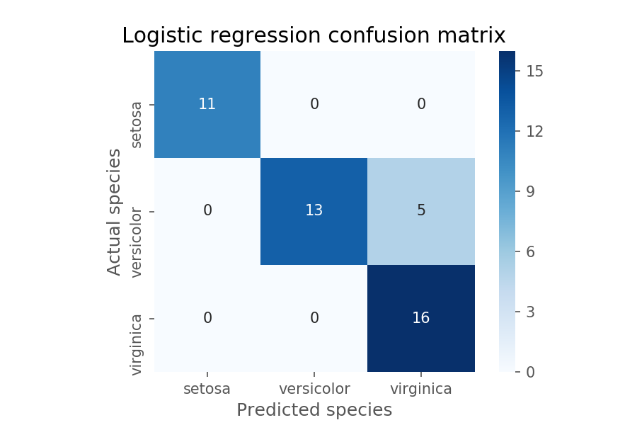
A confusion matrix is useful in multiclass problems

Slide 16
Other accuracy-based metrics:
Precision and recall

Slide 17
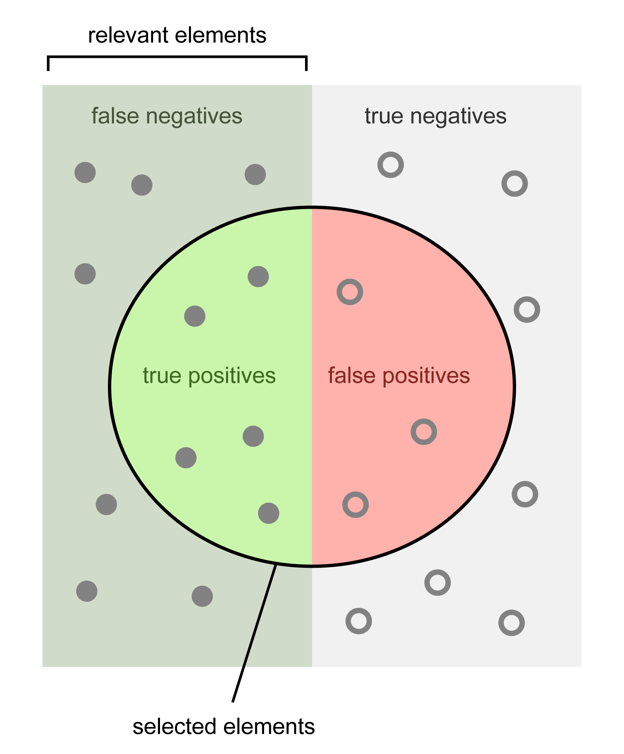
When getting one class correct is more important
Sometimes we don’t care about the accuracy of all classes equally
e.g. Detecting credit card fraud or the presence of a rare disease
Sometimes we’re willing to trade misclassifying one class to get better accuracy in a different class
Images from Wikipedia.
Notes:
Note that we usually talk about precision and recall TOGETHER, not in isolation. How does trading off one affect the other?

Slide 18
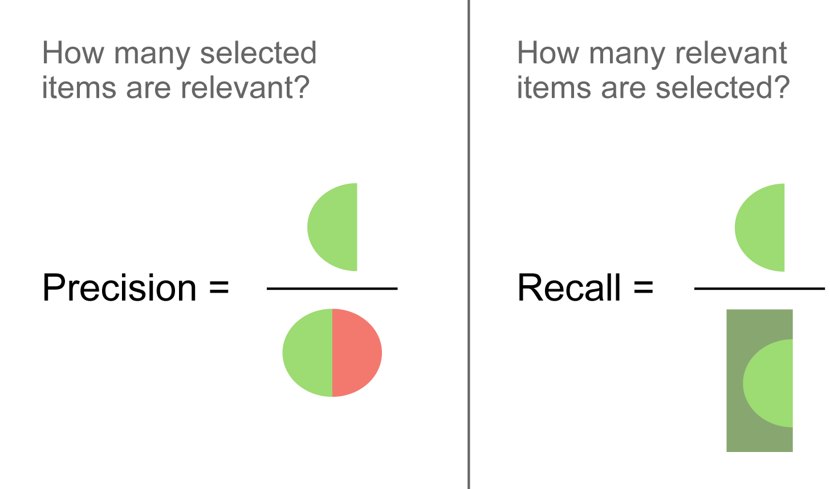
Precision and recall
Student exercise:
Can you name cases where we may care more about precision?
What about cases where we care more about recall?
Images from Wikipedia.
Notes:
Note that we usually talk about precision and recall TOGETHER, not in isolation. How does trading off one affect the other?

Slide 19
Using class probability predictions

Slide 20
Choosing a probability threshold
Some models give us probability predictions and not just class predictions
So far we’ve looked at accuracy, precision and recall derived from a 50% probability threshold (sklearn default)
But, we don’t have to take the 50% cutoff, we can choose our own!
Setting this cutoff means choosing our probability threshold

Slide 21
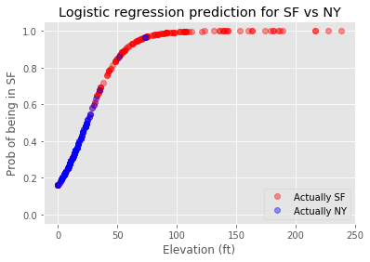
Probability threshold – 50%
SF
NY
Notes:
This is the problem we solve in the notebook; intro it quickly here but you can save more of the discussion for the notebook portion. Over the next three slides, discuss how changing the probability cutoff would change the classifications (whether an apartment is in NYC or SF).

Slide 22
Probability threshold – 70%
SF
NY
Notes:
This is the problem we solve in the notebook; intro it quickly here but you can save more of the discussion for the notebook portion. Over the next three slides, discuss how changing the probability cutoff would change the classifications (whether an apartment is in NYC or SF).

Slide 23
Probability threshold – 90%
SF
NY
Notes:
This is the problem we solve in the notebook; intro it quickly here but you can save more of the discussion for the notebook portion. Over the next three slides, discuss how changing the probability cutoff would change the classifications (whether an apartment is in NYC or SF).

Slide 24
Probability threshold – 90%
Note: SF = positive class
Student exercise:
As we increase the threshold, do we have:
Lower/higher recall?
Lower/higher precision?
Lower/higher true positive rate? (TP/AP)
Lower/higher false positive rate? (FP/AN)
Notes:
This is the problem we solve in the notebook; intro it quickly here but you can save more of the discussion for the notebook portion. Over the next three slides, discuss how changing the probability cutoff would change the classifications (whether an apartment is in NYC or SF).
Note: TPR = Labeled as postive/Actual positives; FPR = Falsely labeled as positive/Actual negatives.

Slide 25
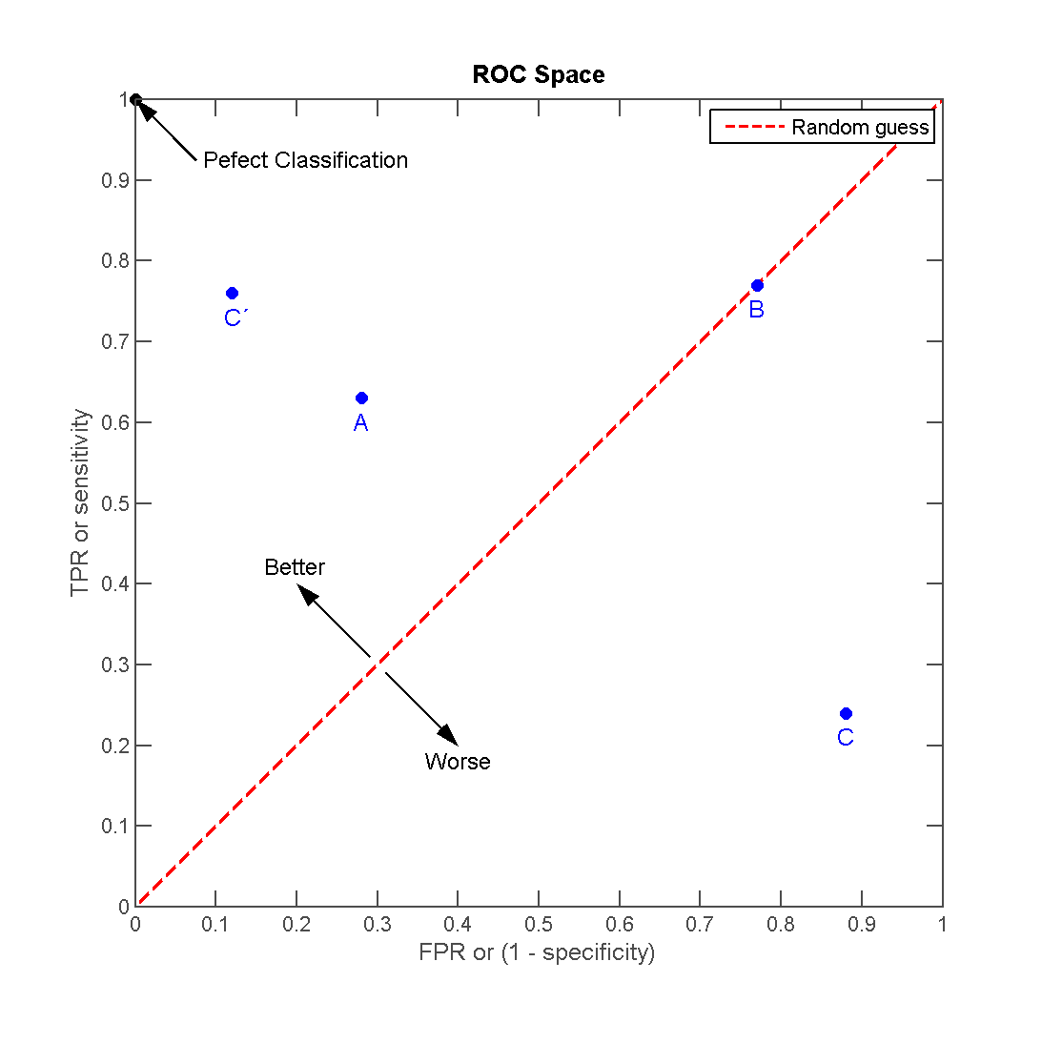
Using a ROC curve to determine probability thresholds
Drawing a ROC curve: change the probability threshold and plot how true positive rate and false positive rate change
Each threshold gives us a new model!
We can plot the ROC curve only for binary cases
Images from Wikipedia.
Notes:
ROC = Receiver operating characteristic

Slide 26
Using a ROC curve to determine probability thresholds
Check for understanding:
Which corner represents a higher threshold? Lower threshold?
NOTE:
TPR = True Positive Rate (True Positives/Actual Positives)
FPR = False Positive Rate (False Positives/Actual Negatives)
Images from Wikipedia.

Slide 27
Using a ROC curve to determine probability thresholds
Lower threshold: Better at catching positives. Higher recall, lower precision. Higher true positive rate, higher false positive rate
Higher threshold: Better at catching negatives. Lower recall, higher precision. Lower true positive rate, lower false positive rate.
Images from Wikipedia.

Slide 28
The perfect classifier
The perfect classifier (pink line) would be a curve that reaches the northwest corner
This represents a zero false positive rate and a 100% true positive rate
A metric related to the ROC curve is the area under the curve (AUC)
Notice that for the perfect classifier, the AUC would equal 1
An AUC closer to 1 is better, and it ranges from 0 (0.5) to 1
Images from Wikipedia.

Slide 29
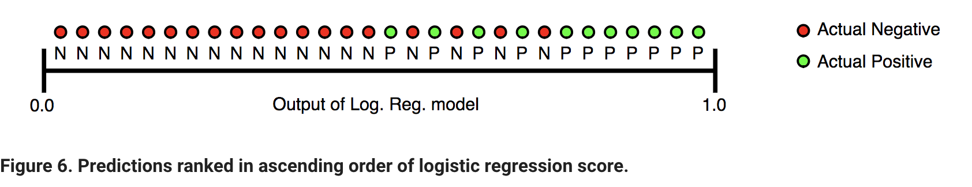
ROC-AUC Interpretation
One way of interpreting AUC:
Probability that random actual positive is ranked higher than random actual negative

Slide 30
ROC-AUC Interpretation
Threshold
Perfect Classifier:
All actual negatives have lower probability than all actual positives.
ROC AUC = 1

Slide 31
Precision and recall -- encore!
Images from Wikipedia.
Notes:
Note that we usually talk about precision and recall TOGETHER, not in isolation. How does trading off one affect the other?

Slide 32
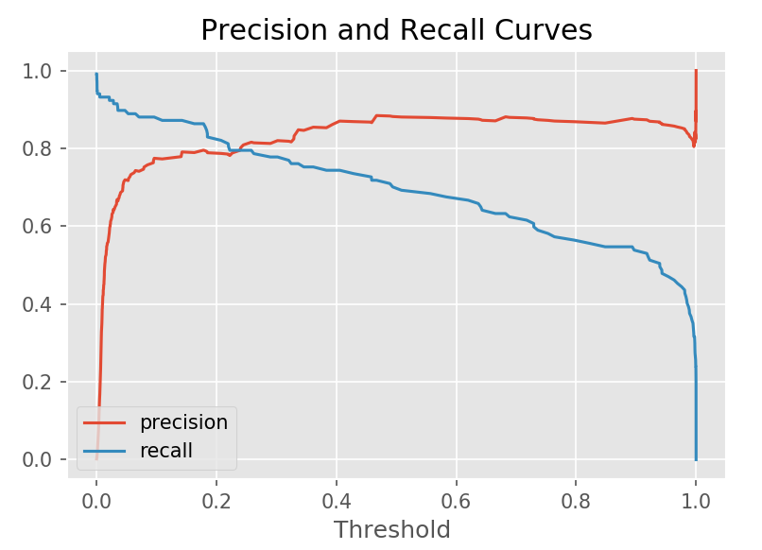
The precision-recall curve
So we can change our probability threshold, and thus the hard classifications of our model
As we move the threshold, we will also change our precision and recall
Want to find every positive class in the data?
Then decrease the threshold to almost nothing: Voilà! Almost all observations will be classified as positive
Want to make sure what you classify as positive is truly positive?
Increase the threshold and make it harder for the model to classify observations as positive

Slide 33
Applications to model development

Slide 34
Fit to training data, evaluate on test (or cross-val)
EVALUATE ERROR METRICS ON VAL
(or K-FOLD CV)
Accuracy, Precision, Recall
Confusion Matrix
ROC Curve
F1-Score
FIT MODEL TO TRAINING DATA
REPORT METRICS FROM HOLDOUT TEST DATA
…AND FINALLY…

Slide 35
Appendix: Objectives & Even more classification metrics

Slide 36
Learning Objectives
Understand the difference between model class predictions vs. probability predictions
Learn about the most common error metrics for classification:
Accuracy and accuracy-based metrics:
Confusion matrix
Precision and recall
Log-loss as a measure that takes the magnitude of uncertainty into account
Others:
ROC curve and maximizing the area under the curve (AUC)
Understand when to apply each metric, particularly the difference between two-class and multiclass problems
Notes:
Instructor note: this deck should be gone through fairly quickly as the notebook dives deep into the metrics. Set up exposure to the ideas here, then take the notebook more slowly to solidify understanding through examples.

Slide 37
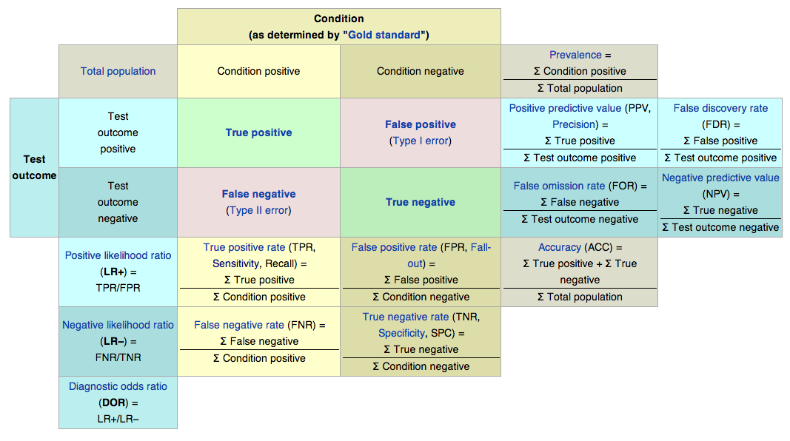
More classification metrics
Image from Wikipedia.
Notes:
Before flipping to this page, warn the students that the table you’re about to show is very busy and overwhelming, but that you’ll soon break it down. Spend only a little bit of time on this page, particularly on the basic confusion matrix, but don’t try to explain every single part.

Slide 38
More classification metrics
Image from Wikipedia.
Notes:
Our naive metric: accuracy

Slide 39
More classification metrics
Image from Wikipedia.
Notes:
Here just point out that we’ll dive deeper into precision and recall. No need to overly explain them now as we’ll go through them more in a moment

Slide 40
More classification metrics
Image from Wikipedia.
Notes:
Point out that this will relate to ROC curve

Slide 41
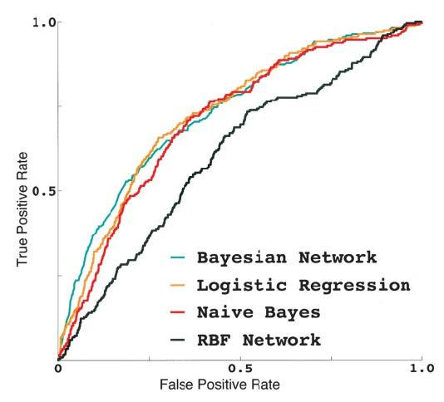
Using a ROC curve to compare algorithms

