Slide 1
LOGISTIC REGRESSION

Slide 2
Objectives
Recognize similarities between linear and logistic regression
Understand the role of the logit and inverse logit in logistic regression

Slide 3
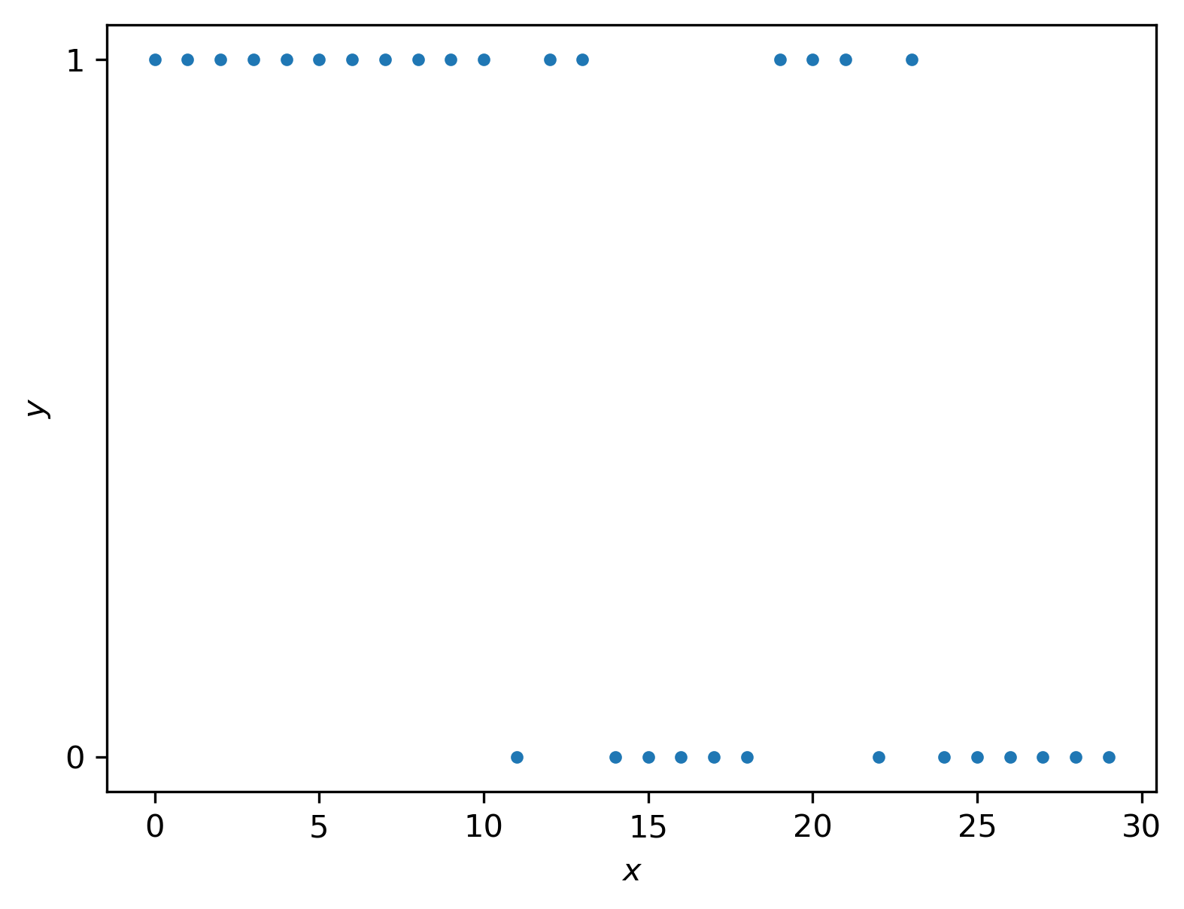
Example: Shooting Baskets
Let’s try shooting baskets from lots of different distances
What effect would you expect? What do you see?

Slide 4
Example: Shooting Baskets
Let’s try shooting baskets from lots of different distances
What effect would you expect? What do you see?
Can we apply the “transformation” approach here?

Slide 5
Example: Shooting Baskets
Let’s try shooting baskets from lots of different distances
What effect would you expect? What do you see?
Can we apply the “transformation” approach here?
The two y values would map into two different y values
What can we do differently?

Slide 6
Example: Shooting Baskets
Let’s try shooting baskets from lots of different distances
What effect would you expect? What do you see?
Can we apply the “transformation” approach here?
The two y values would map into two different y values
What can we do differently?
Let’s think some more about regression and come back to this

Slide 7
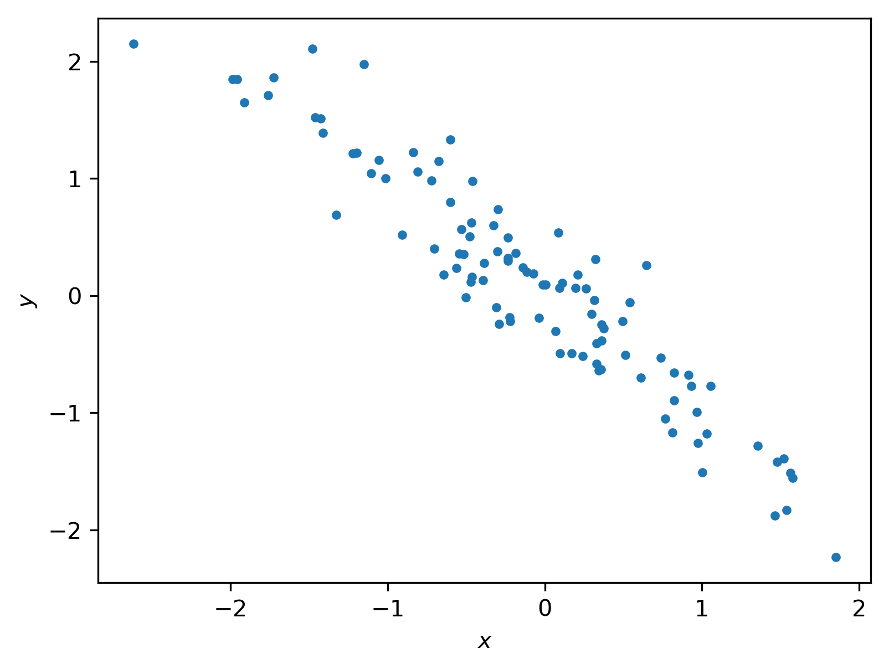
More Regression
Classically, “regression” is about conditional expectation
Do you see a conditional expectation here?

Slide 8
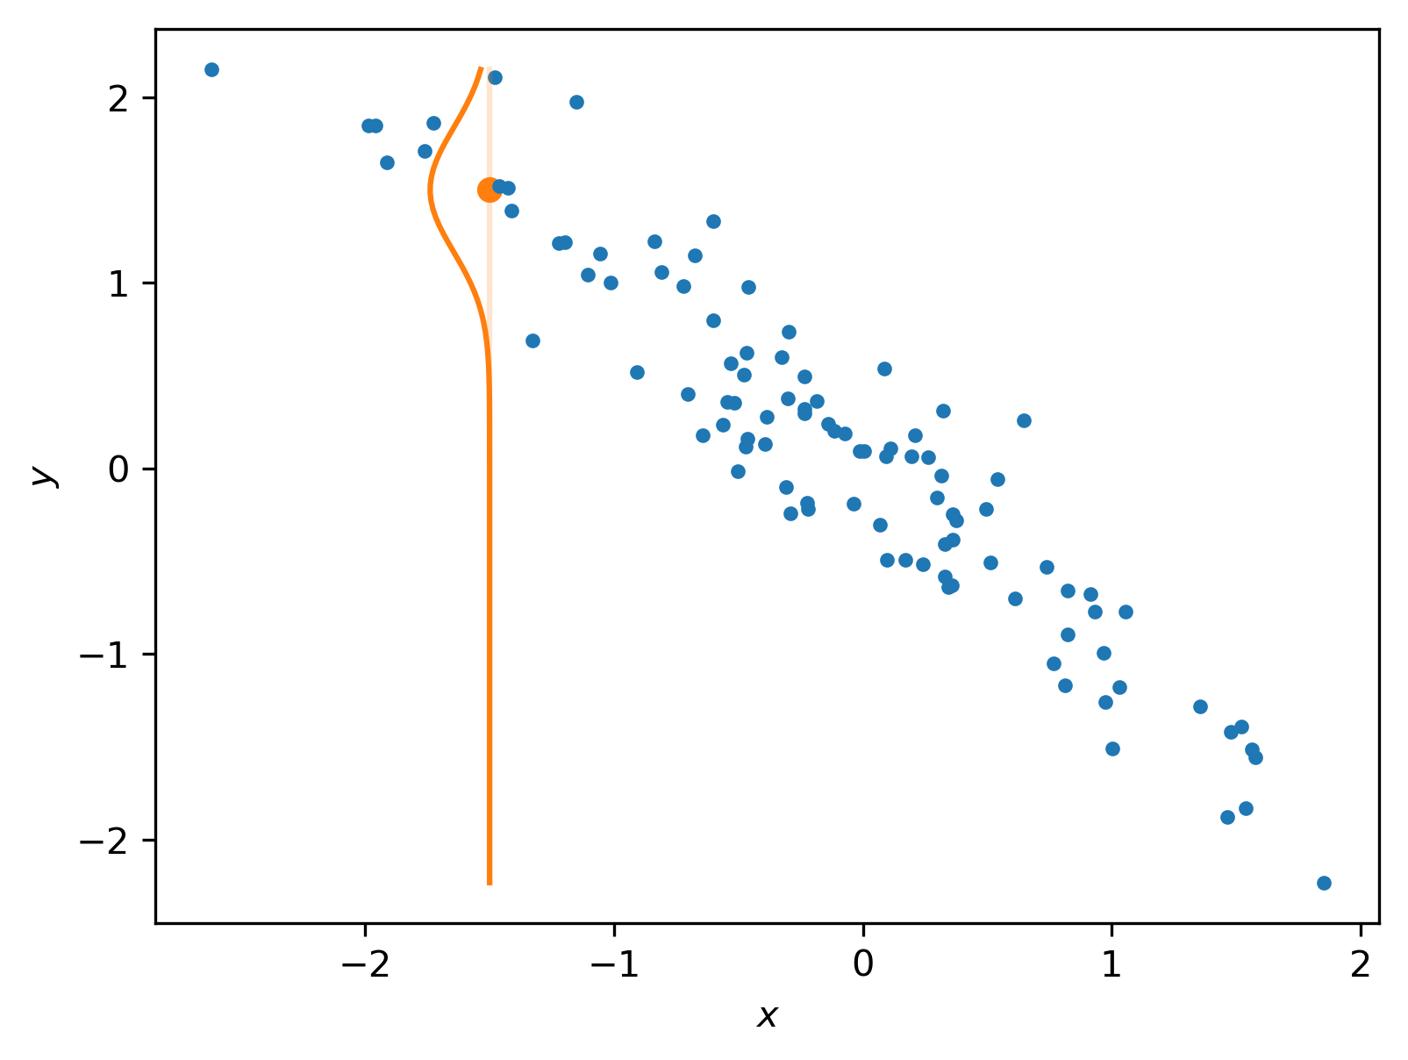
More Regression
Classically, “regression” is about conditional expectation
Do you see a conditional expectation here?
For each x, we get a distribution over y

Slide 9
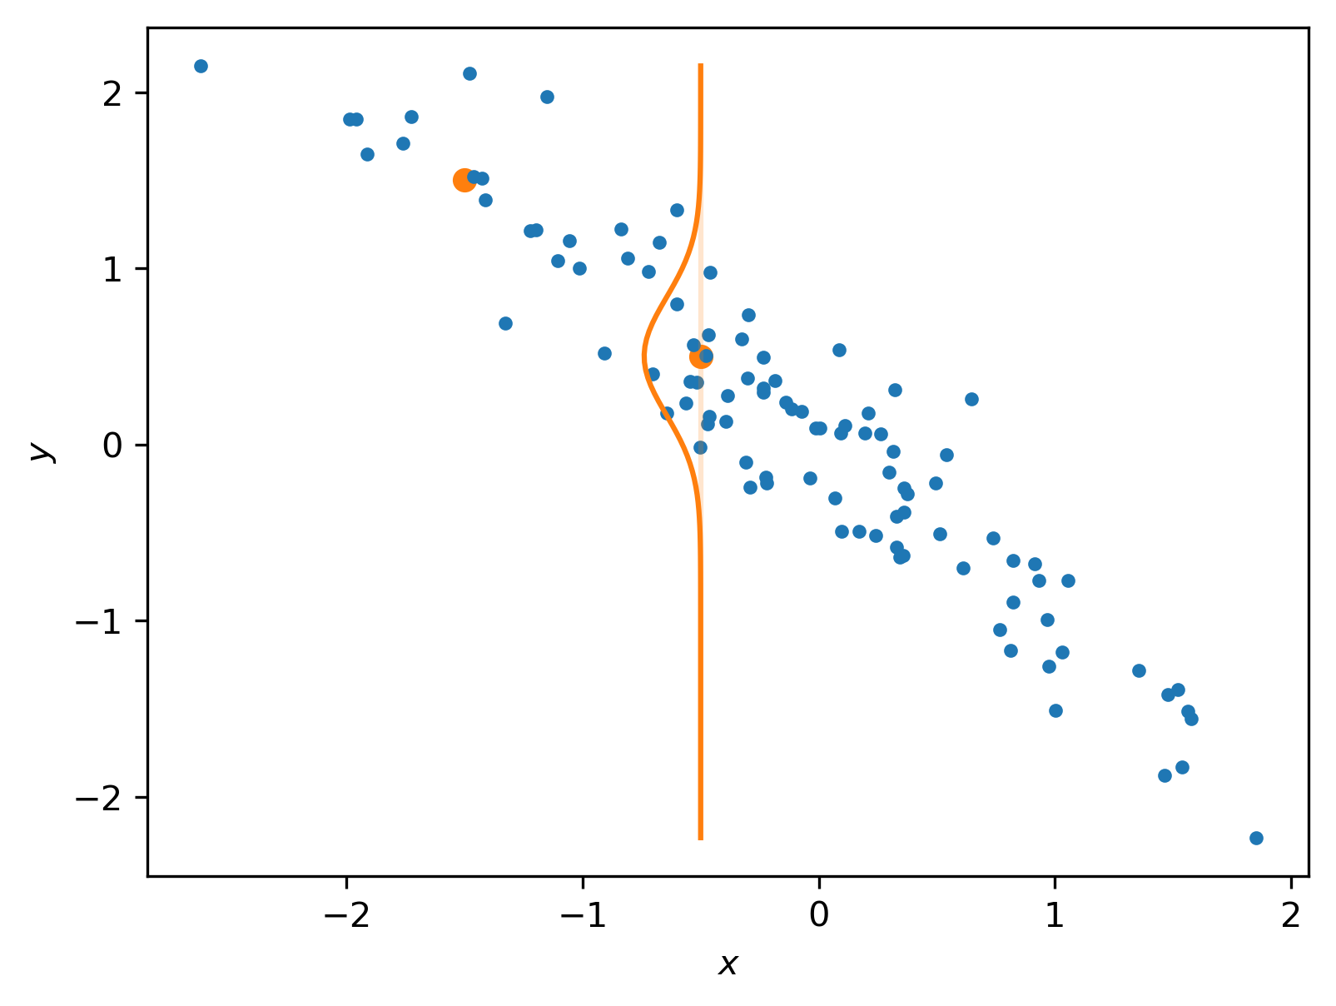

More Regression
Classically, “regression” is about conditional expectation
Do you see a conditional expectation here?
For each x, we get a distribution over y
For any x, our prediction is

Slide 10
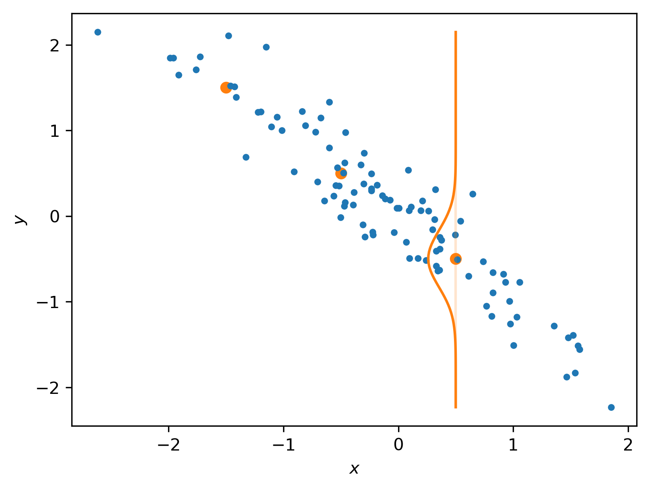
More Regression
Classically, “regression” is about conditional expectation
Do you see a conditional expectation here?
For each x, we get a distribution over y
For any x, our prediction is

Slide 11
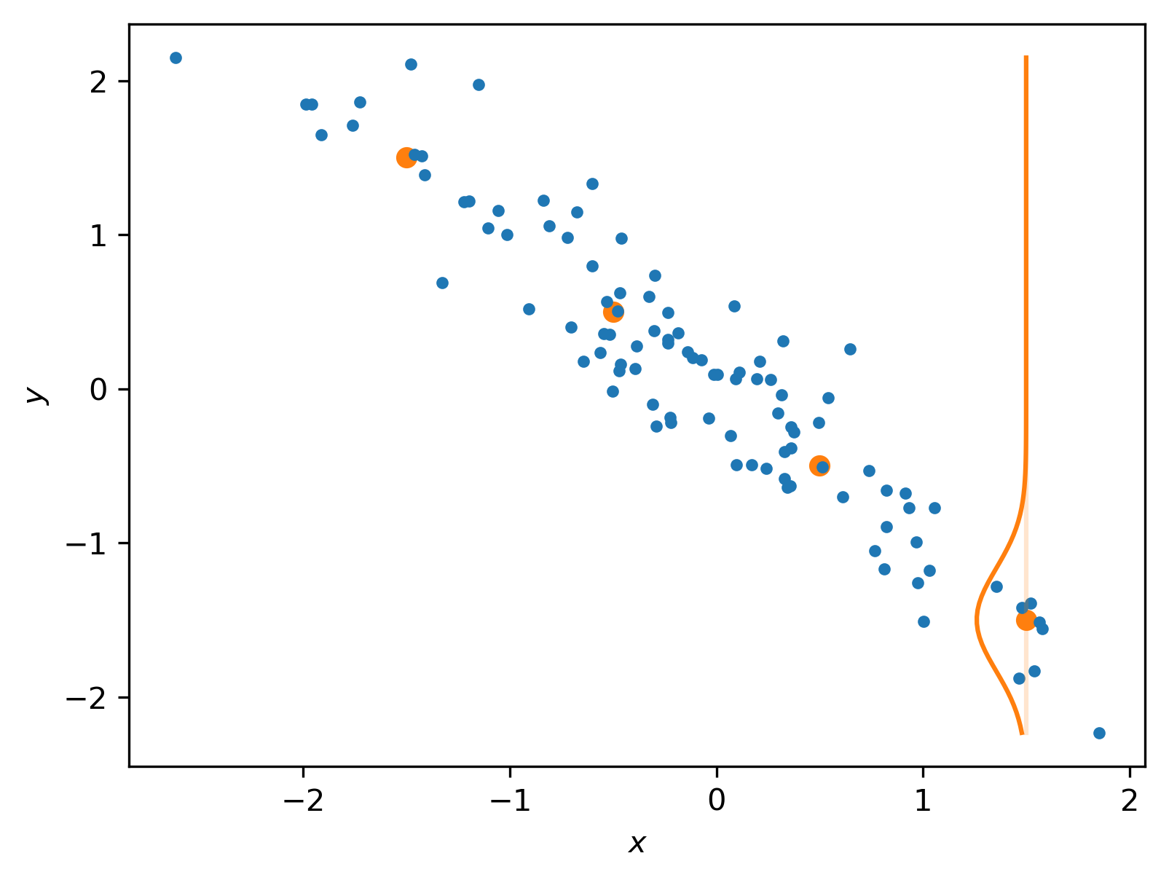
More Regression
Classically, “regression” is about conditional expectation
Do you see a conditional expectation here?
For each x, we get a distribution over y
For any x, our prediction is
Connecting these over all x gives us a curve

Slide 12
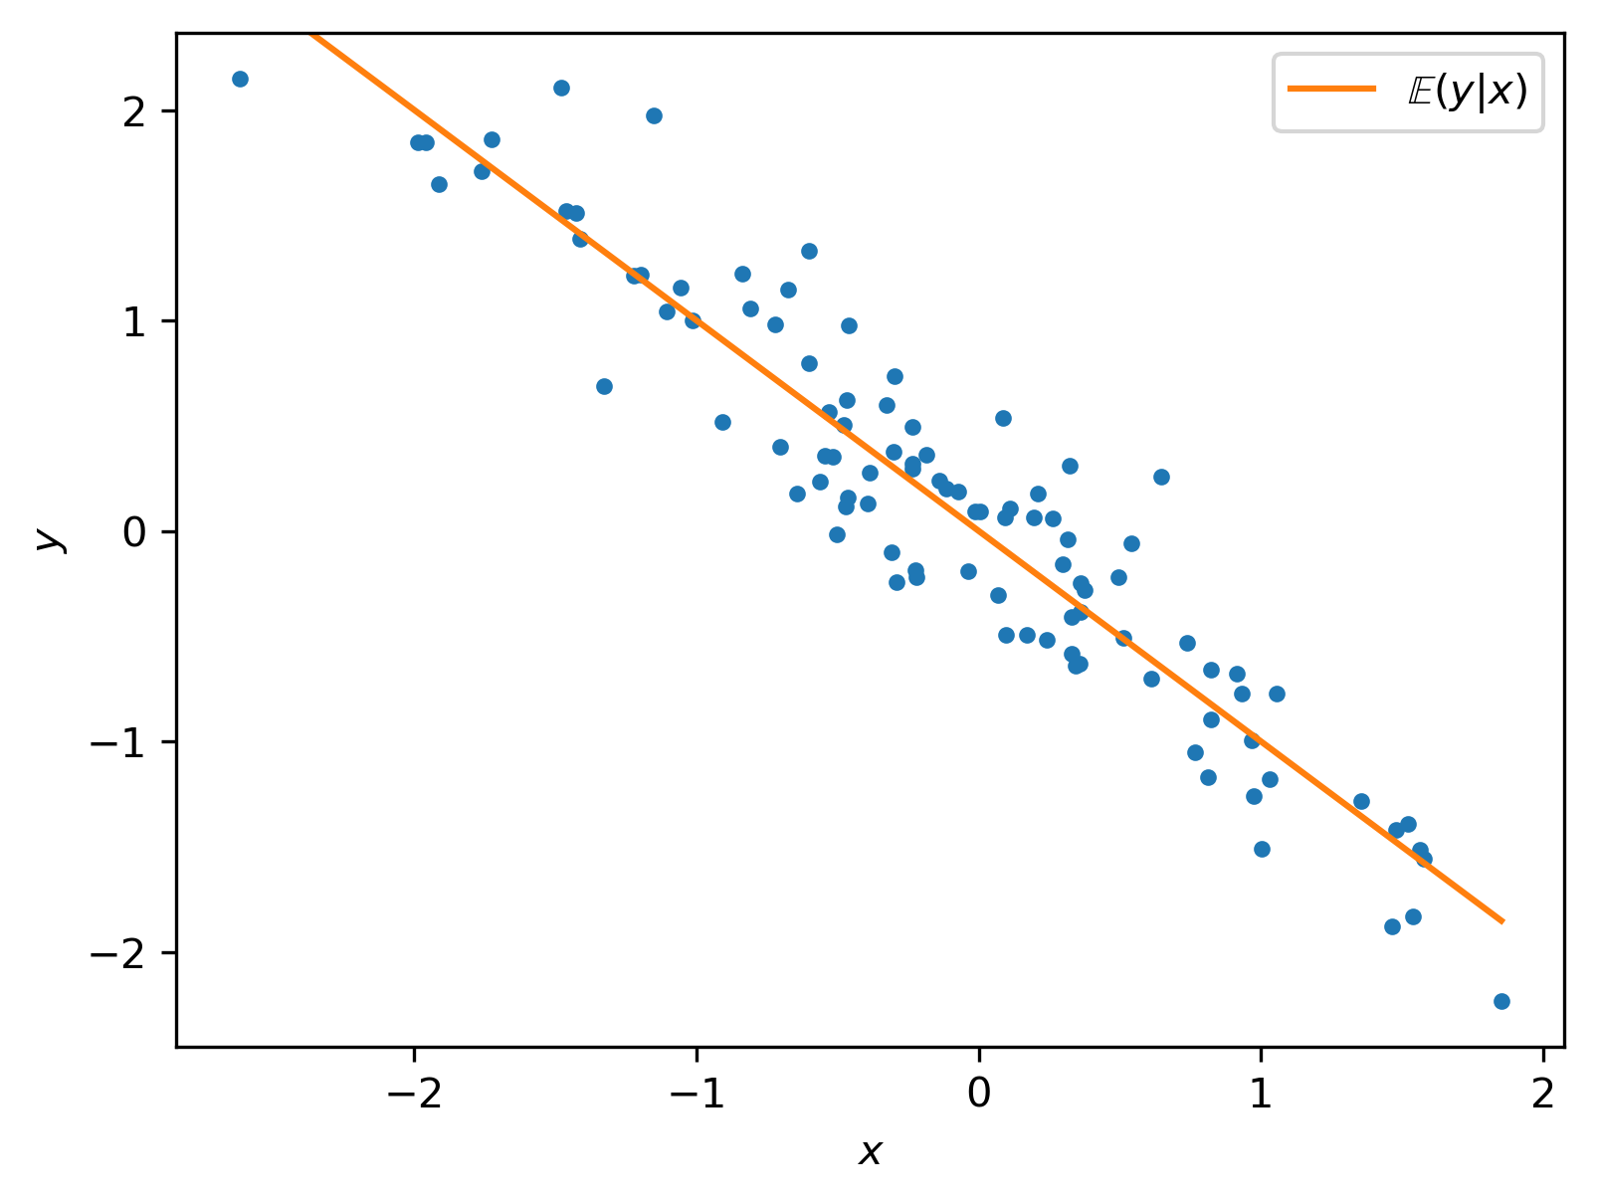
More Regression
Classically, “regression” is about conditional expectation
Do you see a conditional expectation here?
For each x, we get a distribution over y
For any x, our prediction is
Connecting these over all x gives us a curve
For linear regression, this “conditional expectation” curve is linear (in the parameters)

Slide 13
Back to Baskets
For each x, y follows a Bernoulli (“biased coin flip”) distribution
What might conditional expectation look like here?

Slide 14
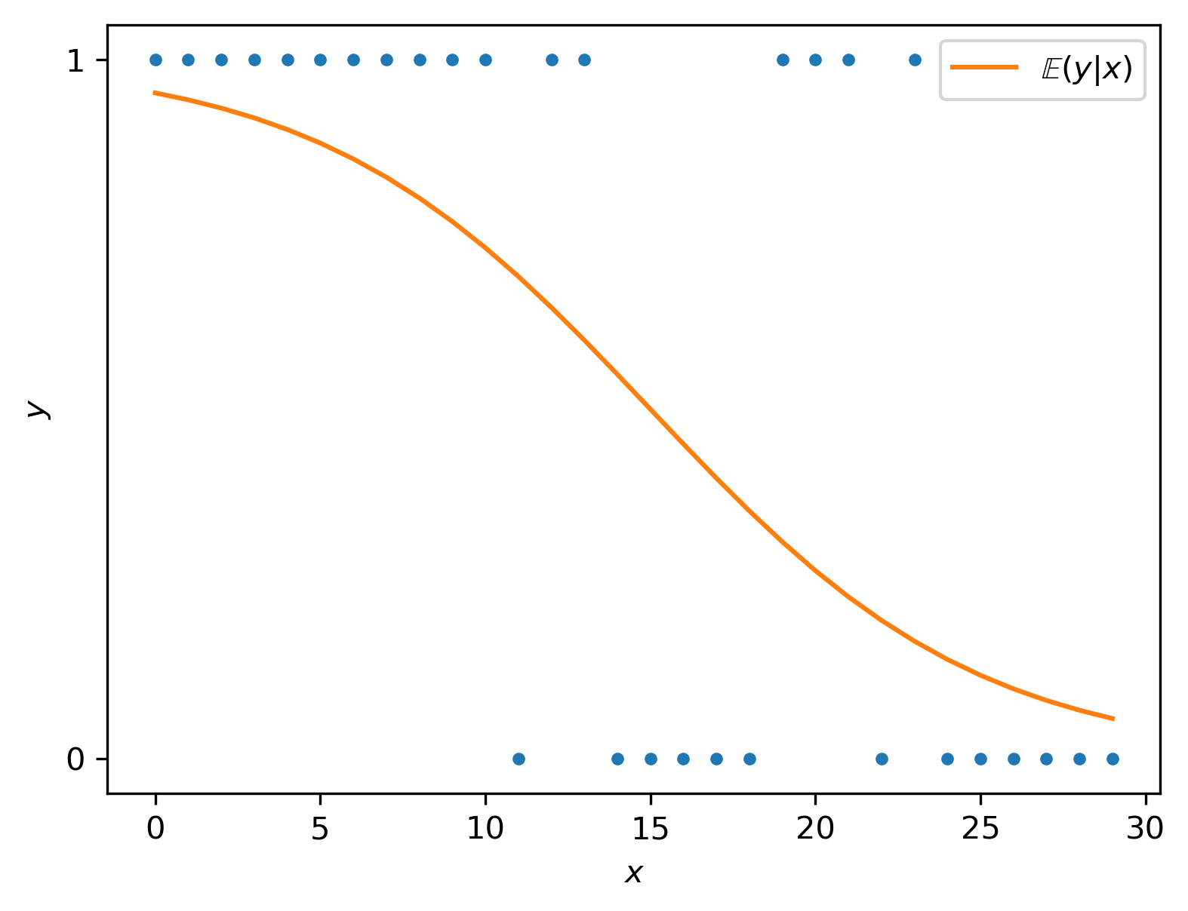

Back to Baskets
For each x, y follows a Bernoulli (“biased coin flip”) distribution
What might conditional expectation look like here?
In this case “conditional expectation” is also a conditional probability,
Hey, that’s what we need for classification!
But… how do we get there from x?

Slide 15



Finding the Link
For linear modeling, our model was
We used the data to find the best
For a new “row vector” , our prediction was
In that case the mean and linear predictor were the same
For the baskets example, we’ll need some transformation to “link” them

Slide 16


Back to Baskets
Here’s an x with
Probabilities are always in (0,1)

Slide 17

Back to Baskets
Here’s an x with
Probabilities are always in (0,1)
We can also work in terms of odds, which are 3:1 or 3/1
If the mean is , odds are
What values are possible for odds?

Slide 18
Back to Baskets
Here’s an x with
Probabilities are always in (0,1)
We can also work in terms of odds, which are 3:1 or 3/1
If the mean is , odds are
What values are possible for odds?
Odds can be any positive number!

Slide 19
Back to Baskets
Here’s an x with
Probabilities are always in (0,1)
We can also work in terms of odds, which are 3:1 or 3/1
If the mean is , odds are
What values are possible for odds?
Odds can be any positive number!
But our linear predictor can be any real number
How can we get from “positives” to “reals”?

Slide 20
Back to Baskets
Here’s an x with
Probabilities are always in (0,1)
We can also work in terms of odds, which are 3:1 or 3/1
If the mean is , odds are
What values are possible for odds?
Odds can be any positive number!
But our linear predictor can be any real number
How can we get from “positives” to “reals”?
Use the log-odds!

Slide 21











Some Brief Math
$$P\left(Basket\right) = \frac{1}{(1+e^{−z})}$$
$$0<P<1$$
$$−∞<z<∞$$
$z= β_{0}$ + $β_{1}x_{1 }$+ $β_{2}x_{2}$ + $β_{3}x_{3}$ + … + $β_{m}x_{m}$
$z$ $=log⁡(\frac{p}{1−p})$
$$e^{z}=\frac{p}{1−p}$$
$$1−p\left(e^{z}\right)=p$$
$$e^{z}−pe^{z}=p$$
$$e^{z}=p+pe^{z}$$
$$e^{z}=p\left(1+e^{z}\right)$$
$$p=\frac{e^{z}}{1+e^{z}}×\frac{e^{−z}}{e^{−z}}$$
$$p=\frac{1}{1+e^{−z}}$$

Slide 22




The Logit
The logit (“low jit”) maps a probability to its log-odds
For a normal linear model, the linear predictor gets us directly to
For logistic regression, it gives us a transformed version,
The logit “links” the linear predictor to the conditional expectation
For logistic regression, the logit is the link function
(We’ll see other link functions another time)

Slide 23
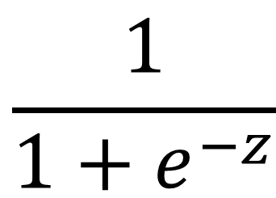

Sorry for the Synonyms
These are all the same thing:
Inverse logit
logistic function
expit (in scipy)
sigmoid (this means “S-shaped”, but people usually mean this specifically)
$$\frac{1}{1+e^{−z}}$$
$$z$$

Slide 24
Final Thoughts
Loosely speaking, logistic regression is “linear regression for probabilities”
Two differences:
Distribution is binomial instead of normal
Link function is logit instead of identity
Many ideas from linear regression apply:
Feature engineering
Regularization (L₁, L₂, Elastic net)
Diagnostics (p-values, log-likelihood, etc)

Slide 25
Multiclass
TODO: Describe softmax and one-vs-rest

Slide 26
Comparing Softmax and One-vs-Rest
Let’s try an experiment:
Generate lots of fake data sets, each with 300 data points over 3 classes
For each of these:
For each data point:
Calculate the “ground truth” probability of the majority class
Use predict_proba to calculate the same for softmax and ovr
For each “ground truth” probability, compare softmax and ovr results
Don’t look yet!!
What do you think we’ll see?

Slide 27
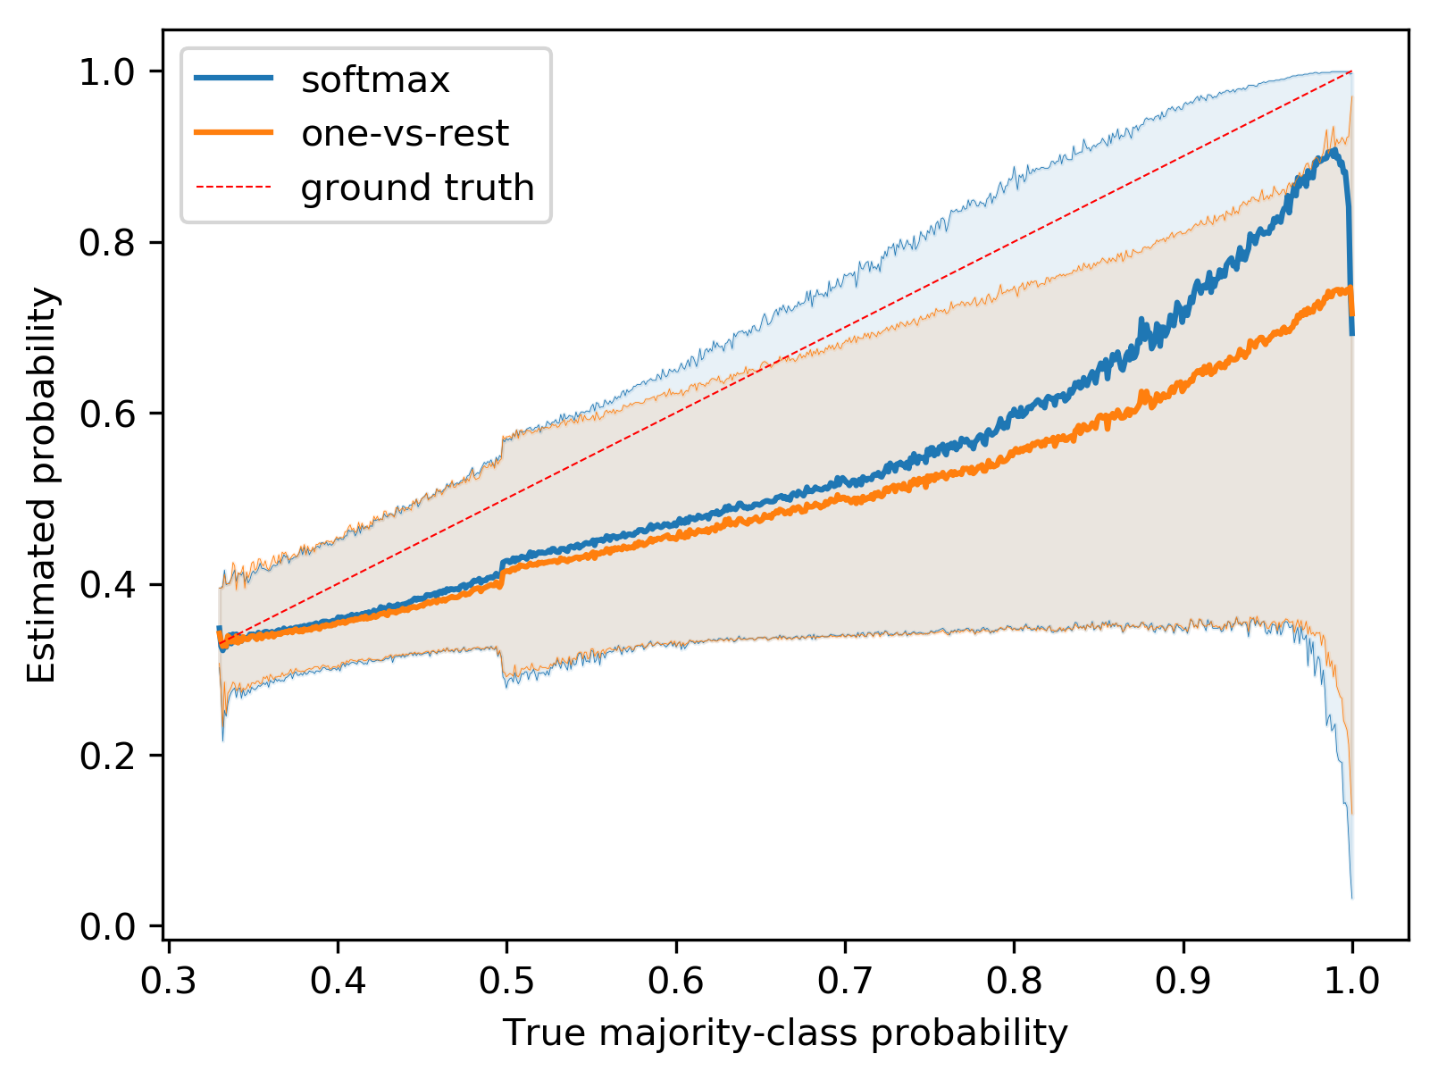
Comparing Softmax and One-vs-Rest
The graph shows median in bold, with 90% intervals shaded
Some discussion questions:
Why doesn’t the x-axis do any lower?
What’s going on at x=0.5?
What about near x=1?
How would you test these hypotheses?
Are there possible misclassifications here?
What about definite misclassifications?
Does this contradict the idea that logistic regression is well-calibrated?
What advantage of softmax over ovr could explain the difference?

