Slide 1

Introduction to
Categorical Data Analysis

Slide 2
Categorical Data Analysis
Methods for response (y) variable having scale that is categorical
Examples:
Binary (Democrat or Republican)
(Success or Not Success)
Nominal (Favorite music genre: rock, classical, jazz)
Ordinal (Rank: 1st, 2nd, 3rd)
For these problems, linear regression is not the correct approach.

Slide 3
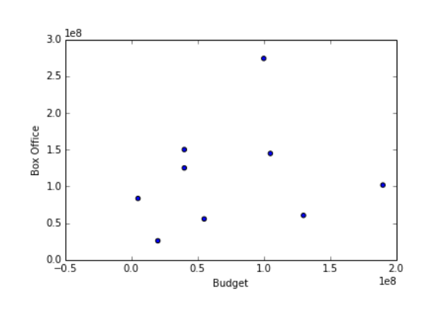
Probability Distributions for Categorical Data
In linear regression: response y is continuous, and the (conditional) response y | x is normally distributed.

Slide 4
Probability Distributions for Categorical Data
In linear regression: response y is continuous, and the (conditional) response y | x is normally distributed.
In models where y is categorical, the response y | x can take other distributions.

Slide 5
Let’s first start simple.

Slide 6
Binomial Experiments
The experiment of tossing a coin n times is an example of a binomial experiment.

Slide 7
Binomial Experiments
The experiment of tossing a coin n times is an example of a binomial experiment.
Three conditions:
n independent trials
The outcome of a single trial is classified as 1 of 2 types:
Success
Not Success
For each trial, the probability of success is the same:
P(Success) = π
Note: π is called the parameter of the experiment.

Slide 8
Binomial Experiments
Y: random variable, represents the # of successes out of n trials
Example:
200 voters
Each person votes:
Democrat – with p = 0.55
Republican – with p = 0.45

Slide 9
Binomial Experiments
Y: random variable, represents the # of successes out of n trials
Example:
200 voters
Each person votes:
Democrat – with p = 0.55
Republican – with p = 0.45
Then # Democrat votes ~ Binomial ( n=200, π = 0.55)

Slide 10
Binomial Experiments
Y: random variable, represents the # of successes out of n trials
Example:
200 voters
Each person votes:
Democrat – with p = 0.55
Republican – with p = 0.45
Then # Democrat votes ~ Binomial ( n=200, π = 0.55)
Note: if n = 1 (just one trial), then Y ~ Bernoulli distribution

Slide 11
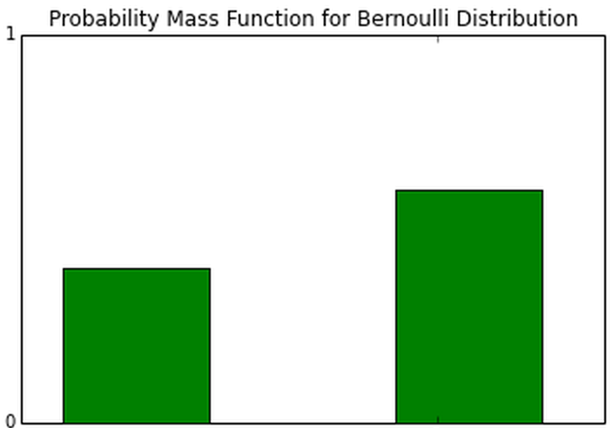
Binomial Experiments
Y: random variable, represents the # of successes out of n trials
Example:
200 voters
Each person votes:
Democrat – with p = 0.55
Republican – with p = 0.45
Then # Democrat votes ~ Binomial ( n=200, π = 0.55)
Note: if n = 1 (just one trial), then Y ~ Bernoulli distribution
π
1 - π
Republican
Democrat

Slide 12
The Binomial Distribution
More generally, the random variable
Y ~ Binomial (n, p)
has probability mass function:
P(Y = y) = π ^{y} (1 – π) ^{n-y}
n!
y!(n – y)!

Slide 13
The Binomial Distribution
More generally, the random variable
Y ~ Binomial (n, π)
has probability mass function:
P(Y = y) = π ^{y} (1 – π) ^{n-y}
In general, for a binomial random variable Y,
The Expected Value is:
E(Y) = μ_{Y} = nπ
The Variance is:
Var(Y) = σ_{Y}² = nπ(1-π)
n!
y!(n – y)!

Slide 14
The Binomial Distribution
More generally, the random variable
Y ~ Binomial (n, π)
has probability mass function:
P(Y = y) = π ^{y} (1 – π) ^{n-y}
In general, for a binomial random variable Y,
The Expected Value is:
E(Y) = μ_{Y} = nπ
The Variance is:
Var(Y) = σ_{Y}² = nπ(1-π)
(
)
n
y

Slide 15
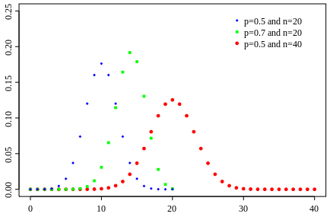
The Binomial Distribution

Slide 16
Example of a Binomial Distribution

Slide 17
Example of a Binomial Distribution
Let Y = # of people who voted Democrat.
n = 3 voters.
Suppose P(vote Dem) = 0.5
Possible values of Y are:

Slide 18
Example of a Binomial Distribution
Let Y = # of people who voted Democrat.
n = 3 voters.
Suppose P(vote Dem) = 0.5
Possible values of Y are: 0, 1, 2, 3

Slide 19
Example of a Binomial Distribution
Let Y = # of people who voted Democrat.
n = 3 voters.
Suppose P(vote Dem) = 0.5
Possible values of Y are: 0, 1, 2, 3
Then Y follows a binomial distribution:
Y ~ Binomial (n = 3, π = 0.5)

Slide 20
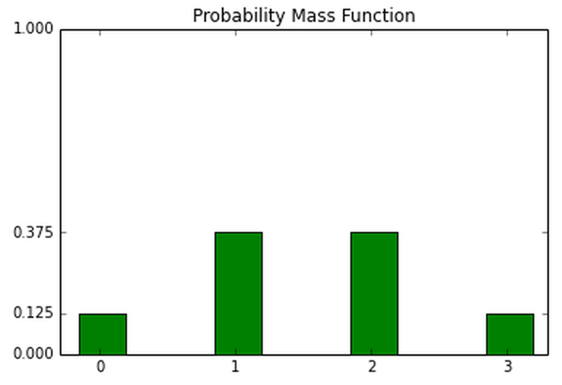
Example of a Binomial Distribution
Let Y = # of people who voted Democrat.
n = 3 voters.
Suppose P(vote Dem) = 0.5
Possible values of Y are: 0, 1, 2, 3
Then Y follows a binomial distribution:
Y ~ Binomial (n = 3, π = 0.5)

Slide 21
Example of a Binomial Distribution
Let Y = # of people who voted Democrat.
n = 3 voters.
Suppose P(vote Dem) = 0.5
Possible values of Y are: 0, 1, 2, 3
Then Y follows a binomial distribution:
Y ~ Binomial (n = 3, π = 0.5)
P(Y = y) = (1/2) ^{y} (1 /2) ^{3-y}
= (1/8)
3!
y!(3 – y)!
3!
y!(3 – y)!

Slide 22
Thinking with Likelihoods

Slide 23
Thinking with Likelihoods
Before, we were thinking about the probability of various possible outcomes of Y, given a parameter π (and n data points).
Given π, what is is the probability of seeing y # successes, P(Y=y) ?
Given P(vote Dem) = 0.5, what is is the probability of seeing y # Democrat votes, P(Y=y) ?

Slide 24
Thinking with Likelihoods
Before, we were thinking about the probability of various possible outcomes of Y, given a parameter π.
Given π, what is is the probability of seeing y # successes, P(Y=y) ?
In real life, we’re often more interested in going the other way. So now let’s flip our thinking:
Given Y = y # successes, what is the underlying proportion π?

Slide 25
Thinking with Likelihoods
Before, we were thinking about the probability of various possible outcomes of Y, given a parameter π.
Given π, what is is the probability of seeing y # successes, P(Y=y) ?
In real life, we’re often more interested in going the other way. So now let’s flip our thinking:
Given Y = y # successes, what is the underlying proportion π?
Example: on Wall St, I count 100 people, 15 of whom are women. What is the proportion of women on Wall St?

Slide 26
Thinking with Likelihoods: The Idea

Slide 27
Thinking with Likelihoods: The Idea
There is an unknown parameter π (like a “state of nature”)
Have data, i.e. observations Y (or Y₁, Y₂, Y₃, …)
Assume a model, i.e. Y ~ Binomial (n, π)

Slide 28
Thinking with Likelihoods: The Idea
There is an unknown parameter π (like a “state of nature”)
Have data, i.e. observations Y (or Y₁, Y₂, Y₃, …)
Assume a model, i.e. Y ~ Binomial (n, π)
Goal: want P(π | Y = y)

Slide 29
Thinking with Likelihoods: The Idea
There is an unknown parameter π (like a “state of nature”)
Have data, i.e. observations Y (or Y₁, Y₂, Y₃, …)
Assume a model, i.e. Y ~ Binomial (n, π)
Goal: want P(π | Y = y)
After we have data, we want to know the probability of seeing various values of π.

Slide 30
Thinking with Likelihoods: The Idea
There is an unknown parameter π (like a “state of nature”)
Have data, i.e. observations Y (or Y₁, Y₂, Y₃, …)
Assume a model, i.e. Y ~ Binomial (n, π)
Goal: want P(π | Y = y)
After we have data, we want to know the probability of seeing various values of π.
In particular, we’d like to find the probability that is maximal.

Slide 31
Thinking with Likelihoods: The Idea
Goal: want P(π | Y = y)
After we have data, we want to know the probability of seeing various values of π.
Two ways:

Slide 32
Thinking with Likelihoods: The Idea
Goal: want P(π | Y = y)
After we have data, we want to know the probability of seeing various values of π.
Two ways:
Bayes Theorem.

Slide 33
Thinking with Likelihoods: The Idea
Goal: want P(π | Y = y)
After we have data, we want to know the probability of seeing various values of π.
Two ways:
Bayes Theorem.
P(π | Y = y) is proportional to P(π) P(Y = y | π)

Slide 34
Thinking with Likelihoods: The Idea
Goal: want P(π | Y = y)
After we have data, we want to know the probability of seeing various values of π.
Two ways:
Bayes Theorem.
P(π | Y = y) is proportional to P(π) P(Y = y | π)
prior
likelihood

Slide 35
Thinking with Likelihoods: The Idea
Goal: want P(π | Y = y)
After we have data, we want to know the probability of seeing various values of π.
Two ways:
Bayes Theorem.
P(π | Y = y) is proportional to P(π) P(Y = y | π)
Some controversy in getting the prior:
How to get it, what it means, subjective disagreements, subjective biases
prior
likelihood

Slide 36
Thinking with Likelihoods: The Idea
Maximum Likelihood
No priors; more limited, working only with the likelihood

Slide 37
Thinking with Likelihoods: The Idea
Maximum Likelihood
No priors; more limited, working only with the likelihood
We can conduct inferences about parameters using maximum likelihood.

Slide 38
Thinking with Likelihoods: The Idea
Maximum Likelihood
No priors; more limited, working only with the likelihood
We can conduct inferences about parameters using maximum likelihood.
Definition. The likelihood function is the probability of the observed data occurring, expressed as a function of the parameter value.

Slide 39
Thinking with Likelihoods: The Idea
Maximum Likelihood
No priors; more limited, working only with the likelihood
We can conduct inferences about parameters using maximum likelihood.
Definition. The likelihood function is the probability of the observed data occurring, expressed as a function of the parameter value.
Example.
Of the N = 2 people on Wall Street, 1 was a woman.
Then Y = # successes = 1.
Y ~ Binomial (n = 2, π = ?)

Slide 40
Maximum Likelihood Example, continued.
Of the n = 2 people on Wall Street, 1 was a woman.
Then Y = # successes = 1.
Y ~ Binomial (n = 2, π = ?)

Slide 41
Maximum Likelihood Example, continued.
Of the n = 2 people on Wall Street, 1 was a woman.
Then Y = # successes = 1.
Y ~ Binomial (n = 2, π = ?)
Binomial Distribution:
P(Y = y | n=2) = (π) ^{y} (1 -π) ^{2-y}
2!
y!(2 – y)!

Slide 42
Maximum Likelihood Example, continued.
Of the n = 2 people on Wall Street, 1 was a woman.
Then Y = # successes = 1.
Y ~ Binomial (n = 2, π = ?)
Binomial Distribution:
P(Y = y | n=2) = (π) ^{y} (1 -π) ^{2-y}
P(Y = 1 | n=2) = 2π(1 – π)
2!
y!(2 – y)!

Slide 43
Maximum Likelihood Example, continued.
Of the n = 2 people on Wall Street, 1 was a woman.
Then Y = # successes = 1.
Y ~ Binomial (n = 2, π = ?)
Binomial Distribution:
P(Y = y | n=2) = (π) ^{y} (1 -π) ^{2-y}
P(Y = 1 | n=2) = 2π(1 – π)
The likelihood function, below, is the probability of observing y=1, expressed as a function of parameter value π:
L(π) = 2π(1 – π)
2!
y!(2 – y)!

Slide 44
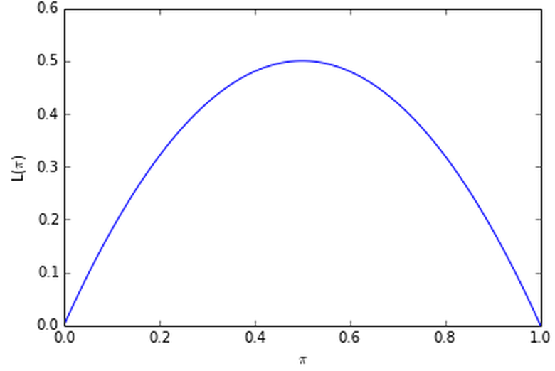
Maximum Likelihood Example, continued.
Of the n = 2 people on Wall Street, 1 was a woman.
Then Y = # successes = 1.
Y ~ Binomial (n = 2, π = ?)
L(π) = 2π(1 – π)
max

Slide 45
Maximum Likelihood Example, continued.
Of the n = 2 people on Wall Street, 1 was a woman.
Then Y = # successes = 1.
Y ~ Binomial (n = 2, π = ?)
L(π) = 2π(1 – π)
max
?
?

Slide 46
Of the n = 2 people on Wall Street, 1 was a woman.
Then Y = # successes = 1.
Y ~ Binomial (n = 2, π = ?)
L(π) = 2π(1 – π)
If π = 1 , the likelihood function represents the probability of observing y = 1.

Slide 47
Of the n = 2 people on Wall Street, 1 was a woman.
Then Y = # successes = 1.
Y ~ Binomial (n = 2, π = ?)
L(π) = 2π(1 – π)
If π = 1 , the likelihood function represents the probability of observing y = 1.
L (π = 1) = 2 × 1 × (1 – 1)
= 0
L (π = 1)

Slide 48
Of the n = 2 people on Wall Street, 1 was a woman.
Then Y = # successes = 1.
Y ~ Binomial (n = 2, π = ?)
L(π) = 2π(1 – π)
If π = 0 , the likelihood function represents the probability of observing y = 1.

Slide 49
Of the n = 2 people on Wall Street, 1 was a woman.
Then Y = # successes = 1.
Y ~ Binomial (n = 2, π = ?)
L(π) = 2π(1 – π)
If π = 0 , the likelihood function represents the probability of observing y = 1.
L (π = 0) = 2 × 0 × (1 – 0)
= 0
L (π = 0)

Slide 50
Of the n = 2 people on Wall Street, 1 was a woman.
Then Y = # successes = 1.
Y ~ Binomial (n = 2, π = ?)
L(π) = 2π(1 – π)
If π = 1/2 , the likelihood function represents the probability of observing y = 1.

Slide 51
Of the n = 2 people on Wall Street, 1 was a woman.
Then Y = # successes = 1.
Y ~ Binomial (n = 2, π = ?)
L(π) = 2π(1 – π)
If π = 1/2 , the likelihood function represents the probability of observing y = 1.
L (π = 1/2) = 2 × 1/2 × (1 – 1/2)
= 1/2
L (π = 1/2)

Slide 52
This is the maximum likelihood estimate.
L (π = 1/2)

Slide 53
Definition. The Maximum Likelihood (ML) estimate of a parameter π is the parameter value at which the likelihood function takes its maximum.
Intuitively, the Maximum Likelihood estimate π is your guess for the “state of nature” that best explains the data. It is the estimate for which the data is most likely to occur.
^

Slide 54
Definition. The Maximum Likelihood (ML) estimate of a parameter π is the parameter value at which the likelihood function takes its maximum.
Intuitively, the Maximum Likelihood estimate π is your guess for the “state of nature” that best explains the data. It is the estimate for which the data is most likely to occur.
Example: L(π) = 2π (1 – π) is maximized at π = ½.
Thus the Maximum Likelihood estimate for L(π) is π = ½.
^
^

Slide 55
Notes.
For Binomial random variable Y: π = y/n
Mathematically, in Ordinary Least Squares (Y|X ~ Normal), the least squares estimates for the β parameters are the Maximum Likelihood estimates.
^

