Slide 1
Introduction to Transfer Learning
General Framework and NLP Applications

Slide 2
Roadmap
What is the structure and purpose of transfer learning?
Leveraging larger datasets and optimizing training time
What are examples of how it’s applied in NLP?
Documents as sequences of pre-trained word embeddings
Seeding embedding parameters for text processing neural nets
Are there examples beyond text?
Image recognition

Slide 3
What is transfer learning?

Slide 4
Transfer learning, as a diagram
In transfer learning, we take parameters from a model learned on one predictive task/dataset as fixed or initial values for parameters of a 2nd model that will learn on a different task. Intuitively, we try to adapt information learned from a broader general task to a related specialist task with less training data.
Example we’ll see: general language modeling -> text classification
Large dataset
Smaller Dataset
ML model 1, trained parameters
ML model 2, some parameters seeded from model 1
Original task target
New task target

Slide 5
Advantages: dataset size
If task 1 is sufficiently related to task 2, transfer learning is a means of leveraging a much larger knowledge base when building a predictive model for task 2, likely improving our model quality.
Large dataset
Smaller Dataset
ML model 1, trained parameters
ML model 2, some parameters seeded from model 1
Original task target
New task target
Notes:
Can discuss the difficulty of acquiring large datasets for certain predictive problems

Slide 6
Advantages: training time
If in modeling task 1 we’ve already found parameters that give a strong representation of some of the information contained in task 2, why reinvent the wheel? Using some pre-trained parameters means fewer parameters to learn for task 2, and therefore reduction in training time.
Large dataset
Smaller Dataset
ML model 1, trained parameters
ML model 2, some parameters seeded from model 1
Original task target
New task target
Notes:
Can discuss the huge number of parameters associated with large vocabulary and high-dimensional word embeddings

Slide 7
Applying transfer learning to NLP

Slide 8
Transfer learning, NLP diagram
NLP transfer learning often exploits the fact that there are readily accessible sources of massive text data for general language modeling, e.g. through the internet.
These massive corpora are used to pre-train word embeddings that the downstream model uses to numerically represent words. Hopefully, the embeddings capture structural information about general language usage that is highly relevant to our domain-specific language usage.
Massive corpus
Smaller, domain specific corpus
Trained word embeddings
ML model 2 with pretrained embeddings as base
Language modeling
Document classification
Notes:
Can start to explain how documents can be represented as a sequence of word vectors, which will come up in more detail shortly

Slide 9
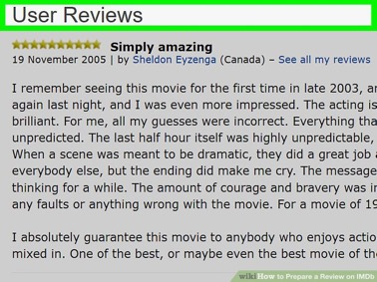

Transfer learning, NLP example
After word embeddings are pre-trained once, they can be permanently maintained and reused across a wide variety of downstream tasks, leading to huge efficiency gains.
In practice, it’s very common to use publicly available pre-trained embeddings like Google’s or Facebook’s FastText.
Trained word embeddings
ML model 2 with pretrained embeddings as base
Language modeling
Binary sentiment classification

Slide 10
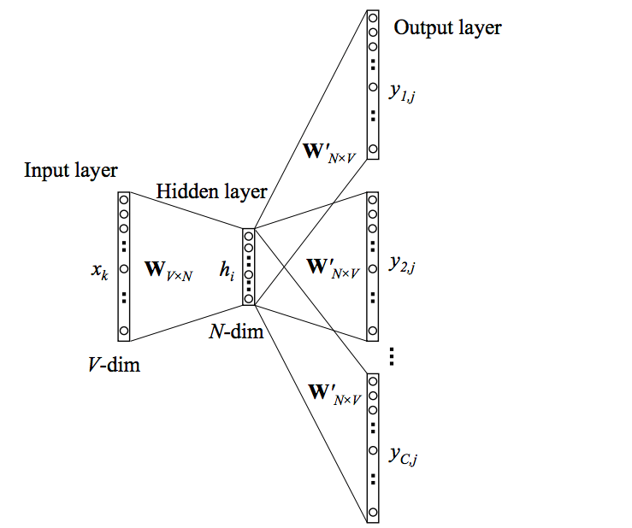
But what does this look like concretely?
Pre-training: learn and extract hidden layer weights of a language modeling neural network
Transfer: represent task-specific documents as a sequence of vectors (the pre-trained weights)
Document: ”Oh hello world”
1.03
1.07
0.03
7.01
3.03
0.01
3.01
0.03
1.11
5.00
1.00
0.03
1.10
1.11
1.09
Sequence of N-dim, pretrained word vectors
Model taking sequences as input
Prediction task
Notes:
Take some time to parse through all of these steps carefully, and emphasize that thinking of data as explicitly sequential is a departure from what we’ve seen in the traditional X, y style of flat machine learning, so it feels new for a reason. Can draw attention to the difference between something like tf-idf which represents documents with flat count features instead of a sequence of vectors.

Slide 11
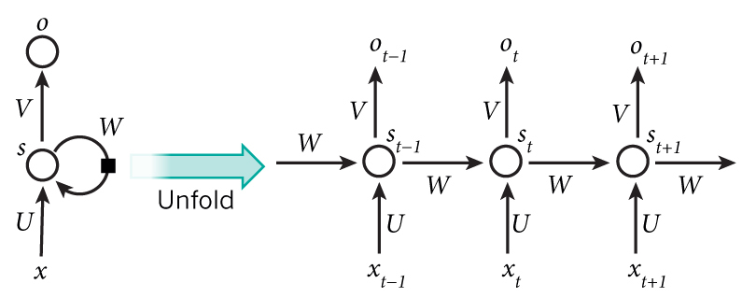
How does a model take sequential input?
Recurrent neural networks can process a sequence step by step for modeling!
We’ll learn more about these; they are very commonly used in text prediction tasks
Can be sequence of word vectors
Notes:
I would make a judgement call about how much detail you want to go into here since we cover it later, but I think it’s important for students to understand that the main use of transferred word vectors is for sequence-based models

Slide 12
What if I don’t want to use a sequence?
Less commonly, there might be cases where you’d want to use pre-trained word vectors for a downstream task that doesn’t involve a sequence-based model
Example: unsupervised tasks such as clustering when syntactical similarities of documents are very relevant, since word vectors can capture syntactic relationships much more effectively than count-based vectors; supervised tasks where you desire a more traditional/simpler model
Approach: summarize/flatten the sequence of word vectors to get a single document-level vector, e.g. simple average
Document: ”Oh hello world”
1.03
1.07
0.03
7.01
3.03
0.01
3.01
0.03
1.11
5.00
1.00
0.03
1.10
1.11
1.09
0.68
1.37
0.36
3.07
3.00
Average
Notes:
My favorite example of where word2vec worked well for clustering is Jeff Kao’s net neutrality comments project, where clustering revealed groupings of comments that had madlibs style swapping of certain words but were otherwise syntactically identical. I think it’s fair to tell students that it’s pretty unlikely they’d actually want to use word2vec for anything like traditional document clustering or topic modeling over count-based document-level vectors, and therefore likely that they won’t have use for it in this project. Emphasize the key difference between document vectors and word vectors.

Slide 13
Beyond text, a glance at image transfer learning

Slide 14
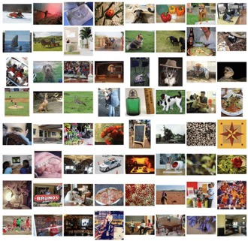
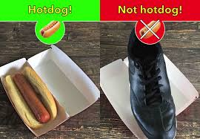
Transfer learning, image data example
Another extremely common use of transfer learning is in computer vision. Neural nets are pre-trained on a massive image classification dataset (e.g. ImageNet with 1000+ object types), and pre-trained weights are transferred to tasks with smaller datasets because they’re able to effectively capture generically useful image patterns.
Trained convolutional layers
Neural net with pre-trained convolutional base
Image classification
Image classification
Notes:
This is a look forward! Some of you may use exactly this workflow in your final project, should you work on an image task.

Slide 15
Summary
Transfer learning is a means of leveraging larger, general datasets in order to improve model performance and training time on tasks with a smaller dataset.
In NLP, transfer learning typically takes the form of representing task-specific documents as a sequence of pre-trained word embeddings, which are then fed to sequence-based neural networks for predictive modeling.
Transfer learning is also very prevalent in computer vision tasks.

