Slide 1
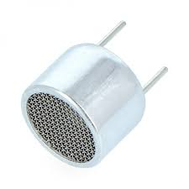
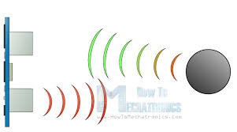
Ultrasonic Sensor

Slide 2
Team members:
1-Taha Mostafa Abbas
2-Abdallah Salah Abdallah
3-Abdelraouf Essam Abdelraouf
4-Abdelrahman Omar Farouk
5-Abdelrahman Mohamed Abdelazeem
6-Salma Abobaker Mahmoud
7-Rawda Abdelradi Mohamed

Slide 3
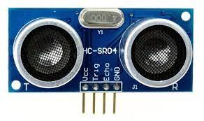
HC-SR04 Ultrasonic Sensor module :
HC-SR04 Ultrasonic Distance Sensor that can report the range of objects up to 13 feet away( between 2 cm to 400).

Slide 4
What is an Ultrasonic Sensor ?
• The Ultrasonic Sensor is a Transceiver Module consists of two ultrasonic transducer (Transmitter + Receiver).
• It transmits High Frequency Ultrasonic Waves of frequency greater
40 KHz.
• Intercepts the waves reflected by an obstacle.

Slide 5
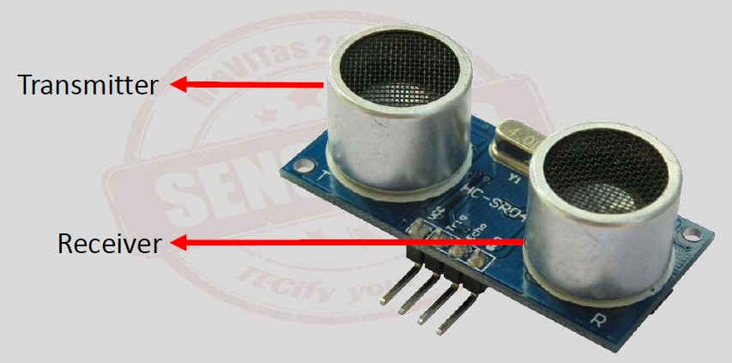
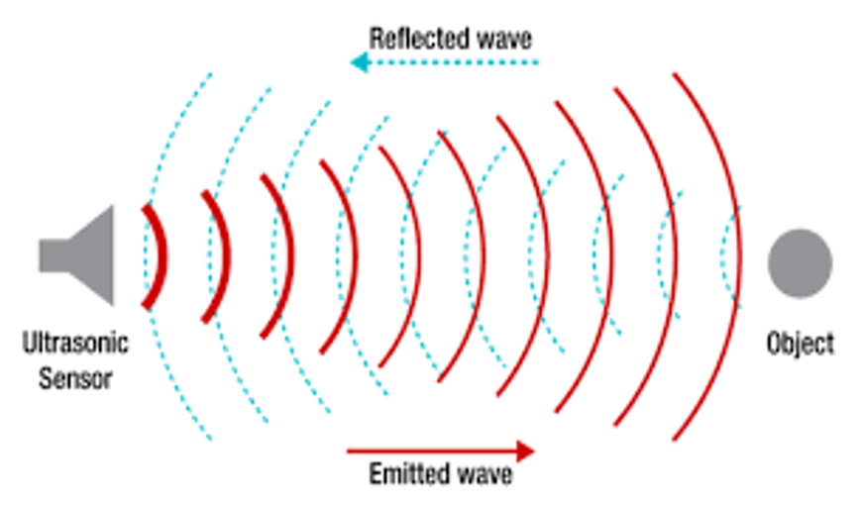

Slide 6
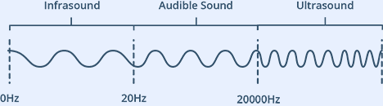
What is Ultrasound?
Ultrasound is high-pitched sound waves with frequencies higher than the audible limit of human hearing.

Slide 7
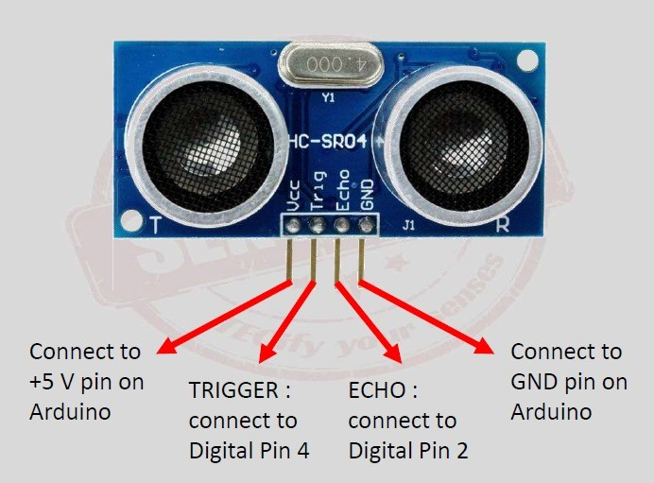
HC-SR04 (Specifications)
✓ It provides 2 - 400 cm non-contact measurement function.
✓ Operating Voltage : 5V
✓ Working Frequency : 40 KHz
Pin Configuration

Slide 8

How Does HC-SR04 Ultrasonic Sensor Work ?

Slide 9
How Does HC-SR04 Ultrasonic Sensor Work
a pulse of at least 10 µS in duration is applied to the Trigger pin.
sensor transmits a sonic burst of eight pulses at 40 KHz.
the Echo pin goes HIGH
Echo pin goes LOW when the travelled signal reflected

Slide 10
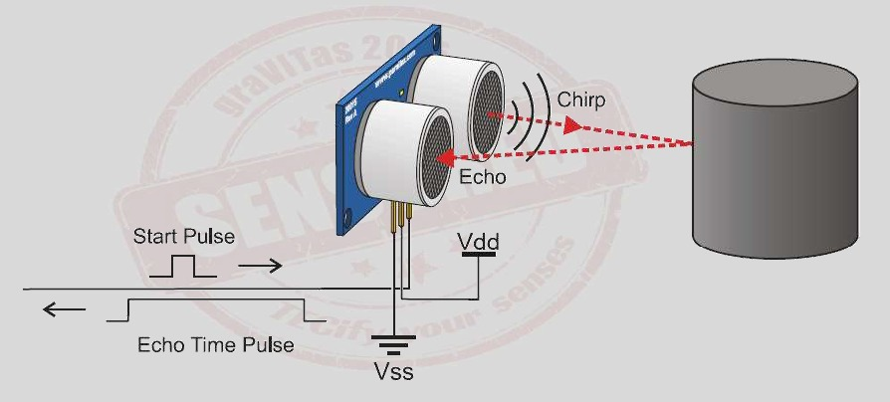

Slide 12
applications
Ultrasonic sensors can measure the following parameters, without
even getting in contact with the medium which is to be measured :
• Distance
• Level
• Diameter
• Position

Slide 13
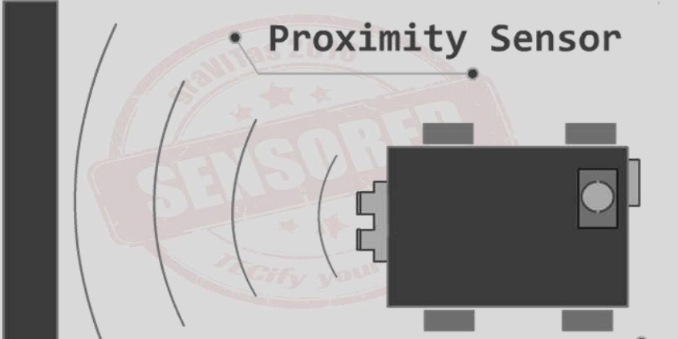
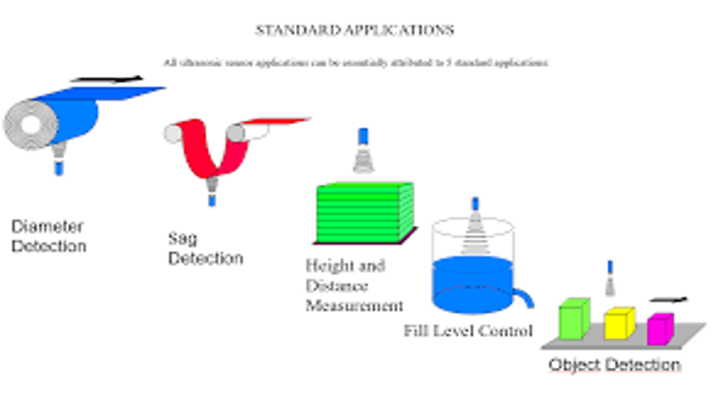

Slide 14
