Slide 1
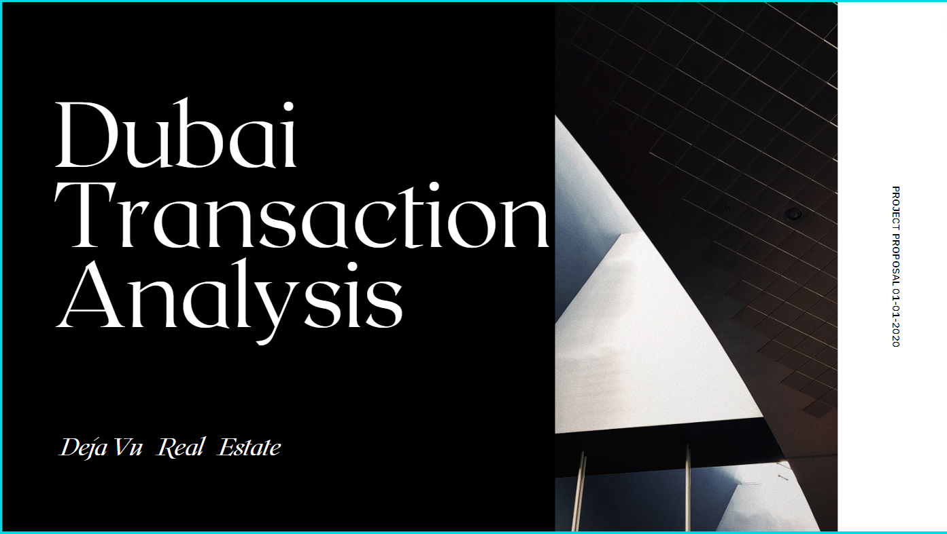

Slide 2
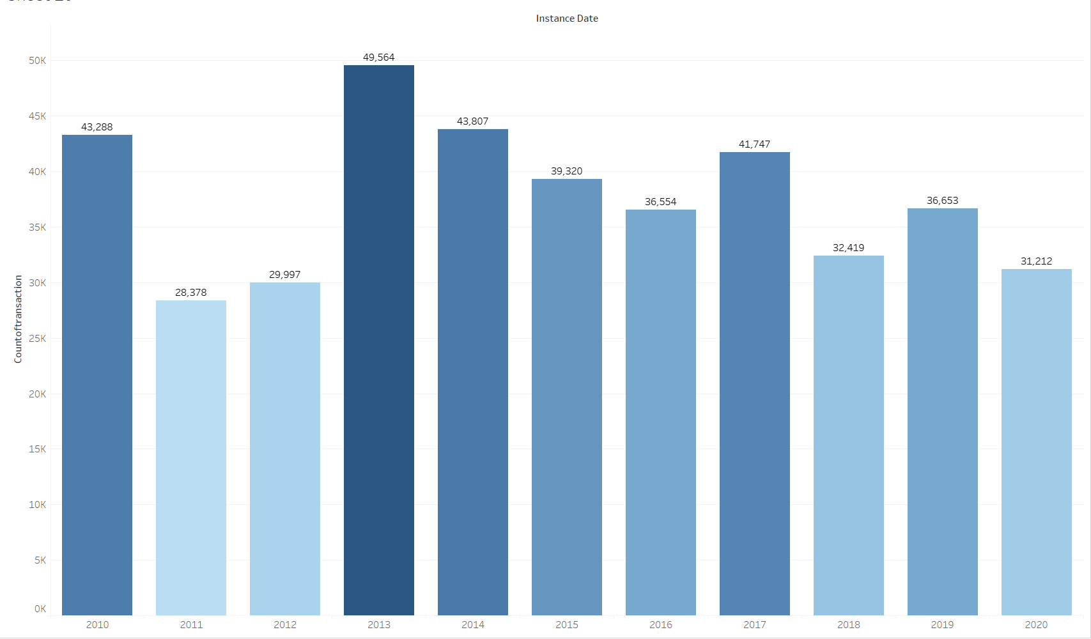
Dubai Total Transaction: 2010 - 2020
Total count of Transaction for a whole decade of Dubai ,with over all Market Peak in 2013

Slide 3
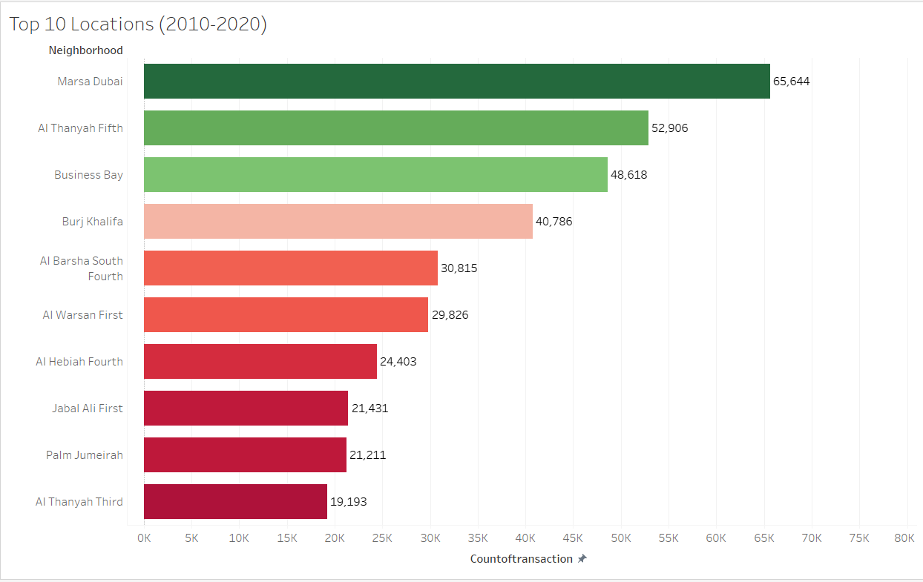
Dubai Top 10 Locations: 2010 - 2020
Dubai Marina has 24% more Transaction than the average top 10 locations in UAE , showing the power of liquidity of asset in Dubai Marina

Slide 4
Ready Vs Off Plan Transactions –(2010-2020)

Slide 5
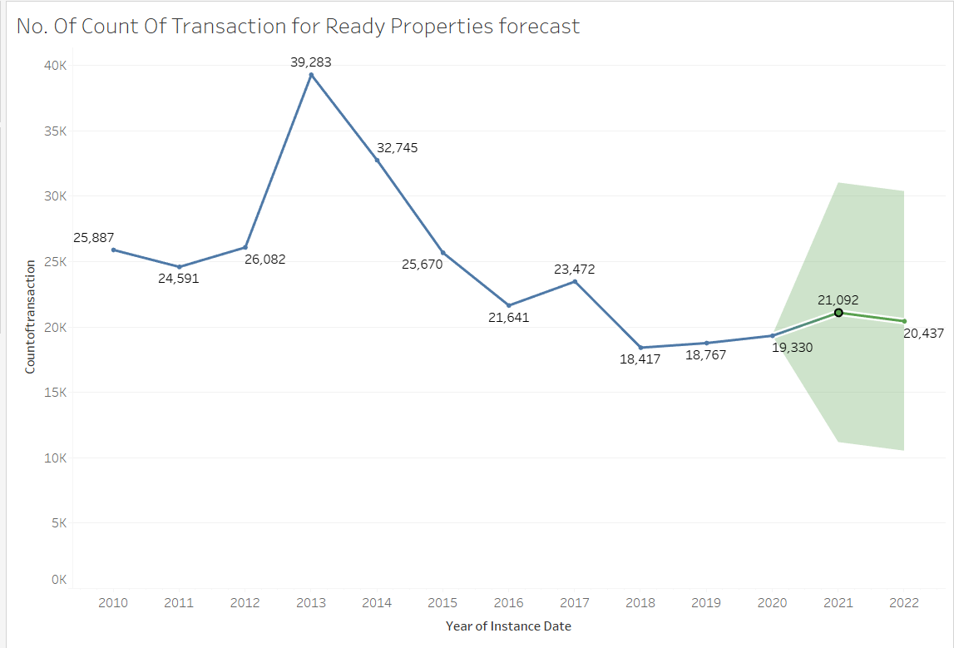
The Transactions Trend of Ready Properties from (2010-2020)
The Overall Trend of Transaction in Ready Properties is a downtrend but as seen In the graph the market bottom was 2018 after than even in 2020 the up trend is continued with 3% more than 2019 , this is forecasted to rise my model at around 10% more

Slide 6
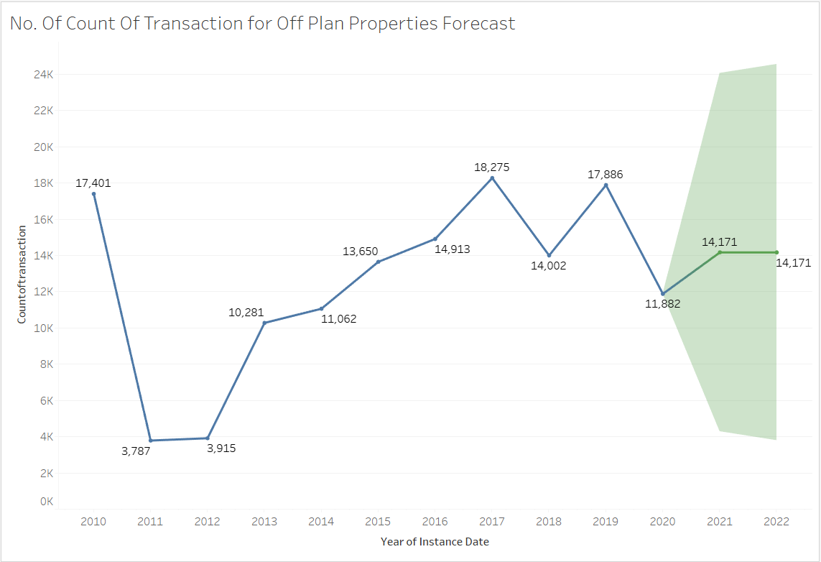
The Transaction Trend of Off Plan Properties from (2010-2020)
The Overall Trend of off plans is majorly an uptrend , with a major drop In 2020 around 34% from 2019.
The forecasted growth shows Approx. 18 % Jump.

Slide 7
Dubai Seasonal Trends

Slide 8
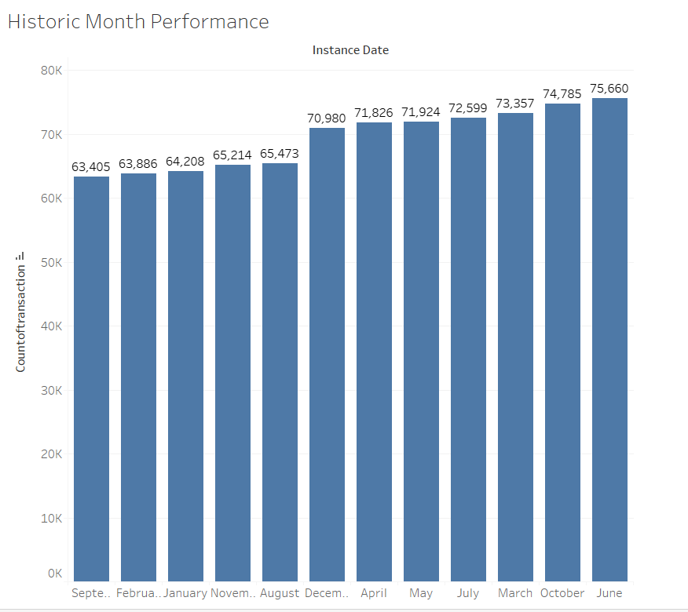
Transactions of Dubai Seasonal Trends: Best Month ( Overall)

Slide 9
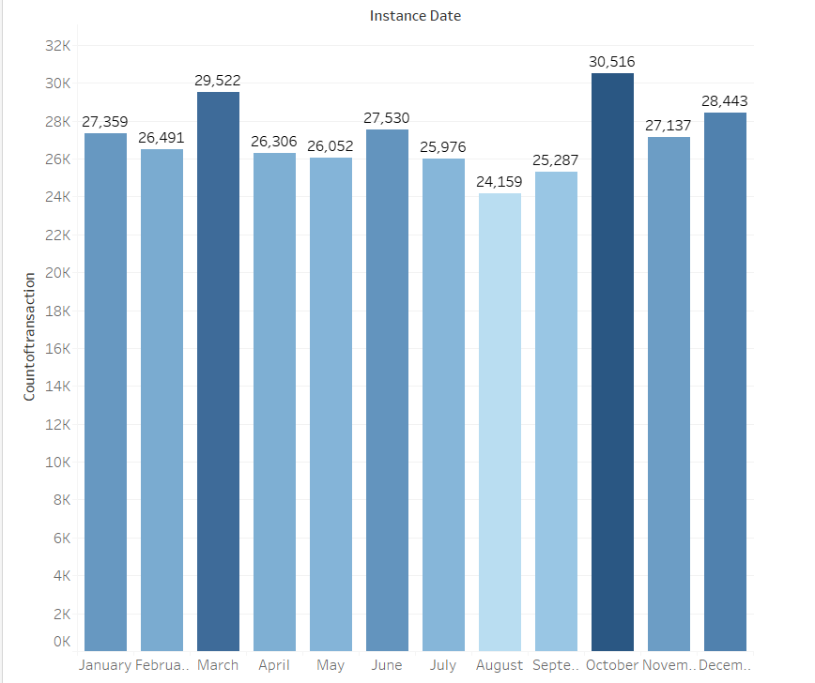
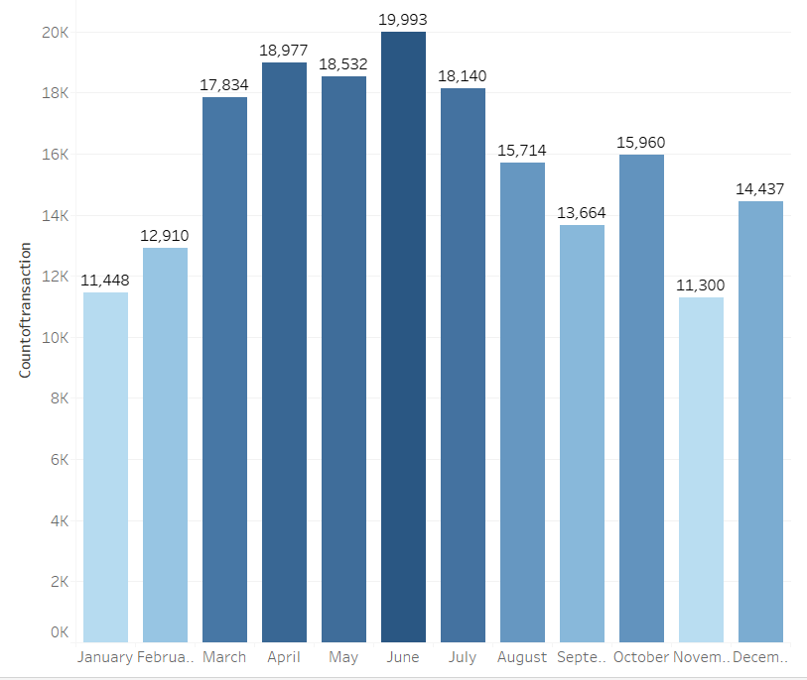
Transaction of Dubai Seasonal Trends: Ready Vs Off Plan
In Ready to Move in properties October is the best Month
In off Plan Properties June is the best Month

Slide 10
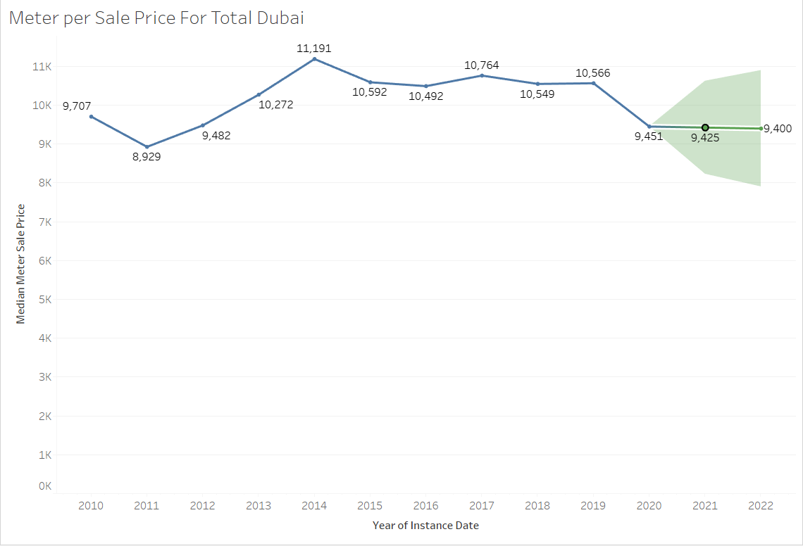
Total Median Meter per Sale Price of Dubai Forecast
The Total Median Sales Price Of Dubai dropped in 2020 as expected and the forecast shows the prices to remain flat which can attracts more buyers

Slide 11
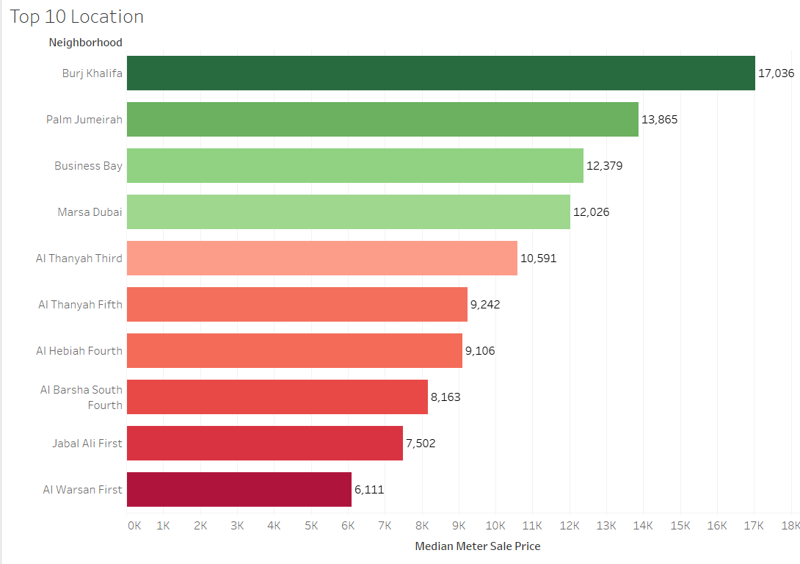
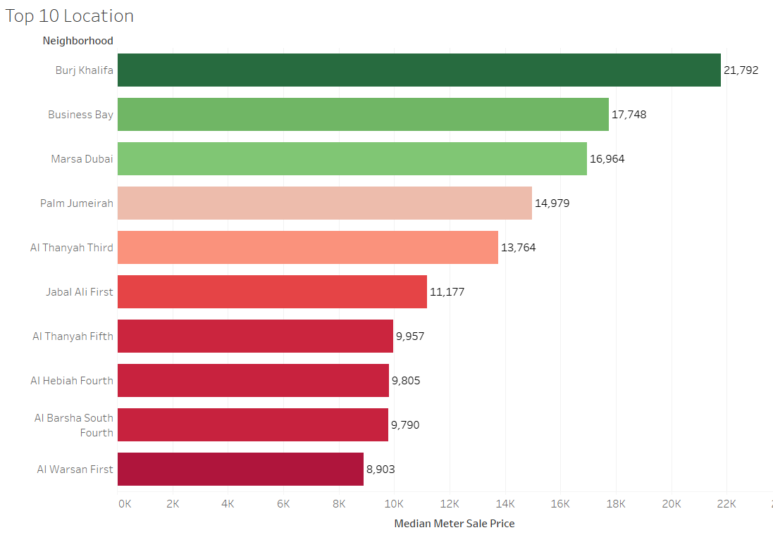
Median Sale Price per Meter :Dubai Seasonal Trends (Ready vs off Plan)
Median Sale Price per meter Ready to Move in
Median Sale Price per meter OFF Plan

Slide 12
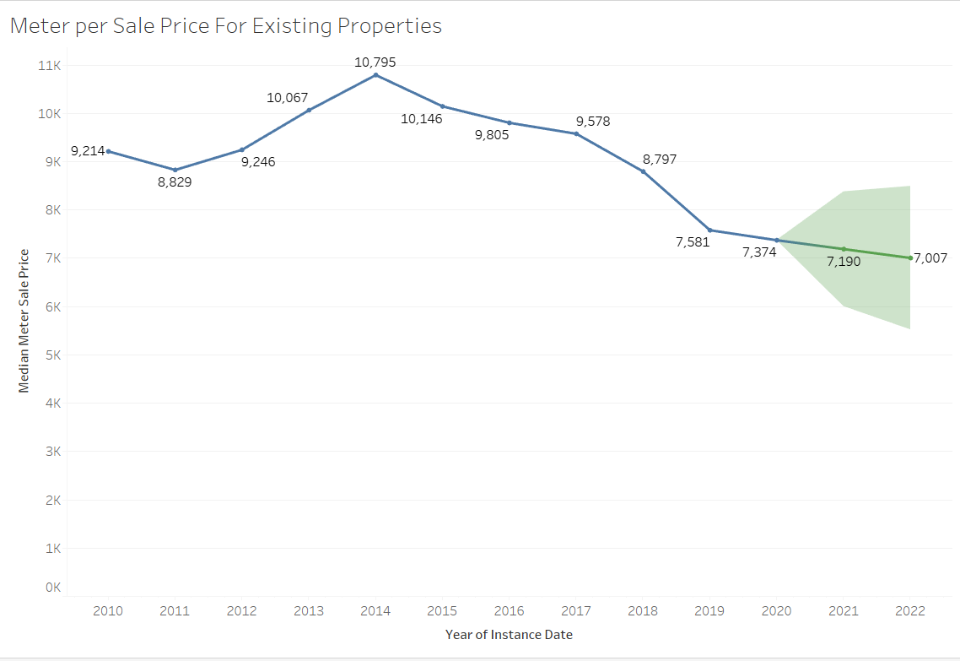
Total Median Meter per Sale Price of Ready Properties Dubai Forecast
The Sale Price shows a downward trend of through from 2014,The percentage drop is 2.73%
The overall Meter per Sale Price is Forecasted to go down more but not much , which may attract more customers

Slide 13
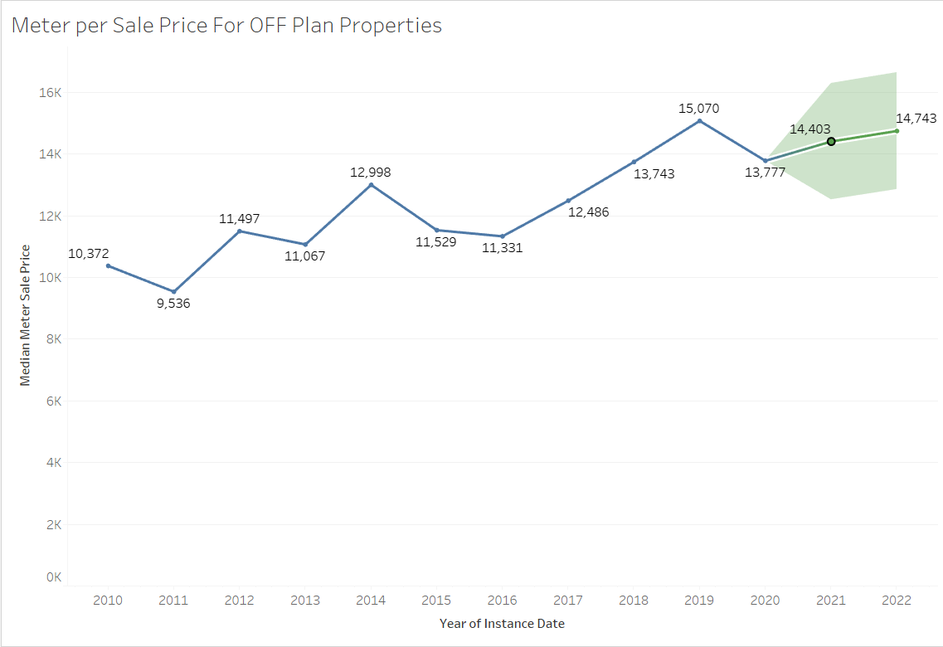
Total Median Meter per Sale Price of Off Plans Properties Dubai Forecast
As we can see from the line graph we are in a uptrend of sales per meter prices when it comes to off plan , And we can also see the median values are more than the existing median prices, there is 8.58% drop in prices from 2019
We are expecting a growth of 4.5% in 2021 as forecasted in the graph

Slide 14
2020 Transaction Analysis

Slide 15
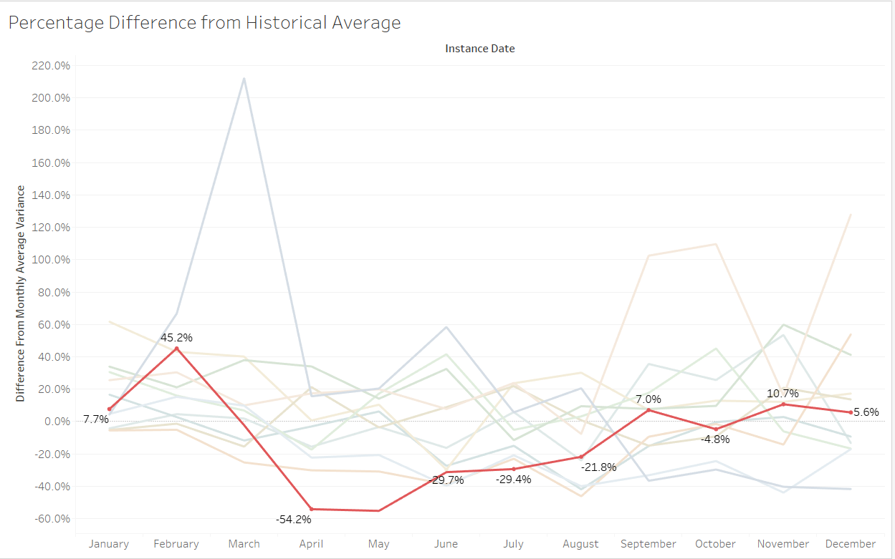
Percentage Difference in Transaction of 2020 from Historical Average

Slide 16
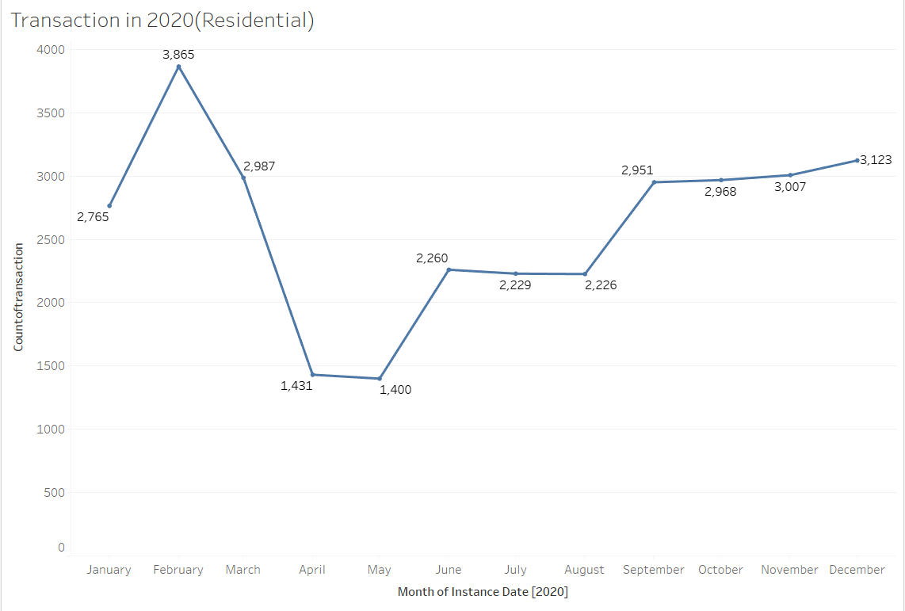
Month Wise Transaction Graph Of 2020
As we Can we see there is an uptrend towards the End of 2020 ,the increase in Transaction is 3.8%from November to December and from the huge drop in May there is an Increase in 123%
Which shows the increase confidence of people in the future of Dubai Real Estate

Slide 17
Individual Area Transaction

Slide 18
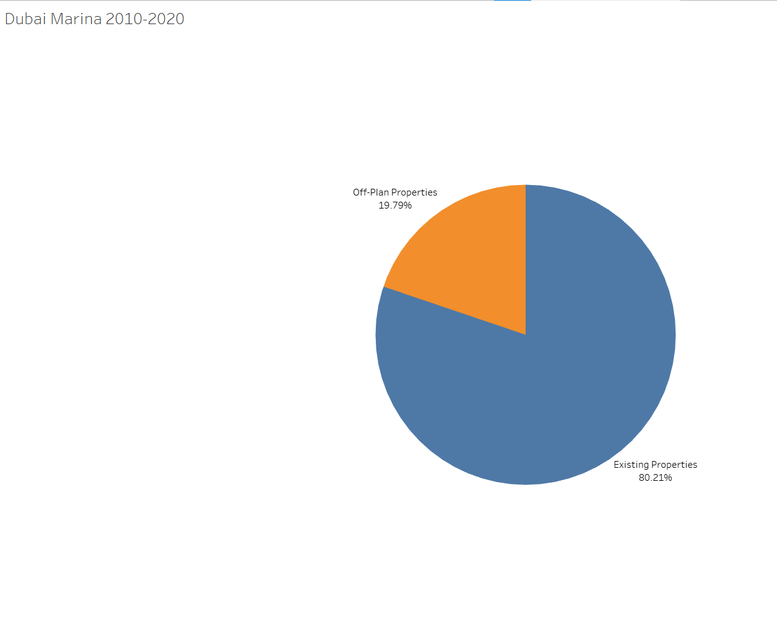
Transaction percentage Distribution Off Plan vs Existing Properties
Dubai Marina

Slide 19
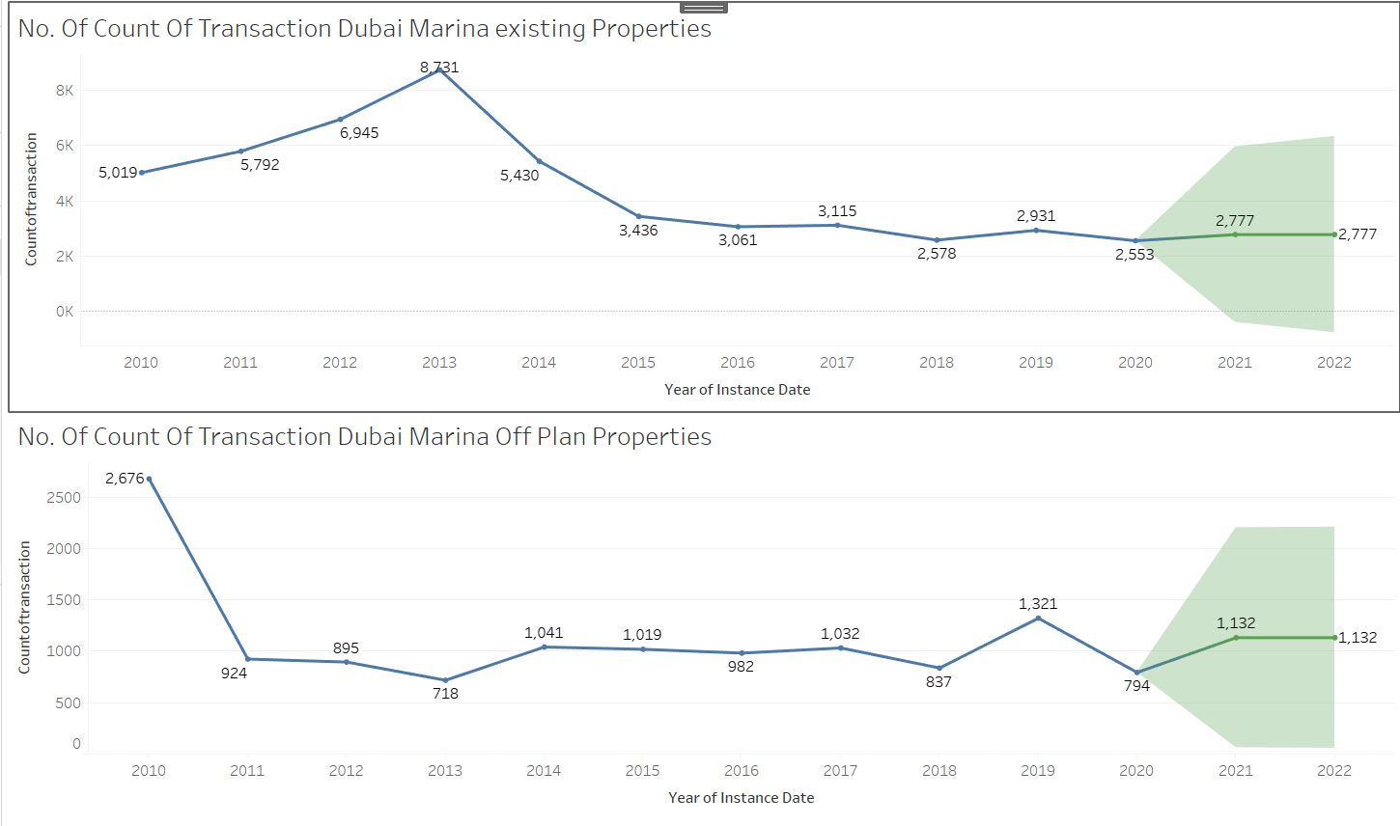
The market dropped around 12% in transaction in 2020 making it the market bottom , the transaction is expected to rise around 9% in 2021
In 2019 the transaction went up to 57% then dropping due to COVID-19 , around 39% . The forecast shows there is expected rise of 43% from drop

Slide 20
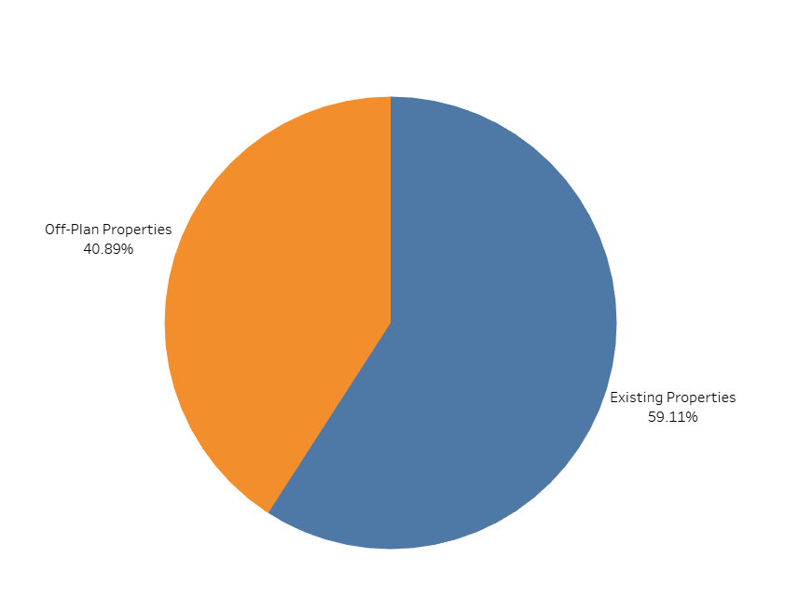
Transaction percentage Distribution Off Plan vs Existing Properties
Burj Khalifa

Slide 21
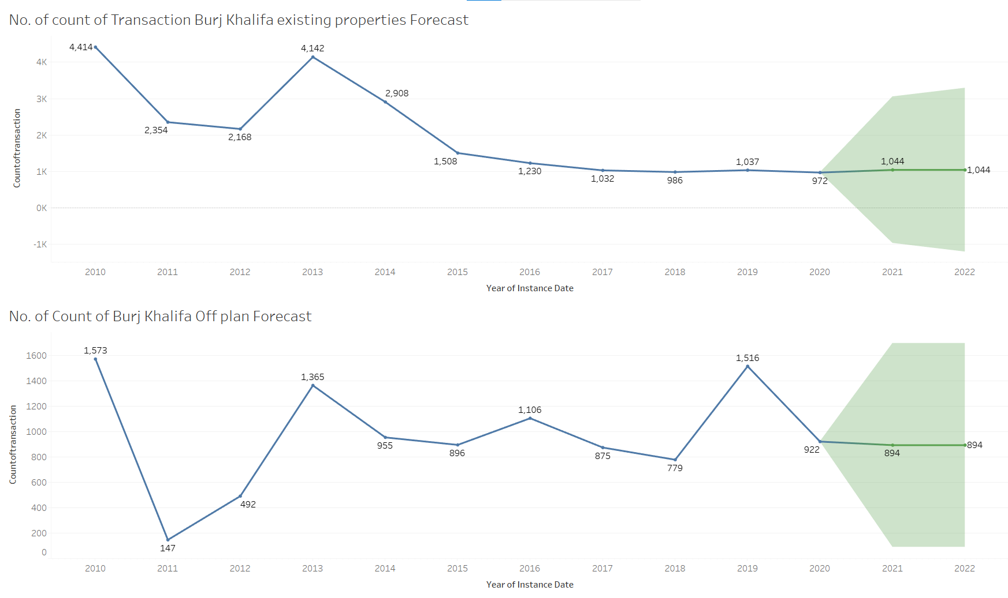

Slide 22
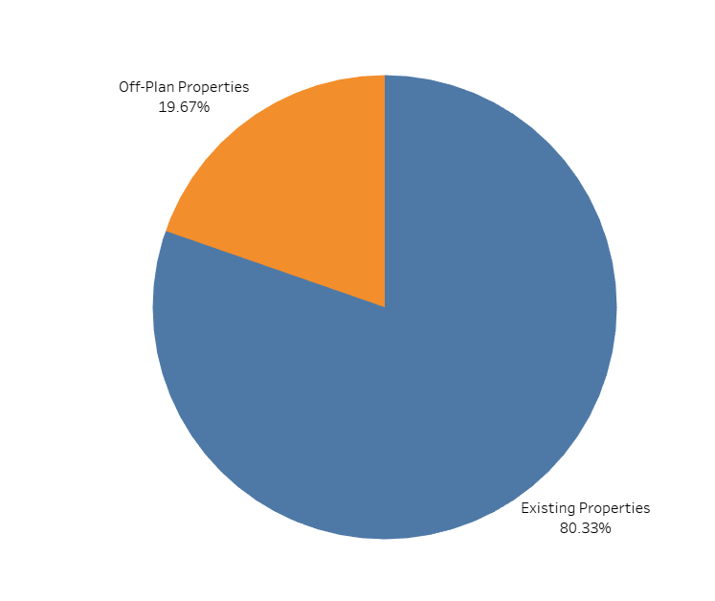
Transaction percentage Distribution Off Plan vs Existing Properties
Palm Jumeira

Slide 23
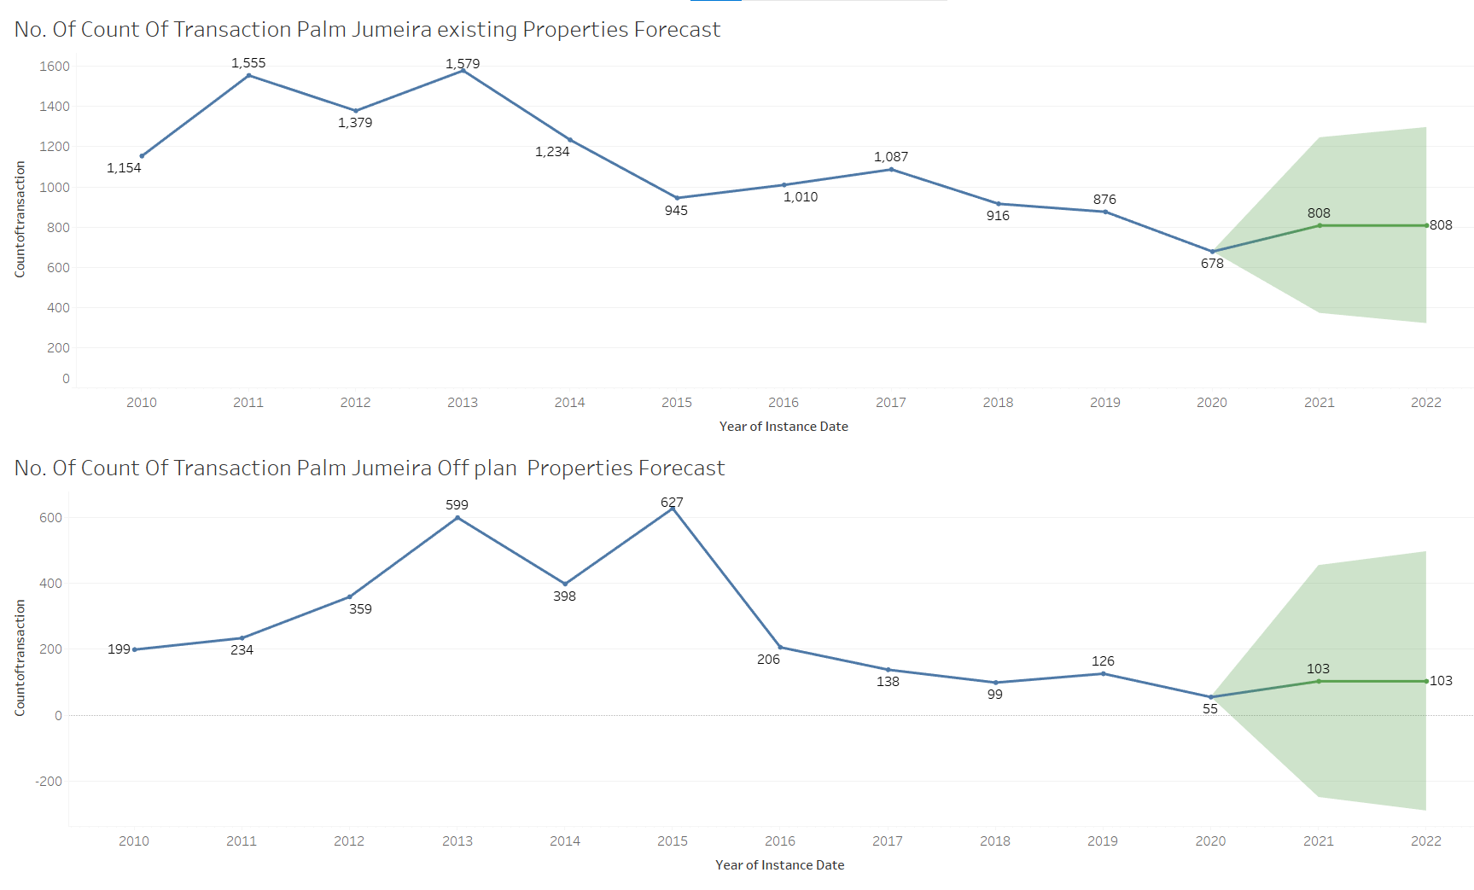

Slide 24
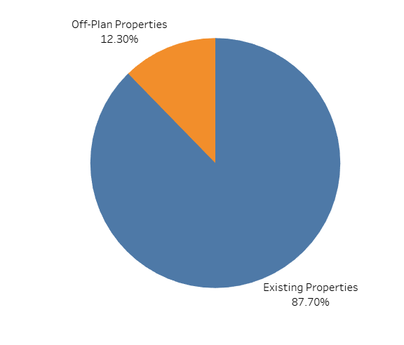
Transaction percentage Distribution Off Plan vs Existing Properties
Al Thanyah fifth

Slide 25
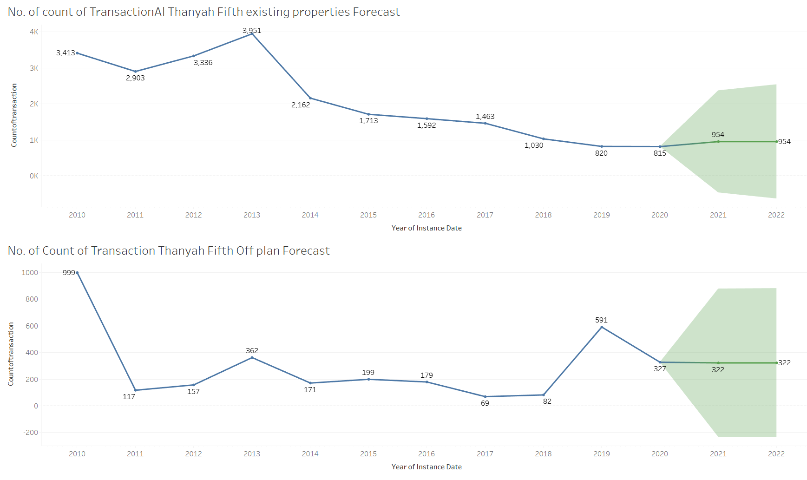

Slide 26
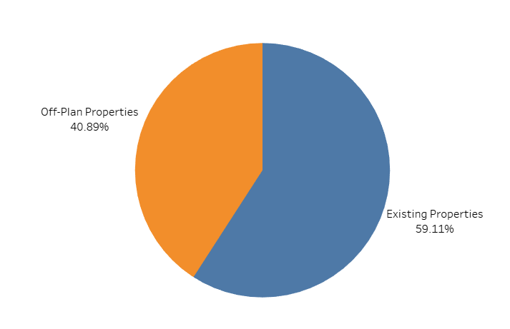
Transaction percentage Distribution Off Plan vs Existing Properties
Business Bay

Slide 27
