Slide 1
K-Nearest Neighbour (kNN)

Slide 2
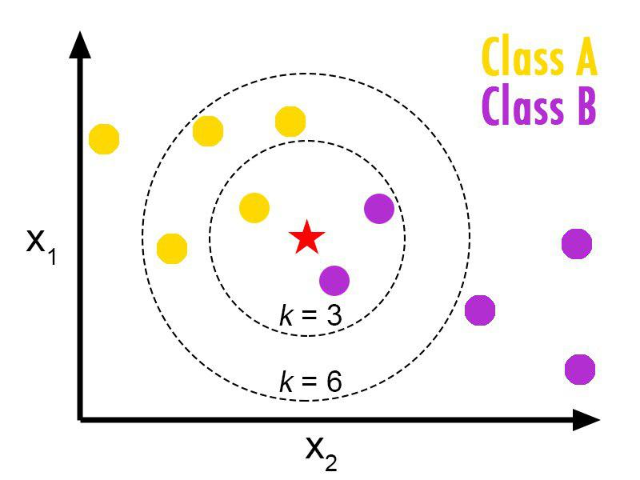
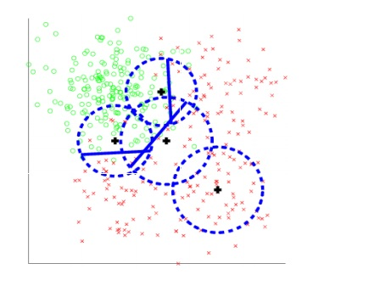
K-Nearest Neighbour (kNN) Classifier

Slide 3
Classification steps
Classification steps
1-Training phase: a model is constructed from the training instances.
- classification algorithm finds relationships between predictors and targets
- relationships are summarised in a model
2-Testing phase: test the model on a test sample whose class labels are known but not used for training the model
3- Usage phase: use the model for classification on new data whose class labels are unknown

Slide 4
How does it work?
Initialization, Define K
Compute distance(test instance each training instance)
Sort the distances
Take K nearest neighbours
Apply simple majority
Class

Slide 5
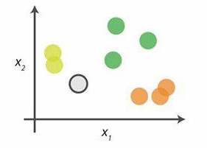
An Example
0.look at the data
Say you want to classify the gray point into a class here , there are three potential classes, lime green, green and orange.

Slide 6
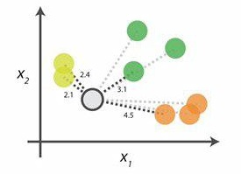
An Example
1.Calculate distances
Start by calculating the distances between the grey point and all other points.

Slide 7
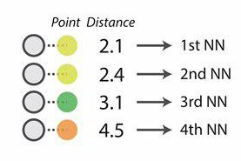
An Example
2.Find neighbours
Next , find the nearest neighbours by ranking points by increasing distance. The nearest neighbours (NNs) of the grey point are the ones closest in dataspace.

Slide 8
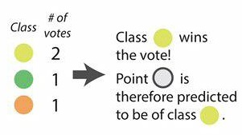
An Example
3.Vote on labels
Vote on the predicted class labels based on the classes of the k nearest neighbours . Here the labels were predicted based on the k=3 nearest neighbours

Slide 9
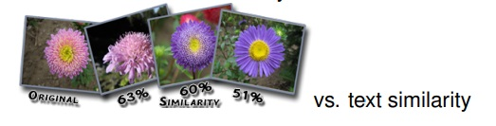
Comparing Objects
Problem : measure similarity between instances
• different types of data: numbers colours, geolocation, Booleans etc.
Solution : convert all features of the instances into numerical values
• represent instances as vectors of features in an n-dimensional space

Slide 10
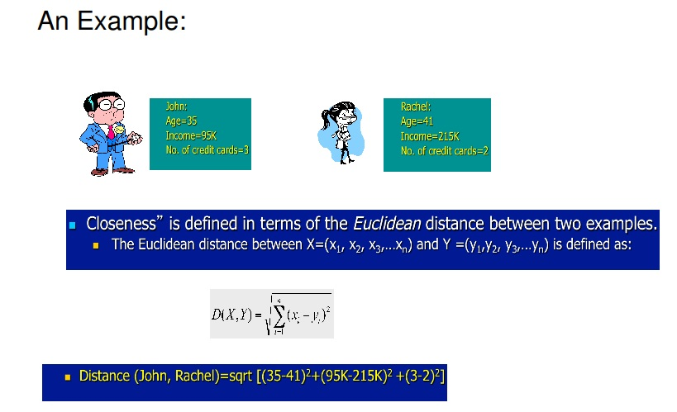
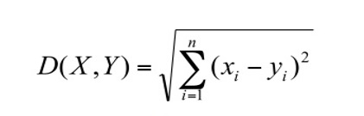

Slide 11
Dataset
Our data set has been divided into negative and positive reviews so there are valid attributes for the classification, and reprocessing using the steps following :
1- a 'category' column where it gets if criticism belongs to the positive or negative set is added.
2- Deleting points from the document
3- Delete numbers from the document
4- Selecting words with more meaning for critical, in this case only nouns and adjectives in English of the data sets are selected, adverbs of the document are removed.
For example, the review "This is an Anthology horror film" we would "Anthology horror film". As you can see the articles "is", "an".

Slide 12
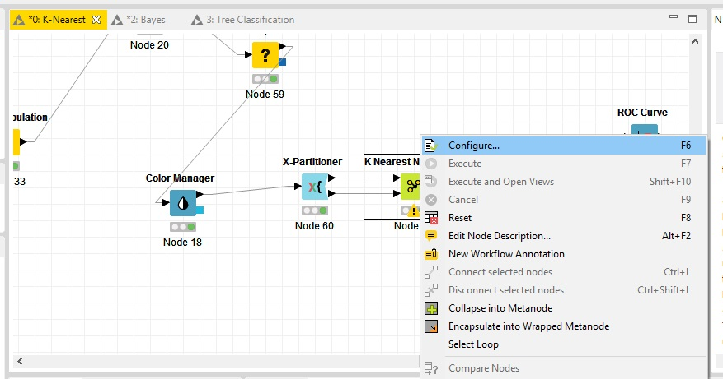
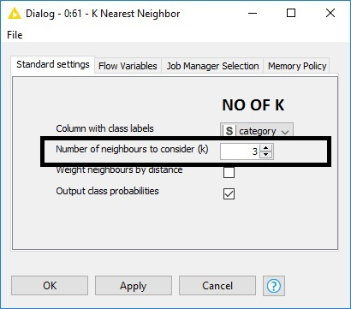
Choosing k
•K represent number of Neighbours
we can select K with configuration of K-Nearest Neighbour (kNN) Classifier
• Classification is sensitive to the correct selection of k
small k? → less stable, influenced by noise
larger k? → less precise, higher bias

Slide 13
The results
Accuracy | Precision of negative | Precision of positive | Recall of negative | Recall of positive | K
0.586 | 0.564 | 0.63 | 0.754 | 0.418 | K=2
0.629 | 0.603 | 0.674 | 0.785 | 0.501 | K=3
0.625 | 0.594 | 0.689 | 0.794 | 0.457 | K=4
0.645 | 0.614 | 0.699 | 0.78 | 0.51 | K=5
the "accuracy" is what percent of our predictions are correct
the "recall" is what percent of the positive and negative cases do we catch
the "precision" is what percent of positive and negative predictions are correct

Slide 14
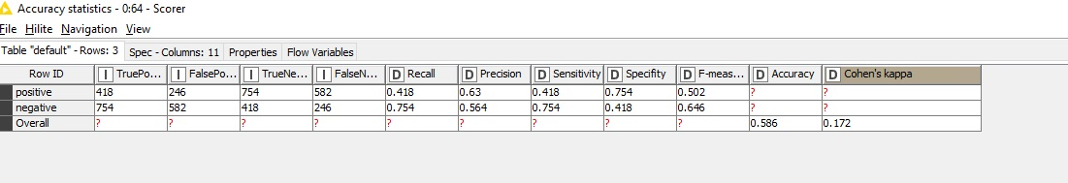
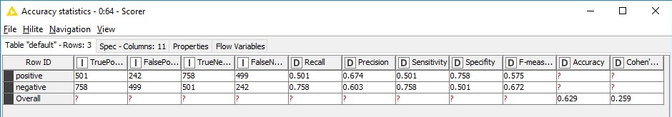
Calculating precision and recall
We record the IDs of our predictions, and when we get the actual results we sum up how many times we are right or wrong. There are four ways of being right or wrong:
TN / True Negative: case was negative and (predicted) negative
TP / True Positive: case was positive and (predicted) positive
FN / False Negative: case was positive but (predicted) negative
FP / False Positive: case was negative but (predicted) positive
K=2
K=3

Slide 15
Calculating precision and recall
Now you count how many of the 10,000 cases fall in, say:
Predicted Positive | Predicted Negative
FP: 140 | TN: 9,760 | Negative Cases
TP: 60 | FN: 40 | Positive Cases
Now, if we have three questions:
What percent of our predictions were correct? we answer: the "accuracy" was (9,760+60) out of 10,000 = 98.2%
What percent of the positive cases did you catch? we answer: the "recall" was 60 out of 100 = 60%
What percent of positive predictions were correct? we answer: the "precision" was 60 out of 200 = 30%

Slide 16
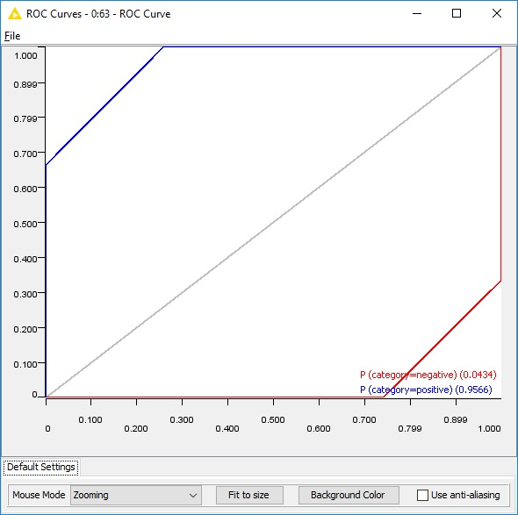
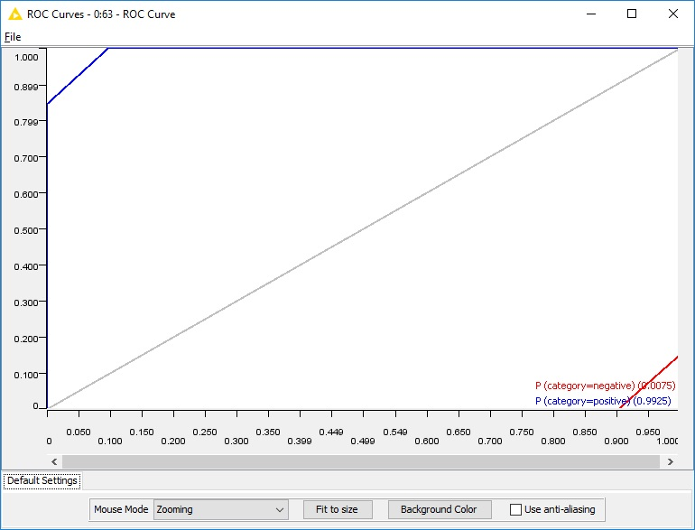
ROC curve
K=2
K=5

Slide 17
advantages and disadvantages
advantages :
1-simple to implement and use
2- strong to noisy data by averaging k-nearest neighbours
3- kNN classification is based on local information

Slide 18
Advantages and Disadvantages
disadvantages :
1- distance can be dominated by irrelevant attributes
2- more expensive to classify a new instance than with a model

