Slide 1
Reactive Programming

Slide 2


Why do we need Reactive Programming?
Traditional Server Model
Examples: tomcat and jetty
Each request is assigned a thread
A thread finishes completing the processing for its current request before picking up another request.
If there is any long running operation such as a database call or call to another service, the thread will be blocked.
To deal with concurrent requests, there must be as many threads as there number of concurrent calls expected. Alternatively, you have to increase the number of instances of your application.

Slide 3
Why do we need Reactive Programming
Examples: netty
Reactive Server Model
Current thread
Delegated thread
Database or service
Thread picks up a request from the event loop.
If there is any long running operation the thread will not block, instead pickup another request from the event loop and start processing it. It will delegate the job of picking up and continue the processing of the request once response from database or downstream call has arrived
The delegated thread does not get blocked either it, it gets notified when the response is ready and callback is ready to get executed
One thread can deal with more than one request
More efficient as requests are being processed while we wait for the response to arrive, as opposed to doing nothing

Slide 4
Why do we need Reactive Programming?
More efficient use of computational resources means less resources required, resulting in cost savings
In OVP some of ours app get high concurrency. Entitlements-Manager (em) and Partner Video Service (pvs)
EM SKY 2.5 million , NBCU 5 million

Slide 5
Reactive Frameworks
Ratpack
Spring Webflux (based on reactor framework)
Reactor implements the reactive streams specification. These are a set of interfaces defined by group of companies including twitter which standardize the way in which synchronous processing of requests is done.

Slide 6
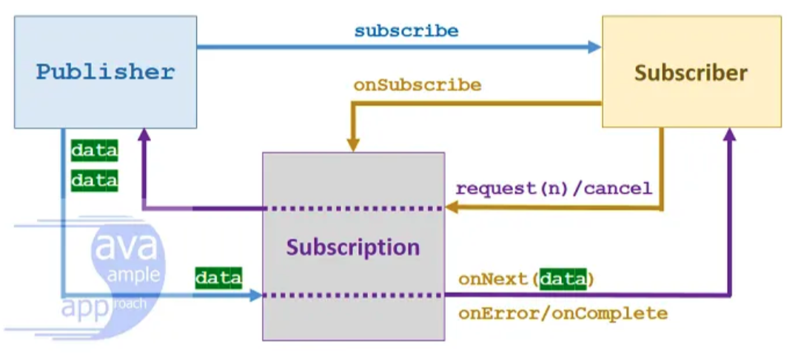
Reactive Streams Interfaces
Publisher (emits data)
Subscriber (expects data)
Subscription (used to signal to the publisher to send or stop sending data

Slide 7
Reactive Streams Flow
An object of type Subscriber is passed to Publisher
Publisher passes is an object of type Subscription to the Subscriber
The Subscriber using the Subscription object to request data from Publisher using subscription.request()
Publisher passes data to the Subscription object using subscription.onNext(data)
After all the data has been emitted by the Publisher it sends on complete or on error to the Publisher

Slide 8
Publisher Interface Implementation by Mono and Flux
Implemented by Mono and Flux
Mono emits single object and then finishes with onSuccess or onError signal. Use to wrap a single object
Flux emits set of objects and then finished with onComplete or onError. Used when you expect a number of objects
Any long running operation inside mono or flux will happen in non-blocking way
Both objects wrap the data. The data may not be present initially and may arrive some time in the future.
Summary about how they work and then jump to intellij show how they are created and how they are tested

Slide 9
Things to remember
Nothing happens if you don’t subscribe
.complete for step verifier

Slide 10
Glossary
Non-blocking – thread does not have wait/block on long running operation. Picks up another request from the que in the meantime
Asynchronous: refers to the sequence in which code is executed. Not executed by thread top to bottom. Callbacks – code inside lambdas that may be executed only after response had arrived. Code before the lambda may be executed first as part of processing for another request
Concurrency: situation where there are is more than one request towards your service at the same time

