Slide 1
Agile Mindset Shifting

Slide 2
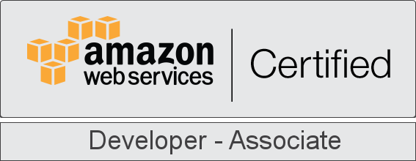
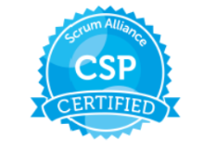


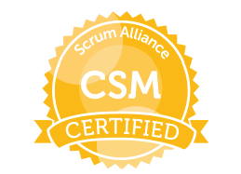
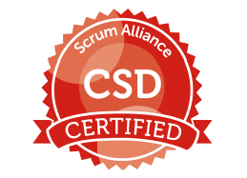
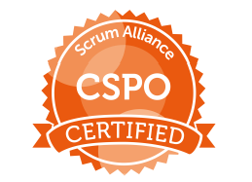
Software Architect
Lead DevOps Engineer
Co-Learner: Syedur Rahman

Slide 3
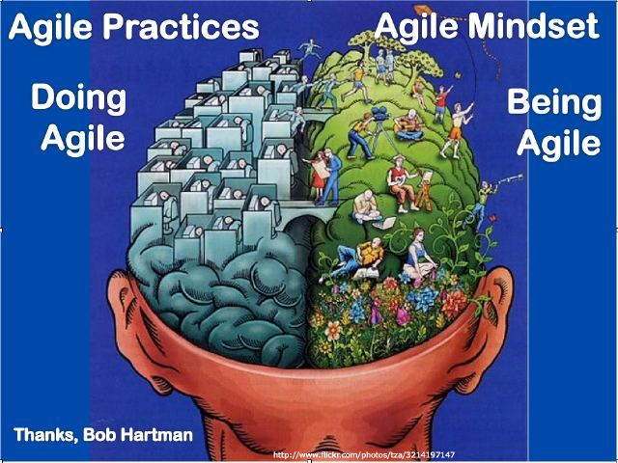

Slide 4
Agile
Process?
Process Framework?
Empirical Process?
Notes:
To solve this mystery we need a detective: Ask a few question. But those will also tell me whether you attend your college or bunked those days.
Q1: What is a process? (5 marks)
Q2: Empirical process? (10 marks): Not in english, can you translate it for me? Ans: Inspect & Adapt
Q3: What is a process framework? (15 marks) Thats still a process. But whats the difference between a process and process framework? Every framework is a collection of best practices. Where did these best practices come from? Did some one just dream off? It comes from some success stories.
Q4: Out of syllabus question: What is philosophy? (25 marks). For religion main principles and values are same in all countries but festival, the way of maintaining is totally different.

Slide 5
Process
A set of interdependent tasks transforming input elements into products
Notes:
To solve this mystery we need a detective: Ask a few question. But those will also tell me whether you attend your college or bunked those days.
Q1: What is a process? (5 marks)
Q2: Empirical process? (10 marks): Not in english, can you translate it for me? Ans: Inspect & Adapt
Q3: What is a process framework? (15 marks) Thats still a process. But whats the difference between a process and process framework? Every framework is a collection of best practices. Where did these best practices come from? Did some one just dream off? It comes from some success stories.
Q4: Out of syllabus question: What is philosophy? (25 marks). For religion main principles and values are same in all countries but festival, the way of maintaining is totally different.

Slide 6
Process Framework
That is still a process.
But what is the difference between a process and process framework?
Every framework is a collection of best practices.
Where did these best practices come from? Did some one just dream off? It comes from some success stories.
Notes:
To solve this mystery we need a detective: Ask a few question. But those will also tell me whether you attend your college or bunked those days.
Q1: What is a process? (5 marks)
Q2: Empirical process? (10 marks): Not in english, can you translate it for me? Ans: Inspect & Adapt
Q3: What is a process framework? (15 marks) Thats still a process. But whats the difference between a process and process framework? Every framework is a collection of best practices. Where did these best practices come from? Did some one just dream off? It comes from some success stories.
Q4: Out of syllabus question: What is philosophy? (25 marks). For religion main principles and values are same in all countries but festival, the way of maintaining is totally different.

Slide 7
Empirical Processes
It is typical to adopt the defined (theoretical) modeling approach when the underlying mechanisms by which a process operates are reasonably well understood. When the process is too complicated for the defined approach, the empirical approach is the appropriate choice.
Translation into English: Inspect and Adapt

Slide 8
The Agile Manifesto
Agile is not a process, not a empirical process, not a framework. It is a philosophy.
Every religion has a holy book. So agile also has one: Agile Manifesto.
We are uncovering better ways of developing software by doing it and helping others do it. Through this work we have come to value.
Notes:
Agile is not a process, not a empirical process, not a framework. It is a philosophy. Every religion has a holy book. So agile also has one. Agile Manifesto.

Slide 9
Agile Mindset
Attitude to accept change is the foremost change that needs to be brought in for any change to survive.
Agile Mindset is way more important than the terms, practices, meetings and user stories.
Agile is actually about mindset change.
A mindset is a culture that you implement with the incentive to accept or adopt the cultural norms.
Notes:
When you are trying to introduce Agile Project Development into your company or to a new team, it is important that you know how to make it work. More than the terms, practices, meetings and user stories, the Agile Mindset keeps the team on point and helps them self-manage even if they are not too familiar with the terms used in Agile.
During one of my recent conversations with few teams who were going through agile transition, I asked them what they understood by “Agile is about mindset change” which is a highly spoken tag line in the agile world. To my surprise, their faces looked blank.
We discuss and debate a lot on this. What behavioral and procedural changes will get us to a different mindset change? Do not we have a right mindset today? What is a Mindset? Why is this more important than the terms and practices of Agile on the habitual and personal level? Essentially a mindset is a culture that you implement with the incentive to accept or adopt the cultural norms. If you want to truly implement Agile, it has to become a part of your company’s culture. There could be many changes that need to be brought in at the team level, management level and overall organization level.
Let me mention here some of the mindset changes need to be achieved both in personal and team level.

Slide 10
Team looks at failure as a learning opportunity
One of the main concepts of Agile is that your working product evolves, improves and develops as time goes on.
This means when a sprint fails, this simply means that there are more improvements to be made.

Slide 11
Team welcomes different perspectives and diversity of thought
The reason why you want a cross-functional team made up of senior developers and other experts is because you want them to have intense Daily Scrum Meeting discussions and self-manage.
If they are all coders, all they will know is how to code. Putting in QA testers, analysts and other experts can produce wonderful results and add value to everything in the project.
The industry is moving towards a T-shaped model. Developing T-shaped skilled engineers does not only mean technical skills but also soft skills and domain skills. Bringing the attitude to broaden an individual’s capability takes some effort.

Slide 12
Test First attitude
Test Driven Development is one of those difficult practices for developers to pick up.
Adoption of TDD or ATDD is easier said than done.
Traditionally developers have written unit test cases that will comply with the code.
Asking them to think about different test scenarios, write test cases, then write code, keep refactoring simply does not go well with them.
‘Am I now also supposed to do QA too?’
Change is never easy.
Notes:
Test Driven Development is one of those difficult practices for developers to pick up. Adoption of TDD or ATDD is easier said than done. Traditionally developers have written unit test cases that will comply with the code. How many times have they written unit test cases after the code was shipped? If you go by their words, there was never enough time for writing unit test cases. Asking them to think about different test scenarios (something that they can find very difficult to do), write test cases, then write code, keep refactoring (not just the code but the test cases as well) simply does not go well with them. ‘Am I now also supposed to do QA too?’ is the question they have on their minds. Who is going to give me that additional time to write those many test cases? Change is never easy.

Slide 13
People are having fun
Now, the definition of fun can be subjective but it is easy to measure and observe.
When energy is high, people are motivated and they spend time with each other outside the Scrum or the office, you know that they are having fun with each other.
If you chose a good team, the learning experience should also give them a lot to be happy about.
We want to make such a team that everyone wants to join.

Slide 14
Collective ownership
Collective ownership not only in terms of code but for the overall quality is to be owned by the entire team.
A developer should be ready to look beyond his code, and, when required, be able to contribute to other parts of the code base.
He should be fearless in making changes in any part of the code.
QA should not be looked as only tester’s responsibility but as a team responsibility.
QA is not to be left for later part of the release but needs to be integrated in the lifecycle right from the beginning.

Slide 15
Individual heroism vs. team collaboration
Agile is a team game and there is no place for individual heroism.
Team collaborates on all aspects of software development.
Pair programming, cross functional teams, frequent communication between stakeholders encourages team collaboration.
It is the team that succeeds or fails and not an individual.
Know it all and letting the secrets go away kind of mindset is expected to be exhibited by an agile team.

Slide 16
Work pace is sustainable
The Burn down Chart is a great way to see if the pace you have set for your Sprints is right for the team.
Late turnovers and unfinished items are indications that the pace is too fast or there are too many items.
Early finishes means the pace is too slow or people are capable of more and are not challenged.
The sustainable pace keeps people on their toes but at healthy stress levels.

Slide 17
Team members can accept change and adapt quickly
It is easy to spot the members who are going to have trouble keeping an Agile Mindset.
These are the people who do not like changes or cannot handle evolving conditions well.

Slide 18
Team is brutally transparent
The Agile Mindset calls for team members to be transparent with their work—including failures.
When a member is struggling, they have to admit it.
Mistakes should be brought up in Daily Scrums to learn lessons and avoid it in the future.

Slide 19
People want and need to collaborate and communicate
Scrum Masters are simply facilitators.
The members who have an Agile Mindset have the urge to interact with the team and self-manage.

Slide 20
Knowledge sharing is done willingly and freely
A truly Agile team wants everyone equipped to deal with problems and tasks.
This is why knowledge sharing is a great indicator that the Agile Mindset is alive and well in the team.

Slide 21
Manager to Servant leadership transition
This is one of the toughest changes to achieve.
I believe the culture of a region plays vital role in how smoothly this transition can be achieved.
Traditionally, in our part of the world, there is some sort of social status attached while identifying oneself as a Project Manager as against Scrum Master.
People feel more comfortable and less risky while they try to manage situations than letting it done by team members.
Putting trust on team is a major deterrence towards achieving servant leadership role.
Notes:
This is one of the toughest changes to achieve. I believe the culture of a region plays vital role in how smoothly this transition can be achieved. Traditionally, in our part of the world, there is some sort of social status attached while identifying oneself as a Project Manager as against Scrum Master. People feel more comfortable and less risky while they try to manage situations than letting it done by team members. Putting trust on team is a major deterrence towards achieving servant leadership role, not to forget that there are many team members who feel more comfortable in taking orders than exhibiting courage to take decisions.

Slide 22
Connect With Me
Syedur Rahman
Twitter: https://twitter.com/syedur1733
LinkedIn: https://bd.linkedin.com/in/syedur-rahman-6689b713
Facebook: https://www.facebook.com/syedur.rahman.syedur
Email: syedur84@gmail.com
Skype: syedur1733

Slide 23


