Slide 1
Chapter 3 Spring AOP
Java EE Enterprise Application Development Tutorial (Spring+Spring MVC+MyBatis) (3rd Edition)

Slide 2
Learning objectives/Target
Understand the concept of AOP and be able to briefly describe the advantages of AOP
Be familiar with JDK dynamic proxy and implement cases of JDK dynamic proxy
Be familiar with CGLIB dynamic proxy and implement cases of CGLIB dynamic proxy
Master an XML-based AOP implementation
Master annotation-based AOP implementations

Slide 3
Chapter Overview/Summary
In Java EE application development, it is often necessary to handle functional requirements that span multiple modules, which are not business logic but involve issues related to the application runtime environment and commonalities such as logging, security controls, transaction management, and performance monitoring. If these functions are implemented repeatedly in each module, problems such as code redundancy and reduced maintainability will occur. To address these issues, developers can leverage the AOP of the Spring framework to manage and reuse these common cross-cutting concerns, thereby enhancing code reusability and maintainability. This chapter will cover the knowledge related to Spring AOP.

Slide 4
Contents/Contents
3.1
Overview of AOP
3.2
The implementation mechanism of Spring AOP
3.3
Spring AOP integrates the implementation of AspectJ

Slide 5
3.1
AOP Overview

Slide 6

3.1 Overview of AOP
Set a small goal first!
Set a small goal first!
Understand the concept of AOP and be able to briefly describe the advantages of AOP

Slide 7
3.1 Overview of AOP
AOP, which stands for Aspect Oriented Programming, is a Programming methodology that complements OOP (Object Oriented Programming). AOP can achieve better code modularization, maintainability, and reusability by separating business logic from cross-cutting concerns such as security controls, logging, and other features that coexist in multiple modules or components.
In Spring AOP, developers can achieve this separation by defining aspects and apply cross-cutting concerns to multiple components, objects, or methods by dynamically weaving aspects into the business logic at runtime, avoiding code duplication and inefficiency.

Slide 8
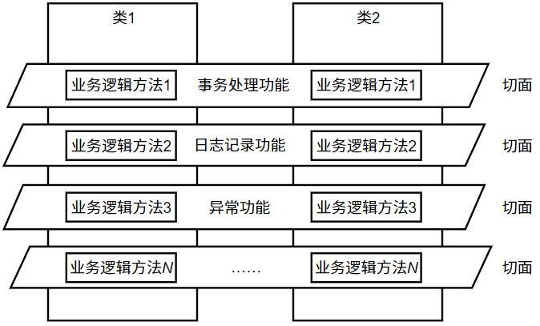
3.1 Overview of AOP
The relationship between classes and facets

Slide 9
3.1 Overview of AOP
The common terms for AOP are as follows.
1. Aspect: An aspect is a modular unit used to horizontally divide concerns and is typically used to encapsulate the functionality of a horizontally inserted system.
2. Joinpoint: A joinpoint is a specific node in the execution of a program, and a joinpoint typically represents the execution of a method.
3. Pointcut: A pointcut is a connection point that meets a pre-specified condition during the execution of a program.
4. Advice: Advice is the actual code in a cut that is used to implement the specific function of the cut.
5. Target Object: The target object refers to the original object enhanced by the aspect.
6. Weaving: Weaving is the process of inserting facet code into a target object to generate a proxy object.
7. Proxy Object: A proxy object is an object created after weaving the facets and is used to apply notifications to the target object.
8. Introduction: An introduction is a special type of notification used to add new properties and methods to the target object.

Slide 10
3.1 Overview of AOP
Think of AOP like this: without making major changes to the original business code, you automatically add some common functions at the right time.
We can imagine a student management system in which many methods need to:
print logs first,
check permissions,
record execution time,
handle errors in a unified way.
If you write this code manually in every method, the code will become very messy. AOP is like secretly adding an extra layer of supporting work before and after a method is executed.

Slide 11
3.1 Overview of AOP
1. Aspect
An aspect is the kind of functionality that needs to be added additionally.
For example: logging, permission checking, transaction management, and performance statistics.
These functions are not the core business logic, but they are needed in many places, so we separate them out. That is what an aspect is.
You can understand it as:
a public helper module
For example: a logging aspect is specifically responsible for printing logs before and after a method is executed.

Slide 12
3.1 Overview of AOP
2. Joinpoint
A joinpoint is a place in the program where extra functionality can be inserted.
In Spring AOP, this usually refers to when a method is being executed.
For example, consider these methods: addUser(), deleteUser(), and updateUser().
When these methods are executed, they can all be regarded as joinpoints.
You can understand it as:
“the timing or location where intervention can be made.”

Slide 13
3.1 Overview of AOP
3. Pointcut
A pointcut means selecting the joinpoints that you really want to intercept from among many joinpoints. Not every method needs logging or permission checking.
For example, you may want to intercept only the methods in UserService, or only the methods whose names start with add. In this case, you need a pointcut. You can understand it as:“a filtering rule.”
For example:
intercept all methods in the service layer, intercept all login() methods,
intercept all add*() methods.

Slide 14
3.1 Overview of AOP
4. Advice
Advice is the additional action that is actually executed.
For example, you may:
print “Start execution” before a method runs,
print “Execution finished” after a method runs,
record exception information when an error occurs.
These specific actions are called advice.
You can understand it as:
“the actual work to be done.”
Common types of advice can be simply remembered as:
Before advice: what to do before a method executes
After advice: what to do after a method executes
Exception advice: what to do when an error occurs
Around advice: can control both before and after the method, and is the most powerful

Slide 15
3.1 Overview of AOP
5. Target Object
The target object is the original object that actually performs the business logic.
For example:
UserService userService = new UserService();
This userService is originally responsible for things like adding users, deleting users, and updating users. It is the one that is actually doing the work, so this original object is called the target object.
You can understand it as:
“the main actor.”
6. Weaving
Weaving is the process of adding aspect functionality to the target object.
In other words, it means combining functions such as logging, permission checking, and transaction management with the original business object.
You can understand it as:
“the process of installing add-on features.”
Originally, the object only had business functions. After weaving, it becomes:
business functions + additional supporting functions

Slide 16
3.1 Overview of AOP
7. Proxy Object
A proxy object is the enhanced object that Spring finally gives you to use.
On the surface, you may think you are calling userService.addUser(), but in many cases, what you actually get is not the original object, but a proxy object created by Spring.
This proxy object will:
first execute the additional functions (such as logging),
then call the original business method,
and finally perform the finishing work. You can understand it as:
“an agent / middleman / enhanced substitute.”It automatically arranges those extra functions for you.
8. Introduction
Introduction means adding some new abilities to an object without modifying the original class code.
For example, suppose the original UserService does not have a sayHello() method. Through introduction, it can be made to seem as if it has gained a new method.
You can understand it as:
“temporarily extending the object with new capabilities.”
However, in actual development, this concept is used less often than the previous one

Slide 17
The implementation mechanism of Spring AOP
3.2

Slide 18
3.2 Spring AOP Implementation Mechanism
When implementing AOP in the Spring framework, the application generates a dynamic proxy object for the target object at runtime and implements enhancements to the target object within the proxy object. Depending on how the proxy object is created, the AOP implementation mechanism can be divided into JDK dynamic proxy and CG LIB dynamic proxy, which will be explained in this section.

Slide 19
3.2.1 Dynamic Proxy of JDK
Set a small goal first!
Set a small goal first!
Get familiar with JDK dynamic proxy and implement cases of JDK dynamic proxy

Slide 20
3.2.1 JDK Dynamic Proxy
JDK dynamic proxy in AOP is an interface-based proxy approach, that is, proxy instances can only be created for interfaces. JDK Dynamic proxy is the default dynamic proxy mechanism of Spring AOP, which uses the Java reflection mechanism to dynamically create proxy objects of the target object at runtime and associate notifications with the proxy objects, thereby enhancing the target object.
JDK Dynamic Proxy uses the java.lang.reflect.proxy class and the java.lang.reflect.invocationHandler interface in java to create proxy objects. First, you need to define an InvocationHandler implementation class that contains an invoke() method in which the enhanced logic is defined. Then create the Proxy object through the newProxyInstance() method of the Proxy class, which generates the proxy object by receiving the class loader, the interface of the proxy implementation, and the InvocationHandler object.

Slide 21
3.2.1 JDK Dynamic Proxy
JDK dynamic proxy means that Spring finds a proxy for an object that implements an interface, and this proxy helps you do some extra things before and after the method call.
Originally, you want to call a method like this:
userService.addUser();
After using a JDK dynamic proxy, the actual process becomes:
first, the call goes to the proxy object,
the proxy object first performs the enhancement functions, such as printing logs,
then it calls the real addUser() method,
after the call is finished, it does some follow-up work.

Slide 22
3. 2.1 JDK Dynamic Proxy
The following demonstrates the implementation process of JDK dynamic proxy in Spring through a case.
(1) Create the project and dependencies
Create a Maven project named chapter03 in IDEA, and then introduce Spring's core dependencies in the project's pom.xml file.

Slide 23

3.2.1 JDK Dynamic Proxy
(2) Create the interface and the implementation class
Create the com.itheima.dao package under chapter03 project, create the UserDao interface under this package, and write the methods for adding and removing in this interface. Create the UserDao interface implementation class UserDaoImpl under the com.itheima.dao package, and add an output statement in the method overriding the interface, as shown in files 3-1 and 3-2.
Source code
File 3-1 UserDao.java
File 3-2 UserDaoImpl.java

Slide 24
3.2.1 JDK Dynamic Proxy
(3) Create the aspect class
Create a com.itheima.aspect package under chapter03 project and create the aspect class MyAspect under that package, defining a method to simulate permission checking and a method to simulate logging as notifications in the aspect, as shown in file 3-3.
Source code
File 3-3
MyAspect.java

Slide 25
3.2.1 JDK Dynamic Proxy
(4) Create the agent class
Create the com.itheima.proxy package under chapter03 project, create the Proxy class JdkProxy that implements the InvocationHandler interface under this package, write proxy methods within the proxy class, and implement dynamic proxy through the proxy class within the proxy methods As shown in File 3-4.
Source code
File 3-4
JdkProxy.java

Slide 26
3.2.1 JDK Dynamic Proxy
(5) Create the test class
Create the test class JdkTest in the com.itheima package of the project. Create the proxy class object and the target object in the main() method of this class, then obtain the proxy object enhanced to the target object userDao, and finally call the add user and remove user methods in that object, as shown in file 3-5.
Source code
File 3-5
JdkTest.java

Slide 27
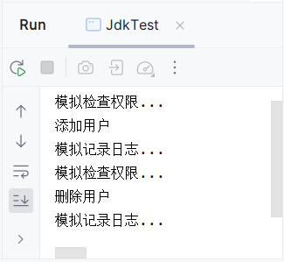
3.2.1 JDK Dynamic Proxy
(6) Test results
Run file 3-5, and the results are shown in the following figure.

Slide 28
3. 2.2 CGLIB Dynamic proxy
Set a small goal first!
Set a small goal first!
Familiarize yourself with CGLIB dynamic proxy and implement cases of CGLIB dynamic proxy

Slide 29
3.2.2 CGLIB Dynamic Proxy
The use of JDK dynamic proxy is very simple, but it has certain limitations - objects using dynamic proxy must implement one or more interfaces. If you want to proxy a class that doesn't implement an interface, you can use a CGLIB dynamic proxy.
CGLIB (Code Generation Library, code generation library) is a high-performance open-source code generation package that extends Java classes and implements interfaces at runtime. The principle of CGLIB dynamic proxy is to create a subclass of the target object through inheritance and override its methods, thereby enabling interceptors to enhance the target methods. CGLIB proxy classes are created relatively slowly compared to JDK dynamic proxies, but they execute faster at runtime than JDK dynamic proxies and do not require the target object to implement the interface.

Slide 30
3. 2.2 CGLIB Dynamic Proxy
CGLIB provides an interceptor interface called MethodInterceptor, in which an intercept() method is defined to intercept calls to target object methods. When using CGLIB dynamic proxy, the proxy class needs to implement the MethodInterceptor interface and write custom logic in the overridden intercept () method to implement enhanced or interception handling of the target method.

Slide 31
3. 2.2 CGLIB Dynamic proxy
The following demonstrates the implementation process of a CGLIB dynamic proxy through a case as follows.
(1) Create the target class
Create a target class OrderDao in the com.itheima.dao package of the project, and define a method to add an order and a method to remove an order in this class, as shown in File 3-6.
Source code
Files 3-6
OrderDao.java

Slide 32
3.2.2 CGLIB Dynamic proxy
(2) Create the proxy class
In the com.itheima.proxy package, create the proxy class CglibProxy, which implements the MethodInterceptor interface, and write enhanced logic code in the intercept() method that overwrites the interface, as shown in file 3-7.
Source code
File 3-7
CglibProxy.java

Slide 33
3.2.2 CGLIB Dynamic proxy
(3) Create the test class
Create the test class CglibTest in the com.itheima package. In the main() method of this class, first create the proxy class object and the target object, then obtain the proxy object enhanced with the target object, and finally call the add order and remove order methods of the proxy object, as shown in file 3-8.
Source code
File 3-8
CglibTest.java

Slide 34
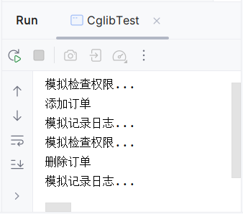
3.2.2 CGLIB Dynamic proxy
(4) Test the results
Run files 3-8, and the results are shown in the following figure.

Slide 35
Spring AOP integrates the implementation of AspectJ
3.3

Slide 36
3.3 Spring AOP integrates implementations of AspectJ
Spring AOP is a simplified version of the AOP component provided by the Spring framework that offers the basic AOP functionality but may have some limitations in some complex cases. To make up for these limitations, developers often combine Spring AOP with other AOP implementations, such as AspectJ, to meet higher-level AOP functionality requirements. In this case, the most common combination is Spring AOP integrated with AspectJ for use. When Spring AOP integrates AspectJ to implement AOP, it can be based on both XML and annotations. The following explains the implementation of these two types of AOP.

Slide 37
3.3.1 AOP Implementation Based on XML
Set a small goal first!
Set a small goal first!
Master an XML-based AOP implementation

Slide 38
3.3.1 XML-based AOP Implementation
When Spring AOP integrates AspectJ, an XML-based AOP implementation requires defining aspects, points, and notifications in an XML file. Spring provides a series of tags for configuring aspects, points, and notifications in an XML file.
Tags | Description
<aop:config> | The root tag for Spring AOP configuration, used to include other AOP-related configurations
<aop:aspect> | Used to configure the aspect, you can define the aspect class and the aspect-related notification types
<aop:advisor> | Used to configure the notificator to combine facets and points and apply them to the target object
<aop:pointcut> | For configuring cuts, you can specify where the cuts work, that is, define the cut expression

Slide 39
Tags | Description
<aop:before> | Used to configure pre-notifications to implement enhancements before the target method is executed, typically applied to permission management functionality
<aop:after> | Used to configure post-notifications to implement enhancements after the target method is executed, typically applied to functions such as closing streams, uploading files, deleting temporary files, etc
<aop:around> | Used to configure the wraparound mode to implement enhancements before and after the target method is executed, typically applied to logging, transaction management, and other functions
<aop:after-returning> | Used to configure the return notification, to invoke the notification after the target method has been successfully executed, typically applied to handle return values, logging, and other functions
<aop:after-throwing> | Used to configure exception throwing notifications, to implement enhancements after a method throws an exception, typically applied to features such as handling exception logging
3.3.1 AOP Implementation based on XML

Slide 40
3.3.1 XML-based AOP implementation
1. Configure the sectioning
In the Spring configuration file, if you want to define an aspect, you can use the <aop:aspect> tag, which converts a defined Spring Bean into an aspect Bean and weaves it onto the methods of the target object. Therefore, before using the <aop:aspect> tag, you need to define a regular Spring Bean in the configuration file first.
The <aop:aspect> tag provides the id attribute and the ref attribute, which are used to specify a unique ID for the aspect in the Spring application context, and to reference an existing aspect Bean.

Slide 41
3.3.1 XML-based AOP implementation
2. Configure the cut point
In Spring's configuration file, the cuts are defined by the <aop:pointcut> tag. When the <aop:pointcut> tag is defined as a subtag of the <aop:config> tag, the defined cut can be shared by multiple facets and thus become a global cut; When the <aop:pointcut> tag is a sub-tag of the <aop:aspect> tag, the cut is only valid for the current aspect and does not become a global cut.

Slide 42
3.3.1 AOP Implementation Based on XML
When defining the <aop:pointcut> tag, two properties, id and expression, are typically specified. Among them, the id property is used to specify a unique identifier in the configuration file for the cut point, and the expression property is used to define the expression of the cut point. The basic format of the pointcut expression is as follows.
execution(modifiers-pattern? return-type-pattern declaring-type-pattern?
name-pattern(param-pattern) throws-pattern?)
(1) modifiers pattern: A pattern used to specify how a method accesses a modifier.
(2) the return - type - the pattern: model method is used to specify the return value type.
(3) declaring -type - the pattern: method of a class model is used to specify the statement.
(4) the name - the pattern: the name of the method is used to specify the model.
(5) the parameter - the pattern: model is used to specify the method parameter list.
(6) Those throws - the pattern: the method is used to specify an exception type model.

Slide 43
3.3.1 AOP Implementation Based on XML
execution(* com.example.myapp.MyClass.myMethod(..) )
Match com. Example. Myapp. All myMethod (int x) in the MyClass class () method of execution.
execution(public * *(..) )
Match the execution of all public methods, regardless of the return type, class name, and method name.
execution(* set*(..) )
Match the execution of all methods starting with set.
execution(* com.example.. *. * (..) )
Match the execution of all methods of all classes in the com.example package and its subpackages.

Slide 44
3.3.1 XML-based AOP implementation
3. Configuration notifications
Notifications in Spring AOP are defined using "facets + join points." A join point is a specific point during the execution of a program, and an aspect defines which join points notifications are woven into. Spring AOP provides five types of notifications, These notifications are classified by the point in time they are woven in as pre-notifications, post-notifications, post-returning notifications, post-throwing notifications, and surround notifications.

Slide 45
3.3.1 XML-based AOP implementation
Notification of common attributes of tags
Properties | Description
pointcut | Used to define a cut point expression within a cut, Spring will weave the notification when the join points match that expression
pointcut-ref | Used to specify an existing cut point name, typically only one of the pointcut and pointcut-ref attributes needs to be used
method | Used to specify the specific notification method
throwing | This attribute works only for the <after-throwing> tag and is used to specify a formal parameter name through which the exception notification method can access the exception thrown by the target method
returning | This attribute works only for the <after-returning> tag and is used to specify a formal parameter name through which the return notification method can access the return value of the target method

Slide 46
3.3.1 An XML-based AOP implementation
The following demonstrates how to implement AOP based on XML in Spring through a case.
(1) Introduce dependencies
The relevant dependencies of the AspectJ framework in the pom.xml file of the chapter03 project, the code added in the pom.xml is as follows.
Source code
pom . xml

Slide 47
3.3.1 AOP Implementation Based on XML
(2) Create the facet class
Create the com.itheima.advice package in the project and create the aspect class XmlAdvice under that package, and define different methods in this class as notifications in the aspect, as shown in File 3-9.
Source code
File 3-9
XmlAdvice.java

Slide 48
3.3.1 AOP Implementation Based on XML
(3) Create the configuration file and configure the AOP information
Create the applicationContext.xml file under the resource folder of the chapter03 project and define two beans in that configuration file: userDao and xmlAdvice set userDao as the cut and xmlAdvice as the cut, as shown in File 3-10.
Source code
File 3-10
aplicationContext.xml

Slide 49
3.3.1 AOP Implementation Based on XML
(4) Create the test class
Create the test class XmlAOPTest in the com.itheima package, obtain the Bean named userDao in the test class, and execute its methods for adding and removing users, as shown in file 3-11.
Source code
File 3-11
XmlAOPTest.java

Slide 50
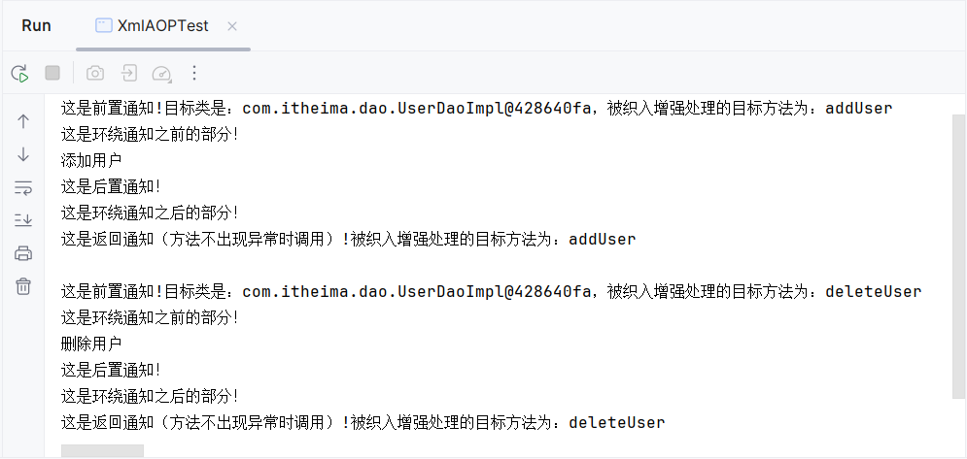
3.3.1 AOP Implementation Based on XML
(5) Test the results
Run file 3-11 in IDEA, and the results are shown in the following figure.

Slide 51
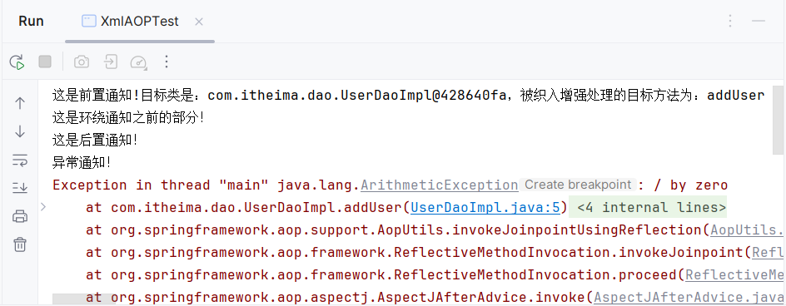
3.3.1 XML-based AOP implementation
(5) Test results
If you want to see how the exception notification works, you can add error code such as "int i = 10/0;" in the addUser() method of the UserDaoImpl class. Re-run the test class and you will see the execution of the exception notification, with the console output as shown in the following figure.

Slide 52
3.3.2 AOP implementation based on annotations
Set a small goal first!
Set a small goal first!
Master an annotation-based AOP implementation

Slide 53
3.3.2 Annotation-based AOP implementation
AspectJ provides an annotation-based way to implement AOP, which avoids a lot of XML configuration, makes the code more concise, more readable, and easier to maintain.
Annotation Name | Description
@AspectJ | Used to mark a class as a facet
@Pointcut | Used to define the pointcut expression, the pointcut name can be represented by a method signature
@Before | Used to define a pre-notification, when in use, use the value attribute to specify a point of cut, which can be an existing point of cut or a point of cut expression defined directly

Slide 54
3.3.2 AOP Implementation Based on annotations
Annotation Name | Description
@AfterReturning | Used to define postnotifications, you can specify the pointcut/value and returning attributes when in use, where both pointcut/value are used to specify the cut point. The returning attribute value is used to indicate that a parameter with the same name can be defined in the Advice method, which can be used to access the return value of the target method
@Around | Used to define surround notifications, specifying a cut point through the value attribute when in use
@AfterThrowing | Used to define exception notifications, you can specify pointcut/value and throwing attributes when in use. Where pointcut/value is used to specify the cut expression, the throwing property is used to specify a parameter name that represents a parameter with the same name that can be defined in the Advice method, which can be used to access the exception thrown by the target method
@After | Used to define post-notification that is executed regardless of whether the application throws an exception or not. When used, specify a cut point through the value attribute

Slide 55
3.3.2 Annotation-based AOP implementation
The following demonstrates an annotation-based AOP implementation through a case.
(1) Create the facet class
Create the aspect class AnnoAdvice under the com.itheima.advice package of the project, label the current class as an aspect with the @AspectJ annotation on this class, and use the relevant annotation to define notifications. The specific code of the AnnoAdvice class is shown in file 3-12.
Source code
File 3-12
AnnoAdvice.java

Slide 56
3.3.2 AOP Implementation Based on annotations
(2) Create the configuration file and enable AspectJ annotation support
Create an applicationContext-Anno.xml file in the project's resource folder and add Spring AOP configuration information using the <bean> tag in this file, as shown in file 3-1.
Source code
File 3-13
applicationContext-Anno.xml

Slide 57
3.3.2 AOP Implementation Based on annotations
(3) Create the test class
Create the test class AnnoAOPTest in the com.itheima.demo04 package and load the applicationContext-Anno.xml file in this class to initialize the container, as shown in file 3-14.
Source code
File 3-14
AnnoAOPTest .java

Slide 58
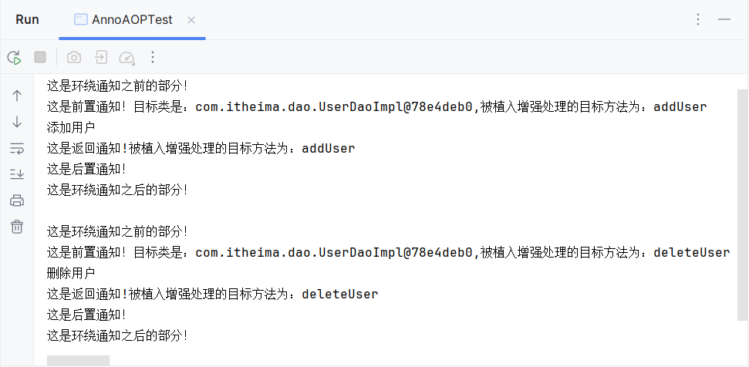
3.3.2 AOP Implementation Based on annotations
(4) Test results
Run file 3-14, and the results are shown in the following figure.

Slide 59
Summary of this chapter
This chapter mainly explains AOP in Spring. An overview of AOP is introduced first; Then the implementation mechanism of Spring AOP is explained, including JDK dynamic proxy and CGLIB dynamic proxy; Finally, the implementation of Spring AOP integration with AspectJ was explained. Through the study of this chapter, readers can have a basic understanding of Spring AOP and lay the foundation for framework development.

