Slide 1
Chapter 4 Database Programming in Spring
Java EE Enterprise Application Development Tutorial (Spring+Spring MVC+MyBatis) (3rd Edition)

Slide 2
Learning objectives/Target
Understand the relevant concepts of JdbcTemplate and be able to briefly describe the function of JdbcTemplate
Understand the concept of Spring transaction management and be able to describe the role of Spring transaction management
Master the add, delete, modify and query operations of JdbcTemplate
Be familiar with XML-based transaction management
Master annotation-based transaction management

Slide 3
Chapter Overview/Summary
In Java enterprise-level development, the operation of the database by the application is an indispensable part. However, the traditional JDBC operation method is relatively cumbersome and error-prone, especially when dealing with resource management and transaction control. As a one-stop service framework, the Spring JDBC module of the Spring framework provides strong database programming support. Also, to address the issue of transactions when operating the database, the Spring framework provides transaction management capabilities. In Spring's database programming, JdbcTemplate in the Spring JDBC module and Spring's transaction management are the most common. This chapter will cover both parts of Spring's database programming.

Slide 4
Contents
4.1
Jdbc Template
4.2
An Overview of Spring Transaction Management
4.3
Declarative transaction management

Slide 5
4.1
Jdbc Template

Slide 6
4.1 JdbcTemplate
The Spring JDBC module in the Spring framework encapsulates the JDBC API mainly with the aim of reducing the difficulty of using the JDBC API and using it in a more direct and concise way. With Spring JDBC, developers can easily program JDBC simply by defining the necessary parameters and specifying the SQL statements to be executed.
Meanwhile, Spring JDBC can handle the cumbersome tasks such as driver loading, database connection opening and closing, SQL statement creation and execution, exception handling, and transaction processing, thus freeing developers from the cumbersome JDBC API. There is more energy to focus on business development. To simplify JDBC development, Spring JDBC offers several practical database access tools, the most commonly used of which is JdbcTemplate. The following is an explanation of JdbcTemplate.

Slide 7

4.1.1 Overview of JdbcTemplate
Set a small goal first!
Set a small goal first!
Understand the concepts related to JdbcTemplate and be able to briefly describe the function of JdbcTemplate

Slide 8
4.1.1 Overview of JdbcTemplate
core (Core package)
object (Object package)
Contains the core classes and interfaces of Spring JDBC, most importantly the JdbcTemplate class
Contains classes and interfaces associated with object mapping
The main package of the Spring JDBC module
dataSource (Source package)
(support package)
Contains classes and interfaces associated with the data source for configuring and managing database connections
It includes some additional support classes and utility classes that provide more convenient database operations

Slide 9
4.1.1 Overview of JdbcTemplate
JdbcTemplate provides a wealth of methods to support database operations, including insertions, queries, updates, and deletions, and placeholders in SQL statements can be set through parameter passing. The common database manipulation methods of JdbcTemplate are as follows.
Methods | Instructions
int update(String sql) | Used to execute the given SQL statement and return the number of affected lines. Typically used to perform operations such as INSERT, UPDATE, and DELETE
int update(String sql, Object... args) | Used to execute the given SQL statement and return the number of affected lines. The args parameter is a variable-length array used to pass the values of the parameters in the SQL statement
int[] batchUpdate(String sql, List<Object[]> batchArgs) | Used to execute the given SQL and return the number of lines affected by each SQL statement execution. batchArgs is a list of arrays of parameters, with each array in the list corresponding to the parameter value of one SQL statement

Slide 10
4.1.1 Overview of JdbcTemplate
Methods | Instructions
List<T> query(String sql, RowMapper<T> rowMapper) | Used to execute the given SQL statement and map the result of each row to an object using the provided RowMapper
List<T> query(String sql, Object[] args, RowMapper<T> rowMapper) | Used to execute query SQL statements with parameters and map the result of each row to an object using the provided RowMapper. An args parameter is a variable-length array used to pass the values of the parameters in an SQL statement
T queryForObject(String sql, RowMapper<T> rowMapper,Object... args) | Used to execute query SQL statements with parameters and return a single-row record of Object type through RowMapper

Slide 11
4.1.1 Overview of JdbcTemplate
Methods | Instructions
Map<String, Object> queryForMap(String sql, Object... args) | Used to execute query SQL statements with parameters and Map single-line results to a map object. An args parameter is a variable-length array used to pass the values of the parameters in an SQL statement
List<T> queryForList(String sql, Class<T> elementType, Object... args) | Used to execute query SQL statements with parameters and map multi-line results to a List object. The elementType parameter is used to specify the type to which the query result is mapped, and the args parameter is a variable-length array used to pass the parameter values in the SQL statement
void execute(String sql) | Used to execute arbitrary SQL statements without returning any result. Typically used to execute DDL statements or SQL operations that do not require a result to be returned

Slide 12
4.1.2 Using JdbcTemplate
Set a small goal first!
Set a small goal first!
Master the add, delete, modify and query operations of JdbcTemplate

Slide 13
4.1.2 Using JdbcTemplate
1 Configure the data source
The data source is the bridge that connects JdbcTemplate to the database. Developers need to configure a data source object and inject it into JdbcTemplate
Steps for using JdbcTemplate
2 Create a JdbcTemplate object
Inject the data source object into JdbcTemplate via Spring's configuration file or annotations to create a JdbcTemplate object
3 Perform database operations
Use the various methods provided by JdbcTemplate, such as update, query, etc., to perform database operations like add, delete, modify, and query

Slide 14


4.1.2 Using JdbcTemplate
The following demonstrates the operation of the common add, delete, modify and query methods of JdbcTemplate through cases.
1 Create the project and import the dependencies
Create a Maven project named chapter04 in IDEA and introduce Spring's core dependencies, database, and unit test-related dependencies in the project's pom.xml file, as shown in file 4-1.
Source code
File 4-1
pom.xml

Slide 15
4.1.2 Use of JdbcTemplate
2 Create data tables and configure the information for connecting to the database
When performing add, delete, modify, and query operations using JdbcTemplate, you need to specify the data table to be operated on in the corresponding SQL statement. First, create the database required for this case. The statements for creating the database and data table are shown in File 4-2.
Source code
File 4-2
account.sql

Slide 16
4.1.2 Use of JdbcTemplate
2 Create the data table and configure the information for the connection database
Create the configuration file application.properties under the resources directory in chapter04, and configure the information for connecting to the database in this configuration file as shown in File 4-3.
Source code
File 4-3
application.properties

Slide 17
4.1.2 Use of JdbcTemplate
3 Create the Spring configuration class and configure the data source and JdbcTemplate
Create the com.itheima.config package in the project, create the Spring configuration class in that package, and load the information in the application.properties file to configure the data source Create a JdbcTemplate object based on the data source and hand it over to Spring for management, as shown in File 4-4.
Source code
File 4-4
DataSourceConfig.java

Slide 18
4.1.2 Use of JdbcTemplate
4 Create the entity class
Create the com.itheima.pojo package in the project, create the entity class Account in that package, and define the id, username, and balance attributes in the Account class, as well as their corresponding getter/setter methods, as shown in File 4-5.
Source code
File 4-5
Account.java

Slide 19
4.1.2 Use of JdbcTemplate
5 Create the Dao interface and the corresponding implementation classes
Create the com.itheima.dao package in the project. In this package, create the Dao interface for operating account information and the corresponding implementation classes for the interface. The interface defines the methods for adding, deleting, modifying, and querying accounts, as shown in files 4-6 and 4-7.
Source code
File 4-6 AccountDao.java
File 4-7 AccountDaoImpl.java

Slide 20
4.1.2 Use of JdbcTemplate
6 Create the test class
Create the test class JDBCTest in the test\java directory of the project, and inject the AccountDao object into the test class as shown in File 4-8.
Source code
File 4-8
JDBCTest.java

Slide 21
4.1.2 Use of JdbcTemplate
7 Define the test method and test the effect
(1) Methods for adding individual information and querying
Define test methods in the JdbcTemplate class to add individual account information and query account information based on account id as follows.
Source code
testAddAccount()

Slide 22
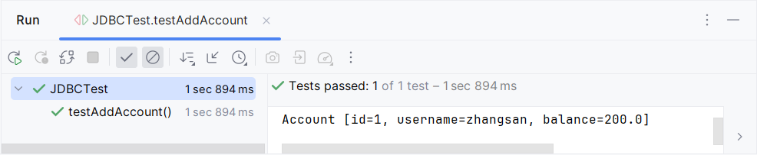
4.1.2 Use of JdbcTemplate
7. Define the test method and test the results
Run the testAddAccount() method as shown in the following figure.

Slide 23
4.1.2 Use of JdbcTemplate
7 Define the test method and test the results
(2) Batch Add and Query methods
Define in the JdbcTemplate class test methods for encapsulating query results into maps and lists, as well as test methods for batch adding account information, as shown below.
Source code
Batch add and query methods

Slide 24
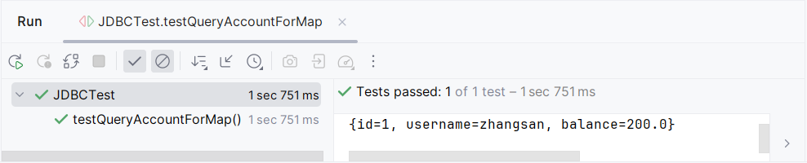
4.1.2 Use of JdbcTemplate
7. Define the test method and test the results
Run the testQueryAccountForMap() method as shown in the following figure.

Slide 25
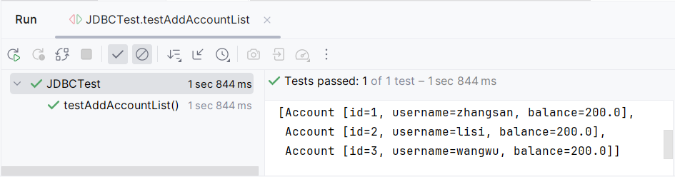
4.1.2 Use of JdbcTemplate
7. Define the test method and test the results
Run the testAddAccountList() method as shown in the following figure.

Slide 26
4.1.2 Use of JdbcTemplate
7 Define the test method and test the effect
(3) Modify and delete methods
In the JdbcTemplate class, define the test methods for modifying and deleting account information as follows.
Source code
Modify and remove methods

Slide 27
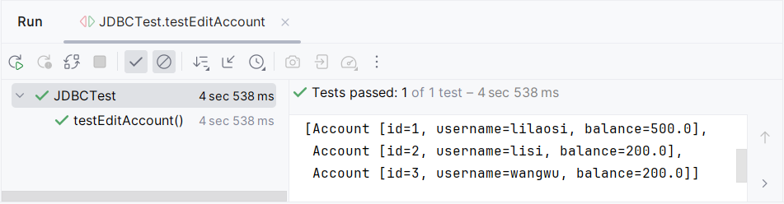
4.1.2 Use of JdbcTemplate
7. Define the test method and test the result
Run the testEditAccount() method as shown in the following figure.

Slide 28
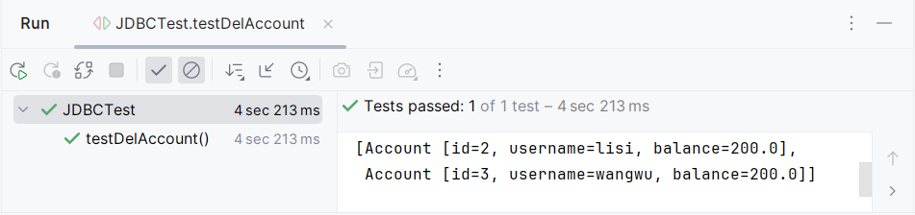
4.1.2 Use of JdbcTemplate
7. Define the test method and test the results
Run the testDelAccount() method as shown in the following figure.

Slide 29
4.1.3 Basic Usage of JUnit
JUNIT
What is JUnit
JUnit is a commonly used Java unit testing framework. It helps developers verify whether a method works correctly by writing and running test cases.
Why use JUnit
It can automatically test program functions
It helps find errors early
It makes code easier to maintain
It is very useful when testing DAO methods, service methods, and transaction logic

Slide 30
4.1.2 Use of JdbcTemplate
Common Annotations in JUnit 5
@Test Marks a method as a test method
@BeforeEach Runs before each test method
@AfterEach Runs after each test method
@BeforeAll Runs once before all test methods
@AfterAll Runs once after all test methods
Common Assertion Methods
assertEquals(expected, actual) Checks whether two values are equal
assertNotNull(object) Checks whether an object is not null
assertTrue(condition) Checks whether a condition is true
assertFalse(condition) Checks whether a condition is false

Slide 31
4.2
Overview of Spring Transaction Management

Slide 32
4.2 Overview of Spring Transaction Management
Set a small goal first!
Set a small goal first!
Understand the concept of Spring transaction management and be able to briefly describe the role of Spring transaction management

Slide 33
4.2 Overview of Spring Transaction Management
In actual development, to ensure the integrity and consistency of data, it is often necessary to perform transaction management when manipulating data, so that a series of operations to add, modify, and delete data either all succeed or all fail. Spring, as a framework that provides a one-stop solution, also offers powerful transaction management capabilities. Spring's transaction management Based mainly on PlatformTransactionManager interface, TransactionDefinition interface, TransactionStatus interface implementation, the following respectively to explain the three interfaces.

Slide 34
4.2 Overview of Spring Transaction Management
1. The PlatformTransactionManager interface
PlatformTransactionManager interface is the core of the Spring transaction management, it provides management methods, such as start, commit the transaction, and roll back the transaction, the interface provides three management methods, specific as follows.
Methods | Instructions
TransactionStatus getTransaction( TransactionDefinition definition ) | Used to get a new transaction or participate in an existing transaction and return the status information of the transaction
void commit(TransactionStatus status) | Used for committing transactions
void rollback(TransactionStatus status) | Used for rolling back transactions

Slide 35
4.2 Overview of Spring Transaction Management
2.TransactionDefinition Interface
The TransactionDefinition interface defines constants related to the transaction description, including the isolation level of the transaction, the propagation behavior of the transaction, the timeout period of the transaction, and whether it is a read-only transaction.
(1) The isolation level of the transaction
The isolation level of a transaction refers to the degree of isolation between transactions. Five isolation levels are defined in the TransactionDefinition interface.

Slide 36
4.2 Overview of Spring Transaction Management
Isolation levels | Instructions
ISOLATION_DEFAULT | Use the default transaction isolation level of the current database
ISOLATION_READ_UNCOMMITTED | Indicates read uncommitted. Allowing another transaction to read uncommitted data from the current transaction at the lowest isolation level may result in dirty reads, phantom reads, or non-repeatable reads
ISOLATION_READ_COMMITTED | Indicates that the read has been committed. Data modified by one transaction can only be read by another transaction after being committed, which avoids dirty reads, cannot avoid phantom reads, and cannot be read repeatedly
ISOLATION_ REPEATABLE_READ | Repeatable reads, this isolation level ensures that the results of reading the same data multiple times within the same transaction are consistent, avoiding dirty reads and increased resource consumption. This is the default isolation level for MySQL databases
REPEATABLE_SERIALIZABLE | Transactions are executed serially, that is, multiple transactions are executed one by one in chronological order. There is no concurrency issue. It is the most reliable but has the lowest performance and efficiency

Slide 37
4.2 An Overview of Spring Transaction Management
(2) Propagation behavior of transactions
The propagation behavior of a transaction refers to the maintenance of the transaction when methods in different transactions call each other, during the execution of the methods. For example, when method B of one transaction calls method A of another transaction, it can be stipulated that method A continues to run in the existing transaction to which method B belongs, or it can be stipulated that method A starts A new transaction, runs in the new transaction, and the existing transaction to which method B belongs is suspended until the new transaction of method A is completed and then resumed.

Slide 38
4.2 An Overview of Spring Transaction Management
Propagation behavior | Notes
PROPAGATION_REQUIRED | Default transaction propagation behavior. If a transaction is currently present, join it; If there is no current transaction, create a new one
PROPAGATION_SUPPORTS | Join a transaction if it exists; If there is no transaction at the moment, execute it as a non-transaction
PROPAGATION_MANDATORY | There must be a transaction currently; if not, an exception is thrown
PROPAGATION_REQUIRES_NEW | Create a new transaction and suspend the existing transaction if it already exists
PROPAGATION_NOT_SUPPORTED | Always execute in a non-transactional manner, suspending the current transaction if it exists
PROPAGATION_NEVER | Never support the current transaction and throw an exception if a transaction already exists
PROPAGATION_NESTED | If a transaction is currently present, it is executed in a sub-transaction of the current transaction

Slide 39
4.2 Overview of Spring Transaction Management
(3) Transaction timeouts
The timeout of a transaction is the time limit for the execution of the transaction. Beyond this time limit, the transaction will be rolled back. The TransactionDefinition interface provides the TIMEOUT_DEFAULT constant to represent the default timeout of the Spring transaction manager.
If developers want to specify the transaction timeout, you can use DefaultTransactionDefinition class setTimeout () method or @ the timeout attribute of Transactional annotation.

Slide 40
4.2 Overview of Spring Transaction Management
(4) Whether a transaction is read-only
When a transaction is marked as read-only, it means that the transaction reads data from the database without modifying it. Attempting to modify data in a read-only transaction typically raises an exception because the vast majority of databases and transaction managers prohibit write operations in a read-only transaction. This design ensures consistency and reliability of the data while also facilitating the optimization of read-only transactions by the database engine, thereby enhancing the overall performance of the system.

Slide 41
4.2 Overview of Spring Transaction Management
In addition to providing the isolation level of the transaction, the propagation behavior of the transaction, the timeout period of the transaction, and the constant for whether it is a read-only transaction, the TransactionDefinition interface provides a series of methods to obtain the properties of the transaction. The common methods of the TransactionDefinition interface are as follows.
Methods | Instructions
int getPropagationBehavior() | Returns the propagation behavior of the transaction
int getIsolationLevel() | Return the isolation level of the transaction
int getTimeout() | Returns the timeout of the transaction
boolean isReadOnly() | Determine if a transaction is read-only
String getName() | Returns the defined transaction name

Slide 42
4.2 Overview of Spring Transaction Management
3.TransactionStatus Interface
The TransactionStatus interface, which is primarily used to define the status of a transaction, provides a series of methods for returning information about the transaction's status as follows.
Methods | Instructions
boolean isNewTransaction() | If the current method is the starting point of the transaction, then the current transaction is a new transaction
boolean hasSavepoint() | Determine if the current transaction has created a save point
boolean isRollbackOnly() | Determine whether the current transaction is marked as rollback-only, that is, whether the transaction can only perform the rollback operation and cannot commit
void setRollbackOnly() | Mark the current transaction as rollback-only
boolean isCompleted() | Determine whether the current transaction has been completed, that is, whether the transaction has been committed or rolled back
void flush() | Refresh the underlying modifications to the database

Slide 43
4.2 Overview of Spring Transaction Management
Program transaction management
Manage operations such as starting, committing, and rolling back transactions by writing code. Developers can take control of transactions by directly invoking the transaction management API in their code
Transaction management approach
Declarative transaction management
Declare how transactions are managed either in a configuration file or by using annotations. Declarative transaction management implements transaction management through AOP technology, allowing developers to separate transaction management from business logic, making the code clearer and more concise

Slide 44
4.3
Declarative transaction management

Slide 45
4.3 Declarative Transaction Management
Spring's declarative transaction management is a very practical and widely adopted approach in enterprise-level applications, which can effectively simplify the implementation of transaction management and improve the quality and maintainability of code. Spring's declarative transaction management can be implemented in two ways, one XML-based and the other annotation-based. This section will cover both of these declarative transaction management approaches.

Slide 46
4.3.1 Declarative Transaction Management based on XML
Set a small goal first!
Set a small goal first!
Master transaction management in an XML-based way

Slide 47
4.3.1 Declarative Transaction management based on XML
Declarative transaction management based on XML is achieved by configuring relevant declarations of transaction rules in an XML configuration file. When configuring declarative transaction management using an XML file, first introduce the tx namespace. After introducing the tx namespace, you can use the <tx:advice> tag to configure transaction notifications for transaction management.
When configuring the <tx:advice> tag, you typically need to specify the id and transaction-manager properties, where the id property is the unique identifier in the configuration file and the transaction-manager property is used to specify the transaction manager. In addition, the <tx:advice> tag contains sub-tags <tx:attributes>. The <tx:attributes> tag can configure multiple <tx:method> sub-tags, which are mainly used to configure specific transaction properties for each method, Including propagation behavior, isolation level, timeouts, etc.

Slide 48
4.3.1 Declarative Transaction management based on XML
Common attributes for <tx:method> tags
Properties | Description
name | Used to specify the matching pattern for the method name, this attribute is mandatory and it specifies the method name associated with the transaction attribute
propagation | Used to specify the propagation behavior of a transaction
isolation | Used to specify the isolation level of a transaction
read-only | Used to specify whether a transaction is read-only
timeout | Used to specify the transaction timeout
rollback-for | Used to specify the exception class that triggers the transaction rollback
no-rollback-for | Used to specify an exception class that does not trigger a transaction rollback

Slide 49
4.3.1 Declarative Transaction Management based on XML
Write a program that simulates a bank transfer and requires control of the transaction through Spring at the time of the transfer.
(1) Introduce the dependencies
Spring's declarative transaction management relies on AOP technology at the bottom layer. To implement this, you need to introduce aspectjrt dependencies and aspectjweaver dependencies in the pop.xml file of the chapter04 project as the dependency packages required for the implementation aspect. The specific code is as follows.
Source code
Introduce dependencies

Slide 50
4.3.1 Declarative Transaction Management based on XML
(2) Define the Dao layer method
In the AccountDao interface of File 4-6, declare the transfer method transfer(), and its code is as follows.
// Transfer
public void transfer(String outUser,String inUser,Double money);

Slide 51
4.3.1 Declarative Transaction management based on XML approach
(3) Implement the Dao layer method
Implement the transfer() method in the AccountDao interface in the AccountDaoImpl implementation class in file 4-7 as follows.
Source code
transfer() method

Slide 52
4.3.1 Declarative Transaction Management based on XML
(4) Create the configuration file
Create the configuration file applicationContext.xml in the chapter04 project and configure the transaction manager and transaction notifications in the configuration file, as shown in File 4-9.
Source code
File 4-9
applicationContext.xml

Slide 53
4.3.1 Declarative Transaction Management based on XML
(5) Create the test class
Create the test class TransactionTest in the test\java directory of the chapter04 project, and inject the AccountDao object into the test class as shown in File 4-10.
Source code
File 4-10
TransactionTest.java

Slide 54
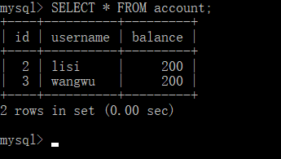
4.3.1 Declarative Transaction Management based on XML
(6) Test the results
For the effect before and after the program runs, query the data in the current account data table before the program runs, as shown in the following figure.

Slide 55
4.3.1 Declarative Transaction management based on XML
(6) Test the results
Run the testTransfer() method in file 4-10 and review the data in the account data sheet again, as shown in the following figure.

Slide 56
4.3.2 Declarative Transaction management based on annotation
Set a small goal first!
Set a small goal first!
Master the way of annotating transactions

Slide 57
4.3.2 Declarative Transaction management based on annotation
There are some drawbacks to implementing declarative transaction management based on XML, such as the need to write a lot of AOP-related configuration in the Spring configuration file, which can lead to code redundancy and reduced readability. To address this issue, annotation-based declarative transaction management can be adopted to simplify the Spring configuration file.
With annotation-based declarative transaction management, annotations can be added directly to the classes or methods where the aspect needs to be applied, specifying the logic of the aspect without the cumbersome configuration in the XML configuration file. Spring provides the @Transactional annotation for declarative transaction management, which has the same functionality as the <tx:advice> tag used in XML configuration. By adding the @Transactional annotation to the methods that require transaction management, transactions can be automatically started, committed, or rolled back without explicitly declaring transaction notifications in the XML configuration file.

Slide 58
4.3.2 Declarative Transaction management based on annotations
@Transactional can be annotated on interfaces, interface methods, classes, or class methods, and when annotated ona class, all public methods of that class will have transaction properties of the same type; When annotating a method in a class, if the class is also annotated with @Transactional, then the annotation of the method in the class will mask the annotation of the class. The common attributes of @Transactional are as shown below.
Properties | Description
value | Used to specify the transaction manager to be used
propagation | Used to specify the propagation behavior of a transaction
isolation | Used to specify the isolation level of a transaction
timeout | Used to specify the timeout period of a transaction
readonly | Used to specify whether a transaction is read-only
rollbackFor | Used to specify an array of exception classes that cause the transaction to roll back
rollbackForClassName | Used to specify an array of exception class names that cause the transaction to roll back
noRollbackFor | Used to specify an array of exception classes that do not cause a transaction rollback
noRollbackForClassName | Used to specify an array of exception class names that do not cause a transaction rollback

Slide 59
4.3.2 Declarative Transaction management based on annotation
When using @Transactional, you also need to configure the transaction annotation-driven in the Spring XML file with the <tx:annotation-driven> tag, which tells Spring to enable annotation-driven transaction management, And it will automatically scan classes and methods with the @Transactional annotation to apply the transaction management configuration.
The <tx:annotation-driven> tag has a common property, Transaction-Manager, which is used to specify the transaction manager. The Transaction-manager property defaults to transactionManager. If there is a transaction manager named transactionManager in the application and the developer wishes to use that transaction manager, the explicit configuration of the TransactionManager property can be omitted.

Slide 60
4.3.2 Declarative Transaction management based on annotations
Modify the code of the chapter04 project to implement transaction management in the project based on annotation.
(1) Create the configuration file
Create the configuration file applicationContext-annotation.xml in the src/main/resources directory of the chapter04 project, and configure the transaction annotation driver in this file as shown in file 4-11.
Source code
File 4-11
applicationContext-annotation.xml

Slide 61
4.3.2 Declarative Transaction management based on Annotation
(2) Modify the Dao layer implementation class
Annotate the transfer() method of the AccountDaoImpl implementation class with the @Transactional annotation, as shown below.
Source code
transfer() method

Slide 62
4.3.2 Declarative Transaction management based on Annotation
(3) Modify the test class
Modify the configuration file required for testing on the TransactionTest test class in File 4-10, as shown in file 4-12.
Source code
File 4-12
TransactionTest.java

Slide 63
4.3.2 Declarative Transaction management based on Annotation
(4) Test the results
After running the testTransfer() method in file 4-12, look at the data in the account data table as shown in the following figure.

Slide 64
Summary of this chapter
This chapter mainly covers database programming in Spring. It begins with JdbcTemplate, including an overview of JdbcTemplate and the operations of adding, deleting, modifying and querying JdbcTemplate; Then an overview of Spring transaction management was presented; Finally, there are two ways to implement declarative transaction management, XML-based declarative transactions and annotation-based declarative transactions. Through the study of this chapter, readers can gain some understanding of database programming in Spring and lay the foundation for database development in the framework.

