Slide 1
Chapter 5: Introduction to the Spring MVC Framework
Java EE Enterprise Application Development Tutorial (Spring+Spring MVC+MyBatis) (3rd Edition)

Slide 2
Learning objectives/Target
Learn about the related concepts and features of Spring MVC
Be familiar with the execution process of Spring MVC
Be able to independently implement a Spring MVC starter program
Master the request mapping of Spring MVC and be able to implement the request mapping of Spring MVC using annotations

Slide 3
Chapter Overview/Summary
Early Java Web applications were typically implemented using the JSP Model2 architecture model, which separated page display, flow control, and business logic using JSP, Servlet, and Java Bean technologies. However, the JSP Model2 architecture model implemented general-purpose logic such as flow control in a hard-coded way, which led to the need to rewrite the URL analysis code for Servlet controllers and general-purpose Web layer logic such as flow control every time a new Web application was developed.
To address the limitations of the JSP Model2 architecture model in practice, some Web MVC application frameworks based on the JSP Model2 architecture have emerged, among which Spring MVC is currently one of the mainstream Web MVC application frameworks. This chapter will start the learning journey of Spring MVC.

Slide 4
Contents
5.1
Introduction to Spring MVC
5.2
Spring MVC for beginners
5.3
The execution flow of Spring MVC
5.4
Request mapping in Spring MVC

Slide 5
5.1
Introduction to Spring MVC

Slide 6

5.1 Introduction to Spring MVC
Set a small goal first!
Set a small goal first!
Learn about the concepts and features of Spring MVC

Slide 7
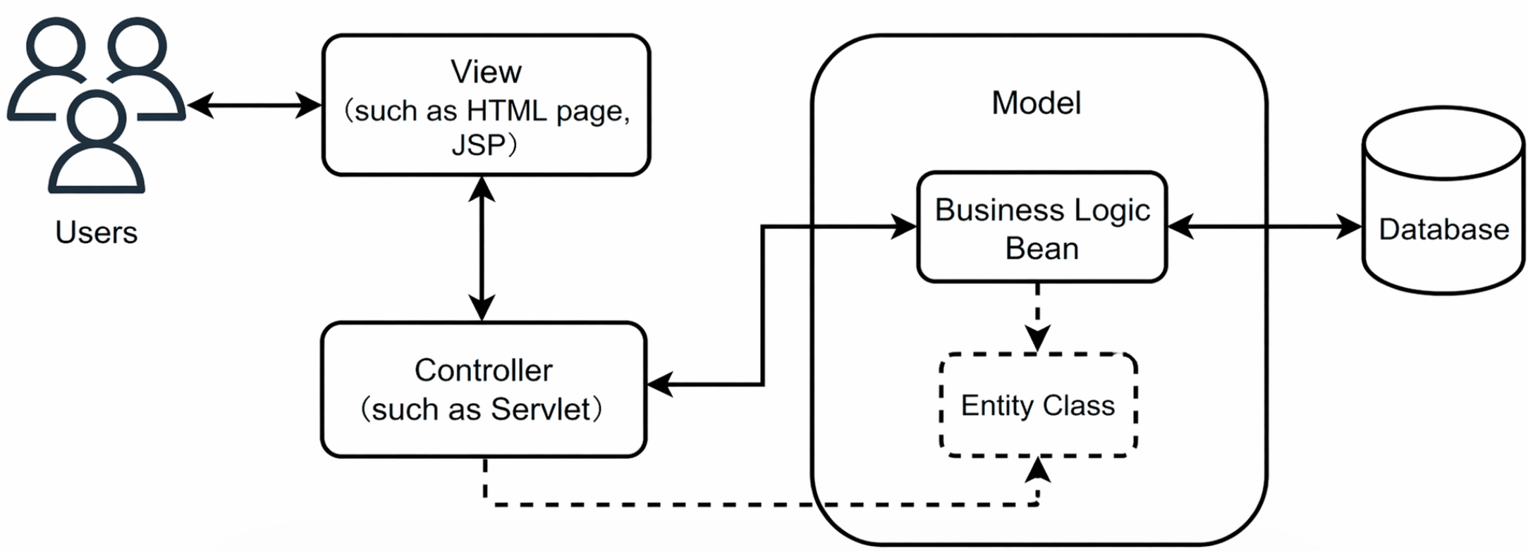
5.1 Introduction to Spring MVC
The MVC (Model-View-Controller) pattern is a widely used software design pattern for organizing the code and functionality of an application, dividing the application into three core parts: Model, View, and Controller.

Slide 8
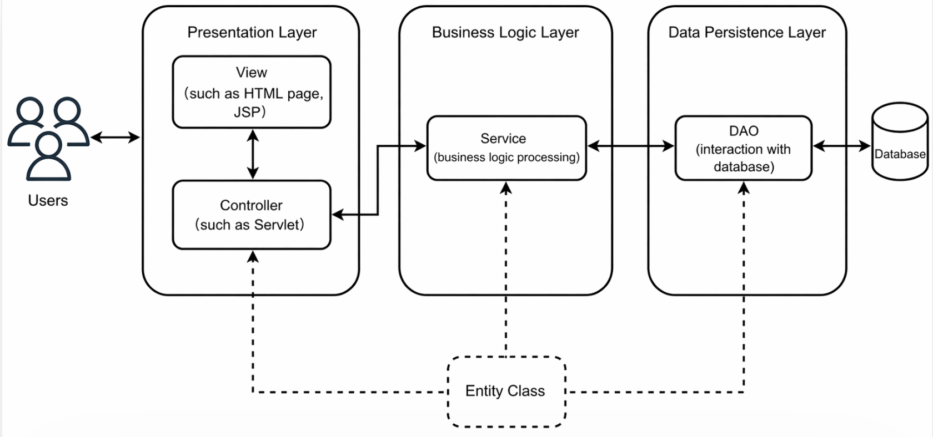
5.1 Introduction to Spring MVC
In Java EE development, the system's classic three-tier architecture includes the presentation layer, the business logic layer, and the data access layer. Among them, the presentation layer is equivalent to the combination of views and controllers in the MVC pattern, which is responsible for receiving client requests and responding to the results from the client; The business logic layer is responsible for handling the business logic and is closely related to the project requirements; The data access layer is responsible for interacting with the database and performing add, delete, modify and query operations on database tables.

Slide 9
5.1 Introduction to Spring MVC
Spring MVC is a lightweight Web framework based on the MVC design pattern. It is a module of the Spring framework, officially known as Spring Web MVC, and is commonly referred to as Spring MVC. Spring MVC simplifies the development process of Web applications by providing a set of classes and interfaces that implement the MVC pattern, and by leveraging features such as Spring's dependency injection and aspect-oriented programming, allowing developers to write more modular and maintainable Web applications.

Slide 10
5.1 Introduction to Spring MVC
Components commonly used in Spring MVC
Components | Instructions
DispatcherServlet | The front-end controller is the center of control for the entire Spring MVC process, responsible for uniformly handling requests and responses and invoking other components to handle user requests
HandlerMapping | The processor mapper finds the corresponding processor based on information such as the requested URL, HTTP method, etc
Handler | A processor is a component of business logic that handles requests. The processor processes specific requests under the dispatch of the DispatcherServlet
HandlerAdapter | The processor adapter is responsible for adapting requests to the corresponding processor to handle the requests
ViewResolver | The View resolver resolves the logical View name into a physical view name, then generates the view object, and finally renders the View object to display the processing result to the user through the page
View | A view, often using page tags or page template techniques, presents model data to a user through a page

Slide 11
5.1 Introduction to Spring MVC
Powerful data validation and binding mechanisms
Integrate the advantages of the Spring framework
With flexible data validation, formatting, and binding mechanisms, it supports data binding for any object without implementing the API of a specific framework
As a spin-off of the Spring framework, it can seamlessly integrate all the features of the Spring framework
Support internationalization
Easy to use
Spring MVC
Features
Support internationalization and be able to display different languages based on the user's region Settings
It is simple and intuitive to use, allowing developers to easily design clear and tidy Web layers
Flexibly request resource mapping policies
Support multi-view technology
A variety of mapping strategies for requesting resources are provided to meet the needs of different business scenarios and enhance the flexibility and scalability of the system
Support multiple view technologies, including JSP, Velocity, FreeMarker, etc

Slide 12
Spring MVC starter program
5.2

Slide 13
5.2 Spring MVC Getting Started Program
Set a small goal first!
Set a small goal first!
A starter program that can independently implement Spring MVC

Slide 14
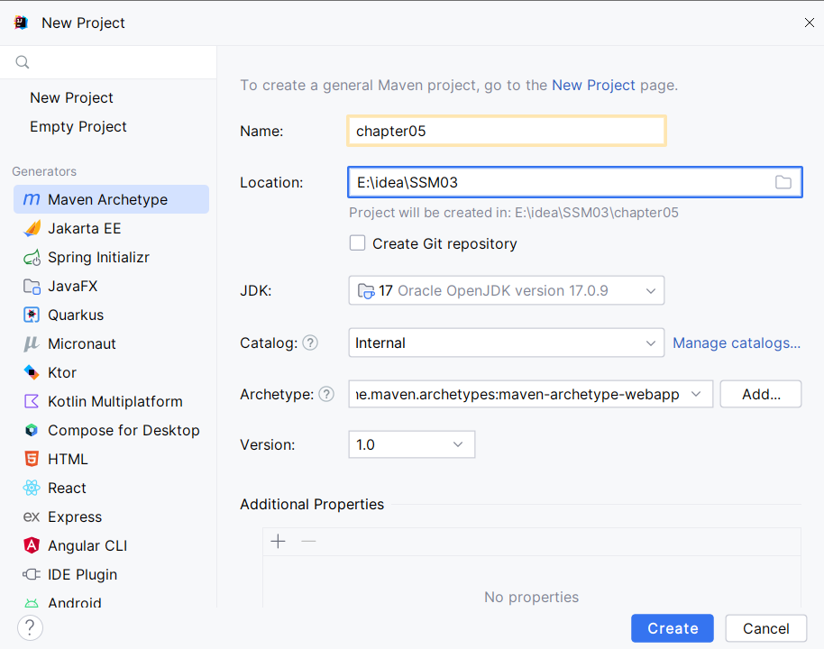
5.2 Spring MVC Starter Program
1. Create a project
After selecting Maven Archetype in the New Project interface in IDEA, choose the corresponding Archetype and enter the basic information of the project.

Slide 15
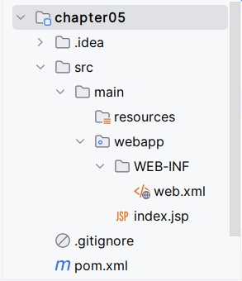
5.2 Getting Started with Spring MVC
1. Create a project
After chapter05 of the project is created, the directory structure of the project is as shown in the figure.

Slide 16


5.2 Getting Started with Spring MVC
2. Introducing dependencies
Introduce Spring MVC dependencies in the project's pom.xml file, as shown in File 5-1.
Source code
File 5-1
pom.xml

Slide 17
5.2 Getting Started with Spring MVC
3. Configure the front-end controller
The DispatcherServlet is essentially a Servlet that can be configured and mapped in a web.xml file, the specific configuration of the web.xml file is shown in file 5-2.
Source code
File 5-2
web.xml

Slide 18
5.2 Getting Started with Spring MVC
4. Configure the processor mapping information and view parser
Create the Spring MVC configuration file spring-mvc.xml in the resources folder of the project to configure the processor mapping information and view parser. The specific configuration of spring-mvc.xml is shown in file 5-3.
Source code
File 5-3
spring-mvc.xml

Slide 19
5.2 Getting Started with Spring MVC
5. Create a processor
Create the package com.itheima.controller in the src/main/java directory of the project. In this package, create the processor FirstController class to handle client requests and specify the page to jump to in response. The details of the FirstController class are shown in File 5-4.
Source code
File 5-4
FirstController.java

Slide 20
5.2 Getting Started with Spring MVC
6. Create a view page
Create a folder named pages under the webapp folder of the project, and create a jsp file named success under the pages folder for displaying the view after the client request has been processed. The success.jsp file is shown in File 5-5.
Source code
File 5-5
success.jsp

Slide 21
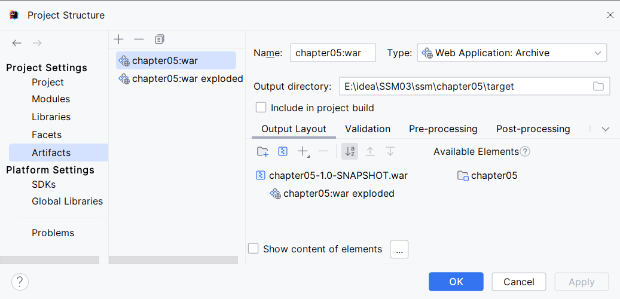
5.2 Getting Started with Spring MVC
7. Modify the name of the project deployment
This project is a Web project, and here you choose to run the project in your local Tomcat. Click File in the IDEA toolbar → Project Structure... The option pops up the Project Structure dialog box. After selecting Artifacts in the Project Structure dialog box, display the Artifacts interface information.

Slide 22
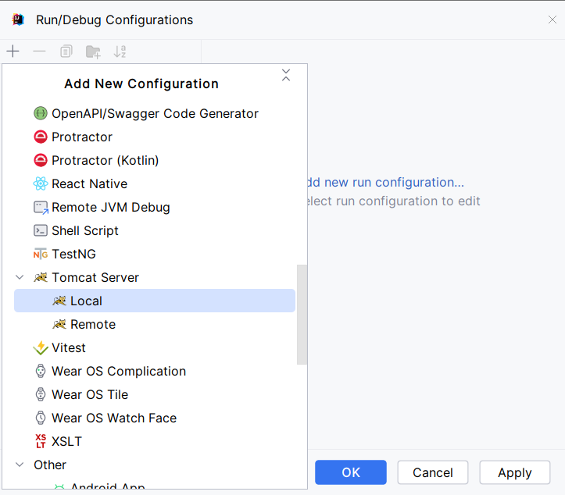
5.2 Spring MVC Starter Program
7. Modify the name of the project deployment
Click "Run" → "Edit Configurations..." on the IDEA toolbar. Options pop up the Run/Debug Configurations dialog box. Click the button in the upper left corner of the Run/Debug Configurations dialog box to bring up the Add New Configurations menu list.

Slide 23
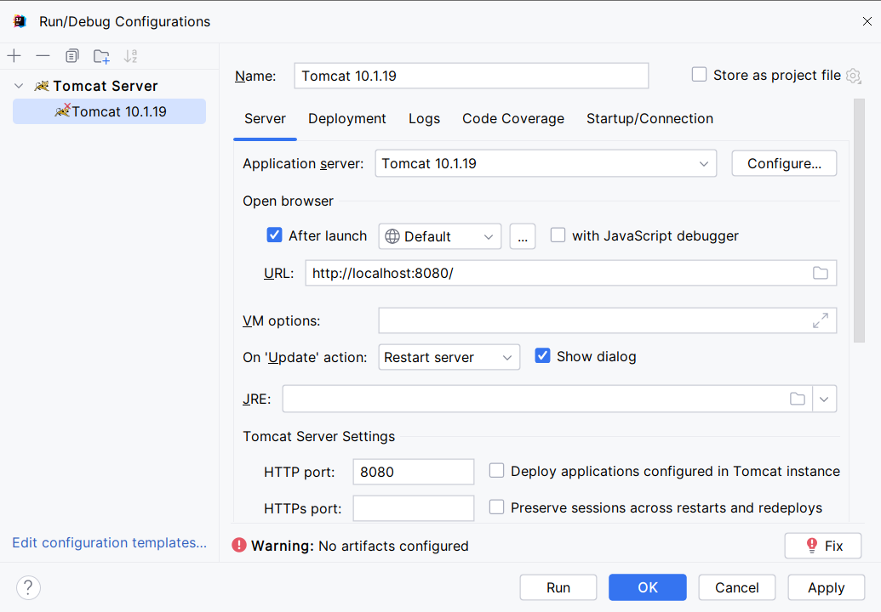
5.2 Spring MVC Starter Program
7. Modify the name of the project deployment
In the menu list, click the Local option of Tomcat Server in the left menu to enter the configuration interface for running the project using the local Tomcat.

Slide 24
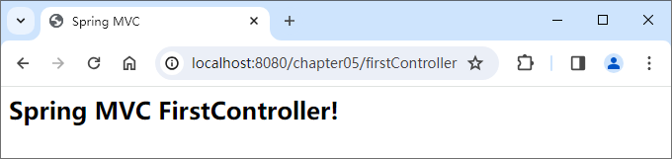
5.2 Spring MVC Starter Program
8. Test results
In the toolbar using the configuration of Tomcat startup project, after the success of the start, in the browser to access the address http://localhost:8080/chapter05/firstController.

Slide 25
5.3
The execution flow of Spring MVC

Slide 26
5.3 Spring MVC Execution Flow
Set a small goal first!
Set a small goal first!
Get familiar with the execution process of Spring MVC

Slide 27
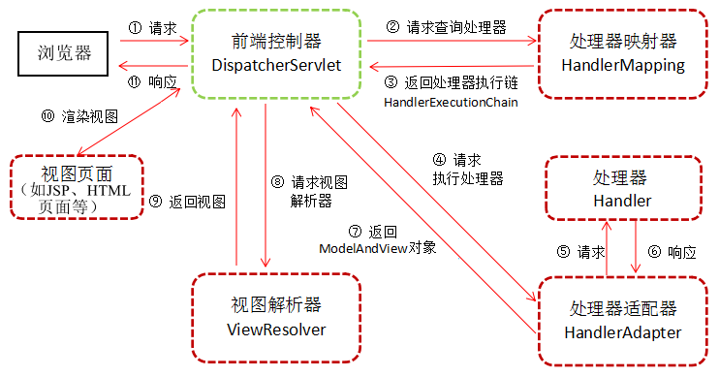
5.3 Spring MVC Execution Flow

Slide 28
5.4
Request mapping in Spring MVC

Slide 29
5.4 Request Mapping in Spring MVC
In Web development, effectively connecting client-side requests with server-side business processing logic is the key to achieving efficient and accurate responses. Spring MVC provides a flexible and powerful request mapping mechanism that allows developers to map requests based on URL patterns, HTTP methods, request parameters, and more. By configuring the request mapping, requests can be routed correctly to the corresponding processors, enabling precise execution of business logic. Request mapping in Spring MVC is typically implemented based on the @Controller annotation and the @RequestMapping annotation. The following explains the implementation of request mapping with these two annotations.

Slide 30
5.4.1 @Controller Annotation
Set a small goal first!
Set a small goal first!
Master the use of the @Controller annotation and be able to annotate processor classes with the @Controller annotation

Slide 31
5.4.1 @Controller Annotation
In the execution flow of Spring MVC, the DispatcherServlet forwards requests to the processor for processing. For ease of development, Spring provides the @Controller annotation to identify the processor class (also known as the controller class) of Spring MVC. When the program is scanned through Spring's scanning mechanism, it can automatically identify and register these classes identified by the @Controller annotation, making them Spring MVC controllers for handling client requests and generating responses.

Slide 32
5.4.1 @Controller Annotation
Sample code for processor classes based on the @Controller annotation is as follows.
import org.springframework.stereotype.Controller;
...
@Controller // annotate @Controller annotations
public class FirstController{
...
}

Slide 33
5.4.1 @Controller Annotation
To ensure that Spring MVC can find the processor class, it is usually necessary to add the corresponding component scanning configuration information in the configuration file of Spring MVC. First, a spring-context declaration needs to be introduced into the namespace of the configuration file to support the use of the <context:component-scan> tag in the configuration file; Then specify the class package to be scanned by Spring through the <context:component-scan> tag. This ensures that Spring MVC can correctly scan and register the controller classes in the application so that they can be properly managed and invoked by the framework, as shown below.
<context:component-scan base-package="com.itheima" />

Slide 34
5.4.2 @RequestMapping annotation
Set a small goal first!
Set a small goal first!
Master the use of the @RequestMapping annotation, and be able to use the @RequestMapping annotation to establish the mapping relationship between the request URL and the processor

Slide 35
5.4.2 @RequestMapping Annotation
Using the @Controller annotation can declare a regular class as a Spring MVC processor class, but with only the @Controller annotation, the Spring MVC framework cannot determine which method in the processor class is handling the current Web request. For this purpose, the Spring MVC framework provides the @RequestMapping annotation, which is used to establish the mapping relationship between the request URL and the processor. The @RequestMapping annotation can provide the necessary mapping information for the methods of the processor class, This enables the binding of requests and processing methods.

Slide 36
5.4.2 @RequestMapping annotation
The use of 1.@RequestMapping annotations
(1) annotate on the method
When the @RequestMapping annotation is annotated on the method, the method becomes a processor that can handle client requests when the path of the request received by Spring MVC matches the path specified in the @RequestMapping annotation on the method, This method is invoked and executed to handle the request.
The corresponding access address of the processor in the browser consists of the project access path plus the mapping path of the method. If the sayHello() method uses the @RequestMapping annotation to specify its mapping path as "/firstController", it means that the method will handle requests that match the path "/firstController". If the project access path for http://localhost:8080/chapter05, then this method will be used to handle the request at http://localhost:8080/chapter05/firstController.

Slide 37
5.4.2 @RequestMapping annotation
(2) annotate on the class
When the @RequestMapping annotation is annotated on a class, the mapping path specified in the @RequestMapping annotation is equivalent to the namespace of the current processor class, which is required to access any method under that processor class. When mapping paths are specified both on the class and on the method using the @RequestMapping annotation, the access address of the processor in the browser consists of the project access path + the mapping path on the class + the mapping path on the method.

Slide 38
5.4.2 @RequestMapping Annotation
Annotate the @RequestMapping annotation on the FirstController class, and the modified FirstController class is shown in File 5-6.
Source code
File 5-6
FirstController.java

Slide 39
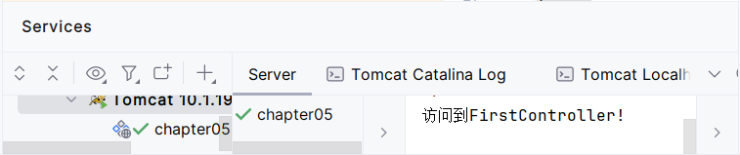
5.4.2 @RequestMapping Annotation
Start the project, visit http://localhost:8080/chapter05/SpringMVC/firstController in the browser, the console output information as shown in the figure below.

Slide 40
5.4.2@RequestMapping annotation
Properties of the 2.@RequestMapping annotation
Property Name | Type | Description
name | String | Optional attribute, used to provide a name for the request mapping, which is primarily used to describe the purpose or function of the request mapping and does not directly affect the processing logic of the request
value | String[] | Optional attribute used to specify the mapping path, that is, the path that matches the requested URL path
path | String[] | Optional property, works in the same way as the value property

Slide 41
5.4.2 @RequestMapping annotation
Property Name | Type | Description
method | RequestMethod[] | Optional properties used to specify what types of HTTP requests the method can handle, including GET, POST, HEAD, OPTIONS, PUT, PATCH, DELETE, and TRACE, etc
params | String[] | Optional attribute used to specify the condition of the request parameter, that is, to specify that the request must contain a particular parameter
headers | String[] | Optional property used to specify the condition of the request header, specifying that certain specified header values must be included in the request for the method to process the request
consumes | String[] | Optional property used to specify the type of request content that the processor method can handle, such as application/json, text/html, etc
produces | String[] | Optional property, used to specify the type of content to be returned, the corresponding method will handle the request and return the corresponding content only if the request's Accept header contains the type specified by this property

Slide 42
5.4.2 @RequestMapping annotation
(1) The value attribute
The value attribute is the default attribute for the @RequestMapping annotation. When the value attribute is the only attribute explicitly used by the @RequestMapping annotation, the attribute name of the value can be omitted. For example, the following two mapping path annotations have the same meaning.
@RequestMapping(value="/firstController")
@RequestMapping("/firstController")

Slide 43
5.4.2 @RequestMapping annotation
When using the value attribute, you can specify the URL path for mapping a single request, or define a list containing multiple mapping addresses for mapping the urls of multiple requests simultaneously, as shown below.
@Controller
public class AuthController {
// Define the list of mapping addresses
@RequestMapping(value = {"/addUser","/deleteUser"})
public void checkAuth(){
System.out.println(" add/delete operation check ");
}
}

Slide 44
5.4.2 @RequestMapping Annotation
(2) The method property
The method attribute can be used to qualify the HTTP request method of the request. If the requested URL is successfully mapped to the processor but the actual HTTP request method does not match the method specified by the method attribute, then the processor method will not be invoked. If the value of the method attribute is not specified, the processor method can handle all HTTP request methods.

Slide 45
5.4.2 @RequestMapping annotation
The following demonstrates the declaration of the HTTP request type in the method property through a case. Create the MethodController class under the controller package in chapter05 of the project, as shown in File 5-7.
Source code
File 5-7
MethodController.java

Slide 46
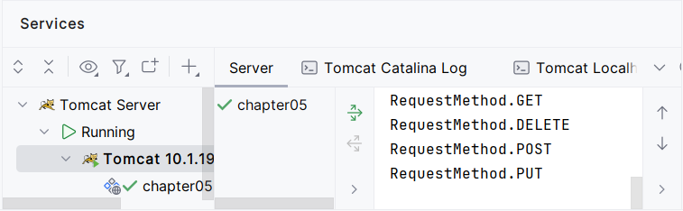
5.4.2 @RequestMapping Annotation
Chapter05 start the project, in order to GET in the Postman, DELETE, POST and PUT methods to http://localhost:8080/chapter05/method, the console output information as shown in figure 5-12.

Slide 47
5.4.2 @RequestMapping annotation
If you need to support multiple types of HTTP request methods at the same time, you need to store the corresponding list of request methods in curly braces, assign values to the method property as an array, and separate multiple request methods with commas, as shown below.
@RequestMapping(value = "/method",
method = {RequestMethod.GET,RequestMethod.POST})
public void getAndPost() {
System.out.println("RequestMethod.GET+RequestMethod.POST");
}

Slide 48
5.4.2 @RequestMapping Annotation
(3)params attribute
Values defined in the params attribute can narrow down the location range of the request mapping. When the client makes a request, if the value of the request parameter is equal to the value defined by the params attribute, the mapped method can be executed normally; otherwise, the mapped method does not execute. An example of how params attribute values are defined is shown.
1@Controller
2public class ParamsController {
3 @RequestMapping(value = "/params",params = "id=1")
4 public void findById(String id) {
5 System.out.println("id="+id);
6}
7}

Slide 49
5.4.3 URL path mapping methods
Set a small target first!
Set a small goal first!
Master the definition of URL path mapping, be able to define URL path mapping based on request methods, URL path mapping based on Ant style, and mapping for defining Spring MVC controllers based on REST style

Slide 50
5.4.3 URL Path Mapping methods
1. URL path mapping based on the request method
In addition to limiting the requested method through the method property of the @RequestMapping annotation, starting from Spring 4.3, you can also use composite annotations to limit the requested method. Composite annotations simplify the mapping of commonly used HTTP request methods and better express the semantics of the annotated methods.
The combined annotations used by Spring MVC to handle requests and qualify the requested methods are as follows.
①@GetMapping: Requests that match HTTP-based GET methods
②@PostMapping: A request that matches the HTTP-based POST method
③@PutMapping: Matching requests for HTTP-based PUT methods
④@DeleteMapping: A request that matches an HTTP-based DELETE method
⑤@PatchMapping: Matches requests for the HTTP-based PATCH method

Slide 51
5.4.3 URL path mapping methods
Using a combined annotation instead of the @RequestMapping annotation can simplify the code by omitting the method attribute. The following uses @GetMapping as an example to explain how to use the combined annotation. @GetMapping is an abbreviation for @RequestMapping(method = RequestMethod.GET), and an example of using the @GetMapping annotation is shown below.
1@GetMapping(value="/firstController")
2public void sayHello(){
3 // logical code
4}

Slide 52
5.4.3 URL path mapping methods
2. URL path mapping based on Ant style
Spring MVC supports Ant-style URL path mapping, which is essentially a wildcard style that associates accessed URL paths using wildcards in processor-mapped paths. There are three types of Ant-style wildcards.
(1)? : Match any single character.
②* : Matches any number of characters.
③** : Match any number of directory levels.

Slide 53
5.4.3 URL path mapping methods
Path matching for Ant-style wildcards
Wildcards | URL path example | Example Instructions
? | /ant1? | Match the /ant1[anyone] path under the project root path, where [anyone] can be any single character, that is, there is exactly one character after /ant1, such as /ant12, /ant1a
* | /ant2/*.do | Match the /ant2/[any].do path under the project root path, where [any] can be any number of characters such as /ant2/findAll.do, /ant2/a.do

Slide 54
5.4.3 URL path mapping methods
Wildcards | URL path example | Example Instructions
** | /**/ant4 | Match the /[anypath]/ant4 path under the project root path, where [anypath] can be any number of directory hierarchies. Such as /ant4, /a/ant4, /a/b/ant4
** | /ant5/** | Match the /ant5/[anypath] path under the project root path, where [anypath] can be any number of directory hierarchies. Such as /ant5, /ant5/a, /ant5/a/b

Slide 55
5.4.3 URL path mapping methods
3. URL path mapping based on RESTful style
REST (Representational State Transfer, representational state transfer) is a style of access to web resources used to standardize the way web resources are accessed. RESTful is a practice of accessing web resources in the style of REST, emphasizing the use of HTTP methods (such as GET, POST, PUT, DELETE, etc.) to manipulate resources and adhering to principles such as statelessness and a unified interface. For example, the URL format for traditional-style access is as follows.
http://... /findUserById? id=1
After adopting the RESTful style, the URL format it accesses is as follows.
http://... /user/id/1

Slide 56
5.4.3 URL path mapping methods
In RESTful style HTTP requests, four basic request operations are represented by four verbs: GET, POST, PUT, and DELETE. Among them, GET is used to retrieve the resource; POST is used to create a new resource; PUT is used to update resources; DELETE is used to delete a resource.
URL path | Request Method | Instructions
http://localhost:8080/chapter05/user/1 | HTTP GET | Get parameter 1 to perform the query user operation
http://localhost:8080/chapter05/user/1 | HTTP DELETE | Get parameter 1 to delete the user
http://localhost:8080/chapter05/user/1 | HTTP PUT | Get parameter 1 to update the user operation
http://localhost:8080/chapter05/user | HTTP POST | Add user operations
Four agreed-upon ways of making requests in the RESTful style

Slide 57
Summary of this chapter
This chapter provides an overall overview of the basics of Spring MVC. A brief introduction to the Spring MVC framework is given first; Then the Spring MVC starter program was explained; Then a detailed explanation of the Spring MVC execution process through the starter program; Finally, the request mapping of Spring MVC was explained. Through the study of this chapter, readers can have a general understanding of the Spring MVC framework and lay the foundation for further study of Spring MVC.

