Slide 1
Why Are Australians Being Hospitalised for Preventable Conditions?
A data-driven analysis of geographic, socioeconomic & Indigenous health gaps
Notes:
1

Slide 2
The Problem
Every year, over 160,000 hospital bed days are consumed by conditions that never needed to reach a hospital. These aren't accidents — they're a signal that our primary care system isn't reaching everyone equally.
160,000+ bed days lost to preventable conditions (Indigenous Australians)
31 Primary Health Networks across Australia studied
Some remote regions have PPH rates 15× higher than cities
Notes:
2

Slide 3
Research Questions
Which factors — geography, poverty, or health service access — best predict preventable hospitalisations across Australia?
Once an Indigenous Australian is admitted for a preventable condition, which factors — clinical diagnosis, category, or demographics — best predict the length of stay (bed-day burden)?
Notes:
2

Slide 4
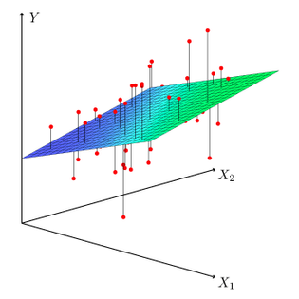
Data & Methods - Australian Institute of Health and Welfare:
Covers all 31 Australian Primary Health Networks (PHNs)
Data Disparities in potentially preventable hospitalisations across Australia, 2012-13 to 2017-18
Variables: PPH rate, remoteness, SEIFA socioeconomic ranking, Indigenous health check uptake
Regional variation in uptake of Indigenous health checks and in preventable hospitalisations and deaths supplement
Table A1: Crude rates of PPH (2013–14 to 2015–16 pooled), PAD (2012 to 2016 pooled) and Indigenous health checks (2014–15), by Primary Health Network (PHN)
Notes:
2

Slide 5
Data & Methods - Australian Institute of Health and Welfare:
Covers all 31 Australian Primary Health Networks (PHNs)
Model 1 (The Access Model): Multiple Linear Regression (OLS) to analyze regional drivers (PHN level).
Model 2 (The Resource Model): Random Forest Machine Learning to predict Average Length of Stay for indigenous people based on clinical conditions.
Notes:
2

Slide 6
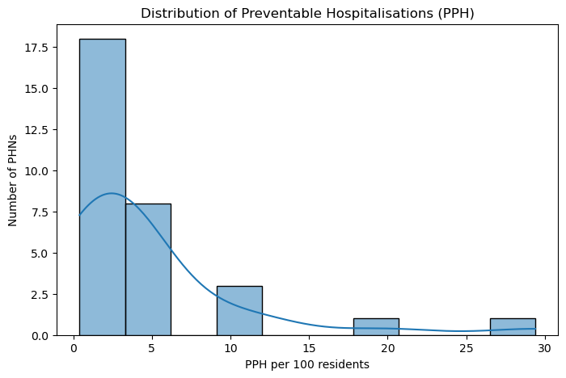
The National Picture: Most PHNs Are Fine — But Not All
Notes:
2

Slide 7
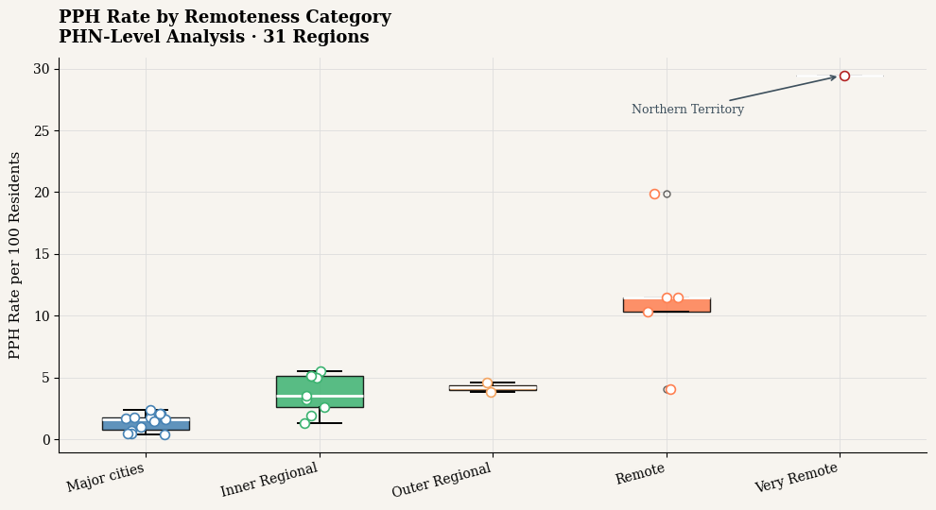
Geography as the First Suspect: The Remoteness Gap
Notes:
2

Slide 8
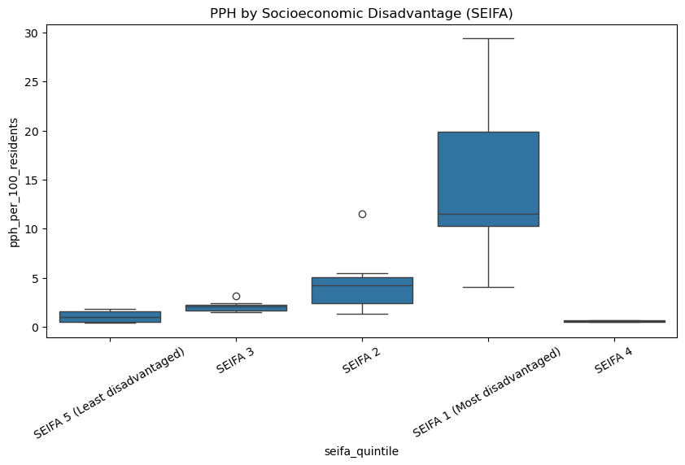
Poverty Makes It Worse: The Socioeconomic Staircase
Notes:
2

Slide 9
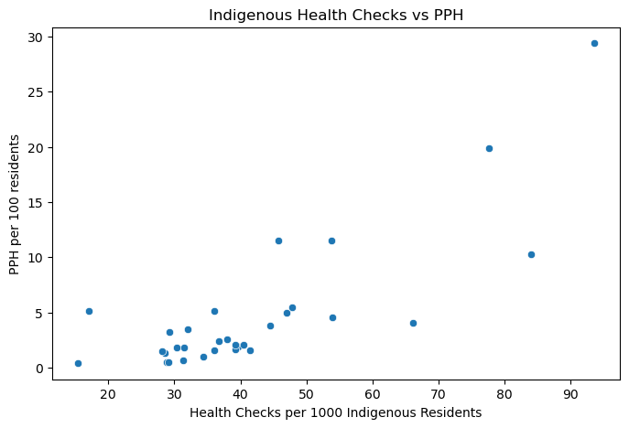
The Health Checks Paradox — More Checks, More Admissions?
Notes:
2

Slide 10
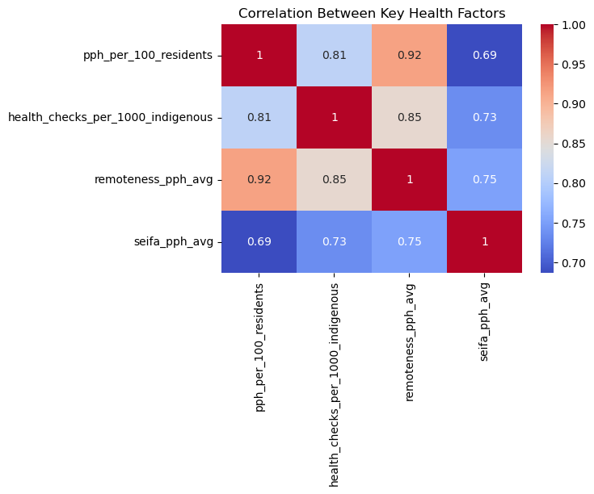
Everything Is Connected — Why We Need a Model
Notes:
2

Slide 11
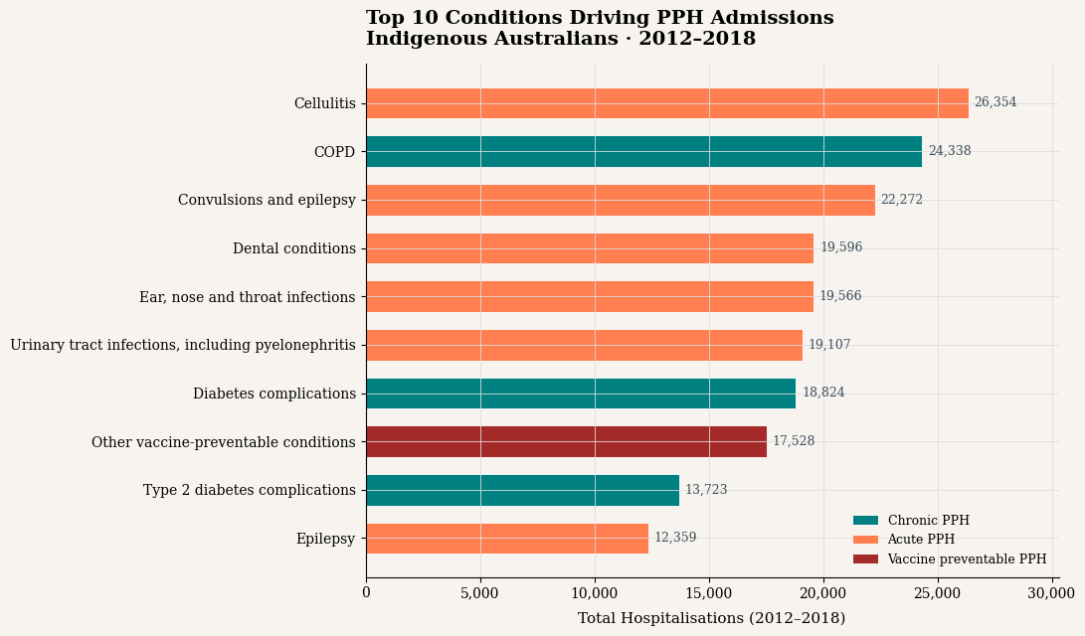
Where the Beds Are Being Filled: Top 10 Clinical Conditions
Notes:
2

Slide 12
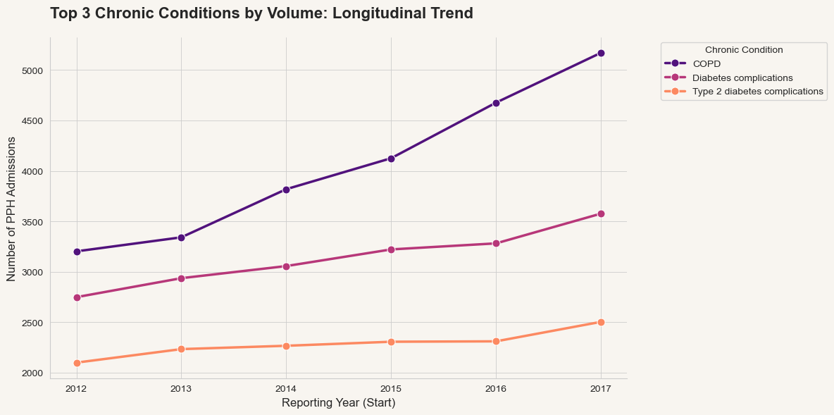
A Worsening Trend: Chronic Conditions Are Rising Year on Year
Notes:
2

Slide 13
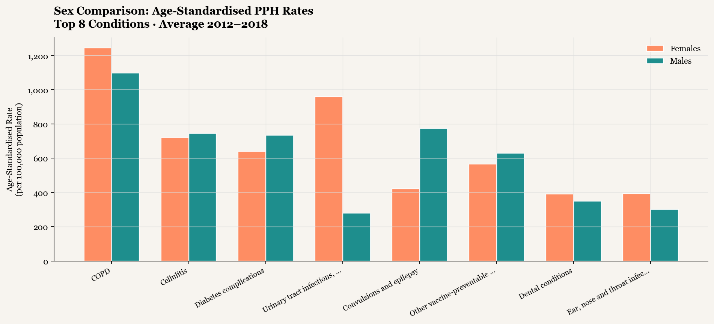
A Gender Gap — But Not the One You'd Expect
Notes:
2

Slide 14
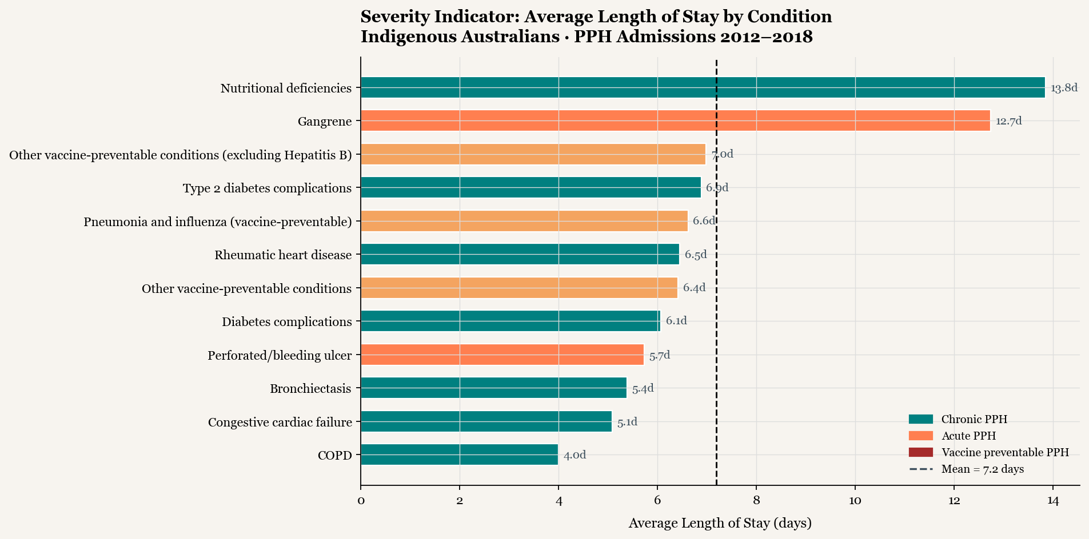
Average length of stay by condition
Notes:
2

Slide 15
Framing the Data Responsibly: A Note on What These Numbers Mean
Aboriginal & Torres Strait Islander module
High PPH rates are evidence of a system access failure, not a community failure
Notes:
2

Slide 16
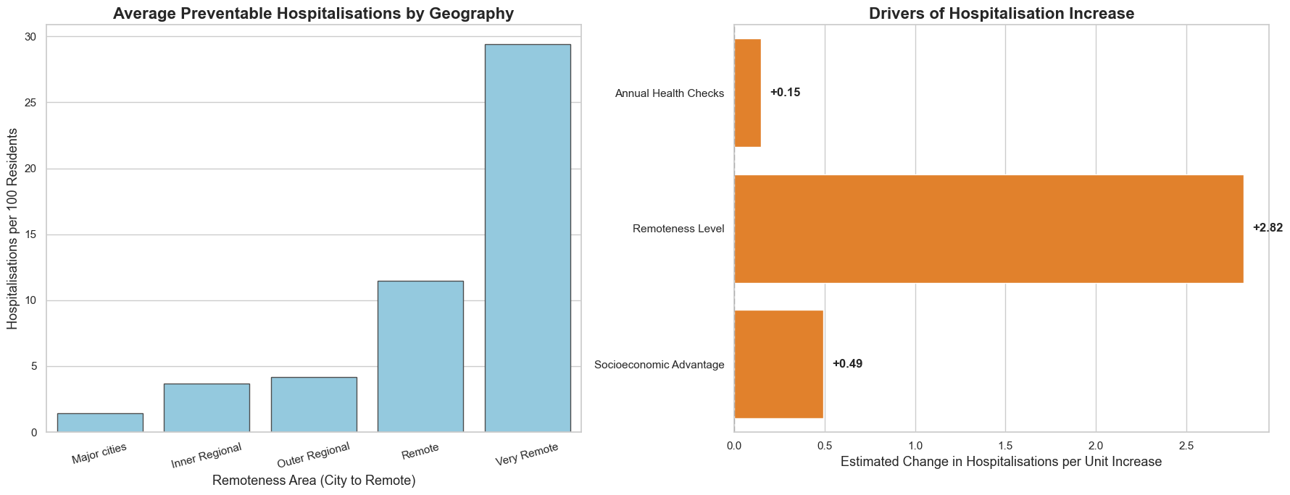
What Our Model Tells Us: Model 1
Remoteness Level: +2.82 (dominant driver)
Socioeconomic Advantage: +0.49
Annual Health Checks: +0.15
Model reliability: R² = 74%
Notes:
2

Slide 17
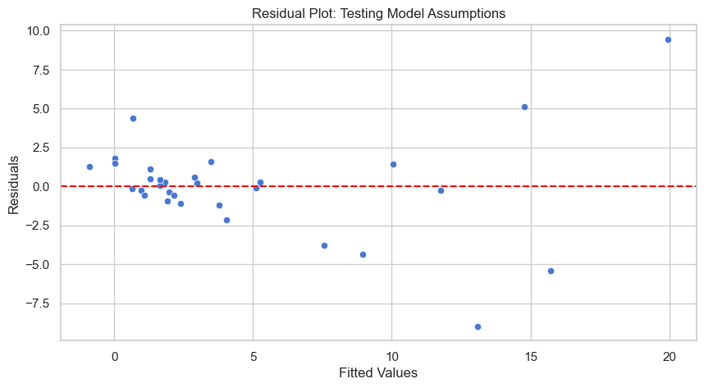
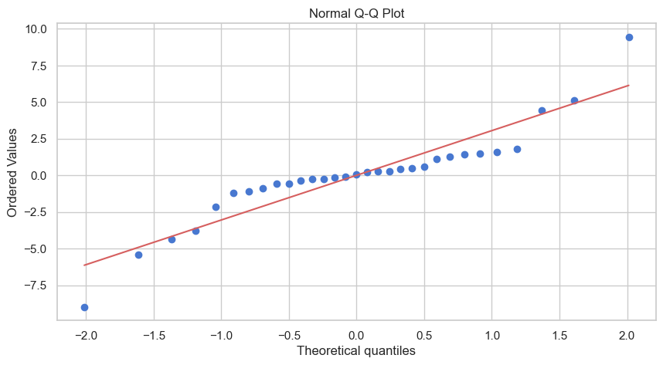
Is Our Model Trustworthy? Testing the Assumptions
Notes:
2

Slide 18
Is Our Model Trustworthy? Testing the Assumptions
Notes:
2

Slide 19
Predicting Bed Demand
Notes:
2

Slide 20
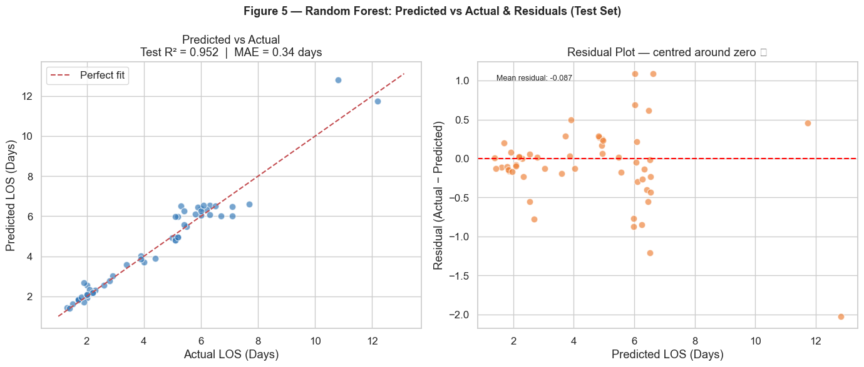
Advanced Analytics: Random Forest Results
Accuracy: 95.2%
MAE = 0.44 days
On average, predictions are within half a day of actual LOS
Notes:
2

Slide 21
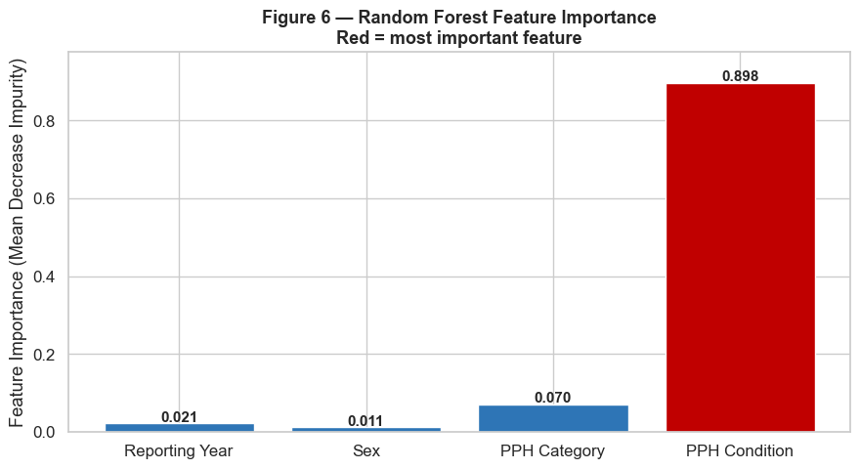
What Truly Matters? (Feature Importance)
Notes:
2

Slide 22
Recommendations for Decision Makers
1. Bridge the distance gap: fund telehealth, mobile clinics, and regional urgent care hubs in remote PHNs
2. Scale vaccination: culturally safe, community-led immunisation programs targeting the 14,000 vaccine-preventable admissions
3. Focus on nutritional deficiencies (13.9-day avg. stay) and gangrene to save the most bed capacity.
4. Scale Culturally Safe Prevention: Prioritize community-led vaccination for the 17,500 annual avoidable admissions.
5. Integrated Chronic Care: Fund integrated programs for COPD, the fastest-rising drivers of system burden.
Notes:
2

Slide 23
Limitations
Small n = 31 PHNs (limits statistical power)
Cross-sectional data: no causal direction proven
PHN to SEIFA/remoteness mapping was manually assigned
Multicollinearity between remoteness and health checks noted
Variables were drawn from different reporting years, creating temporal mismatch
Notes:
2

Slide 24
Conclusion
Your postcode shouldn't determine your health outcomes, but right now, it does :(
Notes:
2

Slide 25

Notes:
2

