Slide 1
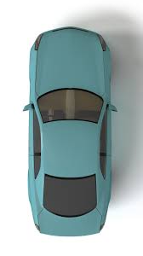




Camera
Lane 2 Flashing
Lane1 Flashing
Lane3 Flashing
From 4 to 5 mt
From 4 to 5 mt
lane3
lane2
lane1
3.75 mt
3.75 mt
3.75 mt
Case 1

Slide 2




Camera
Around 2 mt from
Camera to Flasher 2
Lane 2 Flashing
Lane1 Flashing
Lane3 Flashing
LCS
LCS
LCS
lane3
lane2
lane1
3.75 mt
3.75 mt
3.75 mt
Case 2

