Slide 1
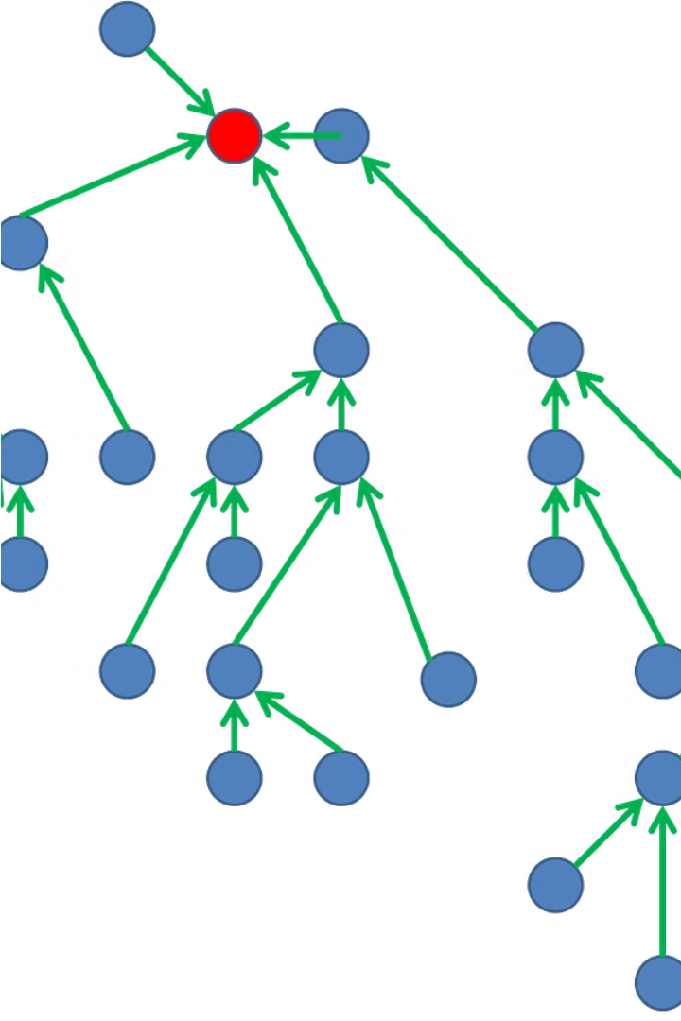
Term Project,
|GT |KNN |
Document Classification
Presented By:
2021-CS-80 2021-CS-101

Slide 2
Objective:
1
Leverage Graph Theory
2
Improve KNN Performance
3
Advance Document Understanding
Explore how graph theory can be used to enhance document classification tasks.
Investigate how graph-based features can boost the accuracy of the KNN algorithm.
Gain deeper insights into the relationships between documents through graph-based analysis.

Slide 3
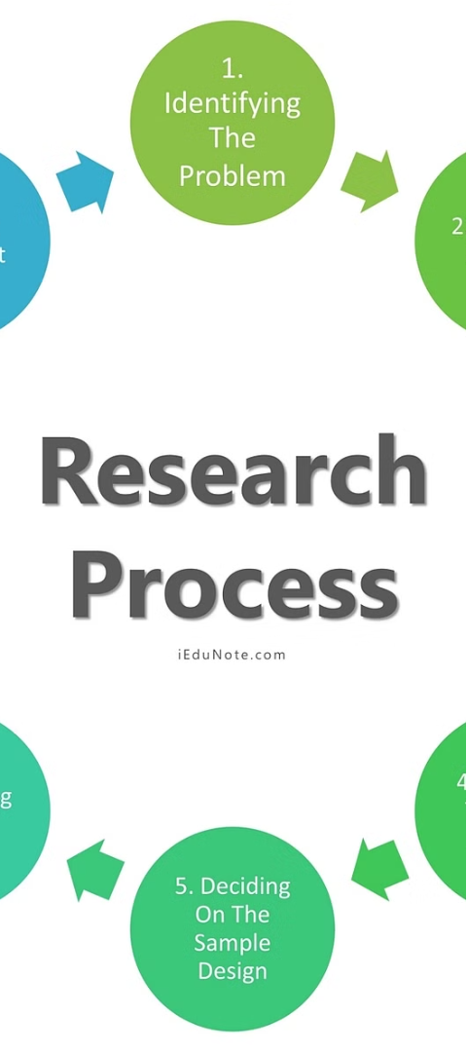
Methodology
1
Data Collection
Gather a diverse corpus of text documents for the classification task.
2
Graph Construction
Build a graph representation of the document relationships using techniques like co-occurrence and citation analysis.
3
Feature Extraction
Extract graph-based features such as centrality, clustering, and community structure to augment the document representations.

Slide 4
Application of Graph Theory to Document Classification
Graph Representation
Graph-based Features
KNN C lassification
We model the document corpus as a graph, where each document is a node, and the edges represent relationships between documents (e.g., co-citation, co-occurrence).
We extract various graph-based features, such as centrality measures, community detection, and structural hole analysis, to capture the importance and relationships of each document.
We incorporate the graph-based features into the KNN algorithm to improve the accuracy of document classification, leveraging the insights provided by the graph representation.

Slide 5
Challenges and Limitations
Scale and Complexity
Data Quality and Noise
Handling large-scale document corpora and the computational complexity of graph-based analysis can pose challenges.
Ensuring the reliability and consistency of the document relationships represented in the graph is crucial for accurate classification.
Interpretability
Generalization
Balancing the performance gains from graph-based features with the interpretability of the classification model is an important consideration.
Ensuring the approach generalizes well to diverse document domains and classification tasks is an ongoing research focus.

Slide 6



Results and Findings
Improved Accuracy
Deeper Insights
Scalability Challenges
The graph-based features significantly enhanced the performance of the KNN algorithm, achieving higher classification accuracy compared to traditional methods.
The graph representation provided valuable insights into the relationships and hierarchies within the document corpus, aiding in the interpretation of classification decisions.
Scaling the graph-based analysis to large-scale document collections required careful optimization and resource management to maintain computational efficiency.

Slide 7


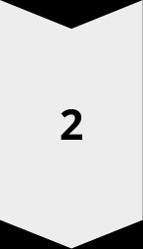

Conclusion and Future Work
Conclusion
Our project has demonstrated the potential of leveraging graph theory to enhance document classification tasks, particularly through the integration of graph-based features into the KNN algorithm.
Future Directions
Exploring more advanced graph-based techniques, expanding the scope to multi-label classification, and investigating the applicability to other domains are promising areas for future research.
Impact
The insights gained from this work can contribute to the broader field of document understanding and knowledge discovery, with applications in areas such as information retrieval, text mining, and digital libraries.

