Slide 1
Virtual Reality Educational game
Assignment 2
By:
- Khaled Bahaa-El-Din (2101397)
- Abdullah Aml (2101398)

Slide 2
Project description.
The project is mainly a virtual reality educational game based on topics in a course.
The actors in the system are:
1. Instructors 2. Students 3. Admins
The software targets 2 perspectives:
System dashboard: Where the instructors, students can communicate with each other and get latest news.
Game system: The software used inside the game.

Slide 3
Project description.
At the beginning of the semester, students register the course through the dashboard system.
Once their registration request is made, the System Admin ensures that student’s registration is compliant with the laws. If it is, registration is done successfully.
Then, Instructors are notified with the registered students to communicate with them.
Instructors can edit/delete/modify stages within the course (following CRUD metric).
On each modification from the instructor, students are notified by their dashboard.
The game types within the system are (design, exploration, assembly and puzzles).
Each instructor specifies the suitable game type related to their course.
The VR game system is connected to the database that contains details to specific course.

Slide 4
PROBLEM VS SOLUTION
PROBLEM
SOLUTION
Students can’t use their imagination to properly visualize the contents of the demonstrated course chapters
A virtual reality game with 3D figures related to the course can greatly improve the students’ understanding

Slide 5
“Agile methods derive much of their agility by relying on the tacit knowledge embodied in the team, rather than writing the knowledge down in plans”
—Prof. Barry Boehm
Quote

Slide 6
System break-down
01
02
03
04
05
06
Login
Dashboard interactions
MVC architecture
No interaction shall be done on dashboard unless the user is logged in
Unique dashboard for every user type (instructor, student)
The project follows MVC(Model, veiw, controller) design pattern
Different game views
Grading system
Effective communication
Various stages across each course that are updated oftenly by instructors
Intelligent grading systems that grant students live grades upon task completion within a stage
Instructors, students can chat lively

Slide 7
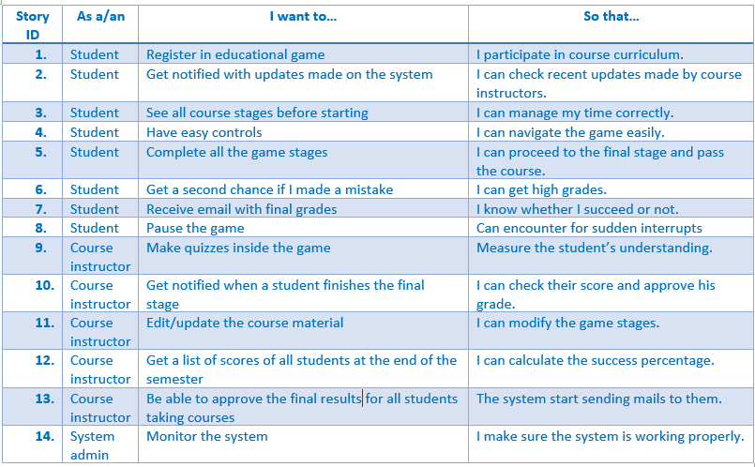
User stories

Slide 8
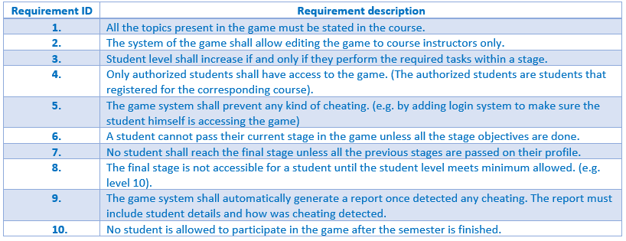
Functional requirements

Slide 9
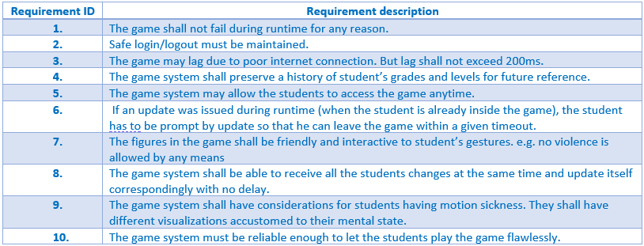
Non-Functional requirements

Slide 10
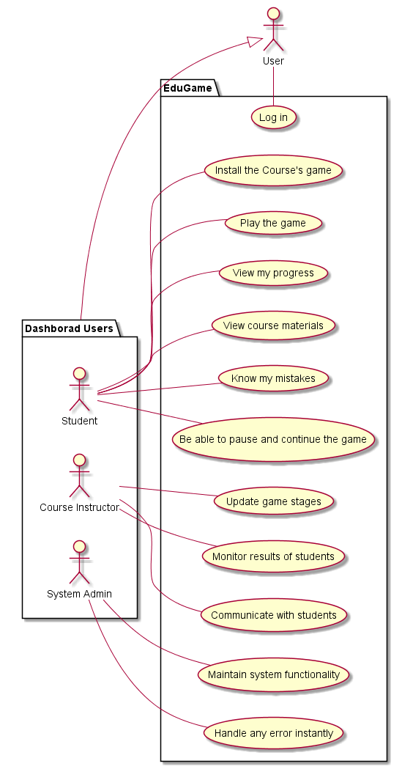
Use case diagram

Slide 11
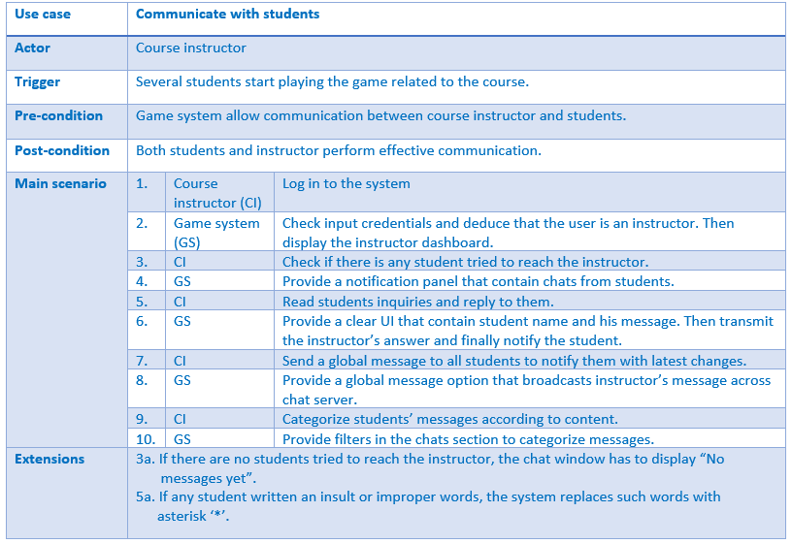
Use case description: Communicate with students

Slide 12
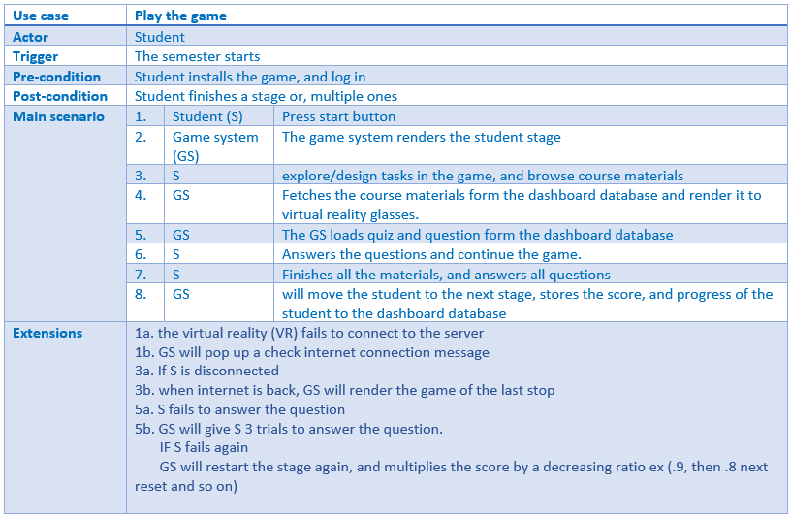
Use case description: Play Game

Slide 13
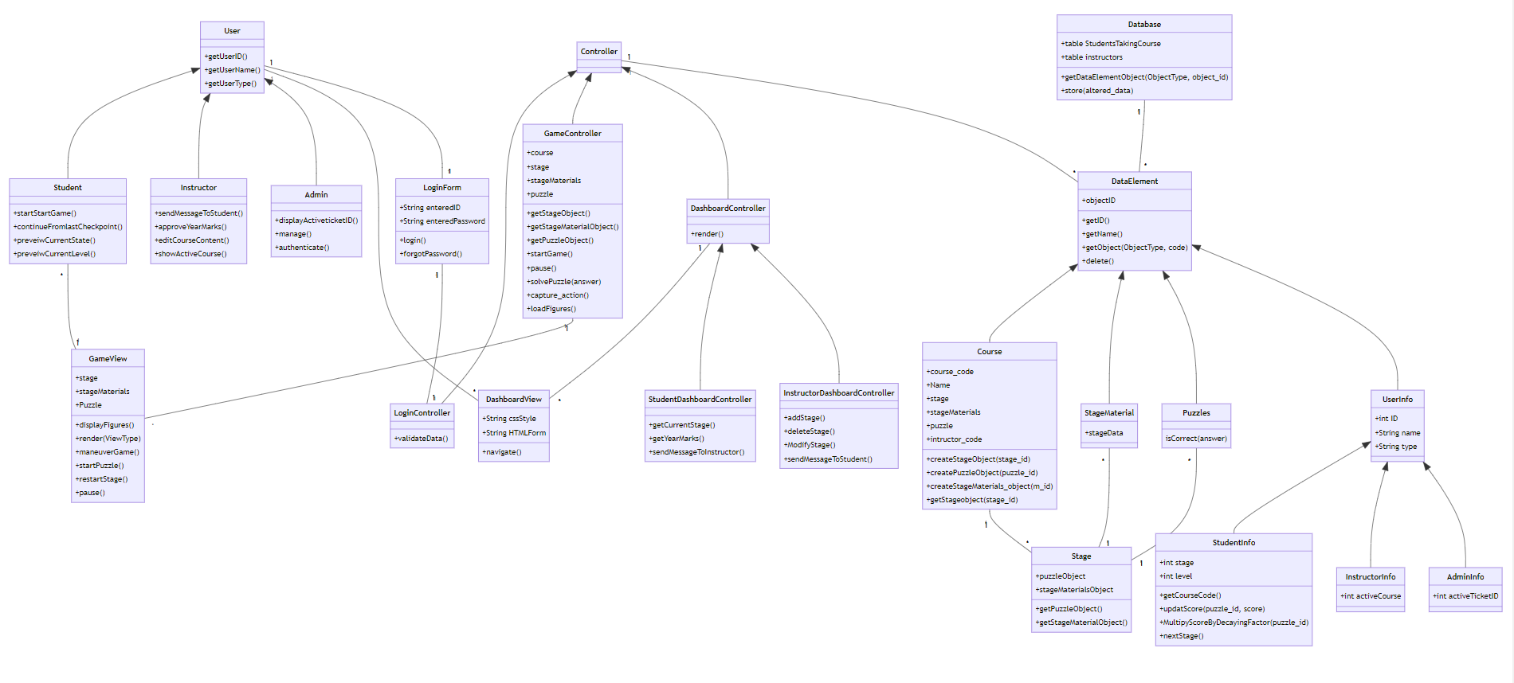
Class diagram

Slide 14
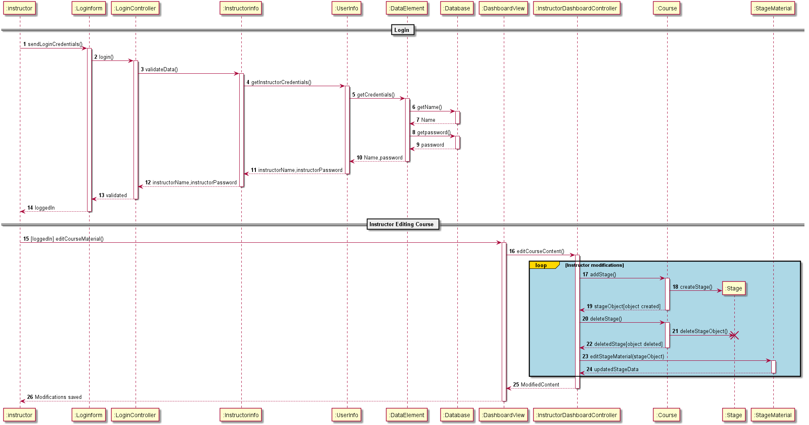
Dashboard sequence diagram

Slide 15
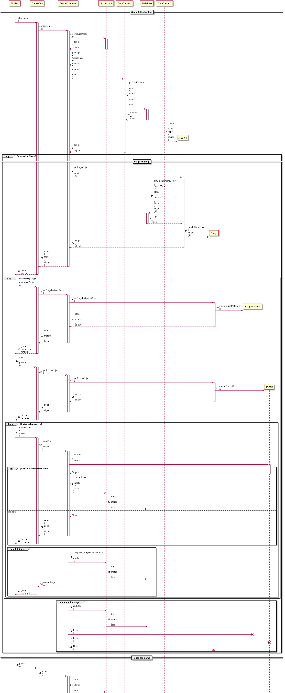
Game sequence diagram
Game sequence diagram: Link

Slide 16
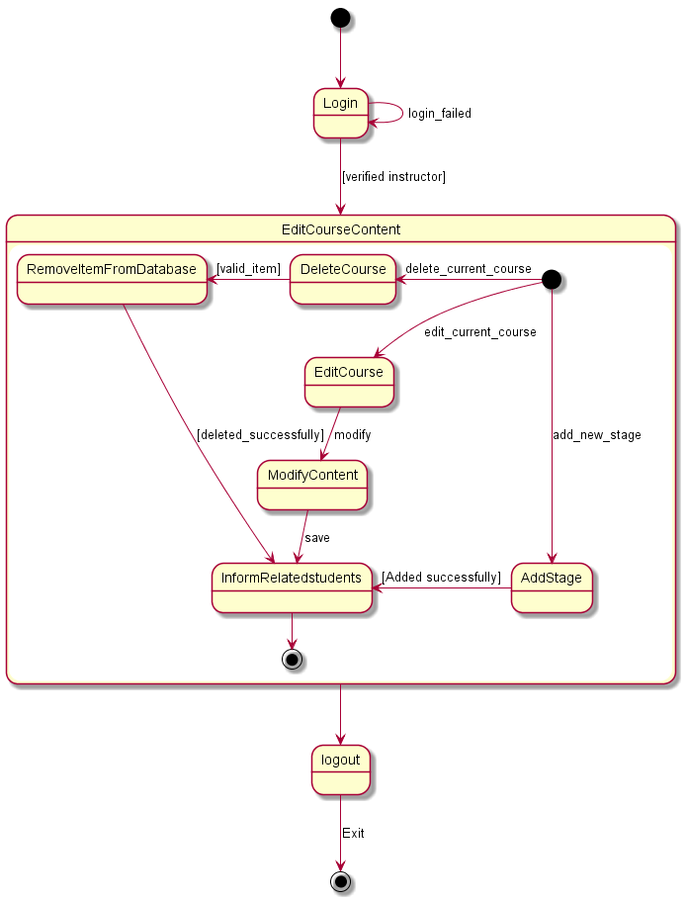
Dashboard state diagram

Slide 17
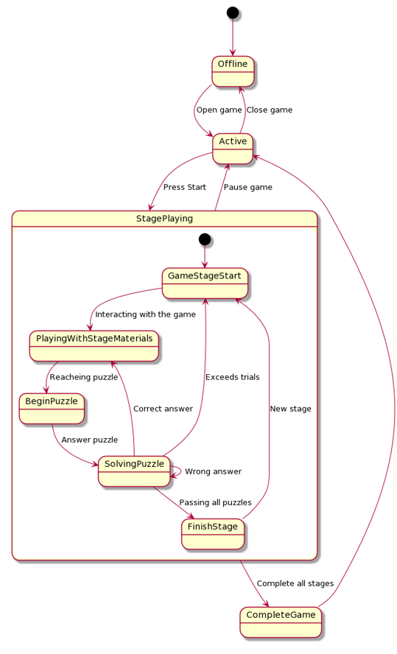
Game state diagram

Slide 18

System actors research

Slide 19

01
Instructor

Slide 20
Instructor research
1
2
3
The instructor age is between 20-40.
The instructor should have material developing experience.
The Instructor should be familiar with technology. If not there will be hand on session to get the instructor ready

Slide 21

02
Student

Slide 22
Student research
1
2
3
The student’s age is between 15-20.
The student is expected to be familiar with smart-phones, and technology, and if not there will be an intro game to make the student familiar with the game.
The student is not supposed to have basic scientific knowledge (can read, write, apply basic mathematical operations

Slide 23

03
Admin

Slide 24
Student research
1
2
3
The admin should have two years of experience.
The admin sets all time on disk so interface should be reliable and consistent.
Age is not a concern if there were an experience.

Slide 25
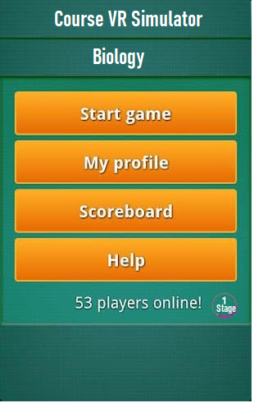
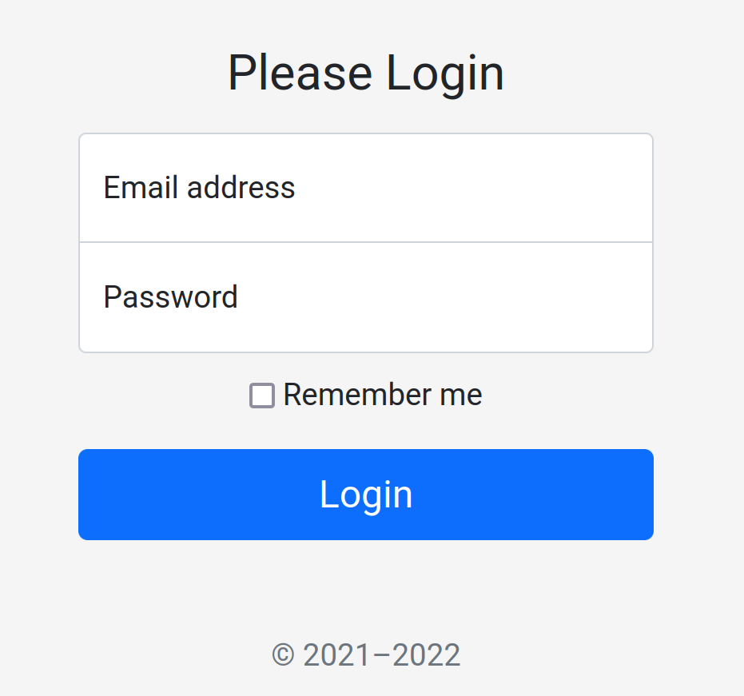
UI screens

Slide 26


Tools
PlantUML: a script driven UML maker visit LINK
And alive demo from our state diagram HERE
Please visit our Repository HERE

Slide 27
Thank you
Presented by:
- Khaled Bahaa El-Din (2101397)
- Abdullah Aml (2101398)

