Slide 1
Virtual Reality Educational game
Assignment 2
By:
- Khaled Bahaa-El-Din (2101397)
- Abdullah Aml (2101398)

Slide 2
Project description.
The project is mainly a virtual reality educational game based on topics in a course.
The actors in the system are:
1. Instructors 2. Students 3. Admins
The software targets 2 perspectives:
System dashboard: Where the instructors, students can communicate with each other and get latest news.
Game system: The software used inside the game.

Slide 3
Project description.
At the beginning of the semester, students register the course through the dashboard system.
Once their registration request is made, the System Admin ensures that student’s registration is compliant with the laws. If it is, registration is done successfully.
Then, Instructors are notified with the registered students to communicate with them.
Instructors can edit/delete/modify stages within the course (following CRUD metric).
On each modification from the instructor, students are notified by their dashboard.
The game types within the system are (design, exploration, assembly and puzzles).
Each instructor specifies the suitable game type related to their course.
The VR game system is connected to the database that contains details to specific course.

Slide 4
PROBLEM VS SOLUTION
PROBLEM
SOLUTION
Students can’t use their imagination to properly visualize the contents of the demonstrated course chapters
A virtual reality game with 3D figures related to the course can greatly improve the students’ understanding

Slide 5
“Agile methods derive much of their agility by relying on the tacit knowledge embodied in the team, rather than writing the knowledge down in plans”
—Prof. Barry Boehm
Quote

Slide 6
System break-down
01
02
03
04
05
06
Login
Dashboard interactions
MVC architecture
No interaction shall be done on dashboard unless the user is logged in
Unique dashboard for every user type (instructor, student)
The project follows MVC(Model, veiw, controller) design pattern
Different game views
Grading system
Effective communication
Various stages across each course that are updated oftenly by instructors
Intelligent grading systems that grant students live grades upon task completion within a stage
Instructors, students can chat lively

Slide 7
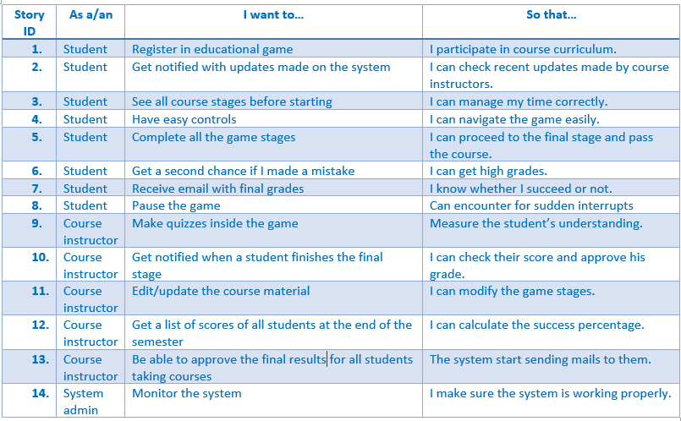
User stories

Slide 8
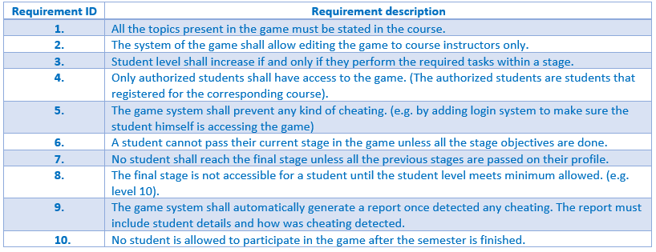
Functional requirements

Slide 9
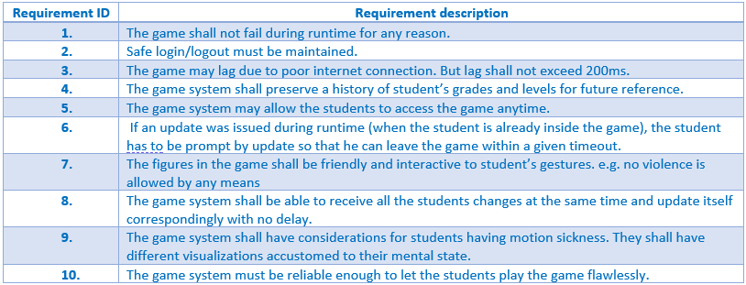
Non-Functional requirements

Slide 10
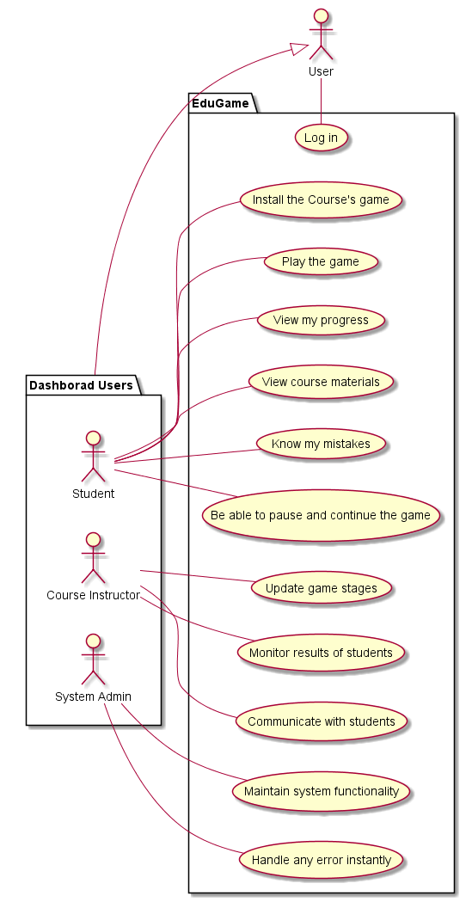
Use case diagram

Slide 11
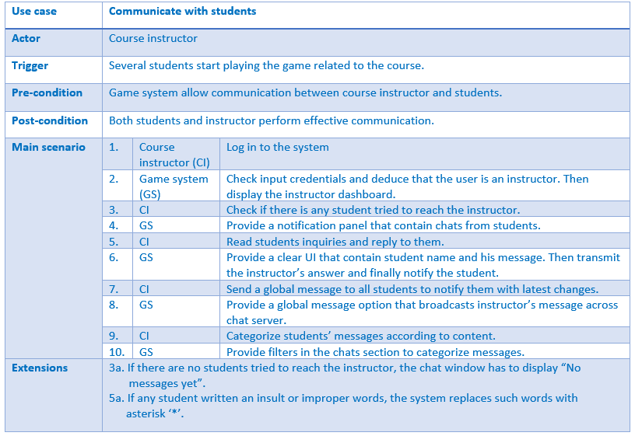
Use case description: Communicate with students

Slide 12
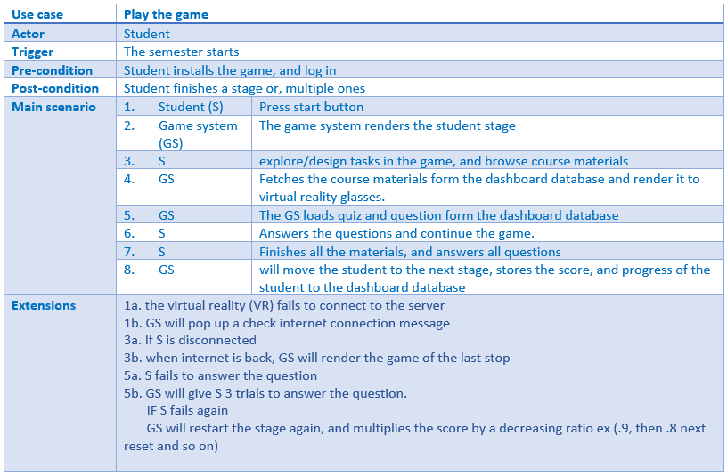
Use case description: Communicate with students

Slide 13
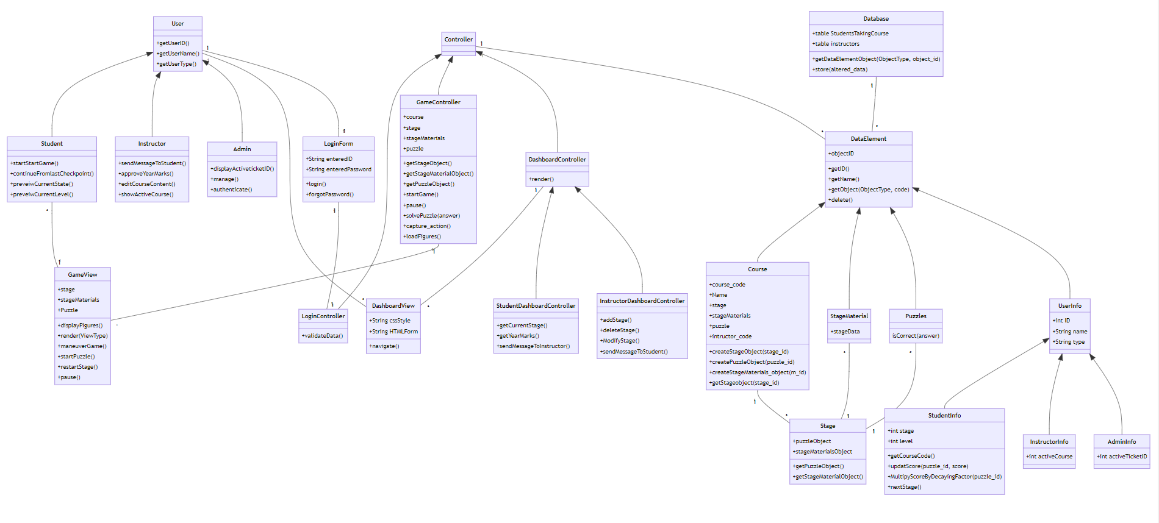
Class diagram

Slide 14
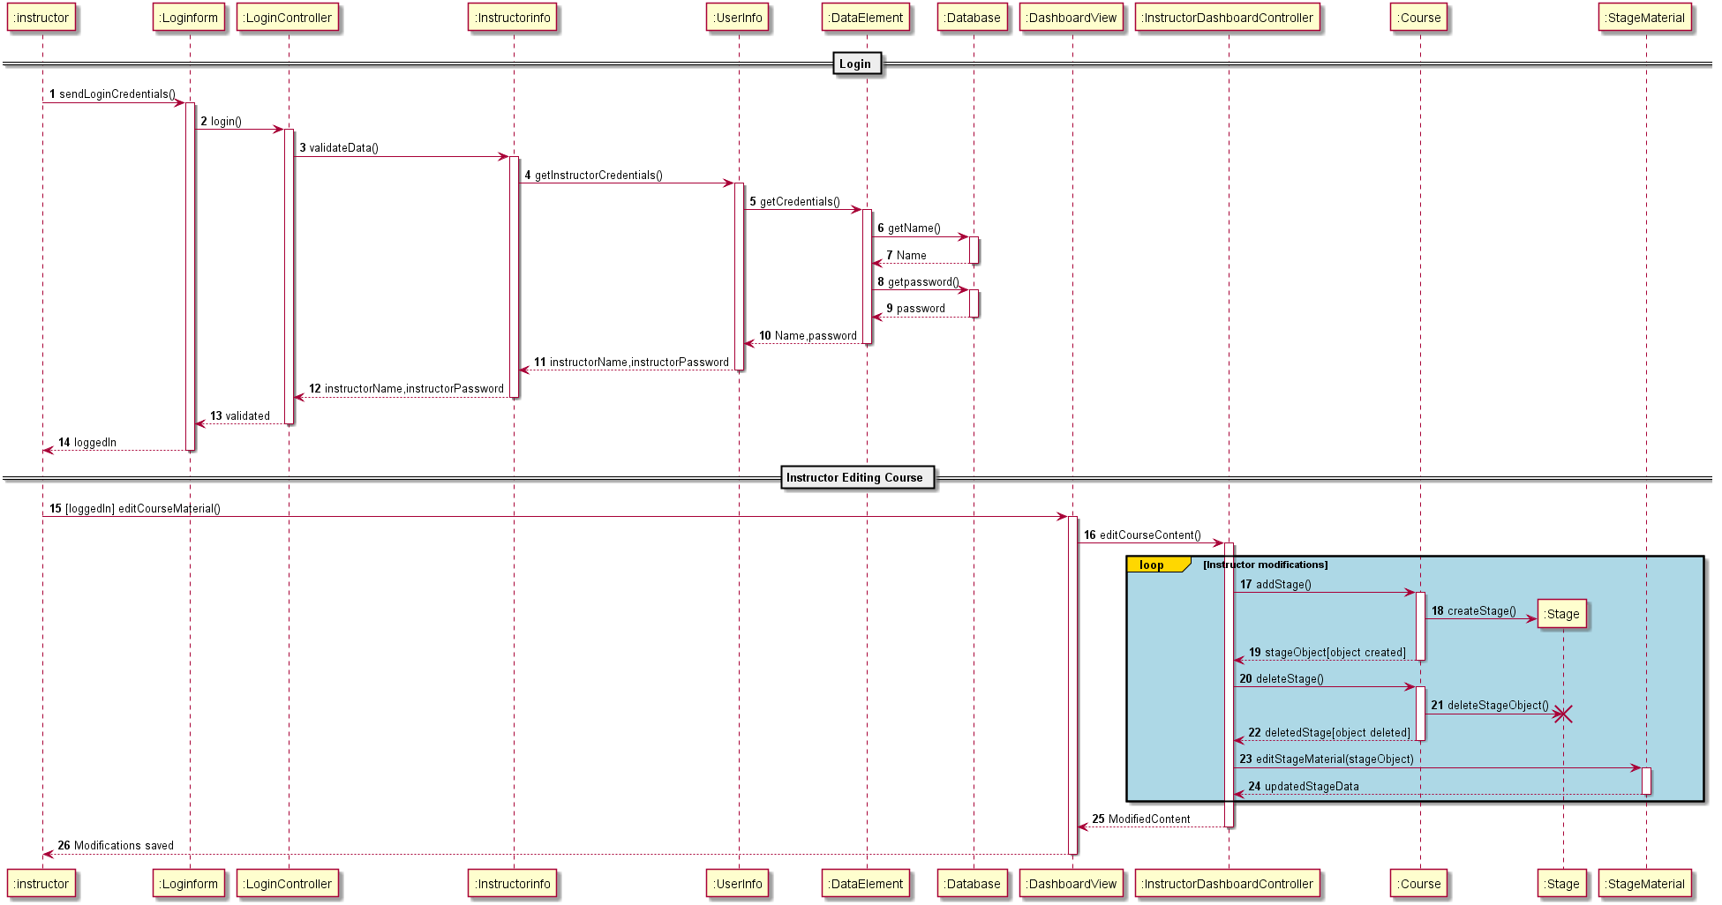
Dashboard sequence diagram

Slide 15
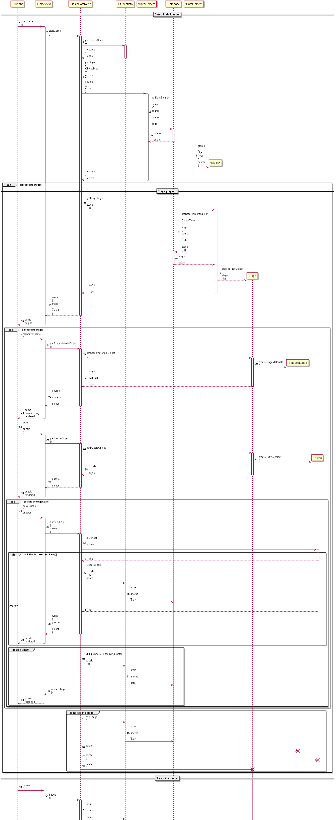
Game sequence diagram

Slide 16
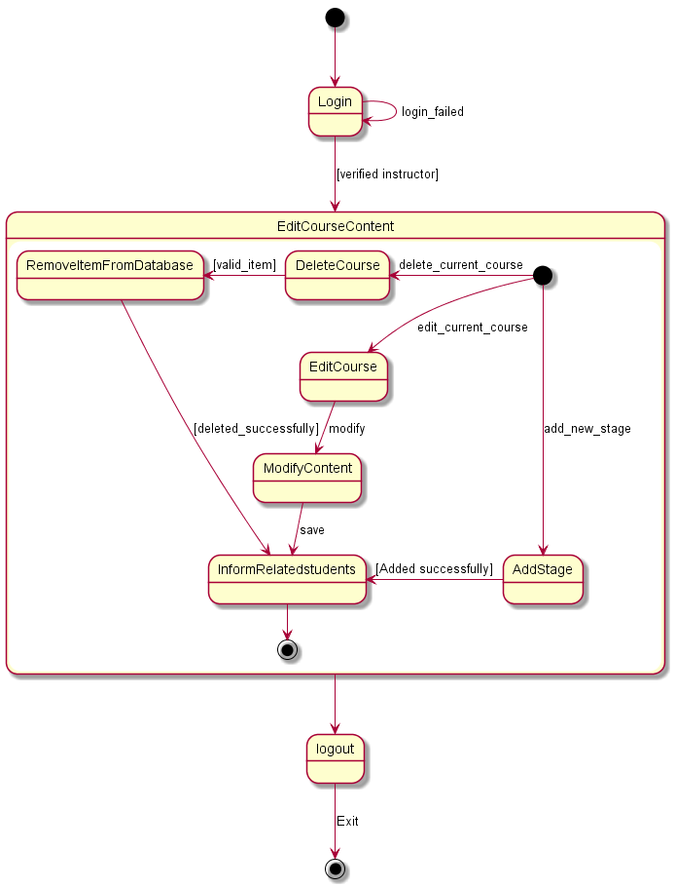
Dashboard state diagram

Slide 17
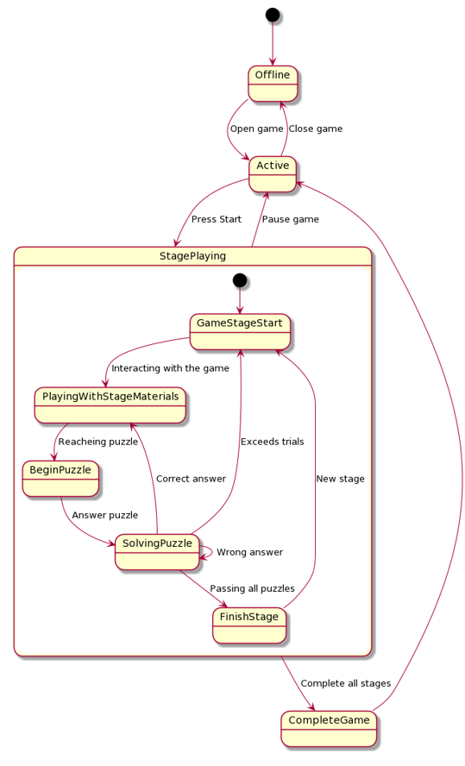
Game state diagram

Slide 18

System actors research

Slide 19

01
Instructor

Slide 20
Instructor research
1
2
3
4
5
Empathize
Define
Ideate
Instructor needs to monitor students’ progress easily
Instructor need a table with students’ progress
The table can be of limited rows and has filters
Proto-type
Test
A table prototype can be shown to instructor for example
Getting instructor’s feedback after seeing the table

Slide 21

02
Student

Slide 22
Student research
1
2
3
4
5
Empathize
Define
Ideate
Student can get perplexed due to strange objects inside the VR game
Student needs obvious metaphors inside the game to react upon
Using common internet metaphors will be straight forward
Proto-type
Test
Some figures can be designed in VR
A student can see the designed figures so we can know whether he got to the point or not

Slide 23

03
Admin

Slide 24
Admin research
1
2
3
4
5
Empathize
Define
Ideate
Admin needs to monitor everything in the system
Admin needs to be notified immediately with system unexpected behavior
Push notifications can catch admin’s attention immediately
Proto-type
Test
A push notification routine can be designed for testing
Get admin’s thoughts about the notification tone and message

Slide 25
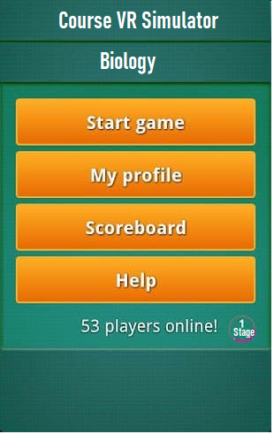
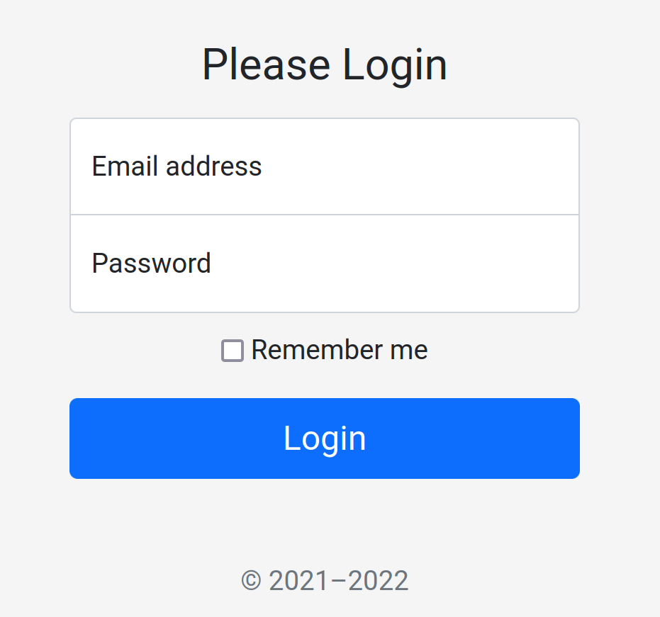
UI screens

Slide 26
Resources
- During the project we used github to synchronize our work.
- The repository is made public for reference.
- Link can be found here: Github Link

Slide 27
Thank you
Presented by:
- Khaled Bahaa El-Din (2101397)
- Abdullah Aml (2101398)

