Slide 1
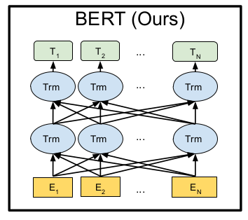
BERT: Pre-training of Deep Bidirectional Transformers for
Language Understanding

Slide 2
Agenda
Background
Masked Language Model
Right to left Language Model
Left to Right with Right to Left Language Model
Transformers

Slide 3
Agenda
BERT
BERT Architecture
Input Representation
Input Embedding
Pre-training
Masked Language Model (MLM)
Next Sentence Prediction (NSP)

Slide 4
Agenda
Using BERT
BEERT Fine-tuning
Experiments
GLUE
SQuAD v1.1
SQuAD v2.0
SWAG
Ablation Studies
Effect of Pre-training Tasks
Effect of Model Size
Effect of number of training steps
Models' comparisons
Conclusion

Slide 5
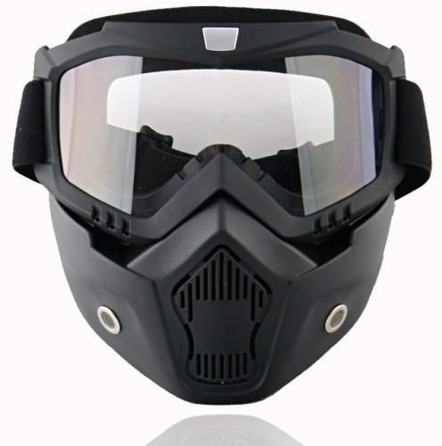
Background Language Modeling
Language Modeling (LM) means predicting the missing word in a sentence.
Masked Language Model (MLM) means to mask (cover) a word in a sentence and train our LM to predict it

Slide 6
Example
Suppose we have this input sentence:
"The sky is blue"
We will mask the verb "is": "The sky ---- blue"

Slide 7
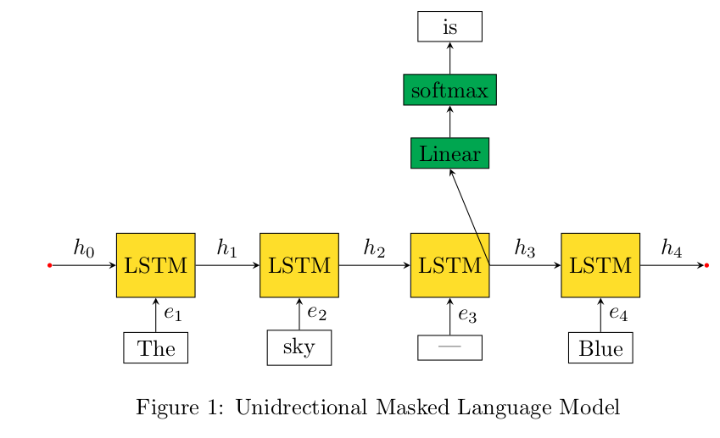
Left To Right LM
Traditional Techniques is to use RNNs with Linear layer and softmax to predict the missing word

Slide 8
WE have problems:
The model has no way to make prediciton is "goes" instead of "is"
"The sky goes blue"
because he cannot see the right context (I.e: "Blue" which is adjective)

Slide 9
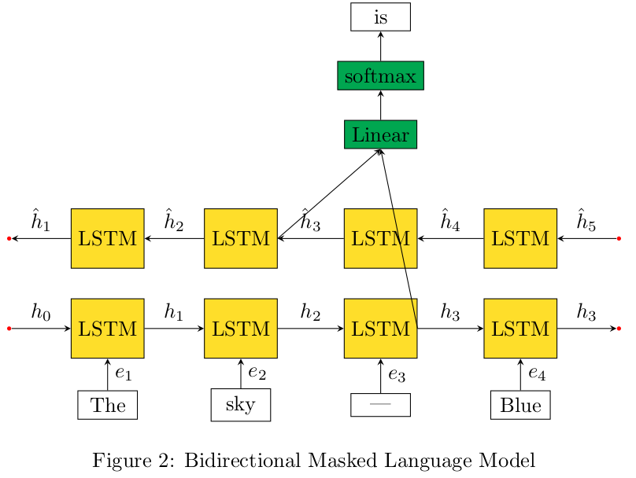
RTL with LTR LM
To solve this problem, we add another RNNs that take care of the Left to right context
Then we concatenate the RTL, and LTR
Then Linear and softmax layers

Slide 10

RTL with LTR LM
Successfully We predict the correct word "is":
"The sky is blue"

Slide 11

RTL with LTR LM
Problem
Suppose the sentence is too long :
"The ball that children plays with in school is blue"
We mask "is"
"The ball that children plays with in school ----- blue"

Slide 12

"The ball that children plays with in school ----- blue"
Does our model predict "is" -> ball, or "are" -> children ?
This Photo by Unknown author is licensed under CC BY-NC.

Slide 13
The answer is NO
Because the Children is closer to the masked word with this architecture

Slide 14
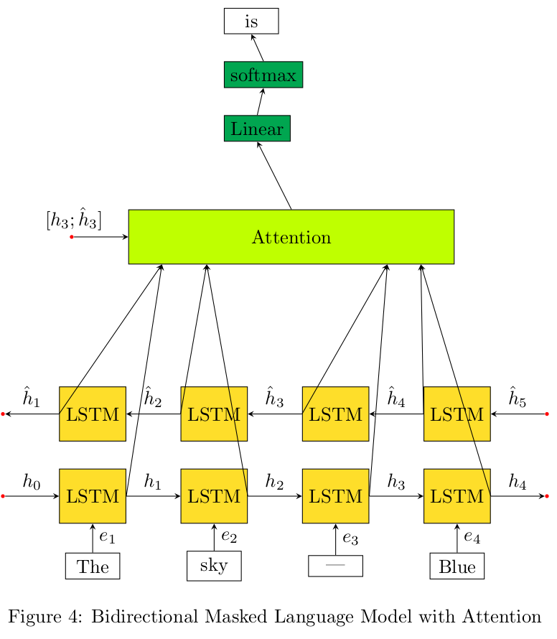
LTR with RTL with Attention

Slide 15
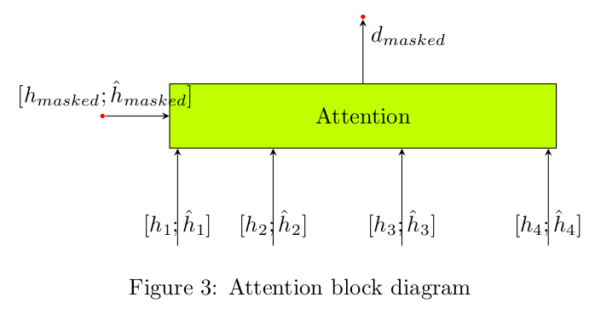


Attention
We multiply every hidden state by a Contant αi, then we sums all the like this:
Then Linear and softmax

Slide 16
LTR with RTL RNNs
Again, we have a problem:
RNNs are sequential in nature, but we have GPUs right ?
Unfortunately, We GPUs loves parallel tasks not sequential task.
What to do ?
What if we take this attention block and replace it with the bidirectional RNNs.
WE introduce "Self Attention" aka: Transformers

Slide 17
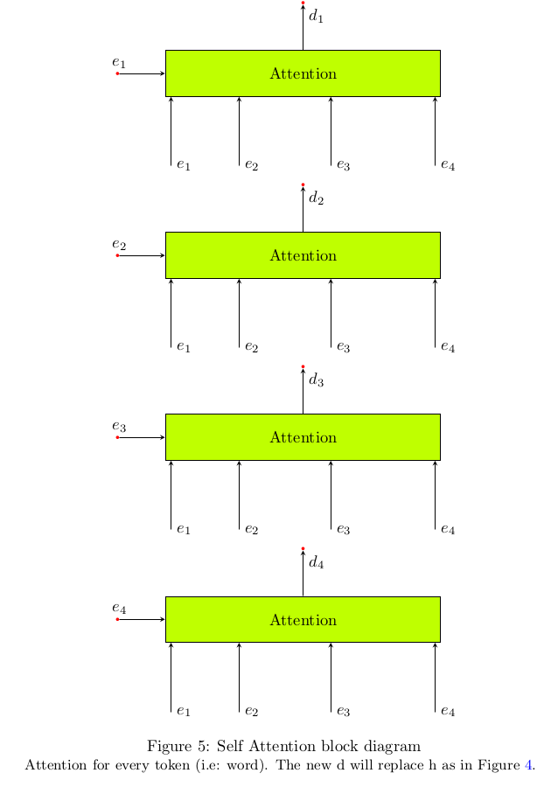
Selft Attention

Slide 18
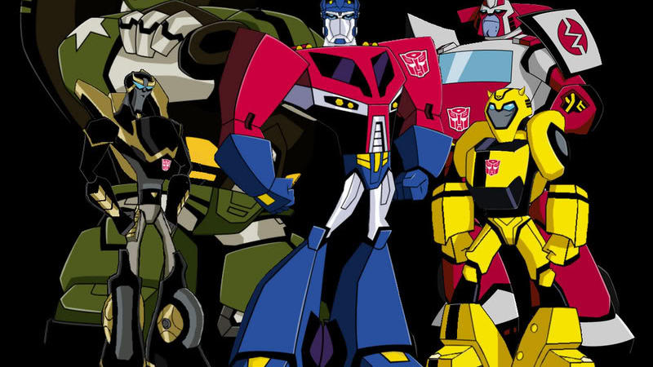
Transforms
Not this
This Photo by Unknown author is licensed under CC BY-NC-ND.

Slide 19
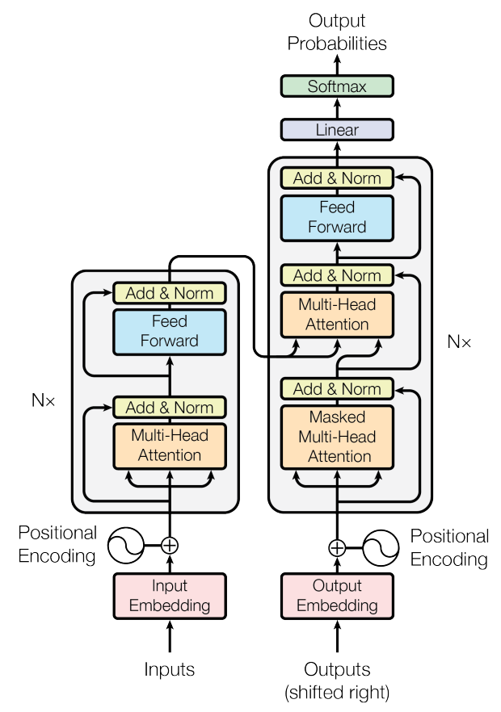
Transformers
But This

Slide 20
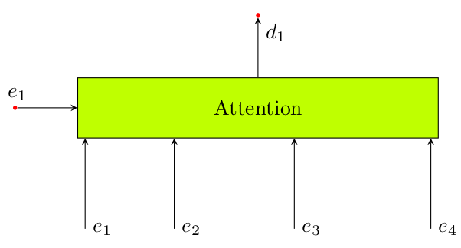
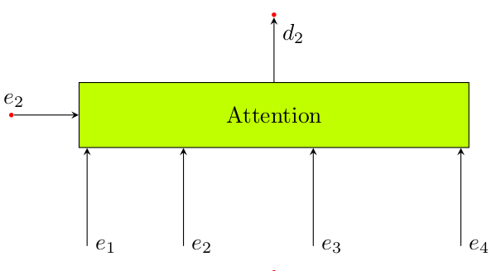

Attention layer

Slide 21

Can Attention handle variable length sequence ?

Slide 22
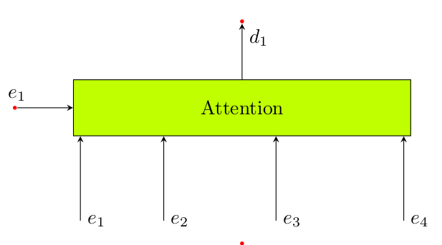
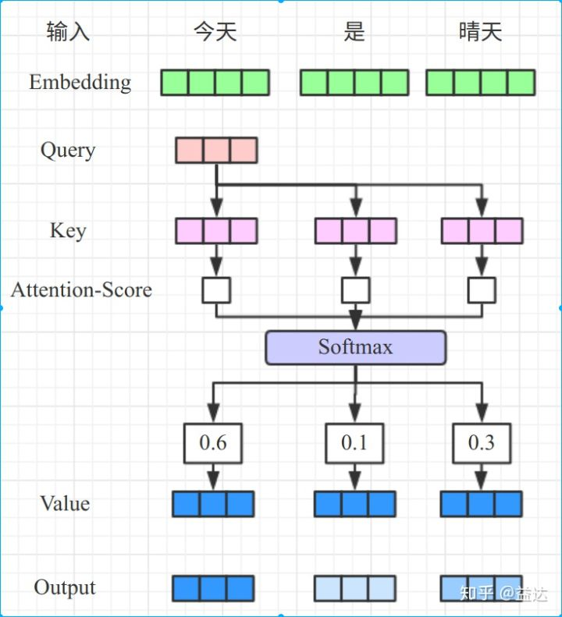
Let's dive into attention block
We have three matrices shared across all self-attention block:
Wq, Wk, Wv
query= e_{i} Wq
Key = e_{i} Wk
Value = e_{i} Wv

Slide 23
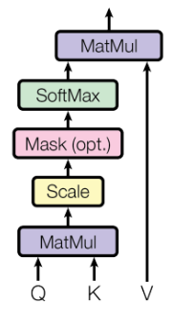
Selft Attention Block
We can generalize as matrix multiplication (more parallel)

Slide 24
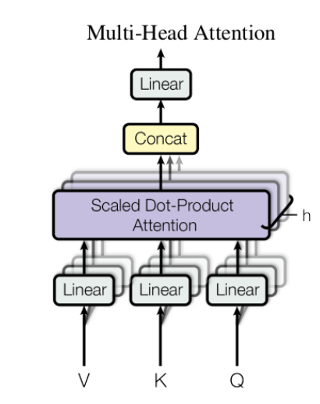
Multi head Attention
We can add multiple parallel "self attention" blocks (A) with different: Wq, Wk, Wv
Then we have a decoder (has multiple parallel heads I.e: "self attentions" blocks)

Slide 25
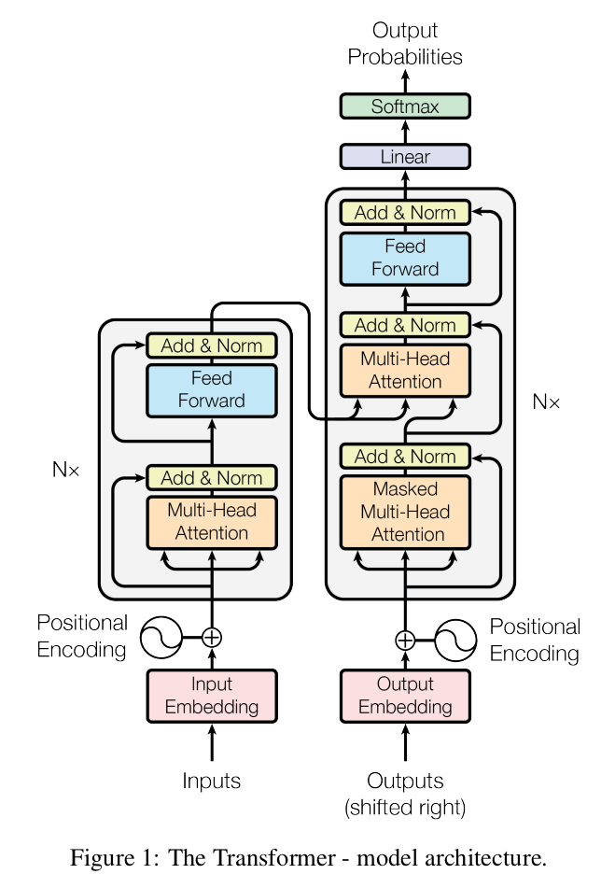
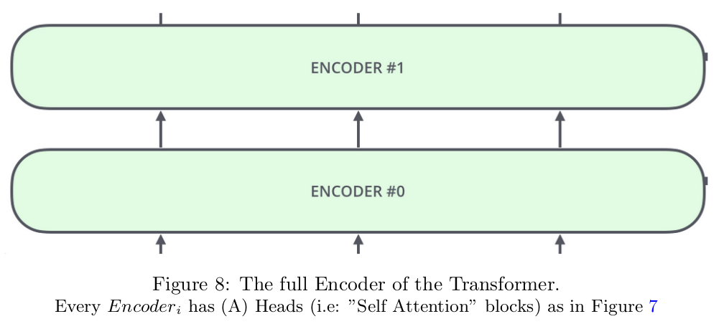
The complete transformer Stacking multiple Encoders -> then we have a full Transformer decoder

Slide 26
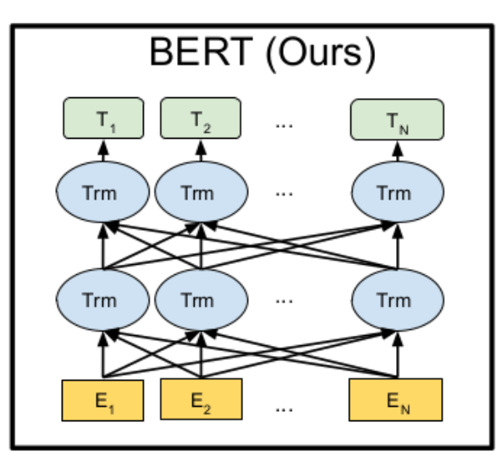
The transformer Encoder
Every output has contextual representation of all the inputs

Slide 27
BERT
Finally, we head to our paper goal which is BERT
BERT: Bidirectional Encoder Representation form Transformers.
Why is it called ImageNet of the NLP ?
BERT was pre-trained on 800M word corpus, 2,500M Wkippedia, and achieved state of the art in 11 NLP tasks !!!!!
BERT Introduces a generic model that can be fine-tuned (2 to 3 epochs) a single hour on TPU, and we can get the state of the are results.
It has more than 40K citations !!!!!

Slide 28
BERT Architecture
BERT is the Encoder block of the transformer
L: is the # encoders, A #heads, H the length of hidden vector
Model | #L | #A | #H | #Prameters
BERT_{base} | 12 | 12 | 768 | 110M
BERT_{large} | 24 | 16 | 1024 | 340M

Slide 29
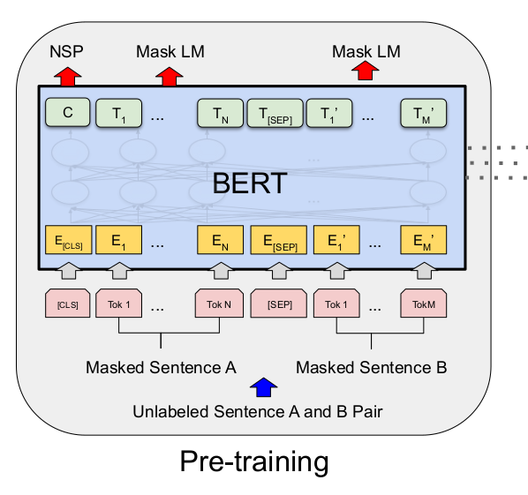
BERT Architecture Input Representation
The model input is a sequence of two sentences: sentenceA and sentenceB.
Sentence here means: a sequence word not the linguistic sentence
We have 3 special tokens:
[cls]: (class) token donates the start of sequence is ouput is C
[sep]: end of sentences: sentenceA, and sentenceB
[mask]: a token to the hidden sentence

Slide 30
BERT Architecture Input Embedding
We use wordPiece embedding with 300,000 words as input.
The second layer is the positional encoding form transformer
The third layer is sentence embedding for ever sentence, sentenceA, and sentenceB

Slide 31
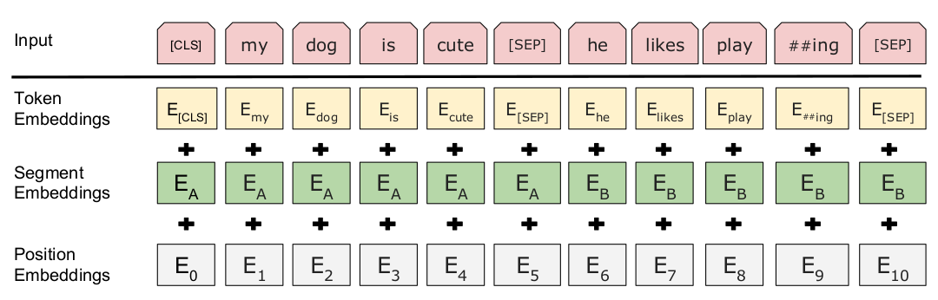
BERT Architecture Input Embedding

Slide 32
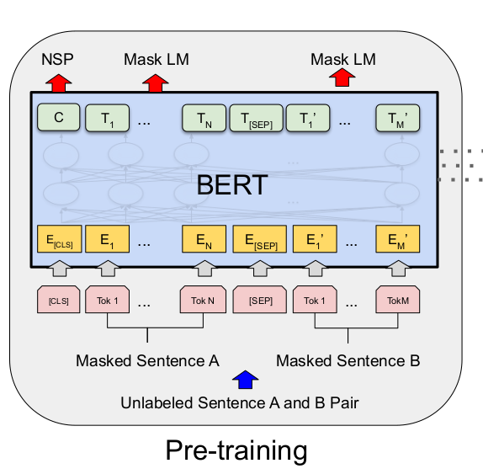
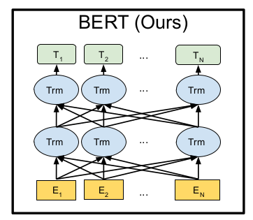
BERT Architecture BERT is the encoder of the Transformer

Slide 33
BERT Pre-training
We pre-train our model on two things:
Masked Language Model (MLM)
Next Sentence Prediction (NSP)

Slide 34
BERT Pre-training Masked Language Model
We will mask 15% of the input sequence the masked words will be replaced by:
• the [mask] token 80% of the time
• a random word (i.e: token) 10% of the time.
• the word itself 10% of the time.

Slide 35
BERT Pre-training Masked Language Model
80% of the time: Replace the word with the [MASK] token, e.g., my dog is hairy → my dog is [MASK]
• 10% of the time: Replace the word with a random word, e.g., my dog is hairy → my dog is apple.
• 10% of the time: Keep the word unchanged, e.g., my dog is hairy → my dog is hairy .
The purpose of this is to bias the representation towards the actual observed word.

Slide 36
BERT Pre-training Next Sentence Prediction
In many application we have more than one sentence like: Question Answer
We pre-train our model to learn relation between sentences by the following:
we train a barbarized next sentence predictor (NSP) that predicts whether the SentenceB follows SentenceA or not. At training we put:
50% of the time SentenceB is actually following sentenceA with labeled as IsNext.
50% of the time SentenceB is NOT following sentenceA with labeled as NotNext.
This binary classification is done throw the output token (C) the corresponds to input token [cls]

Slide 37
How to use the pre-trained model ?

Slide 38
Using BERT pretrained model
WE have two approaches:
Fine-tuning
Feature Based

Slide 39
BERT Fine-tuning
Fine-tuning means make small changes at the BERT model with weighs initialized form the pre-training
And train form small epochs (2 to 4)
These small changes includes:
Manipulating BERT input
Manipulating BERT output

Slide 40
BERT Fine-tuning Manipulating Input
While manipulating input: we have two sentences: sentenceA, sentenceB to the
BERT input. The sentenceA, sentenceB are:
• Sentencing paris in praphrasing task.
• hypothesis, and premises (e.g: Mohamed goes to school by bike, Mohamed can ride bike) in instalment task.
• question, and sentence that have the answer in Question Answer Task.
• input sentence, and degenerate textϕ in text classification tasks.

Slide 41
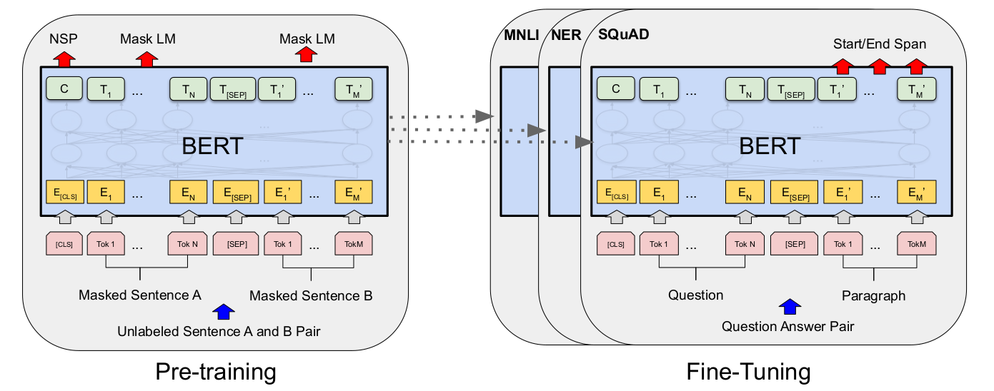
BERT Fine-tuning Manipulating Output

Slide 42
BERT Fine-tuning Manipulating Output
Binary Classification: (like Sentiment classification, or entailment classification) we use the output (C) that corresponds to [cls] token as.
Downstream Tasks that involves manipulating more than one output token (T_{i} ) like; Question Answer

Slide 43
Experiments GLUE Benchmark
The General Understanding Evaluation Benchmark (GLUE) a set of several data sets of different classification tasks.
We used C ∈ R^{H} that corresponding the aggregate representation for the input sequence, and a classification layer W ∈ R ^{KxH} , where K is the number of classes.
We used standard classification loss i.e: log(sof tmax(CW^{T} )).

Slide 44
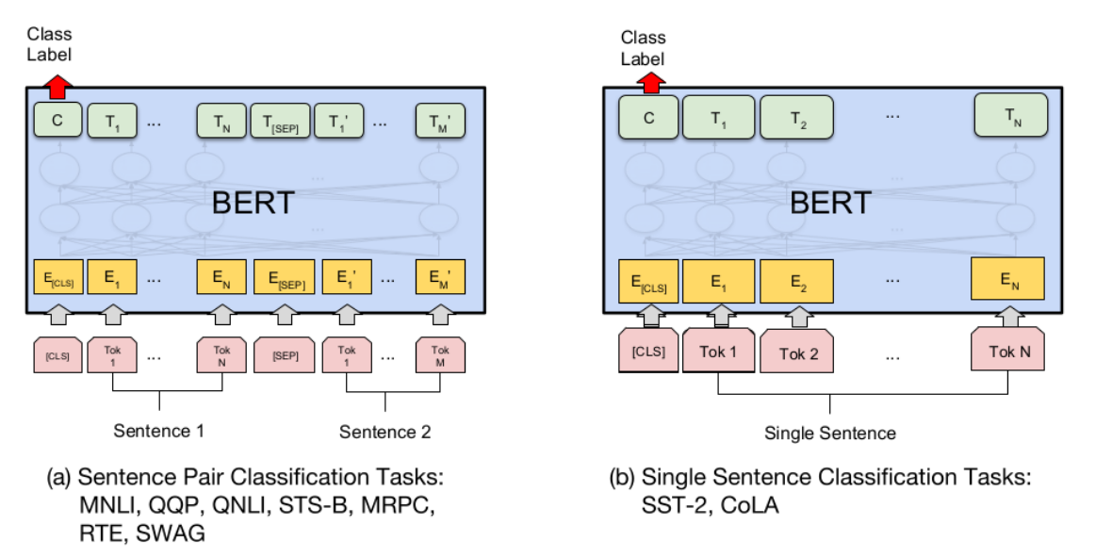
Experiments GLUE Benchmark

Slide 45
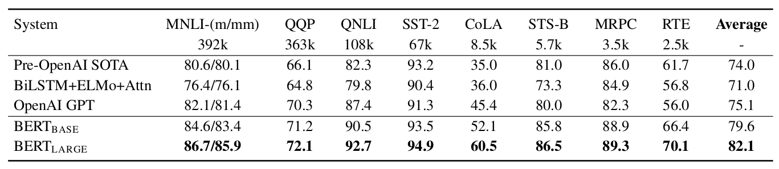
Experiments GLUE Benchmark

Slide 46
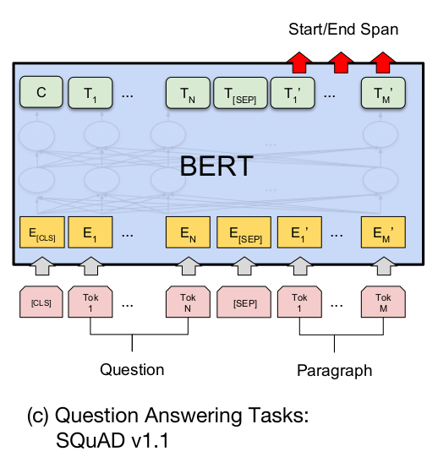
Experiments SQuAD v1.1
The Stanford Question Answering Dataset (SQuAD v1.1) is a collection of 100k crowd-sourced question/answer pairs. In QA we have two sentences:
The question Sentence, that will be sentenceA in BERT.
The Answer Sentence that have the answer, that will be sentenceB in BERT.
Our goal is to find the start and the end of the answer in the answer sentence.

Slide 47


Experiments SQuAD v1.1
As we goal is to find the start of answer token T_{i} ∈ R^{H} , and end of answer token T_{i} ∈ R^{H} .
We introduce start vector (S ∈ R^{H} , then we do product S with every output token of sentenceB T_{i} ,
Then we take softmax among words in sentenceB as in equation.
Similar to start we introduce end vector (E ∈ R^{H} , the end of answer is calculated as in where i is the start token, j is the end.
The loss is the log-likelihood of correct start and end positrons

Slide 48
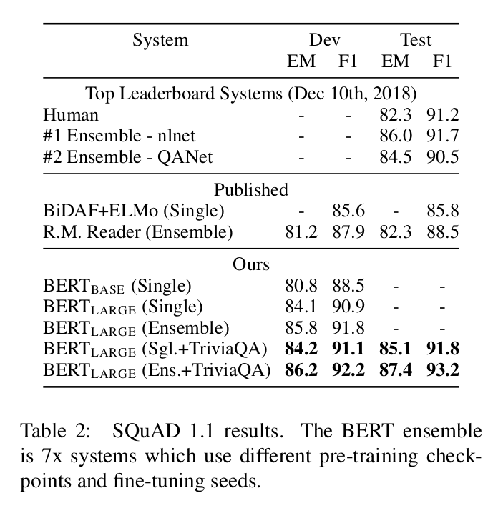
Experiments SQuAD v1.1

Slide 49
Experiments SQuAD v2.0
The data set is the same as SQuAD v1.1 but with a no answer.
We solve the no answer as the start and the end of the answer at [cls] token. For Prediction we compare s_{null} = S.C + E.C (null answer span) with:
ŝ = max _{j>i} (S.T_{i} + E.T_{j} ) (answer span).
We predict a none null answer if ŝ > s_{null} + taw .

Slide 50
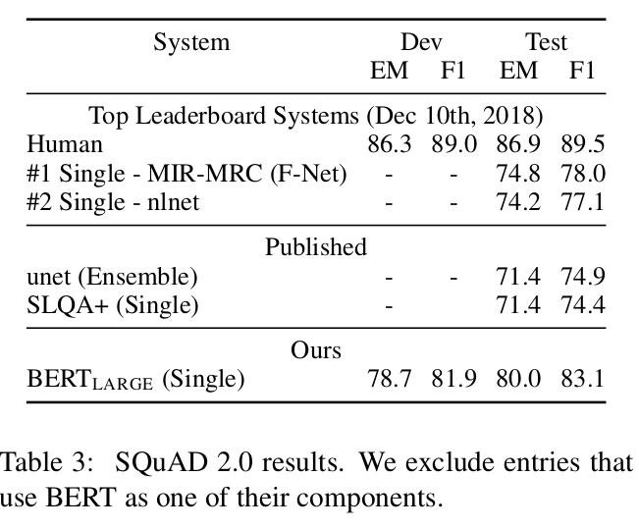
Experiments SQuAD v2.0

Slide 51
Experiments SWAG
The Situations With Adversarial Generations (SWAG) dataset contains 113k sentence-pair completion examples that evaluate grounded common-sense inference.
Given an input sentence the task is to find the most suitable answer among 4 choices.
We fin-tune by constructing four output vector each one has input of:
sentenceA is the input sentence
sentecneB is one of the four choices
The output of every choice is (C) (i.e: output of [cls]).
The only task specific parameter we introduce is a vector (V ∈ R^{H} ). We dot product V with C for every choice, Then we take softmax with the four choices.

Slide 52
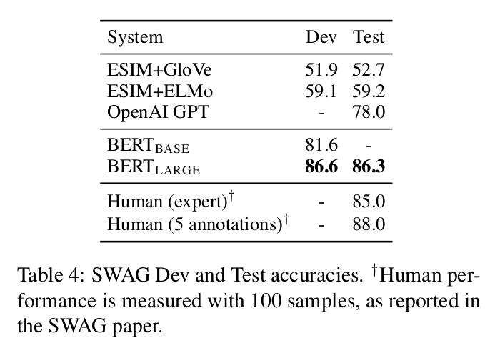
Experiments SWAG

Slide 53
Experiments Hyper-parameters
Model | Adam Learning rate | Epochs | Batch size
GLUE | among(5e- 5, 4e− 5, 3e−5,and 2e−5) | 3 | 32
SQuAD v1.1 | 5e-5 | 3 | 32
SQuAD v2.0 | 5e-5 | 2 | 48
SWAG | 2e-5 | 3 | 16

Slide 54
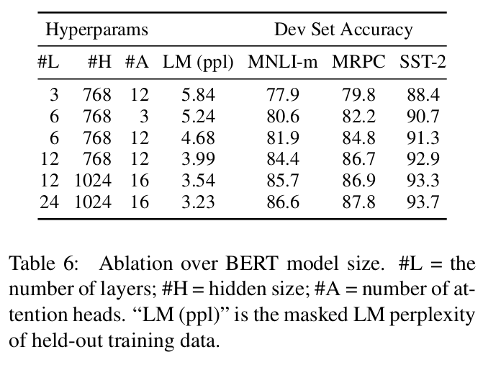
Ablation Studies Effect of Model Size
We used to know that using bigger model on small dateset will under-fit that model, so performance will degrade.
But here we show that using larger model improves the accuracy even with small dataset like MPRC with 3,600 samples why ?
this due to the pre-training process we used, we pre-trained our model with 3,300M wrod (our model has learned before this is only fine-tuning).

Slide 55
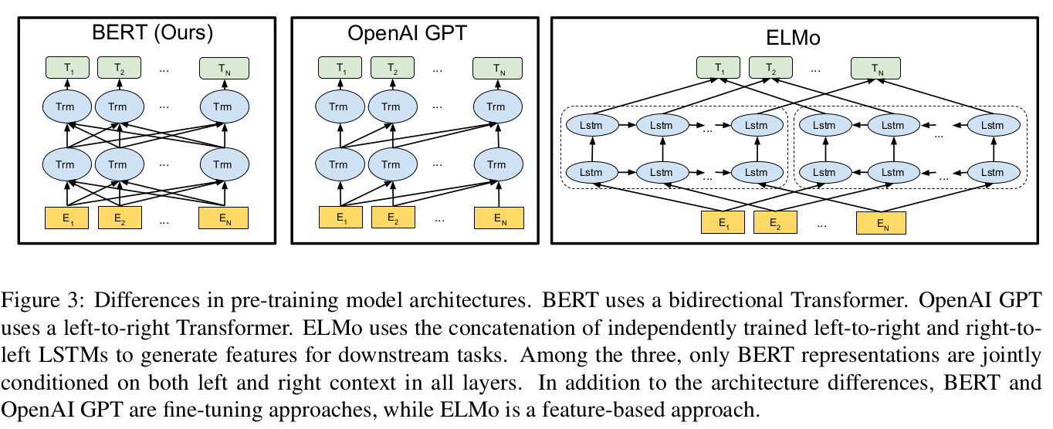
LM Comparisons BERT vs Open AI GPT vs ELMo

Slide 56
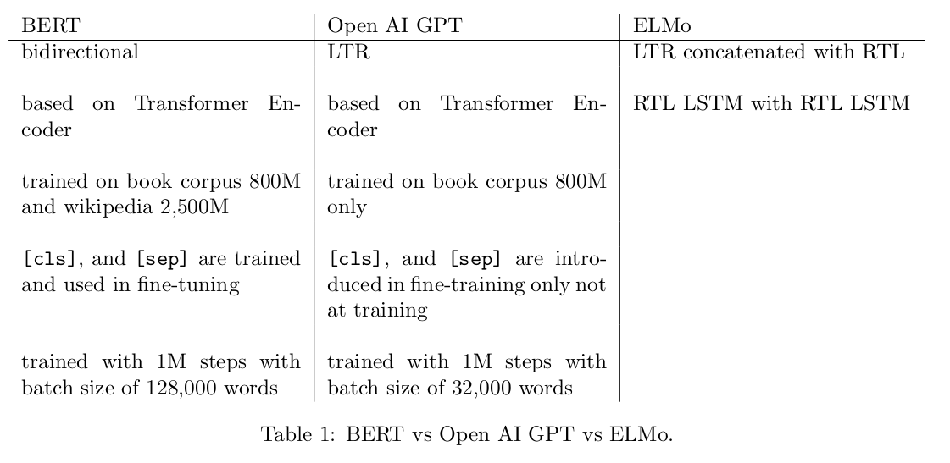
LM Comparisons BERT vs Open AI GPT vs ELMo

Slide 57
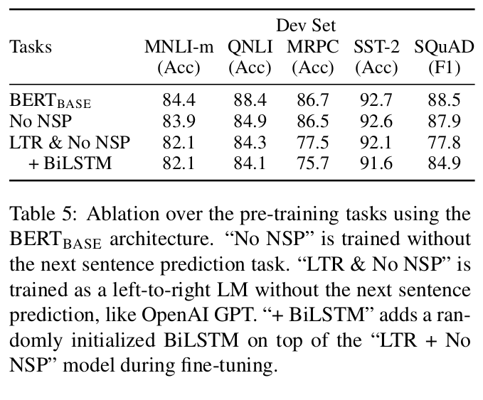
Ablation Studies Effect of Pre-training Tasks

Slide 58
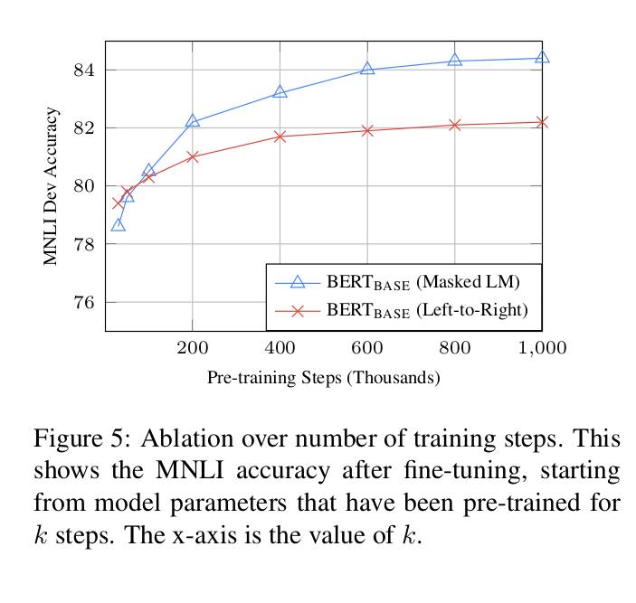
Ablation Studies Effect of Number of training steps
BERT converges slower than LTR transformer like (I.e: Open AI GPT)

Slide 59

Conclusion
We introduced a generalized model that can be used in many NLP tasks which proves the benefit of using transfer learning in language models, and bidirectional context representation.
Even if we fine-tune our model on small datasets we can get high performance thank to pre-training.
This Photo by Unknown author is licensed under CC BY-NC.

Slide 60
Resources to learn transformers and BERT
Videos by Eng Ahmed Fathi very powerful. We built the background over it.
"The Illustrated Transforms " blog post by Jay.
The paper itself: Attention is all you need.
Step by step explained Implementation of Transformers Notebook using Pytorch.
"The Illustrated BERT " blog post by Jay.

Slide 61
Questions !

Slide 62

Thank You

