Slide 1
Object Oriented Programming (OOP)
Prepared by: Muhammad Abdullah

Slide 2
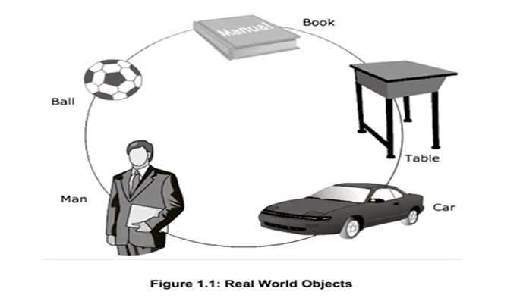
Object
An object is any person or a thing, living or non-living which has some characteristics or attributes which help to describe it.

Slide 3
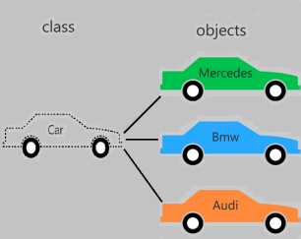
Object Oriented Programming
Object-oriented programming is a programming paradigm based on the concept of "objects", which can contain data, in the form of fields, and code.

Slide 4
Object Oriented Programming Versus Procedure Oriented Programming
OOP
POP
In OOP, program is divided into parts called object.
Has access specifier named public, private etc.
OOP more secure.
Java and C# are some example of OOP.
In POP, program is divided into parts called function.
Does not has access specifier.
POP is less secure
C, Pascal are some example of POP

Slide 5
OOP Concept
OOP uses following four programming concepts:
Encapsulation
Abstraction
Inheritance
Polymorphism

Slide 6
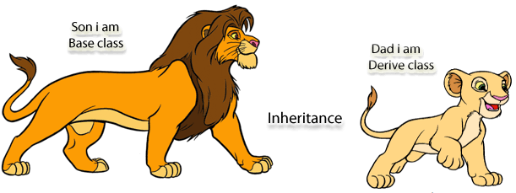
Inheritance
To pass on characteristic, property, title and right of individual to his/her successors.
Some types of inheritance:
Single inheritance
Multi level inheritance
Hierarchical inheritance

Slide 7
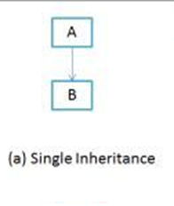
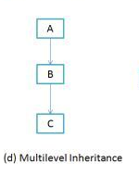
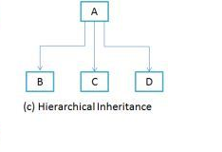
Types of Inheritance
Single Inheritance: When a class extends another one class only then we call it a single inheritance.
Multi level inheritance: When a class is derived from a class which is also derived from another class, such inheritance is called Multilevel Inheritance.
Hierarchical inheritance: In such kind of inheritance one class is inherited by many sub classes.

Slide 8
Polymorphism
Polymorphism means to process objects differently based on their data type.
Polymorphism could be static and dynamic both. Method Overloading is static polymorphism while, Method Overriding is dynamic polymorphism.

Slide 9

Abstraction
Abstraction is a process where you show only “relevant” data and “hide” unnecessary details of an object from the user.

Slide 10
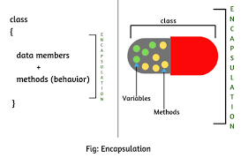
Encapsulation
Provides bundling of data members and methods into an enclosed structure.
Hiding the data for the purpose of protection.

Slide 11
Access Modifiers
Determine how members of a class, such as instance variable and methods are accessible from outside the class.
Are of four types:
Public
Private
Protected
Default

Slide 12
Advantages of OOP
Code Reusability
Reliability and flexibility
Security

Slide 13


