Slide 1
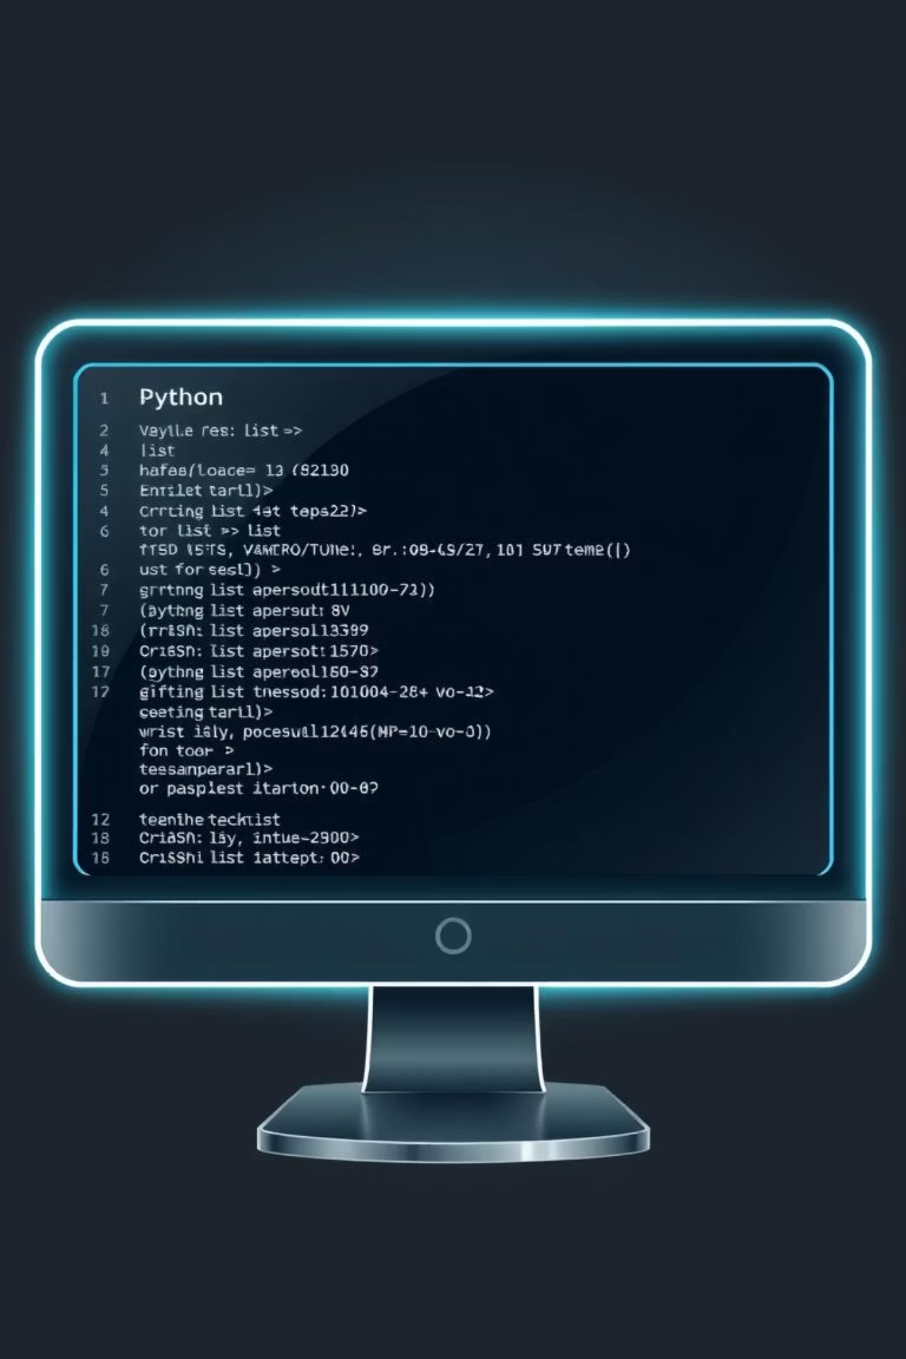
Python Lists: From Basics to Advanced Mastery
Master the most versatile data structure in Python. From creating your first list to building complex multi-dimensional arrays, this comprehensive guide takes you through every concept, method, and best practice you need to become proficient with Python lists.

Slide 2
What are Lists?
The Definition
Why Use Lists?
A list is an ordered, mutable collection of items in Python. Unlike tuples or sets, lists allow you to store multiple elements of any data type and modify them after creation. Lists are fundamental to Python programming and serve as the backbone for countless applications.
Flexibility: Store mixed data types in one collection
Mutability: Add, remove, or modify elements anytime
Ordered: Preserve the sequence of your data
Indexable: Access elements by position instantly
Versatile: Perfect for stacks, queues, and more
Key characteristic: Lists maintain the order in which elements are added, making them ideal for sequential data.
Real-world analogy: Think of a list like a to-do list. Each to-do has a position, you can rearrange , cross them off, or add new ones. In programming, this translates to storing student grades, inventory items, or game high scores.

Slide 3
Declaring and Initializing Lists
Understanding how to create lists is your first step toward mastery. Python offers multiple ways to declare and initialize lists, each suited for different scenarios.
Empty List
Single Data Type
Mixed Data Types
Create a placeholder list with no elements, ready to be populated later.
Initialize a list with elements of the same type for consistency and clarity.
Python lists embrace flexibility by allowing different data types in one collection.
my_list = []
# or
my_list = list()
numbers = [1, 2, 3, 4, 5]
names = ["Alice", "Bob", "Charlie"]
mixed = [42, "Hello", 3.14, True]
data = [1, "text", None, [1,2]]

Slide 4
Accessing List Elements
Once you have a list, accessing its elements efficiently is crucial. Python provides powerful indexing mechanisms to retrieve exactly what you need.
Positive Indexing
Negative Indexing
Slicing
Access elements from the start using 0-based indexing. The first element is always at index 0.
Count backward from the end using negative indices. Index -1 refers to the last element.
Extract multiple elements using the slice notation [start:end:step]. The end index is exclusive.
fruits = ["apple", "banana", "cherry", "date"]
print(fruits[0]) # Output:apple
print(fruits[2]) # Output: cherry
fruits = ["apple", "banana", "cherry", "date"]
print(fruits[-1]) # Output: date
print(fruits[-2]) #Output: cherry
numbers = [0, 1, 2, 3, 4, 5,6,7]
print(numbers[2:5]) # [2, 3, 4]
print(numbers[::2]) # [0, 2, 4,6]
print(numbers[::-1]) # Reversed list

Slide 5
Essential List Operations
Master the fundamental operations that form the foundation of list manipulation. These operations allow you to measure, combine, and duplicate your lists.
Length Function
Concatenation
Determine how many elements exist in your list using len(). This is essential for loops and boundary checking.
Combine two or more lists using the + operator to create a new, unified list.
students = ["Emma", "Liam", "Sophia"]
print(len(students)) # Output: 3
empty_list = []
print(len(empty_list)) # Output: 0
list1 = [1, 2, 3]
list2 = [4, 5, 6]
combined = list1 + list2
print(combined) # Output: [1, 2, 3, 4, 5, 6]
Repetition Operation
Repeat list elements using the * operator to quickly generate patterns or fill initial data structures.
pattern = [0] * 5
print(pattern) # Output: [0, 0, 0, 0, 0]
repeated = ["x", "y"] * 3
print(repeated) # Output: ['x', 'y', 'x', 'y', 'x', 'y']

Slide 6
Modifying Lists: Adding and Removing Elements
Lists are mutable, meaning you can change them after creation. Master these essential methods to add, insert, and remove elements dynamically.
1
2
append() Method
insert() Method
Add a single element to the end of the list. This is the most common way to grow a list.
Add an element at a specific position. Elements after the insertion point shift to the right.
tasks = ["code", "test"]
tasks.append("deploy")
print(tasks) # Output: ["code", "test", "deploy"]
colors = ["red", "blue"]
colors.insert(1, "green")
print(colors) # Output: ["red", "green", "blue"]
3
4
remove() Method
pop() Method
Delete the first occurrence of a value. Raises an error if the element doesn't exist.
Remove and return an element by index (default: last element). Useful for stacks and queues.
inventory = ["apple", "banana", "apple"]
inventory.remove("apple")
print(inventory) # Output: ["banana", "apple"]
scores = [100, 85, 92, 78]
last = scores.pop() # Returns 78
first = scores.pop(0) # Returns 100
print(scores) # Output: [85, 92]

Slide 7
Advanced List Methods
Elevate your list manipulation skills with these powerful methods for sorting, searching, and transforming your data structures.
sort() and reverse()
count() and index()
clear() Method
sort() arranges elements in order (modifies in-place). reverse() flips the list.
count() returns how many times an element appears. index() finds its position.
clear() empties the entire list while keeping the variable intact.
data = [1, 2, 3, 4, 5]
data.clear()
print(data)# Output: []
print(len(data)) # Output: 0
numbers = [3, 1, 4, 1, 5]
numbers.sort()
print(numbers)# [1, 1, 3, 4, 5]
numbers.reverse()
print(numbers)# [5, 4, 3, 1, 1]
letters = ['a', 'b', 'a', 'c', 'a']
print(letters.count('a'))# Output: 3
print(letters.index('c'))# Output: 3

Slide 8
Multi-Dimensional Lists: Matrices and Beyond
Step into advanced territory by nesting lists within lists. Multi-dimensional lists represent matrices, tables, and complex data structures essential for data science and
game development.
2D Lists: Tables and Matrices
A 2D list is essentially a list of lists, where each inner list represents a row. This is perfect for representing grids, spreadsheets, and game boards.
matrix = [ [1, 2, 3], [4, 5, 6], [7, 8, 9]]
print(matrix[0][1]) # Output: 2 (first row, second column)
print(matrix[2][2]) # Output: 9 (third row, third column)
Practical Example: Game Board
3D Lists and Beyond
board = [ ['X', 'O', 'X'], ['O', 'X', 'O'], [' ', 'X', 'O']]
# Access and modify
print(board[1][0]) # 'O'
board[2][0] = 'X'# Iterate through all cells
for row in board:
for cell in row:
print(cell, end=' ')
Extend the concept further with deeper nesting. A 3D list could represent layers in a 3D grid or multiple tables.
data_3d = [ [[1, 2], [3, 4]], [[5, 6], [7, 8]]]# Access
element: layer, row, column
print(data_3d[0][1][0]) # Output: 3

Slide 9
List Comprehensions: Elegant and Powerful
List comprehensions are Python's gift to concise, efficient code. They allow you to create complex lists in a single, readable line by combining filtering, transformation, and iteration elegantly.
1
Basic Syntax and Simple Transformation
2
Filtering with Conditions
3
Nested Comprehensions
Create lists with only elements that meet specific criteria. Add an if clause to filter data efficiently.
Combine multiple loops and conditions to create complex data structures in a single expression.
Generate a new list by applying an operation to each element. This replaces traditional for loops with clean, Pythonic syntax.
numbers = [1, 2, 3, 4, 5, 6, 7, 8, 9, 10]
evens = [n for n in numbers if n % 2 == 0]
print(evens) # [2, 4, 6, 8, 10]
words = ["cat", "elephant", "dog", "butterfly"]
long_words = [w for w in words if len(w) > 4]
print(long_words) # ['elephant', 'butterfly']
matrix = [[x*y for x in range(1, 4)] for y in range(1, 4)]
print(matrix)# [[1, 2, 3], [2, 4, 6], [3, 6, 9]]
squares = [x**2 for x in range(1, 6)]
print(squares) # [1, 4, 9, 16, 25]
names = ["alice", "bob", "charlie"]
upper = [name.upper() for name in names]
print(upper) # ['ALICE', 'BOB', 'CHARLIE']

Slide 10
Best Practices, Common Pitfalls, and Next Steps
Master lists completely by learning from best practices and avoiding common mistakes. Understanding these principles will make your code more efficient, readable, and maintainable.
✓ Best Practices
⚠ Common Pitfalls
🚀 Next Steps
Use meaningful variable names that describe content
IndexError: Accessing indices beyond list bounds
Explore tuples and sets for immutable alternatives
Prefer list comprehensions for concise, readable code
Modifying lists while iterating through them
Master lambda functions with map() and filter()
Check list length before accessing elements
Confusing append() with concatenation
Study NumPy arrays for numerical computing
Assuming remove() removes by index (it doesn't)
Use proper indexing to avoid confusion
Practice complex algorithms with lists
Document complex list operations with comments
Creating nested lists without proper initialization
Build real projects: games, data processing, web apps
"Lists are the Swiss Army knife of Python data structures. Master them, and you unlock the door to intermediate and advanced Python programming."

