Slide 1
Week 2:
Machine Learning

Slide 2
Last Lecture..
Machine Learning Defined
Types
Categories of Data Sets

Slide 3
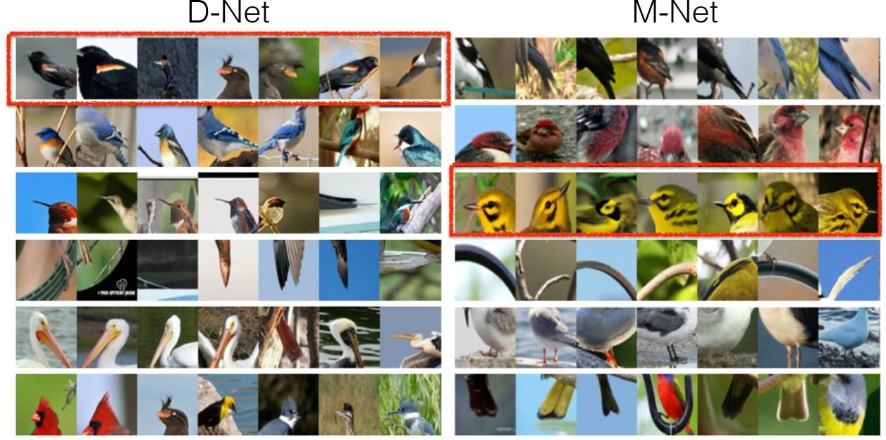
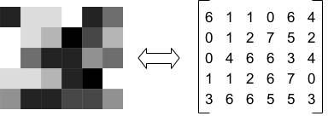
Machine Learning: Overview
Dataset Types
Images
Each image (greyscale) is a 2D data which can be represented as a matrix

Slide 4
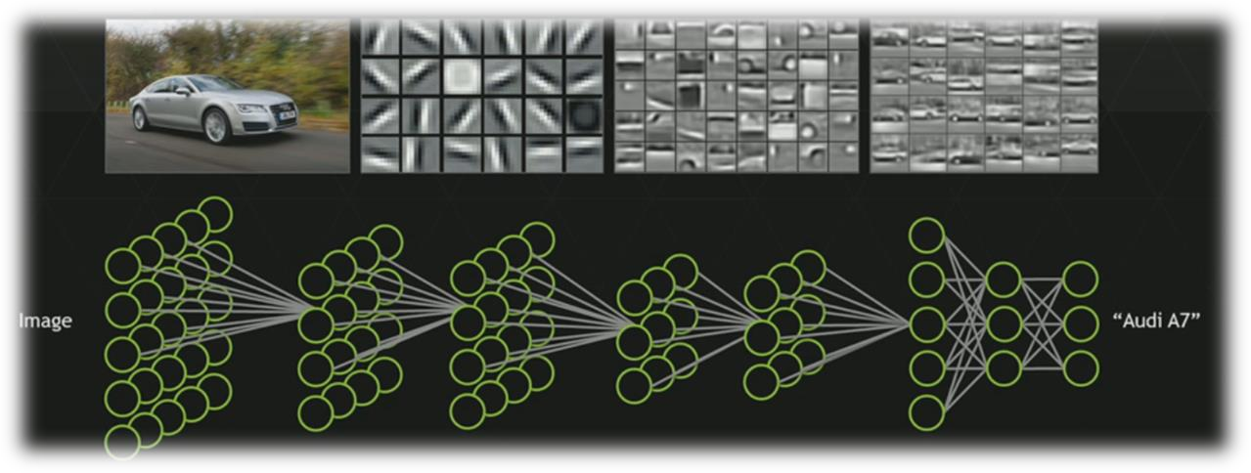
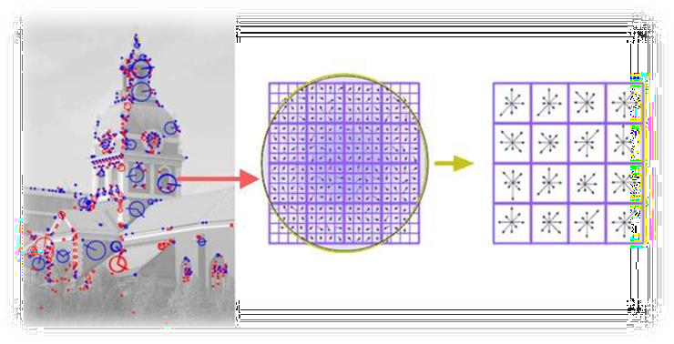
Image Descriptors:
Manually extract features
Deep Learning:
Let machine learning extract most important features
Speeded-Up Robust Features (SURF)
Binary Robust Independent Elementary Features (BRIEF)
Oriented FAST and Rotated BRIEF (ORB)
Scale-Invariant Feature Transform (SIFT)
Histogram of Oriented Gradients (HOG)
HAAR features
etc.
Neural Networks such as Convolutional Neural Networks (CNN) take raw images as input and first process it inside multiple layers to get best features called intrinsic dimension of the data

Slide 5
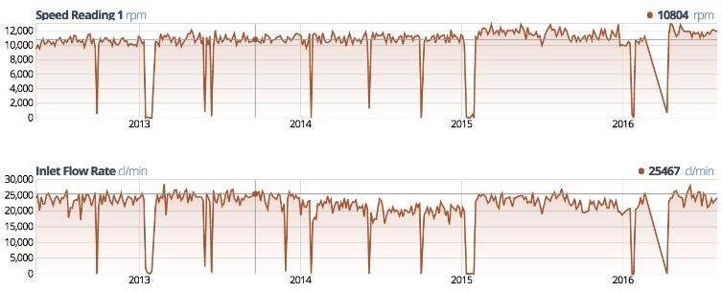
Machine Learning: Overview
Data Types
Time Series
Much difficult to deal with
  Enormous Size
  Cumbersome Labeling
  Not so standard feature extraction strategies as in case of images. (Direct modeling of time series is preferred)

Slide 6
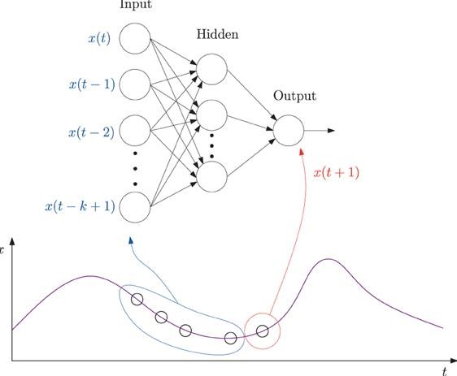
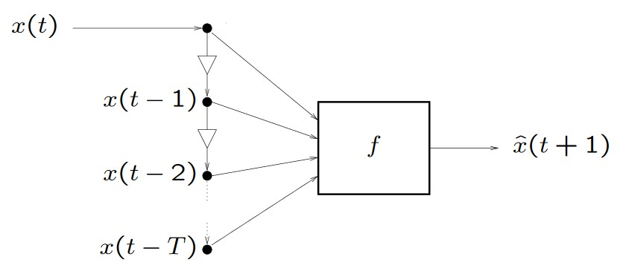
Machine Learning:Let machine learning handle the task !
Time series Models:Manually model it !
Exponential Smoothing (ETS)
Autoregressive Integrated Moving Average (ARIMA) models
Linear regression
Generalized Autoregressive Conditional Heteroskedasticity (GARCH)
Bayesian Models
Vector auto-regression (VAR) models
etc.
Neural Networks such as Convolutional Neural Networks (CNN) take raw waveforms as input and first process it inside multiple layers to get best predictive model for it

Slide 7
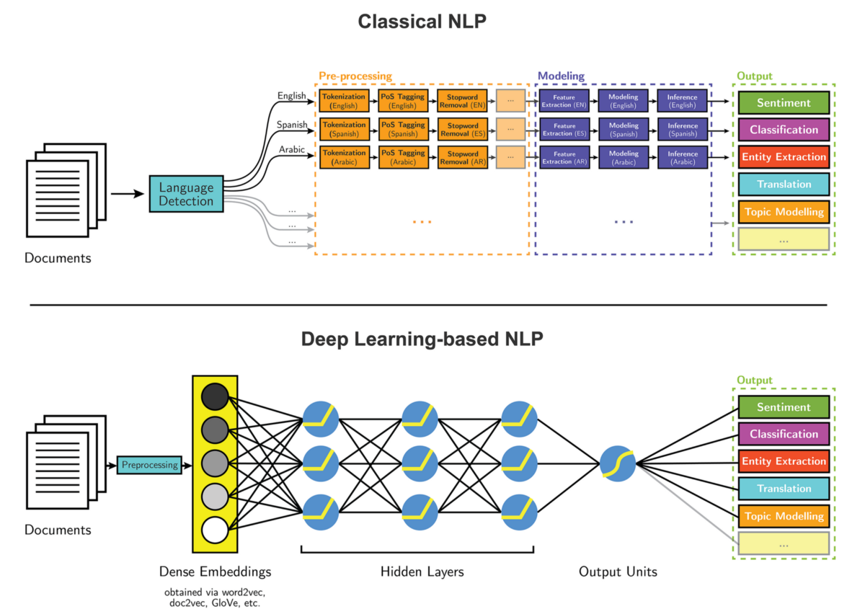

Slide 8
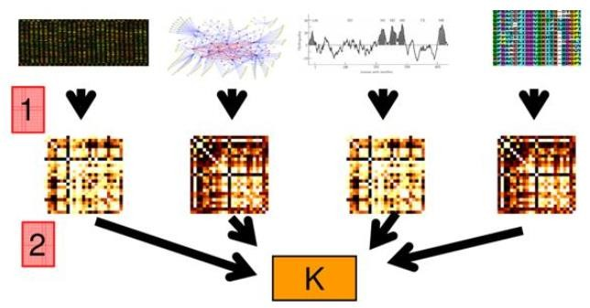
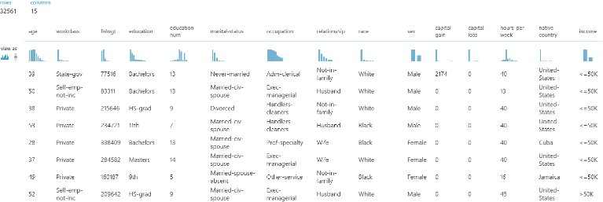
Machine Learning: Overview
Data Types
Heterogeneous data
Multimodal Machine Learning !
+
+

Slide 9
Batch and Online Learning
Another criterion used to classify Machine Learning systems is whether or not the system can learn incrementally from a stream of incoming data.

Slide 10
Batch learning
In batch learning, the system is incapable of learning incrementally:
It must be trained using all the available data.
This will generally take a lot of time and computing resources, so it is typically done offline.
First the system is trained, and then it is launched into production and runs without learning anymore;
it just applies what it has learned. This is called offline learning.

Slide 11
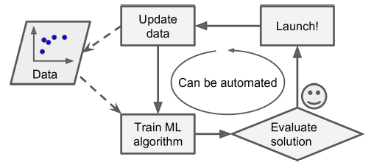
Batch learning

Slide 12
Online learning
In online learning, you train the system incrementally by feeding it data instances sequentially,
either individually or by small groups called mini-batches.
Each learning step is fast and cheap, so the system can learn about new data on the fly,
Online learning is great for systems that receive data as a continuous flow (e.g., stock prices)

Slide 13
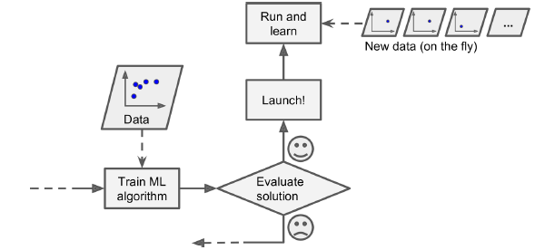
Online learning

Slide 14
Components Training Data
  Instances/Examples
  Individual, independent examples of a concept
  Attributes/Features
  measuring aspects of an instance
    We will focus on nominal and numeric ones

Slide 15
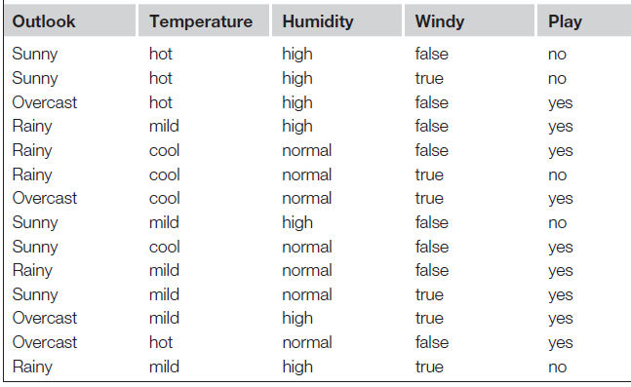
Training Data

Slide 16
Feature Types
Features can be classified on the basis of their values
Nominal
  Values are distinct Symbols
Numeric
  Either real or integer valued

Slide 17
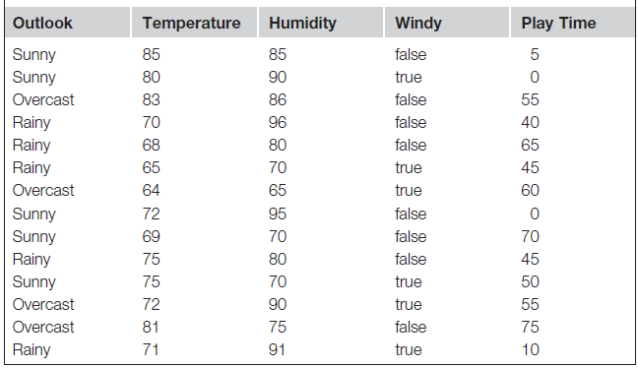
Feature Types

Slide 18
Attributes
Attribute (or dimensions, features, variables): a data field, representing a characteristic or feature of a data object.
  E.g., customer _ID, name, address
Types:
  Nominal
  Binary
  Numeric: (Discrete, Continuous)
    Interval-scaled
    Ratio-scaled

Slide 19
Attribute Types
Nominal: categories, states, or “names of things”
  Hair_color = {auburn, black, blond, brown, grey, red, white}
  marital status, occupation, ID numbers, zip codes
Binary
  Nominal attribute with only 2 states (0 and 1)
  Symmetric binary: both outcomes equally important
    e.g., gender
  Asymmetric binary: outcomes not equally important.
    e.g., medical test (positive vs. negative)
    Convention: assign 1 to most important outcome (e.g., HIV positive)
Ordinal
  Values have a meaningful order (ranking) but magnitude between successive values is not known.
  Size = {small, medium, large}, grades, army rankings

Slide 20
Numeric Attribute Types
Quantity (integer or real-valued)
Interval
Measured on a scale of equal-sized units
Values have order
  E.g., temperature in C˚or F˚, calendar dates
No true zero-point
Intangible
We can add and subtract, but we cannot multiply, divide or calculate ratios.
Ratio
Inherent zero-point
tangible
We can speak of values as being an order of magnitude larger than the unit of measurement (10 K˚ is twice as high as 5 K˚).
  e.g., temperature in Kelvin, length, counts, monetary quantities

Slide 21
General Characteristics of Data Sets
Dimensionality
The dimensionality of a data set is the number of attributes that the objects in the data set have.
  In a particular data set if there are high number of attributes, then it can become difficult to analyze such a data set. This problem is referred as Curse of Dimensionality.
Sparsity
For some data sets, most attributes of an object have values of 0; in many cases fewer than 1% of the entries are non-zero. Such a data is called sparse data or it can be said that the data set has Sparsity.
Resolution
Resolution is the smallest change that can be measured.
  Finer resolution reduces rounding errors. However, resolution that is too coarse may add rounding errors.

Slide 22
Main Challenges of Machine Learning
In short, since your main task is to select a learning algorithm and train it on some data,
the two things that can go wrong are “bad algorithm” and “bad data.”
Let’s start with examples of bad data.

Slide 23
Insufficient Quantity of Training Data
It takes a lot of data for most Machine Learning algorithms to work properly.
Even for very simple problems you typically need thousands of examples, and
For complex problems such as image or speech recognition you may need millions of examples (unless you can reuse parts of an existing model).

Slide 24
Non-representative Training Data
In order to generalize well, it is crucial that your training data be representative of the new cases you want to generalize to
If the sample is too small, you will have sampling noise (i.e., nonrepresentative data as a result of chance),
But even very large samples can be non-representative if the sampling method is flawed. This is called sampling bias.

Slide 25
Poor-Quality Data
If training data is full of errors, outliers, and noise (e.g., due to poor quality measurements), it will make it harder for the system to detect the underlying patterns
Its well worth the effort to spend time cleaning up your training data.
If some instances are clearly outliers, it may help to simply discard them or try to fix the errors manually.
If some instances are missing a few features (e.g., 5% of your customers did not specify their age), you must decide whether you want to ignore this attribute altogether, ignore these instances, fill in the missing values (e.g., with the median age), or train one model with the feature and one model without it, and so on.

Slide 26
Irrelevant Features
Your system will only be capable of learning if the training data contains enough relevant features and not too many irrelevant ones.
A critical part of the success of a Machine Learning project is coming up with a good set of features to train on. This process, called feature engineering,
Feature selection : selecting the most useful features to train on among existing features.
Feature extraction : combining existing features to produce a more useful one (dimensionality reduction algorithms can help).
Creating new features by gathering new data.

Slide 27
Overfitting the Training Data
Say you are visiting a foreign country and the taxi driver rips you off. You might be tempted to say that all taxi drivers in that country are thieves. Overgeneralizing is something that we humans do all too often, and unfortunately machines can fall into the same trap if we are not careful.
In Machine Learning this is called overfitting:
It means that the model performs well on the training data, but it does not generalize well

Slide 28
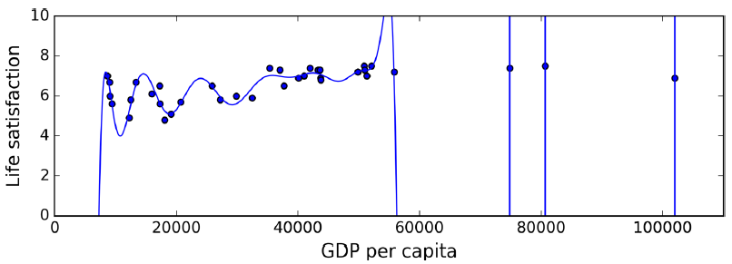
Overfitting the Training Data

Slide 29
Overfitting the Training Data
Overfitting happens when the model is too complex relative to the amount and noisiness of the training data. The possible solutions are:
To simplify the model by selecting one with fewer parameters (e.g., a linear model rather than a high-degree polynomial model), by reducing the number of attributes in the training data
Or by constraining the model
To gather more training data
To reduce the noise in the training data (e.g., fix data errors and remove outliers)

Slide 30
Underfitting the Training Data
As you might guess, underfitting is the opposite of overfitting: it occurs when your model is too simple to learn the underlying structure of the data.
For example, a linear model of life satisfaction is prone to underfit; reality is just more complex than the model, so its predictions are bound to be inaccurate, even on the training examples.

Slide 31
Underfitting the Training Data
The main options to fix this problem are:
Selecting a more powerful model, with more parameters
Feeding better features to the learning algorithm (feature engineering)
Reducing the constraints on the model (e.g., reducing the regularization hyperparameter)

Slide 32
Supervised Machine Learning

Slide 33
Inductive Machine Learning Process …
Preparation of Training Data
Learning Scheme OR
Learning Algorithm
Trained Model
Testing and Evaluation
Test Data
Deploy Trained & Tested Model in Domain

Slide 34
Deployed Model…
New/ Unknown Instance
ML Model
Result/ Prediction

Slide 35
Supervised Machine Learning Types
Types Supervised Machine Learning
Classification
Association
Regression \ Numeric Prediction
Also Known as Predictive Learning

Slide 36
Supervised Machine Learning Types
Types Supervised Machine Learning
Classification
Regression \ Numeric Prediction
Also Known as Predictive Learning

Slide 37
Classification Learning
Supervised Learning
Prediction Belongs to one of distinct\Discrete class
If Prediction Consists of two Classes also known as Binary Prediction otherwise Multi-Class Classification
Measure success on fresh data for which class labels are known (test data)

Slide 38
Classification Learning
Classification
Association
Regression \ Numeric Prediction
Class Attribute

Slide 39
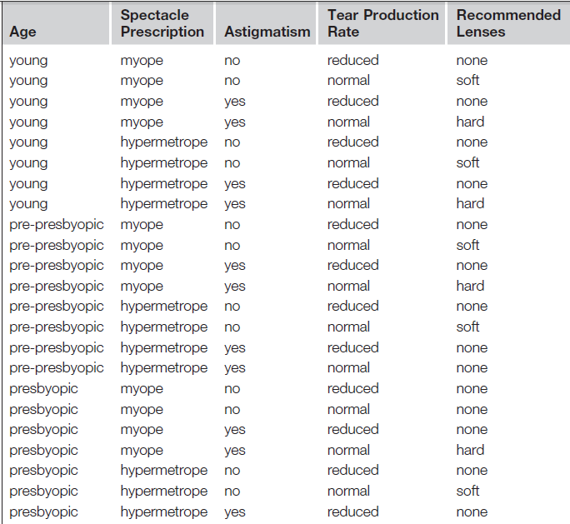
Contact Lens Problem (Classification )
Class Attribute

Slide 40
Regression \ Numeric Prediction
Variant of classification learning where “class” is numeric (also called “regression”)
Learning is supervised
  Scheme is being provided with target value
Measure success on test data
Classification
Association
Regression \ Numeric Prediction

Slide 41
Numeric Prediction

Slide 42
Classification Algorithms
There are many algorithms for classification. Some of the famous are following:
Decision trees
Naive Bayes classifier
Linear Regression
Logistic regression
Neural networks
  Perceptron
  Multi Layer Neural Networks
Support vector machines (SVM)
Quadratic classifiers
Instance Based Learning
  k-nearest neighbor

Slide 43
K-Nearest Neighbor Algorithm (K-NN)
"Show me who your friends are and I’ll tell you who you are?"

Slide 44

What is KNN Algorithm?
KNN – K Nearest Neighbors, is one of the simplest Supervised Machine Learning algorithm mostly used for
Classification
It classifies a data point based on how its neighbors are classified
Notes:
,. Unlike other regression algorithms where we have one or more than one dependent variables

Slide 45


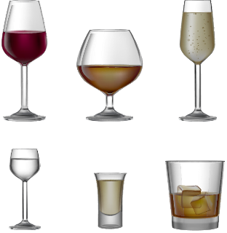
What is KNN Algorithm?
KNN stores all available cases and classifies new cases based on a similarity measure
Sulphur Dioxide Level →
RED or WHITE?
Chloride Level →
Notes:
,. Unlike other regression algorithms where we have one or more than one dependent variables

Slide 46
What is KNN Algorithm?
But, what is K?
Sulphur Dioxide Level →
RED or WHITE?
Chloride Level →
Notes:
,. Unlike other regression algorithms where we have one or more than one dependent variables

Slide 47
What is KNN Algorithm?
k in KNN is a parameter that refers to the number of nearest neighbors to include in the majority voting process
K=5
Sulphur Dioxide Level →
RED or WHITE?
Chloride Level →
Notes:
,. Unlike other regression algorithms where we have one or more than one dependent variables

Slide 48
What is KNN Algorithm?
A data point is classified by majority votes from its 5 nearest neighbors
K=5
Sulphur Dioxide Level →
RED or WHITE?
Chloride Level →
Notes:
,. Unlike other regression algorithms where we have one or more than one dependent variables

Slide 49
What is KNN Algorithm?
Here, the unknown point would be classified as red, since 4 out of 5 neighbors are red
K=5
Sulphur Dioxide Level →
RED
Chloride Level →
Notes:
,. Unlike other regression algorithms where we have one or more than one dependent variables

