Slide 1

Apache Airflow
Session 04

Slide 2

Core Components
Webserver: A flask server running with gunicorn that serves the airflow UI.
Scheduler: a daemon responsible for scheduling jobs. This is a multi-threaded python process that determines tasks need to be run, when they need to be run, and where they are run.
Database: a database where all dag and task metadata are stored. This is typically a postgres database, but mysql, mssql, and sqlite are also supported.
Executor: the mechanism for running tasks. An executor is running within the scheduler whenever airflow is operational.

Slide 3
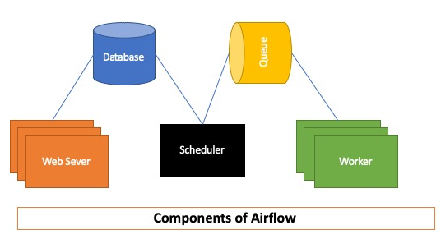
Other components
Worker: The process that executes tasks, as defined by the executor. Depending on which executor you choose, you may or may not have workers as part of your Airflow infrastructure.
Triggerer: A separate process which supports deferrable operators. This component is optional and must be run separately. It is needed only if you plan to use deferrable (or "asynchronous") operators.

Slide 4
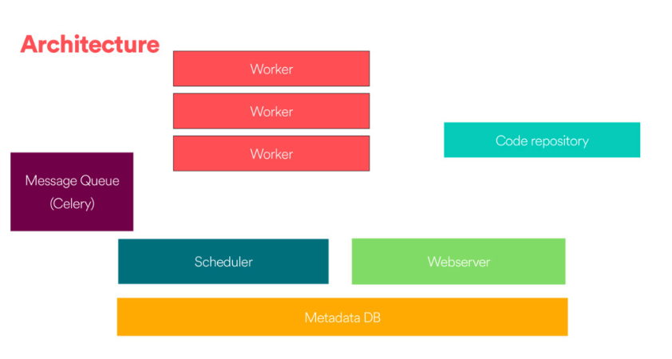
Architecture

Slide 5
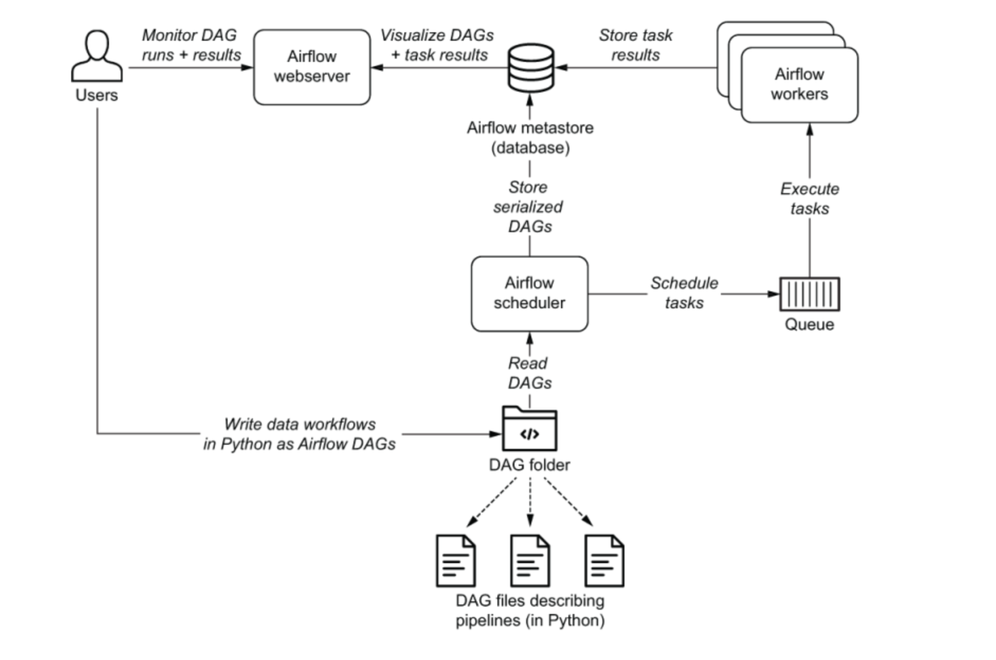

How it works?

Slide 6

Core Airflow concepts
DAG: Directed Acyclic Graph. An Airflow DAG is a workflow defined as a graph, where all dependencies between nodes are directed and nodes do not self-reference. For more information on Airflow DAGs, see Github DAGs.
DAG run: The execution of a DAG at a specific point in time. A DAG run can be scheduled or manually triggered.
Task: A step in a DAG describing a single unit of work.
Task instance: The execution of a task at a specific point in time.

Slide 7
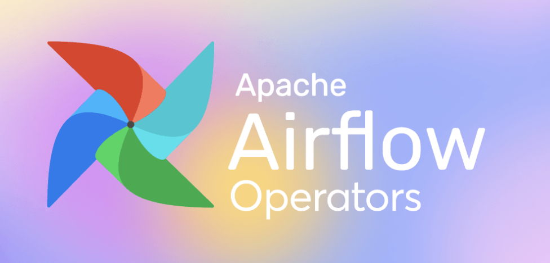
Operators
Action operators: Execute a function. For example, the PythonOperator or the BashOperator.
Transfer operators: Move data from a source to a destination. For example, the S3ToRedshiftOperator.
Sensors: Wait for something to happen. For example, the ExternalTaskSensor or the HttpSensorAsync.

Slide 8
Airflow Executors
After a DAG is defined, the following needs to happen in order for the tasks within that DAG to execute and be completed:
The Metadata Database keeps a record of all tasks within a DAG and their corresponding status (queued, scheduled, running, success, failed, and so on) behind the scenes.
The scheduler reads from the metadata database to check on the status of each task and decide what needs to get done and when.
The executor works closely with the scheduler to determine what resources will actually complete those tasks (using a worker process or otherwise) as they're queued.
Types:
1. Local executor: Running Apache Airflow on a Local executor exemplifies single-node architecture.
2. Celery executor: The way of running python processes in a distributed fashion. Celery executor works with a "pool" of independent
workers and uses messages to delegate tasks. On Celery, your deployment's scheduler adds a message to the queue
and the Celery broker delivers it to a Celery worker (perhaps one of many) to execute.
3. Kubernetes executor: The Kubernetes executor leverages the power of Kubernetes for resource optimization.

Slide 9
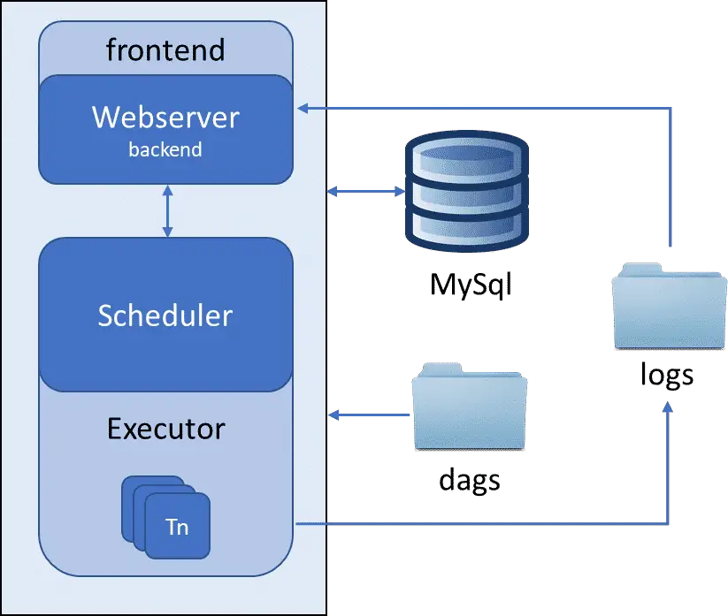
.

Slide 10

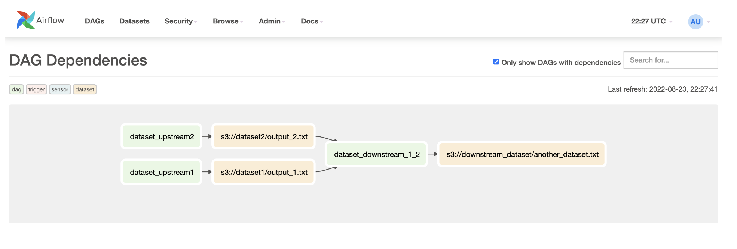
Datasets
Datasets and data-aware scheduling were made available in Airflow 2.4. DAGs can be scheduled based on updates to these datasets.
Datasets can help resolve common issues. For example, consider a data engineering team with a DAG that creates a dataset and an analytics team with a DAG that analyses the dataset. Using datasets, the data analytics DAG runs only when the data engineering team's DAG publishes the dataset.

Slide 11

Questions

