Slide 1
Project
DIGITAL COMMUNICATION PROJECT
Investigating different aspects of digital communication systems.

Slide 2
Team
عبدالرحمن إيهاب محمود أبودغيدي 18010917
Monica Ihab Eldabaeh 18012559
سعيد مبروك سعيد الشيخ 18010788
محمد ياسر محمد احمد 18012553
عبدالله محمد صلاح الدين قرطام 18011029
زياد سلامه سعد تركي 18010727
اسلام عبداللطيف دياب 18010333
آسر محمد عاطف زايد 18010299
Farris Essam Al-Saqqar 18012585
احمد محمود فخر الدين 18010244

Slide 3
TABLE OF CONTENTS
01
02
03
Inter-Symbol Interference due to band-limited channels
Part 1
Inter-Symbol Interference due to multi-path channels
Part 2
Comparisons of coding techniques
(Repetition, Convolution, Polar)
Part 3

Slide 4
01
Part 1
Inter-Symbol Interference due to band-limited channels

Slide 5
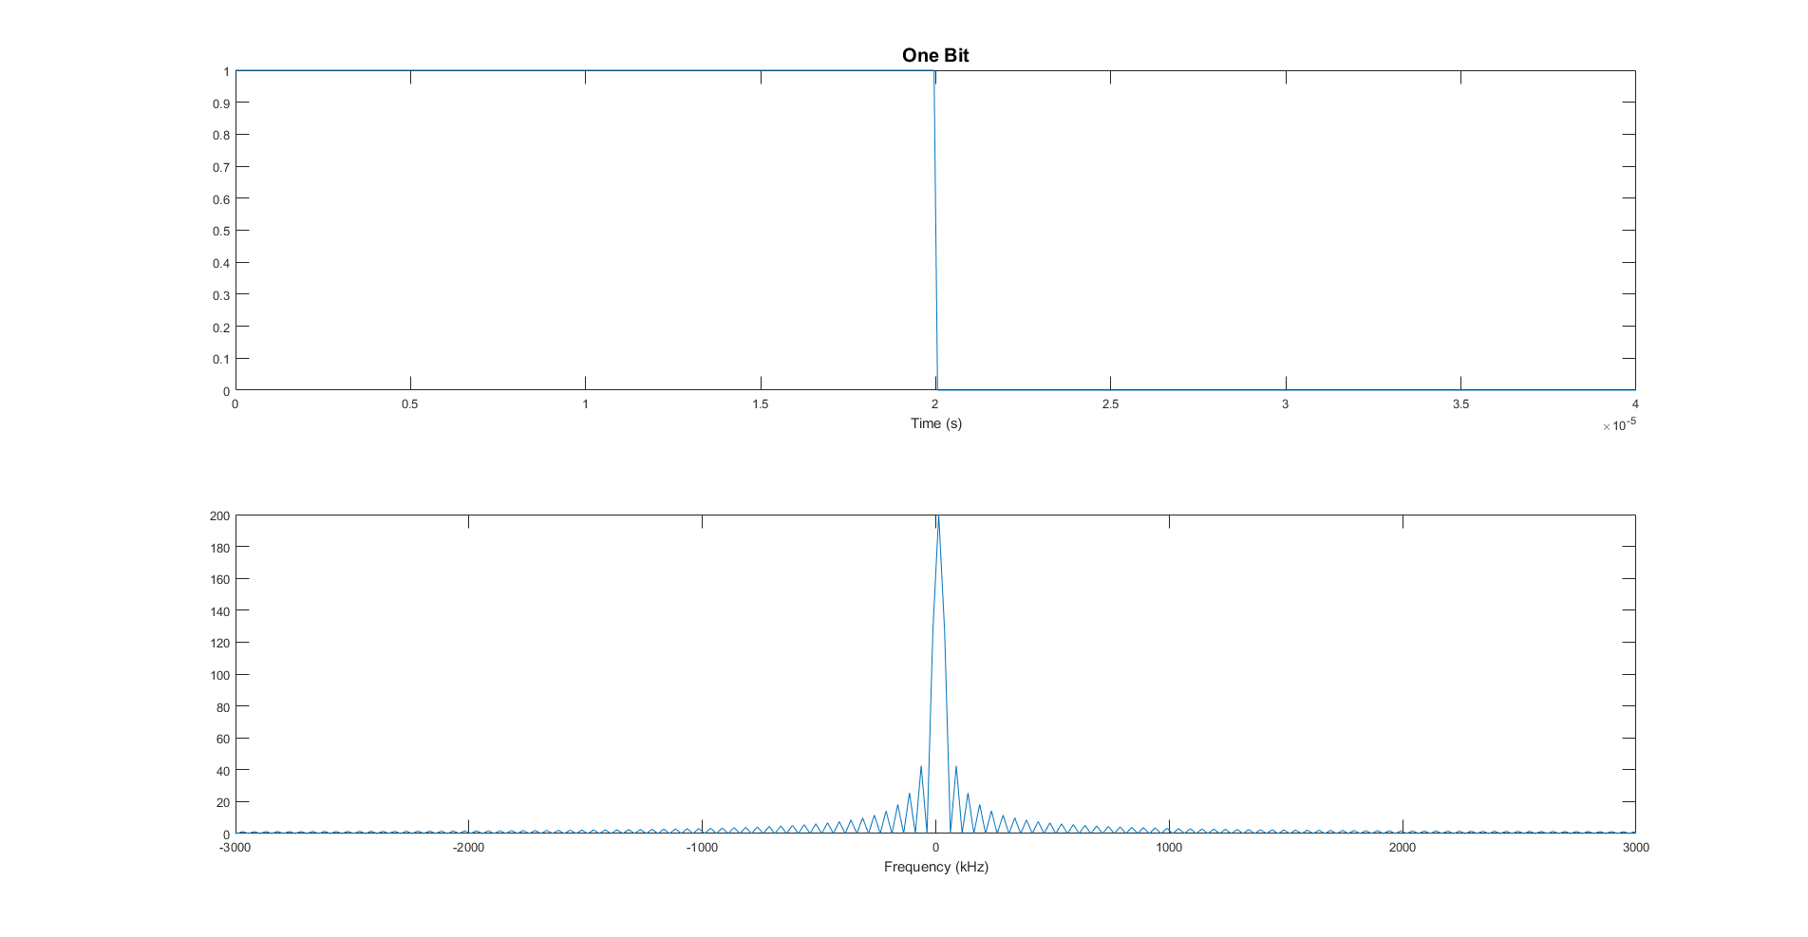
Square Pulse
As expected, the square pulse corresponds to a sinc in the frequency domain, which has infinite bandwidth.

Slide 6
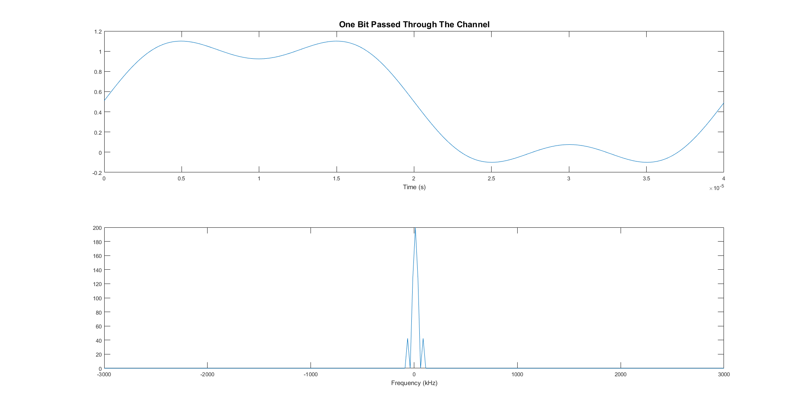
The channel trims the infinite sinc, which results in the pulse spreading to the neighbouring bits in time.

Slide 7
Mathematical Criterion That Insures No ISI
Nyquist proposed three different criteria that ensure no ISI:
The first criterion achieves zero ISI by choosing a pulse shape that has a non-zero amplitude at its center and zero amplitudes at t = ±nTb, where Tb is the separation between successive pulses.
The second criterion works by adding a controlled amount of ISI (precisely at 0 and Tb ). Since the degree of ISI is known, it can be easily accounted for at the receiver. The point of this method is to increase the pulse’s width so that we can decrease the bandwidth.
All pulses that fulfill these criteria resemble sinc functions.

Slide 8
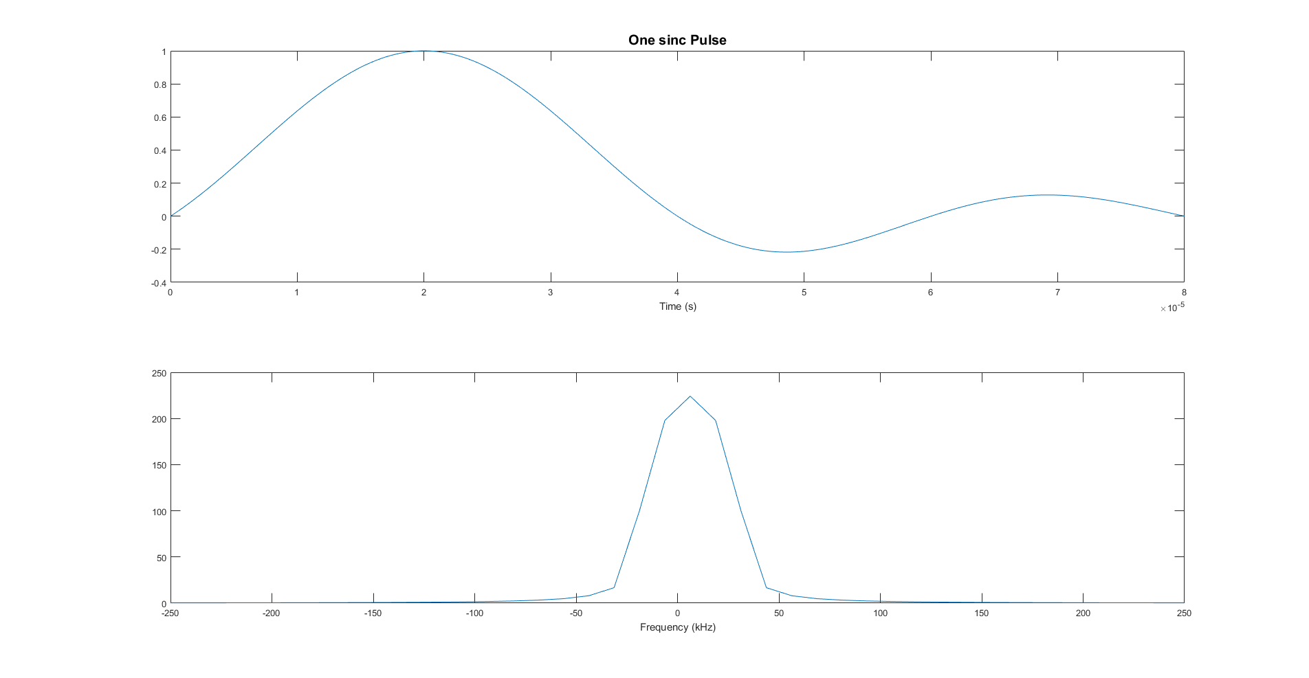
Generic sinc pulse
The first example is a generic sinc pulse whose nulls are at the start of each other bit.

Slide 9
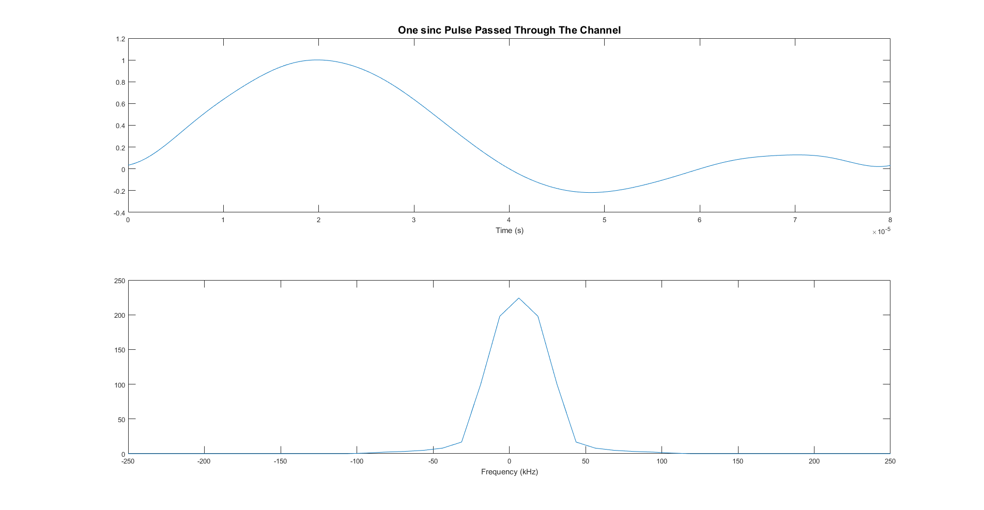
Since the sinc is finite in the frequency domain, the channel has practically no effect on it.

Slide 10
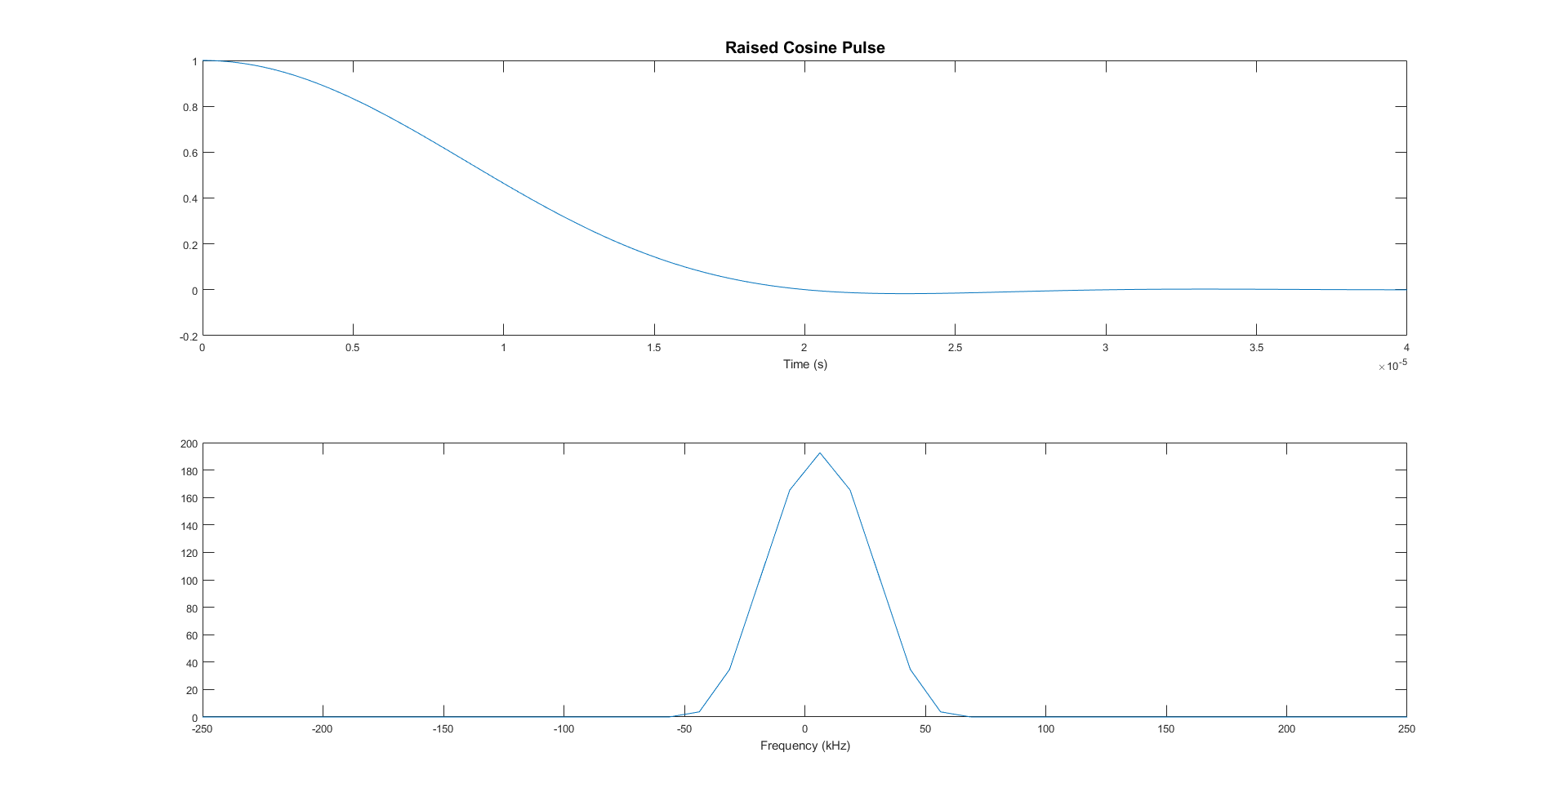
Raised Cosine Pulse
Another pulse shape that satisfies the criterion is the raised cosine.

Slide 11
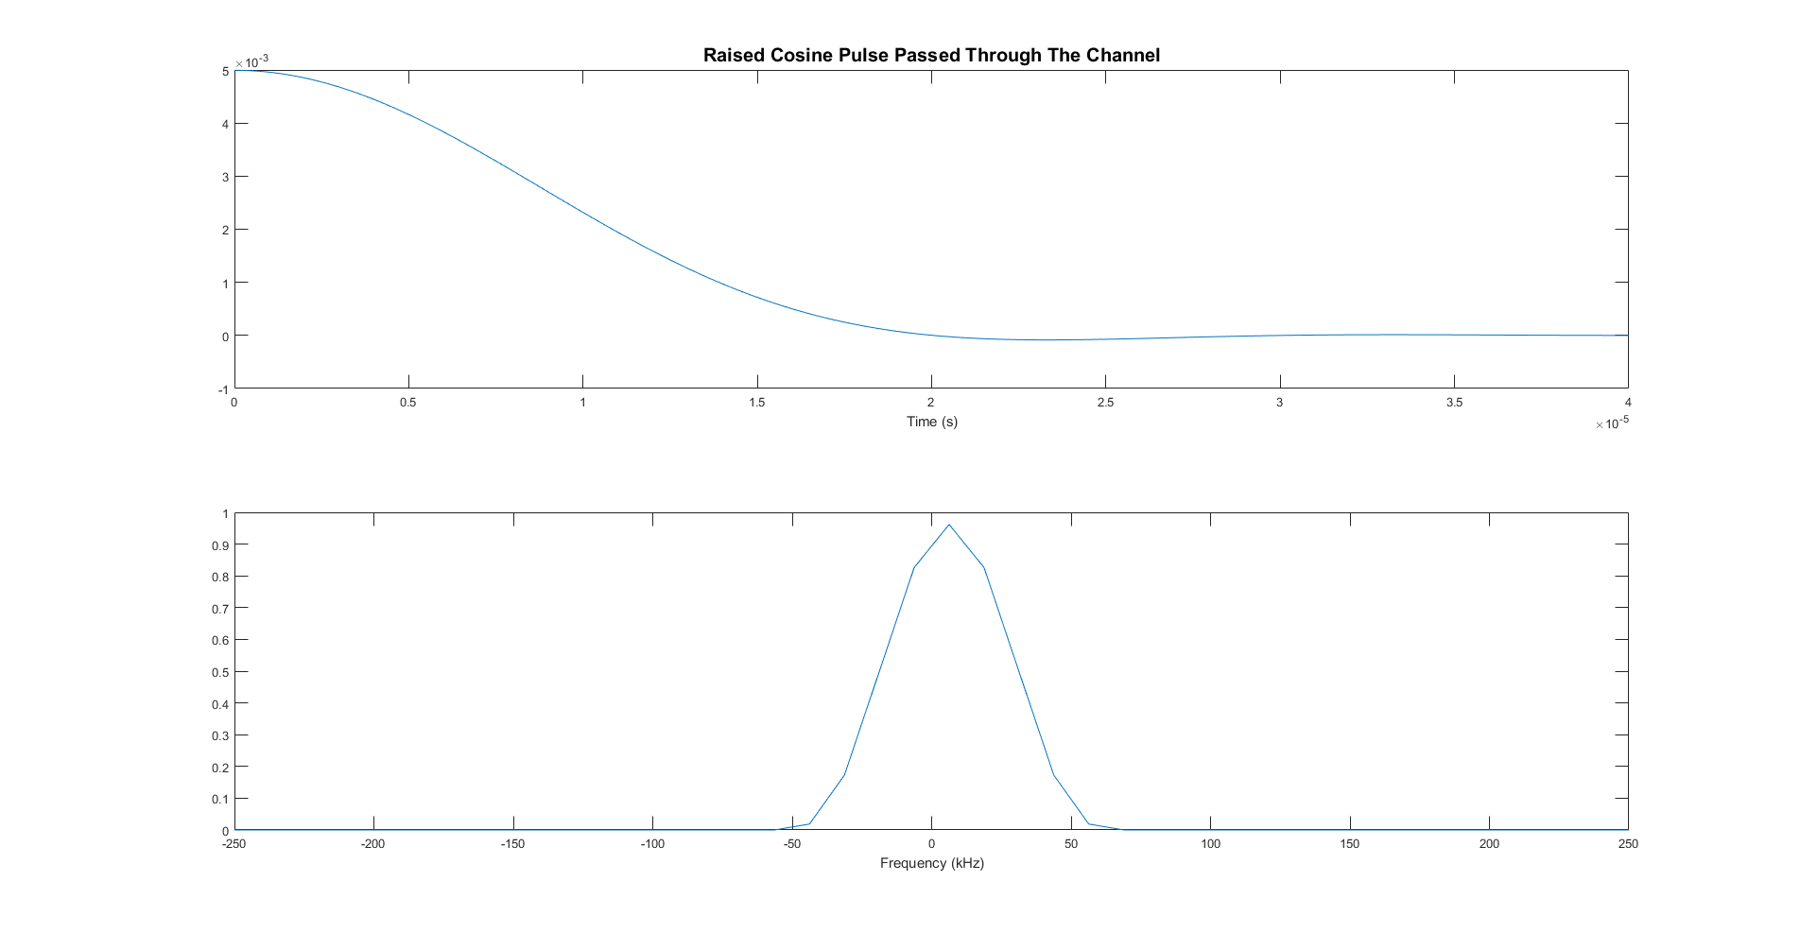
Similar to the generic sinc pulse, the channel also has no effect on it.

Slide 12
02
Part 2
Inter-Symbol Interference due to multi-path channels

Slide 13
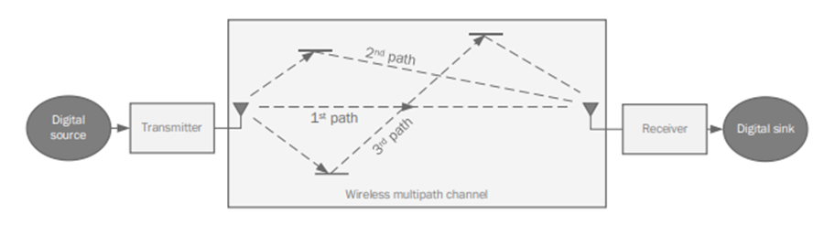
Multiple copies of the signal would travel around and reach the receiver at different times. This effect is what is known as the multipath effect.
To avoid this phenomenon, we need to reverse the multipath channel effect at the receiver.
Multipath channel effect is distributed exponentially decreasing.

Slide 14
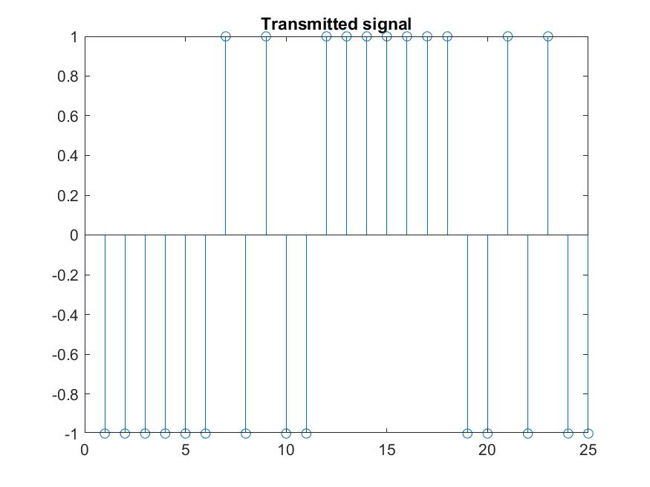
Transmitter
BPSK symbols with energy Eb = 1.
Square pulses (1, -1).

Slide 15
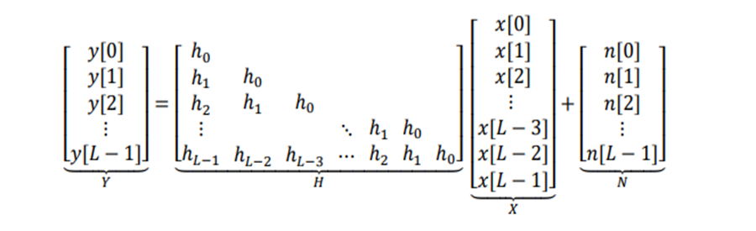
Channel
Multi-path channel effect

Slide 16
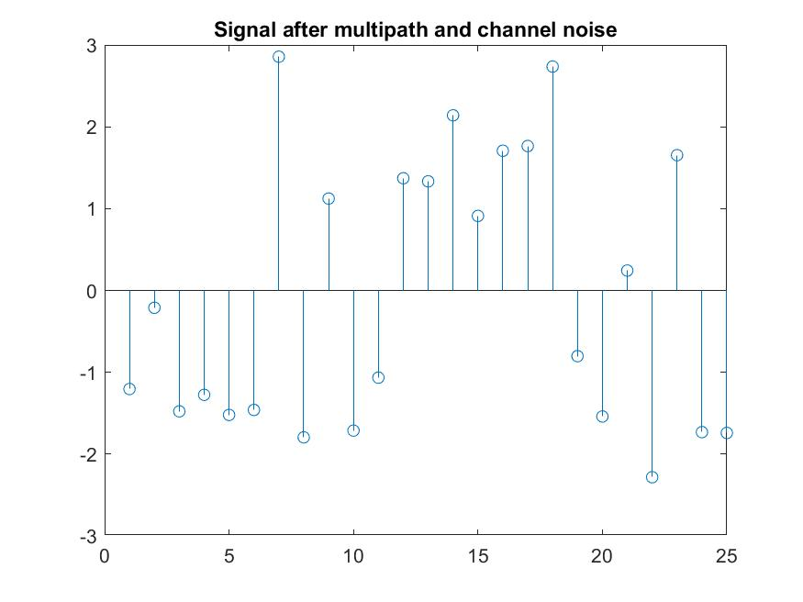
AWGN effect with zero mean and variance 1.

Slide 17
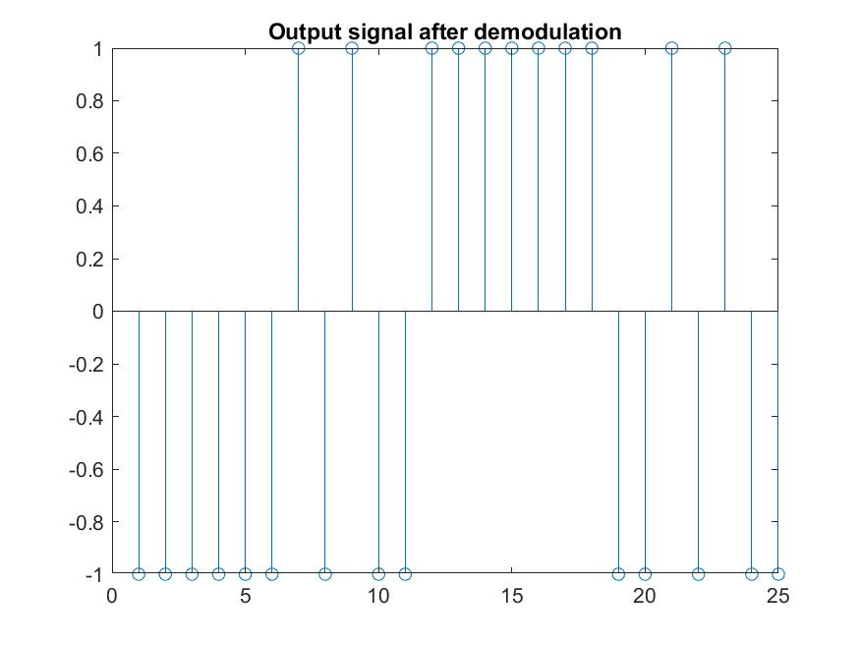
Receiver
Equalizer to reverse the multi-path channel effect.
AWGN can’t be reversed.
Simple detector

Slide 18
What is the best way of estimating the transmitted symbols 𝑿?
Square pulses then reverse the multi-path channel effect by equalizer which is an inverse for the multi-path matrix.

Slide 19
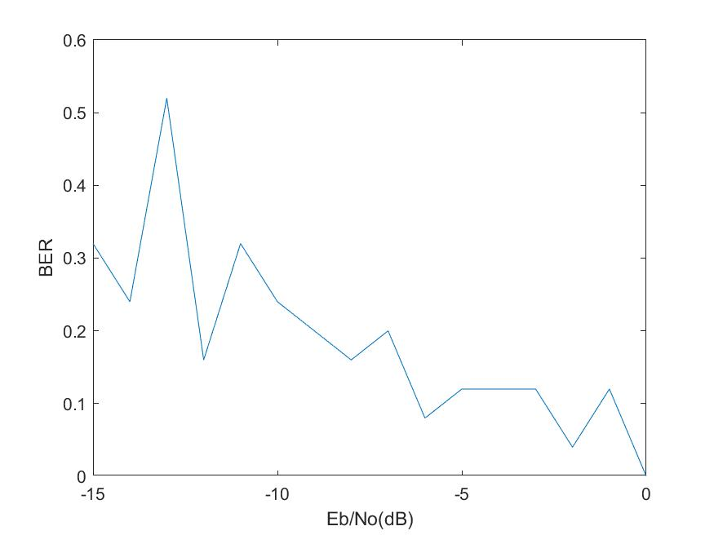
BER vs Eb/No(dB):

Slide 20
03
Part 3
Comparisons of coding techniques

Slide 21
Repetition Code
In this coding technique, each information bit is repeated L times. If the coding rate of the repetition code is r = B/C, this means that each information bit is repeated L = C/B = 1/r times. The decoding algorithm suitable for BSC is a majority rule vote.

Slide 22
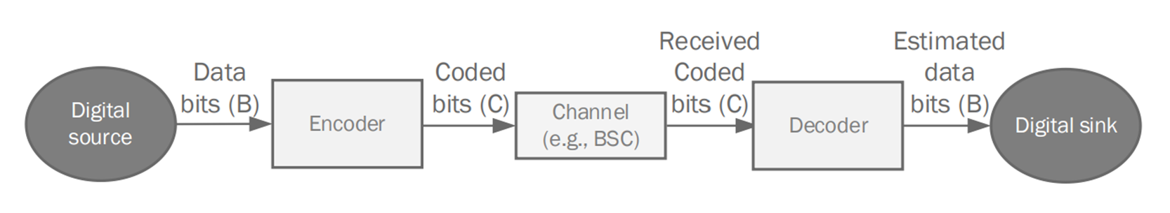
Process Steps
Generate Random bits using the GenerateBits function
Repeat each bit L times using GenerateSamples function, which takes the desired value of L and the randomly generated sequence
Check the effect of the BSC channel depending on the desired value P
Decode bits from sample using the majority rule vote
Compute BER

Slide 23
Convolutional Code
The encoding of convolutional codes is based on a given Generator polynomial that defines the relation between the input bit and its corresponding output, and the decoding of convolutional codes is using Viterbi algorithm.

Slide 24
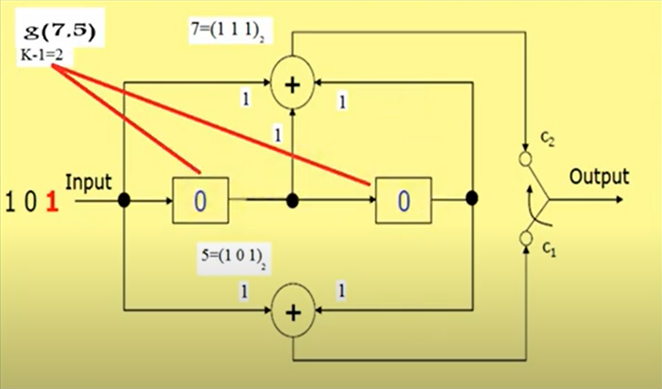
2G Polynomial Generator

Slide 25
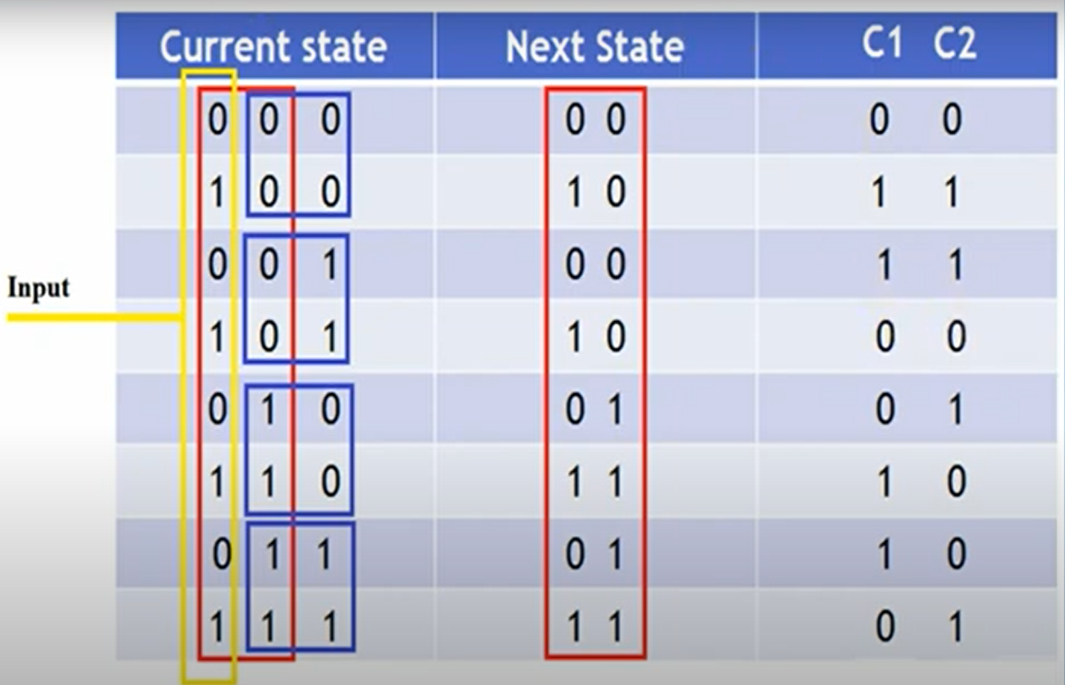
2G Polynomial Generator - TruthTable

Slide 26
Convolutional Encoder Steps
Finding the next state:
Start with a current state of 00
Loop over the input and concatenate the first bit with the current state
Take the first two bits and consider them the next state
Next state = current state
Repeat
Encoding the sequence:
Within the previous loop, we apply the relations of out 2G polynomial generator (5,7) to extract the encoded sequence

Slide 27
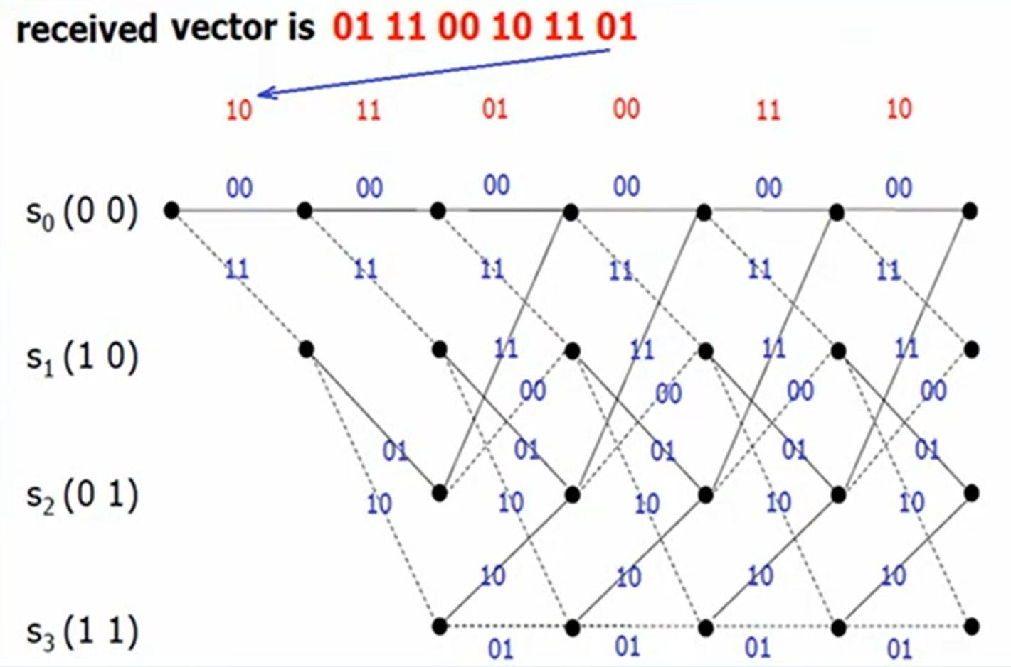
Trellis Diagram

Slide 28

Viterbi Decoder Steps
The Viterbi Algorithm is basically following the path with the lowest error in the trellis shown in the previous slide.
From the precious diagram, we can conclude that the trellis is divided into 3 parts.
Our code is based a Graph data structure to facilitate the process
Code Steps:
Dividing the sequence coming from the BSC channel to pairs of 2
Defining a Source and Target vectors for the first 2 paths
Defining the path vector for the first 2 paths
XORing the path with the input bits to find the error
(weight) of each path.
5. Add the weights to a vector

Slide 29
Viterbi Decoder Steps
This process is repeated for each section, and then looped over N times (B-4) to complete the source, destination, path, and weights vectors.
We add those vectors to the MATLAB function digraph(s,t,weights), and use the function “shortestpath” to find the shortest 4 vectors starting from the first vertex to the last 4
To find the final decoded output, we follow the shortest path vector starting from the second vertex. If the vertex is odd, then the input was 1, if the vertex is even, the input was 0.

Slide 30
Polar Code
Polar Code is a form of linear block codes which has shown very good performance in different communication systems. The encoding of polar codes is using the polarization transformation, and the decoding can be done using Successive Cancellation (SC) decoding.

Slide 31
Polar Encoder Steps
We will double the size of the message bits.
Then we will freeze (zero out) half of the sequence.
Using the reliability sequence, we will determine which indices of the vector are to be frozen.
We send data from TX in channel (noisy).
Polar encoding decomposes the channel into multiple virtual channels.
Those virtual channels can be: 1. Ideal channels. 2. super noisy channels.
Reliability sequence and frozen bits are used to make sure we inserted our data into those ideal channels.
4. Then we will combine the bits of the message using polar transform (demonstrated in the following image).

Slide 32
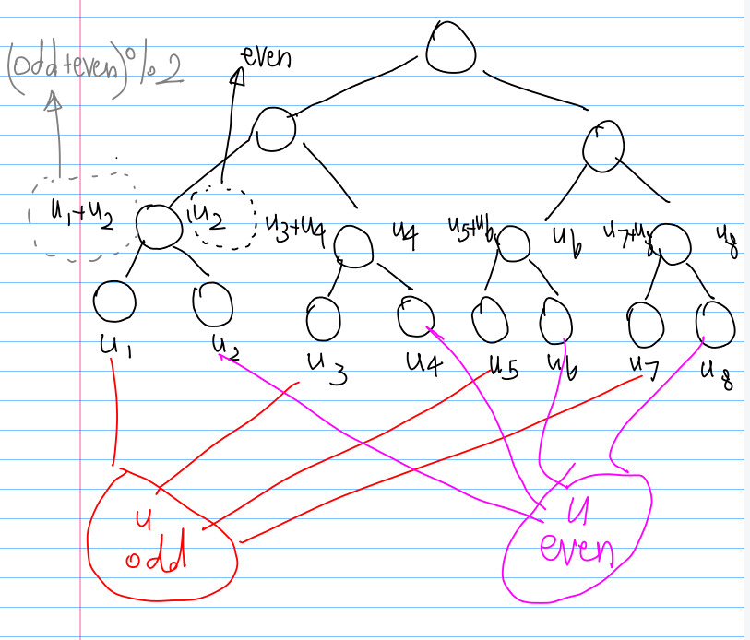

Slide 33
THANKS!

