Slide 1

Digital HealthCare System
National E-Care

Slide 2
Project Supervisor
Lecturer. Laeeq Khan Niazi
Developer
Rayan Rasheed (2021-CS-59)
Project Owner
M Abdullah (2021-CS-104)

Slide 3
Motivation
"Empowering healthcare through innovation, NEC (National E-Care) System brings together patients and doctors in a seamless digital experience, revolutionizing the way we approach care and appointments”
M Abdullah

Slide 4
Description
The National Care System (NEC) is a revolutionary healthcare solution designed to streamline and enhance the patient-doctor appointment experience. In response to the challenges faced by traditional appointment systems, NEC provides a centralized, secure, and user-friendly platform that facilitates efficient communication between patients and healthcare providers.

Slide 5
Modules
Appointment Management
Reviews Management
User Management
Patient Management
Doctor Management

Slide 6
Actors
Actors
Offstage actor
Admin
Doctor
Patient
Government
Hospital

Slide 7
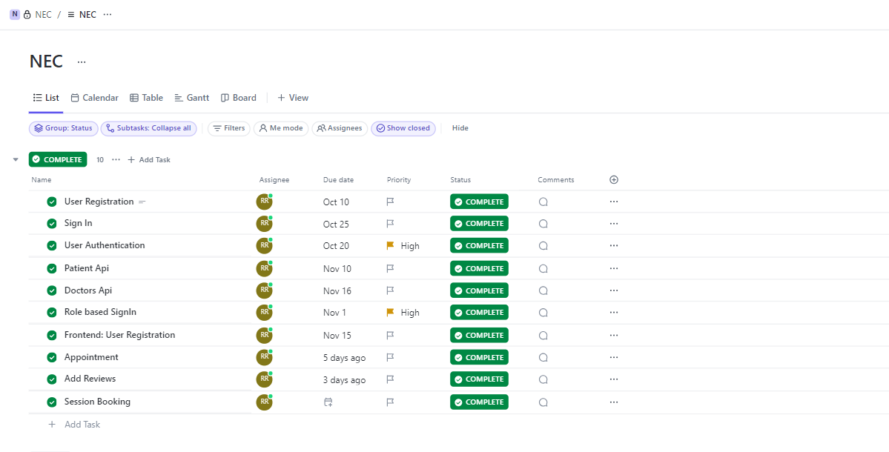
Project Management-Clickup

Slide 8
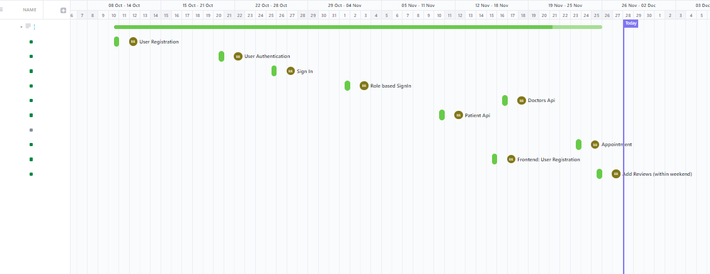
Project Management-GANTT CHART

Slide 9
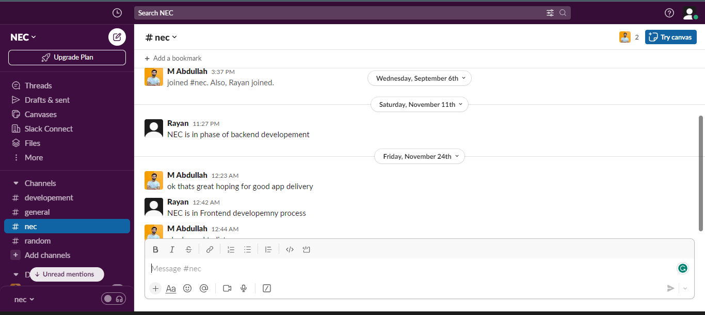
Slack Communication-NEC Channel

Slide 10
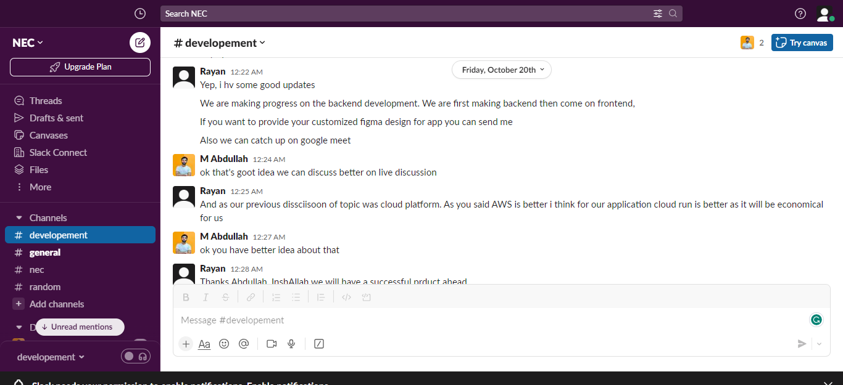
Slack Communication-Development Channel

Slide 11
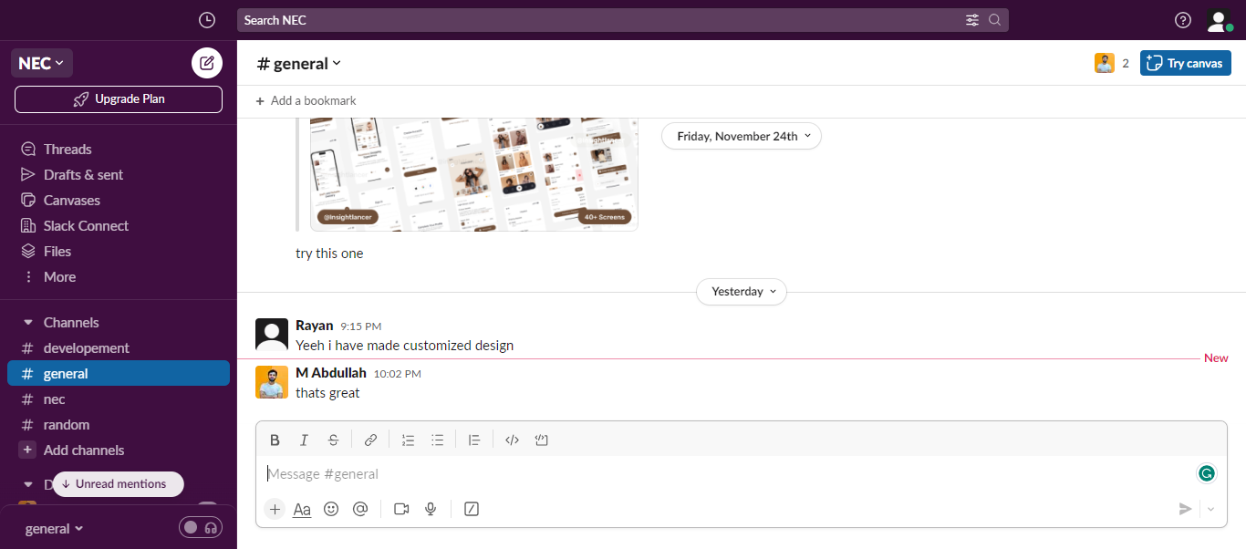
Slack Communication-General Channel

Slide 12
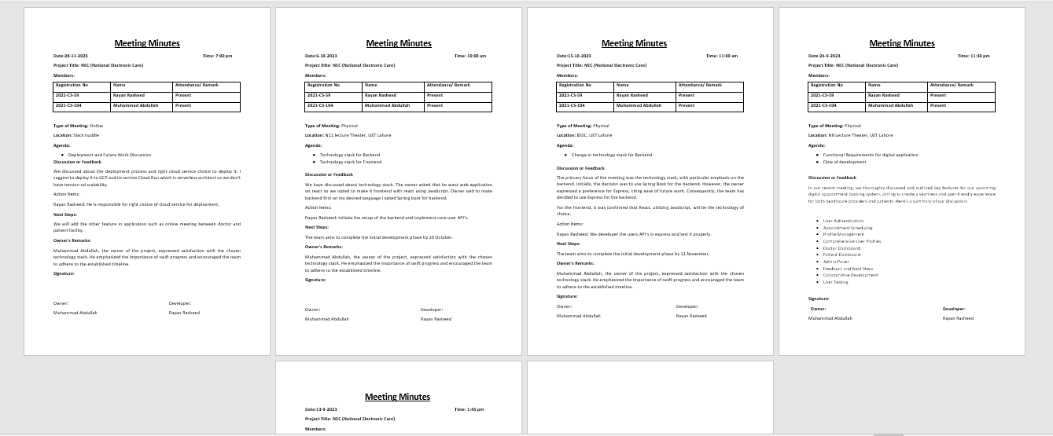
Meeting Minutes

Slide 13
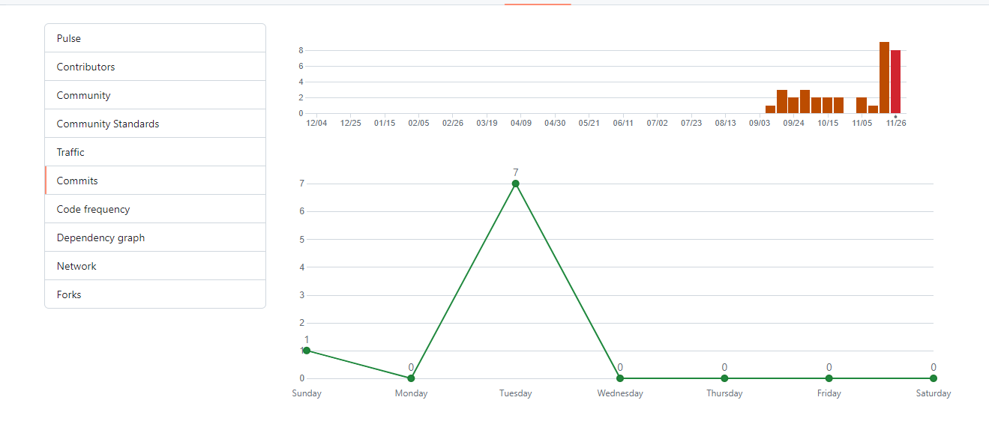
GitHub Documentation (Commits)

Slide 14
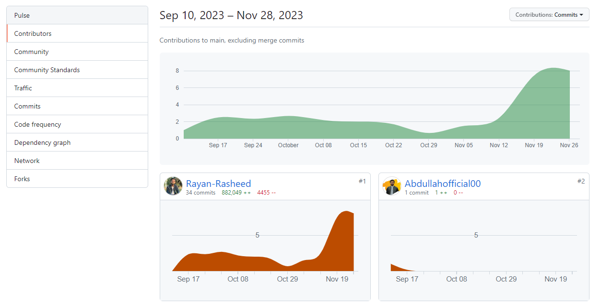
GitHub Documentation (Contributions)

Slide 15
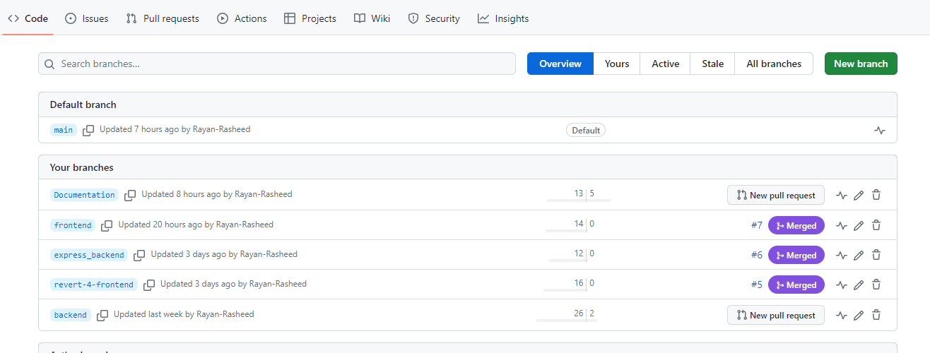
GitHub Documentation (Branching )

Slide 16
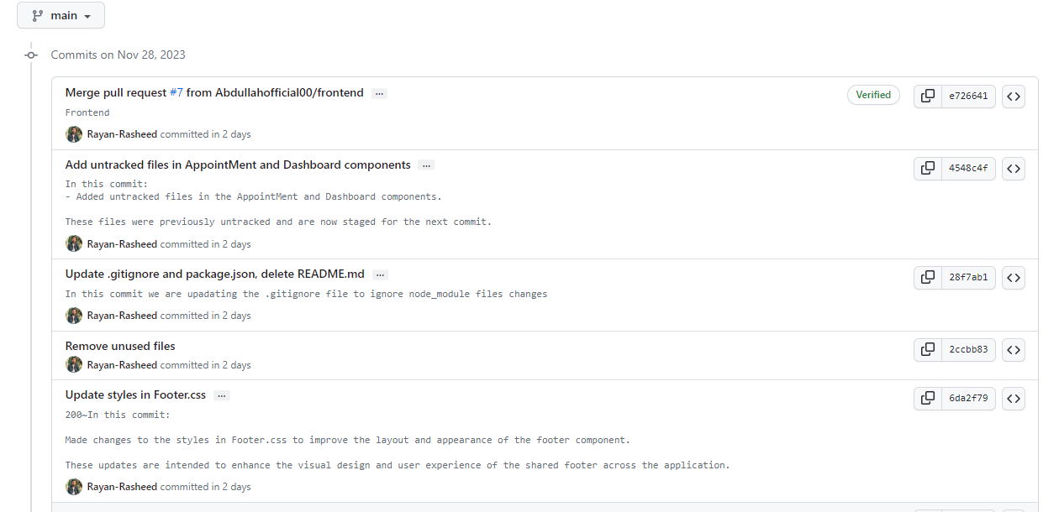
GitHub Documentation (Commit Style)

Slide 17
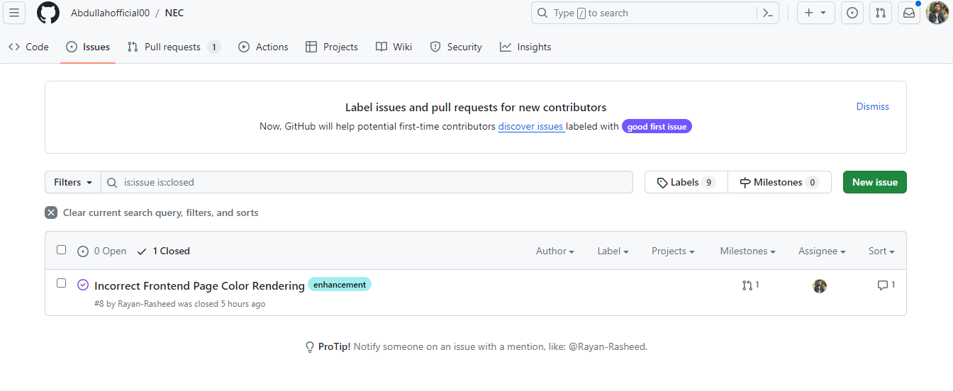
GitHub Documentation (Issue)

Slide 18
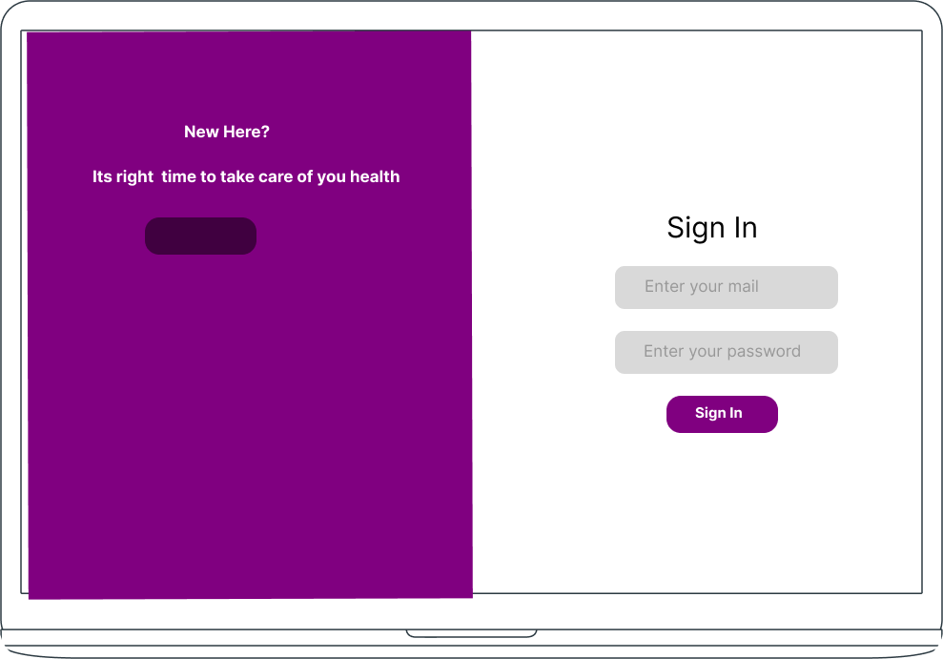
Wireframes-Sign In

Slide 19
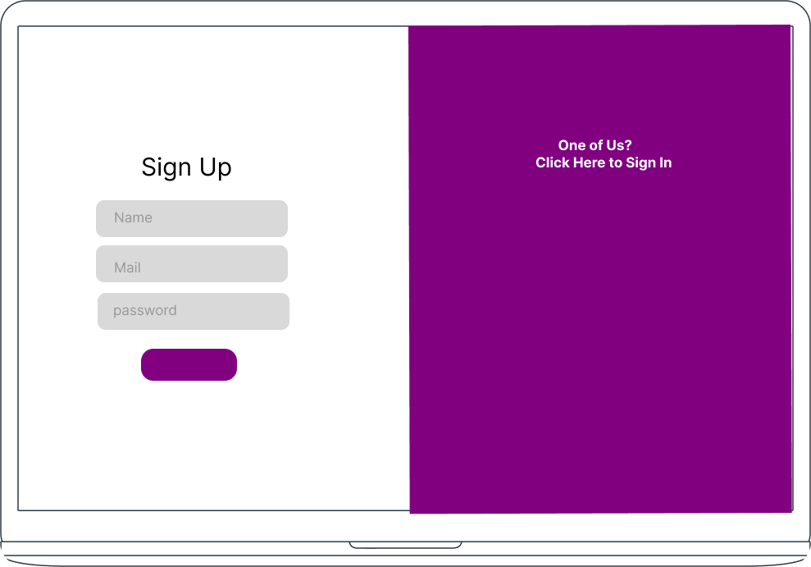
Wireframes-Sign Up

Slide 20

Wireframes-Homepage

Slide 21
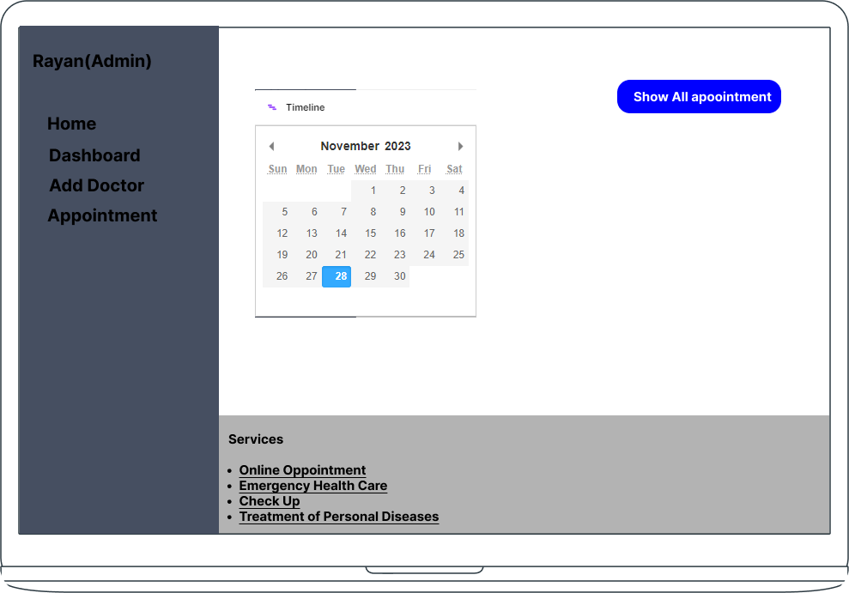
Wireframes-Homepage

Slide 22
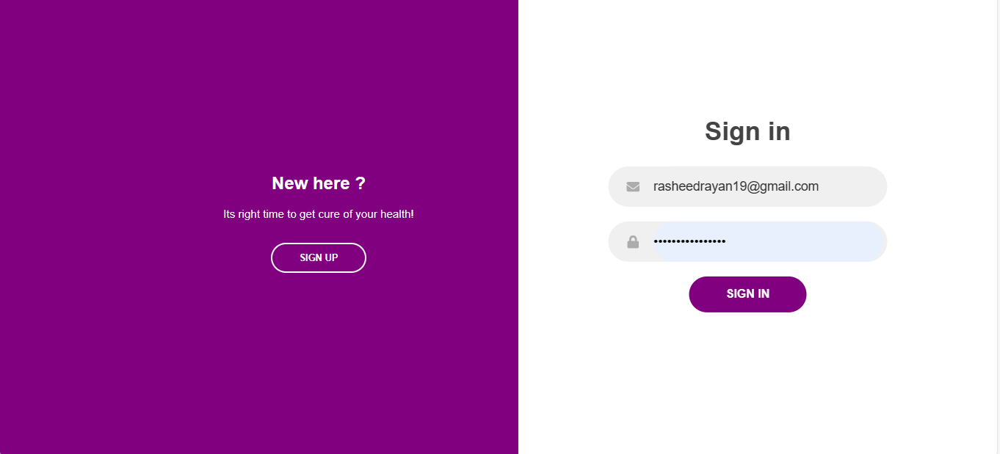
Frontend- SignIn

Slide 23

Frontend- Homepage

Slide 24
Technology Stack
Service | Technology Stack | Reason
Frontend | React | Interactive UI Component Bases Structure Virtual DOM Maintained by Facebook, so there is large community of react.
Backend | Express | Robust Routing Capability Middleware Support Scalability Large Community Easy syntax Best for small scale application like NEC

Slide 25
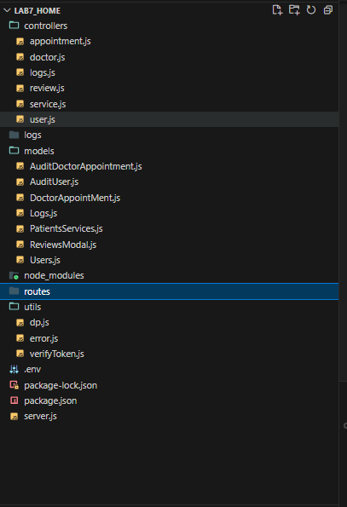
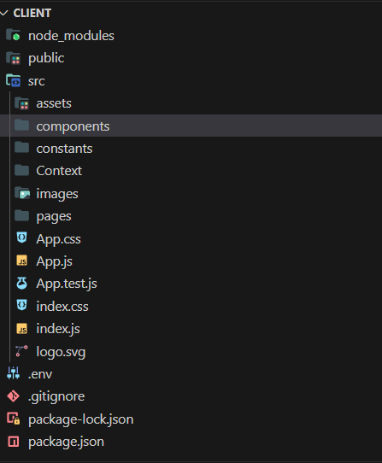
Best Practise-Backend
Frontend

Slide 26
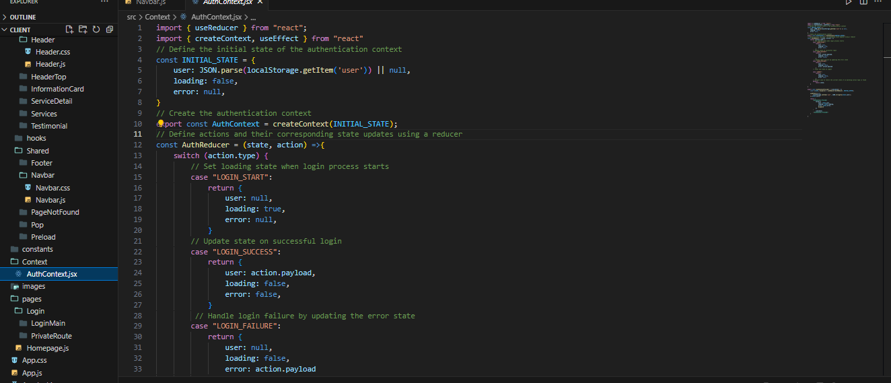
Best Practises

Slide 27
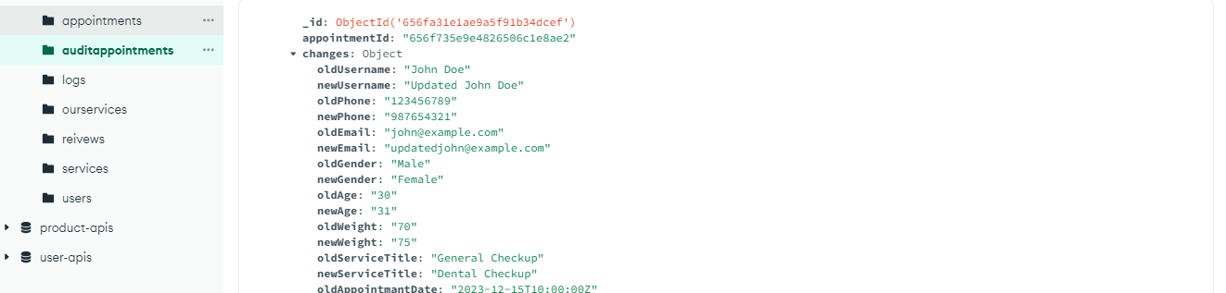
Database Scheme
Database | use
MongoDb | Flexible schema Perfect Combination with Express

Slide 28
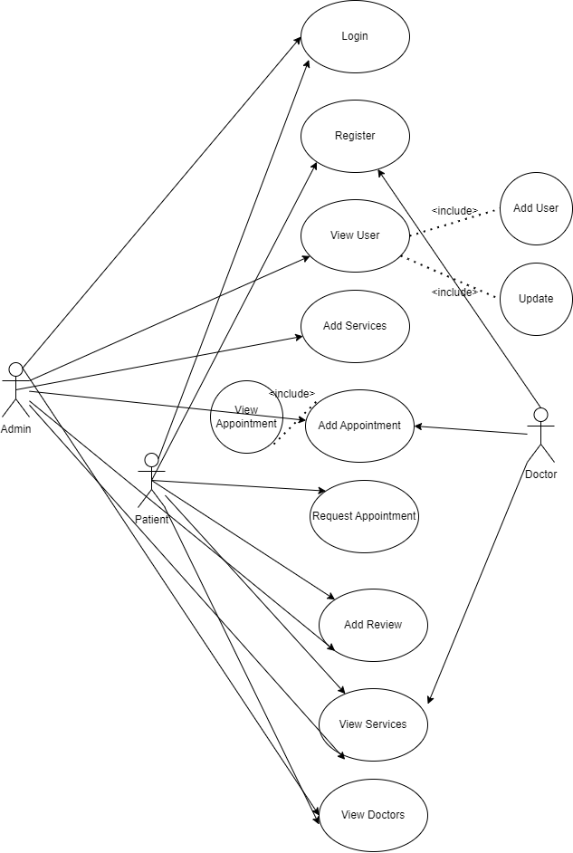
Use Cases Diagram

Slide 29
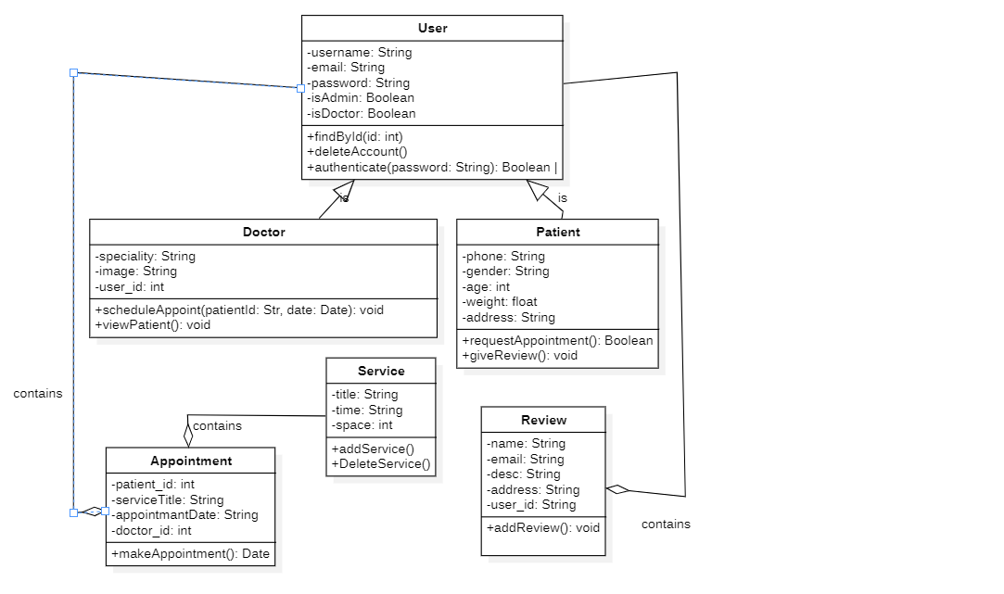
Class Diagram

Slide 30
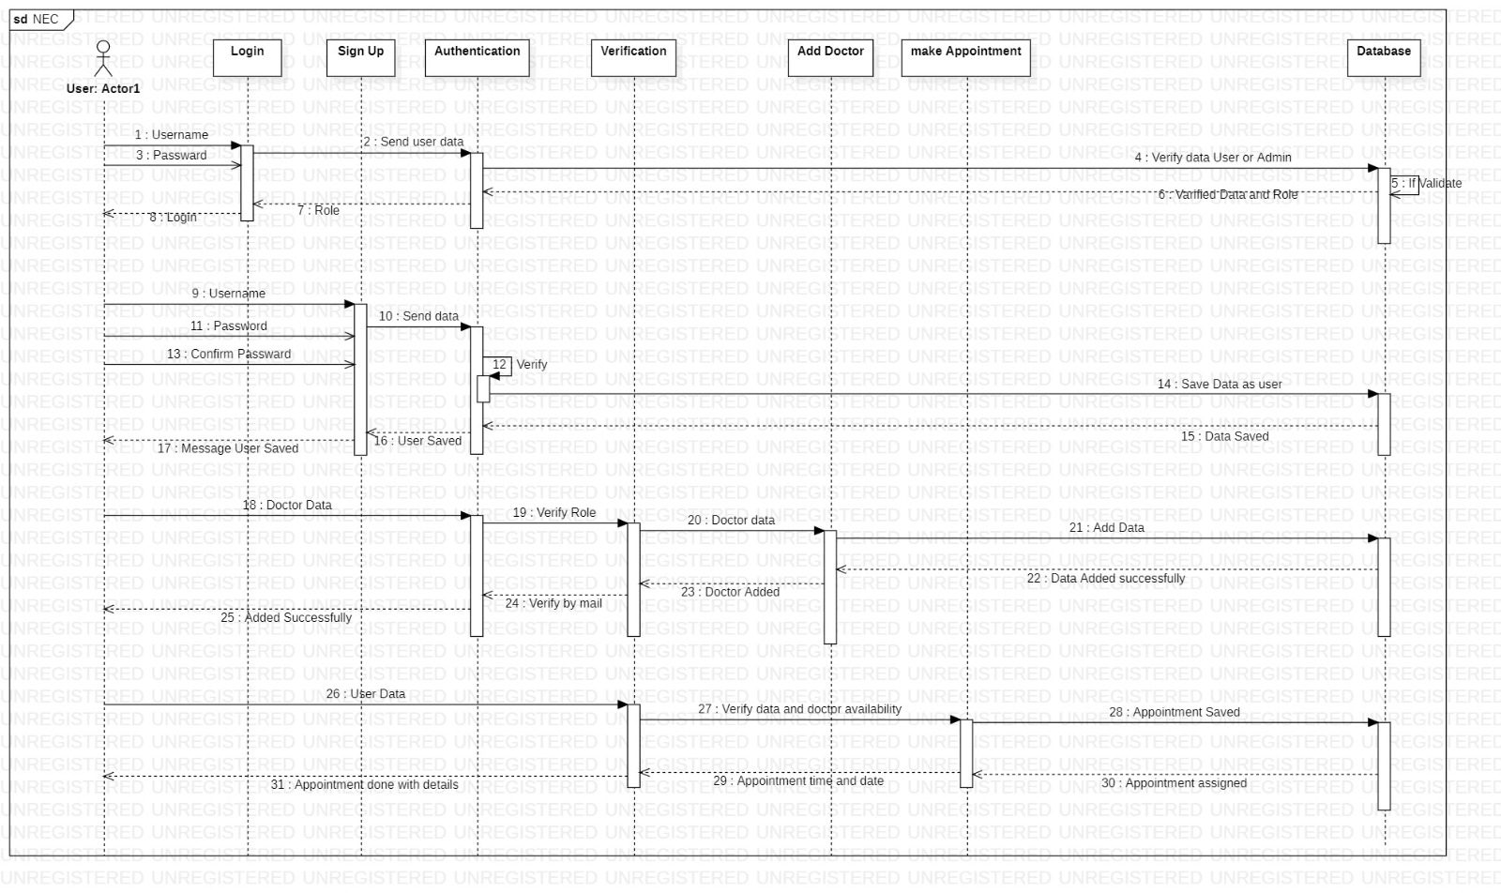
Sequence Diagram

Slide 31
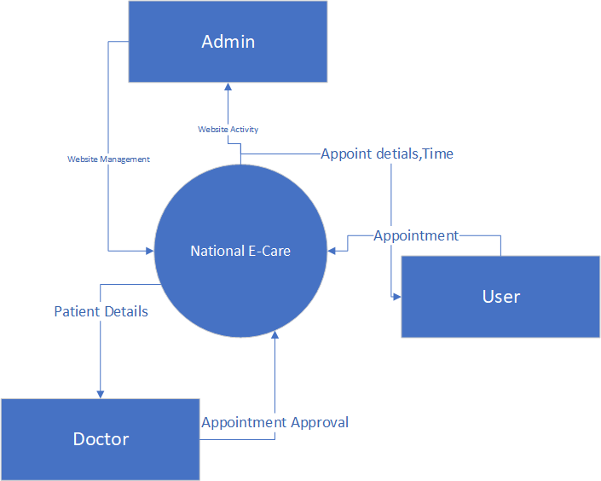
DFD Level 0

Slide 32
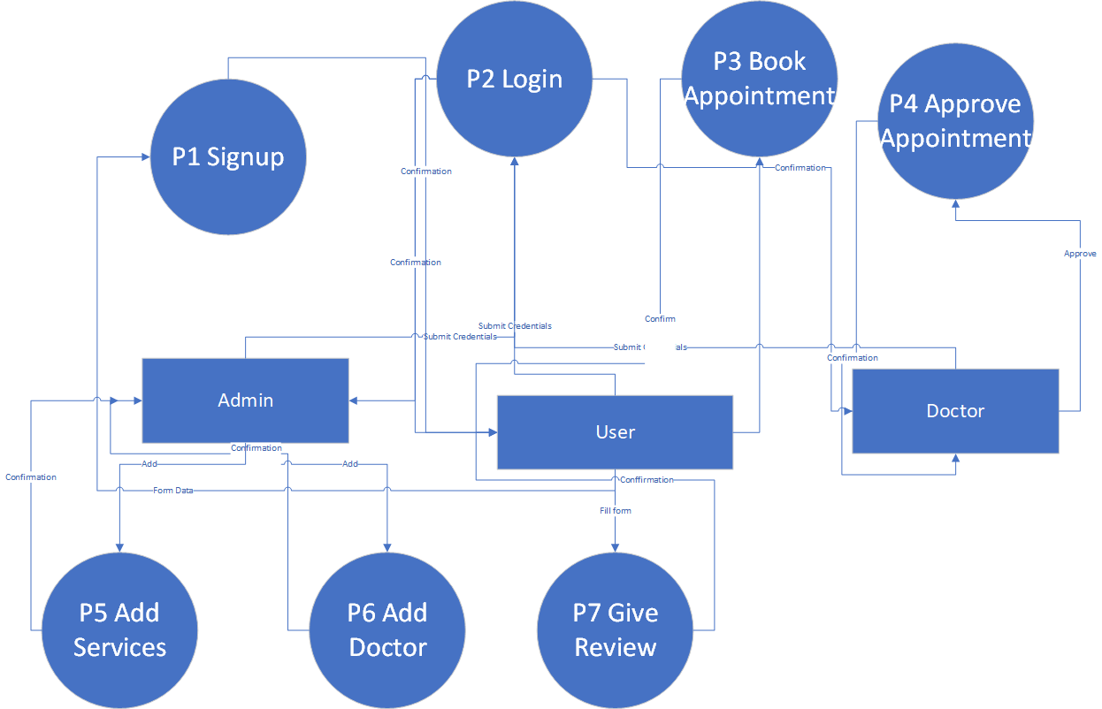
DFD Level 1

Slide 33
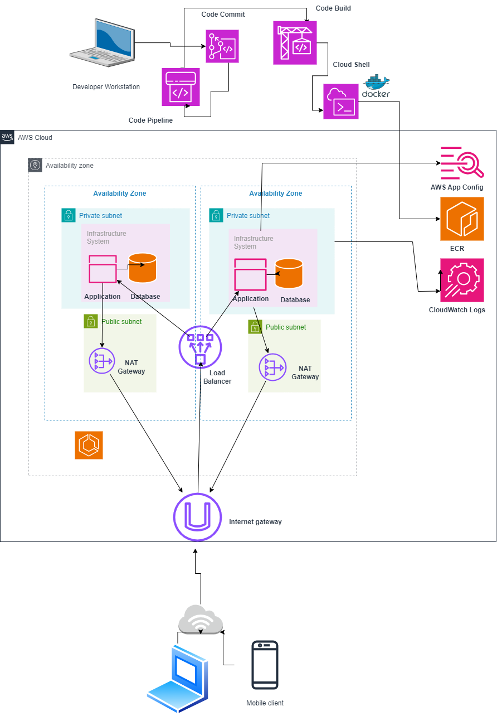
Architecture Diagram

Slide 34
Some Features
Role-Based Login
Appointment Booking
Review System
Doctor Management
Patient Management
Add Medical Services

Slide 35
Any Question?

