Slide 1
A Gentle Introduction to Parsers

Slide 2
Parsing?
The process of analyzing a string of symbols, either in natural language, computer languages or data structures, conforming to the rules of a formal grammar.
https://en.wikipedia.org/wiki/Parsing

Slide 3
Parsing?
Given an input, and a set of grammar, produce an abstract syntax tree
Grammar
Parser
AST
input

Slide 4
Parsing?
Given an input, and a set of grammar, produce an abstract syntax tree
(a + b) * (c * d / e + f)

Slide 5
Parsing?
Given an input, and a set of grammar, produce an abstract syntax tree
(a + b) * (c * d / e + f)
variable = {ASCII_ALPHA_LOWER }
atom = _{ ASCII_DIGIT | variable | "(" ~ expr ~ ")" }
bin_op = _{ add | subtract | multiply | divide | modulo }
add = { "+" }
subtract = { "-" }
multiply = { "*" }
divide = { "/" }
modulo = { "%" }
expr = { atom ~ (bin_op ~ atom)* } equation = _{ SOI ~ expr ~ EOI }

Slide 6
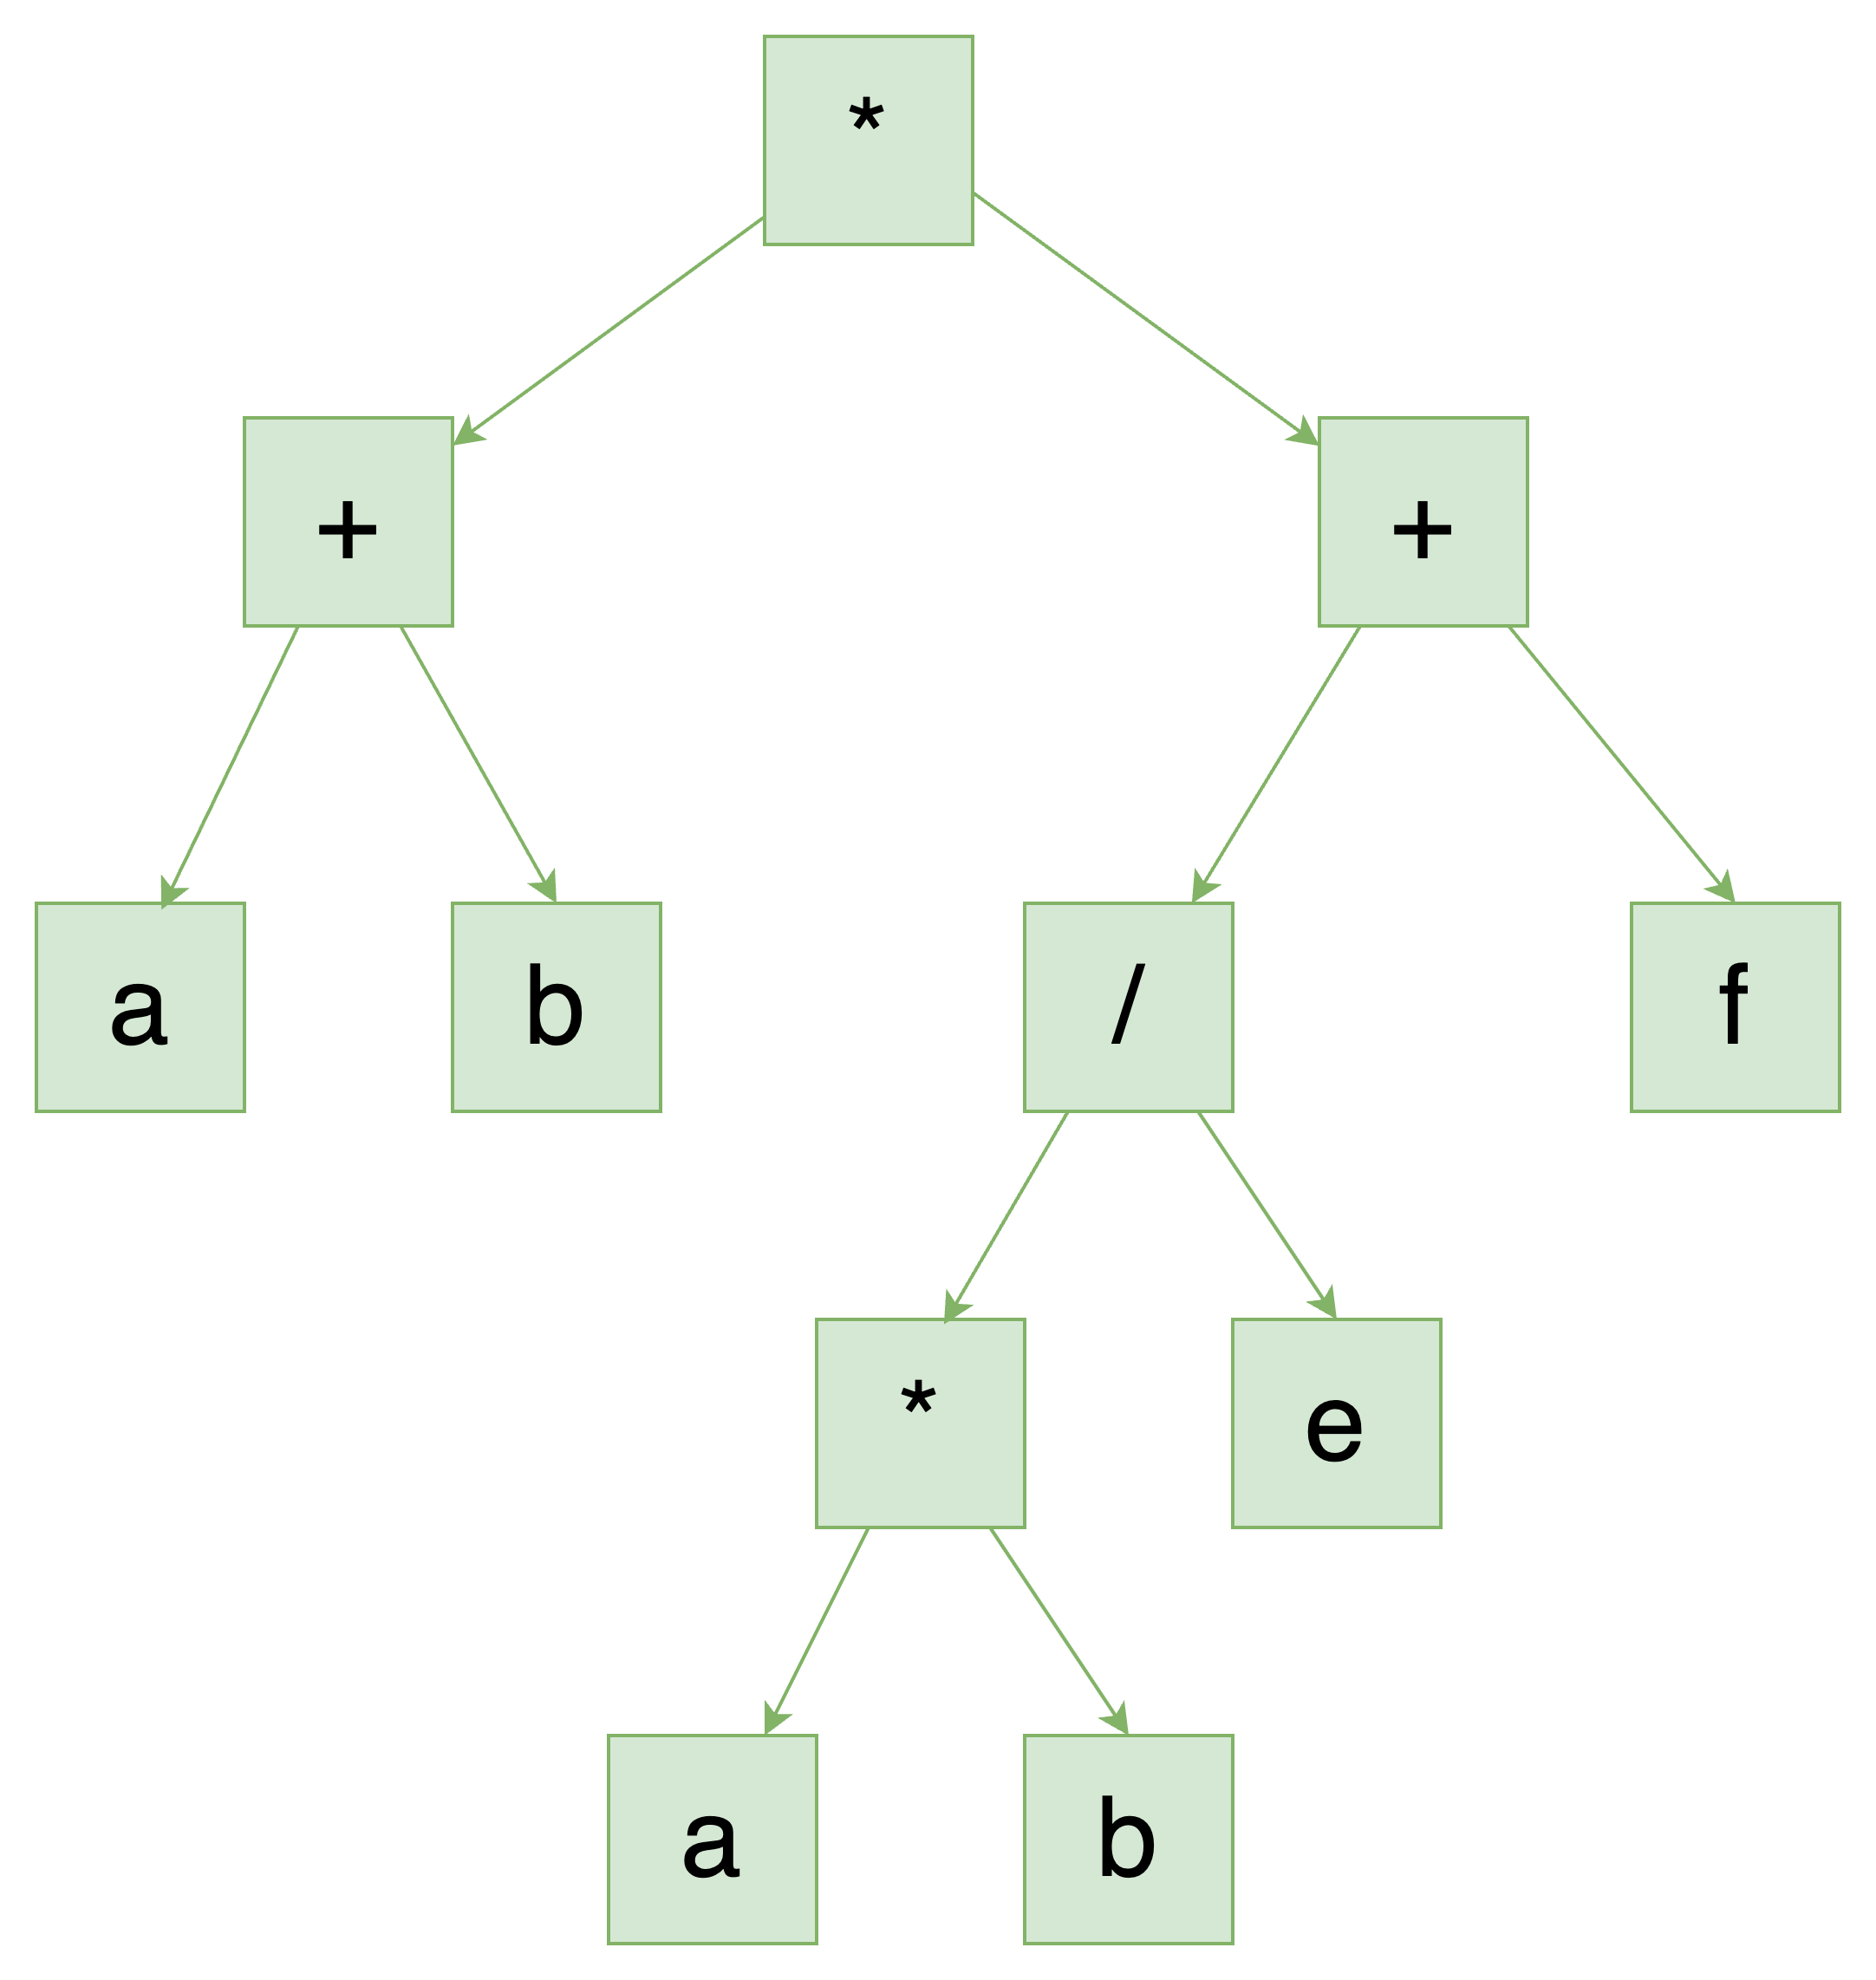
Parsing?
Given an input, and a set of grammar, produce an abstract syntax tree
(a + b) * (c * d / e + f)
variable = {ASCII_ALPHA_LOWER }
atom = _{ ASCII_DIGIT | variable | "(" ~ expr ~ ")" }
bin_op = _{ add | subtract | multiply | divide | modulo }
add = { "+" }
subtract = { "-" }
multiply = { "*" }
divide = { "/" }
modulo = { "%" }
expr = { atom ~ (bin_op ~ atom)* } equation = _{ SOI ~ expr ~ EOI }

Slide 7
Parsing?
Given an input, and a set of grammar, produce an abstract syntax tree
(a + b) * (c * d / e + f)
- expr
- expr
- variable: "a"
- add: "+"
- variable: "b"
- multiply: "*"
- expr
- variable: "c"
- multiply: "*"
- variable: "d"
- divide: "/"
- variable: "e"
- add: "+"
- variable: "f"
- EOI: ""
variable = {ASCII_ALPHA_LOWER }
atom = _{ ASCII_DIGIT | variable | "(" ~ expr ~ ")" }
bin_op = _{ add | subtract | multiply | divide | modulo }
add = { "+" }
subtract = { "-" }
multiply = { "*" }
divide = { "/" }
modulo = { "%" }
expr = { atom ~ (bin_op ~ atom)* } equation = _{ SOI ~ expr ~ EOI }

Slide 8
Motivation
Computers are stupid.
“(a + b) * (c * d / e + f)” is too difficult to process

Slide 9
Motivation
Computers are stupid.
“(a + b) * (c * d / e + f)” is too difficult to process
Is the expression correct?
What does “a”, ”b”mean? What does ”+” “/” mean?
What does “(“ and “)” mean?

Slide 10
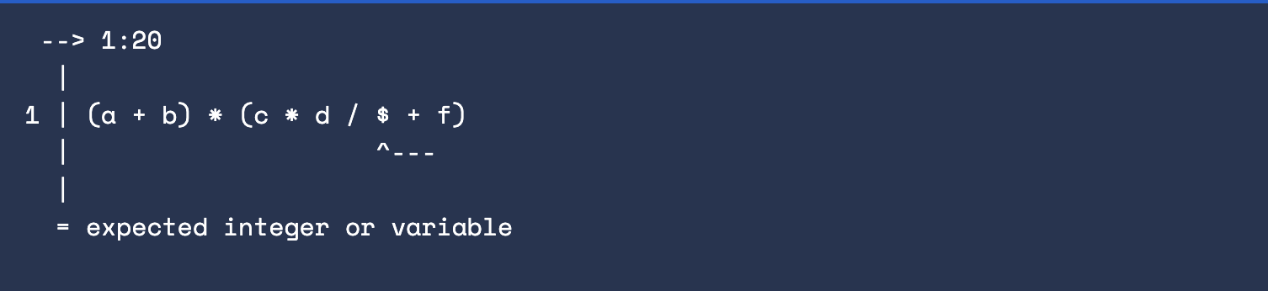
Motivation
Is the expression correct?
(a + b) * (c * d / $ + f)

Slide 11
Motivation
What does “a”, ”b”mean? What does ”+” “/” mean?
(a + b) * (c * d / e + f)
- expr
- expr
- variable: "a"
- add: "+"
- variable: "b"
- multiply: "*"
- expr
- variable: "c"
- multiply: "*"
- variable: "d"
- divide: "/"
- variable: "e"
- add: "+"
- variable: "f"
The AST is enriched with information about the different parts of the expression

Slide 12
Motivation
What does “(“ and “)” mean?
(a + b) * (c * d / e + f)
- expr
- expr
- variable: "a"
- add: "+"
- variable: "b"
- multiply: "*"
- expr
- variable: "c"
- multiply: "*"
- variable: "d"
- divide: "/"
- variable: "e"
- add: "+"
- variable: "f"
Parser already processed and validated “(“ and “)”. We don’t care about them in the business logic

Slide 13

History

Slide 14

History
John Backus

Slide 15
History
The earliest compilers were written with the definition of the langauge buried deeply within the code. With these compilers it was very difficult to verify that the compiler accepted all of the langauge syntax and only the language syntax. This became especially difficult when the definition of the language was changed for later versions.
https://www.andrews.edu/~bidwell/456/history.html

Slide 16
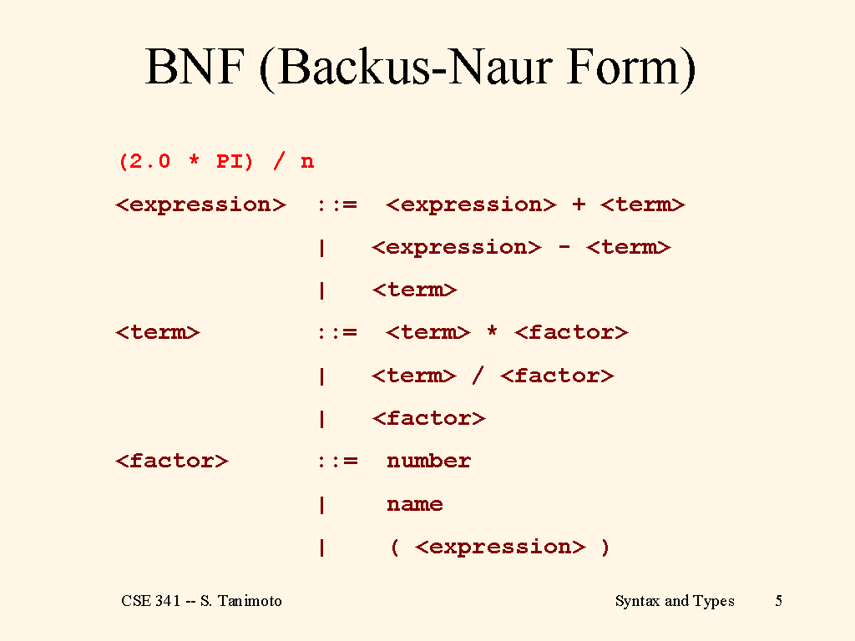

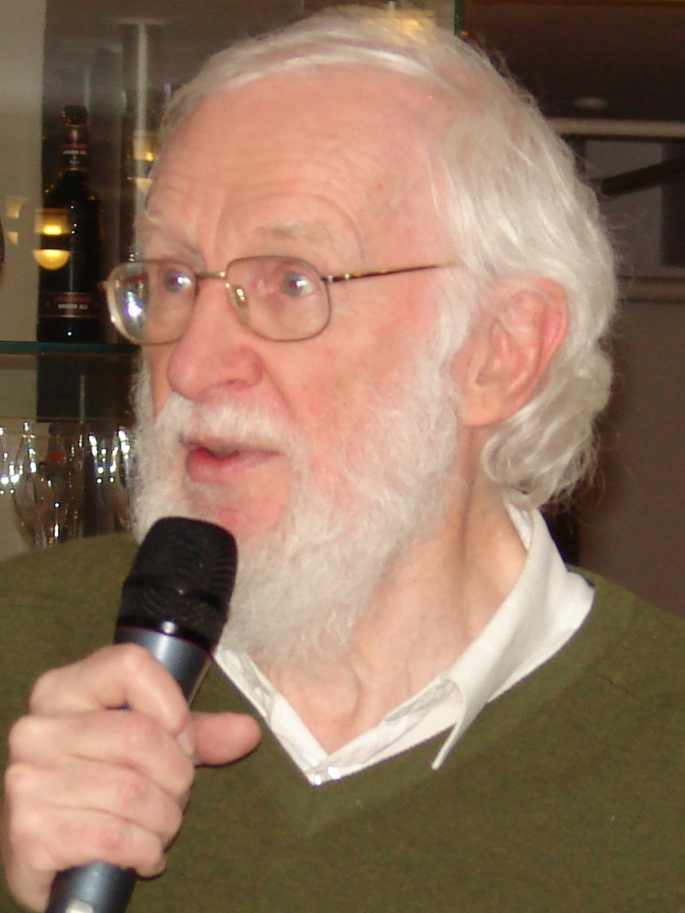
History
https://courses.cs.washington.edu/courses/cse341/03sp/slides/Syntax-and-Type/sld005.htm
Peter Naur

Slide 17
Parsing
Input
Parse
Process
Output
This is maintainable and easy to debug. When you mix parsing logic and processing logic in the same code, I wish you good luck debugging it

Slide 18

Technical intro: pest.rs

Slide 19
Technical intro: pest.rs
Generating grammar code at compile time
Easy to use
Good errors
Fantastic documentation
Big community

Slide 20
Technical intro: pest.rs
65279,1179403647,1463895090 3.1415927,2.7182817,1.618034
-40,-273.15 13,42
65537
numbers.csv

Slide 21
Technical intro: pest.rs
65279,1179403647,1463895090 3.1415927,2.7182817,1.618034
-40,-273.15 13,42
65537
numbers.csv
field = { (ASCII_DIGIT | "." | "-")+ }
record = { field ~ ("," ~ field)* }
file = { SOI ~ (record ~ ("\r\n" | "\n"))* ~ EOI }
project/src/csv.pest
Rules are defined in a separate file –> even easier to maintain ☺

Slide 22
Technical intro: pest.rs
field = { (ASCII_DIGIT | "." | "-")+ }
record = { field ~ ("," ~ field)* }
file = { SOI ~ (record ~ ("\r\n" | "\n"))* ~ EOI }
project/src/csv.pest
use pest::Parser;
use pest_derive::Parser;
#[derive(Parser)]
#[grammar = "csv.pest"]
pub struct CSVParser;
project/src/main.rs

Slide 23
Technical intro: pest.rs
field = { (ASCII_DIGIT | "." | "-")+ }
record = { field ~ ("," ~ field)* }
file = { SOI ~ (record ~ ("\r\n" | "\n"))* ~ EOI }
project/src/csv.pest
use std::fs;
fn main() {
let unparsed_file = fs::read_to_string("numbers.csv").expect("cannot read file");
// ...
}
project/src/main.rs
Input
Parse
Process
Output

Slide 24
Technical intro: pest.rs
field = { (ASCII_DIGIT | "." | "-")+ }
record = { field ~ ("," ~ field)* }
file = { SOI ~ (record ~ ("\r\n" | "\n"))* ~ EOI }
project/src/csv.pest
fn main() {
// ...
let file = CSVParser::parse(Rule::file, &unparsed_file)
.expect("unsuccessful parse")
.next().unwrap();
// ...
}
project/src/main.rs
Input
Parse
Process
Output

Slide 25
Technical intro: pest.rs
fn main() {
// ...
let mut field_sum: f64 = 0.0;
let mut record_count: u64 = 0;
for record in file.into_inner() {
match record.as_rule() {
Rule::record => {
record_count += 1;
for field in record.into_inner() {
field_sum += field.as_str().parse::<f64>().unwrap();
}
}
Rule::EOI => (),
_ => unreachable!(),
}
}
// ...
}
field = { (ASCII_DIGIT | "." | "-")+ }
record = { field ~ ("," ~ field)* }
file = { SOI ~ (record ~ ("\r\n" | "\n"))* ~ EOI }
project/src/csv.pest
project/src/main.rs
Input
Parse
Process
Output

Slide 26
Technical intro: pest.rs
field = { (ASCII_DIGIT | "." | "-")+ }
record = { field ~ ("," ~ field)* }
file = { SOI ~ (record ~ ("\r\n" | "\n"))* ~ EOI }
project/src/csv.pest
fn main() {
// ...
println!("Sum of fields: {}", field_sum);
println!("Number of records: {}", record_count);
}
project/src/main.rs
Input
Parse
Process
Output

Slide 27
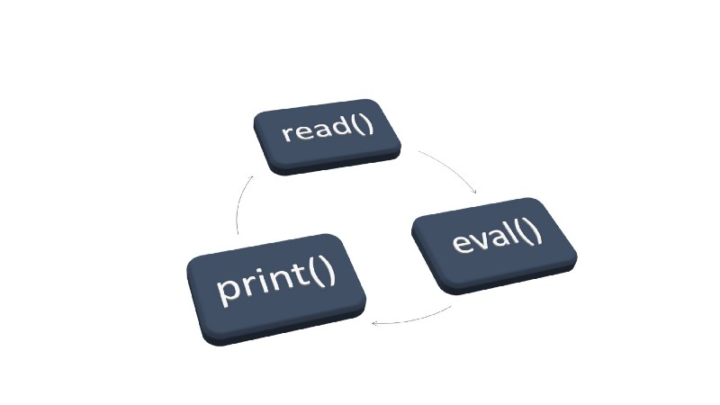
Technical intro: pest.rs
Input
Parse
Process
Output
This approach is traditionally known as REPL
Read
Eval
Print
Loop
https://en.wikipedia.org/wiki/Read%E2%80%93eval%E2%80%93print_loop

Slide 28
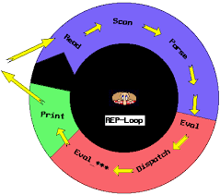
Technical intro: pest.rs
Input
Parse
Process
Output
This approach is traditionally known as REPL
Read
Eval
Print
Loop
https://en.wikipedia.org/wiki/Read%E2%80%93eval%E2%80%93print_loop

Slide 29
Technical intro: pest.rs
field = { (ASCII_DIGIT | "." | "-")+ }
record = { field ~ ("," ~ field)* }
file = { SOI ~ (record ~ ("\r\n" | "\n"))* ~ EOI }

Slide 30
Technical intro: pest.rs
field = { (ASCII_DIGIT | "." | "-")+ }
record = { field ~ ("," ~ field)* }
file = { SOI ~ (record ~ ("\r\n" | "\n"))* ~ EOI }
+ One or more
| Or
ASCII_DIGIT A digit between 0 and 9
Field: At least one digit, containing a dot or a minus
Note: didactic example. Dot and minus are not enforced to be in their correct position

Slide 31
Technical intro: pest.rs
field = { (ASCII_DIGIT | "." | "-")+ }
record = { field ~ ("," ~ field)* }
file = { SOI ~ (record ~ ("\r\n" | "\n"))* ~ EOI }
~: Followed by
*: Zero or more
Record: a field followed by zero or more fields seperated by a comma

Slide 32
Technical intro: pest.rs
field = { (ASCII_DIGIT | "." | "-")+ }
record = { field ~ ("," ~ field)* }
file = { SOI ~ (record ~ ("\r\n" | "\n"))* ~ EOI }
SOI Start of input
EOI End of input
File: contains one or more records seperated by a new line

Slide 33
Technical intro: pest.rs
field = { (ASCII_DIGIT | "." | "-")+ }
record = { field ~ ("," ~ field)* }
file = { SOI ~ (record ~ ("\r\n" | "\n"))* ~ EOI }
The pest.rs book: https://pest.rs/book/intro.html (very easy to follow. Believe me)
pest.rs documentation: https://docs.rs/pest/latest/pest/

Slide 34
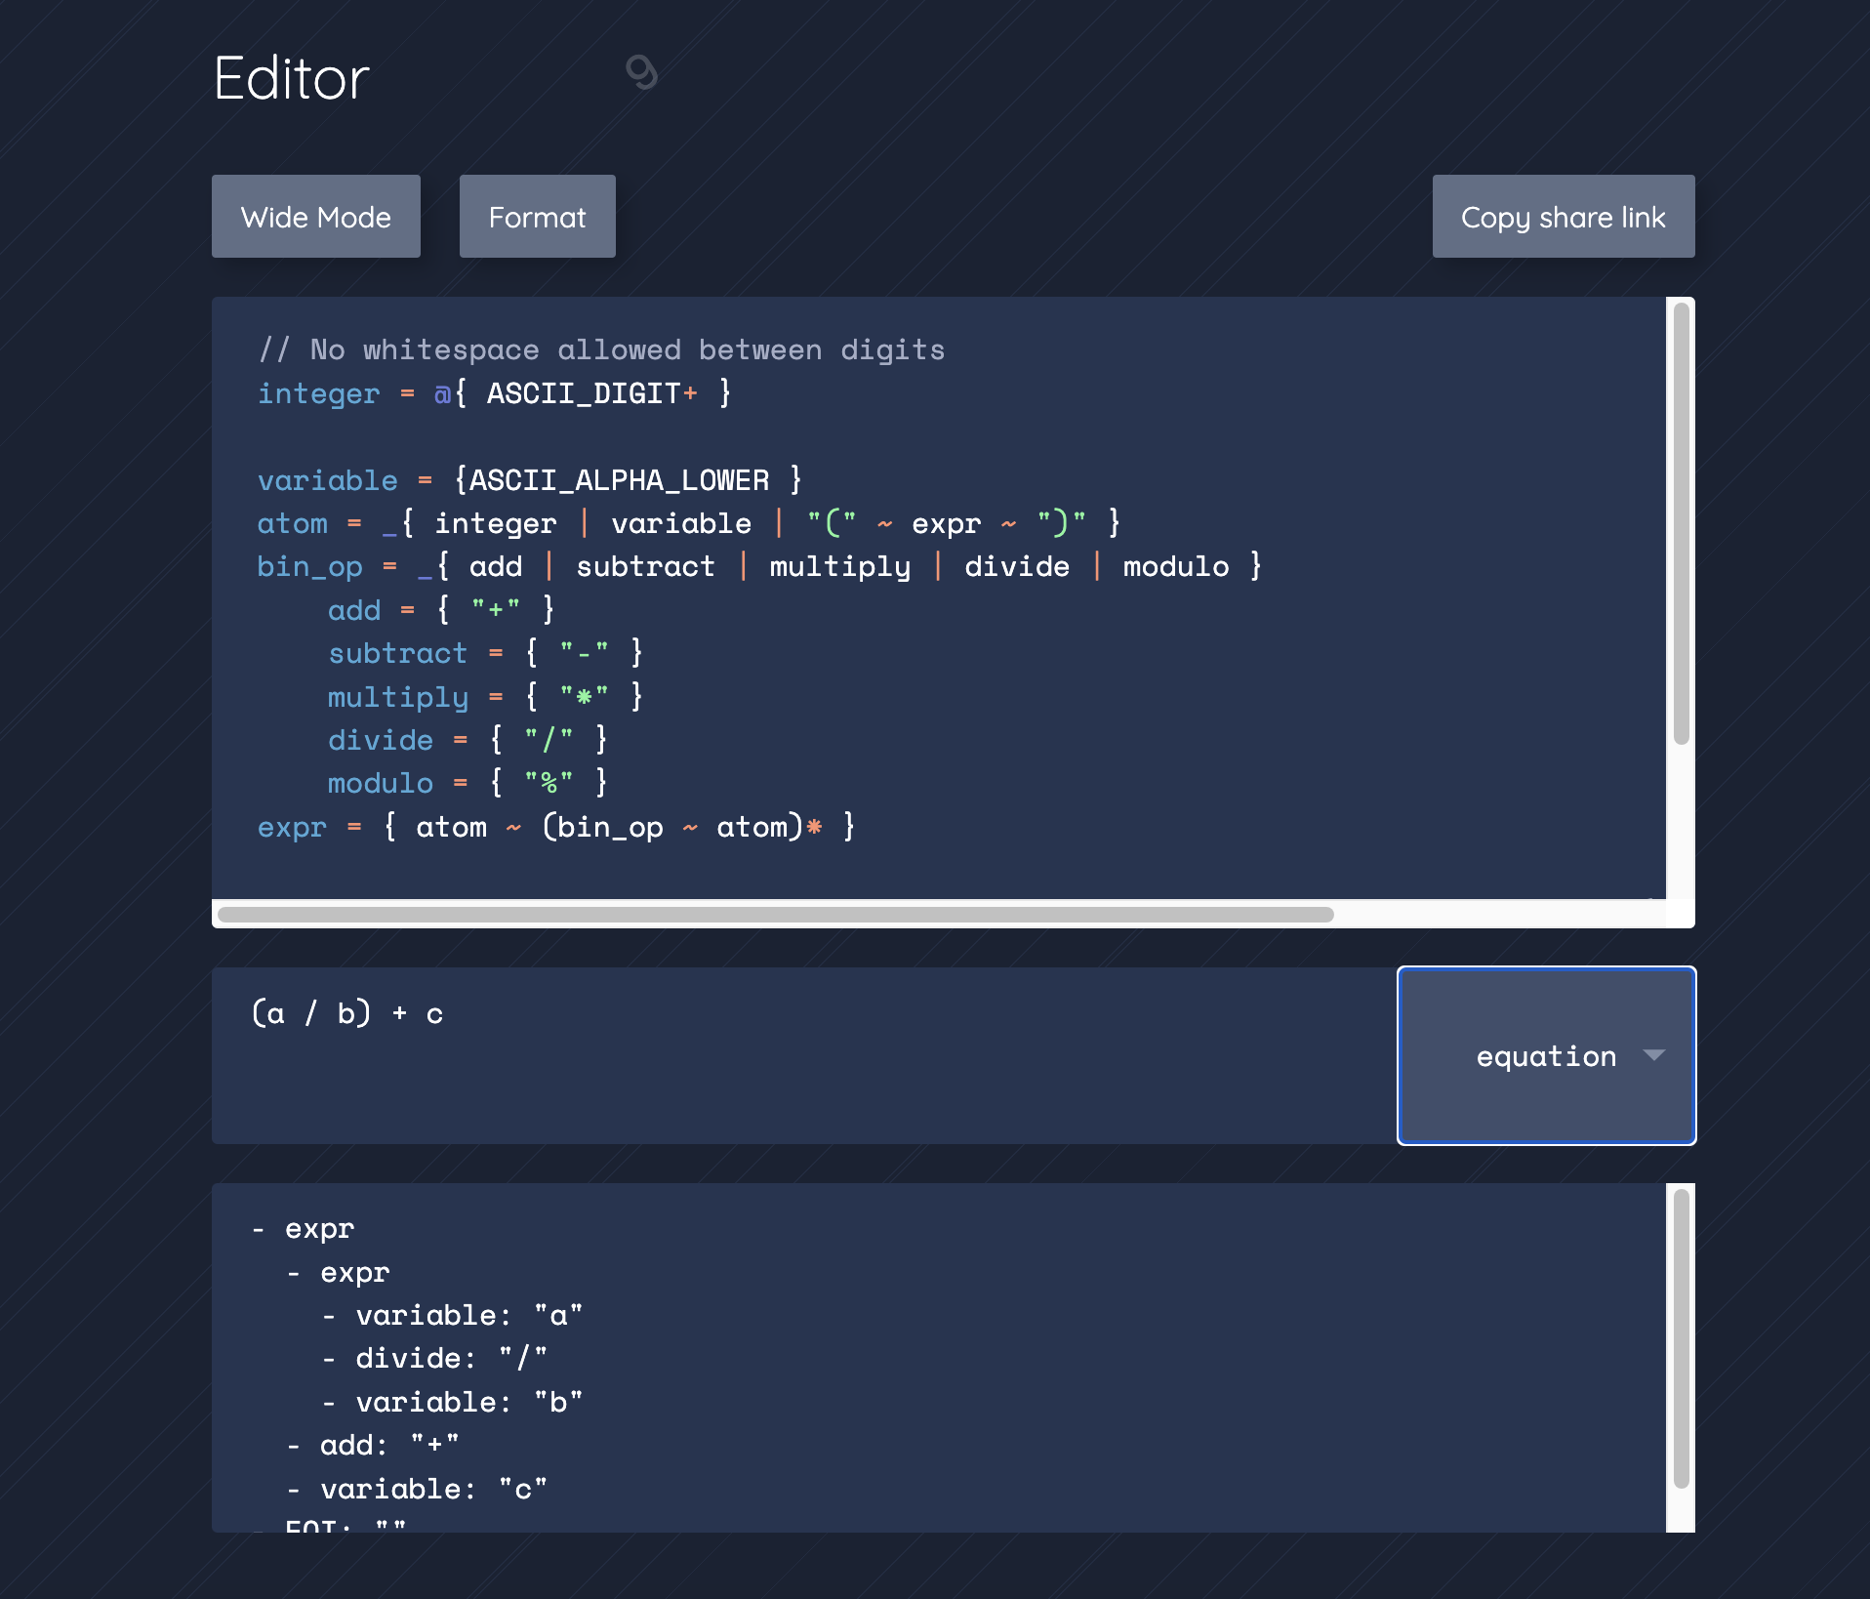
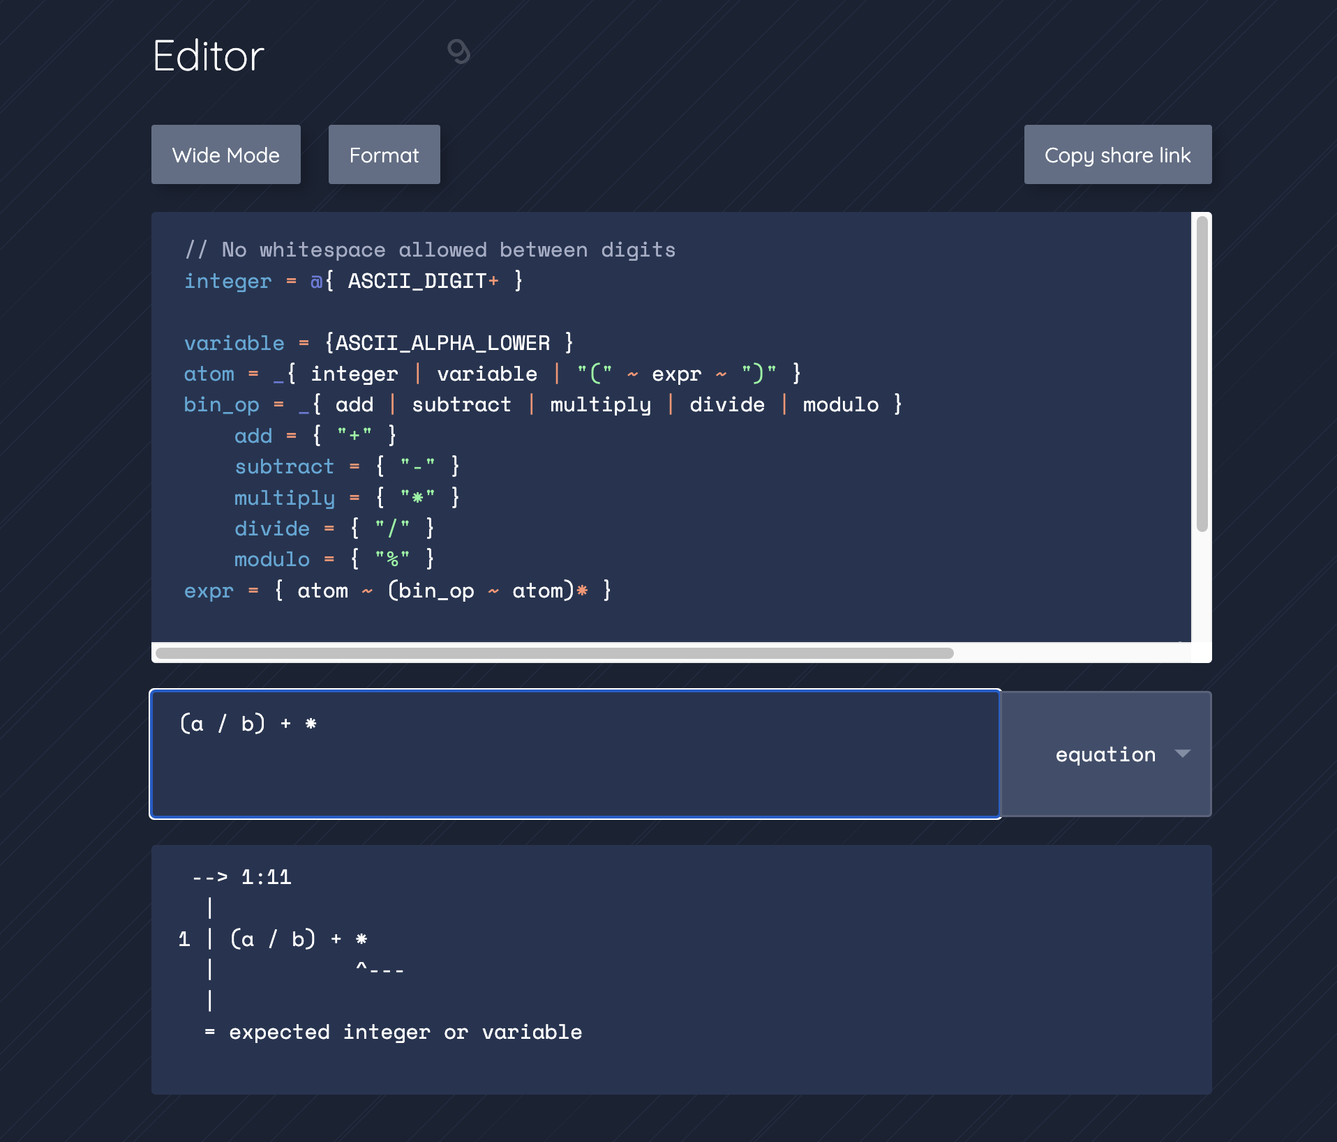
Technical intro: pest.rs
pest.rs online editor: Validate and test your grammar online: https://pest.rs/

Slide 35
Small remark
Traditionally, lexing and parsing are two seperated steps
Lexing: Which tokens do I need to accept and use in my parser
Parsing: Which rules should my program accept

Slide 36
Small remark
(define imprec/cc2-parser
(parser
(tokens imprec/cc2-tokens imprec/cc2-empty-tokens)
(precs (left AMB))
(grammar
(expr
((number) $1)
((variable) $1)
((let) $1)
((letrec) $1)
((if) $1)
((procedure) $1)
((apply) $1)
((assign) $1)
((block) $1)
((while) $1)
)
(number
((NUM) (num-exp $1)))
(let
((LET VAR DEF expr IN expr) (let-exp $2 $4 $6))
((LET PERSISTENT VAR DEF expr IN expr) (let-exp $3 $5 $7)))
(letrec
((REC VAR DEF expr IN expr) (rec-exp $2 $4 $6)))
(if
((IF expr THEN expr ELSE expr) (ite-exp $2 $4 $6)))
Traditionally, lexing and parsing are two seperated steps
Lexing: Which tokens do I need to accept and use in my parser
Parsing: Which rules should my program accept
This is a parser. You define the grammar (syntax) of the program

Slide 37
Small remark
(define imprec/cc2-lexer
(lexer
;; Keywords
["let"
(token-LET)]
["letrec"
(token-REC)]
["in"
(token-IN)]
["if"
(token-IF)]
["then"
(token-THEN)]
["else"
(token-ELSE)]
["proc"
(token-PROC)]
["begin"
(token-BEGIN)]
["end"
(token-END)]
[#\=
(token-DEF)]
[(:: #\: #\=)
(token-ASS)]
[#\;
(token-SEM)]
[#\,
(token-COM)]
[#\newline
(imprec/cc2-lexer input-port)
Traditionally, lexing and parsing are two seperated steps
Lexing: Which tokens do I need to accept and use in my parser
Parsing: Which rules should my program accept
This is a lexer. You define which tokens to accept

Slide 38
Small remark
Traditionally, lexing and parsing are two seperated steps
Lexing: Which tokens do I need to accept and use in my parser
Parsing: Which rules should my program accept
pest.rs does not have a distinction between lexing/parsing
This makes it more practical (less boilerplate to write ☺ )

