Slide 1
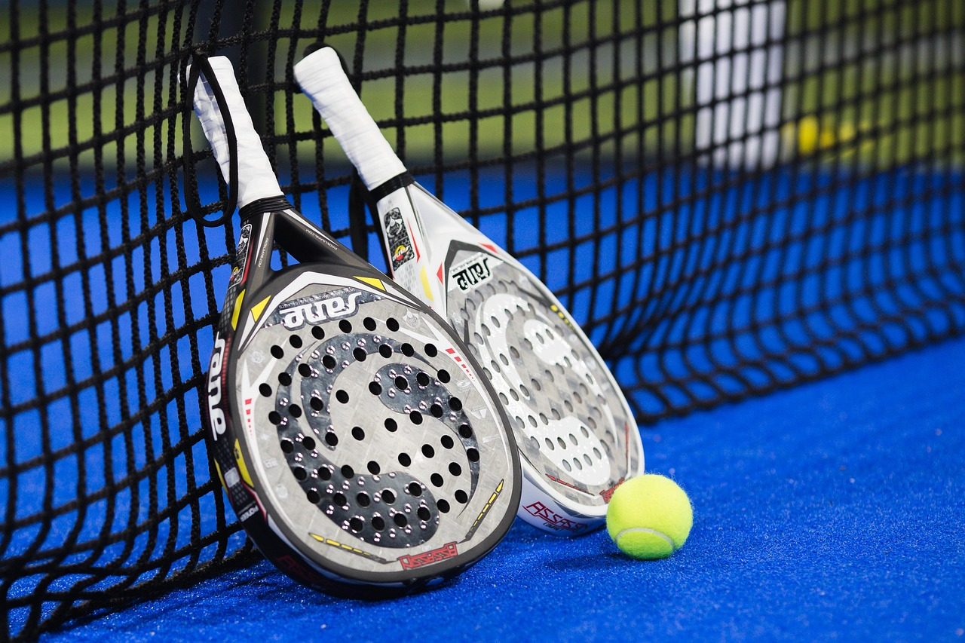
PADELLENS
Pro Tour Insights + My Match Log
A data visualization tool for amateur padel players.
Resubmission - with real data & discovered insights
Data Visualization for Sport · Sports Engineering MSc
Politecnico di Milano · AY 2025/2026

Slide 2
OVERVIEW
How this talk is organized
1
The Brief
Sport domain, audience, editorial angle
2
Working with Data
Sources, schema, exploration
3
UX Design
Wireframes, principles, heuristic eval
4
Data Representation
Chart choices, color, interactivity
5
Technical Implementation
Python, Streamlit, architecture
6
Demo & Conclusions
Live walkthrough, future work
Slides marked NEW/UPDATED show what changed since the first submission.
PadelLens · DV4S Exam · Politecnico Milano · AY 2025/2026
2

Slide 3
WHAT CHANGED
What changed since the first submission - at a glance
+
A real 776-match dataset
padelapi.org, 2026 season - 26 tournaments, 2,165 ranked players, my own API key.
+
Genuine data exploration
Ten hypotheses tested; seven discovered findings, including an honest null.
+
A new analytics layer
Elo ratings, a logistic win-probability model, and confidence intervals on every statistic
+
An upgraded application
SQLite-backed, multi-user-ready, with a new Insights page (seven discovery cards).
+
Validation, honestly reported
Instruments ready (survey, SUS, protocols); sessions with real club players scheduled.
+
A polished, verified deliverable
This deck: consistent numbering, zero placeholders, speaker notes on every slide.
PadelLens · DV4S Exam · Politecnico Milano · AY 2025/2026
3

Slide 4
PART 1
The Brief
Context & Vision · Stage 1 of Kirk's data visualization process

Slide 5
1.1 SPORT DOMAIN
Why padel?
Padel is exploding.
THE GAP
What amateurs feel
1.1M+ federated players in Italy (2024)
"I always lose in the third set."
"I play better with Luca."
"My bandeja is OK, my smash isn't."
Up from ~30,000 in 2019 (FIP data).
Pros have analytics.
Amateurs have a group chat.
What they can confirm
Nothing.
Premier Padel rankings, ball-tracking, broadcast overlays - none of that reaches the club player.
That gap is the project.
PadelLens · DV4S Exam · Politecnico Milano · AY 2025/2026
5

Slide 6
1.2 PROBLEM & USER
Who's at the other end of the screen?
PROBLEM STATEMENT
Amateur padel players want to see patterns in their own game that they can't feel - but no simple tool turns a player's match log into honest visual feedback.
Personas now being grounded in a real survey + interviews (07_Validation)
PRIMARY USER
SECONDARY USER
Marco · the club player
Luca · the amateur coach
22-40 years old
Plays 1-5 times per week at his local club
6 months to 5 years of experience
Will spend 90 seconds logging on his phone
Wants to improve · is not a pro
Gives weekly 1-hour lessons
Needs a 2-min summary of each student before training
Cares about shot balance, error trends, partner effect
Reads on a laptop, not a phone
PadelLens · DV4S Exam · Politecnico Milano · AY 2025/2026
6

Slide 7
1.3 EDITORIAL THINKING
Angle · Framing · Focus (Kirk)
ANGLE
FRAMING
FOCUS
Reflective self-analysis over time
What an amateur can log on a phone
One number above the fold
Temporal · Categorical · Comparative.
Inside: matches, sets, shot tallies, partners, surface.
Last-10-matches win rate.
Spatial overlays (court heatmaps) deliberately excluded - we don't have sensor data.
Outside: ball-trajectory, biometrics, opponent scouting.
Plus: net shot balance, plain-language insight ("You win 80% with Luca").
PadelLens · DV4S Exam · Politecnico Milano · AY 2025/2026
7

Slide 8
1.4 RELEVANCE
Scored on Kirk's four factors
Timeliness
Opens after a match or before the next one - actionable now.
3/3
Interestingness
Confirms or contradicts gut feelings - both outcomes are interesting.
3/3
Pertinence
Literally the user's own data - maximum personal connection.
3/3
Sufficiency
Deliberate trade-off: enough to inform, not so much it overwhelms.
2/3
“You don't have to feel your game - you can see it.”
PadelLens · DV4S Exam · Politecnico Milano · AY 2025/2026
8

Slide 9
PART 2
Working with Data
Acquisition · Transformation · Exploration

Slide 10
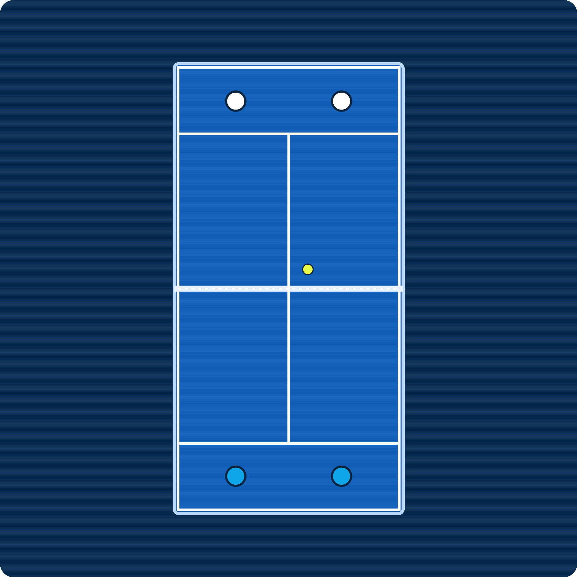
2.0 PRO DATA SOURCE
Premier Padel: the elite circuit behind our data
The official global professional padel tour (launched 2022, run by the FIP and Qatar Sports Investments). Data comes from padelapi.org, a real REST API called with my own API key, covering the full 2026 season: 776 completed matches and 2,165 ranked players.
~26 tournaments per season, on 5 continents (Majors + P1 + P2 + Finals)
Majors
2,000 pts
Top tier - 4 a year (Qatar, Italy, France, Mexico)
P1
1,000 pts
Second tier - e.g. Madrid, Milano, Dubai, London
P2
~500 pts
Entry tier - e.g. Brussels, Rotterdam, Germany
Finals
1,500 pts
Season finale - top 16 pairs, Barcelona
Premier Padel court (top-down). Swap in an official photo if you have rights.
2026 season, real data: 776 completed matches, 26 tournaments, full draws Round-of-64 to Final, men's and women's competitions, 2,165 ranked players.
PadelLens · DV4S Exam · Politecnico Milano · AY 2025/2026
10

Slide 11
2.1 ACQUISITION
Two layers, two sources
LAYER A · PRO TOUR (REAL)
LAYER B · PERSONAL LOG
Padel API · padelapi.org
Seed data + user-generated
Rankings + real 2026-season match results
10 req/min throttle, under the free-tier cap
Restartable: one file per tournament
Archives every raw response first
No public amateur padel match data exists.
That absence is part of why this project exists.
APPROACH
SAFEGUARDS
Realistic seed log demonstrates the app
Real users replace it via Log Match form
Every personal page shows a visible SYNTHETIC DEMO DATA badge
429 backoff, up to 4 retries
hidden_free_plan values are skipped
PadelLens · DV4S Exam · Politecnico Milano · AY 2025/2026
11

Slide 12
2.2 EXAMINATION & TRANSFORMATION
Two real CSVs - and the bug I caught
pro_players_real.csv
2,165 rows
pro_matches_real.csv
776 rows
my_matches.csv (demo)
40+ rows
player_id
name
country
age
ranking_points
+ 2 more (hand/height, patchy)
match_id
date · tournament
round
team1_p{1,2}
team2_p{1,2}
winner_team
set{1,2,3}
source (API record id)
duration_min
match_id · date
partner · opponents
club · surface
set scores (per set)
winners_{shot} · errors_{shot}
result · duration · notes
Examination caught a real bug: the API returns scores as a JSON array of sets, not the comma-string my first parser assumed - fixed in build_real_csv.py, zero re-fetching.
PadelLens · DV4S Exam · Politecnico Milano · AY 2025/2026
12

Slide 13
2.3 EXPLORATION - HOW
How I explored, before I trusted a single number
SCOPE
All ten run against the real 776-match dataset, two-sided tests at alpha=0.05 - nothing cherry-picked.
10 tests
hypotheses, E1-E10
CONFIDENCE
Every win rate in this report ships with a confidence interval, never a bare point estimate.
Wilson 95% CI
on every proportion
VERDICTS
A finding that fails a test is reported as a null or insufficient - never hidden or rounded up.
3 honest labels
signal · null · insufficient
PadelLens · DV4S Exam · Politecnico Milano · AY 2025/2026
13

Slide 14
2.4 THE DATASET IN NUMBERS
A full professional season, captured end to end
Source: padelapi.org REST API (official professional padel data service) · personal API key · season window Feb-Jul 2026
MATCHES
TOURNAMENTS
PLAYERS
776
26
2,165
completed, 2026 season
Feb-Jul 2026, 5 continents
ranked, men + women
COVERAGE
PER-MATCH FIELDS
PER-PLAYER FIELDS
Round-of-64 → Final
Men 456 · Women 320
P2 350 · P1 340 · Major 86
date, round, seeds
player IDs, court sides
set scores, duration
ranking, points
age, nationality
Data hygiene: statistics use the 763 matches that finished normally - 13 retired/walkovers excluded. Every raw API response is archived as JSONL before transformation (fetch → archive → clean → SQLite).
PadelLens · DV4S Exam · Politecnico Milano · AY 2025/2026
14

Slide 15
2.5 STATISTICAL TOOLKIT - TESTS
Four tools, applied the same way every time
All tests two-sided, α = 0.05 · every proportion carries a 95% Wilson confidence interval · win rates with n < 10 are never shown as claims
Wilson 95% CI - (p̂ + z²/2n ± z·√(p̂(1−p̂)/n + z²/4n²)) / (1 + z²/n), z = 1.96
Unlike the naive interval it stays inside [0,1] and is reliable for small n.
Binomial test - is an observed proportion different from 50/50?
Used for momentum (86%), favorites (78.5%), upsets (22.4%).
Chi-square test - χ² = Σ (O−E)²/E - are win rates equal across groups?
Used for the 4 chemistry buckets (1-3, 4-7, 8-15, 16+ matches together).
Welch t-test - t = (x̄₁−x̄₂) / √(s₁²/n₁ + s₂²/n₂)
Difference of means without assuming equal variance - used for match durations.
PadelLens · DV4S Exam · Politecnico Milano · AY 2025/2026
15

Slide 16
2.6 STATISTICAL TOOLKIT - MODELS
Two models turn tests into predictions
LOGISTIC MODEL
P(team1 wins) = 1 / (1 + e^−(β₀ + β₁·log(pts₁/pts₂))) - log of the points ratio, because ranking advantages act multiplicatively. In 88% of winner-loser pairs the model ranked the winner higher.
AUC 0.88
decile calib. vs y = x
ELO ENGINE
Expected score E_A = 1/(1+10^((R_B−R_A)/400)); update R′_A = R_A + K·(S_A−E_A), zero-sum and unit-tested. Disagreement between Elo and official points is the over/under-rated-players insight.
K = 32
start 1500, chronological
All implemented in analytics.py - 12/12 unit tests passing.
PadelLens · DV4S Exam · Politecnico Milano · AY 2025/2026
16

Slide 17
2.7 FINDINGS - MOMENTUM & CHEMISTRY
The first set decides a lot. Chemistry takes longer.
MOMENTUM
n=668, p<0.001 - consistent across gender and level. A near-decisive early lead.
86%
win match after set 1
DECIDING SET
Once a match actually reaches a 3rd set, the set-1 winner's edge evaporates (n=207).
~49%
coin flip in a decider
CHEMISTRY
p<0.001 across buckets. Caveat: survivorship - winning pairs simply get more reps together.
40% → 67%
win rate, 1-3 vs 16+ matches together
PadelLens · DV4S Exam · Politecnico Milano · AY 2025/2026
17

Slide 18
2.8 FINDINGS - RANKING, UPSETS, EFFICIENCY
Rankings predict. They just don’t decide.
RANKING
Logistic model AUC 0.88. Caveat: points are a single end-of-window snapshot, not match-date values.
78.5%
favorite (by points) wins
UPSETS
n=165, p<0.001. Non-monotonic by round - finals land close to a coin flip (50%).
22.4%
of seeded matches
EFFICIENCY
n=233, p=0.004 - fewer games in the previous round is a real efficiency/fatigue signal.
59.7%
next-match win rate
PadelLens · DV4S Exam · Politecnico Milano · AY 2025/2026
18

Slide 19
2.9 THE HONEST NULLS
What the data honestly does NOT show
HOME ADVANTAGE
n=109, p=0.18 - not significant. No detectable home advantage overall.
43%
home-team win rate
AGE GAP
Mean gap ≈0 years (p=0.277). A within-pair correlation is significant but explains <1% of variance.
No effect
winner vs loser age
HANDEDNESS / HEIGHT
Hand data covers 38.4% of participants, height 33.8% - both below the 60% usability threshold.
Insufficient data
coverage too low to test
Trustworthy analysis reports what the data does NOT show.
PadelLens · DV4S Exam · Politecnico Milano · AY 2025/2026
19

Slide 20
PART 3
UX Design
Wireframes · Principles · Heuristic evaluation

Slide 21
3.1 PROCESS
From paper sketch to working app
1
2
3
4
Paper sketches
Low-fi wireframes
Mid-fi pass
Streamlit build
30 min. Just box drawings - which pages exist.
Figma · 5 SVGs · grayscale layout only.
Same layout, real chart shapes drawn in.
High-fi, working app. No click-prototype.
PadelLens · DV4S Exam · Politecnico Milano · AY 2025/2026
21

Slide 22
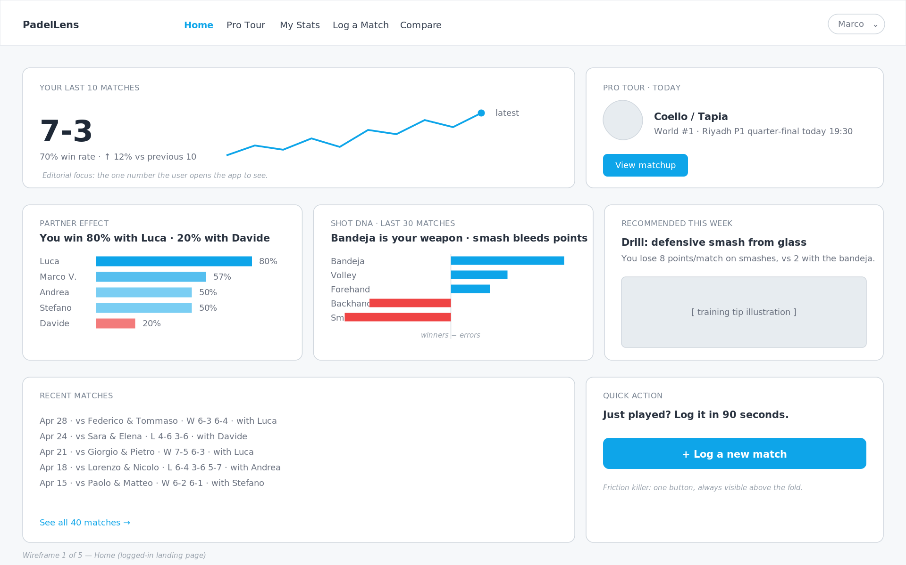
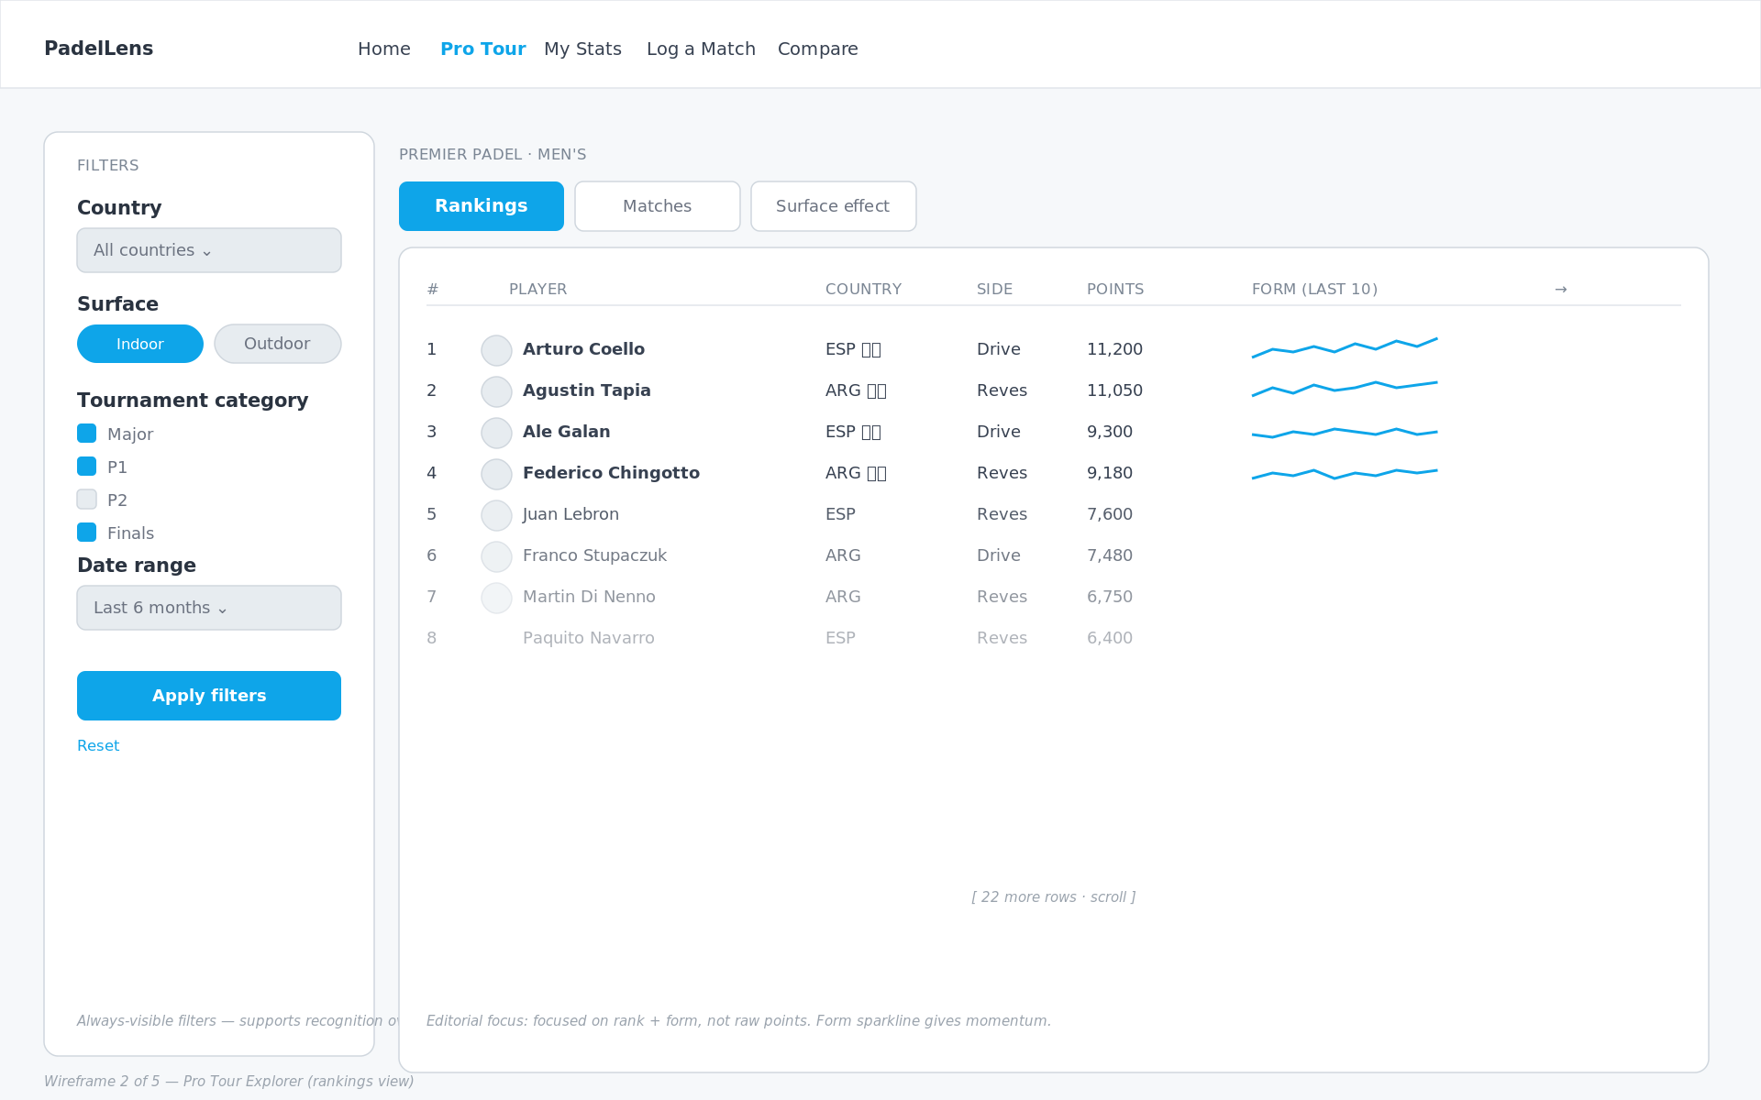
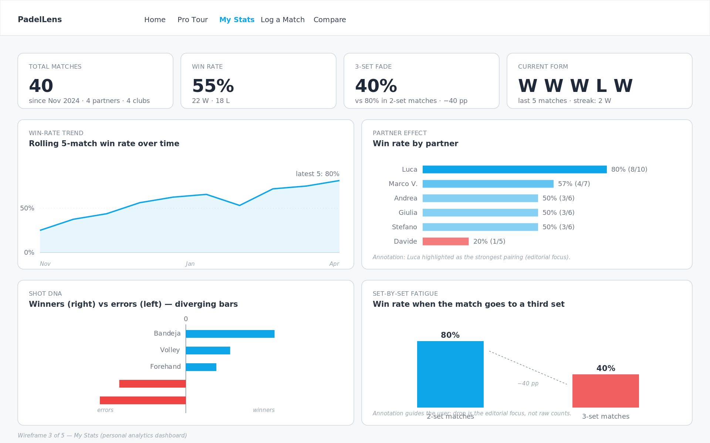
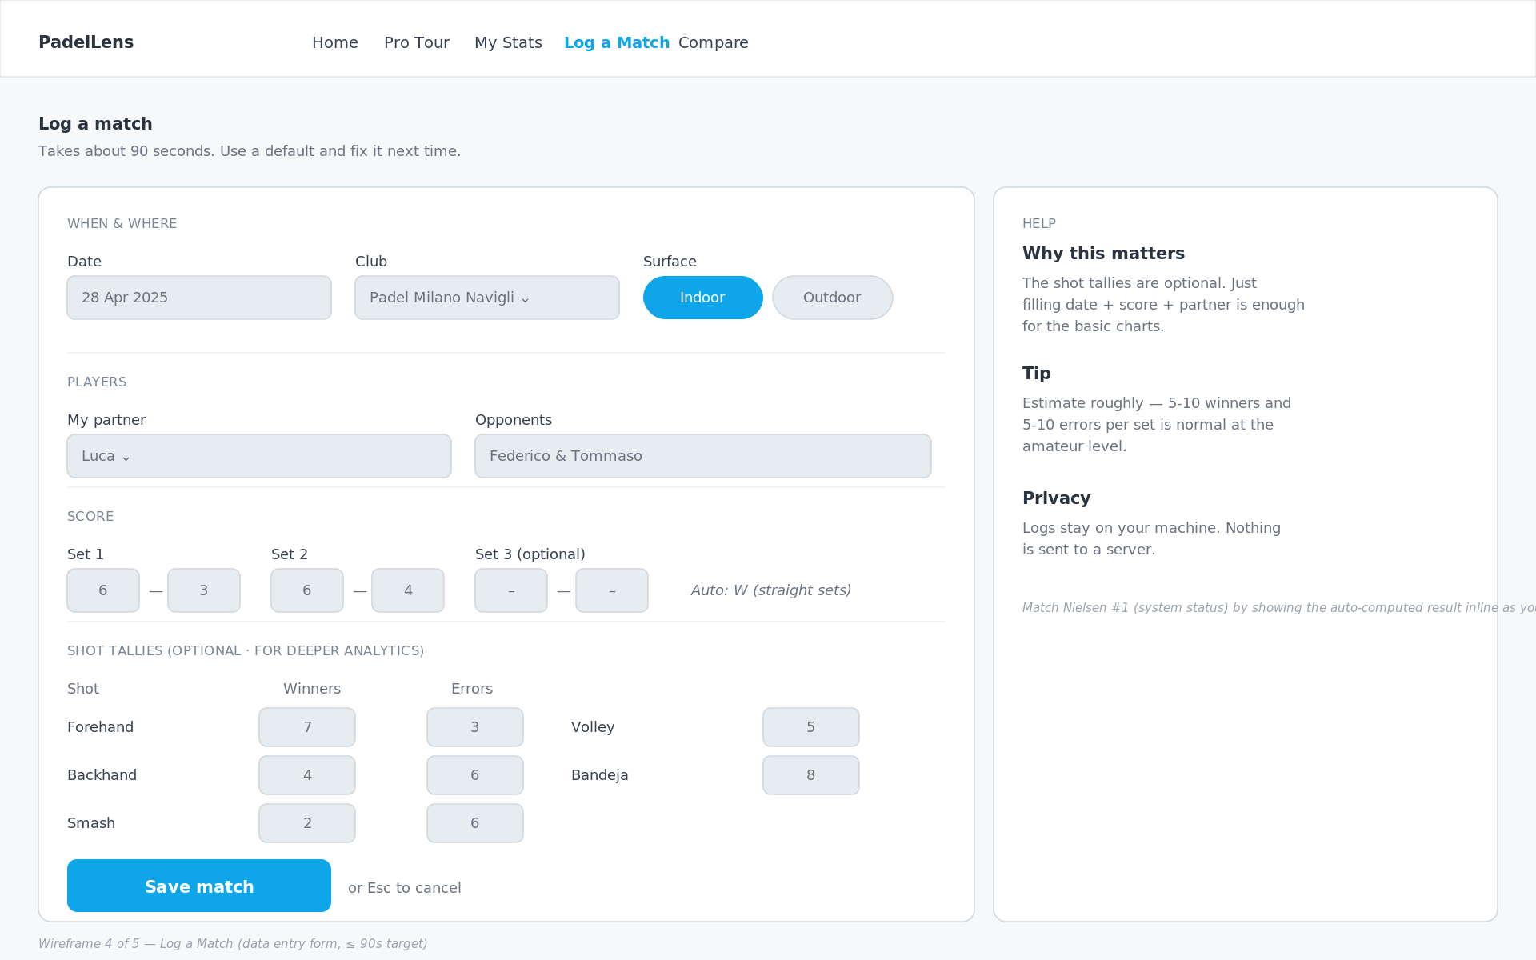
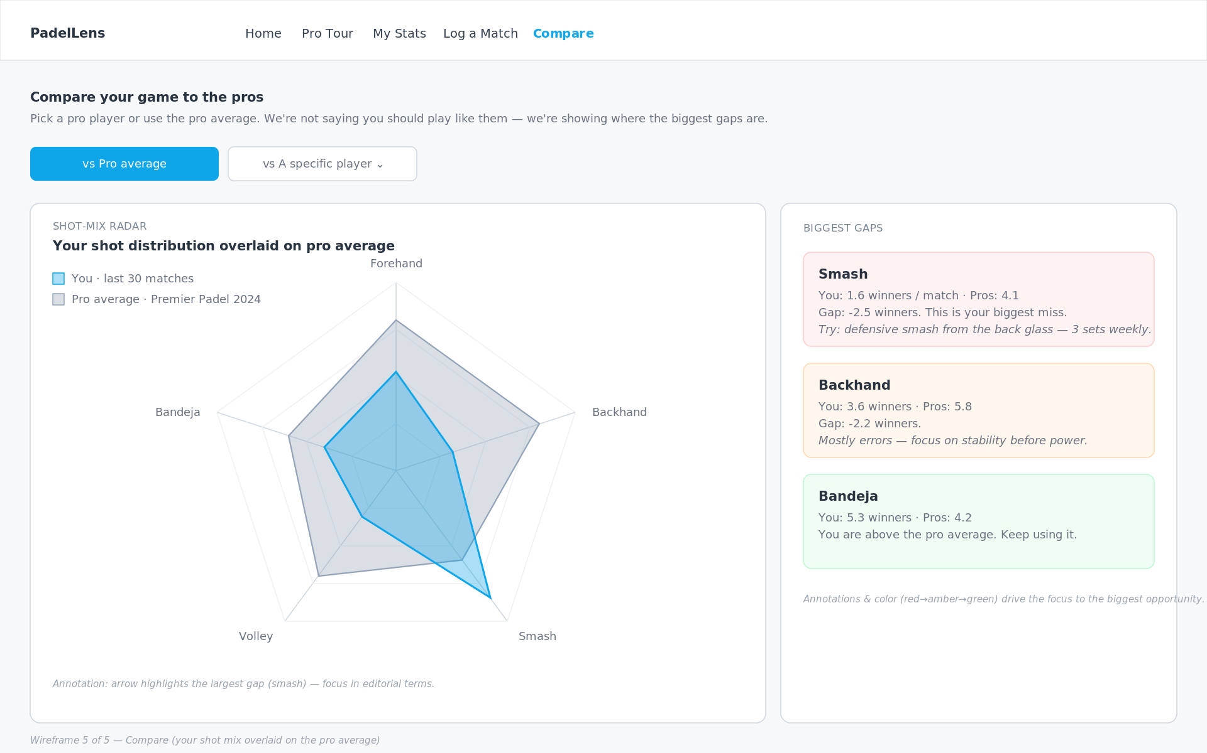
3.2 WIREFRAMES
Five pages, each built around one user task
Home
Pro Tour
My Stats
Log Match
Compare
Last 10 + partner + shot DNA
Rankings + filters
Personal dashboard
90-second data entry
Radar vs pro reference
Figma Wireframes
Each page answers ONE task from the brief.
Home → "How am I doing right now?" · Pro Tour → "Explore the pro game" · My Stats → "Why am I winning/losing?" · Log Match → "Add today's match" · Compare → "How big is the gap to a pro?"
PadelLens · DV4S Exam · Politecnico Milano · AY 2025/2026
22

Slide 23
3.3 PRINCIPLES
Six rules applied throughout
1
One number above the fold
2
Recognition over recall
The app is opened in bursts. 42-pt KPI on Home.
Filters always visible - never behind a button.
3
Default to action
4
Reduce data-entry friction
+ Log a match is the most prominent CTA on Home.
Shot tallies optional. Score + partner is enough.
5
Honest visual hierarchy
6
Annotate, don't decorate
Red only for negative signal. No gratuitous color.
Every chart has at least one in-canvas annotation.
PadelLens · DV4S Exam · Politecnico Milano · AY 2025/2026
23

Slide 24
3.4 HEURISTIC EVALUATION
Two real changes from Nielsen's 10
#5
BEFORE
AFTER
Original form let me enter Set-3 scores even when sets 1-2 were already decided (6-0, 6-0).
Set-3 inputs are disabled until sets 1-2 are split 1-1.
Error prevention
#6
BEFORE
AFTER
First sketch had filters hidden behind a 'Filters' button - user has to remember what they filtered by.
Filters live in an always-visible sidebar on the Pro Tour page.
Recognition over recall
PadelLens · DV4S Exam · Politecnico Milano · AY 2025/2026
24

Slide 25
3.5 CLOSING THE VALIDATION LOOP
Instruments ready. Sessions scheduled. No invented score.
+
Persona-grounding survey (EN/IT)
Grounds Marco and Luca in real respondents instead of assumptions.
+
Interview guide
Semi-structured questions for club players, to probe beyond the survey.
+
SUS questionnaire + scoring sheet
Standard 10-item System Usability Scale, ready to run - not yet run.
+
Task-based user-testing protocol
Concrete tasks (log a match, compare to a pro) with success criteria.
+
Heuristic evaluation round 2
A template for external evaluators, going beyond my own first pass.
Status, honestly: sessions with real club players are scheduled - no SUS score is invented.
PadelLens · DV4S Exam · Politecnico Milano · AY 2025/2026
25

Slide 26
PART 4
Data Representation
Chart choices · Color · Interactivity

Slide 27
4.1 CHART INVENTORY
Sixteen chart types · each answers one EDA finding
CHART
WHERE
WHAT does it Represent ?
KPI + sparkline
Home
Last-10 win rate
Horizontal bar
Home / My Stats
Partner win rate
Diverging bar
Home / My Stats
Shot DNA (winners − errors)
Ranking table + row sparkline
Pro Tour
Top players + form
Small-multiples
Pro Tour
Surface effect
Rolling-mean line
My Stats
Win-rate trend
Set-by-set columns
My Stats
Fatigue (2-set vs 3-set)
Radar overlay
Compare
You vs pro shot mix
Inline annotations
All pages
Headline numbers
Rejected: pie charts, court heatmaps, Sankeys, 3D bars, animated rankings - each lost head-to-head against a simpler alternative.
+ 7 new Insights-page charts (v3): momentum slope · chemistry band · calibration lollipop · Elo delta · upset-by-round · efficiency · home-advantage null.
PadelLens · DV4S Exam · Politecnico Milano · AY 2025/2026
27

Slide 28
4.2 CASE STUDY
Why a diverging bar for shot DNA?
THE QUESTION
YOUR SHOT DNA · 40 MATCHES
Which shots win me points, which bleed them?
Bandeja
+176
Forehand
+87
The question is signed. Some shots are net positive, others net negative.
Volley
+86
CONSIDERED:
Backhand
-117
Pie of shot share - hides the zero line.
Stacked bar - needs eye traversal.
Two side-by-side bar charts - same problem.
Diverging bar - chosen.
Smash
-170
0
Zero line dead center · sign readable at a glance · winners and errors share the bar.
PadelLens · DV4S Exam · Politecnico Milano · AY 2025/2026
28

Slide 29
4.3 CASE STUDY
Why a slope chart for momentum?
THE QUESTION
SET-1 WIN RATE → DECIDER WIN RATE
100%
86%
If I win set 1, how much does that really tell me - and does it survive a decider?
win match after set 1
A two-part story on purpose: a strong signal (86%) that quietly evaporates under one condition (49%).
49%
coin flip
50%
CONSIDERED:
Grouped bars - the 37-pt collapse has to live in a caption, not the ink.
Waterfall - implies an additive step that doesn't exist; different subsets.
Sankey - ribbon width implies a population flow that isn't actually true here.
Two-point slope chart - chosen.
coin flip in a decider
0%
86% → 49%: your set-1 lead evaporates once it's a decider.
PadelLens · DV4S Exam · Politecnico Milano · AY 2025/2026
29

Slide 30
4.4 CASE STUDY
Does chemistry build with reps - or is it survivorship?
THE QUESTION
Matches together, ordered left to right
WIN RATE BY MATCHES TOGETHER
100%
Does playing more matches together make a pair better, or are we just watching the survivors?
68%
Unlike momentum, this finding needs a caveat that is structural, not a footnote: the sample shrinks as buckets grow.
52%
45%
50%
40%
CONSIDERED:
Bar per bucket - no room left to layer in the shrinking-sample signal.
Scatter per pair - noisy at low n; the thin high-x tail is easy to miss.
Small multiples - solves a re-stitching problem this finding doesn't have.
Line + CI, narrowing wedge - chosen.
0%
Only 39% of pairs (89 of 230) ever reach 5+ matches together - the rise partly reflects who stays paired.
1-3
4-8
9-15
16+
PadelLens · DV4S Exam · Politecnico Milano · AY 2025/2026
30

Slide 31
4.5 CASE STUDY
Do rankings predict - or decide?
THE QUESTION
WIN RATE ABOVE A COIN FLIP, BY RANKING GAP
season average (78.5%)
How much should a ranking gap change my expectations, and does trust scale with gap size?
Closest gap
58.8%
The audience (Marco, Luca) never asked whether the model is honest - they asked whether the gap matters.
Season average
78.5%
CONSIDERED:
ROC curve - answers 'is the model good', not 'does the gap matter'.
Calibration-vs-diagonal plot - presupposes the reader accepts a model's output.
Simple KPI (78.5%) - hides that the average masks a 58.8-96.7% range.
Lollipop by ranking-gap size - chosen.
Widest gap
96.7%
coin flip (50%)
Even the closest gap tips to the favorite (59%); the widest gap is almost a sure thing (97%).
PadelLens · DV4S Exam · Politecnico Milano · AY 2025/2026
31

Slide 32
4.6 COLOR
Editorial use, not decoration
Blue
Red
Gray
#0EA5E9
#EF4444
#94A3B8
Positive / interactive / default
Negative signal requiring action
Pro reference frame
Ink
Muted
BG
#1F2937
#6B7280
#F8FAFC
Body text
Secondary text
Page background
ACCESSIBILITY CHECKS
WCAG AA body-text contrast 12.6:1 ✓ · Blue/red palette: deuteranopia & protanopia safe ✓ · No green/red pairs · Every red mark is also negatively signed numerically.
PadelLens · DV4S Exam · Politecnico Milano · AY 2025/2026
32

Slide 33
4.7 INTERACTIVITY & ANNOTATIONS
Kirk's last two design layers
INTERACTIVITY
ANNOTATION
Sidebar filters (country, surface, category, dates)
Row-click drill from rankings to player detail
Time-range toggle on My Stats (30/60/90/all)
Hover tooltips: precision on demand
Live auto-result preview while typing a score
Static in-canvas: the headline ("-40 pp")
Dynamic hover: the detail (exact value, date)
Captions outside the chart: WHAT
Callouts inside the chart: WHY you should care
Color-coded gap cards on Compare (red→amber→green)
Every insight card: in-canvas headline annotation + method note (test, n, p)
PadelLens · DV4S Exam · Politecnico Milano · AY 2025/2026
33

Slide 34
PART 5
Technical Implementation
Python · Streamlit · Plotly

Slide 35
5.1 TECH STACK & ARCHITECTURE
What's under the hood
STACK
ARCHITECTURE
Python 3.11
Language
Padel API
SQLite DB
REST + JSON
users table
Streamlit 1.32
Multi-page web app framework
Pandas
Pandas 2.x
Data wrangling, groupby, rolling means
load + transform
Plotly 5.x
Interactive charts (hover, zoom, brush)
Plotly
SQLite3
Embedded DB - users table, multi-user-ready
interactive
analytics.py
Elo · win model · Wilson CIs (12/12 tests)
Streamlit · run_app.bat launcher
Every pro view captions its data source.
PadelLens · DV4S Exam · Politecnico Milano · AY 2025/2026
35

Slide 36
5.2 THE ANALYTICS MODULE
From raw CSVs to a real modelling layer
+
Elo rating engine
Per-player ratings computed chronologically over all 776 real matches (K=32, base 1500).
+
Logistic win model + calibration
Predicts win probability from the ranking gap; decile calibration checked against outcomes.
+
Wilson confidence intervals
Computed on every win rate shown in the app - never a bare point estimate.
+
Small-n guard
Fewer than 10 matches behind a stat, and the app refuses to make a claim.
PadelLens · DV4S Exam · Politecnico Milano · AY 2025/2026
36

Slide 37
PART 6
Demo & Conclusions
Live walkthrough · Future work

Slide 38
6.1 DEMO
Five-step walkthrough I'll show you next
1 · Home
2 · Log Match
3 · My Stats
4 · Compare
5 · Insights
Open the app. Last 10: 7-3. Partner card shows Luca on top, Davide red.
Add today's match in 30 seconds. Watch the auto-result update.
Filter to last 60 days. Read the partner & fatigue panels.
Toggle to a specific pro. See the radar gap on the smash.
Land on the new Insights page: 7 discovery cards, each with its method note.
PadelLens - Dashboard · Streamlit
Every personal page shows a visible SYNTHETIC DEMO DATA badge.
PadelLens · DV4S Exam · Politecnico Milano · AY 2025/2026
38

Slide 39
6.2 FUTURE DEVELOPMENTS
What happens next
+
Run the scheduled user tests + SUS
Sessions with real club players are booked; SUS scoring sheet is ready. No score is invented ahead of time.
+
Real personal logging, replacing the synthetic layer
Every match I actually play gets logged from now on, retiring the seeded demo data match by match.
+
Full-history ingestion (paid API tier)
One month at €19 unlocks multi-season history: 2,000+ matches and ranking evolution over time.
+
Streamlit Cloud deployment
Ship a public link so Marco and Luca can use PadelLens without installing anything.
+
LLM-generated weekly digest
"This week your bandeja was on; your smash bled 12 points. Drill X."
PadelLens · DV4S Exam · Politecnico Milano · AY 2025/2026
39

Slide 40
THANK YOU
Questions?
GitHub repo: Abdullahsaeed10/PadelLens
"You don't have to feel your game - you can see it."

