Slide 1
PADELLENS
Pro Tour Insights + My Match Log
A data visualization tool for amateur padel players.
Sensei · Data Visualization for Sport · Sports Engineering MSc
Politecnico di Milano · AY 2025/2026
Notes:
Open with confidence. "Good evening. My name is Sensei, this is my final project for Data Visualization for Sport. I'll walk you through the whole process, from the brief all the way to the live demo. The application is called PadelLens. It's a data viz tool for amateur padel players, with a real-data pro tour layer underneath."

Slide 2
OVERVIEW
How this talk is organized
1
The Brief
Sport domain, audience, editorial angle
2
Working with Data
Sources, schema, exploration
3
UX Design
Wireframes, principles, heuristic eval
4
Data Representation
Chart choices, color, interactivity
5
Technical Implementation
Python, Streamlit, architecture
6
Demo & Conclusions
Live walkthrough, future work
PadelLens · DV4S Exam · Politecnico Milano · AY 2025/2026
2
Notes:
"The exam rubric has six sections. I'll cover them in order. The brief, data, UX, visualization layer, code, then a live demo. Total time is about 30 minutes. Please save questions for the end."

Slide 3
PART 1
The Brief
Context & Vision · Stage 1 of Kirk's data visualization process
Notes:
"Part one. The brief - what am I building, for whom, and why. This is the most important part of the whole project. Everything that follows traces back to a decision made here."

Slide 4
1.1 SPORT DOMAIN
Why padel?
Padel is exploding.
THE GAP
What amateurs feel
1.1M+ federated players in Italy (2024)
"I always lose in the third set."
"I play better with Luca."
"My bandeja is OK, my smash isn't."
Up from ~30,000 in 2019 (FIP data).
Pros have analytics.
Amateurs have a group chat.
What they can confirm
Nothing.
Premier Padel rankings, ball-tracking, broadcast overlays - none of that reaches the club player.
That gap is the project.
PadelLens · DV4S Exam · Politecnico Milano · AY 2025/2026
4
Notes:
"I picked padel because the gap is the right size. It's exploding in Italy - over a million federated players - but the analytical tools available stop at the pro tier. Amateurs have gut feelings - 'I always lose in the third set' - but no way to confirm any of them. The whole project is built around closing that gap."

Slide 5
1.2 PROBLEM & USER
Who's at the other end of the screen?
PROBLEM STATEMENT
Amateur padel players want to see patterns in their own game that they can't feel - but no simple tool turns a player's match log into honest visual feedback.
PRIMARY USER
SECONDARY USER
Marco · the club player
Luca · the amateur coach
22-40 years old
Plays 1-3 times per week at his local club
6 months to 5 years of experience
Will spend 90 seconds logging on his phone
Wants to improve · is not a pro · has no coach
Gives weekly 1-hour lessons
Needs a 2-min summary of each student before training
Cares about shot balance, error trends, partner effect
Reads on a laptop, not a phone
PadelLens · DV4S Exam · Politecnico Milano · AY 2025/2026
5
Notes:
"My primary user - I call him Marco - is a club player, 22 to 40 years old, plays a couple of times a week, willing to spend 90 seconds logging a match on his phone. Not a pro. Not a coach. The whole app is built around what Marco actually wants to know. The secondary user is the amateur coach - same data, different reading habits. Builds for Marco automatically work for the coach."

Slide 6
1.3 EDITORIAL THINKING
Angle · Framing · Focus (Kirk)
ANGLE
FRAMING
FOCUS
Reflective self-analysis over time
What an amateur can log on a phone
One number above the fold
Temporal · Categorical · Comparative.
Inside: matches, sets, shot tallies, partners, surface.
Last-10-matches win rate.
Spatial overlays (court heatmaps) deliberately excluded - we don't have sensor data.
Outside: ball-trajectory, biometrics, opponent scouting.
Plus: net shot balance, plain-language insight ("You win 80% with Luca").
PadelLens · DV4S Exam · Politecnico Milano · AY 2025/2026
6
Notes:
"Using Kirk's editorial-thinking framework from the lecture, the angle is reflective self-analysis over time. The framing keeps only what an amateur can actually log on a phone after a match - no sensor data, no biometrics, no opponent scouting. The focus is one number above the fold: your last 10 matches. That's what Marco opens the app to see."

Slide 7
1.4 RELEVANCE
Scored on Kirk's four factors
Timeliness
Opens after a match or before the next one - actionable now.
3/3
Interestingness
Confirms or contradicts gut feelings - both outcomes are interesting.
3/3
Pertinence
Literally the user's own data - maximum personal connection.
3/3
Sufficiency
Deliberate trade-off: enough to inform, not so much it overwhelms.
2/3
“You don't have to feel your game - you can see it.”
PadelLens · DV4S Exam · Politecnico Milano · AY 2025/2026
7
Notes:
"Scoring relevance on Kirk's four factors - timeliness, interestingness, pertinence and sufficiency - the project hits maximum on the first three and intentionally trades off on sufficiency. I'd rather show less and have it land, than show everything and have the user bounce. The core message of the whole project boils down to one line: you don't have to feel your game - you can see it."

Slide 8
PART 2
Working with Data
Acquisition · Transformation · Exploration
Notes:
"Part two. Where the data comes from, what shape it's in, and what it told me before I drew a single chart."

Slide 9
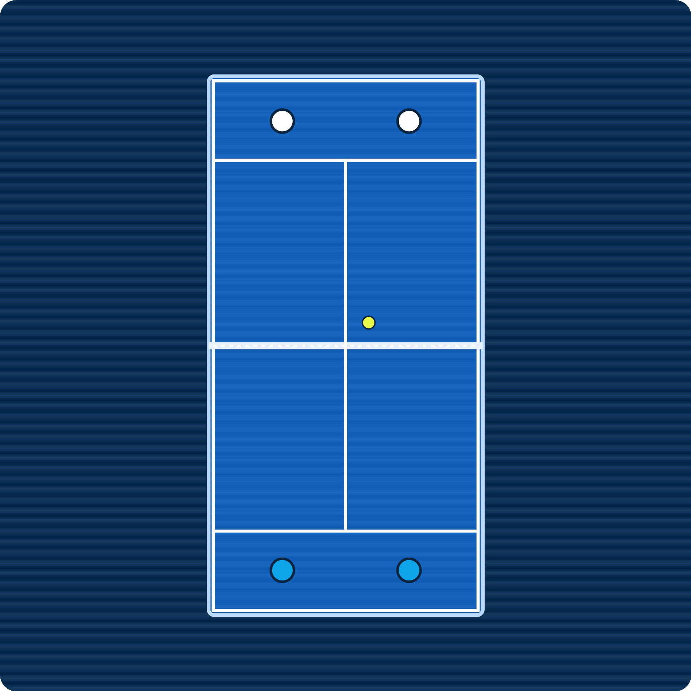
2.0 PRO DATA SOURCE
Premier Padel: the elite circuit behind our data
The official global professional padel tour (launched 2022, run by the FIP and Qatar Sports Investments). In 2024 it absorbed the former World Padel Tour, unifying the pro game. My app's Pro Tour layer pulls its rankings and match results from this circuit.
~26 tournaments per season, on 5 continents (Majors + P1 + P2 + Finals)
Majors
2,000 pts
Top tier - 4 a year (Qatar, Italy, France, Mexico)
P1
1,000 pts
Second tier - e.g. Madrid, Milano, Dubai, London
P2
~500 pts
Entry tier - e.g. Brussels, Rotterdam, Germany
Finals
1,500 pts
Season finale - top 16 pairs, Barcelona
Premier Padel court (top-down). Swap in an official photo if you have rights.
Below Premier Padel: the CUPRA FIP Tour feeder circuit (Platinum / Gold / Silver / Bronze), where emerging pairs earn points and climb toward P2 and P1.
PadelLens · DV4S Exam · Politecnico Milano · AY 2025/2026
9
Notes:
"Before I talk about my data, a quick word on where the real pro data comes from. Premier Padel is the official global professional tour, launched in 2022 and backed by the International Padel Federation and Qatar Sports Investments. In 2024 it absorbed the old World Padel Tour, so it's now the single elite circuit. There are about 26 tournaments a year across five continents, in three tiers: Majors at the top worth 2,000 ranking points, then P1 at 1,000, then the more accessible P2 at around 500, plus a season-ending Finals in Barcelona for the top 16 pairs. Below all of that sits the FIP feeder tour - Platinum, Gold, Silver, Bronze - where new pairs earn points and climb. My app's Pro Tour layer takes its rankings and results from this Premier Padel circuit, which is why this data is real and verifiable."

Slide 10
2.1 ACQUISITION
Two layers, two sources
LAYER A · PRO TOUR (REAL)
LAYER B · PERSONAL LOG
Padel API · padelapi.org
Seed data + user-generated
Premier Padel rankings + match results
Free tier: 50k req/month, 6 months of data
Token auth, REST + JSON
Paid only: full history · live point-by-point · shot stats
No public amateur padel match data exists.
That absence is part of why this project exists.
APPROACH
Realistic seed log demonstrates the app
Real users replace it via Log Match form
Transparently disclosed - not hidden
BACKUP
Kaggle Padel Tennis WC dataset
Premier Padel website scrape
Cached CSV for offline demo
PadelLens · DV4S Exam · Politecnico Milano · AY 2025/2026
10
Notes:
"Two data layers, two sources. The pro layer comes from the Padel API - real Premier Padel results, free tier, 50k requests a month. The cached CSV is the offline fallback for the live demo so I'm not at the mercy of the wifi. The personal layer is seed data. No public amateur padel dataset exists - and that gap is exactly why the project is interesting in the first place. The lecture on editorial thinking specifically says: when the data isn't there, make the absence part of the story. That's what I did."

Slide 11
2.2 EXAMINATION & TRANSFORMATION
Three CSVs, tidy schemas
pro_players.csv
30 rows
pro_matches.csv
276 rows
my_matches.csv
40+ rows
player_id
name
country
side (D/R)
ranking_points
+ 3 more
match_id
date · tournament
round
team1_p{1,2}
team2_p{1,2}
winner_team
set{1,2,3}
surface
duration_min
match_id · date
partner · opponents
club · surface
set scores (per set)
winners_{shot} · errors_{shot}
result · duration · notes
Transformations (cached in Streamlit): score-string parsing → numeric · derived 'won' & 'net_<shot>' · groupby on partner / surface / shot · 5-match rolling win rate.
PadelLens · DV4S Exam · Politecnico Milano · AY 2025/2026
11
Notes:
"Three CSVs. Thirty top pros, two hundred and seventy-six pro matches across twelve real tournaments, and forty seed personal matches. The transformations are mostly small - parsing tournament score strings into numeric pairs, computing derived columns like 'won' and net per shot type, and grouping by partner, surface and shot. All cached in Streamlit at load time so the UI stays snappy."

Slide 12
2.3 EXPLORATION
What the data told me before I drew anything
PRO TOUR
Matches the real Premier Padel rate (~68-72%). Means: third-set analytics are rare on the pro side. Don't waste space on them.
68%
straight-set rate
PARTNER
60-point spread across the same player. This is the single most surprising actionable fact in the data.
80% vs 20%
Luca vs Davide
FATIGUE
Two-set win rate is 80%, three-set is 40%. The fade is real, and it's the biggest learnable pattern.
−40 pp
drop in 3-set matches
PadelLens · DV4S Exam · Politecnico Milano · AY 2025/2026
12
Notes:
"Three findings drove the entire design. One: on the pro tour, two-thirds of matches end in straight sets - meaning I should not waste screen real estate on third-set analytics for the pro side. Two: on my personal log, the partner effect is enormous - eighty percent win rate with one partner, twenty with another. Three: when matches go to a third set, my win rate drops by forty percentage points. Every chart I'll show you in a minute earned its place by answering one of these three findings."

Slide 13
PART 3
UX Design
Wireframes · Principles · Heuristic evaluation
Notes:
"Part three. How the app is laid out, why those choices, and what I changed after a heuristic evaluation."

Slide 14
3.1 PROCESS
From paper sketch to working app
1
2
3
4
Paper sketches
Low-fi wireframes
Mid-fi pass
Streamlit build
30 min. Just box drawings - which pages exist.
Figma · 5 SVGs · grayscale layout only.
Same layout, real chart shapes drawn in.
High-fi == working app. No click-prototype.
Why I stopped at low-fi: The deliverable is a Streamlit app, and going from a Streamlit-shaped wireframe to a Streamlit-built app is a one-step jump. Click-prototypes are theatre.
PadelLens · DV4S Exam · Politecnico Milano · AY 2025/2026
14
Notes:
"My design process was deliberately short. I sketched on paper, moved to low-fi Figma wireframes, did a mid-fi pass with the actual chart shapes drawn in, then jumped directly to the Streamlit build. I did not do a full click-prototype because the deliverable is a working app - building a click-prototype that nobody will demo is wasted time. The Streamlit build is the high-fi version."

Slide 15
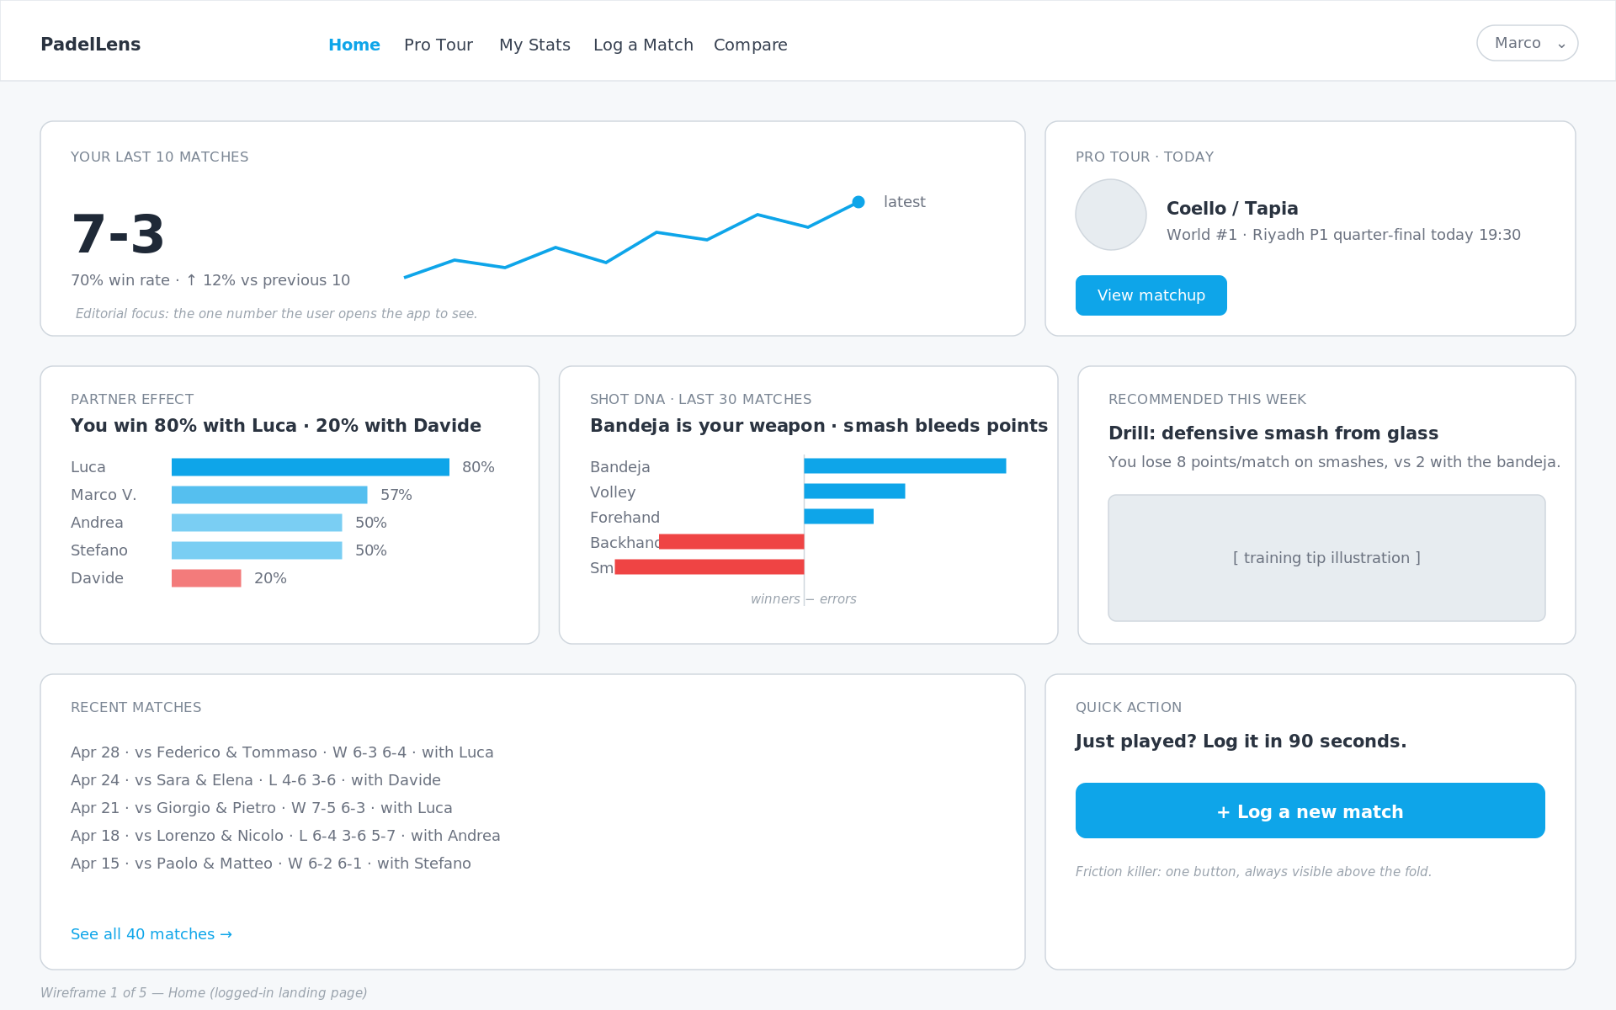
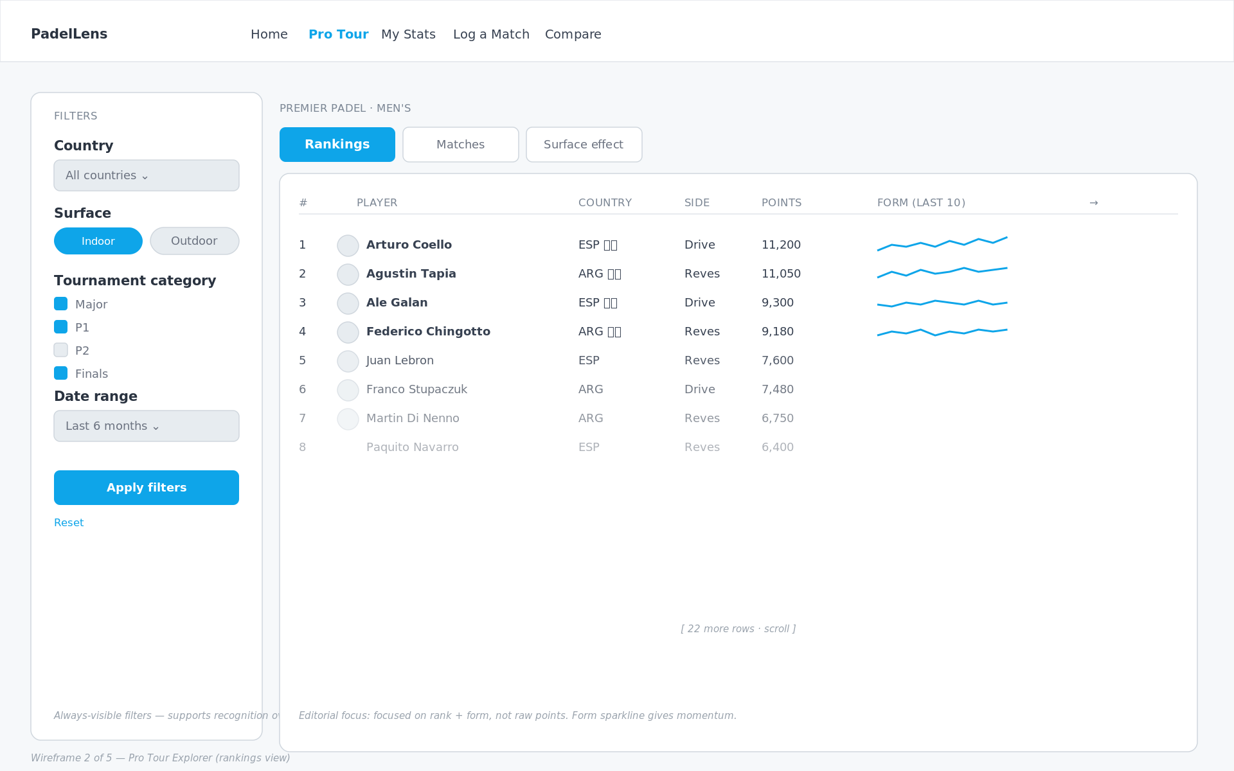
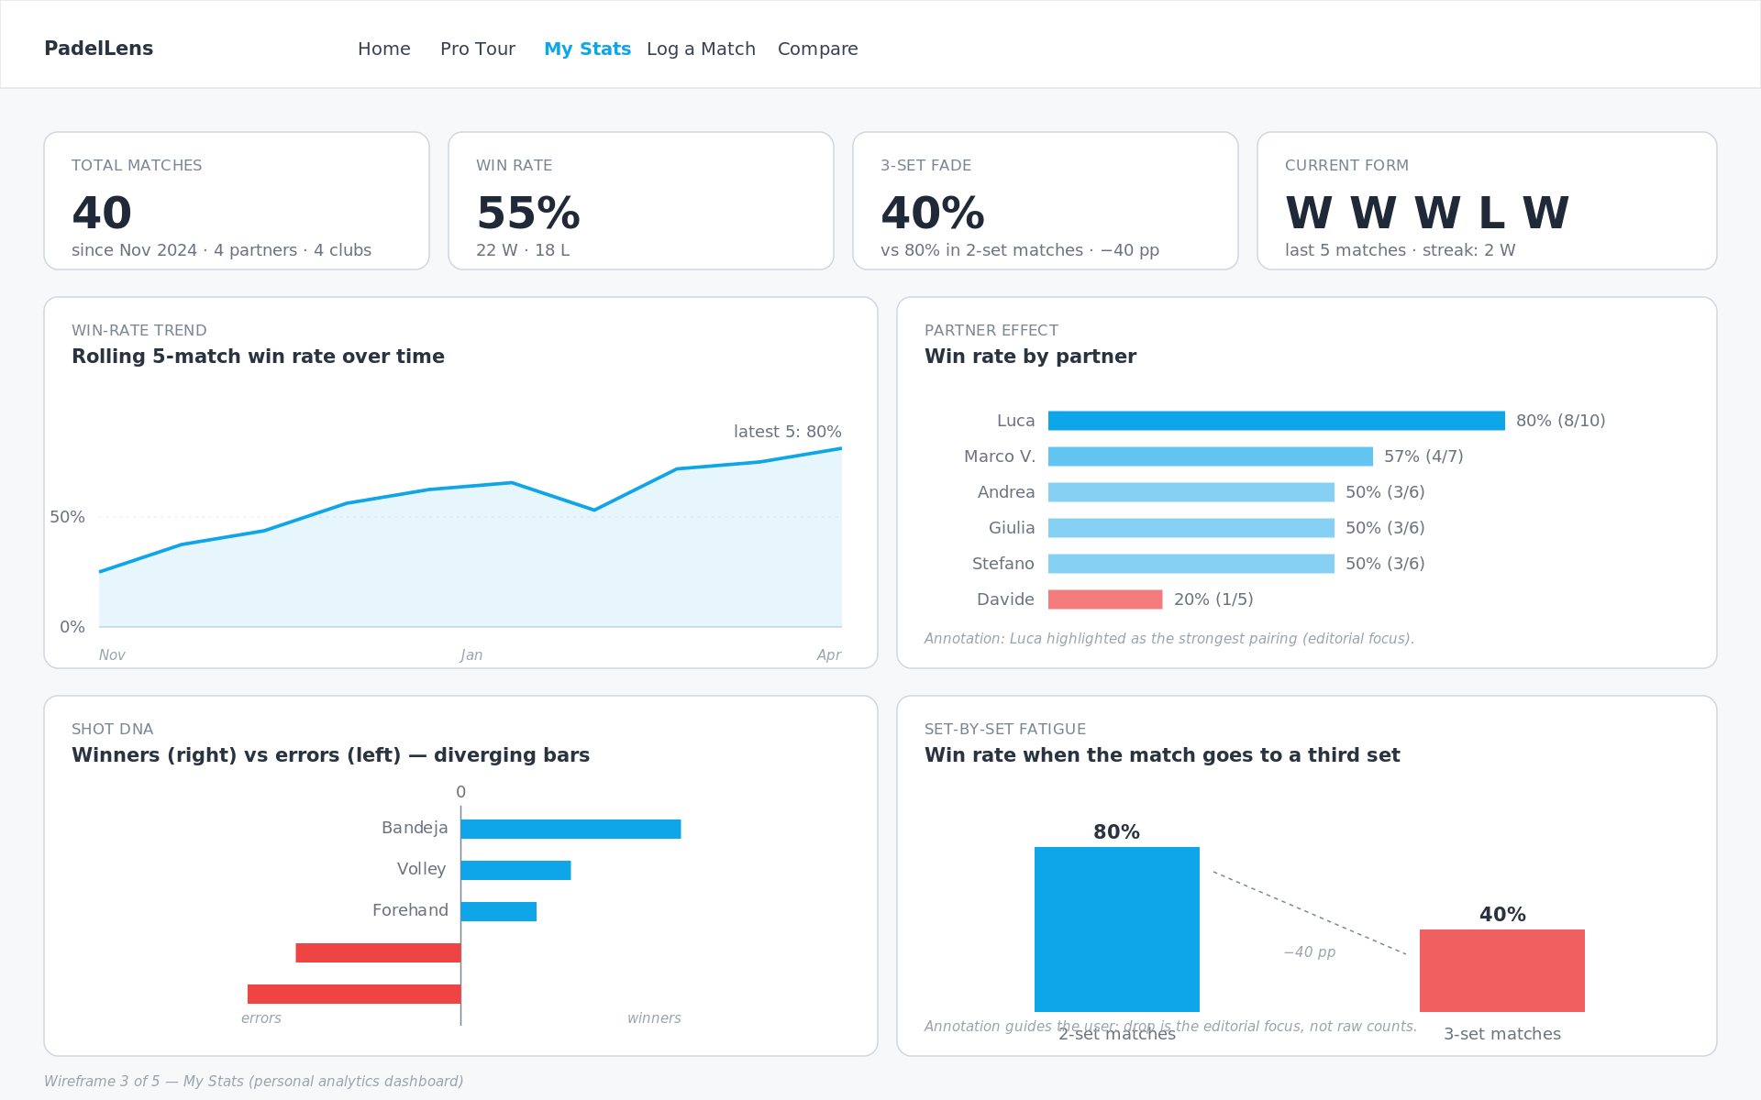
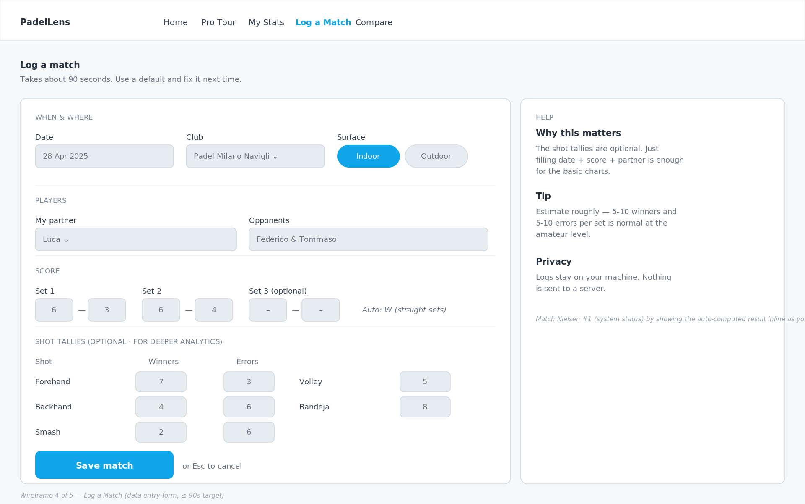
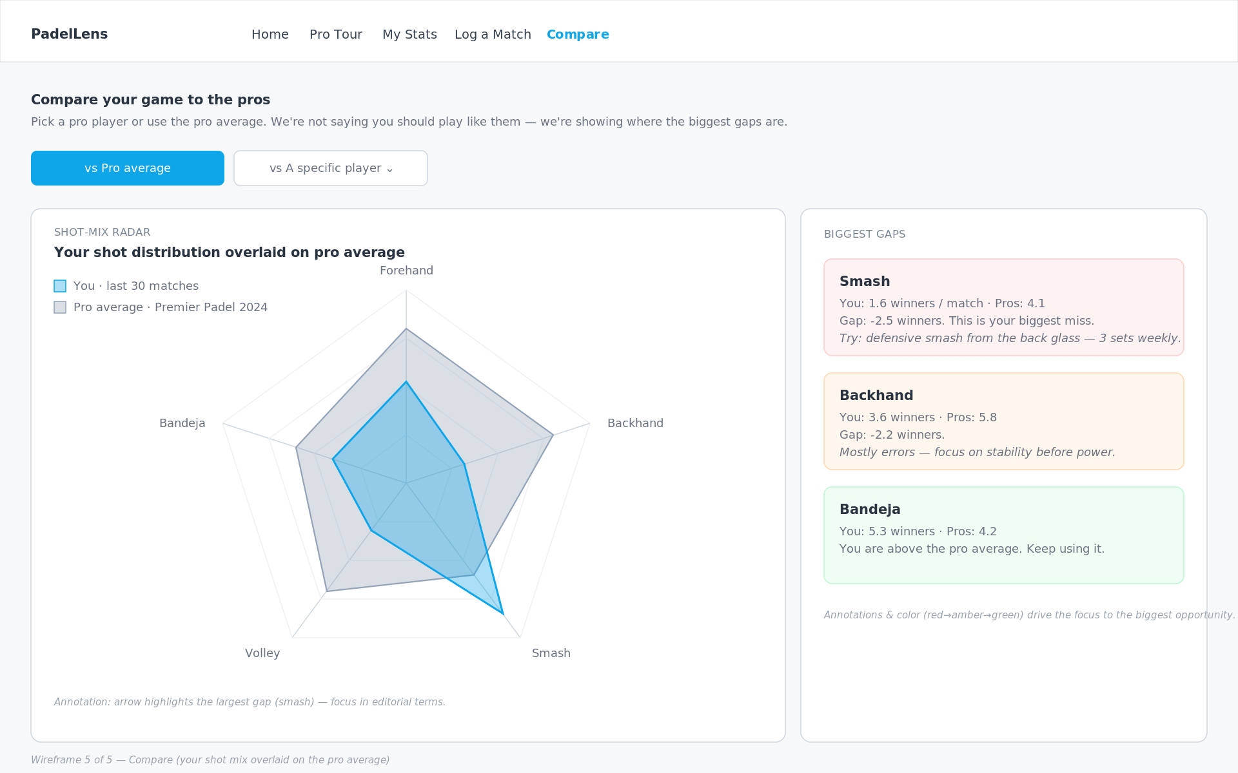
3.2 WIREFRAMES
Five pages, each built around one user task
Home
Pro Tour
My Stats
Log Match
Compare
Last 10 + partner + shot DNA
Rankings + filters
Personal dashboard
90-second data entry
Radar vs pro reference
Each page answers ONE task from the brief.
Home → "How am I doing right now?" · Pro Tour → "Explore the pro game" · My Stats → "Why am I winning/losing?" · Log Match → "Add today's match" · Compare → "How big is the gap to a pro?"
PadelLens · DV4S Exam · Politecnico Milano · AY 2025/2026
15
Notes:
"Five pages. Home is the landing - the last-10 KPI plus the partner-effect and shot-DNA cards. Pro Tour is the rankings explorer with the always-visible filter sidebar. My Stats is the personal deep-dive. Log Match is the data entry form, deliberately frictionless - under 90 seconds to log a match. Compare is the radar overlay of your shot mix against the pro reference. Each page is built around exactly one user task."

Slide 16
3.3 PRINCIPLES
Six rules applied throughout
1
One number above the fold
2
Recognition over recall
The app is opened in bursts. 42-pt KPI on Home.
Filters always visible - never behind a button.
3
Default to action
4
Reduce data-entry friction
+ Log a match is the most prominent CTA on Home.
Shot tallies optional. Score + partner is enough.
5
Honest visual hierarchy
6
Annotate, don't decorate
Red only for negative signal. No gratuitous color.
Every chart has at least one in-canvas annotation.
PadelLens · DV4S Exam · Politecnico Milano · AY 2025/2026
16
Notes:
"Six principles drove the design. One number above the fold because users open the app in bursts. Recognition over recall - filters are always visible in the sidebar. Default to action - the log-a-match button is the most prominent CTA. Reduce friction in data entry - shot tallies are optional, score plus partner is enough. Honest visual hierarchy - red is reserved for negative signal. And annotate, don't decorate - every chart has an in-canvas callout. That last one ties directly back to the focus principle from the editorial thinking lecture."

Slide 17
3.4 HEURISTIC EVALUATION
Two real changes from Nielsen's 10
#5
BEFORE
AFTER
Original form let me enter Set-3 scores even when sets 1-2 were already decided (6-0, 6-0).
Set-3 inputs are disabled until sets 1-2 are split 1-1.
Error prevention
#6
BEFORE
AFTER
First sketch had filters hidden behind a 'Filters' button - user has to remember what they filtered by.
Filters live in an always-visible sidebar on the Pro Tour page.
Recognition over recall
PadelLens · DV4S Exam · Politecnico Milano · AY 2025/2026
17
Notes:
"I ran Nielsen's ten heuristics against my first paper sketches. Two of them flagged real problems. Number five - error prevention - my original log form let me enter a third-set score even when sets one and two were already decided. I added input gating. Number six - recognition over recall - I'd originally hidden filters behind a button. I moved them to an always-visible sidebar. These two changes are the difference between the paper sketch and the wireframe you just saw."

Slide 18
PART 4
Data Representation
Chart choices · Color · Interactivity
Notes:
"Part four. How the data is shown. Chart by chart."

Slide 19
4.1 CHART INVENTORY
Nine chart types · each answers one EDA finding
CHART
WHERE
ANSWERS
KPI + sparkline
Home
Last-10 win rate
Horizontal bar
Home / My Stats
Partner win rate
Diverging bar
Home / My Stats
Shot DNA (winners − errors)
Ranking table + row sparkline
Pro Tour
Top players + form
Small-multiples
Pro Tour
Surface effect
Rolling-mean line
My Stats
Win-rate trend
Set-by-set columns
My Stats
Fatigue (2-set vs 3-set)
Radar overlay
Compare
You vs pro shot mix
Inline annotations
All pages
Headline numbers
Rejected: pie charts, court heatmaps, Sankeys, 3D bars, animated rankings. Each lost head-to-head against a simpler alternative.
PadelLens · DV4S Exam · Politecnico Milano · AY 2025/2026
19
Notes:
"Nine chart types in the app. Each one answers one specific finding from the exploratory analysis. I had a longer list - pie charts, court heatmaps, Sankeys, animated rankings - that I cut. They each lost head-to-head against a simpler alternative on the specific question they were trying to answer."

Slide 20
4.2 CASE STUDY
Why a diverging bar for shot DNA?
THE QUESTION
YOUR SHOT DNA · 40 MATCHES
Which shots win me points, which bleed them?
Bandeja
+176
Forehand
+87
The question is signed. Some shots are net positive, others net negative.
Volley
+86
CONSIDERED:
Backhand
-117
Pie of shot share - hides the zero line.
Stacked bar - needs eye traversal.
Two side-by-side bar charts - same problem.
Diverging bar - chosen.
Smash
-170
0
Zero line dead center · sign readable at a glance · winners and errors share the bar.
PadelLens · DV4S Exam · Politecnico Milano · AY 2025/2026
20
Notes:
"Walk through one chart choice as a case study. The shot DNA question is signed - bandeja is net-positive, smash is net-negative. A pie chart shows proportions, not signs. Stacked bars hide the zero line. Two bar charts force eye traversal. A diverging bar puts the zero line dead center, lets winners go right and errors go left, and the sign is readable at a glance. Every chart in the app went through this kind of head-to-head choice."

Slide 21
4.3 COLOR
Editorial use, not decoration
Blue
Red
Gray
#0EA5E9
#EF4444
#94A3B8
Positive / interactive / default
Negative signal requiring action
Pro reference frame
Ink
Muted
BG
#1F2937
#6B7280
#F8FAFC
Body text
Secondary text
Page background
ACCESSIBILITY CHECKS
WCAG AA body-text contrast 12.6:1 ✓ · Blue/red palette: deuteranopia & protanopia safe ✓ · No green/red pairs · Every red mark is also negatively signed numerically.
PadelLens · DV4S Exam · Politecnico Milano · AY 2025/2026
21
Notes:
"Color is doing editorial work, not decoration. Blue is the neutral and positive case. Red is reserved for negative signal that requires action - losing partner, net-negative shot, the third-set fade KPI. Gray is the pro reference frame on the Compare page. No green anywhere - green/red is the worst color-blindness pair. And every red mark is also signed numerically, so even on a black-and-white printout the chart still tells the same story."

Slide 22
4.4 INTERACTIVITY & ANNOTATIONS
Kirk's last two design layers
INTERACTIVITY
ANNOTATION
Sidebar filters (country, surface, category, dates)
Row-click drill from rankings to player detail
Time-range toggle on My Stats (30/60/90/all)
Hover tooltips: precision on demand
Live auto-result preview while typing a score
Static in-canvas: the headline ("-40 pp")
Dynamic hover: the detail (exact value, date)
Captions outside the chart: WHAT
Callouts inside the chart: WHY you should care
Color-coded gap cards on Compare (red→amber→green)
PadelLens · DV4S Exam · Politecnico Milano · AY 2025/2026
22
Notes:
"Interactivity follows Kirk's framing layer - filters let the user reframe the data. Hover tooltips give precision on demand without cluttering the chart. The most important annotations are static and in-canvas, like the minus-forty-pp tag on the fatigue chart - those are the headline, not a footnote. Hover tooltips are for the detail-seeking user; static annotations are for the user who's not even reading carefully."

Slide 23
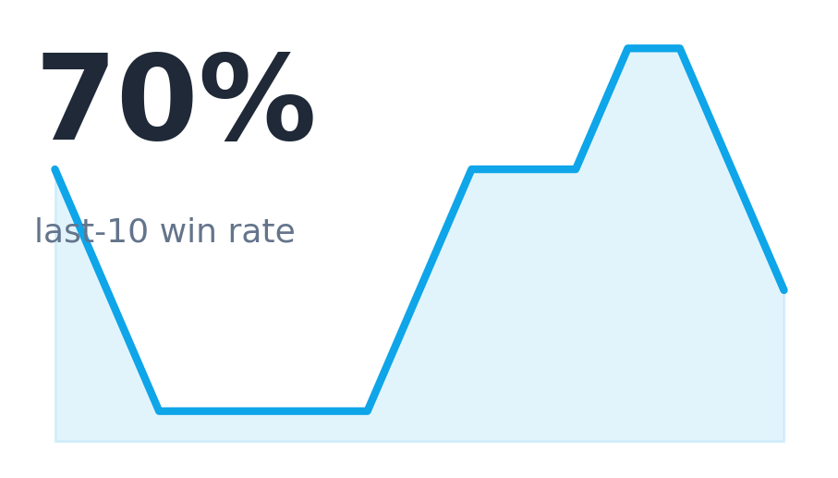
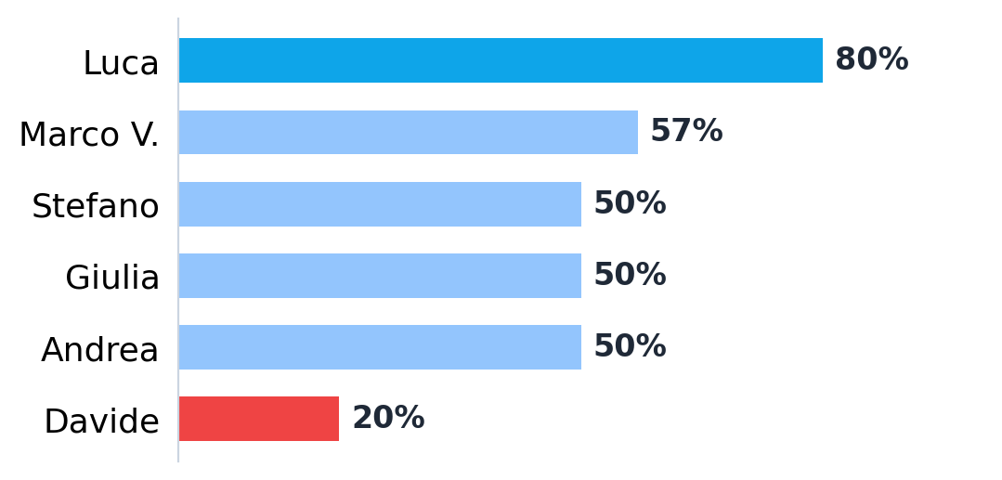
4.5 CHART GALLERY
The charts in the app (1/4)
Win-rate KPI + sparkline
Partner win-rate bars
The single headline number the user opens the app for, with a sparkline showing recent momentum.
Win rate per partner; bar length is the fastest channel for comparison (Luca 80% best, Davide 20% worst).
PadelLens · DV4S Exam · Politecnico Milano · AY 2025/2026
23
Notes:
"These next four slides are the actual charts, rendered from my real data. First, the headline KPI with its sparkline, and the partner bars - which immediately surface the 80-versus-20 partner effect."

Slide 24
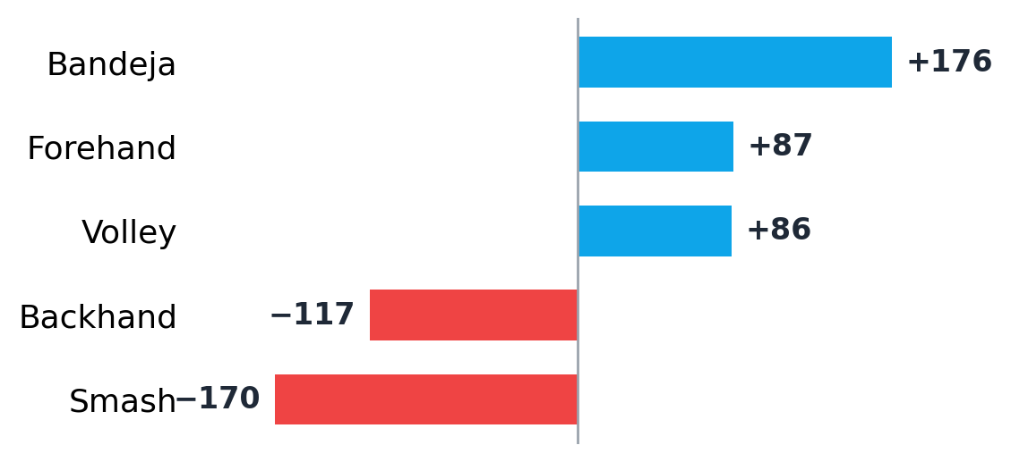
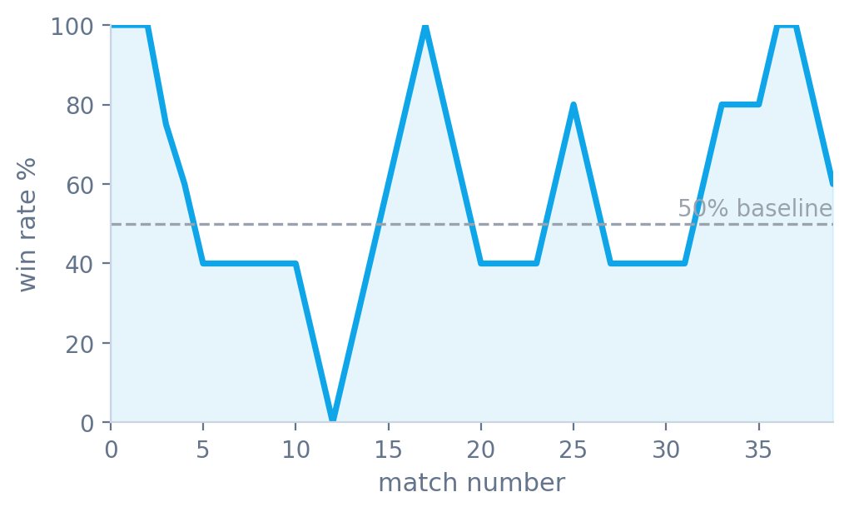
4.6 CHART GALLERY
The charts in the app (2/4)
Shot DNA (diverging bars)
Rolling win-rate line
Winners minus errors per shot around a zero line - strengths point right (Bandeja +176), weaknesses left (Smash -170).
A 5-match rolling mean against a 50% baseline smooths single-match noise to reveal the real trend.
PadelLens · DV4S Exam · Politecnico Milano · AY 2025/2026
24
Notes:
"The shot-DNA diverging bar is my signed-magnitude chart; the rolling line is my trend chart - the rolling mean stops a single bad match from dominating."

Slide 25
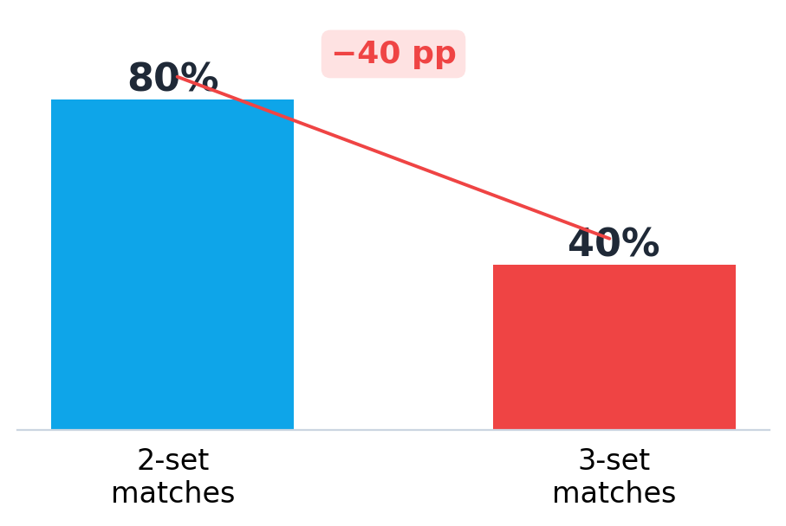
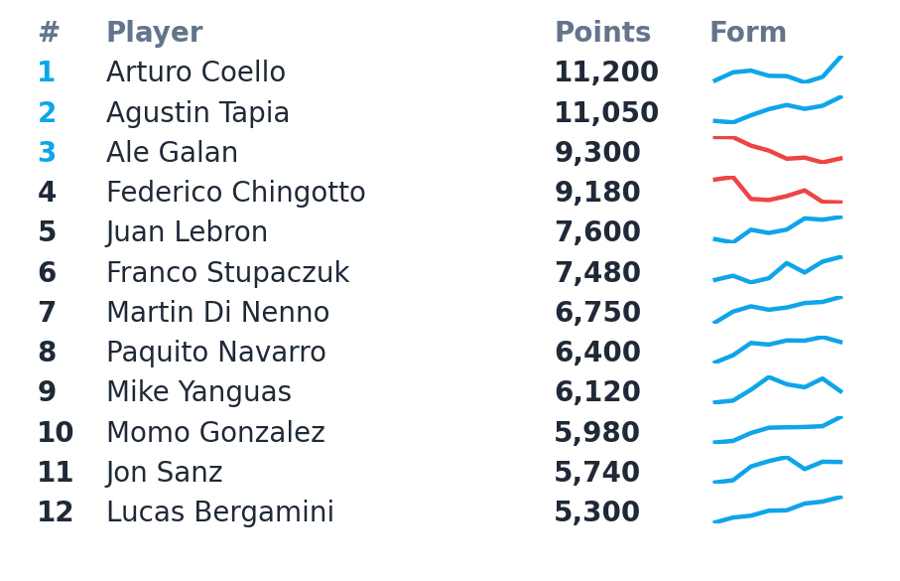
4.7 CHART GALLERY
The charts in the app (3/4)
Set-by-set fatigue
Pro rankings + form sparklines
Two-set vs three-set win rate, with the -40-point fatigue gap annotated directly on the chart.
A ranking is inherently tabular; a tiny form sparkline per row adds momentum without a spaghetti plot.
PadelLens · DV4S Exam · Politecnico Milano · AY 2025/2026
25
Notes:
"The fatigue chart makes the gap the hero with a direct annotation. The rankings table stays tabular but adds a per-row form sparkline."

Slide 26
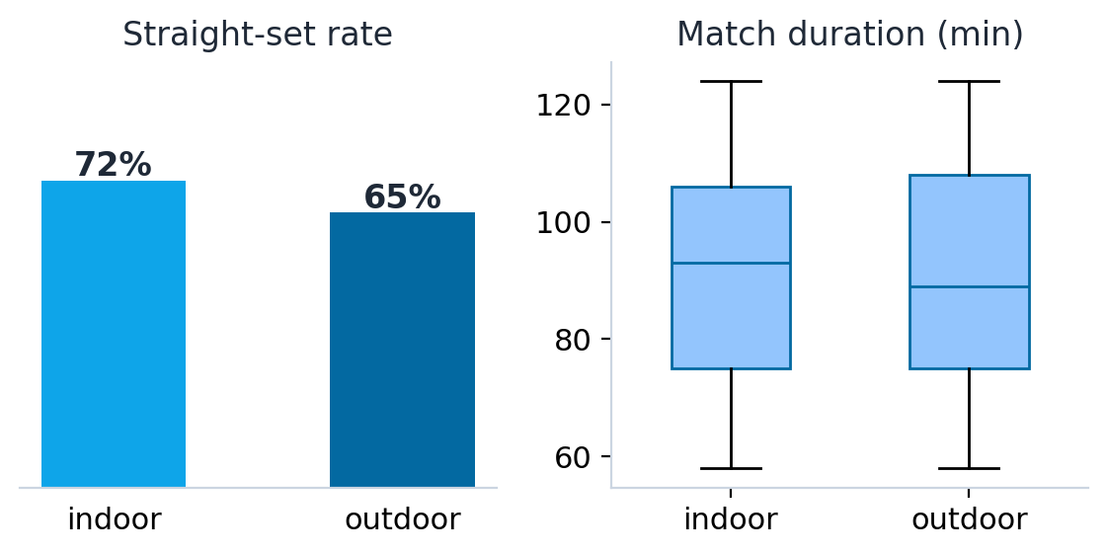
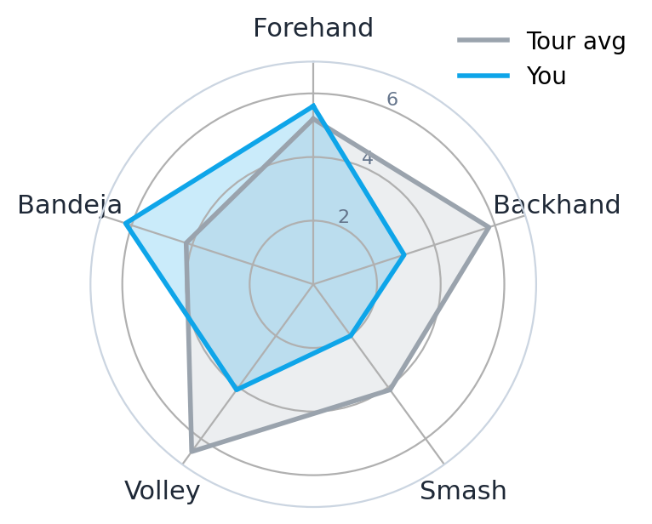
4.8 CHART GALLERY
The charts in the app (4/4)
Surface effect (small multiples)
Shot-profile radar
Indoor vs outdoor panels show overlapping distributions - surface is a weak predictor, so it is a filter, not a headline.
Your average winners per shot overlaid on the tour reference across five shot types - the shape gap is the story.
PadelLens · DV4S Exam · Politecnico Milano · AY 2025/2026
26
Notes:
"Finally the surface small multiples - which justify treating surface as a minor filter - and the Compare radar, my one radar chart, used because the question is the shape difference across a small fixed set of categories."

Slide 27
PART 5
Technical Implementation
Python · Streamlit · Plotly
Notes:
"Part five, quickly - what's under the hood."

Slide 28
5.1 TECH STACK & ARCHITECTURE
What's under the hood
STACK
ARCHITECTURE
Python 3.11
Language
Padel API
CSV cache
REST + JSON
offline-safe
Streamlit 1.32
Multi-page web app framework
Pandas
Pandas 2.x
Data wrangling, groupby, rolling means
load + transform
Plotly 5.x
Interactive charts (hover, zoom, brush)
Plotly
interactive
Requests
Padel API client
Streamlit · multi-page web
PadelLens · DV4S Exam · Politecnico Milano · AY 2025/2026
28
Notes:
"The stack is intentionally boring: Python, Streamlit, Pandas, Plotly, Requests. Total app code is about six hundred lines across five files. The architecture is simple - the Padel API or the cached CSV feeds into Pandas, which feeds into Plotly, which renders inside Streamlit. Streamlit's caching means each CSV is read once per session. The whole thing runs on a laptop in under three seconds from cold start."

Slide 29
PART 6
Demo & Conclusions
Live walkthrough · Future work
Notes:
"Last part. I'll switch to the live app now and walk through a real use case, then close with what would come next."

Slide 30
6.1 DEMO
Five-step walkthrough I'll show you next
1 · Home
2 · Log Match
3 · My Stats
4 · Compare
5 · Pro Tour
Open the app. Last 10: 7-3. Partner card shows Luca on top, Davide red.
Add today's match in 30 seconds. Watch the auto-result update.
Filter to last 60 days. Read the partner & fatigue panels.
Toggle to a specific pro. See the radar gap on the smash.
Filter to indoor majors. Read the form sparkline column.
→ Switch to live app now: streamlit run app.py
PadelLens · DV4S Exam · Politecnico Milano · AY 2025/2026
30
Notes:
"I'll show you this live next. Five stops: open Home, log a match in thirty seconds, filter My Stats, toggle the Compare radar, and finish on the Pro Tour rankings. Then I'll switch to the running app."

Slide 31
6.2 FUTURE DEVELOPMENTS
What v2 would add
+
Per-player shot averages
Padel API doesn't currently expose them. v2 would scrape them from match-level video annotations.
+
Sensor integration
Modern padel paddles (Babolat Pop, Zepp) push event streams. Plugging them in unlocks the spatial layer deliberately left out of v1.
+
Multi-user support
Currently single-user. Add Streamlit auth + per-user CSV so a club coach can see every student.
+
Mobile-first redesign
Logging is a phone task. Streamlit's mobile layout is OK; a native wrap would be better.
+
LLM-generated weekly digest
"This week your bandeja was on; your smash bled 12 points. Drill X."
PadelLens · DV4S Exam · Politecnico Milano · AY 2025/2026
31
Notes:
"Five things I'd add next: per-player shot stats once the data exists, paddle-sensor integration to unlock the spatial layer, multi-user support for coaches, a mobile-first redesign, and an LLM weekly digest. None of these change the core thesis - they extend it."

Slide 32
THANK YOU
Questions?
App code, wireframes, data and these slides bundled in the Padel-Project repository - available on request.
"You don't have to feel your game - you can see it."
Notes:
"That's PadelLens. Thank you - happy to take questions."

