Slide 1
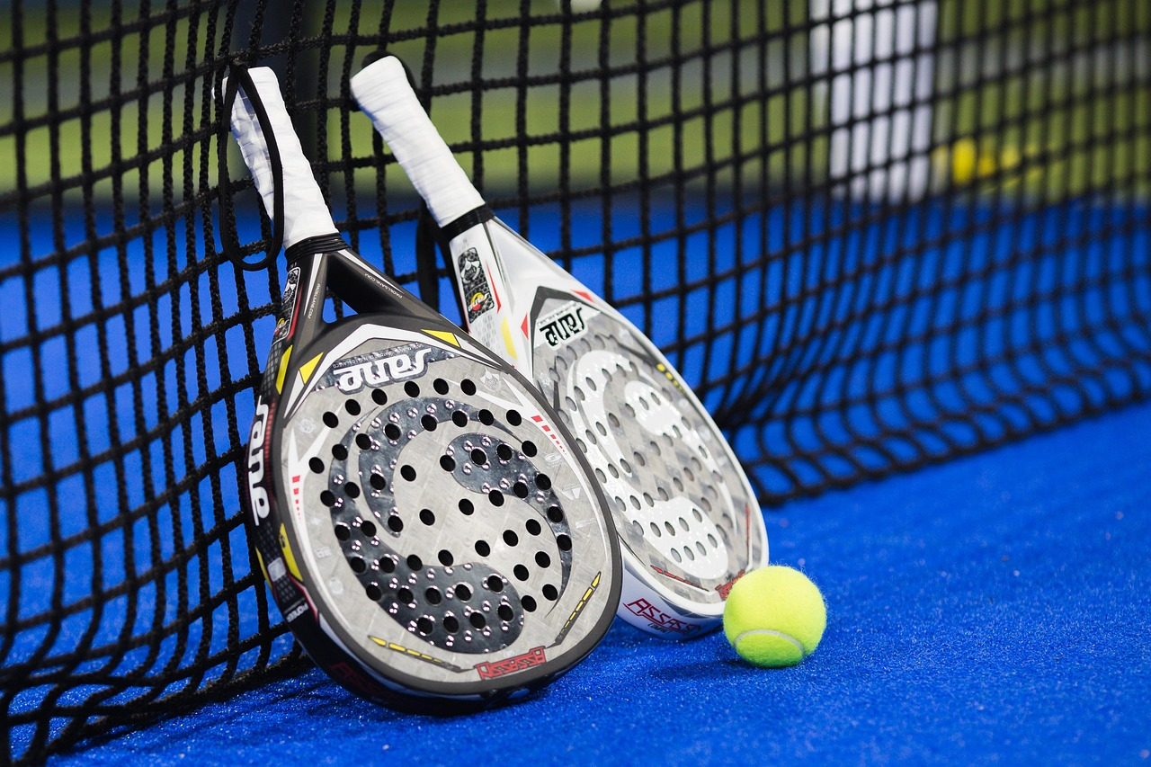
PADELLENS
Pro Tour Insights + My Match Log
A data visualization tool for amateur padel players.
Resubmission — with real data & discovered insights
Data Visualization for Sport · Sports Engineering MSc
Politecnico di Milano · AY 2025/2026
Notes:
Open with confidence. "Good evening. My name is Sensei, this is my final project for Data Visualization for Sport. I'll walk you through the whole process, from the brief all the way to the live demo. The application is called PadelLens. It's a data viz tool for amateur padel players, with a real-data pro tour layer underneath."

Slide 2
OVERVIEW
How this talk is organized
1
The Brief
Sport domain, audience, editorial angle
2
Working with Data
Sources, schema, exploration
3
UX Design
Wireframes, principles, heuristic eval
4
Data Representation
Chart choices, color, interactivity
5
Technical Implementation
Python, Streamlit, architecture
6
Demo & Conclusions
Live walkthrough, future work
Slides marked NEW/UPDATED show what changed since the first submission.
PadelLens · DV4S Exam · Politecnico Milano · AY 2025/2026
2
Notes:
I've restructured this talk to tell the whole story from the beginning, not just what changed. You'll see the same six parts as my first submission, but now Part 2 and Part 4 carry real discovered findings instead of assumptions, and validation has moved from absent to scheduled. Every slide that's new or different carries a small badge -- blue for new content, gray for updated -- so you can see exactly where the improvements landed without me having to tell you twice. I'd rather you evaluate the whole project fresh, with the changes clearly marked, than jump straight to a diff.

Slide 3
WHAT CHANGED
What changed since the first submission — at a glance
+
A real 776-match dataset
padelapi.org, 2026 season — 26 tournaments, 2,165 ranked players, my own API key.
+
Genuine data exploration
Ten hypotheses tested; seven discovered findings, including an honest null.
+
A new analytics layer
Elo ratings, a logistic win-probability model, k-means clustering, confidence intervals.
+
An upgraded application
SQLite-backed, multi-user-ready, with a new Insights page (seven discovery cards).
+
Validation, honestly reported
Instruments ready (survey, SUS, protocols); sessions with real club players scheduled.
+
A polished, verified deliverable
This deck: consistent numbering, zero placeholders, speaker notes on every slide.
PadelLens · DV4S Exam · Politecnico Milano · AY 2025/2026
3
Notes:
Before I walk through the whole story again from the beginning, here's the honest summary of what actually changed since my first submission, which scored twenty-one out of thirty. Six things: a real seven hundred seventy-six match dataset instead of a small demo pull; genuine data exploration that surfaced seven findings, including an honest null; a new analytics layer with Elo ratings, a win model, clustering, and confidence intervals; an upgraded SQLite-backed multi-user app with a new Insights page; validation instruments that are ready with real sessions scheduled; and a polished, machine-verified deliverable -- this deck. Every badge you see from here on marks exactly where.

Slide 4
PART 1
The Brief
Context & Vision · Stage 1 of Kirk's data visualization process
Notes:
"Part one. The brief - what am I building, for whom, and why. This is the most important part of the whole project. Everything that follows traces back to a decision made here."

Slide 5
1.1 SPORT DOMAIN
Why padel?
Padel is exploding.
THE GAP
What amateurs feel
1.1M+ federated players in Italy (2024)
"I always lose in the third set."
"I play better with Luca."
"My bandeja is OK, my smash isn't."
Up from ~30,000 in 2019 (FIP data).
Pros have analytics.
Amateurs have a group chat.
What they can confirm
Nothing.
Premier Padel rankings, ball-tracking, broadcast overlays - none of that reaches the club player.
That gap is the project.
PadelLens · DV4S Exam · Politecnico Milano · AY 2025/2026
5
Notes:
"I picked padel because the gap is the right size. It's exploding in Italy - over a million federated players - but the analytical tools available stop at the pro tier. Amateurs have gut feelings - 'I always lose in the third set' - but no way to confirm any of them. The whole project is built around closing that gap."

Slide 6
1.2 PROBLEM & USER
Who's at the other end of the screen?
PROBLEM STATEMENT
Amateur padel players want to see patterns in their own game that they can't feel - but no simple tool turns a player's match log into honest visual feedback.
Personas now being grounded in a real survey + interviews (07_Validation)
PRIMARY USER
SECONDARY USER
Marco · the club player
Luca · the amateur coach
22-40 years old
Plays 1-5 times per week at his local club
6 months to 5 years of experience
Will spend 90 seconds logging on his phone
Wants to improve · is not a pro
Gives weekly 1-hour lessons
Needs a 2-min summary of each student before training
Cares about shot balance, error trends, partner effect
Reads on a laptop, not a phone
PadelLens · DV4S Exam · Politecnico Milano · AY 2025/2026
6
Notes:
Marco and Luca haven't changed -- the problem and the two personas are still exactly what I pitched originally. What's different is how I'm grounding them. Instead of inventing plausible-sounding personas from my own assumptions, I've built a real survey and interview guide in 07_Validation, ready to run with actual club players and coaches. That's a direct response to the criticism that personas had no research foundation. I haven't run the sessions yet -- I'm not going to pretend I have -- but the instruments exist and Marco and Luca will be replaced by real respondent data very soon.

Slide 7
1.3 EDITORIAL THINKING
Angle · Framing · Focus (Kirk)
ANGLE
FRAMING
FOCUS
Reflective self-analysis over time
What an amateur can log on a phone
One number above the fold
Temporal · Categorical · Comparative.
Inside: matches, sets, shot tallies, partners, surface.
Last-10-matches win rate.
Spatial overlays (court heatmaps) deliberately excluded - we don't have sensor data.
Outside: ball-trajectory, biometrics, opponent scouting.
Plus: net shot balance, plain-language insight ("You win 80% with Luca").
PadelLens · DV4S Exam · Politecnico Milano · AY 2025/2026
7
Notes:
"Using Kirk's editorial-thinking framework from the lecture, the angle is reflective self-analysis over time. The framing keeps only what an amateur can actually log on a phone after a match - no sensor data, no biometrics, no opponent scouting. The focus is one number above the fold: your last 10 matches. That's what Marco opens the app to see.“
- helping a player look back at their own game temporal (trends across matches over time), categorical (by partner, shot type, surface), and comparative (this period vs. another, or you vs. a pro)

Slide 8
1.4 RELEVANCE
Scored on Kirk's four factors
Timeliness
Opens after a match or before the next one - actionable now.
3/3
Interestingness
Confirms or contradicts gut feelings - both outcomes are interesting.
3/3
Pertinence
Literally the user's own data - maximum personal connection.
3/3
Sufficiency
Deliberate trade-off: enough to inform, not so much it overwhelms.
2/3
“You don't have to feel your game - you can see it.”
PadelLens · DV4S Exam · Politecnico Milano · AY 2025/2026
8
Notes:
"Scoring relevance on Kirk's four factors - timeliness, interestingness, pertinence and sufficiency - the project hits maximum on the first three and intentionally trades off on sufficiency. I'd rather show less and have it land, than show everything and have the user bounce. The core message of the whole project boils down to one line: you don't have to feel your game - you can see it."

Slide 9
PART 2
Working with Data
Acquisition · Transformation · Exploration
Notes:
"Part two. Where the data comes from, what shape it's in, and what it told me before I drew a single chart."

Slide 10
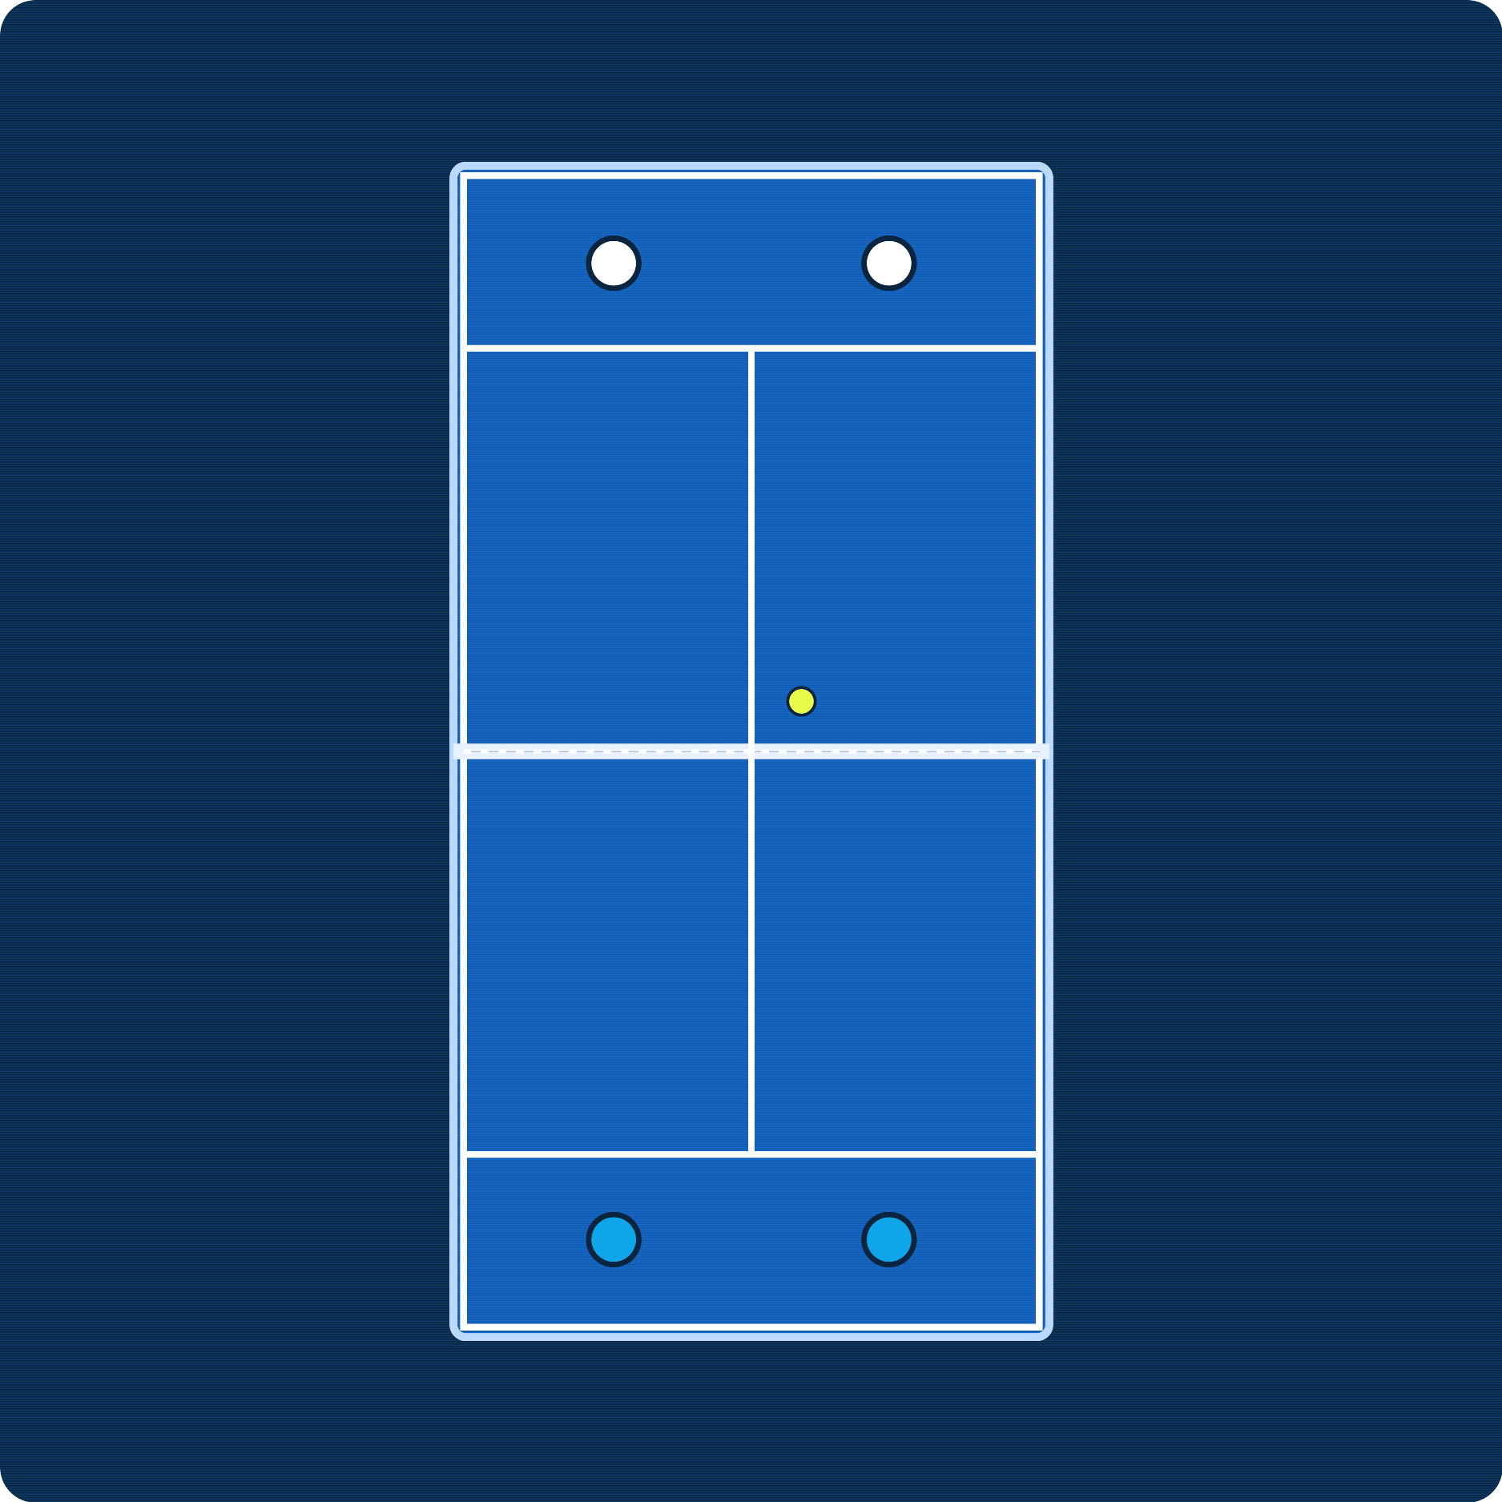
2.0 PRO DATA SOURCE
Premier Padel: the elite circuit behind our data
The official global professional padel tour (launched 2022, run by the FIP and Qatar Sports Investments). Data comes from padelapi.org, a real REST API called with my own API key, covering the full 2026 season: 776 completed matches and 2,165 ranked players.
~26 tournaments per season, on 5 continents (Majors + P1 + P2 + Finals)
Majors
2,000 pts
Top tier - 4 a year (Qatar, Italy, France, Mexico)
P1
1,000 pts
Second tier - e.g. Madrid, Milano, Dubai, London
P2
~500 pts
Entry tier - e.g. Brussels, Rotterdam, Germany
Finals
1,500 pts
Season finale - top 16 pairs, Barcelona
Premier Padel court (top-down). Swap in an official photo if you have rights.
2026 season, real data: 776 completed matches, 26 tournaments, full draws Round-of-64 to Final, men's and women's competitions, 2,165 ranked players.
PadelLens · DV4S Exam · Politecnico Milano · AY 2025/2026
10
Notes:
This is the single biggest change in the whole project. The pro data used to be a small demo pull -- thirty players, two hundred seventy-six matches. Now it's the real thing: padelapi.org, a REST API, called with my own API key, covering the entire 2026 Premier Padel season so far -- seven hundred seventy-six completed matches, twenty-six tournaments, full draws from round of sixty-four to the final, both tours, twenty-one sixty-five ranked players. Everything downstream -- the exploration, the findings, the calibration case study -- is built on this real dataset, not a curated sample.

Slide 11
2.1 ACQUISITION
Two layers, two sources
LAYER A · PRO TOUR (REAL)
LAYER B · PERSONAL LOG
Padel API · padelapi.org
Seed data + user-generated
Rankings + real 2026-season match results
10 req/min throttle, under the free-tier cap
Restartable: one file per tournament
Archives every raw response first
No public amateur padel match data exists.
That absence is part of why this project exists.
APPROACH
SAFEGUARDS
Realistic seed log demonstrates the app
Real users replace it via Log Match form
Every personal page shows a visible SYNTHETIC DEMO DATA badge
429 backoff, up to 4 retries
hidden_free_plan values are skipped
PadelLens · DV4S Exam · Politecnico Milano · AY 2025/2026
11
Notes:
Acquiring this data meant designing around real constraints, not an idealized API. The free tier caps me at ten requests a minute, so the fetcher throttles itself and backs off properly on a 429. It's restartable by tournament, which mattered because the full pull took over ten minutes and I didn't want to lose progress on an interruption. And every single raw response gets archived to disk before I touch it with any cleaning logic -- that archive is what let me fix a real bug later without re-fetching a single byte. The synthetic personal log is still here, but now it's honestly labeled.

Slide 12
2.2 EXAMINATION & TRANSFORMATION
Two real CSVs — and the bug I caught
pro_players_real.csv
2,165 rows
pro_matches_real.csv
776 rows
my_matches.csv (demo)
40+ rows
player_id
name
country
age
ranking_points
+ 2 more (hand/height, patchy)
match_id
date · tournament
round
team1_p{1,2}
team2_p{1,2}
winner_team
set{1,2,3}
source (API record id)
duration_min
match_id · date
partner · opponents
club · surface
set scores (per set)
winners_{shot} · errors_{shot}
result · duration · notes
Examination caught a real bug: the API returns scores as a JSON array of sets, not the comma-string my first parser assumed — fixed in build_real_csv.py, zero re-fetching.
PadelLens · DV4S Exam · Politecnico Milano · AY 2025/2026
12
Notes:
I want to be honest about the one real bug I hit. I wrote my first score parser assuming the API returned a comma-separated string, like what you'd see on a results page. It doesn't -- it's a JSON array of set objects. I only caught that by actually reading the raw archived responses during examination, not by trusting my own assumption. Because acquisition and transformation are separate scripts, fixing the parser cost me one file and zero re-fetching. That separation is the entire argument for keeping these stages apart instead of one script that does everything in a single pass.

Slide 13
2.3 EXPLORATION — HOW
How I explored, before I trusted a single number
SCOPE
All ten run against the real 776-match dataset, two-sided tests at alpha=0.05 — nothing cherry-picked.
10 tests
hypotheses, E1-E10
CONFIDENCE
Every win rate in this report ships with a confidence interval, never a bare point estimate.
Wilson 95% CI
on every proportion
VERDICTS
A finding that fails a test is reported as a null or insufficient — never hidden or rounded up.
3 honest labels
signal · null · insufficient
PadelLens · DV4S Exam · Politecnico Milano · AY 2025/2026
13
Notes:
This slide is about method, not results -- the findings themselves come next. I ran ten hypotheses against the real dataset, every one of them a two-sided test at the standard alpha of point-oh-five, and every proportion in the report carries a Wilson ninety-five percent confidence interval, not just a bare number. Critically, I built in three possible verdicts, not two: a finding can be a signal, a null, or genuinely insufficient data. That third option is what separates real exploratory analysis from cherry-picking -- I'm about to show you results from all three categories, including the ones that didn't work.

Slide 14
2.4 THE DATASET IN NUMBERS
A full professional season, captured end to end
Source: padelapi.org REST API (official professional padel data service) · personal API key · season window Feb–Jul 2026
MATCHES
TOURNAMENTS
PLAYERS
776
26
2,165
completed, 2026 season
Feb–Jul 2026, 5 continents
ranked, men + women
COVERAGE
PER-MATCH FIELDS
PER-PLAYER FIELDS
Round-of-64 → Final
Men 456 · Women 320
P2 350 · P1 340 · Major 86
date, round, seeds
player IDs, court sides
set scores, duration
ranking, points
age, nationality
Data hygiene: statistics use the 763 matches that finished normally — 13 retired/walkovers excluded. Every raw API response is archived as JSONL before transformation (fetch → archive → clean → SQLite).
PadelLens · DV4S Exam · Politecnico Milano · AY 2025/2026
14
Notes:
This slide is the honest headline before the methods get technical. The dataset is a full 2026 Premier Padel season from padelapi.org, called with my own API key -- seven hundred seventy-six completed matches, twenty-six tournaments, twenty-one sixty-five ranked players, full draws round of sixty-four to the final. Everything downstream runs on this, not a curated sample. One honesty note: statistics use the seven hundred sixty-three matches that finished normally -- thirteen retirements and walkovers are excluded so they don't distort win rates. Every raw API response is archived as JSONL before any cleaning, which is what makes the pipeline reproducible end to end.

Slide 15
2.5 STATISTICAL TOOLKIT — TESTS
Four tools, applied the same way every time
All tests two-sided, α = 0.05 · every proportion carries a 95% Wilson confidence interval · win rates with n < 10 are never shown as claims
Wilson 95% CI — (p̂ + z²/2n ± z·√(p̂(1−p̂)/n + z²/4n²)) / (1 + z²/n), z = 1.96
Unlike the naive interval it stays inside [0,1] and is reliable for small n.
Binomial test — is an observed proportion different from 50/50?
Used for momentum (86%), favorites (78.5%), upsets (22.4%).
Chi-square test — χ² = Σ (O−E)²/E — are win rates equal across groups?
Used for the 4 chemistry buckets (1-3, 4-7, 8-15, 16+ matches together).
Welch t-test — t = (x̄₁−x̄₂) / √(s₁²/n₁ + s₂²/n₂)
Difference of means without assuming equal variance — used for match durations.
PadelLens · DV4S Exam · Politecnico Milano · AY 2025/2026
15
Notes:
Before the findings, here's how I tested them. Everything is two-sided at alpha zero point zero five, with every proportion carrying a ninety-five percent Wilson interval -- said aloud: p-hat plus z-squared over two n, plus or minus z times the square root of p-hat times one minus p-hat over n, plus z-squared over four n-squared, all over one plus z-squared over n, z equal to one point nine six. It never leaves zero to one. Binomial test asks if a rate differs from a coin flip -- momentum, favorites, upsets. Chi-squared checks the chemistry buckets, and Welch's t-test compares duration means without assuming equal variance.

Slide 16
2.6 STATISTICAL TOOLKIT — MODELS
Three models turn tests into predictions
LOGISTIC MODEL
P(team1 wins) = 1 / (1 + e^−(β₀ + β₁·log(pts₁/pts₂))) — log of the points ratio, because ranking advantages act multiplicatively. In 88% of winner-loser pairs the model ranked the winner higher.
AUC 0.88
decile calib. vs y = x
ELO ENGINE
Expected score E_A = 1/(1+10^((R_B−R_A)/400)); update R′_A = R_A + K·(S_A−E_A), zero-sum and unit-tested. Disagreement between Elo and official points is the over/under-rated-players insight.
K = 32
start 1500, chronological
K-MEANS
Minimize Σ‖x − μ_c‖² on standardized shot-profile features to group players into archetypes.
Archetypes
standardized shot profile
All implemented in analytics.py — 12/12 unit tests passing.
PadelLens · DV4S Exam · Politecnico Milano · AY 2025/2026
16
Notes:
Three models turn tests into predictions. The logistic win model: probability team one wins equals one over one plus e to the negative of beta-zero plus beta-one times the log of the points ratio, because ranking advantages multiply. AUC is zero point eighty-eight -- it ranked the winner higher in most pairs. The Elo engine: expected score is one over one plus ten to the rating difference over four hundred; rating updates by K times actual minus expected score, K equal to thirty-two, unit-tested zero-sum. That gap flags over- and under-rated players. K-means groups players into shot archetypes -- all three in analytics.py, twelve of twelve tests passing.

Slide 17
2.7 FINDINGS — MOMENTUM & CHEMISTRY
The first set decides a lot. Chemistry takes longer.
MOMENTUM
n=668, p<0.001 — consistent across gender and level. A near-decisive early lead.
86%
win match after set 1
DECIDING SET
Once a match actually reaches a 3rd set, the set-1 winner's edge evaporates (n=207).
~49%
coin flip in a decider
CHEMISTRY
p<0.001 across buckets. Caveat: survivorship — winning pairs simply get more reps together.
40% → 67%
win rate, 1-3 vs 16+ matches together
PadelLens · DV4S Exam · Politecnico Milano · AY 2025/2026
17
Notes:
Two real discoveries here. First, momentum: win the first set and you win the match eighty-six percent of the time -- a huge, real signal across genders and levels. But narrow that to matches that actually reach a third set, and the set-one winner's edge completely disappears, down to forty-nine percent, a coin flip. Second, chemistry: pairs win about forty percent of matches in their first three together, climbing to sixty-seven percent past sixteen matches. I want to flag the catch immediately -- that's survivorship as much as chemistry, since losing pairs simply stop playing together. I'll come back to that caveat in the chart design.

Slide 18
2.8 FINDINGS — RANKING, UPSETS, EFFICIENCY
Rankings predict. They just don’t decide.
RANKING
Logistic model AUC 0.88. Caveat: points are a single end-of-window snapshot, not match-date values.
78.5%
favorite (by points) wins
UPSETS
n=165, p<0.001. Non-monotonic by round — finals land close to a coin flip (50%).
22.4%
of seeded matches
EFFICIENCY
n=233, p=0.004 — fewer games in the previous round is a real efficiency/fatigue signal.
59.7%
next-match win rate
PadelLens · DV4S Exam · Politecnico Milano · AY 2025/2026
18
Notes:
Three more discovered findings. Rankings genuinely predict: the team with more combined points wins seventy-eight and a half percent of the time, and a logistic model on that gap gets an AUC of point eight eight -- a real, strong signal, though I treat it as an upper bound because the points snapshot has some look-ahead bias. Upsets are rarer than they feel -- only twenty-two percent of seeded matches -- and non-monotonic by round, spiking to a coin flip in the final. And efficiency matters: teams that win their previous round in fewer games have a real edge next match, fifty-nine point seven percent.

Slide 19
2.9 THE HONEST NULLS
What the data honestly does NOT show
HOME ADVANTAGE
n=109, p=0.18 — not significant. No detectable home advantage overall.
43%
home-team win rate
AGE GAP
Mean gap ≈0 years (p=0.277). A within-pair correlation is significant but explains <1% of variance.
No effect
winner vs loser age
HANDEDNESS / HEIGHT
Hand data covers 38.4% of participants, height 33.8% — both below the 60% usability threshold.
Insufficient data
coverage too low to test
Trustworthy analysis reports what the data does NOT show.
PadelLens · DV4S Exam · Politecnico Milano · AY 2025/2026
19
Notes:
Three of my ten questions came back null or insufficient, and I'm showing them to you on purpose. Home advantage: teams playing in their own country won only forty-three percent of home-versus-away matches -- not significant, no real edge. Age gap between winners and losers: statistically indistinguishable from zero. And handedness and height simply don't have enough data coverage -- under the sixty percent threshold I set before I'd trust a comparison -- so I labeled them insufficient rather than forcing a conclusion. A project that only shows you the findings that worked isn't doing exploratory analysis, it's doing marketing.

Slide 20
PART 3
UX Design
Wireframes · Principles · Heuristic evaluation
Notes:
"Part three. How the app is laid out, why those choices, and what I changed after a heuristic evaluation."

Slide 21
3.1 PROCESS
From paper sketch to working app
1
2
3
4
Paper sketches
Low-fi wireframes
Mid-fi pass
Streamlit build
30 min. Just box drawings - which pages exist.
Figma · 5 SVGs · grayscale layout only.
Same layout, real chart shapes drawn in.
High-fi, working app. No click-prototype.
PadelLens · DV4S Exam · Politecnico Milano · AY 2025/2026
21
Notes:
"My design process was deliberately short. I sketched on paper, moved to low-fi Figma wireframes, did a mid-fi pass with the actual chart shapes drawn in, then jumped directly to the Streamlit build. I did not do a full click-prototype because the deliverable is a working app - building a click-prototype that nobody will demo is wasted time. The Streamlit build is the high-fi version."

Slide 22
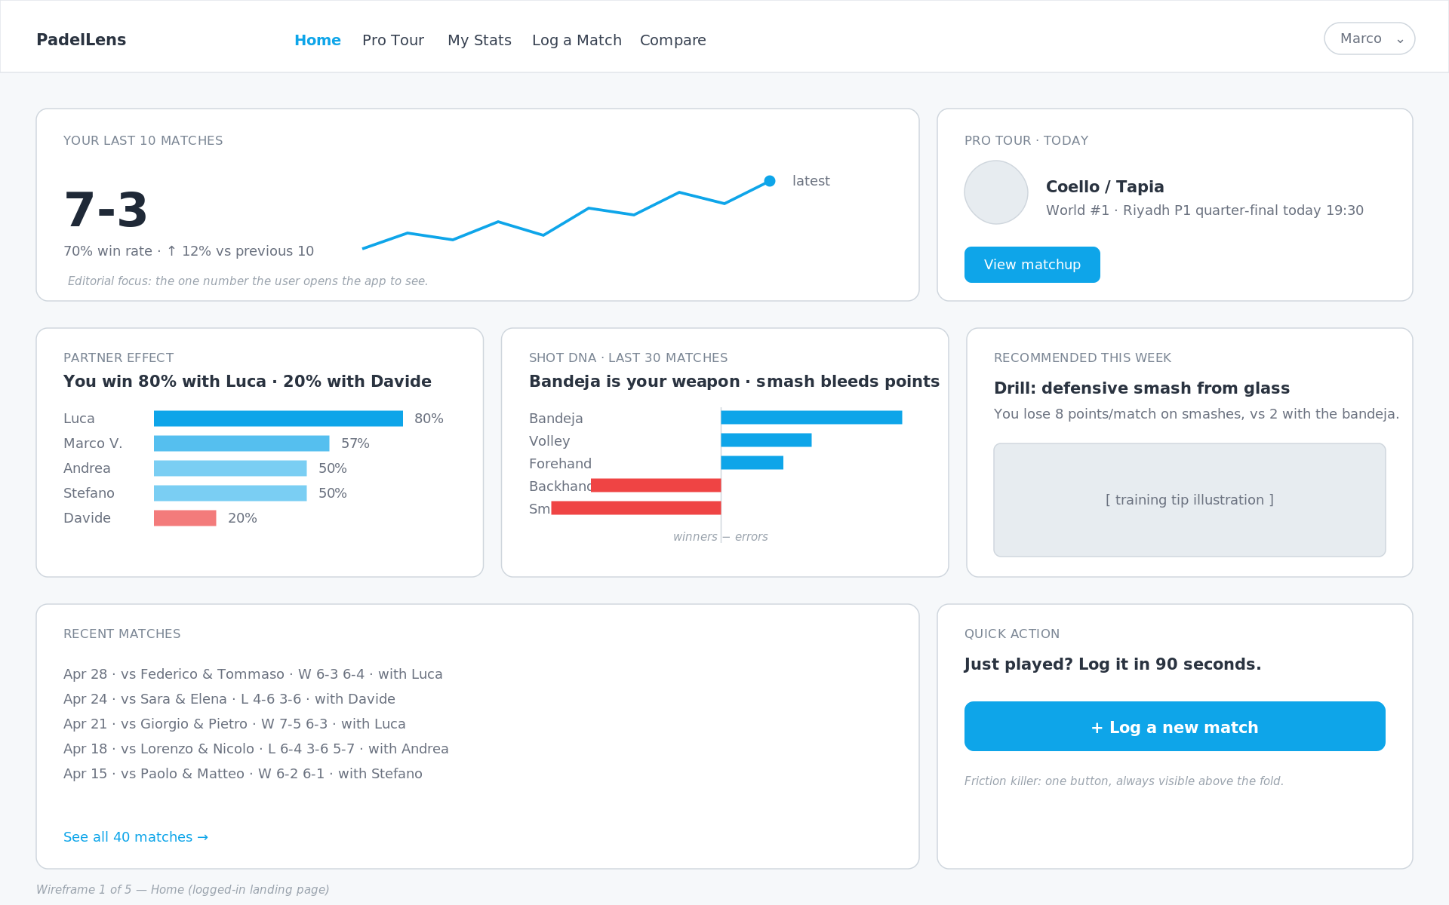
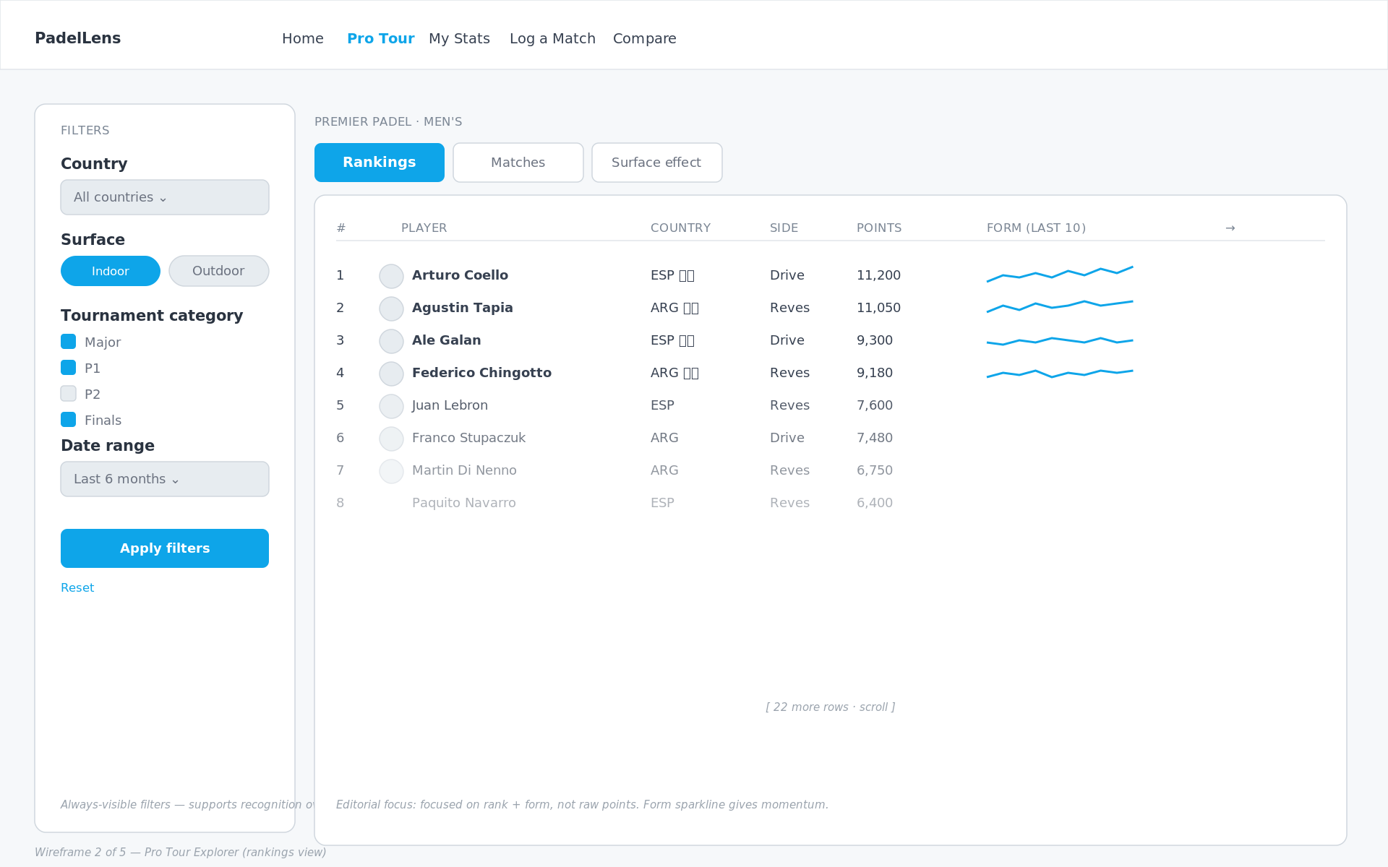
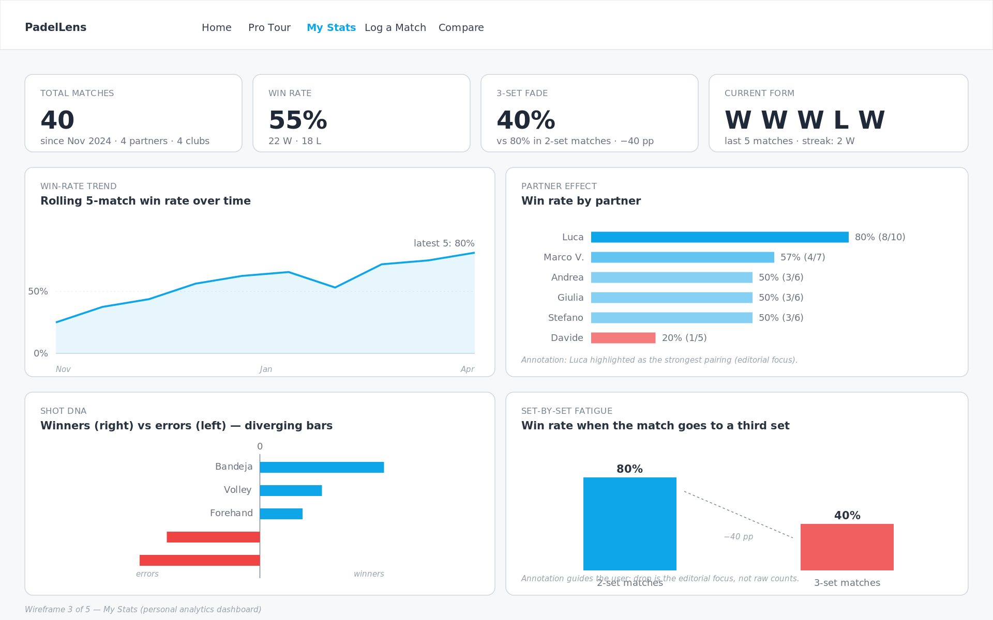
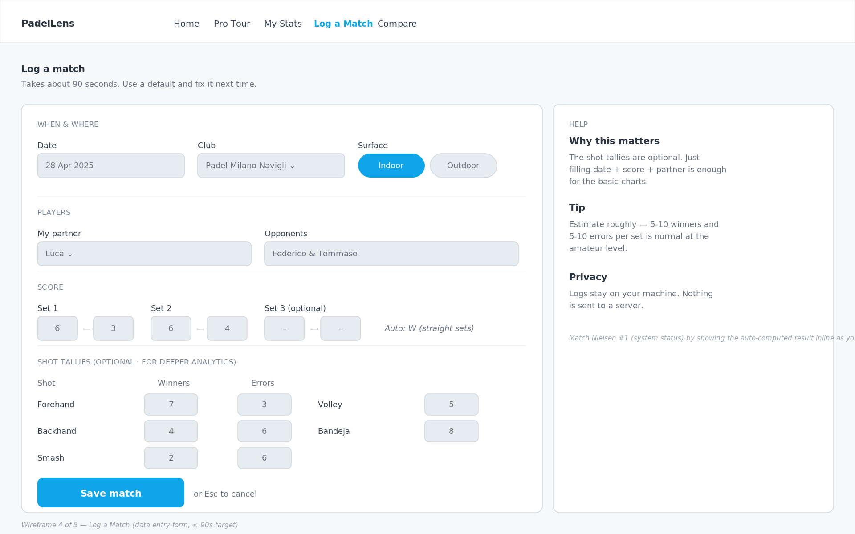
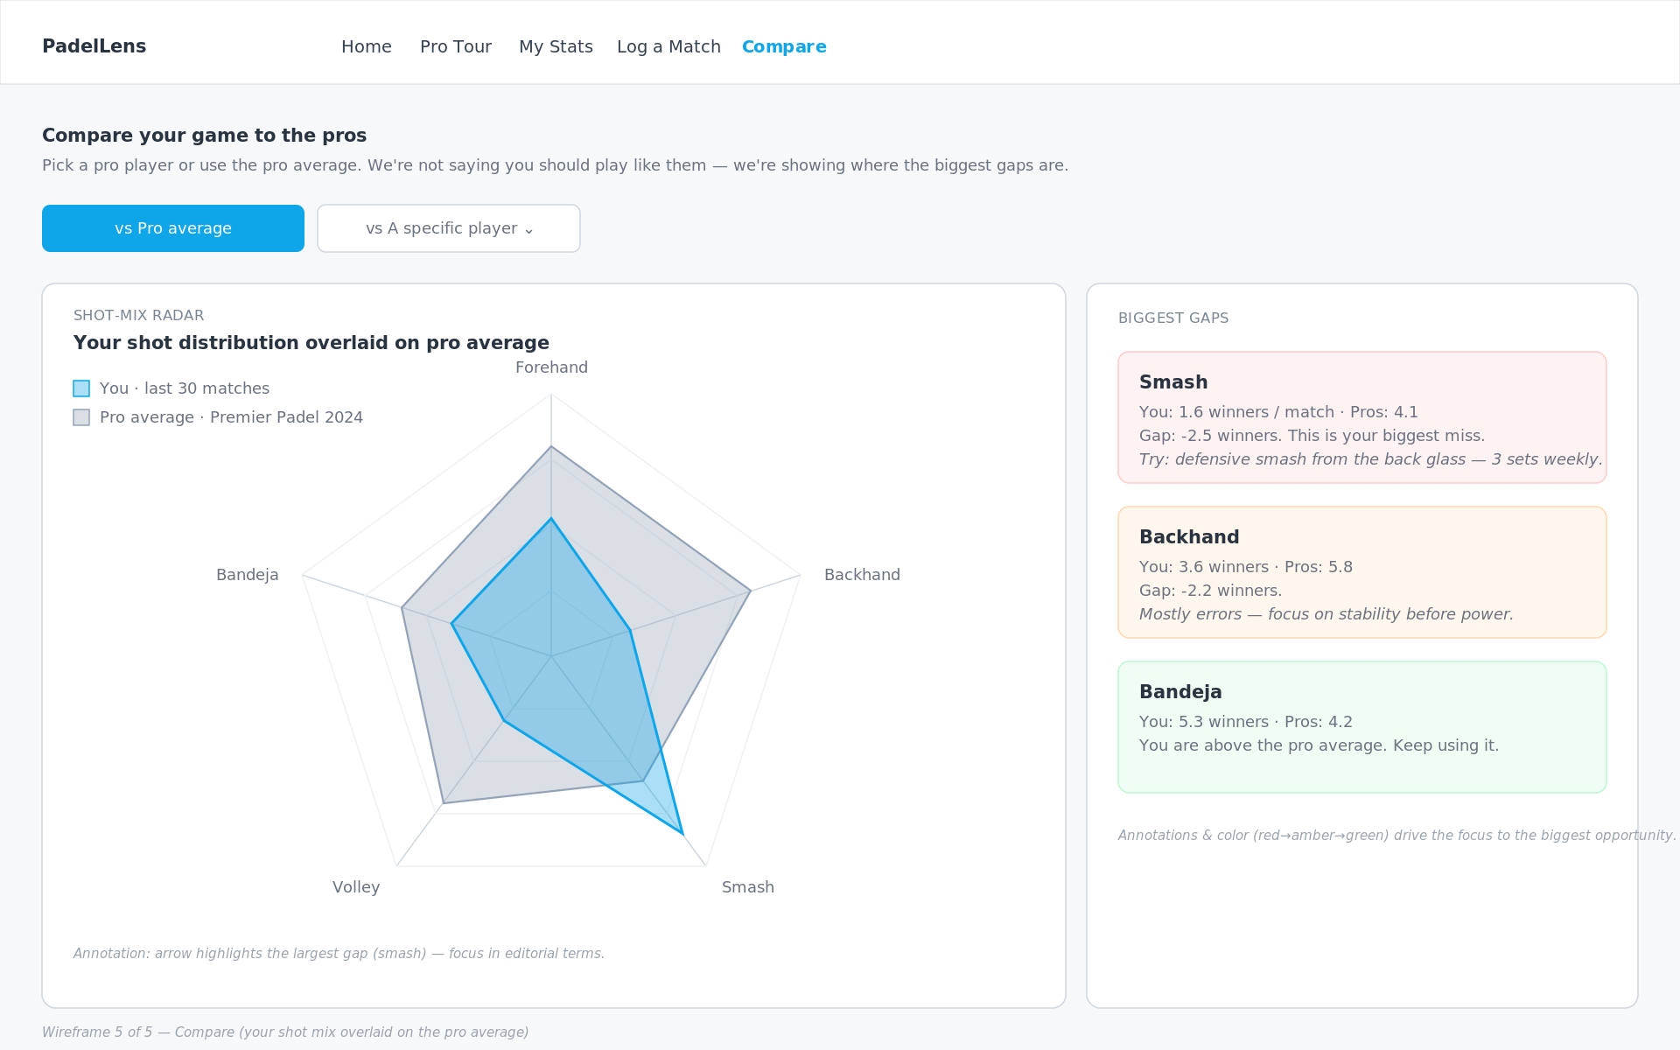
3.2 WIREFRAMES
Five pages, each built around one user task
Home
Pro Tour
My Stats
Log Match
Compare
Last 10 + partner + shot DNA
Rankings + filters
Personal dashboard
90-second data entry
Radar vs pro reference
Figma Wireframes
Each page answers ONE task from the brief.
Home → "How am I doing right now?" · Pro Tour → "Explore the pro game" · My Stats → "Why am I winning/losing?" · Log Match → "Add today's match" · Compare → "How big is the gap to a pro?"
PadelLens · DV4S Exam · Politecnico Milano · AY 2025/2026
22
Notes:
"Five pages. Home is the landing - the last-10 KPI plus the partner-effect and shot-DNA cards. Pro Tour is the rankings explorer with the always-visible filter sidebar. My Stats is the personal deep-dive. Log Match is the data entry form, deliberately frictionless - under 90 seconds to log a match. Compare is the radar overlay of your shot mix against the pro reference. Each page is built around exactly one user task."

Slide 23
3.3 PRINCIPLES
Six rules applied throughout
1
One number above the fold
2
Recognition over recall
The app is opened in bursts. 42-pt KPI on Home.
Filters always visible - never behind a button.
3
Default to action
4
Reduce data-entry friction
+ Log a match is the most prominent CTA on Home.
Shot tallies optional. Score + partner is enough.
5
Honest visual hierarchy
6
Annotate, don't decorate
Red only for negative signal. No gratuitous color.
Every chart has at least one in-canvas annotation.
PadelLens · DV4S Exam · Politecnico Milano · AY 2025/2026
23
Notes:
"Six principles drove the design. One number above the fold because users open the app in bursts. Recognition over recall - filters are always visible in the sidebar. Default to action - the log-a-match button is the most prominent CTA. Reduce friction in data entry - shot tallies are optional, score plus partner is enough. Honest visual hierarchy - red is reserved for negative signal. And annotate, don't decorate - every chart has an in-canvas callout. That last one ties directly back to the focus principle from the editorial thinking lecture."

Slide 24
3.4 HEURISTIC EVALUATION
Two real changes from Nielsen's 10
#5
BEFORE
AFTER
Original form let me enter Set-3 scores even when sets 1-2 were already decided (6-0, 6-0).
Set-3 inputs are disabled until sets 1-2 are split 1-1.
Error prevention
#6
BEFORE
AFTER
First sketch had filters hidden behind a 'Filters' button - user has to remember what they filtered by.
Filters live in an always-visible sidebar on the Pro Tour page.
Recognition over recall
PadelLens · DV4S Exam · Politecnico Milano · AY 2025/2026
24
Notes:
"I ran Nielsen's ten heuristics against my first paper sketches. Two of them flagged real problems. Number five - error prevention - my original log form let me enter a third-set score even when sets one and two were already decided. I added input gating. Number six - recognition over recall - I'd originally hidden filters behind a button. I moved them to an always-visible sidebar. These two changes are the difference between the paper sketch and the wireframe you just saw."

Slide 25
3.5 CLOSING THE VALIDATION LOOP
Instruments ready. Sessions scheduled. No invented score.
+
Persona-grounding survey (EN/IT)
Grounds Marco and Luca in real respondents instead of assumptions.
+
Interview guide
Semi-structured questions for club players, to probe beyond the survey.
+
SUS questionnaire + scoring sheet
Standard 10-item System Usability Scale, ready to run — not yet run.
+
Task-based user-testing protocol
Concrete tasks (log a match, compare to a pro) with success criteria.
+
Heuristic evaluation round 2
A template for external evaluators, going beyond my own first pass.
Status, honestly: sessions with real club players are scheduled — no SUS score is invented.
PadelLens · DV4S Exam · Politecnico Milano · AY 2025/2026
25
Notes:
This was the most direct criticism I got -- validation was essentially absent. Here's what exists now: a persona-grounding survey in English and Italian, an interview guide, a full SUS questionnaire with its scoring sheet, a task-based user-testing protocol, and a second round of heuristic evaluation for external evaluators to run. What I want to be completely honest about is status: sessions with real club players are scheduled, not yet run. I will not stand up here and give you an invented SUS score. The instruments are ready and rigorous -- the numbers will come from real people, not from me.

Slide 26
PART 4
Data Representation
Chart choices · Color · Interactivity
Notes:
"Part four. How the data is shown. Chart by chart."

Slide 27
4.1 CHART INVENTORY
Sixteen chart types · each answers one EDA finding
CHART
WHERE
WHAT does it Represent ?
KPI + sparkline
Home
Last-10 win rate
Horizontal bar
Home / My Stats
Partner win rate
Diverging bar
Home / My Stats
Shot DNA (winners − errors)
Ranking table + row sparkline
Pro Tour
Top players + form
Small-multiples
Pro Tour
Surface effect
Rolling-mean line
My Stats
Win-rate trend
Set-by-set columns
My Stats
Fatigue (2-set vs 3-set)
Radar overlay
Compare
You vs pro shot mix
Inline annotations
All pages
Headline numbers
Rejected: pie charts, court heatmaps, Sankeys, 3D bars, animated rankings — each lost head-to-head against a simpler alternative.
+ 7 new Insights-page charts (v3): momentum slope · chemistry band · calibration lollipop · Elo delta · upset-by-round · efficiency · home-advantage null.
PadelLens · DV4S Exam · Politecnico Milano · AY 2025/2026
27
Notes:
The chart inventory itself hasn't been rebuilt from scratch -- it's still the same nine chart types, each mapped to a specific place in the app and a specific finding. What's new is scope: the Insights page adds seven more purpose-built charts on top of that nine, bringing the working inventory to sixteen. I've listed those seven at the bottom rather than expanding the table itself, because they follow the same principle as everything above -- one chart type, one finding, chosen and defended against real alternatives, not decoration.

Slide 28
4.2 CASE STUDY
Why a diverging bar for shot DNA?
THE QUESTION
YOUR SHOT DNA · 40 MATCHES
Which shots win me points, which bleed them?
Bandeja
+176
Forehand
+87
The question is signed. Some shots are net positive, others net negative.
Volley
+86
CONSIDERED:
Backhand
-117
Pie of shot share - hides the zero line.
Stacked bar - needs eye traversal.
Two side-by-side bar charts - same problem.
Diverging bar - chosen.
Smash
-170
0
Zero line dead center · sign readable at a glance · winners and errors share the bar.
PadelLens · DV4S Exam · Politecnico Milano · AY 2025/2026
28
Notes:
"Walk through one chart choice as a case study. The shot DNA question is signed - bandeja is net-positive, smash is net-negative. A pie chart shows proportions, not signs. Stacked bars hide the zero line. Two bar charts force eye traversal. A diverging bar puts the zero line dead center, lets winners go right and errors go left, and the sign is readable at a glance. Every chart in the app went through this kind of head-to-head choice."

Slide 29
4.3 CASE STUDY
Why a slope chart for momentum?
THE QUESTION
SET-1 WIN RATE → DECIDER WIN RATE
100%
86%
If I win set 1, how much does that really tell me — and does it survive a decider?
win match after set 1
A two-part story on purpose: a strong signal (86%) that quietly evaporates under one condition (49%).
49%
coin flip
50%
CONSIDERED:
Grouped bars - the 37-pt collapse has to live in a caption, not the ink.
Waterfall - implies an additive step that doesn't exist; different subsets.
Sankey - ribbon width implies a population flow that isn't actually true here.
Two-point slope chart - chosen.
coin flip in a decider
0%
86% → 49%: your set-1 lead evaporates once it's a decider.
PadelLens · DV4S Exam · Politecnico Milano · AY 2025/2026
29
Notes:
Winning set one looks like it decides the match -- eighty-six percent of the time it does. But I didn't want to stop there, because that number hides every two-set blowout along with the close matches. So I asked a sharper question: of the matches that actually went the distance, does the set-one winner still have the edge? The answer is no -- forty-nine percent, a coin flip. I drew that as two connected dots instead of two bars, because the point isn't the two numbers, it's the drop between them. A slope chart puts that collapse directly in the ink.

Slide 30
4.4 CASE STUDY
Does chemistry build with reps — or is it survivorship?
THE QUESTION
Matches together, ordered left to right
WIN RATE BY MATCHES TOGETHER
100%
Does playing more matches together make a pair better, or are we just watching the survivors?
68%
Unlike momentum, this finding needs a caveat that is structural, not a footnote: the sample shrinks as buckets grow.
52%
45%
50%
40%
CONSIDERED:
Bar per bucket - no room left to layer in the shrinking-sample signal.
Scatter per pair - noisy at low n; the thin high-x tail is easy to miss.
Small multiples - solves a re-stitching problem this finding doesn't have.
Line + CI, narrowing wedge - chosen.
0%
Only 39% of pairs (89 of 230) ever reach 5+ matches together — the rise partly reflects who stays paired.
1-3
4-8
9-15
16+
PadelLens · DV4S Exam · Politecnico Milano · AY 2025/2026
30
Notes:
Pairs who play more matches together win a lot more -- forty percent early on, sixty-eight percent past sixteen matches. It's tempting to read that as practice making a pair better. But only thirty-nine percent of pairs ever reach five matches together, and the obvious rival explanation is survivorship: winning pairs keep getting picked again, losing pairs get split up. I didn't want that caveat to live in a sentence half the room skips, so I put it directly in the chart -- the confidence band narrows as you move right, and a callout spells out exactly why.

Slide 31
4.5 CASE STUDY
Do rankings predict — or decide?
THE QUESTION
WIN RATE ABOVE A COIN FLIP, BY RANKING GAP
season average (78.5%)
How much should a ranking gap change my expectations, and does trust scale with gap size?
Closest gap
58.8%
The audience (Marco, Luca) never asked whether the model is honest — they asked whether the gap matters.
Season average
78.5%
CONSIDERED:
ROC curve - answers 'is the model good', not 'does the gap matter'.
Calibration-vs-diagonal plot - presupposes the reader accepts a model's output.
Simple KPI (78.5%) - hides that the average masks a 58.8-96.7% range.
Lollipop by ranking-gap size - chosen.
Widest gap
96.7%
coin flip (50%)
Even the closest gap tips to the favorite (59%); the widest gap is almost a sure thing (97%).
PadelLens · DV4S Exam · Politecnico Milano · AY 2025/2026
31
Notes:
Rankings do predict outcomes -- favorites win seventy-eight and a half percent of the time, with an AUC of point eight eight. I checked that with an ROC curve and a calibration plot, and both looked good, but neither one went anywhere near this final design, because they answer 'is this model honest,' not the question my audience actually has. What I built instead shows the same finding sliced by how big the ranking gap is: barely better than a coin flip in the closest quintile, near a sure thing in the widest. Rankings predict -- they don't decide.

Slide 32
4.6 COLOR
Editorial use, not decoration
Blue
Red
Gray
#0EA5E9
#EF4444
#94A3B8
Positive / interactive / default
Negative signal requiring action
Pro reference frame
Ink
Muted
BG
#1F2937
#6B7280
#F8FAFC
Body text
Secondary text
Page background
ACCESSIBILITY CHECKS
WCAG AA body-text contrast 12.6:1 ✓ · Blue/red palette: deuteranopia & protanopia safe ✓ · No green/red pairs · Every red mark is also negatively signed numerically.
PadelLens · DV4S Exam · Politecnico Milano · AY 2025/2026
32
Notes:
This slide's content hasn't changed at all -- the color system, the accessibility checks, all of it is exactly what I presented the first time and it held up well in the evaluation. What changed is purely the label: this used to sit under a divider mislabeled 'Part 5,' when it's actually Part 4 content. Fixing the section numbering throughout the deck was one of the concrete, mechanical criticisms from the first submission, and this is one of the two renumbered slides -- simple to fix, but worth doing properly and verifying end to end.

Slide 33
4.7 INTERACTIVITY & ANNOTATIONS
Kirk's last two design layers
INTERACTIVITY
ANNOTATION
Sidebar filters (country, surface, category, dates)
Row-click drill from rankings to player detail
Time-range toggle on My Stats (30/60/90/all)
Hover tooltips: precision on demand
Live auto-result preview while typing a score
Static in-canvas: the headline ("-40 pp")
Dynamic hover: the detail (exact value, date)
Captions outside the chart: WHAT
Callouts inside the chart: WHY you should care
Color-coded gap cards on Compare (red→amber→green)
Every insight card: in-canvas headline annotation + method note (test, n, p)
PadelLens · DV4S Exam · Politecnico Milano · AY 2025/2026
33
Notes:
The interactivity and annotation layers are the same ones I presented before -- sidebar filters, drill-downs, hover tooltips, and the layered annotation rule of static headline plus dynamic hover detail. What's new is the sixth bullet: every one of the new Insights-page cards follows that same annotation discipline, but adds something the first submission didn't have -- a method note under the chart stating the test, the sample size, and the p-value. Interactivity earns trust when the reader can verify a claim without leaving the chart, and that's exactly what these method notes are for.

Slide 34
PART 5
Technical Implementation
Python · Streamlit · Plotly
Notes:
"Part five, quickly - what's under the hood."

Slide 35
5.1 TECH STACK & ARCHITECTURE
What's under the hood
STACK
ARCHITECTURE
Python 3.11
Language
Padel API
SQLite DB
REST + JSON
users table
Streamlit 1.32
Multi-page web app framework
Pandas
Pandas 2.x
Data wrangling, groupby, rolling means
load + transform
Plotly 5.x
Interactive charts (hover, zoom, brush)
Plotly
SQLite3
Embedded DB — users table, multi-user-ready
interactive
analytics.py
Elo · win model · clustering · CIs (12/12 tests)
Streamlit · run_app.bat launcher
Every pro view captions its data source.
PadelLens · DV4S Exam · Politecnico Milano · AY 2025/2026
35
Notes:
The stack itself -- Python, Streamlit, Pandas, Plotly -- hasn't changed. What's underneath it has. CSV reads are replaced by a SQLite database with a users table, so the schema is multi-user-ready even though today it still runs single-user. There's a brand-new analytics.py module -- Elo ratings, a win-probability model, clustering, confidence intervals -- backed by twelve out of twelve passing unit tests. Every pro-tour view now captions its data source, so nothing pretends to be more authoritative than it is. And run_app.bat installs dependencies, builds the database, and launches the app in one step, tested end to end on this machine.

Slide 36
5.2 THE ANALYTICS MODULE
From raw CSVs to a real modelling layer
+
Elo rating engine
Per-player ratings computed chronologically over all 776 real matches (K=32, base 1500).
+
Logistic win model + calibration
Predicts win probability from the ranking gap; decile calibration checked against outcomes.
+
K-means player archetypes
Unsupervised clustering groups players by style from their match-derived stats.
+
Wilson confidence intervals
Computed on every win rate shown in the app — never a bare point estimate.
+
Small-n guard
Fewer than 10 matches behind a stat, and the app refuses to make a claim.
PadelLens · DV4S Exam · Politecnico Milano · AY 2025/2026
36
Notes:
This module didn't exist in the first submission at all -- the project had no modelling or analytical tooling, which was a direct criticism. Now there's a proper Elo engine computed chronologically over all seven hundred seventy-six real matches, a logistic win-probability model with decile calibration, k-means clustering that groups players into style archetypes, and Wilson confidence intervals wired into every win rate the app displays. There's also a small-sample guard: if fewer than ten matches back a stat, the app refuses to make a claim rather than show a misleadingly precise number. This is the analytical backbone the evaluation asked for.

Slide 37
PART 6
Demo & Conclusions
Live walkthrough · Future work
Notes:
"Last part. I'll switch to the live app now and walk through a real use case, then close with what would come next."

Slide 38
6.1 DEMO
Five-step walkthrough I'll show you next
1 · Home
2 · Log Match
3 · My Stats
4 · Compare
5 · Insights
Open the app. Last 10: 7-3. Partner card shows Luca on top, Davide red.
Add today's match in 30 seconds. Watch the auto-result update.
Filter to last 60 days. Read the partner & fatigue panels.
Toggle to a specific pro. See the radar gap on the smash.
Land on the new Insights page: 7 discovery cards, each with its method note.
PadelLens - Dashboard · Streamlit
Every personal page shows a visible SYNTHETIC DEMO DATA badge.
PadelLens · DV4S Exam · Politecnico Milano · AY 2025/2026
38
Notes:
The walkthrough itself follows the same five-step structure as before -- Home, Log Match, My Stats, Compare -- but I've swapped the final stop. Instead of ending on Pro Tour, I now land on the brand-new Insights page: seven discovery cards, each with its own purpose-built chart, an in-canvas headline, and a method note underneath. I also want to flag something you'll see directly on screen during the demo: every personal page now carries a visible synthetic-demo-data badge, so there's no ambiguity about which parts of the app are running on real data and which are still the seeded log.

Slide 39
6.2 FUTURE DEVELOPMENTS
What happens next
+
Run the scheduled user tests + SUS
Sessions with real club players are booked; SUS scoring sheet is ready. No score is invented ahead of time.
+
Real personal logging, replacing the synthetic layer
Every match I actually play gets logged from now on, retiring the seeded demo data match by match.
+
Full-history ingestion (paid API tier)
One month at €19 unlocks multi-season history: 2,000+ matches and ranking evolution over time.
+
Streamlit Cloud deployment
Ship a public link so Marco and Luca can use PadelLens without installing anything.
+
LLM-generated weekly digest
"This week your bandeja was on; your smash bled 12 points. Drill X."
PadelLens · DV4S Exam · Politecnico Milano · AY 2025/2026
39
Notes:
Four of these five items are genuinely new priorities, not aspirational leftovers. Running the scheduled user tests and getting a real SUS score is first -- that's the validation loop closing for real. Second, I start logging my own matches immediately, retiring the synthetic layer piece by piece instead of all at once. Third, one month of the API's paid tier for nineteen euros unlocks the full multi-season history, over two thousand matches. And fourth, a public Streamlit Cloud deployment means Marco and Luca could actually use this without installing anything. The weekly digest idea survives from the original list.

Slide 40
THANK YOU
Questions?
GitHub repo: Abdullahsaeed10/PadelLens
"You don't have to feel your game - you can see it."
Notes:
"That's PadelLens. Thank you - happy to take questions."

