Slide 1
Problem Solving with Python
Predict the heart failure
Abdullah Saeed

Slide 2
Introduction
Cardiovascular Disease
According to last meta-analysis published 2018 that Cardiovascular disease (CVD) is associated with significant morbidity and mortality.1 In order to reduce the burden of CVD, there is great interest in identifying risk factors in the general population so that those deemed to be at high risk for future cardiovascular events can be targeted for interven tion. While 80% of the risk for future CVD can be predicted from known cardiovascular risk factors such as old age, male sex, hypertension, smoking and diabetes mellitus, the determinants for the remaining 20% risk remain unclear

Slide 3
The project goal
Help in plans capacity and servers
Burden and severity of CVD risk factors and control of these risk factors.
Presence of risk-enhancing conditions. It is difficult to determine how much a risk-enhancing factor may change a patient’s 10-year risk estimate quantitatively and therefore, clinician judgment is also crucial to determine whether factors are significant enough to reclassify an individual’s risk category.
Adherence to healthy lifestyle recommendations. For all patients, appropriate lifestyle modification should be recommended. In patients at higher absolute predicted risk for Arteriosclerotic cardiovascular disease (typically, a 10-year estimated risk) more intensive lifestyle efforts are recommended.
Potential for Arteriosclerotic cardiovascular disease risk-reduction benefits
CVD is an increasing public health concern in the Middle East and the Gulf Council Countries (GCC). It is estimated that the overall deaths from CVD in the GCC countries, including Saudi Arabia, represent over 45% of all deaths

Slide 4
About data
What is the framing question of your analysis?
The data will help to know about the risk of cardiovascular disease
Predicat the case of heart failure for enough time to management and planning

Slide 5
what is the framing question of your analysis?
Analysis the risk factor cause heart diseases

Slide 6
Who benefits from exploring this question or building this model/system
Ministry of health for planning and capacity building and prevention programmed
Patient to know their own risk for heart sick and start prevention

Slide 7
What dataset(s) do you plan to use, and how will you obtain the data from ministry of health record
Variable | Total
Age (N) (%)
18–44 years
45–64 years
$65 years
Gender
Systolic blood pressure (mmHg)
Diastolic blood pressure (mmHg)
BMI (kg/m2)
Total cholesterol (mg/dL)
LDL-C (mg/dL)
HDL-C (mg/dL)
Fasting plasma glucose (mmol/L)

Slide 8
What is an individual sample/unit of analysis in this project
The people over 18 years old and have one of risk factors

Slide 9
what will you predict as your target?
Predict heart failure
Cardiovascular risk score

Slide 10
Data source
Cardiovascular research center USA
Open sourse data

Slide 11
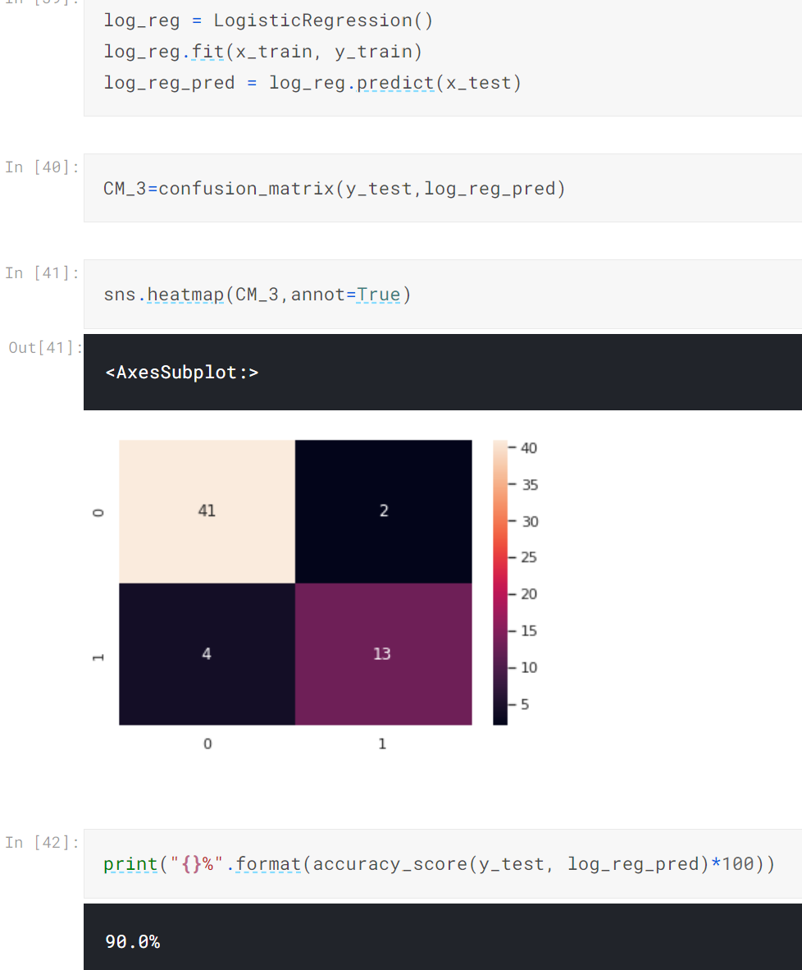
Modeling
Use logistic regression because the outcome variable Is binary

Slide 12
The tools
numpy
Pandas
Matplotlib
.Seaborn
xgboost
lightgbm
sklearn

Slide 13
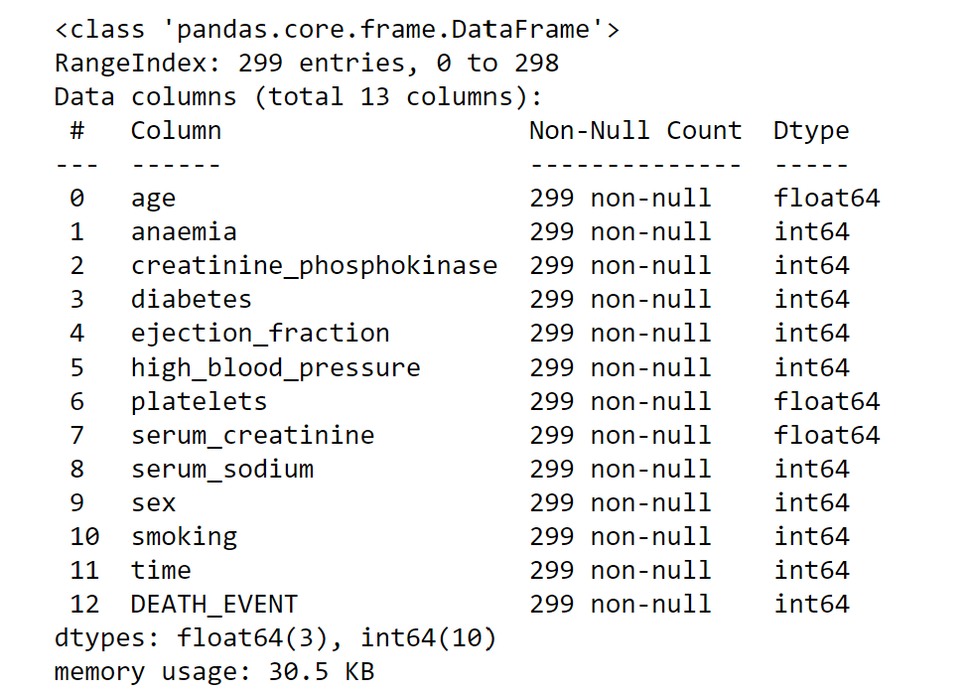
Data description

Slide 14
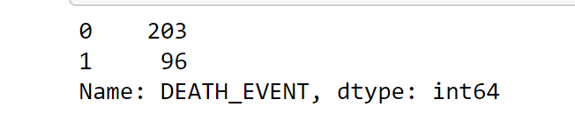
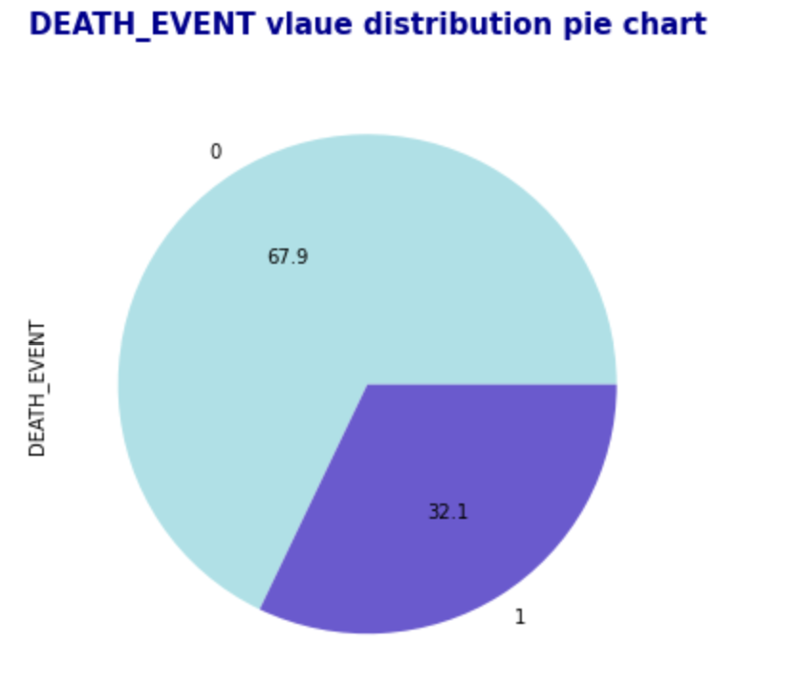
Event rate death from heart failer

Slide 15
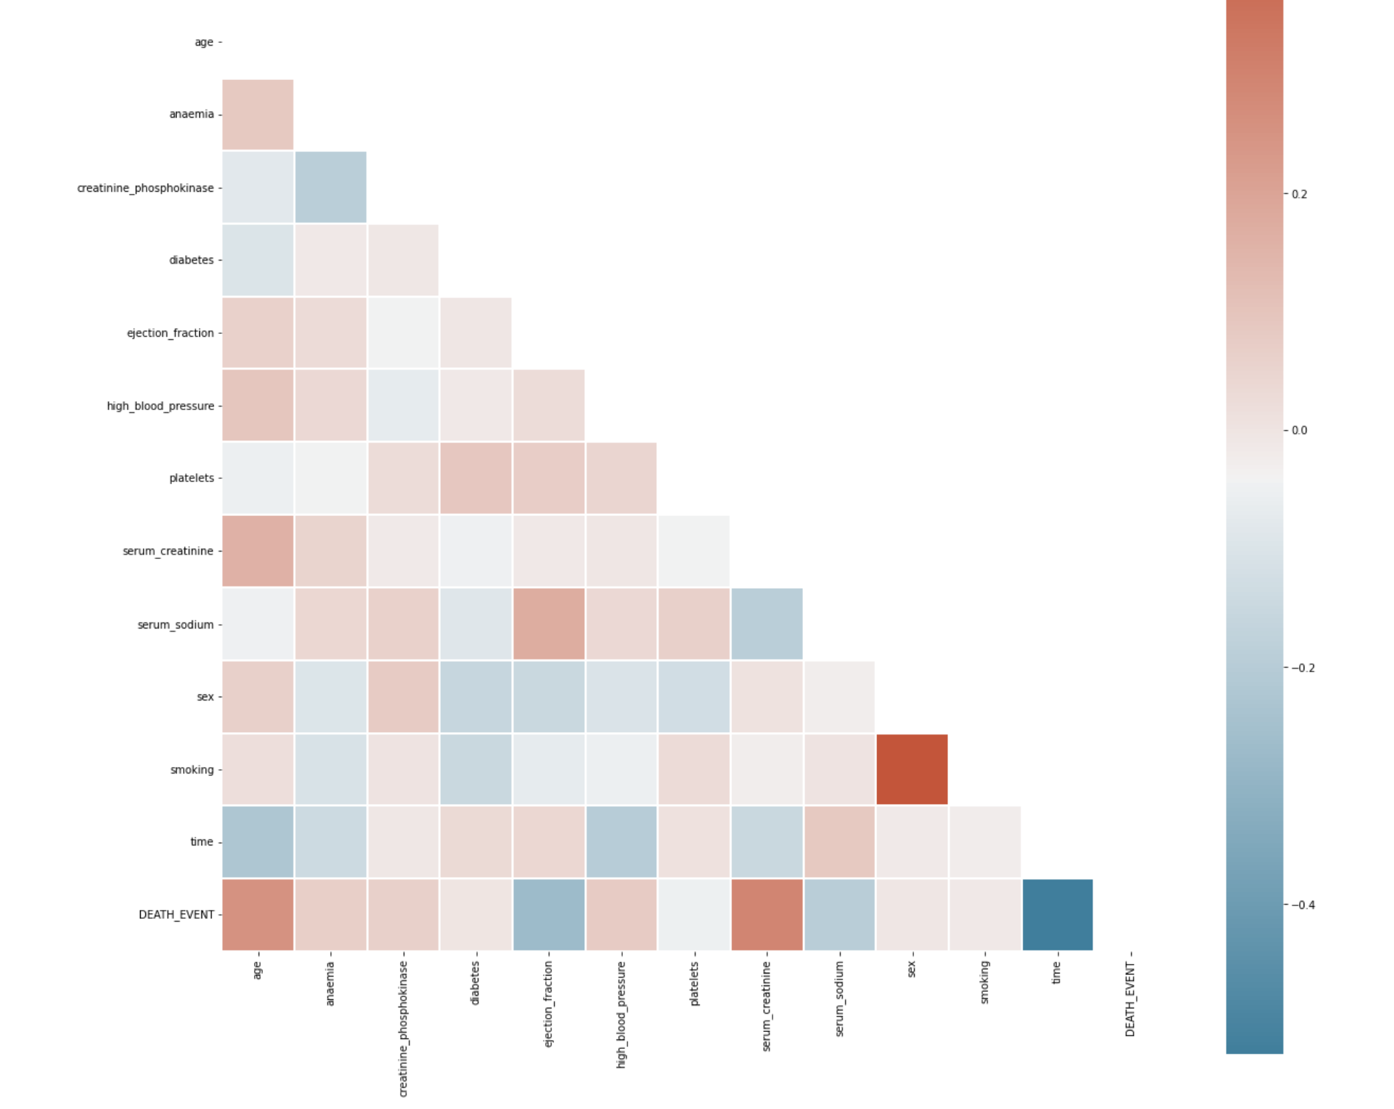

Slide 16
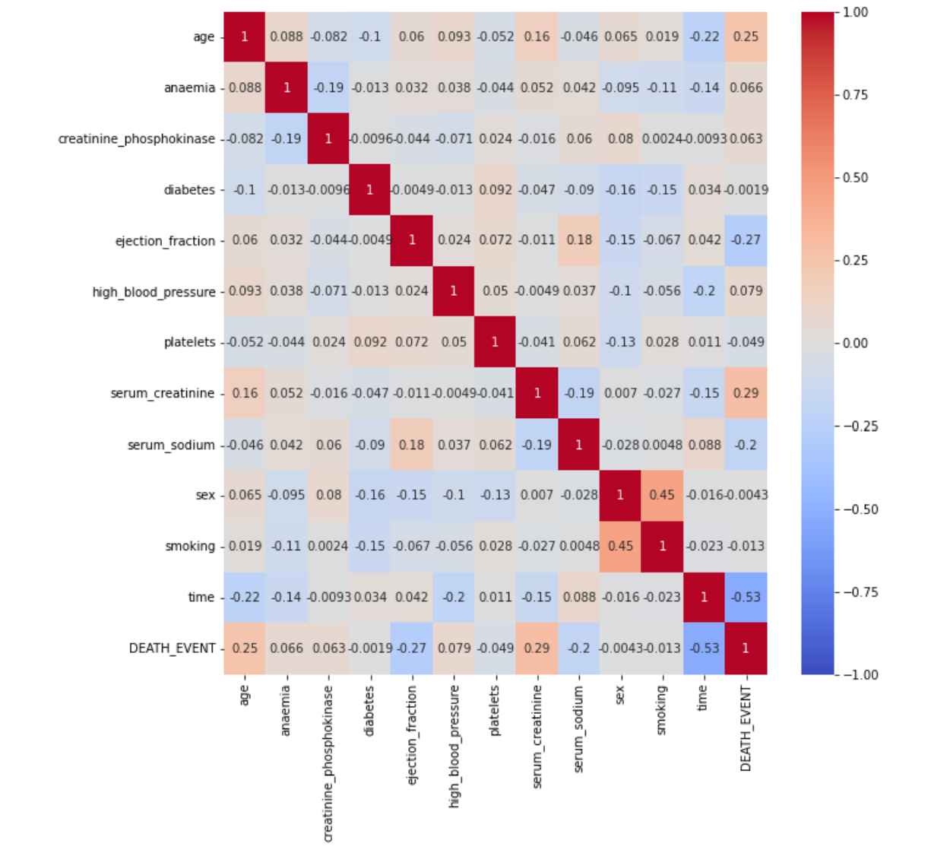

Slide 17
Why use heat map
To show relation between two variable
The color help to summary frequency
Visualization heart risk factors
Correlogram risk ratio
Easy to explain stakeholder

Slide 18
The conclusion
The heart disease is still the higher death rate and we need to increase capacity of heart center and awareness of heart disease risk
The male gender and smoking show the most group have heart disease this main to increase the awareness among this category high sodium intake show effect on kidney and blood pressure that cause heart disease also need-aware the community about sodium and salt risk

