Slide 1
Presentation Outline
Registers
Shift Registers and their Applications
Ripple Counters
Synchronous Counters

Slide 2










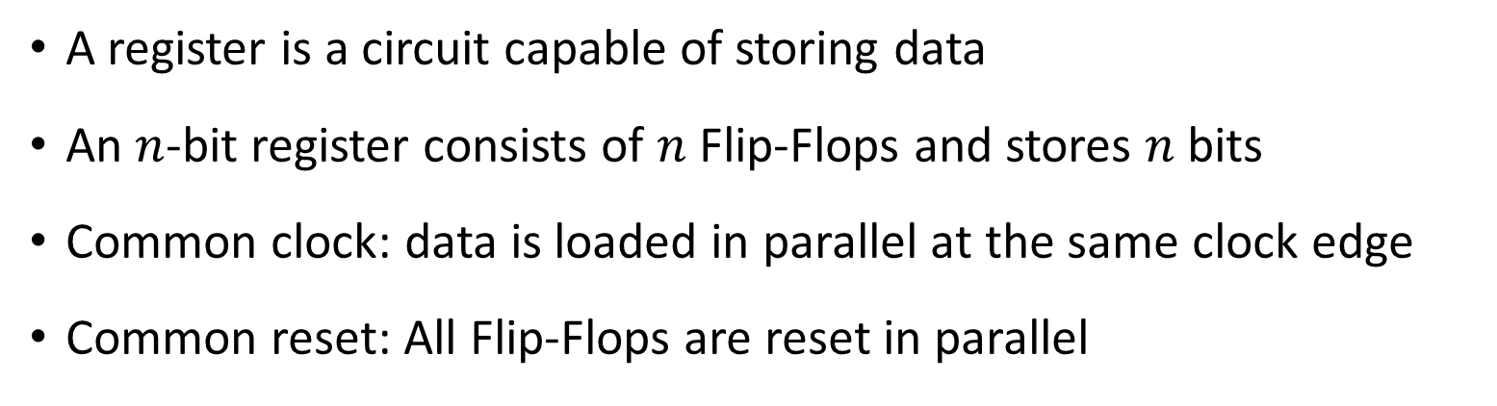





















Register
A register is a circuit capable of storing data
An $n$-bit register consists of $n$ Flip-Flops and stores $n$ bits
Common clock: data is loaded in parallel at the same clock edge
Common reset: All Flip-Flops are reset in parallel
4-bit
Register
$$D_{3}$$
$$D_{2}$$
$$D_{1}$$
$$D_{0}$$
$$D_{3}$$
$$Q_{3}$$
$$D_{3}$$
$$Q_{3}$$
$$D_{2}$$
$$Q_{2}$$
$$D_{1}$$
$$Q_{1}$$
$$D_{0}$$
$$Q_{0}$$
$$D_{2}$$
$$Q_{2}$$
$$D_{1}$$
$$Q_{1}$$
$$R$$
$$R$$
$$R$$
$$R$$
$$D_{0}$$
$$Q_{0}$$
$$Clock$$
$$Reset$$
$$Q_{3}$$
$$Q_{2}$$
$$Q_{1}$$
$$Q_{0}$$
$$Reset$$

Slide 3







Register Load (or Enable)
Question: How to control the loading of data into a register?
Solution: Introduce a register Load (or Enable) signal
If the register is enabled, load the data into the register
Otherwise, do not change the value of the register
Question: How to implement register Load?
$$I[n−1:0]$$
$$n$$
$Load (Enable)$
n-bit Register
$$Reset$$
$Clock$
$$n$$
$$Q[n−1:0]$$

Slide 4









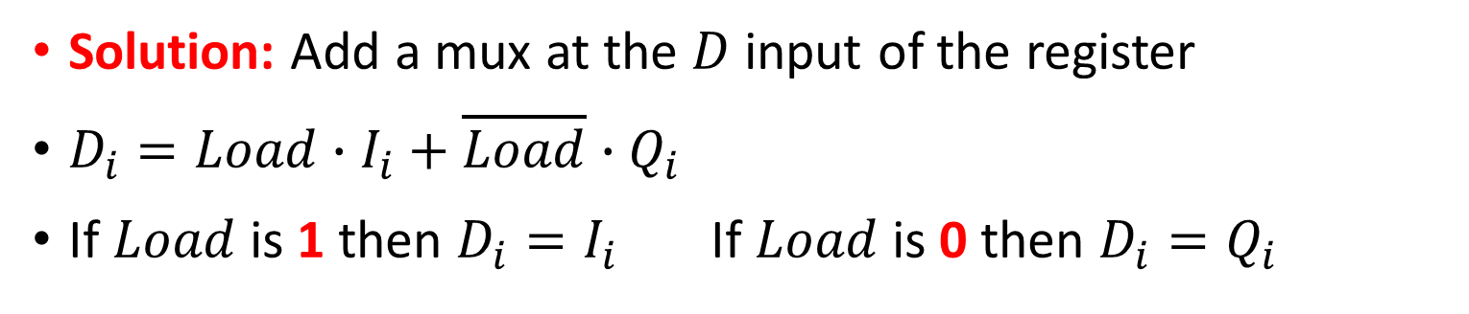














Register with Parallel Load
Solution: Add a mux at the $D$ input of the register
$D_{i}=Load∙I_{i}+\overline{Load}∙Q_{i}$
If $Load$ is 1 then $D_{i}=I_{i}$ If $Load$ is 0 then $D_{i}=Q_{i}$
$$I_{3}$$
$$I_{2}$$
$$I_{1}$$
$$I_{0}$$
$$Load$$
1
0
1
0
1
0
1
0
$$D_{3}$$
$$Q_{3}$$
$$D_{2}$$
$$Q_{2}$$
$$D_{1}$$
$$Q_{1}$$
$$D_{0}$$
$$Q_{0}$$
$$R$$
$$R$$
$$R$$
$$R$$
$$Clock$$
$$Reset$$
$$Q_{3}$$
$$Q_{2}$$
$$Q_{1}$$
$$Q_{0}$$

Slide 5














Shift Registers
A shift register is a cascade of flip flops sharing the same clock
Allows the data to be shifted from each flip-flop to its neighbor
The output of a flip-flop is connected to the input of its neighbor
Shifting can be done in either direction
All bits are shifted simultaneously at the active edge of the clock
Serial Input SI
$$D_{3}$$
$$Q_{3}$$
$$D_{2}$$
$$Q_{2}$$
$$D_{1}$$
$$Q_{1}$$
$$D_{0}$$
$$Q_{0}$$
Serial Output SO
$$R$$
$$R$$
$$R$$
$$R$$
$$Clock$$
$$Reset$$
Right Shift Register

Slide 6

Timing of a Shift Register
Serial Input SI
$$D_{3}$$
$$Q_{3}$$
$$D_{2}$$
$$Q_{2}$$
$$D_{1}$$
$$Q_{1}$$
$$D_{0}$$
$$Q_{0}$$
Serial Output SO
$$R$$
$$R$$
$$R$$
$$R$$
$$Clock$$
$$Reset$$
Cycle | SI | Q3 | Q2 | Q1 | Q0 = SO
T0 | 1 | 1 | 0 | 1 | 0
T1 | 0 | 1 | 1 | 0 | 1
T2 | 1 | 0 | 1 | 1 | 0
T3 | 1 | 1 | 0 | 1 | 1
T4 | 0 | 1 | 1 | 0 | 1
T5 | 1 | 0 | 1 | 1 | 0
T6 | 0 | 1 | 0 | 1 | 1

Slide 7






Shift Register with Parallel Output
The output of a shift register can be serial or parallel
A Serial-In Parallel-Out (SIPO) shift register is shown below
All flip-flop outputs can be read in parallel
Serial Input SI
$$D_{3}$$
$$Q_{3}$$
$$D_{2}$$
$$Q_{2}$$
$$D_{1}$$
$$Q_{1}$$
$$D_{0}$$
$$Q_{0}$$
$$R$$
$$R$$
$$R$$
$$R$$
$$Clock$$
$$Reset$$
$$Q_{3}$$
$$Q_{2}$$
$$Q_{1}$$
$$Q_{0}$$
Parallel Output PO

Slide 8


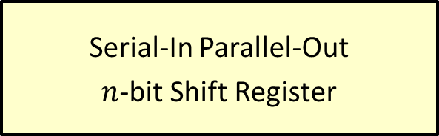


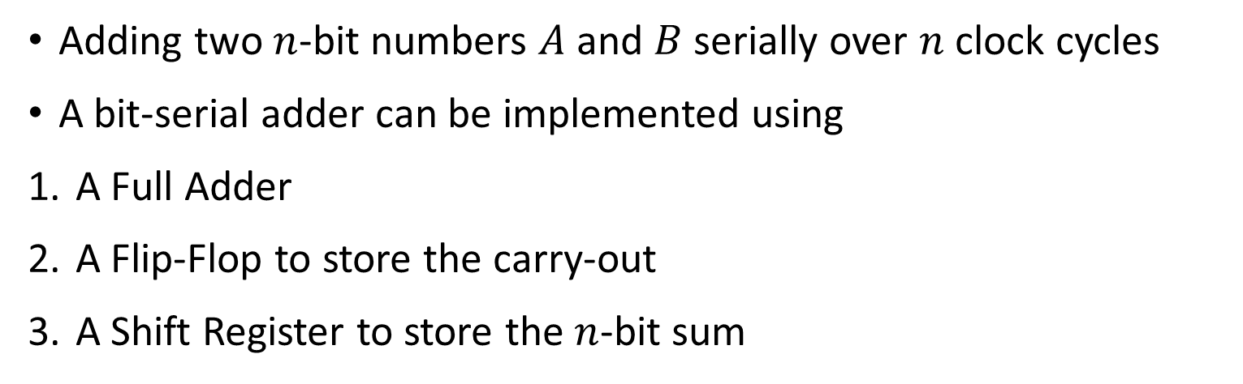








Bit Serial Adder
Adding two $n$-bit numbers $A$ and $B$ serially over $n$ clock cycles
A bit-serial adder can be implemented using
A Full Adder
A Flip-Flop to store the carry-out
A Shift Register to store the $n$-bit sum
Serial Addition
Starts at the
Least-significant bit
Full
Adder
$$S$$
Serial-In Parallel-Out
$n$-bit Shift Register
Serial Inputs
$$A$$
$$Reset$$
$$B$$
$$n$$
$$Cin$$
$$Cout$$
Flip
Flop
$$Q$$
$$D$$
$$Sum[n−1:0]$$
$$Reset$$
$$Clock$$

Slide 9


















Sequence Detector with a Shift Register
A sequence detector can be implemented using:
Left Shift Register (SIPO) + AND Gates
Example: Detecting the sequences 1010 and 1100
Bits are shifted left starting at the most-significant bit
1
$$Q_{3}$$
$$D_{3}$$
0
$$Q_{2}$$
$$D_{2}$$
1
$$Q_{1}$$
$$D_{1}$$
0
$$Q_{0}$$
$$D_{0}$$
Serial Input SI
$$Q_{3}^{′}$$
$$R$$
$$Q_{2}^{′}$$
$$R$$
$$Q_{1}^{′}$$
$$R$$
$$Q_{0}^{′}$$
$$R$$
$$Clock$$
$$Reset$$
Detect
1010
Detect
1100

Slide 10

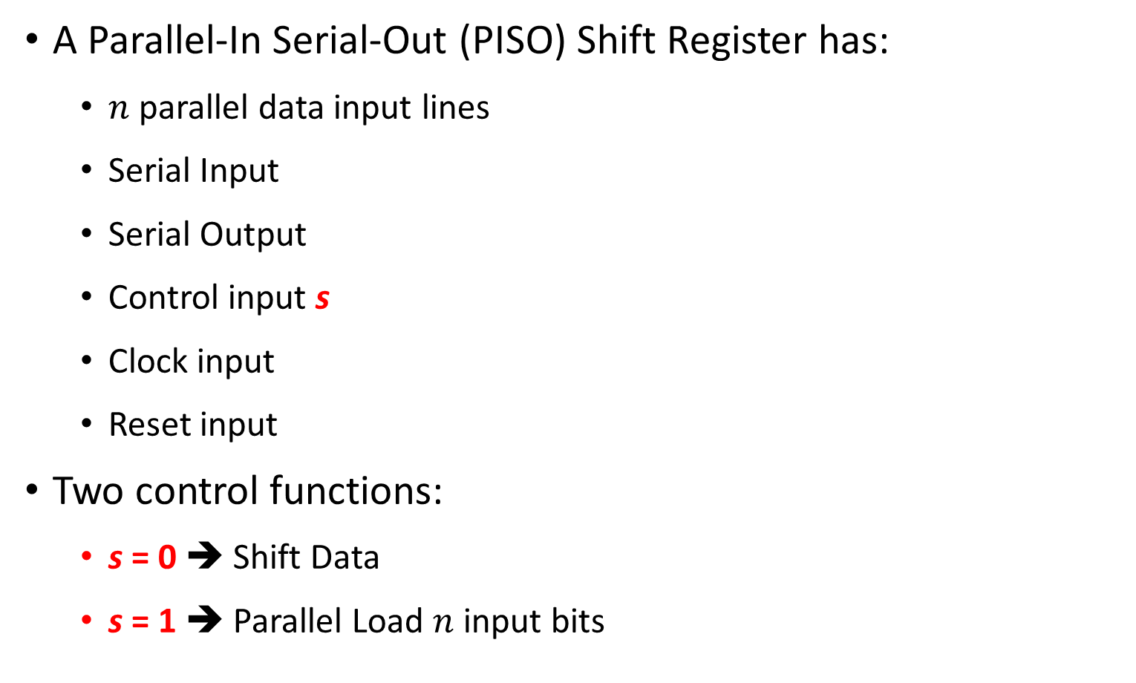


Parallel-In Serial-Out Shift Register
A Parallel-In Serial-Out (PISO) Shift Register has:
$n$ parallel data input lines
Serial Input
Serial Output
Control input s
Clock input
Reset input
Two control functions:
s = 0 ➔ Shift Data
s = 1 ➔ Parallel Load $n$ input bits
Parallel Data Input
Serial In
$$n$$
Control
Parallel-In Serial-Out
Shift Register
$$s$$
Clock
Reset
$$R$$
Serial Output

Slide 11



















Parallel In Serial Out Shift Register
Two control functions:
s = 0 ➔ Shift s = 1 ➔ Load data
Parallel Data Input
Serial
Input SI
$$I_{3}$$
$$I_{2}$$
$$I_{1}$$
$$I_{0}$$
$$s$$
0
1
0
1
0
1
0
1
Serial
Output SO
$$D_{3}$$
$$Q_{3}$$
$$D_{2}$$
$$Q_{2}$$
$$D_{1}$$
$$Q_{1}$$
$$D_{0}$$
$$Q_{0}$$
$$R$$
$$R$$
$$R$$
$$R$$
$$Clock$$
$$Reset$$

Slide 12

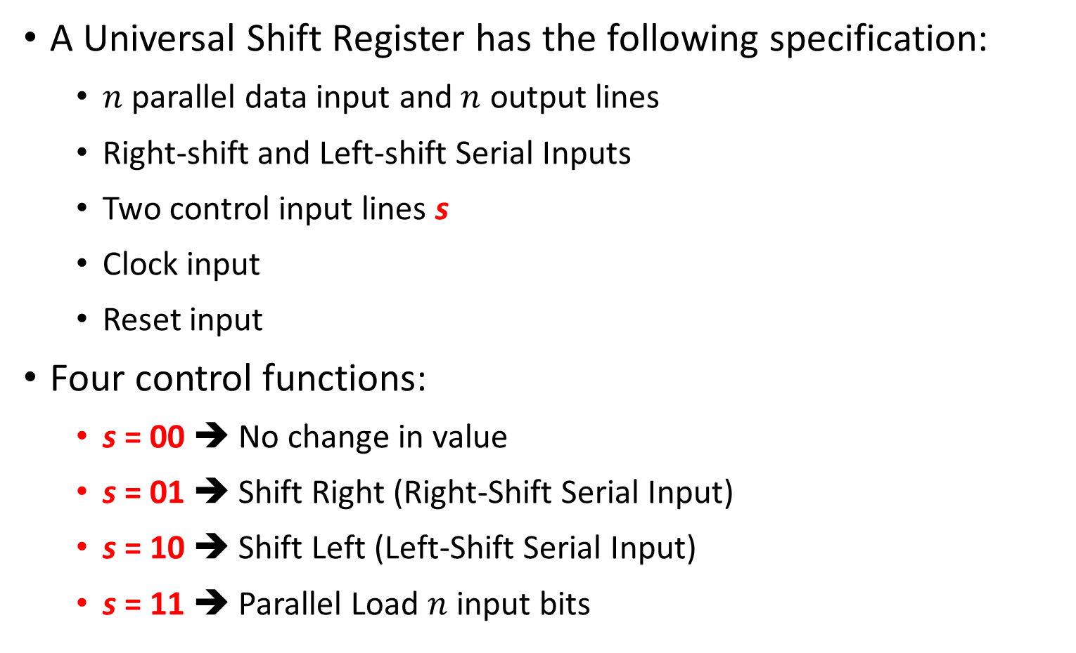



Universal Shift Register
A Universal Shift Register has the following specification:
$n$ parallel data input and $n$ output lines
Right-shift and Left-shift Serial Inputs
Two control input lines s
Clock input
Reset input
Four control functions:
s = 00 ➔ No change in value
s = 01 ➔ Shift Right (Right-Shift Serial Input)
s = 10 ➔ Shift Left (Left-Shift Serial Input)
s = 11 ➔ Parallel Load $n$ input bits
R-shift
Serial
Input
Parallel
Data
Input
L-shift
Serial
Input
$$n$$
Control
2
Universal
Shift Register
$$s$$
Clock
Reset
$$R$$
$$n$$
Parallel Data Output

Slide 13























Universal Shift Register Design
Parallel Inputs
$$I_{3}$$
$$I_{2}$$
$$I_{1}$$
$$I_{0}$$
Right-Shift
Serial Input
Left-Shift
Serial Input
$$s$$
3
2
1
0
3
2
1
0
3
2
1
0
3
2
1
0
2
s = 0 ➔
No change
s = 1 ➔
Shift Right
s = 2 ➔
Shift Left
s = 3 ➔
Parallel Load
$$D_{3}$$
$$D_{2}$$
$$D_{1}$$
$$D_{0}$$
$$R$$
$$Q_{3}$$
$$R$$
$$Q_{2}$$
$$R$$
$$Q_{1}$$
$$R$$
$$Q_{0}$$
$$Clock$$
$$Reset$$
$$Q_{3}$$
$$Q_{2}$$
$$Q_{1}$$
$$Q_{0}$$
Parallel Outputs

Slide 14



Counter
Sequential circuit that goes through a specific sequence of states
Output of the counter is the count value
Modulo-N counter: goes through 0, 1, 2, …, (N – 1)
Modulo-8 binary counter: goes through 0, 1, 2, …, 7
Modulo-10 (BCD) counter: goes through 0, 1, 2, …, 9
Counting can be up or down
Some Applications:
Timers
Event Counting
Frequency Division
Counter
$$clock$$
n
$$Count$$
$$reset$$

Slide 15
Implementing Counters
Two Basic Approaches:
Ripple Counters
The system clock is connected to the clock input of the first flip-flop (LSB)
Each flip-flop output connects to the clock input of the next flip-flop
Advantage: simple circuit and low power consumption
Disadvantage: The counter is not truly synchronous
No common clock to all flip-flops
Ripple propagation delay as the clock signal propagates to the MSB
Synchronous Counters
The system clock is connected to the clock input of ALL flip-flops
Combinational logic is used to implement the desired state sequence

Slide 16






















Ripple Counter
Q₀ toggles at the positive edge of every cycle
Q₁ toggles when Q₀ goes from 1 down to 0
Q₂ toggles when Q₁ goes from 1 down to 0
Q₃ toggles when Q₂ goes from 1 down to 0
$$D_{3}$$
$$Q_{3}$$
$$Q_{3}$$
$$R$$
$$Q_{3}^{′}$$
$$D_{2}$$
$$Q_{2}$$
$$Q_{2}$$
Q3 | Q2 | Q1 | Q0
0 | 0 | 0 | 0
0 | 0 | 0 | 1
0 | 0 | 1 | 0
0 | 0 | 1 | 1
0 | 1 | 0 | 0
0 | 1 | 0 | 1
0 | 1 | 1 | 0
0 | 1 | 1 | 1
1 | 0 | 0 | 0
$$R$$
$$Q_{2}^{′}$$
Counts Up from 0 to 15 then back to 0
$$D_{1}$$
$$Q_{1}$$
$$Q_{1}$$
$$R$$
$$Q_{1}^{′}$$
$$D_{0}$$
$$Q_{0}$$
$$Q_{0}$$
$$Clock$$
$$Reset$$
$$R$$
$$Q_{0}^{′}$$

Slide 17



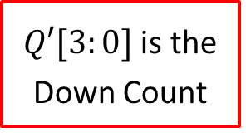





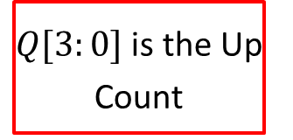
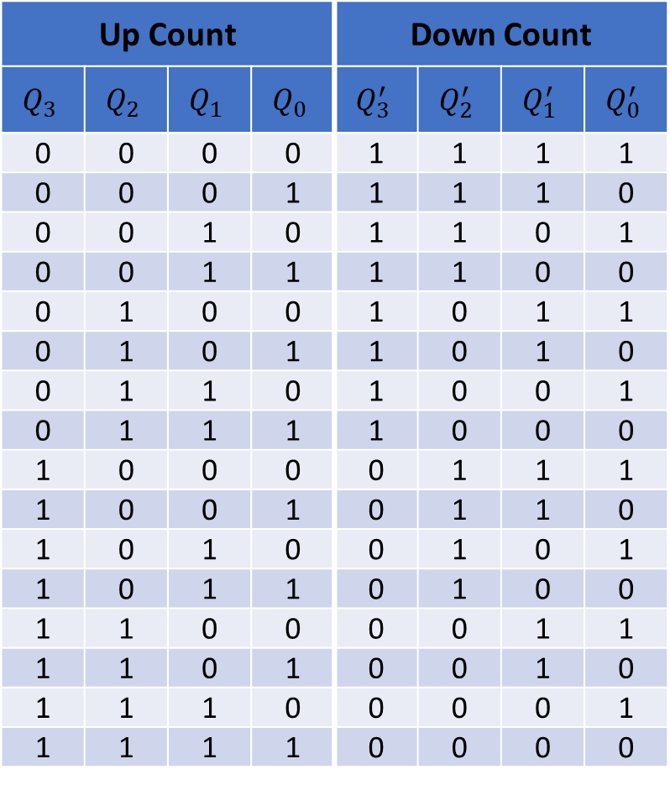














Ripple Counter (cont'd)
Up Count |  |  |  | Down Count
$$Q_{3}$$ | $$Q_{2}$$ | $$Q_{1}$$ | $$Q_{0}$$ | $$Q_{3}^{′}$$ | $$Q_{2}^{′}$$ | $$Q_{1}^{′}$$ | $$Q_{0}^{′}$$
0 | 0 | 0 | 0 | 1 | 1 | 1 | 1
0 | 0 | 0 | 1 | 1 | 1 | 1 | 0
0 | 0 | 1 | 0 | 1 | 1 | 0 | 1
0 | 0 | 1 | 1 | 1 | 1 | 0 | 0
0 | 1 | 0 | 0 | 1 | 0 | 1 | 1
0 | 1 | 0 | 1 | 1 | 0 | 1 | 0
0 | 1 | 1 | 0 | 1 | 0 | 0 | 1
0 | 1 | 1 | 1 | 1 | 0 | 0 | 0
1 | 0 | 0 | 0 | 0 | 1 | 1 | 1
1 | 0 | 0 | 1 | 0 | 1 | 1 | 0
1 | 0 | 1 | 0 | 0 | 1 | 0 | 1
1 | 0 | 1 | 1 | 0 | 1 | 0 | 0
1 | 1 | 0 | 0 | 0 | 0 | 1 | 1
1 | 1 | 0 | 1 | 0 | 0 | 1 | 0
1 | 1 | 1 | 0 | 0 | 0 | 0 | 1
1 | 1 | 1 | 1 | 0 | 0 | 0 | 0
$Q[3:0]$ is the Up Count
$$D_{3}$$
$$Q_{3}$$
$$Q_{3}$$
$$R$$
$$Q_{3}^{′}$$
$Q′[3:0]$ is the Down Count
$$D_{2}$$
$$Q_{2}$$
$$Q_{2}$$
How to Count
Down?
$$R$$
$$Q_{2}^{′}$$
Connect
Q0 to Clk Q1 Q1 to Clk Q2
Q2 to Clk Q3
$$D_{1}$$
$$Q_{1}$$
$$Q_{1}$$
$$R$$
$$Q_{1}^{′}$$
$$D_{0}$$
$$Q_{0}$$
$$Q_{0}$$
$$Clock$$
$$Reset$$
$$R$$
$$Q_{0}^{′}$$

Slide 18
Timing of a Ripple Counter
Clock
Q₀
Q₁
Q₂
Q₃
Drawback of ripple counter:
Flip-flops are NOT driven by the same clock (Not Synchronous)
Q delay increases as we go from Q₀ to Q₃
Given Δ = flip-flop delay ➔ Delay of Q₀, Q₁, Q₂, Q₃ = Δ, 2Δ, 3Δ, 4Δ

Slide 19


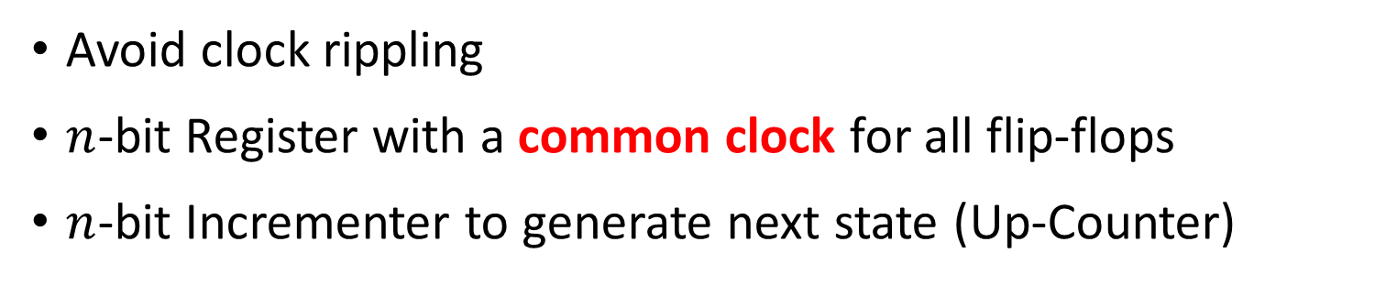


Synchronous Counter
Avoid clock rippling
$n$-bit Register with a common clock for all flip-flops
$n$-bit Incrementer to generate next state (Up-Counter)
$$n$$
n-bit Incrementer (+1)
$$n$$
$$Reset$$
n-bit Register
$Clock$
$$Q[n−1:0]$$

Slide 20







4-Bit Synchronous Counter with Enable
An incrementer is a reduced (contracted) form of an adder
4-Bit Incrementer
$$c3$$
$$c2$$
$$c1$$
EN = 0 ➔
No Change
EN = 1 ➔
Increment
$$Cout$$
$$EN$$
$$D_{3}$$
$$Q_{3}$$
$$D_{2}$$
$$Q_{2}$$
$$D_{1}$$
$$Q_{1}$$
$$D_{0}$$
$$Q_{0}$$
How to
Count
Down?
$$R$$
$$R$$
$$R$$
$$R$$
$$Clock$$
$$Reset$$
Increment
Q' (Not Q)
$$Q_{3}$$
$$Q_{2}$$
$$Q_{1}$$
$$Q_{0}$$
4-bit Counter Output

Slide 21
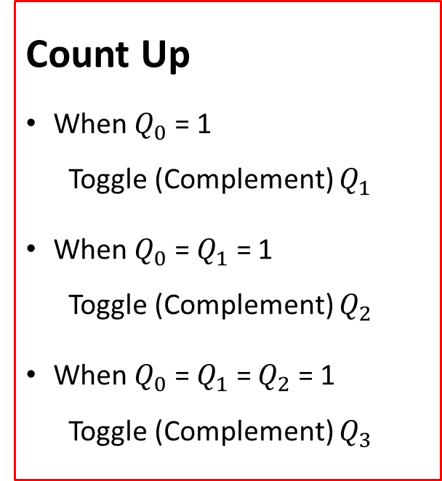
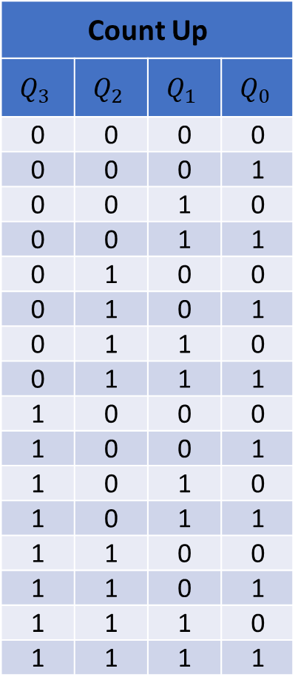
Synchronous Counter (Counting Up)
Count Up
$$Q_{3}$$ | $$Q_{2}$$ | $$Q_{1}$$ | $$Q_{0}$$
0 | 0 | 0 | 0
0 | 0 | 0 | 1
0 | 0 | 1 | 0
0 | 0 | 1 | 1
0 | 1 | 0 | 0
0 | 1 | 0 | 1
0 | 1 | 1 | 0
0 | 1 | 1 | 1
1 | 0 | 0 | 0
1 | 0 | 0 | 1
1 | 0 | 1 | 0
1 | 0 | 1 | 1
1 | 1 | 0 | 0
1 | 1 | 0 | 1
1 | 1 | 1 | 0
1 | 1 | 1 | 1
Count Up
When $Q_{0}$ = 1
Toggle (Complement) $Q_{1}$
When $Q_{0}$ = $Q_{1}$ = 1
Toggle (Complement) $Q_{2}$
When $Q_{0}$ = $Q_{1}$ = $Q_{2}$ = 1
Toggle (Complement) $Q_{3}$

Slide 22











4-Bit Synchronous Counter with T Flip-Flops
Toggle Q1 when c1 = 1, Toggle Q2 when c2 = 1, etc.
$$c3$$
$$c2$$
$$c1$$
EN = 0 ➔
No Change
EN = 1 ➔
Increment
$$Cout$$
$$EN$$
$$T_{3}$$
$$Q_{3}$$
$$T_{2}$$
$$Q_{2}$$
$$T_{1}$$
$$Q_{1}$$
$$T_{0}$$
$$Q_{0}$$
$$R$$
$$R$$
$$R$$
$$R$$
$$Clock$$
$$Reset$$
$$Q_{3}$$
$$Q_{2}$$
$$Q_{1}$$
$$Q_{0}$$
4-bit Counter Output

Slide 23
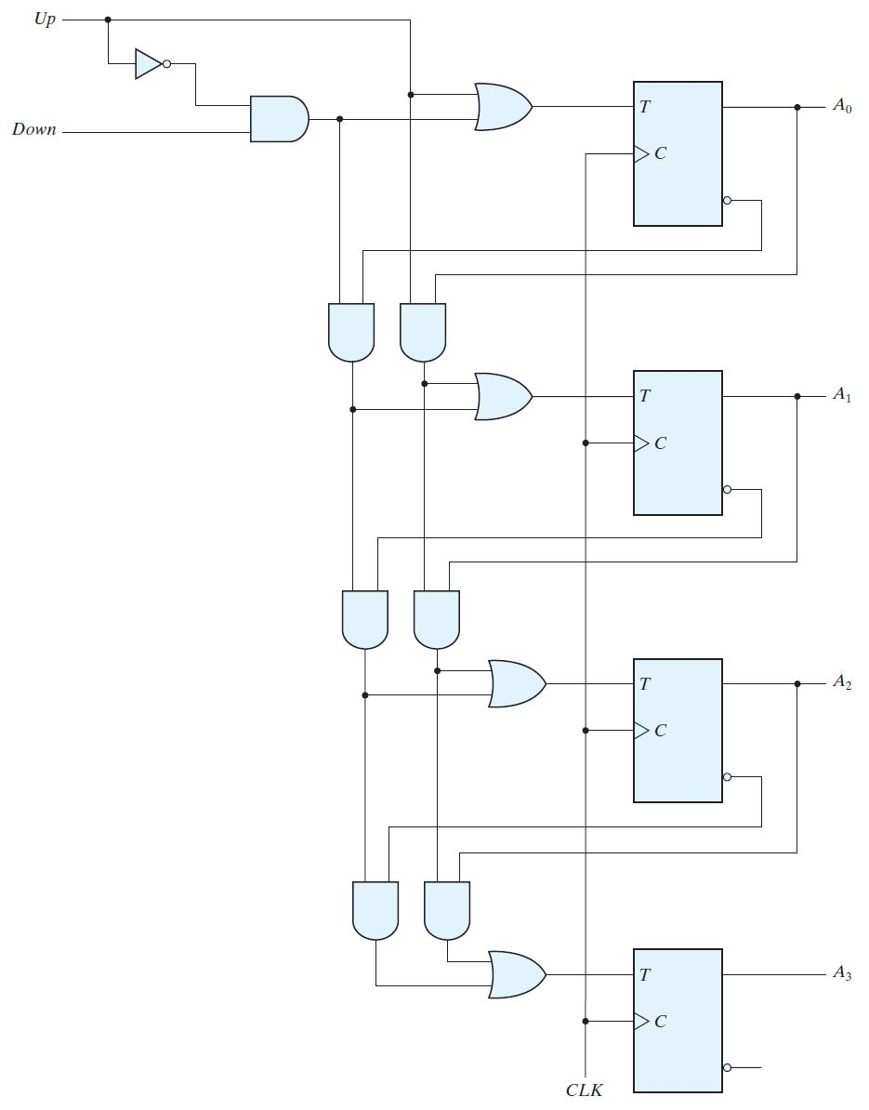




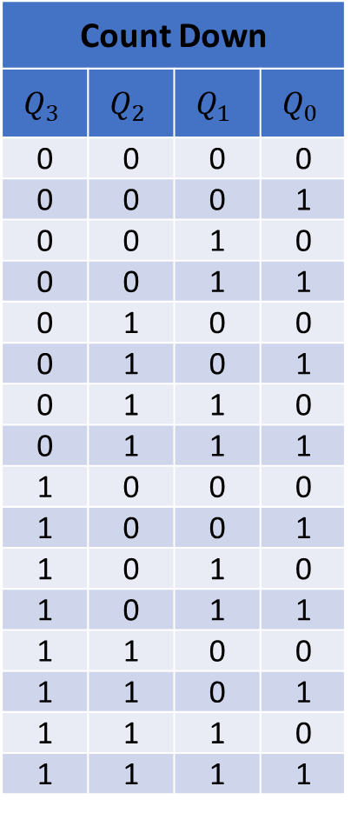






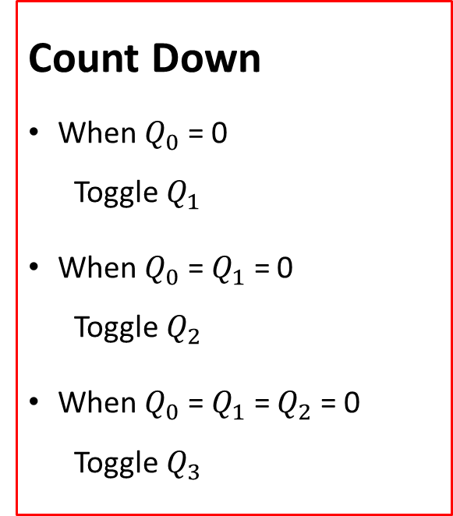
Synchronous Up-Down Counter (T Flip-Flops)
$$Up$$
$$Q_{0}$$
Count Down
$$Q_{3}$$ | $$Q_{2}$$ | $$Q_{1}$$ | $$Q_{0}$$
0 | 0 | 0 | 0
0 | 0 | 0 | 1
0 | 0 | 1 | 0
0 | 0 | 1 | 1
0 | 1 | 0 | 0
0 | 1 | 0 | 1
0 | 1 | 1 | 0
0 | 1 | 1 | 1
1 | 0 | 0 | 0
1 | 0 | 0 | 1
1 | 0 | 1 | 0
1 | 0 | 1 | 1
1 | 1 | 0 | 0
1 | 1 | 0 | 1
1 | 1 | 1 | 0
1 | 1 | 1 | 1
$$Down$$
$$Q_{0}^{′}$$
Count Down
When $Q_{0}$ = 0
Toggle $Q_{1}$
When $Q_{0}$ = $Q_{1}$ = 0
Toggle $Q_{2}$
When $Q_{0}$ = $Q_{1}$ = $Q_{2}$ = 0
Toggle $Q_{3}$
$$Q_{1}$$
$$Q_{1}^{′}$$
$$Q_{2}$$
$$Q_{2}^{′}$$
$$Q_{3}$$
$$Q_{3}^{′}$$

Slide 24
Timing of a Synchronous Counter
Clock
Q₀
Q₁
Q₂
Q₃
Advantage of Synchronous counter:
ALL Flip-flops are driven by the same clock
Delay of all outputs is identical ➔ Delay of Q₀ = Q₁ = Q₂ = Q₃ = Δ

Slide 25
Frequency Division
A counter can be used as a frequency divider
Counter is driven by a Clock with frequency F
Output Q₀ Frequency = F/2, Output Q₁ Frequency = F/4
Output Q₂ Frequency = F/8, Output Q₃ Frequency = F/16
Clock
Q₀
Q₁
Q₂
Q₃

Slide 26


















BCD Counter
Problem: Convert a 4-bit binary counter into a BCD counter
Solution: When output reaches 9 then reset back to 0
Asynchronous Reset: Count to 10 and reset immediately
4-bit Counter with
Synchronous Reset
4-bit Counter with
Asynchronous Reset
4-bit
Counter
4-bit
Counter
$$Cout$$
$$EN$$
1
$$Cout$$
$$EN$$
1
$$clock$$
$$clock$$
$$Reset$$
$$Reset$$
(Synchronous)
$$Reset$$
$$Reset$$
(Asynchronous)
$$Q_{3}$$
$$Q_{2}$$
$$Q_{1}$$
$$Q_{0}$$
$$Q_{3}$$
$$Q_{2}$$
$$Q_{1}$$
$$Q_{0}$$

Slide 27







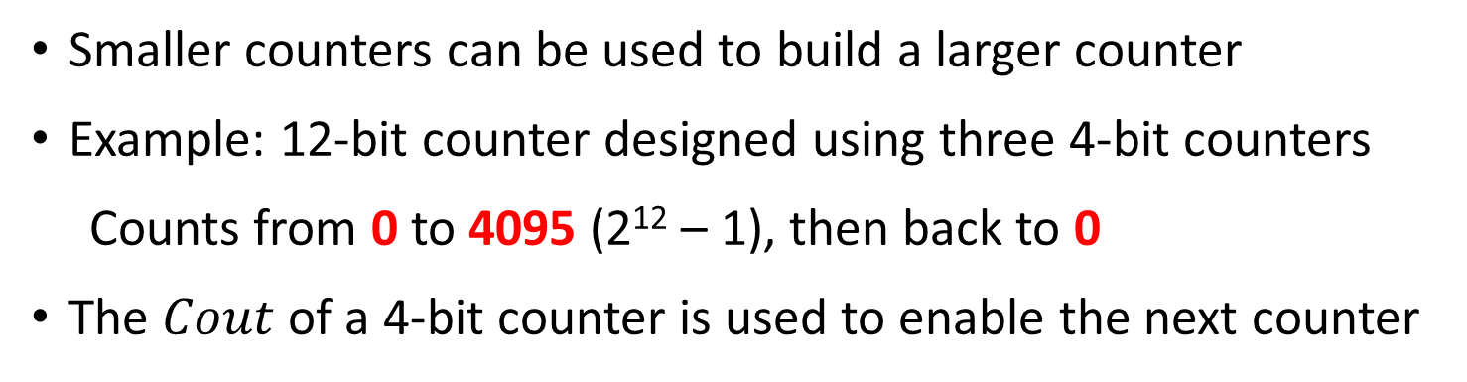









Building Larger Synchronous Counters
Smaller counters can be used to build a larger counter
Example: 12-bit counter designed using three 4-bit counters
Counts from 0 to 4095 (2¹² – 1), then back to 0
The $Cout$ of a 4-bit counter is used to enable the next counter
$$clock$$
$$reset$$
$$Cout$$
4-bit
Counter
4-bit
Counter
4-bit
Counter
$$Cout$$
$$EN$$
$$Cout$$
$$EN$$
$$Cout$$
$$EN$$
$$EN$$
$$R$$
$$R$$
$$R$$
4
4
4
$$Q[11:8]$$
$$Q[7:4]$$
$$Q[3:0]$$

Slide 28








Synchronous Counter with Parallel Load
Ability to load an initial binary number into the counter
Prior to the count operation
Two control inputs:
Load: Initialize counter with input Data
EN: enables the counting
$$Load$$
$$Data[3:0]$$
4
Very useful in implementing different counting sequences
4-bit
Counter
$$Cout$$
$$Cout$$
$$EN$$
$$EN$$
$$clock$$
4
$$Q[3:0]$$

Slide 29



















Implementing a Counter with Parallel Load
$$Load$$
$$D_{3}$$
$$D_{2}$$
$$D_{1}$$
$$D_{0}$$
$$c3$$
$$c2$$
$$c1$$
$$Cout$$
$$EN$$
0
1
0
1
0
1
0
1
Load | EN | Action
0 | 0 | No change
0 | 1 | Increment Count
1 | X | Load data
$$D$$
$$Q$$
$$D$$
$$Q$$
$$D$$
$$Q$$
$$D$$
$$Q$$
$$Clock$$
$$Q_{3}$$
$$Q_{2}$$
$$Q_{1}$$
$$Q_{0}$$
4-bit Counter Output

Slide 30















3-to-12 Counter
Convert a 4-bit binary counter with load into 3-to-12 counter
Solution: Detect binary count 12 and then load 3
Detect 12: Binary count with Q₃ = Q₂ = 1
$$Preset$$
$$D_{3}$$
$$D_{2}$$
$$D_{1}$$
$$D_{0}$$
0
0
1
1
Synchronous Preset
Load: 0011
$$Load$$
$$Cout$$
4-bit Counter
$$EN$$
$$Cout$$
$$EN$$
$$clock$$
$$Q_{3}$$
$$Q_{2}$$
$$Q_{1}$$
$$Q_{0}$$

Slide 31


























9-to-99 Counter
Problem: Use two 4-bit binary counters with parallel load and logic gates to build a counter that counts from 9 to 99 = 'b01100011
Add a synchronous Preset input to initialize the counter to value 9
$$D_{7}$$
$$D_{6}$$
$$D_{5}$$
$$D_{4}$$
$$D_{3}$$
$$D_{2}$$
$$D_{1}$$
$$D_{0}$$
$$Preset$$
0
1
0
0
1
$$Load$$
$$Load$$
$$Cout$$
4-bit Counter
4-bit Counter
$$EN$$
$$Cout$$
$$EN$$
$$Cout$$
$$EN$$
$$clock$$
$$Q_{7}$$
$$Q_{6}$$
$$Q_{5}$$
$$Q_{4}$$
$$Q_{3}$$
$$Q_{2}$$
$$Q_{1}$$
$$Q_{0}$$

