Slide 1
Introduction to Digital Circuits
Digital Logic Design

Slide 2
What will I Learn in this Course?
Towards the end of this course, you should be able to:
Represent numbers and perform arithmetic in various number systems.
Understand the basic identities of Boolean algebra and perform algebraic manipulations of Boolean expressions.
Simplify functions using the K-map method.
Design efficient combinational circuits utilizing basic functional blocks such as multiplexors, encoders, decoders, adders, and comparators.
Analyze and design efficient Mealy and Moore sequential circuits.
Model simple combinational and sequential circuits using Verilog HDL and use tools to simulate and verify correctness of design.
Design registers and counters and understand their applications.

Slide 3
Is it Worth the Effort?
Absolutely!
Digital circuits are employed in the design of:
Digital computers
Data communication
Digital phones
Digital cameras
Digital TVs, etc.
This course provides the fundamental concepts and the basic tools for the design of digital circuits and systems

Slide 4
Presentation Outline
Analog versus Digital Circuits
Digitization of Analog Signals
Binary Numbers and Number Systems
Number System Conversions
Representing Fractions
Binary Codes

Slide 5
Analog versus Digital
Analog means continuous
Analog parameters have continuous range of values
Example: temperature is an analog parameter
Temperature increases/decreases continuously
Other analog parameters?
Sound, speed, voltage, current, time
Digital means discrete using numerical digits
Digital parameters have fixed set of discrete values
Example: month number ∈ {1, 2, 3, …, 12}, month cannot be 1.5!
Other digital parameters?
Alphabet letters, ten decimal digits, twenty-four hours, sixty minutes

Slide 6
Analog versus Digital System
Are computers analog or digital systems?
Computer are digital systems
Which is easier to design an analog or a digital system?
Digital systems are easier to design, because they deal with a limited set of values rather than an infinitely large range of continuous values
The world around us is analog
It is common to convert analog parameters into digital form
This process is called digitization

Slide 7
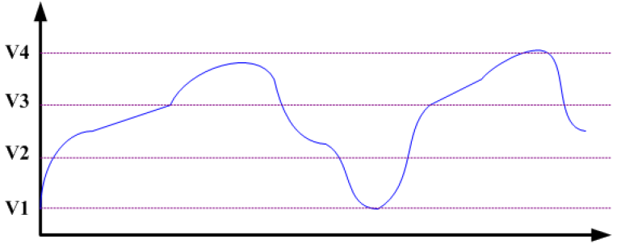
Digitization of Analog Signals
Digitization is converting an analog signal into digital form
Example: consider digitizing an analog voltage signal
Digitized output is limited to four values = {V1,V2,V3,V4}
Voltage
Time

Slide 8
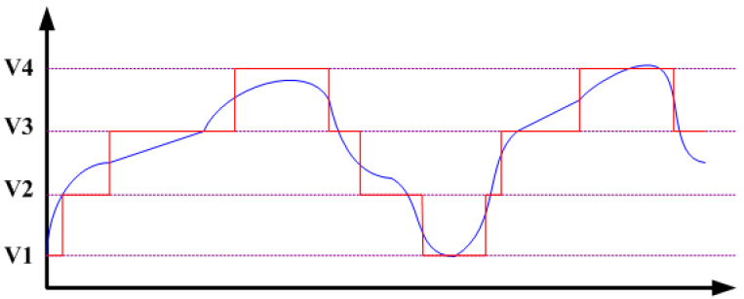
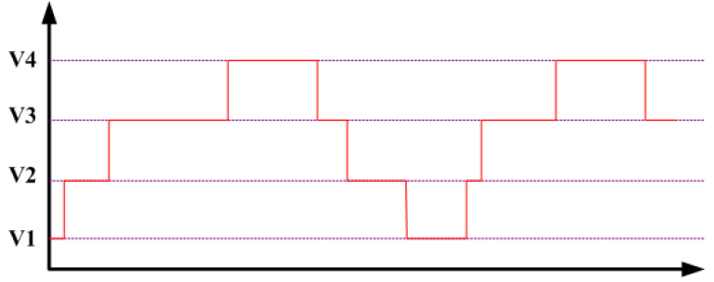
Digitization of Analog Signals – cont’d
Voltage
Time
Voltage
Time
Some loss of accuracy, why?
How to improve accuracy?
Add more voltage values

Slide 9
ADC and DAC Converters
Analog-to-Digital Converter (ADC)
Produces digitized version of analog signals
Analog input => Digital output
Digital-to-Analog Converter (DAC)
Regenerate analog signal from digital form
Digital input => Analog output
Our focus is on digital systems only
Both input and output to a digital system are digital signals
input analog signals
Analog-to-Digital Converter (ADC)
input digital signals
Digital System
output digital signals
Digital-to-Analog Converter (DAC)
output analog signals

Slide 10
Next . . .
Analog versus Digital Circuits
Digitization of Analog Signals
Binary Numbers and Number Systems
Number System Conversions
Representing Fractions
Binary Codes

Slide 11
How do Computers Represent Digits?
Binary digits (0 and 1) are the simplest to represent
Using electric voltage
Used in processors and digital circuits
High voltage = 1, Low voltage = 0
Using electric charge
Used in memory cells
Charged memory cell = 1, discharged memory cell = 0
Using magnetic field
Used in magnetic disks, magnetic polarity indicates 1 or 0
Using light
Used in optical disks, optical lens can sense the light or not
High = 1
Unused
Voltage Level
Low = 0

Slide 12
Binary Numbers
Each binary digit (called a bit) is either 1 or 0
Bits have no inherent meaning, they can represent …
Unsigned and signed integers
Fractions
Characters
Images, sound, etc.
Bit Numbering
Least significant bit (LSB) is rightmost (bit 0)
Most significant bit (MSB) is leftmost (bit 7 in an 8-bit number)
Most
Significant Bit
Least
Significant Bit
7
6
5
4
3
2
1
0
1
0
0
1
1
1
0
1
2
7
2
6
2
5
2
4
2
3
2
2
2
1
2
0

Slide 13
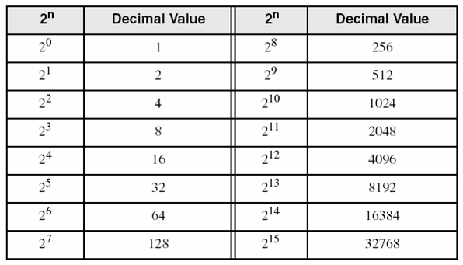
Decimal Value of Binary Numbers
Each bit represents a power of 2
Every binary number is a sum of powers of 2
Decimal Value = (d_{n-1} × 2^{n-1}) + ... + (d₁ × 2¹) + (d₀ × 2⁰)
Binary (10011101)₂ =
2⁷ + 2⁴ + 2³ + 2² + 1 = 157
7
6
5
4
3
2
1
0
1
0
0
1
1
1
0
1
2
7
2
6
2
5
2
4
2
3
2
2
2
1
2
0
Some common powers of 2

Slide 14
Positional Number Systems
Different Representations of Natural Numbers
XXVII Roman numerals (not positional)
27 Radix-10 or decimal number (positional)
11011₂ Radix-2 or binary number (also positional)
Fixed-radix positional representation with n digits
Number N in radix r = (d_{n–1}d_{n–2} . . . d₁d₀)_{r}
N_{r} Value = d_{n–1}×r ^{n–1} + d_{n–2}×r ^{n–2} + … + d₁×r + d₀
Examples: (11011)₂ =
(2107)₈ =
1×2⁴ + 1×2³ + 0×2² + 1×2 + 1 = 27
2×8³ + 1×8² + 0×8 + 7 = 1095

Slide 15
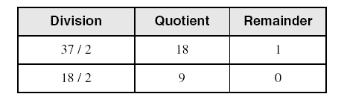
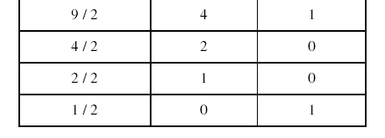
Convert Decimal to Binary
Repeatedly divide the decimal integer by 2
Each remainder is a binary digit in the translated value
Example: Convert 37₁₀ to Binary
least significant bit
37 = (100101)₂
most significant bit
stop when quotient is zero

Slide 16
Decimal to Binary Conversion
N = (d_{n-1} × 2^{n-1}) + ... + (d₁ × 2¹) + (d₀ × 2⁰)
Dividing N by 2 we first obtain
Quotient₁ = (d_{n-1} × 2^{n-2}) + … + (d₂ × 2) + d₁
Remainder₁ = d₀
Therefore, first remainder is least significant bit of binary number
Dividing first quotient by 2 we first obtain
Quotient₂ = (d_{n-1} × 2^{n-3}) + … + (d₃ × 2) + d₂
Remainder₂ = d₁
Repeat dividing quotient by 2
Stop when new quotient is equal to zero
Remainders are the bits from least to most significant bit

Slide 17
Popular Number Systems
Binary Number System: Radix = 2
Only two digit values: 0 and 1
Numbers are represented as 0s and 1s
Octal Number System: Radix = 8
Eight digit values: 0, 1, 2, …, 7
Decimal Number System: Radix = 10
Ten digit values: 0, 1, 2, …, 9
Hexadecimal Number Systems: Radix = 16
Sixteen digit values: 0, 1, 2, …, 9, A, B, …, F
A = 10, B = 11, …, F = 15
Octal and Hexadecimal numbers can be converted easily to Binary and vice versa

Slide 18
Octal and Hexadecimal Numbers
Octal = Radix 8
Only eight digits: 0 to 7
Digits 8 and 9 not used
Hexadecimal = Radix 16
16 digits: 0 to 9, A to F
A=10, B=11, …, F=15
First 16 decimal values (0 to15) and their values in binary, octal and hex. Memorize table
Decimal Radix 10 | Binary Radix 2 | Octal Radix 8 | Hex Radix 16
0 | 0000 | 0 | 0
1 | 0001 | 1 | 1
2 | 0010 | 2 | 2
3 | 0011 | 3 | 3
4 | 0100 | 4 | 4
5 | 0101 | 5 | 5
6 | 0110 | 6 | 6
7 | 0111 | 7 | 7
8 | 1000 | 10 | 8
9 | 1001 | 11 | 9
10 | 1010 | 12 | A
11 | 1011 | 13 | B
12 | 1100 | 14 | C
13 | 1101 | 15 | D
14 | 1110 | 16 | E
15 | 1111 | 17 | F

Slide 19
Binary, Octal, and Hexadecimal
Binary, Octal, and Hexadecimal are related:
Radix 16 = 2⁴ and Radix 8 = 2³
Hexadecimal digit = 4 bits and Octal digit = 3 bits
Starting from least-significant bit, group each 4 bits into a hex digit or each 3 bits into an octal digit
Example: Convert 32-bit number into octal and hex
3
5
3
0
5
5
2
3
6
2
4
Octal
1
1
1
0
1
0
1
1
0
0
0
1
0
1
1
0
1
0
1
0
0
1
1
1
1
0
0
1
0
1
0
0
32-bit binary
E
B
1
6
A
7
9
4
Hexadecimal

Slide 20
Converting Octal & Hex to Decimal
Octal to Decimal: N₈ = (d_{n-1} × 8^{n-1}) +... + (d₁ × 8) + d₀
Hex to Decimal: N₁₆ = (d_{n-1} × 16^{n-1}) +... + (d₁ × 16) + d₀
Examples:
(7204)₈ = (7 × 8³) + (2 × 8²) + (0 × 8) + 4 = 3716
(3BA4)₁₆ = (3 × 16³) + (11 × 16²) + (10 × 16) + 4 = 15268

Slide 21
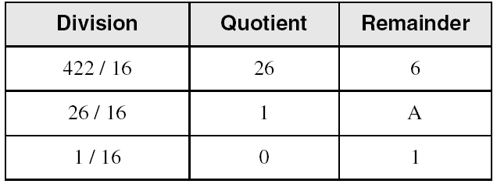
Converting Decimal to Hexadecimal
Repeatedly divide the decimal integer by 16
Each remainder is a hex digit in the translated value
Example: convert 422 to hexadecimal
least significant digit
most significant digit
422 = (1A6)₁₆
stop when quotient is zero
To convert decimal to octal divide by 8 instead of 16

Slide 22
Important Properties
How many possible digits can we have in Radix r ?
r digits: 0 to r – 1
What is the result of adding 1 to the largest digit in Radix r?
Since digit r is not represented, result is (10)_{r} in Radix r
Examples: 1₂ + 1 = (10)₂ 7₈ + 1 = (10)₈
9₁₀ + 1 = (10)₁₀ F₁₆ + 1 = (10)₁₆
What is the largest value using 3 digits in Radix r?
In binary: (111)₂ = 2³ – 1
In octal: (777)₈ = 8³ – 1
In decimal: (999)₁₀ = 10³ – 1
In Radix r:
largest value = r³ – 1

Slide 23
Important Properties – cont’d
How many possible values can be represented …
Using n binary digits?
Using n octal digits
Using n decimal digits?
Using n hexadecimal digits
Using n digits in Radix r ?
2^{n} values: 0 to 2^{n} – 1
8^{n} values: 0 to 8^{n} – 1
10^{n} values: 0 to 10^{n} – 1
16^{n} values: 0 to 16^{n} – 1
r^{n} values: 0 to r^{n} – 1

Slide 24
Next . . .
Analog versus Digital Circuits
Digitization of Analog Signals
Binary Numbers and Number Systems
Number System Conversions
Representing Fractions
Binary Codes

Slide 25
Representing Fractions
A number N_{r} in radix r can also have a fraction part:
N_{r} = d_{n-1}d_{n-2} … d₁d₀ . d₋₁ d₋₂ … d_{-m+1} d_{-m}
The number N_{r} represents the value:
N_{r} = d_{n-1} × r^{n-1} + … + d₁ × r + d₀ + (Integer Part)
d₋₁ × r ⁻¹ + d₋₂ × r ⁻² … + d_{-m} × r ^{–m} (Fraction Part)
0 ≤ d_{i} < r
Integer Part
Fraction Part
Radix Point
i = n-1
j = -1
∑
∑
N_{r} =
d_{i} × r^{i}
+
d_{j} × r^{j}
i = 0
j = -m

Slide 26
Examples of Numbers with Fractions
(2409.87)₁₀
(1101.1001)₂
(703.64)₈
(A1F.8)₁₆
(423.1)₅
(263.5)₆
= 2×10³ + 4×10² + 9 + 8×10⁻¹ + 7×10⁻²
= 2³ + 2² + 2⁰ + 2⁻¹ + 2⁻⁴ = 13.5625
= 7×8² + 3 + 6×8⁻¹ + 4×8⁻² = 451.8125
= 10×16² + 16 + 15 + 8×16⁻¹ = 2591.5
= 4×5² + 2×5 + 3 + 5⁻¹ = 113.2
Digit 6 is NOT allowed in radix 6

Slide 27
Converting Decimal Fraction to Binary
Convert N = 0.6875 to Radix 2
Solution: Multiply N by 2 repeatedly & collect integer bits
Stop when new fraction = 0.0, or when enough fraction bits are obtained
Therefore, N = 0.6875 = (0.1011)₂
Check (0.1011)₂ = 2⁻¹ + 2⁻³ + 2⁻⁴ = 0.6875
Multiplication | New Fraction | Bit
0.6875 × 2 = 1.375 | 0.375 | 1
0.375 × 2 = 0.75 | 0.75 | 0
0.75 × 2 = 1.5 | 0.5 | 1
0.5 × 2 = 1.0 | 0.0 | 1
First fraction bit
Last fraction bit

Slide 28
Converting Fraction to any Radix r
To convert fraction N to any radix r
N_{r} = (0.d₋₁ d₋₂ … d_{-m})_{r} = d₋₁ × r ⁻¹ + d₋₂ × r ⁻² … + d_{-m} × r ^{–m}
Multiply N by r to obtain d₋₁
N_{r} × r = d₋₁ + d₋₂ × r ⁻¹ … + d_{-m} × r ^{–m+1}
The integer part is the digit d₋₁ in radix r
The new fraction is d₋₂ × r ⁻¹ … + d_{-m} × r ^{–m+1}
Repeat multiplying the new fractions by r to obtain d₋₂ d₋₃ ...
Stop when new fraction becomes 0.0 or enough fraction digits are obtained

Slide 29
More Conversion Examples
Convert N = 139.6875 to Octal (Radix 8)
Solution: N = 139 + 0.6875 (split integer from fraction)
The integer and fraction parts are converted separately
Therefore, 139 = (213)₈ and 0.6875 = (0.54)₈
Now, join the integer and fraction parts with radix point
N = 139.6875 = (213.54)₈
Division | Quotient | Remainder
139 / 8 | 17 | 3
17 / 8 | 2 | 1
2 / 8 | 0 | 2
Multiplication | New Fraction | Digit
0.6875 × 8 = 5.5 | 0.5 | 5
0.5 × 8 = 4.0 | 0.0 | 4

Slide 30
Conversion Procedure to Radix r
To convert decimal number N (with fraction) to radix r
Convert the Integer Part
Repeatedly divide the integer part of number N by the radix r and save the remainders. The integer digits in radix r are the remainders in reverse order of their computation. If radix r > 10, then convert all remainders > 10 to digits A, B, … etc.
Convert the Fractional Part
Repeatedly multiply the fraction of N by the radix r and save the integer digits that result. The fraction digits in radix r are the integer digits in order of their computation. If the radix r > 10, then convert all digits > 10 to A, B, … etc.
Join the result together with the radix point

Slide 31
Simplified Conversions
Converting fractions between Binary, Octal, and Hexadecimal can be simplified
Starting at the radix pointing, the integer part is converted from right to left and the fractional part is converted from left to right
Group 4 bits into a hex digit or 3 bits into an octal digit
Use binary to convert between octal and hexadecimal
integer: right to left
fraction: left to right
7
2
6
1
3
.
2
4
7
4
5
2
Octal
1
1
1
0
1
0
1
1
0
0
0
1
0
1
1
.
0
1
0
1
0
0
1
1
1
1
0
0
1
0
1
0
1
Binary
7
5
8
B
.
5
3
C
A
8
Hexadecimal

Slide 32
Important Properties of Fractions
How many fractional values exist with m fraction bits?
2^{m} fractions, because each fraction bit can be 0 or 1
What is the largest fraction value if m bits are used?
Largest fraction value = 2⁻¹ + 2⁻² + … + 2^{-m} = 1 – 2^{-m}
Because if you add 2^{-m} to largest fraction you obtain 1
In general, what is the largest fraction value if m fraction digits are used in radix r?
Largest fraction value = (r – 1) × (r ⁻¹ + r ⁻² + … + r ^{-m}) = 1 – r ^{-m}
For decimal, largest fraction value = 1 – 10^{-m}
For hexadecimal, largest fraction value = 1 – 16^{-m}

Slide 33
Next . . .
Analog versus Digital Circuits
Digitization of Analog Signals
Binary Numbers and Number Systems
Number System Conversions
Representing Fractions
Binary Codes

Slide 34
Binary Codes
How to represent characters, colors, etc?
Define the set of all represented elements
Assign a unique binary code to each element of the set
Given n bits, a binary code is a mapping from the set of elements to a subset of the 2^{n} binary numbers
Coding Numeric Data (example: coding decimal digits)
Coding must simplify common arithmetic operations
Tight relation to binary numbers
Coding Non-Numeric Data (example: coding colors)
More flexible codes since arithmetic operations are not applied

Slide 35
Example of Coding Non-Numeric Data
Suppose we want to code 7 colors of the rainbow
As a minimum, we need 3 bits to define 7 unique values
3 bits define 8 possible combinations
Only 7 combinations are needed
Code 111 is not used
Other assignments are also possible
Color | 3-bit code
Red | 000
Orange | 001
Yellow | 010
Green | 011
Blue | 100
Indigo | 101
Violet | 110

Slide 36
Minimum Number of Bits Required
Given a set of M elements to be represented by a binary code, the minimum number of bits, n, should satisfy:
2^{(n - 1)} < M ≤ 2^{n}
n = log₂ M where x , called the ceiling function, is the integer greater than or equal to x
How many bits are required to represent 10 decimal digits with a binary code?
Answer: log₂ 10 = 4 bits can represent 10 decimal digits
Notes:
M = 10
Therefore n = 4 since:
2⁴ =16 is ≥ 10 > 2³ = 8
and the ceiling function for log₂ 10 is 4.

Slide 37
Decimal Codes
Binary number system is most natural for computers
But people are used to the decimal number system
Must convert decimal numbers to binary, do arithmetic on binary numbers, then convert back to decimal
To simplify conversions, decimal codes can be used
Define a binary code for each decimal digit
Since 10 decimal digits exit, a 4-bit code is used
But a 4-bit code gives 16 unique combinations
10 combinations are used and 6 will be unused

Slide 38
Binary Coded Decimal (BCD)
Simplest binary code for decimal digits
Only encodes ten digits from 0 to 9
BCD is a weighted code
The weights are 8,4,2,1
Same weights as a binary number
There are six invalid code words
1010, 1011, 1100, 1101, 1110, 1111
Example on BCD coding:
13 ⇔ (0001 0011)_{BCD}
Decimal | BCD
0 | 0000
1 | 0001
2 | 0010
3 | 0011
4 | 0100
5 | 0101
6 | 0110
7 | 0111
8 | 1000
9 | 1001
Unused | 1010 ··· 1111
Notes:
Answer 1: 6
Answer 2: 1010, 1011, 1100, 1101, 1110, 1111

Slide 39
Warning: Conversion or Coding?
Do NOT mix up conversion of a decimal number to a binary number with coding a decimal number with a binary code
13₁₀ = (1101)₂ This is conversion
13 ⇔ (0001 0011)_{BCD} This is coding
In general, coding requires more bits than conversion
A number with n decimal digits is coded with 4n bits in BCD

Slide 40
Other Decimal Codes
BCD, 5421, 2421, and 8 4 -2 -1 are weighted codes
Excess-3 is not a weighted code
2421, 8 4 -2 -1, and Excess-3 are self complementary codes
Decimal | BCD 8421 | 5421 code | 2421 code | 8 4 -2 -1 code | Excess-3 code
0 | 0000 | 0000 | 0000 | 0000 | 0011
1 | 0001 | 0001 | 0001 | 0111 | 0100
2 | 0010 | 0010 | 0010 | 0110 | 0101
3 | 0011 | 0011 | 0011 | 0101 | 0110
4 | 0100 | 0100 | 0100 | 0100 | 0111
5 | 0101 | 1000 | 1011 | 1011 | 1000
6 | 0110 | 1001 | 1100 | 1010 | 1001
7 | 0111 | 1010 | 1101 | 1001 | 1010
8 | 1000 | 1011 | 1110 | 1000 | 1011
9 | 1001 | 1100 | 1111 | 1111 | 1100
Unused | ··· | ··· | ··· | ··· | ···

Slide 41
Character Codes
Character sets
Standard ASCII: 7-bit character codes (0 – 127)
Extended ASCII: 8-bit character codes (0 – 255)
Unicode: 16-bit character codes (0 – 65,535)
Unicode standard represents a universal character set
Defines codes for characters used in all major languages
Each character is encoded as 16 bits
UTF-8: variable-length encoding used in HTML
Encodes all Unicode characters
Uses 1 byte for ASCII, but multiple bytes for other characters
Null-terminated String
Array of characters followed by a NULL character

Slide 42
Printable ASCII Codes
 | 0 | 1 | 2 | 3 | 4 | 5 | 6 | 7 | 8 | 9 | A | B | C | D | E | F
2 | space | ! | " | # | $ | % | & | ' | ( | ) | * | + | , | - | . | /
3 | 0 | 1 | 2 | 3 | 4 | 5 | 6 | 7 | 8 | 9 | : | ; | < | = | > | ?
4 | @ | A | B | C | D | E | F | G | H | I | J | K | L | M | N | O
5 | P | Q | R | S | T | U | V | W | X | Y | Z | [ | \ | ] | ^ | _
6 | ` | a | b | c | d | e | f | g | h | i | j | k | l | m | n | o
7 | p | q | r | s | t | u | v | w | x | y | z | { | | | } | ~ | DEL
Examples:
ASCII code for space character = 20 (hex) = 32 (decimal)
ASCII code for 'L' = 4C (hex) = 76 (decimal)
ASCII code for 'a' = 61 (hex) = 97 (decimal)

Slide 43
Control Characters
The first 32 characters of ASCII table are used for control
Control character codes = 00 to 1F (hexadecimal)
Not shown in previous slide
Examples of Control Characters
Character 0 is the NULL character ⇒ used to terminate a string
Character 9 is the Horizontal Tab (HT) character
Character 0A (hex) = 10 (decimal) is the Line Feed (LF)
Character 0D (hex) = 13 (decimal) is the Carriage Return (CR)
The LF and CR characters are used together
They advance the cursor to the beginning of next line
One control character appears at end of ASCII table
Character 7F (hex) is the Delete (DEL) character

Slide 44
Parity Bit & Error Detection Codes
Binary data are typically transmitted between computers
Because of noise, a corrupted bit will change value
To detect errors, extra bits are added to each data value
Parity bit: is used to make the number of 1’s odd or even
Even parity: number of 1’s in the transmitted data is even
Odd parity: number of 1’s in the transmitted data is odd
7-bit ASCII Character | With Even Parity | With Odd Parity
‘A’ = 1000001 | 0 1000001 | 1 1000001
‘T’ = 1010100 | 1 1010100 | 0 1010100

Slide 45
Detecting Errors
Sender
7-bit ASCII character + 1 Parity bit
Receiver
Sent ‘A’ = 01000001, Received ‘A’ = 01000101
Suppose we are transmitting 7-bit ASCII characters
A parity bit is added to each character to make it 8 bits
Parity can detect all single-bit errors
If even parity is used and a single bit changes, it will change the parity to odd, which will be detected at the receiver end
The receiver end can detect the error, but cannot correct it because it does not know which bit is erroneous
Can also detect some multiple-bit errors
Error in an odd number of bits

