Slide 1
Analysis of Sequential Circuits
Digital Logic Design

Slide 2
Outline
Analysis of Clocked Sequential circuits
State and Output Equations
State Table
State Diagram

Slide 3
Analysis of Clocked Sequential Circuits
Analysis is describing what a given circuit will do
The output of a clocked sequential circuit is determined by
Inputs
State of the Flip-Flops
Analysis Procedure:
Obtain the equations at the inputs of the Flip-Flops
Obtain the output equations
Fill the state table for all possible input and state values
Draw the state diagram

Slide 4
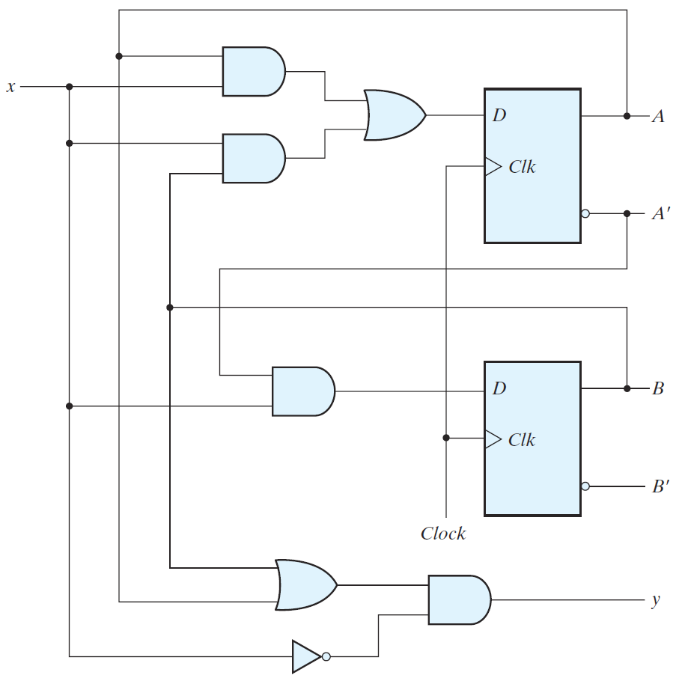
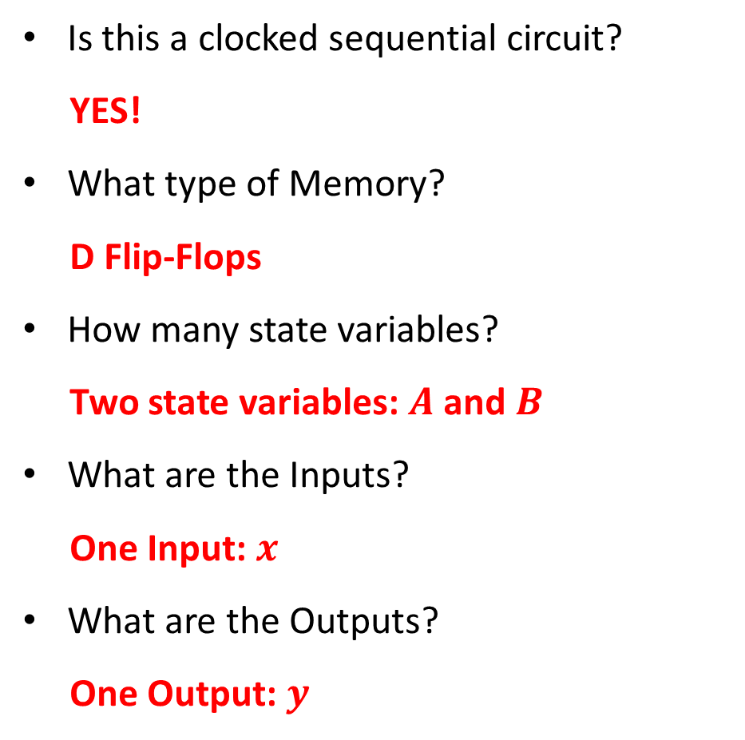
Analysis Example
Is this a clocked sequential circuit?
YES!
What type of Memory?
D Flip-Flops
How many state variables?
Two state variables: $A$ and $B$
What are the Inputs?
One Input: $x$
What are the Outputs?
One Output: $y$

Slide 5

Flip-Flop Input Equations
What are the equations on the $D$ inputs of the flip-flops?
$D_{A}=A x+B x$
$D_{B}=A^{′} x$
$A$ and $B$ are the current state
$A(t)=A, B(t)=B$
$D_{A}$ and $D_{B}$ are the next state
$A(t+1)=D_{A}, B(t+1)=D_{B}$
The values of $A$ and $B$ will be $D_{A}$
and $D_{B}$ at the next clock edge

Slide 6

Next State and Output Equations
The next state equations define the next state
At the inputs of the Flip-Flops
Next state equations?
$A\left(t+1\right)=D_{A}=A x+B x$
$B\left(t+1\right)=D_{B}=A^{′} x$
There is only one output $y$
What is the output equation?
$y=\left(A+B\right) x′$

Slide 7
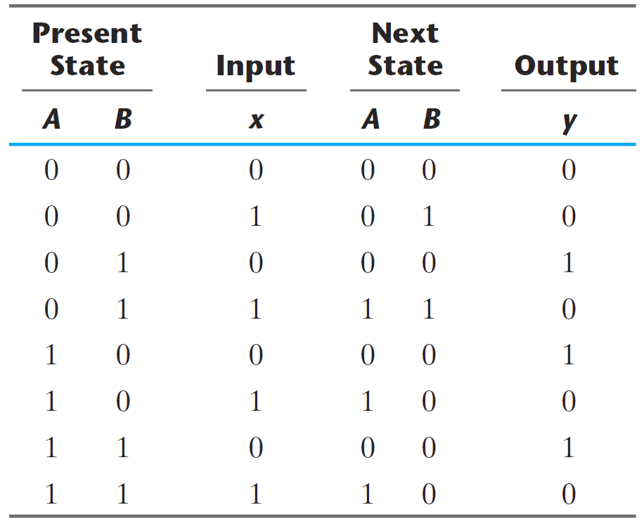
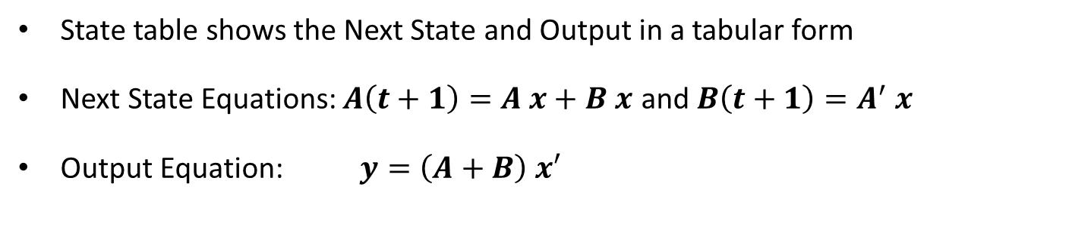
State Table
State table shows the Next State and Output in a tabular form
Next State Equations: $A\left(t+1\right)=A x+B x$ and $B\left(t+1\right)=A^{′} x$
Output Equation: $y=\left(A+B\right) x′$

Slide 8
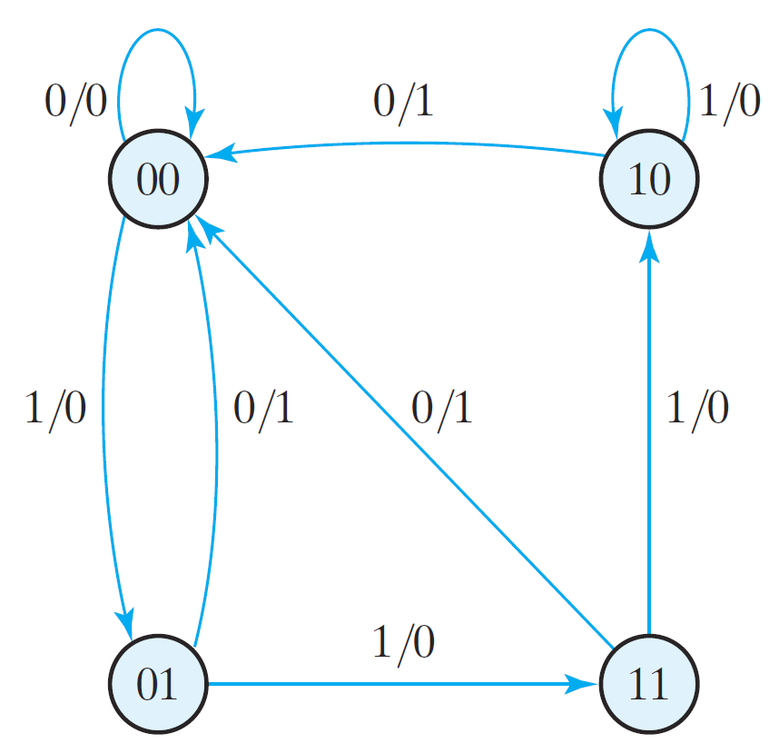
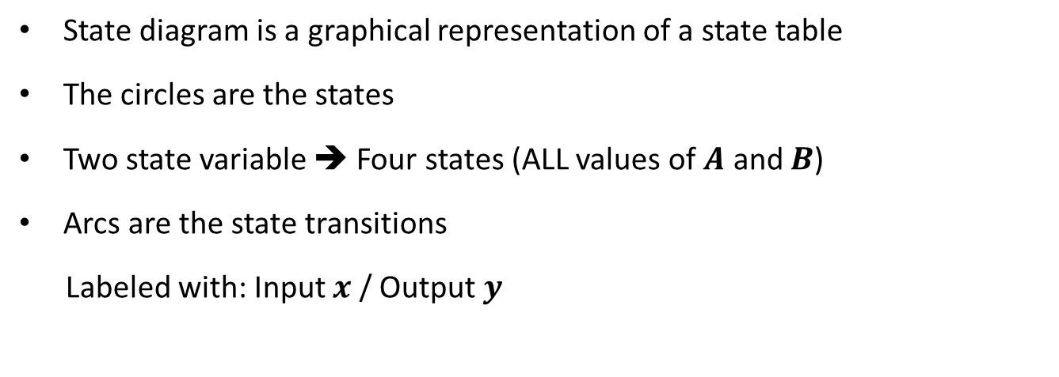
State Diagram
State diagram is a graphical representation of a state table
The circles are the states
Two state variable ➔ Four states (ALL values of $A$ and $B$)
Arcs are the state transitions
Labeled with: Input $x$ / Output $y$

Slide 9
Combinational versus Sequential Analysis
Analysis of Combinational Circuits
Obtain the Boolean Equations
Fill the Truth Table
Analysis of Sequential Circuits
Obtain the Next State Equations
Obtain the Output Equations
Fill the State Table
Draw the State Diagram
Output is a function of input only
Next state is a function of input and current state
Output is a function of input and current state

Slide 10
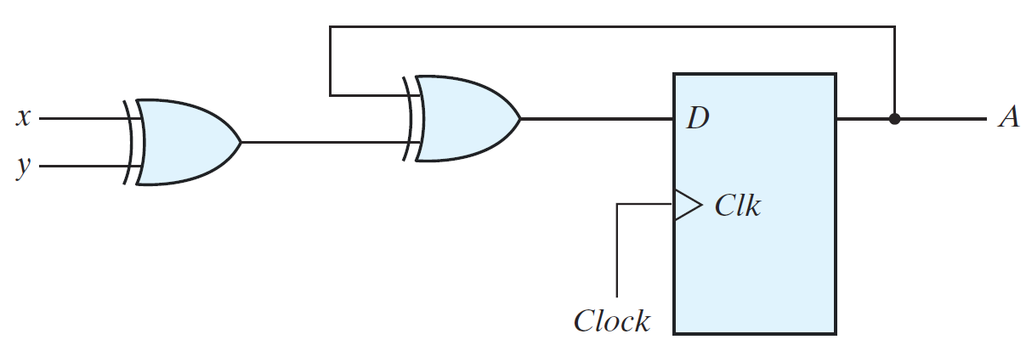
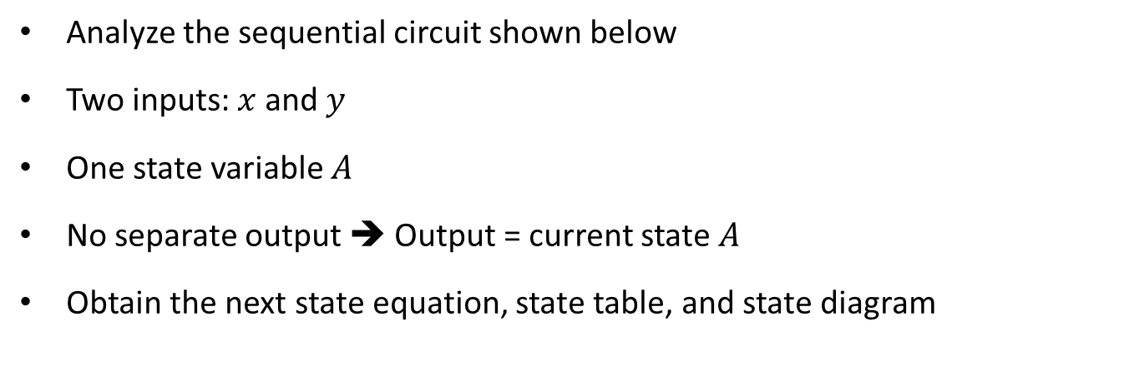
Example with Output = Current State
Analyze the sequential circuit shown below
Two inputs: $x$ and $y$
One state variable $A$
No separate output ➔ Output = current state $A$
Obtain the next state equation, state table, and state diagram

Slide 11
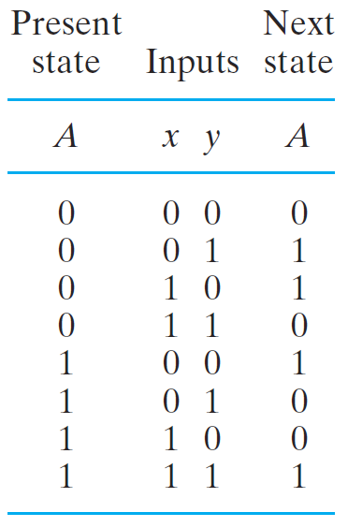
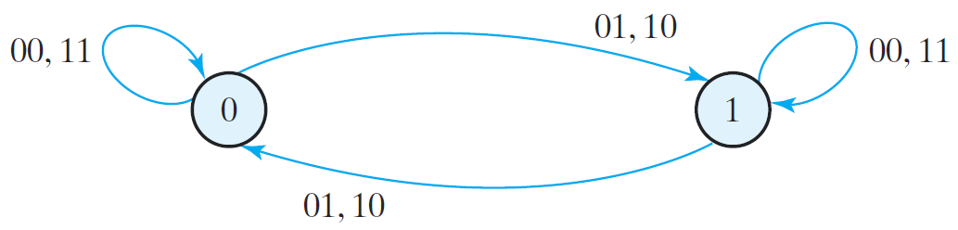
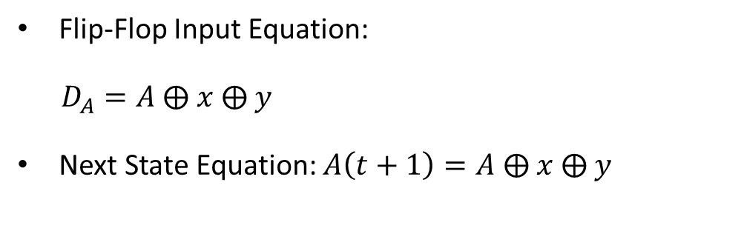
Example with Output = Current State
Flip-Flop Input Equation:
$D_{A}=A$ ⨁ $x$ ⨁ $y$
Next State Equation: $A\left(t+1\right)=A$ ⨁ $x$ ⨁ $y$

Slide 12
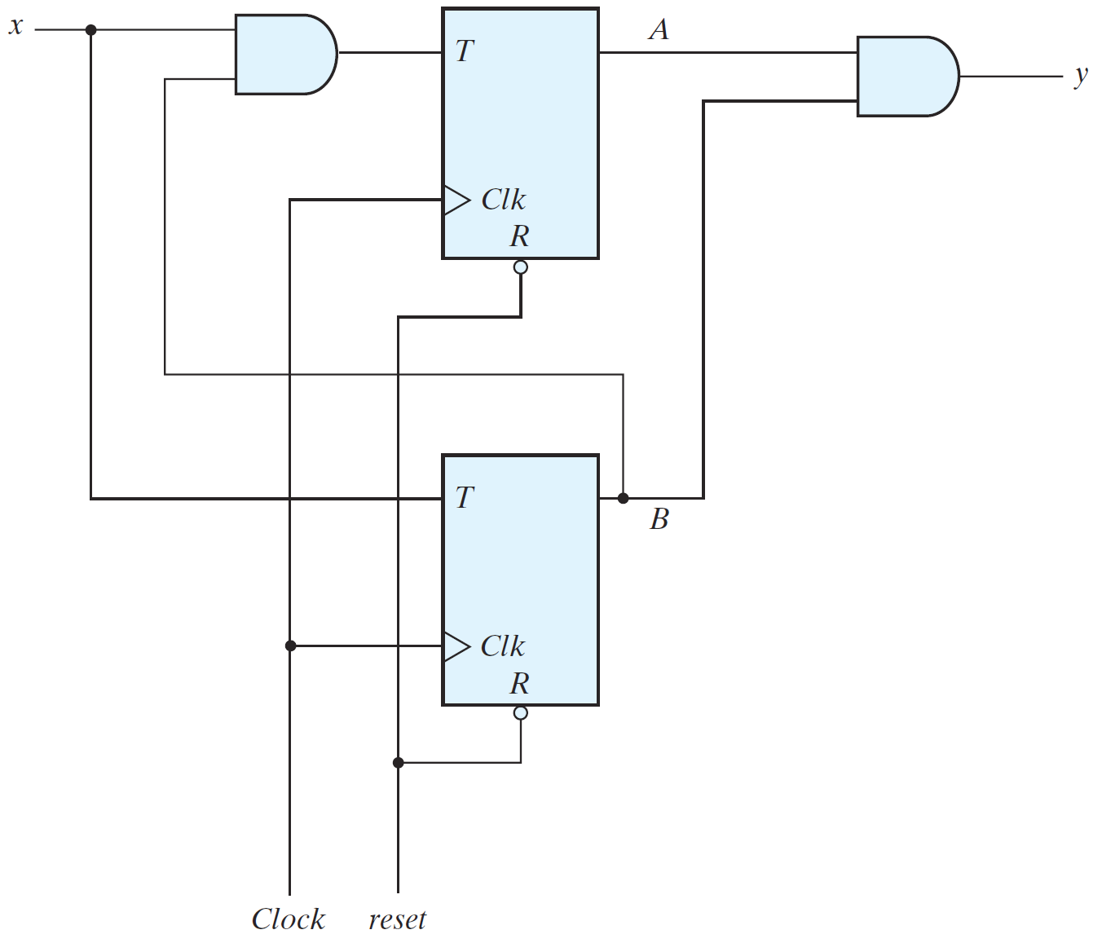

Sequential Circuit with T Flip-Flops
Circuit has two T Flip-Flops
One Input $x$
One output $y$
Two state variables: $A$ and $B$
Obtain the T-FF input equations
Obtain the next state equations
Fill the state table
Draw the state diagram

Slide 13

Recall: Flip-Flop Characteristic Equation
For D Flip-Flop: $Q\left(t+1\right)=D$
For T Flip-Flop: $Q\left(t+1\right)=T$ ⨁ $Q(t)$
For JK Flip-Flop: $Q\left(t+1\right)=J Q^{′}\left(t\right)+K^{′} Q(t)$
These equations define the Next State
D Flip-Flop
D | Q(t+1)
0 | 0 Reset
1 | 1 Set
T Flip-Flop
T | Q(t+1)
0 | Q(t) No change
1 | Q'(t) Complement
JK Flip-Flop
J K | Q(t+1)
0 0 | Q(t) No change
0 1 | 0 Reset
1 0 | 1 Set
1 1 | Q'(t) Complement

Slide 14

Sequential Circuit with T Flip-Flops
T Flip-Flop Input Equations:
$T_{A}=B x$
$T_{B}=x$
Next State Equations:
$A(t+1)=T_{A}$ ⨁ $A=(B x)$ ⨁ $A$
$B(t+1)=T_{B}$ ⨁ $B=x$ ⨁ $B$
Output Equation:
$y=A B$

Slide 15
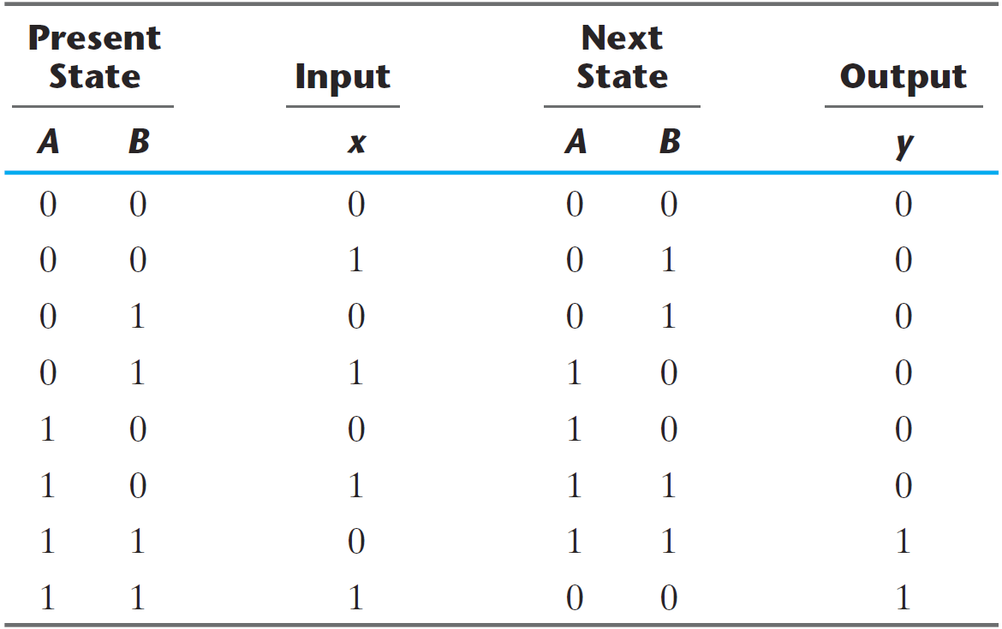
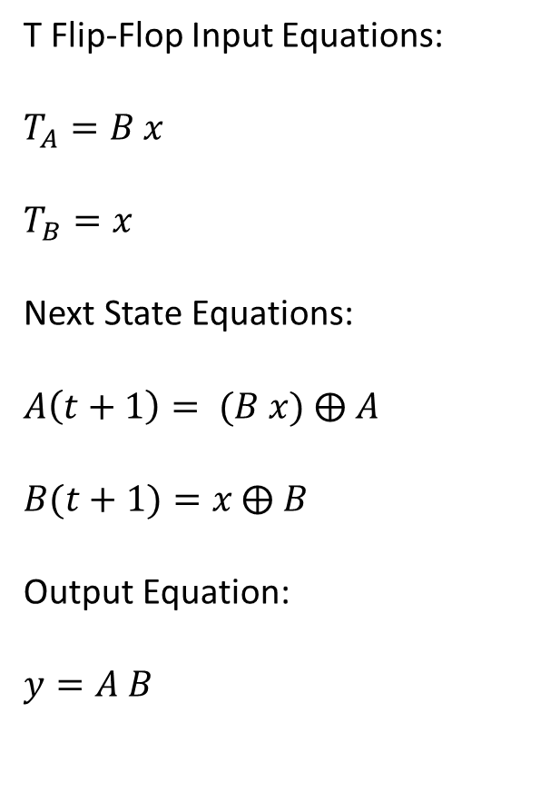
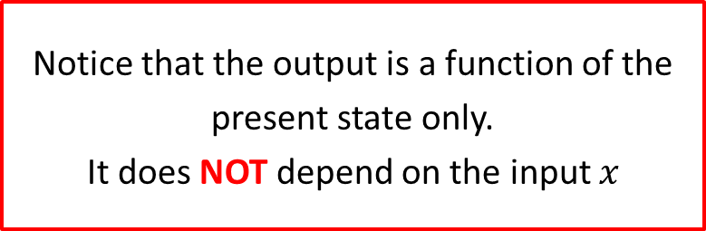
From Next State Equations to State Table
T Flip-Flop Input Equations:
$T_{A}=B x$
$T_{B}=x$
Next State Equations:
$A\left(t+1\right)= (B x)$ ⨁ $A$
$B(t+1)=x$ ⨁ $B$
Output Equation:
$y=A B$
Notice that the output is a function of the present state only.
It does NOT depend on the input $x$

Slide 16
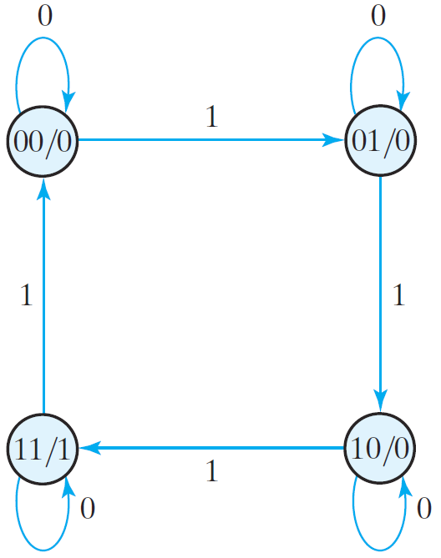
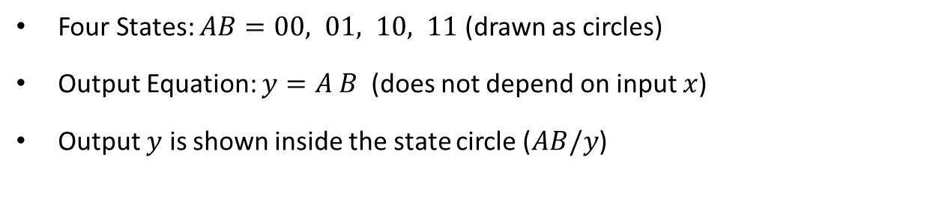
From State Table to State Diagram
Four States: $AB=00, 01, 10, 11$ (drawn as circles)
Output Equation: $y=A B$ (does not depend on input $x$)
Output $y$ is shown inside the state circle ($AB/y$)

Slide 17
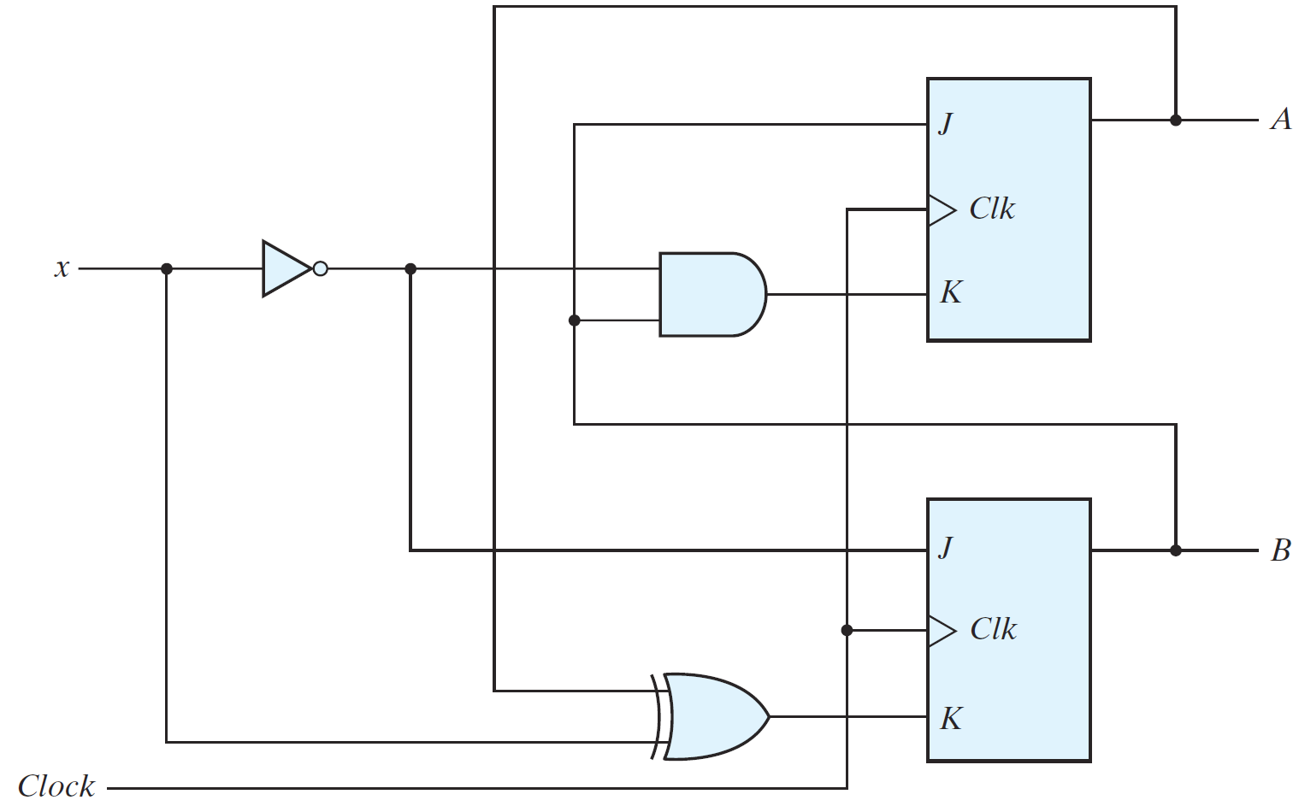

Sequential Circuit with a JK Flip-Flops
One Input $x$ and two state variables: $A$ and $B$ (outputs of Flip-Flops)
No separate output ➔ Output = Current state $A B$
Obtain the JK input equations
Obtain the next state equations
Fill the state table
Draw the state diagram

Slide 18
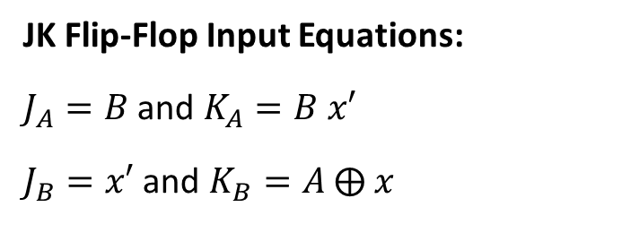
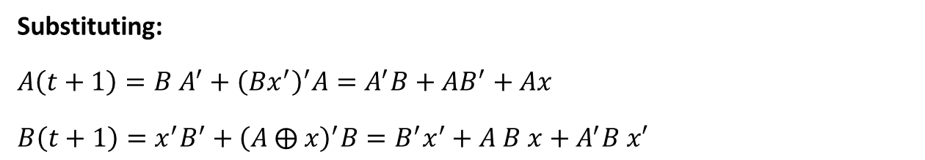
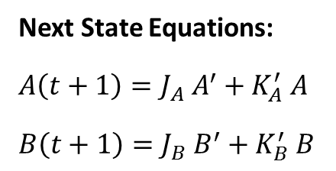
JK Input and Next State Equations
JK Flip-Flop Input Equations:
$J_{A}=B$ and $K_{A}=B x′$
$J_{B}=x′$ and $K_{B}=A$ ⨁ $x$
Next State Equations:
$A\left(t+1\right)=J_{A} A^{′}+K_{A}^{′} A$
$B\left(t+1\right)=J_{B} B^{′}+K_{B}^{′} B$
Substituting:
$A\left(t+1\right)=B A^{′}+{\left(Bx^{′}\right)}^{′}A=A^{′}B+AB^{′}+Ax$
$B\left(t+1\right)=x^{′}B^{′}+{\left(A ⨁ x\right)}^{′}B=B^{′}x^{′}+A B x+A^{′}B x′$

Slide 19
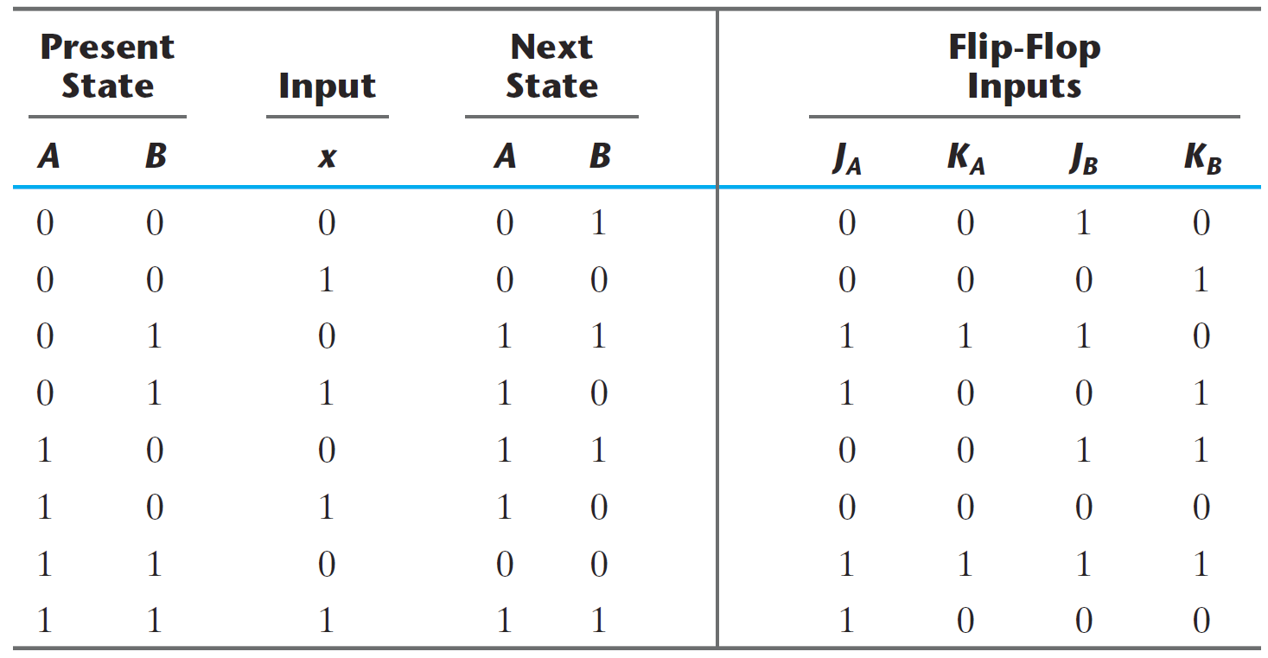
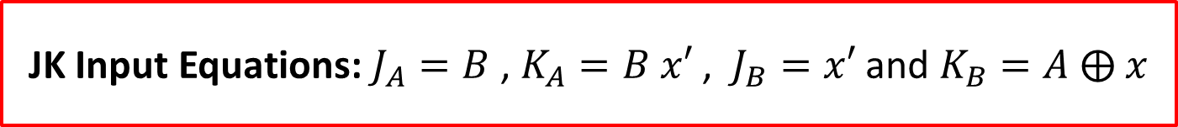
From JK Input Equations to State Table
JK Input Equations: $J_{A}=B$ , $K_{A}=B x′$ , $J_{B}=x′$ and $K_{B}=A$ ⨁ $x$

Slide 20
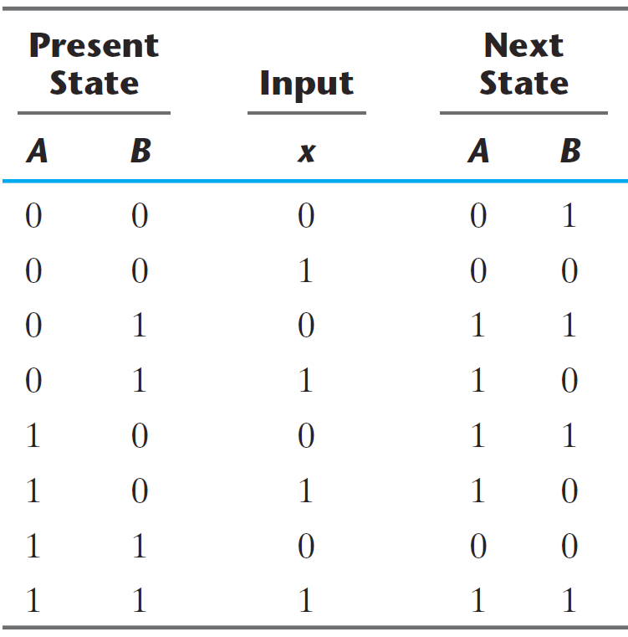
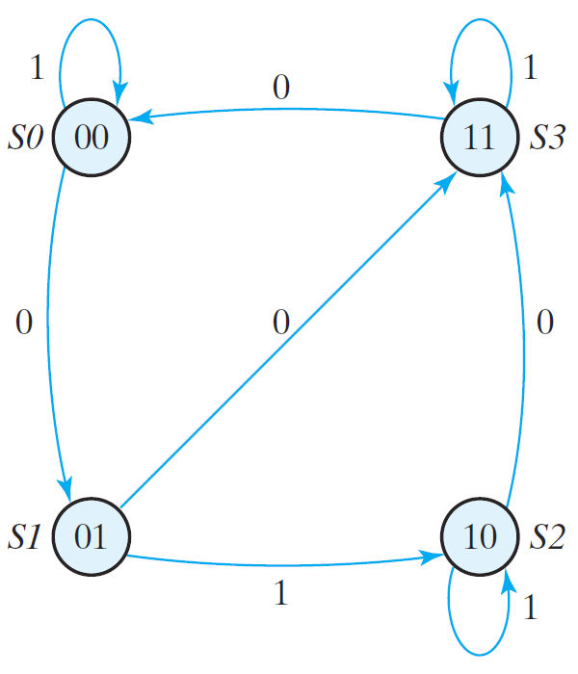

From State Table to State Diagram
Four states: $A B=00, 01, 10, and 11$ (drawn as circles)
Arcs show the input value $x$ on the state transition

