Slide 1
Outline
The Design Procedure
Moore Sequence Detector
Mealy Sequence Detector
Tracing State Diagrams and Verifying Correctness
Sequential Comparator
Binary Counter
Up/Down Counter with Enable

Slide 2
The Design Procedure
Given a Description (or Specification) of the Problem
Obtain a state diagram for the sequential circuit
Assign binary codes to the states and fill the state table
Select the type of Flip-Flops and derive the FF input equations
Derive the output equations
Draw the circuit diagram
Verify the correctness of the final design (verification)

Slide 3
The State Diagram
A state is an abstraction of memory
A state remembers a history of inputs applied to the circuit
Examples:
State S0 represents the fact that the last input is a 0
State S1 represents the fact that the last input is a 1
State S2 represents the fact that the last two-input sequence is "11"
Obtaining the state diagram is the most important step
Requires experience and good understanding of the problem

Slide 4

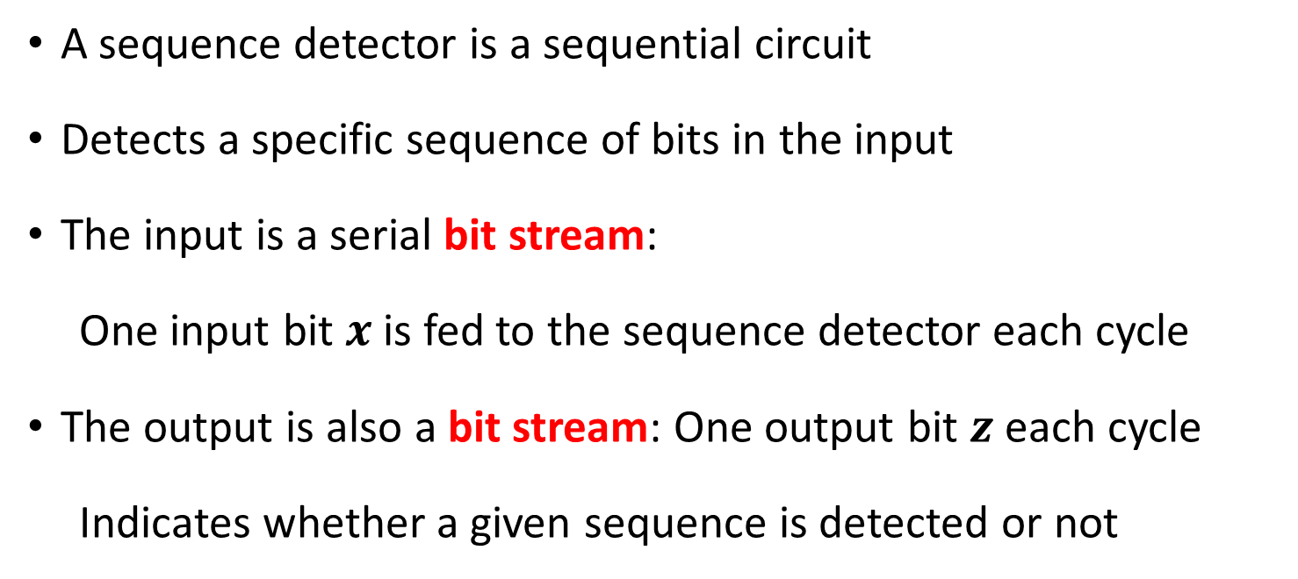


Example: Sequence Detector
A sequence detector is a sequential circuit
Detects a specific sequence of bits in the input
The input is a serial bit stream:
One input bit $x$ is fed to the sequence detector each cycle
The output is also a bit stream: One output bit $z$ each cycle
Indicates whether a given sequence is detected or not
$$x$$
Sequence Detector
$$z$$
$$clk$$

Slide 5
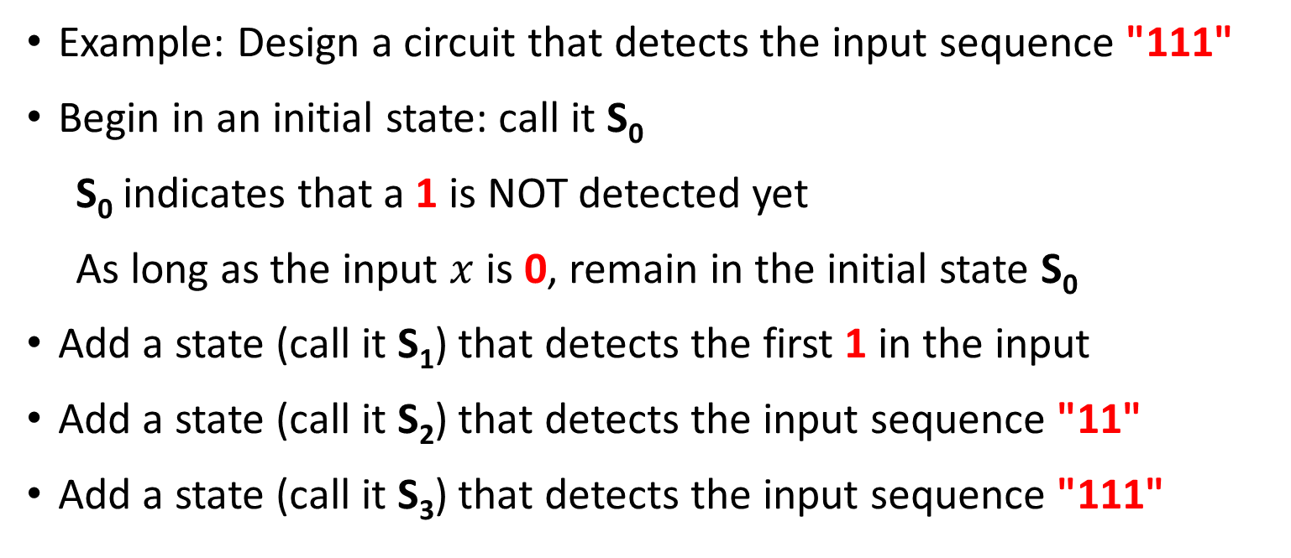
State Diagram for a Sequence Detector
Example: Design a circuit that detects the input sequence "111"
Begin in an initial state: call it S₀
S₀ indicates that a 1 is NOT detected yet
As long as the input $x$ is 0, remain in the initial state S₀
Add a state (call it S₁) that detects the first 1 in the input
Add a state (call it S₂) that detects the input sequence "11"
Add a state (call it S₃) that detects the input sequence "111"
0
S₀
1
S₁
1
S₂
1
S₃

Slide 6
Complete the State Diagram
Moore Design: Assign Output to States
The output in S₀, S₁, and S₂ should be 0
The output in S₃ should be 1
0
0
S₀
0
S₁
0
1
Now complete the state diagram:
Add transitions from S₁, S₂, S₃ back to S₀ if the input is 0
Add transition from S₃ to itself if the input is 1 to detect sequences longer than three 1's
0
0
1
S₃
1
S₂
0
1
1

Slide 7
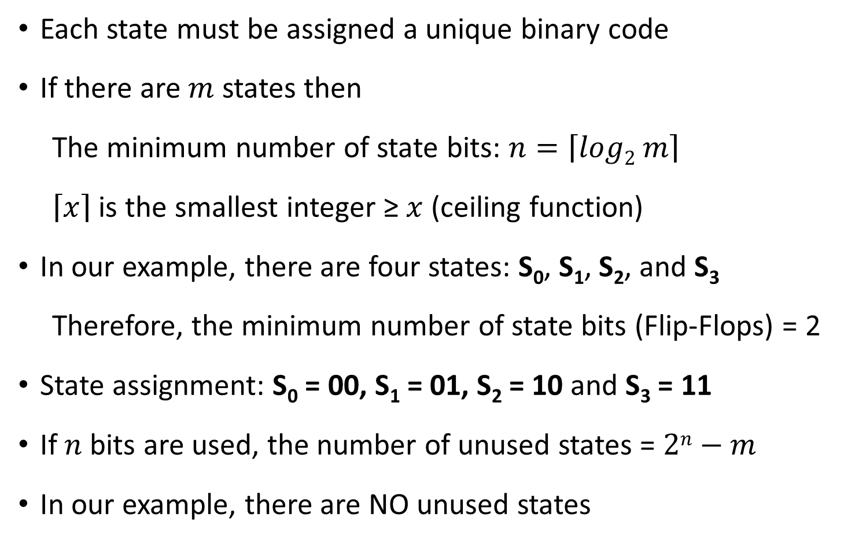
State Assignment
Each state must be assigned a unique binary code
If there are $m$ states then
The minimum number of state bits: $n=\left\lceil log2 m\right\rceil$
$\left\lceil x\right\rceil$ is the smallest integer ≥ $x$ (ceiling function)
In our example, there are four states: S₀, S₁, S₂, and S₃
Therefore, the minimum number of state bits (Flip-Flops) = 2
State assignment: S₀ = 00, S₁ = 01, S₂ = 10 and S₃ = 11
If $n$ bits are used, the number of unused states = $2n−m$
In our example, there are NO unused states

Slide 8
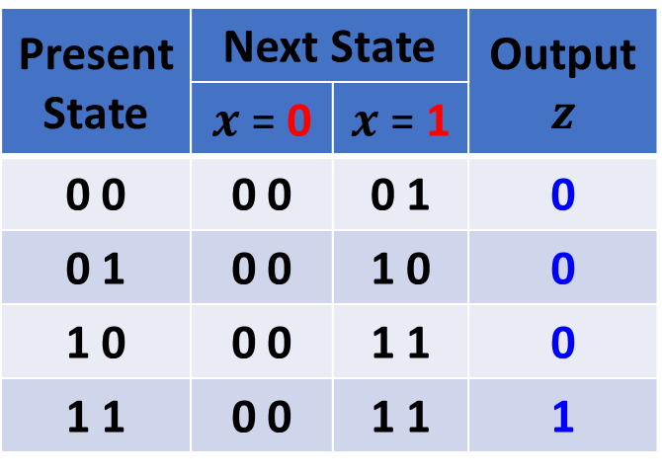
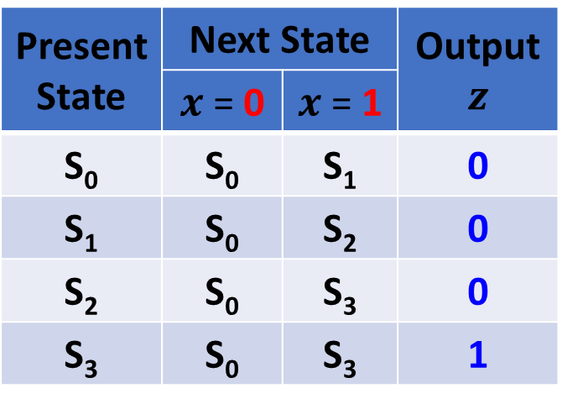
From State Diagram to State Table
0
Present State | Next State |  | Output $$z$$
 | $x$ = 0 | $x$ = 1
S₀ | S₀ | S₁ | 0
S₁ | S₀ | S₂ | 0
S₂ | S₀ | S₃ | 0
S₃ | S₀ | S₃ | 1
0
S₀
0
S₁
0
1
0
0
1
Present State | Next State |  | Output $$z$$
 | $x$ = 0 | $x$ = 1
0 0 | 0 0 | 0 1 | 0
0 1 | 0 0 | 1 0 | 0
1 0 | 0 0 | 1 1 | 0
1 1 | 0 0 | 1 1 | 1
S₃
1
S₂
0
1
State Assignment
S₀ = 00, S₁ = 01
S₂ = 10, S₃ = 11
1

Slide 9


Structure of a Moore Sequence Detector
Next
State
Current
State
$$x$$
Next State
Logic
D Flip
Flops
Output
Logic
$$z$$
clock
In our design examples, only D-type Flip-Flops will be used
They are the simplest to analyze and implement
Next, we need minimal expressions for
Next State Logic
Output Logic

Slide 10

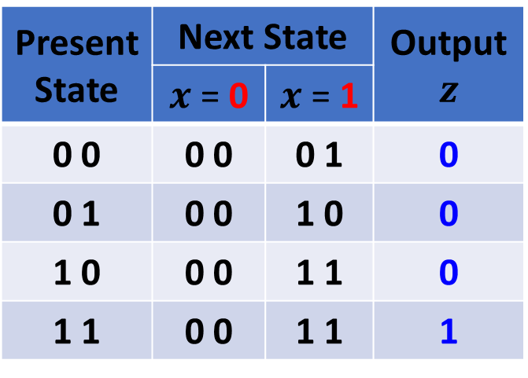

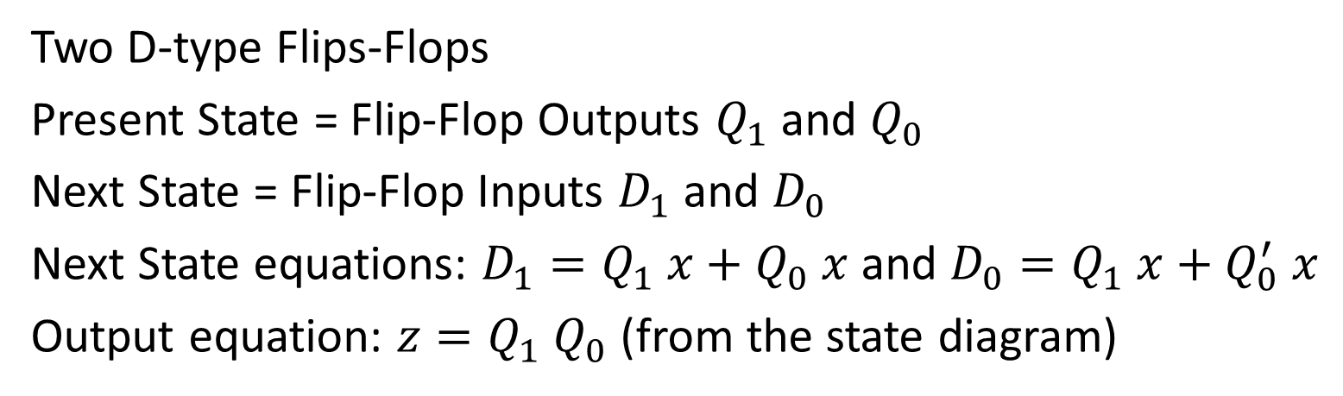






Derive Next State an Output Equations
$$x$$
$$D_{1}$$
$$x$$
$$D_{0}$$
Present State | Next State |  | Output $$z$$
 | $x$ = 0 | $x$ = 1
0 0 | 0 0 | 0 1 | 0
0 1 | 0 0 | 1 0 | 0
1 0 | 0 0 | 1 1 | 0
1 1 | 0 0 | 1 1 | 1
$$Q_{1}Q_{0}$$
0
1
$$Q_{1}Q_{0}$$
0
1
00
0
0
00
0
1
01
0
1
01
0
0
0
1
0
1
11
11
10
0
1
10
0
1
$$Q_{1} x+Q_{0} x$$
$$Q_{1} x+Q_{0}^{′} x$$
Two D-type Flips-Flops
Present State = Flip-Flop Outputs $Q_{1}$ and $Q_{0}$
Next State = Flip-Flop Inputs $D_{1}$ and $D_{0}$
Next State equations: $D_{1}=Q_{1} x+Q_{0} x$ and $D_{0}=Q_{1} x+Q_{0}^{′} x$
Output equation: $z=Q_{1} Q_{0}$ (from the state diagram)

Slide 11
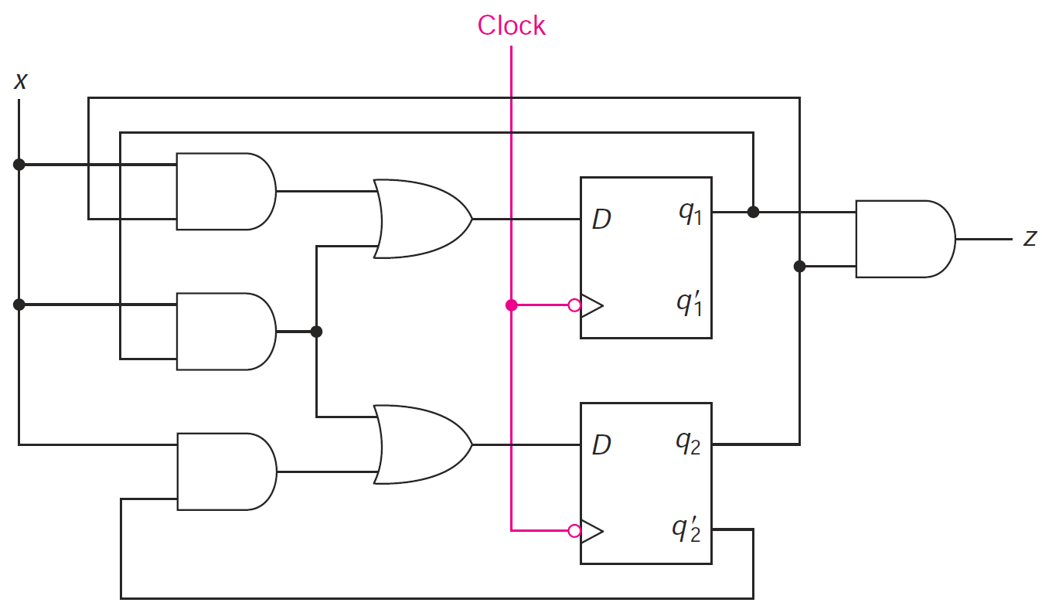







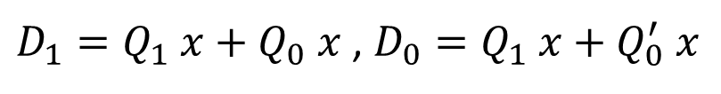
Draw the Moore Sequence Detector Circuit
$D_{1}=Q_{1} x+Q_{0} x$ , $D_{0}=Q_{1} x+Q_{0}^{′} x$
$z=Q_{1} Q_{0}$
Next State Logic
Output
Logic
$$D_{1}$$
$$Q_{1}$$
$$Q_{1}^{′}$$
$$D_{0}$$
$$Q_{0}$$
$$Q_{0}^{′}$$

Slide 12
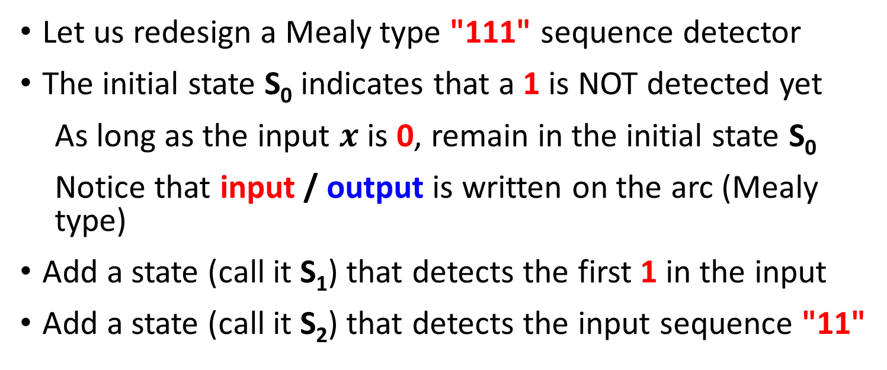
Mealy Type Sequence Detector
Let us redesign a Mealy type "111" sequence detector
The initial state S₀ indicates that a 1 is NOT detected yet
As long as the input $x$ is 0, remain in the initial state S₀
Notice that input / output is written on the arc (Mealy type)
Add a state (call it S₁) that detects the first 1 in the input
Add a state (call it S₂) that detects the input sequence "11"
0 / 0
S₀
S₁
S₂
1 / 0
1 / 0

Slide 13
Complete the Mealy State Diagram
State S₂ is reached after detecting the input sequence "11"
At S₂, if the next input is 1 then the output should be 1
Make a transition from S₂ back to itself labeled 1 / 1
No need for state S₃, because output is on the arc
Now complete the state diagram
Add transitions from S₁ and S₂ back to S₀ when input is 0
0 / 0
0 / 0
1 / 1
Mealy Machines typically use
less states than Moore Machines
0 / 0
S₀
S₁
S₂
1 / 0
1 / 0

Slide 14
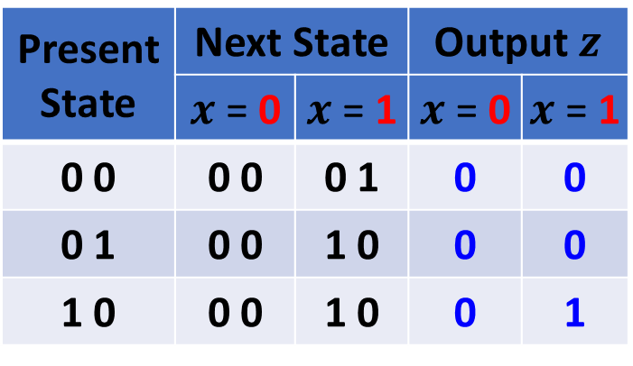
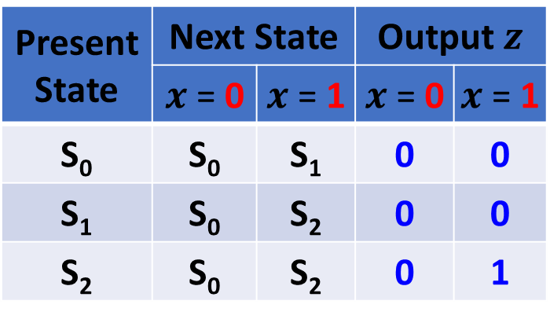
State Assignment and State Table
Three States ➔ Minimum number of state bits (Flip-Flops) = 2
Assign: S₀ = 00, S₁ = 01, and S₂ = 10 (State 11 is Unused)
0 / 0
0 / 0
1 / 1
0 / 0
S₀
S₁
S₂
1 / 0
1 / 0
Present State | Next State |  | Output $z$
 | $x$ = 0 | $x$ = 1 | $x$ = 0 | $x$ = 1
S₀ | S₀ | S₁ | 0 | 0
S₁ | S₀ | S₂ | 0 | 0
S₂ | S₀ | S₂ | 0 | 1
Present State | Next State |  | Output $z$
 | $x$ = 0 | $x$ = 1 | $x$ = 0 | $x$ = 1
0 0 | 0 0 | 0 1 | 0 | 0
0 1 | 0 0 | 1 0 | 0 | 0
1 0 | 0 0 | 1 0 | 0 | 1

Slide 15

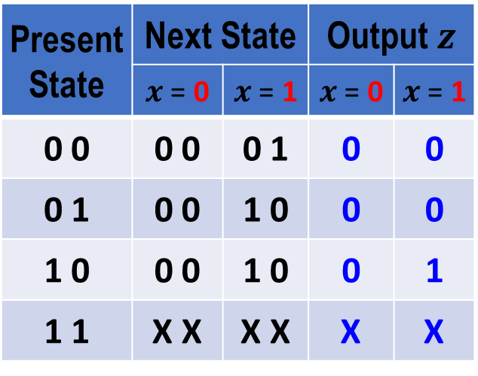


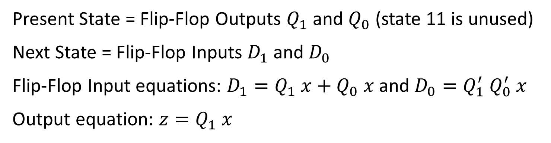






Derive Next State and Output Equations
$$D_{1}$$
$$D_{0}$$
$$z$$
Present State | Next State |  | Output $z$
 | $x$ = 0 | $x$ = 1 | $x$ = 0 | $x$ = 1
0 0 | 0 0 | 0 1 | 0 | 0
0 1 | 0 0 | 1 0 | 0 | 0
1 0 | 0 0 | 1 0 | 0 | 1
1 1 | X X | X X | X | X
$$x$$
$$x$$
$$x$$
$$Q_{1}Q_{0}$$
0
1
$$Q_{1}Q_{0}$$
0
1
$$Q_{1}Q_{0}$$
0
1
00
0
0
00
0
1
00
0
0
01
0
1
01
0
0
01
0
0
X
X
X
X
X
X
11
11
11
10
0
1
10
0
0
10
0
1
$$Q_{1} x+Q_{0} x$$
$$Q_{1}^{′} Q_{0}^{′} x$$
$$Q_{1} x$$
Present State = Flip-Flop Outputs $Q_{1}$ and $Q_{0}$ (state 11 is unused)
Next State = Flip-Flop Inputs $D_{1}$ and $D_{0}$
Flip-Flop Input equations: $D_{1}=Q_{1} x+Q_{0} x$ and $D_{0}=Q_{1}^{′} Q_{0}^{′} x$
Output equation: $z=Q_{1} x$

Slide 16
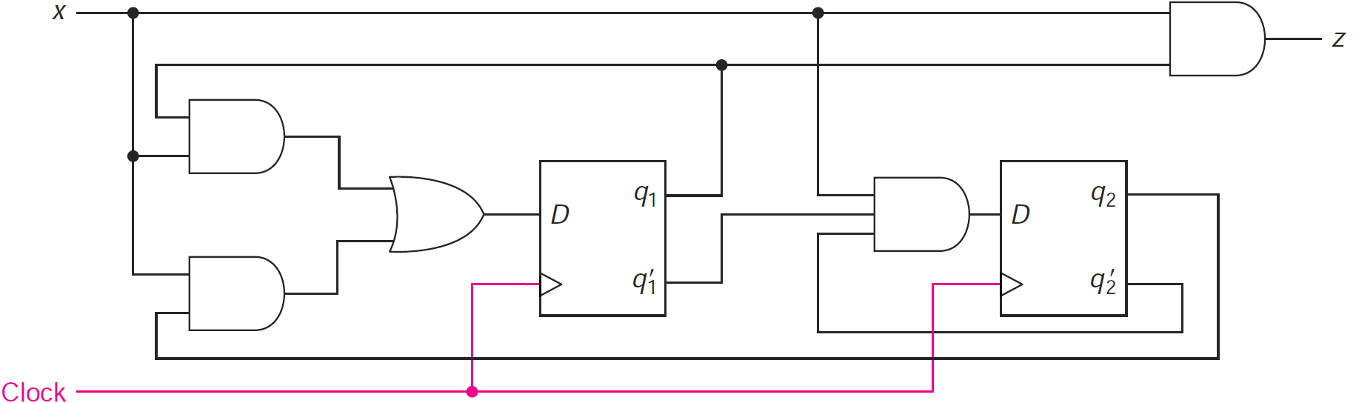









Draw the Mealy Sequence Detector Circuit
$$D_{1}=Q_{1} x+Q_{0} x$$
$$D_{0}=Q_{1}^{′} Q_{0}^{′} x$$
$$z=Q_{1} x$$
Output Logic
Next State
Logic
Next State
Logic
$$Q_{1}$$
$$Q_{0}$$
$$D_{1}$$
$$D_{0}$$
$$Q_{1}^{′}$$
$$Q_{0}^{′}$$
Reset

Slide 17
Mealy versus Moore Sequence Detector
Mealy Sequence Detector
Moore
Sequence
Detector
0 / 0
0 / 0
1 / 1
0
0 / 0
0
S₀
S₁
S₂
S₀
0
S₁
0
1 / 0
1 / 0
1
In general, Moore state diagrams have more states than corresponding Mealy.
The drawback of Mealy is that glitches can appear in the output if the input is not synchronized with the clock.
0
0
1
S₃
1
S₂
0
1
1

Slide 18
Verification
Sequential circuits should be verified by showing that the circuit produces the original state diagram
Verification can be done manually, or with the help of a simulation program
All possible input combinations are applied at each state and the state variables and outputs are observed
A reset input is used to reset the circuit to its initial state
Apply a sequence of inputs to test all the state-input combinations, i.e., all transitions in the state diagram
Observe the output and the next state that appears after each clock edge in the timing diagram

Slide 19
Input Test Sequence
Required to verify the correct operation of a sequential circuit
It should test each state transition of the state diagram
Test sequences can be produced from the state diagram
Consider the Mealy sequence detector, starting at S₀ (reset), we can use an input test sequence to verify all state transitions:
Input test sequence: reset then x = 0, 1, 0, 1, 1, 0, 1, 1, 1, 1
0 / 0
0 / 0
1 / 1
Reset input forces initial state to be S₀
0 / 0
S₀
S₁
S₂
reset
1 / 0
1 / 0

Slide 20
Verifying the Mealy Sequence Detector
0 / 0
0 / 0
1 / 1
0 / 0
S₀
S₁
S₂
reset
1 / 0
1 / 0
Input test sequence: reset then x = 0, 1, 0, 1, 1, 0, 1, 1, 1, 1
cc0
cc1
cc2
cc3
cc4
cc5
cc6
cc7
cc8
cc9
cc10
clock
reset
x
0
1
0
1
1
0
1
1
1
1
Q1
S0
S0
S1
S0
S1
S2
S0
S1
S2
S2
Q0
glitch
z
0
0
0
0
0
0
0
0
1
1

Slide 21






Sequential Comparator
Problem Description:
Design a sequential circuit that compares two numbers A and B
Two Inputs: A and B
A consists of n bits
B consists of n bits
Bit streaming starting at bit 0
Compare A₀ with B₀, A₁ with B₁, etc. (Bit 0 is least significant bit)
A reset signal resets the comparator to its initial state
Reset is required before starting a new comparison
Two outputs: GT (Greater Than) and LT (Less Than)
$$A$$
Sequential
Comparator
$$GT$$
$$B$$
$$LT$$
$$Clock$$
$$Reset$$

Slide 22
Designing the State Diagram
Reset: start initially in state EQ
EQ indicates Equality (output is 00)
Stay in EQ as long as A_{i}B_{i} = 00 or 11
Go to LT if A_{i} < B_{i} (A_{i}B_{i} = 01)
LT indicates Less Than (output is 01)
Go to GT if A_{i} > B_{i} (A_{i}B_{i} = 10)
GT is Greater Than (output is 10)
Complete the state diagram
LT → GT and GT → LT
LT → LT and GT → GT
Moore State Diagram
00, 11
EQ
00
Reset
01
10
01
LT
01
GT
10
10
00, 11, 01
00, 11, 10

Slide 23
State Assignment and State Table
Three States ➔ Two Flip-Flops
D-type Flip-Flops will be used
State Assignment: EQ = 00, LT = 01, GT = 10
Output = Present State (Q₁ and Q₀)
00, 11
EQ
00
Reset
Present State Q₁ Q₀ | Next State (D₁ D₀)
 | A B 0 0 | A B 0 1 | A B 1 0 | A B 1 1
0 0 | 0 0 | 0 1 | 1 0 | 0 0
0 1 | 0 1 | 0 1 | 1 0 | 0 1
1 0 | 1 0 | 0 1 | 1 0 | 1 0
1 1 | X X | X X | X X | X X
01
10
01
LT
01
GT
10
10
00, 11, 01
00, 11, 10

Slide 24
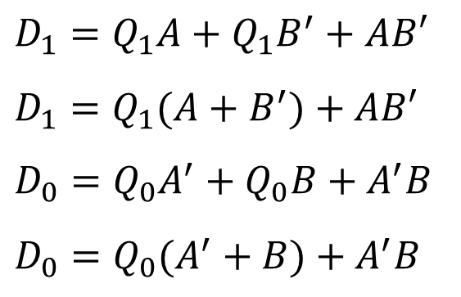






Deriving the Next State Equations
Present State Q₁ Q₀ | Next State (D₁ D₀)
 | A B 0 0 | A B 0 1 | A B 1 0 | A B 1 1
0 0 | 0 0 | 0 1 | 1 0 | 0 0
0 1 | 0 1 | 0 1 | 1 0 | 0 1
1 0 | 1 0 | 0 1 | 1 0 | 1 0
1 1 | X X | X X | X X | X X
State 11 is unused
When present state is 11, don't cares are used to fill the next state.
Output = Present state
$$D_{1}$$
$$D_{0}$$
$$AB$$
$$AB$$
$$Q_{1}Q_{0}$$
00
01
11
10
$$Q_{1}Q_{0}$$
00
01
11
10
$D_{1}=Q_{1}A+Q_{1}B^{′}+AB′$
$D_{1}=Q_{1}(A+B^{′})+AB′$
$D_{0}=Q_{0}A^{′}+Q_{0}B+A^{′}B$
$D_{0}=Q_{0}(A^{′}+B)+A^{′}B$
00
0
0
0
1
00
0
1
0
0
01
0
0
0
1
01
1
1
1
0
11
X
X
X
X
11
X
X
X
X
10
1
0
1
1
10
0
1
0
0

Slide 25












Sequential Comparator Circuit Diagram
$D_{1}=Q_{1}(A+B^{′})+AB′$ $D_{0}=Q_{0}(A^{′}+B)+A^{′}B$
$$A$$
$$D_{1}$$
$$Q_{1}$$
$$GT$$
$$Q_{1}^{′}$$
$$B$$
$$D_{0}$$
$$Q_{0}$$
$$LT$$
$$Clock$$
$$Q_{0}^{′}$$
$$Reset$$

Slide 26
Designing with Unused States
A circuit with n flip-flops has 2^{n} binary states
However, the state diagram may have m states
Therefore, the number of unused states = 2^{n} – m
Unused states do not appear in the state diagram
Sometimes treated as don't cares when simplifying expressions in K-maps
However, it is possible to enter an unused state!
Caused by outside interference or a circuit malfunction
Must specify the output and next state values for unused states
A special (invalid) output can be used to indicate an unused state
A return to a valid state must be possible without reset
Next state for unused states should be specified (NOT don't cares!)

Slide 27
Design of a Binary Counter
Problem Specification:
Design a circuit that counts up from 0 to 7 then back to 0
000 → 001 → 010 → 011 → 100 → 101 → 110 → 111 → 000
When reaching 7, the counter goes back to 0 then goes up again
There is no input to the circuit
The counter is incremented each cycle
The output of the circuit is the present state (count value)
The circuit should be designed using D-type Flip-Flops

Slide 28
Designing the State Diagram
Eight states are needed to store the count values 0 to 7
No input, state transition happens at the edge of each cycle
S0
Three Flip-Flops
are required for
the eight states
S7
S1
S6
S2
Each state is
assigned a unique
binary count value
S5
S3
S4

Slide 29
State Table
Only two columns: Present State and Next State
State changes each cycle
Present State Q₂ Q₁ Q₀ | Next State D₂ D₁ D₀
0 0 0 | 0 0 1
0 0 1 | 0 1 0
0 1 0 | 0 1 1
0 1 1 | 1 0 0
1 0 0 | 1 0 1
1 0 1 | 1 1 0
1 1 0 | 1 1 1
1 1 1 | 0 0 0
000
111
001
110
010
101
011
100

Slide 30



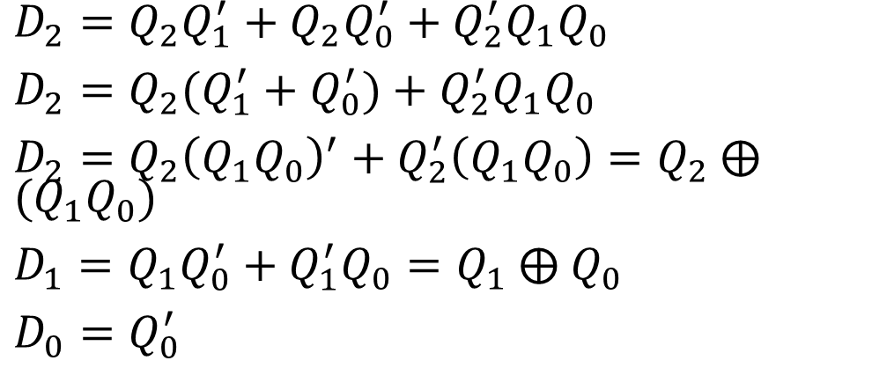






Deriving the Next State Equations
Present State Q₂ Q₁ Q₀ | Next State D₂ D₁ D₀
0 0 0 | 0 0 1
0 0 1 | 0 1 0
0 1 0 | 0 1 1
0 1 1 | 1 0 0
1 0 0 | 1 0 1
1 0 1 | 1 1 0
1 1 0 | 1 1 1
1 1 1 | 0 0 0
$$Q_{0}$$
$$D_{2}$$
$$Q_{0}$$
$$D_{1}$$
$$Q_{0}$$
$$D_{0}$$
$$Q_{2}Q_{1}$$
0
1
$$Q_{2}Q_{1}$$
0
1
$$Q_{2}Q_{1}$$
0
1
00
0
0
00
0
1
00
1
0
01
0
1
01
1
0
01
1
0
1
0
1
0
1
0
11
11
11
10
1
1
10
0
1
10
1
0
$D_{2}=Q_{2}Q_{1}^{′}+Q_{2}Q_{0}^{′}+Q_{2}^{′}Q_{1}Q_{0}$
$D_{2}=Q_{2}(Q_{1}^{′}+Q_{0}^{′})+Q_{2}^{′}Q_{1}Q_{0}$
$D_{2}=Q_{2}{\left(Q_{1}Q_{0}\right)}^{′}+Q_{2}^{′}\left(Q_{1}Q_{0}\right)=Q_{2}$ ⨁ $(Q_{1}Q_{0})$
$D_{1}=Q_{1}Q_{0}^{′}+Q_{1}^{′}Q_{0}=Q_{1} \text{⨁} Q_{0}$
$D_{0}=Q_{0}^{′}$

Slide 31





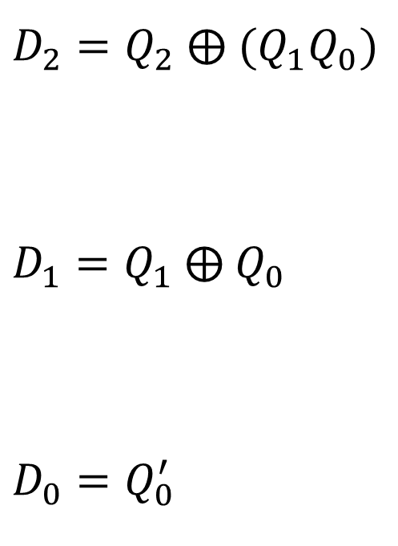








3-Bit Counter Circuit Diagram
$D_{2}=Q_{2}$ ⨁ $(Q_{1}Q_{0})$
$D_{1}=Q_{1} \text{⨁} Q_{0}$
$D_{0}=Q_{0}^{′}$
$$D_{2}$$
$$Q_{2}$$
$$Q_{2}$$
$$Q_{2}^{′}$$
$$D_{1}$$
$$Q_{1}$$
Output = 3-bit Count Value
$$Q_{1}$$
$$Q_{1}^{′}$$
$$D_{0}$$
$$Q_{0}$$
$$Q_{0}$$
$$Clock$$
$$Q_{0}^{′}$$

Slide 32
Up/Down Counter with Enable
Problem Specification:
Design a 2-bit Up / Down counter
Two inputs: E (Enable) and U (Up)
If E = 0 then counter remains in the same state (regardless of U)
If EU = 11 then count up from 0 to 3, then back to 0
If EU = 10 then count down from 3 down to 0, then back to 3
The output of the counter is the present state (count value)
The circuit should be designed using T Flip-Flops
A reset signal resets the counter to its initial state

Slide 33
Designing the State Diagram
Four states are required
to store the count 0 to 3
Count up if EU = 11
Count down if EU = 10
Disable counter if E = 0
Transition to same state if
EU = 00 or 01
Asynchronous reset to
start initially at state S0
E = 0
E = 0
EU = 10
S0
S1
Reset
EU = 11
EU = 10
EU = 11
EU = 11
EU = 10
S3
EU = 11
S2
EU = 10
E = 0
E = 0

Slide 34
State Assignment and State Table
Four States ➔ Two State variables (2 Flip-Flops)
State Assignment: S0 = 00, S1 = 01, S2 = 10, and S3 = 11
E = 0
E = 0
EU = 10
00
01
Present State Q₁ Q₀ | Next State
 | E U 0 0 | E U 0 1 | E U 1 0 | E U 1 1
0 0 | 0 0 | 0 0 | 1 1 | 0 1
0 1 | 0 1 | 0 1 | 0 0 | 1 0
1 0 | 1 0 | 1 0 | 0 1 | 1 1
1 1 | 1 1 | 1 1 | 1 0 | 0 0
Reset
EU = 11
EU = 10
EU = 11
EU = 11
EU = 10
11
EU = 11
10
EU = 10
E = 0
E = 0

Slide 35
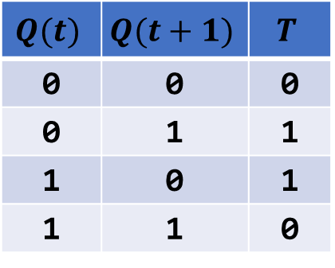
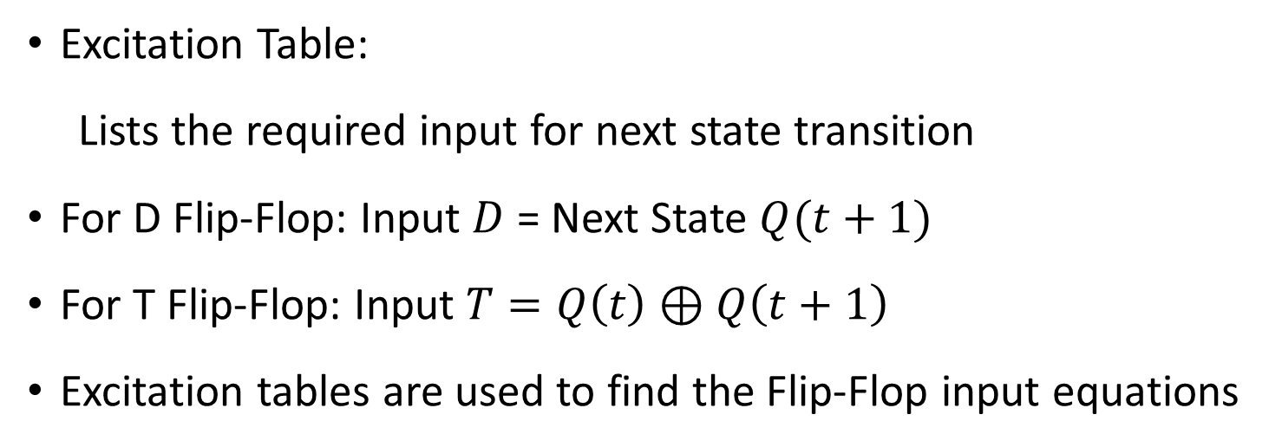
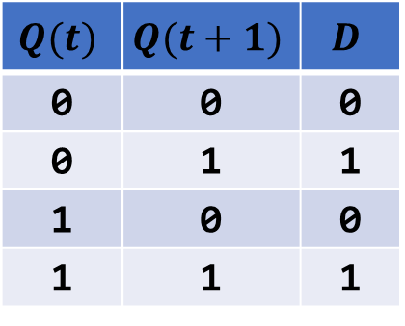
Excitation Table for Flip-Flops
Excitation Table:
Lists the required input for next state transition
For D Flip-Flop: Input $D$ = Next State $Q(t+1)$
For T Flip-Flop: Input $T=Q\left(t\right)⊕Q\left(t+1\right)$
Excitation tables are used to find the Flip-Flop input equations
Excitation Tables for the D and T Flip-Flops
$$Q(t)$$ | $$Q(t+1)$$ | $$D$$
0 | 0 | 0
0 | 1 | 1
1 | 0 | 0
1 | 1 | 1
$$Q(t)$$ | $$Q(t+1)$$ | $$T$$
0 | 0 | 0
0 | 1 | 1
1 | 0 | 1
1 | 1 | 0

Slide 36
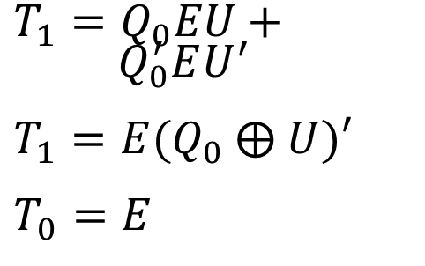





Deriving the T-Flip-Flop Input Equations
Present State Q₁ Q₀ | Next State at (t+1)
 | E U 0 0 | E U 0 1 | E U 1 0 | E U 1 1
0 0 | 0 0 | 0 0 | 1 1 | 0 1
0 1 | 0 1 | 0 1 | 0 0 | 1 0
1 0 | 0 | 1 0 | 0 1 | 1 1
1 1 | 1 | 1 1 | 1 0 | 0 0
Present State Q₁ Q₀ | Flip-Flop Inputs T₁ T₀
 | E U 0 0 | E U 0 1 | E U 1 0 | E U 1 1
0 0 | 0 0 | 0 0 | 1 1 | 0 1
0 1 | 0 0 | 0 0 | 0 1 | 1 1
1 0 | 0 0 | 0 0 | 1 1 | 0 1
1 1 | 0 0 | 0 0 | 0 1 | 1 1
$$T_{1}$$
$$T_{0}$$
$$EU$$
$$EU$$
$$Q_{1}Q_{0}$$
00
01
11
10
$$Q_{1}Q_{0}$$
00
01
11
10
00
0
0
0
1
00
0
0
1
1
$T_{1}=Q_{0}EU+Q_{0}^{′}EU^{′}$
$T_{1}=E(Q_{0} \text{⨁} U)′$
$T_{0}=E$
01
0
0
1
0
01
0
0
1
1
11
0
0
1
0
11
0
0
1
1
10
0
0
0
1
10
0
0
1
1

Slide 37
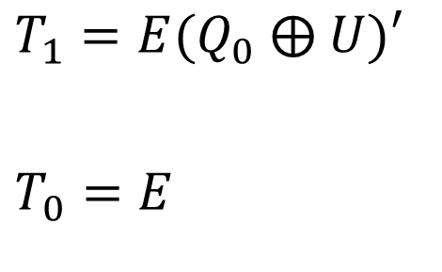







2-bit Up/Down Counter Circuit Diagram
$$U$$
$$T_{1}$$
$$Q_{1}$$
$$Q_{1}$$
$T_{1}=E(Q_{0} \text{⨁} U)′$
$T_{0}=E$
$$Q_{1}^{′}$$
2-bit Count Value
$$E$$
$$T_{0}$$
$$Q_{0}$$
$$Q_{0}$$
$$Clock$$
$$Q_{0}^{′}$$
$$Reset$$

