Slide 1
Boolean Algebra and Logic Gates
Digital Logic Design

Slide 2
Presentation Outline
Boolean Algebra
Boolean Functions and Truth Tables
DeMorgan's Theorem
Algebraic manipulation and expression simplification
Logic gates and logic diagrams
Minterms and Maxterms
Sum-Of-Products and Product-Of-Sums

Slide 3
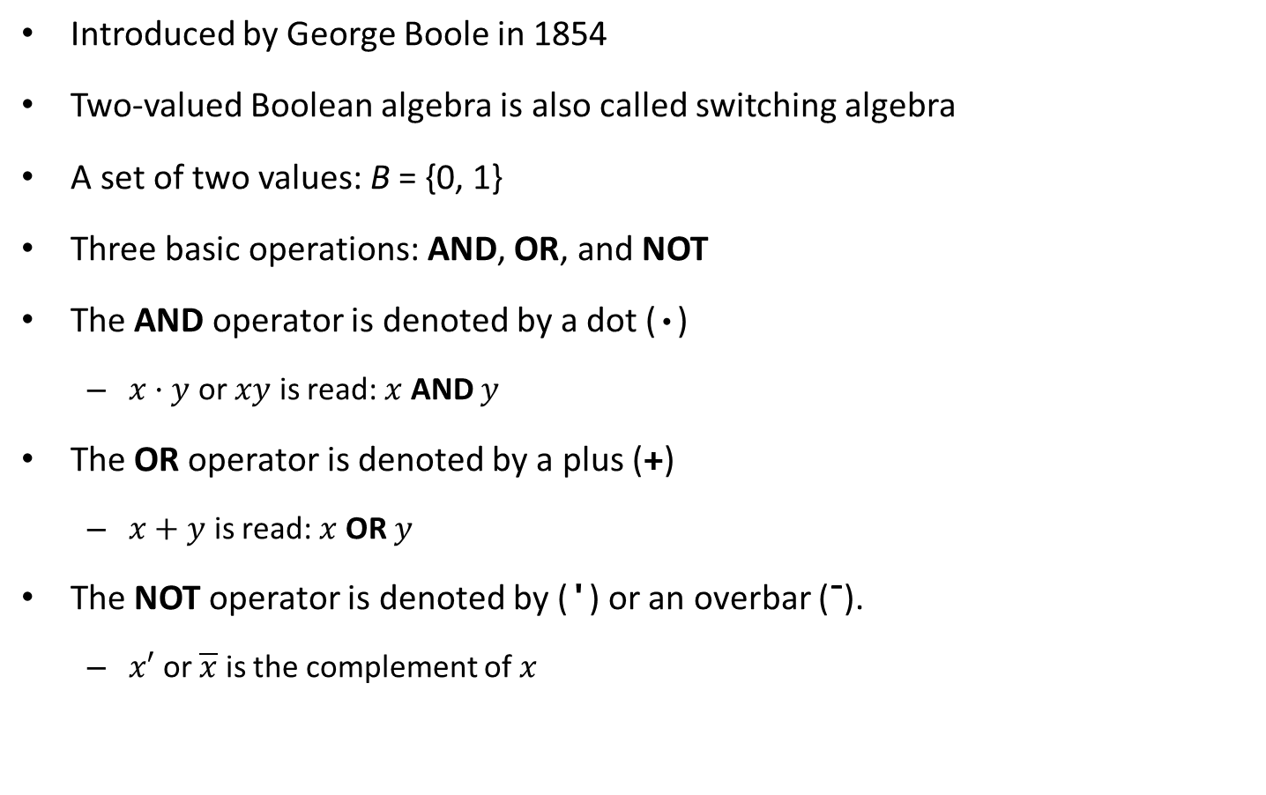
Boolean Algebra
Introduced by George Boole in 1854
Two-valued Boolean algebra is also called switching algebra
A set of two values: B = {0, 1}
Three basic operations: AND, OR, and NOT
The AND operator is denoted by a dot (·)
$x·y$ or $xy$ is read: $x$ AND $y$
The OR operator is denoted by a plus (+)
$x+y$ is read: $x$ OR $y$
The NOT operator is denoted by (') or an overbar (¯).
$x′$ or $\overline{x}$ is the complement of $x$

Slide 4
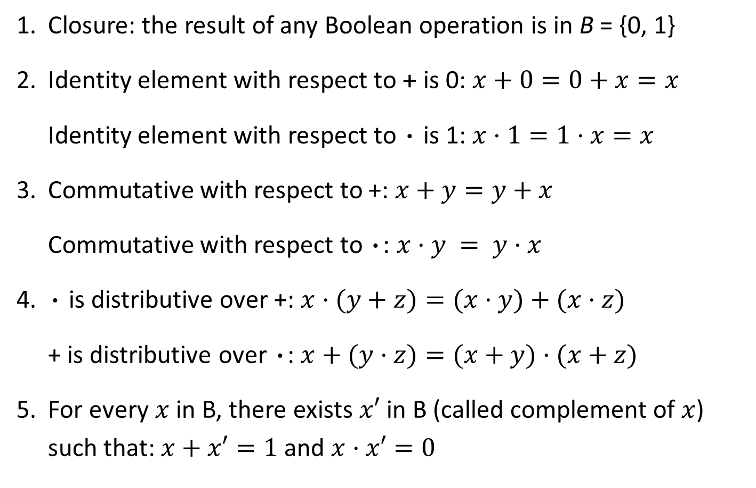
Postulates of Boolean Algebra
1. Closure: the result of any Boolean operation is in B = {0, 1}
2. Identity element with respect to + is 0: $x+0=0+x=x$
Identity element with respect to · is 1: $x·1=1·x=x$
3. Commutative with respect to +: $x+y=y+x$
Commutative with respect to ·: $x·y = y·x$
4. · is distributive over +: $x·(y+z)=(x·y)+(x·z)$
+ is distributive over ·: $x+(y·z)=(x+y)·(x+z)$
5. For every $x$ in B, there exists $x′$ in B (called complement of $x$) such that: $x+x′=1$ and $x·x′=0$

Slide 5
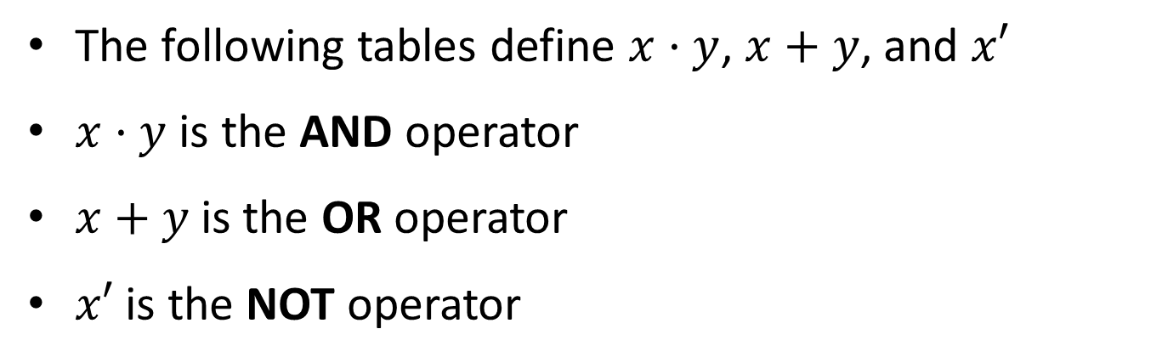
AND, OR, and NOT Operators
The following tables define $x·y$, $x+y$, and $x′$
$x·y$ is the AND operator
$x+y$is the OR operator
$x′$ is the NOT operator
x y | x·y
0 0 | 0
0 1 | 0
1 0 | 0
1 1 | 1
x y | x+y
0 0 | 0
0 1 | 1
1 0 | 1
1 1 | 1
x | x'
0 | 1
1 | 0

Slide 6
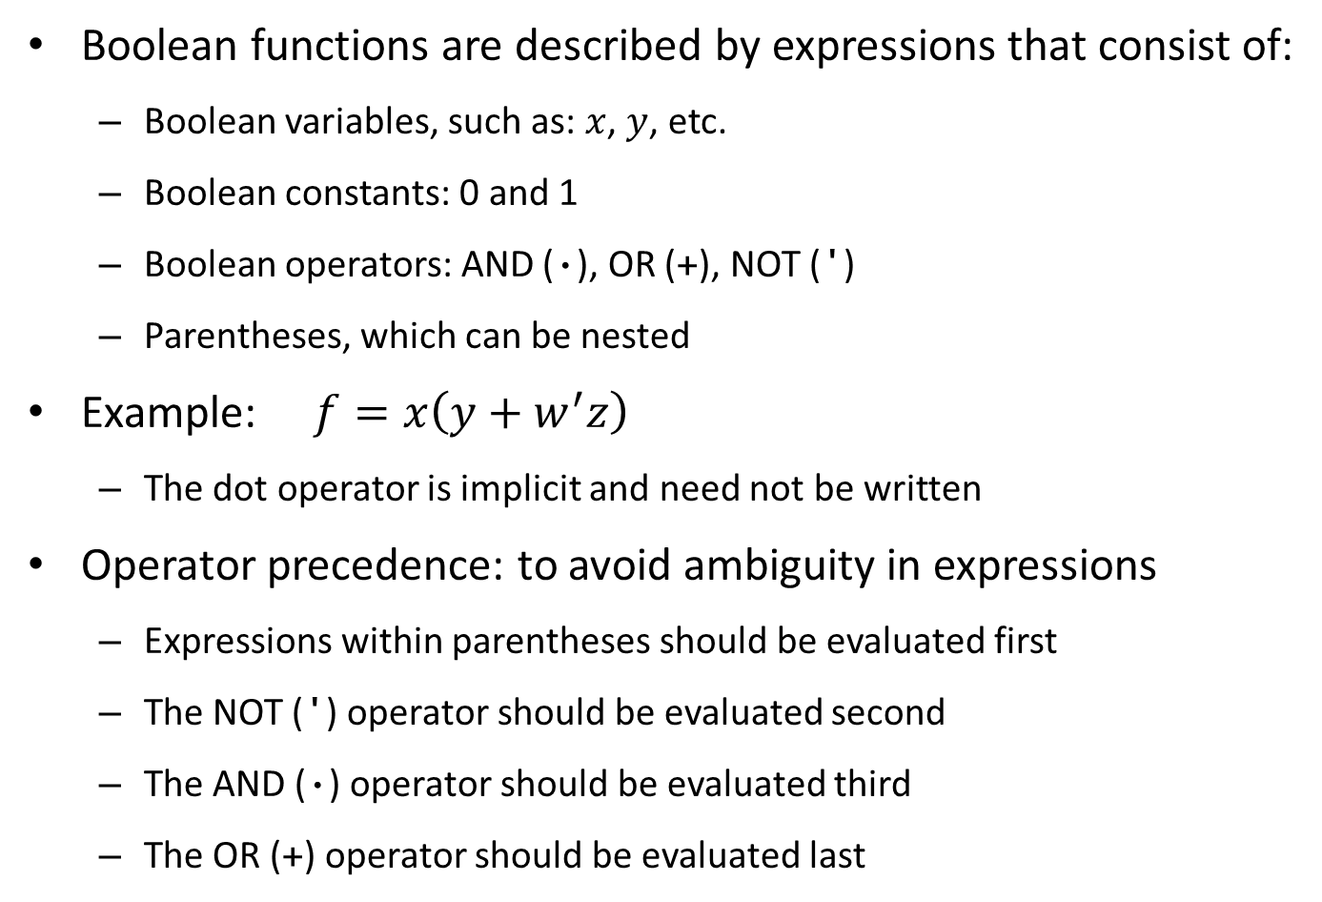
Boolean Functions
Boolean functions are described by expressions that consist of:
Boolean variables, such as: $x$, $y$, etc.
Boolean constants: 0 and 1
Boolean operators: AND (·), OR (+), NOT (')
Parentheses, which can be nested
Example: $f=x\left(y+w^{′}z\right)$
The dot operator is implicit and need not be written
Operator precedence: to avoid ambiguity in expressions
Expressions within parentheses should be evaluated first
The NOT (') operator should be evaluated second
The AND (·) operator should be evaluated third
The OR (+) operator should be evaluated last

Slide 7
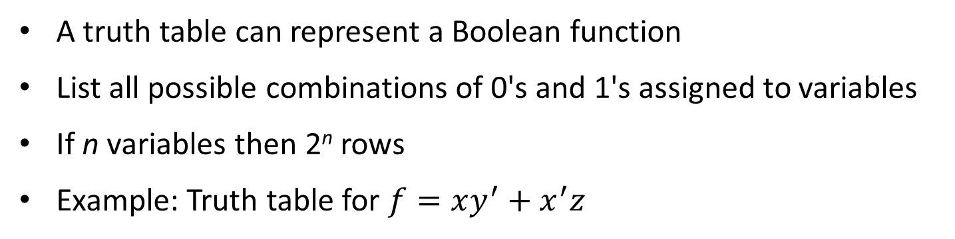
Truth Table
A truth table can represent a Boolean function
List all possible combinations of 0's and 1's assigned to variables
If n variables then 2^{n} rows
Example: Truth table for $f=xy^{′}+x^{′}z$
x y z | y' | xy' | x' | x'z | f = xy'+ x'z
0 0 0 | 1 | 0 | 1 | 0 | 0
0 0 1 | 1 | 0 | 1 | 1 | 1
0 1 0 | 0 | 0 | 1 | 0 | 0
0 1 1 | 0 | 0 | 1 | 1 | 1
1 0 0 | 1 | 1 | 0 | 0 | 1
1 0 1 | 1 | 1 | 0 | 0 | 1
1 1 0 | 0 | 0 | 0 | 0 | 0
1 1 1 | 0 | 0 | 0 | 0 | 0

Slide 8
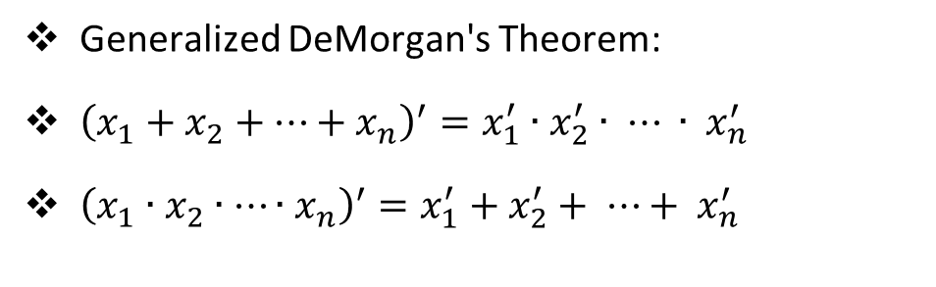
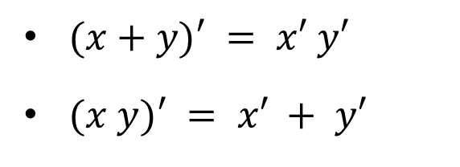
DeMorgan's Theorem
$(x+y)′ = x′ y′$
$(x y)′ = x′ + y′$
Can be verified
Using a Truth Table
x | y | x' | y' | x+y | (x+y)' | x'y' | x y | (x y)' | x'+ y'
0 | 0 | 1 | 1 | 0 | 1 | 1 | 0 | 1 | 1
0 | 1 | 1 | 0 | 1 | 0 | 0 | 0 | 1 | 1
1 | 0 | 0 | 1 | 1 | 0 | 0 | 0 | 1 | 1
1 | 1 | 0 | 0 | 1 | 0 | 0 | 1 | 0 | 0
Identical
Identical
Generalized DeMorgan's Theorem:
${\left(x_{1}+x_{2}+…+x_{n}\right)}^{′}=x_{1}^{′}∙x_{2}^{′}∙ ⋯ ∙ x_{n}^{′}$
${\left(x_{1}∙x_{2}∙…∙x_{n}\right)}^{′}=x_{1}^{′}+x_{2}^{′}+ ⋯+ x_{n}^{′}$

Slide 9
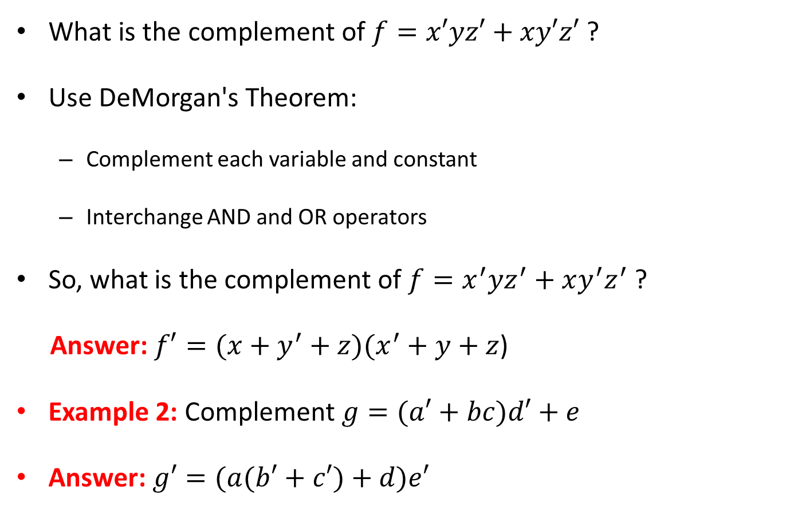
Complementing Boolean Functions
What is the complement of $f=x′yz′+xy′z′$ ?
Use DeMorgan's Theorem:
Complement each variable and constant
Interchange AND and OR operators
So, what is the complement of $f=x^{′}yz^{′}+xy^{′}z^{′}$ ?
Answer: $f′=(x+y^{′}+z)(x^{′}+y+z$)
Example 2: Complement $g=(a′+bc)d′+e$
Answer: $g′=(a(b′+c′)+d)e′$

Slide 10
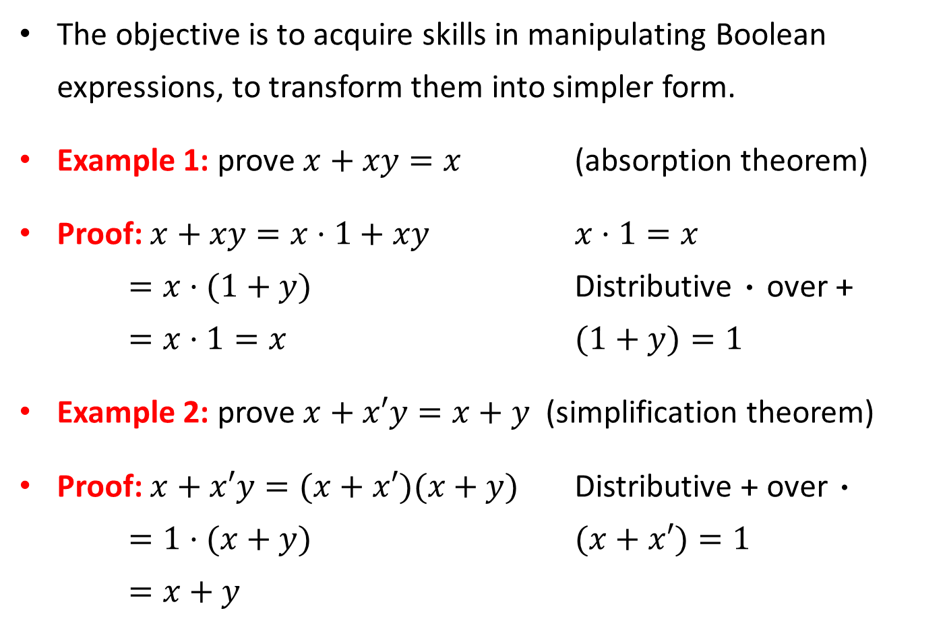
Algebraic Manipulation of Expressions
The objective is to acquire skills in manipulating Boolean expressions, to transform them into simpler form.
Example 1: prove $x+xy=x$ (absorption theorem)
Proof: $x+xy=x·1+xy$ $x·1=x$
$=x·(1+y)$ Distributive · over +
$=x·1=x$ $(1+y)=1$
Example 2: prove $x+x′y=x+y$ (simplification theorem)
Proof: $x+x′y=(x+x′)(x+y)$ Distributive + over ·
$=1·(x+y)$ $(x+x′)=1$
$=x+y$

Slide 11
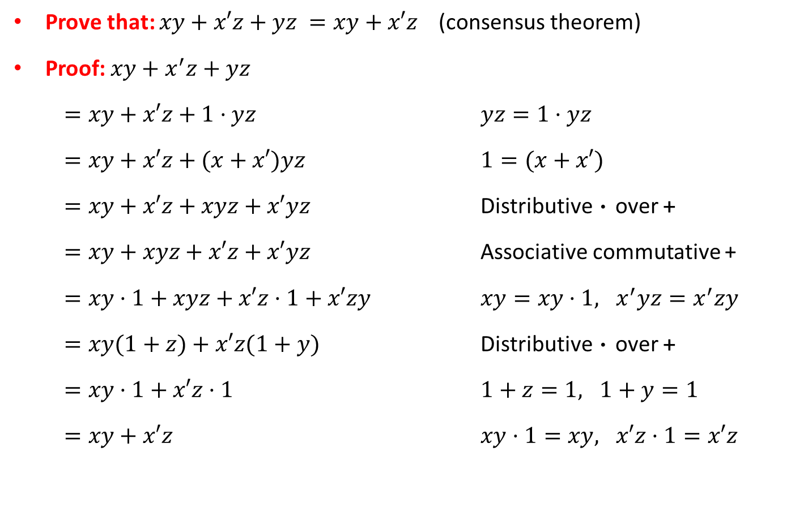
Consensus Theorem
Prove that: $xy+x′z+yz =xy+x′z$ (consensus theorem)
Proof: $xy+x^{′}z+yz$
$=xy+x′z+1·yz$ $yz=1·yz$
$=xy+x′z+(x+x′)yz$ $1=(x+x′)$
$=xy+x′z+xyz+x′yz$ Distributive · over +
$=xy+xyz+x′z+x′yz$ Associative commutative +
$=xy·1+xyz+x′z·1+x′zy$ $xy=xy·1, x^{′}yz=x^{′}zy$
$=xy(1+z)+x′z(1+y)$ Distributive · over +
$=xy·1+x′z·1$ $1+z=1, 1+y=1$
$=xy+x′z$ $xy·1=xy, x′z·1=x′z$

Slide 12
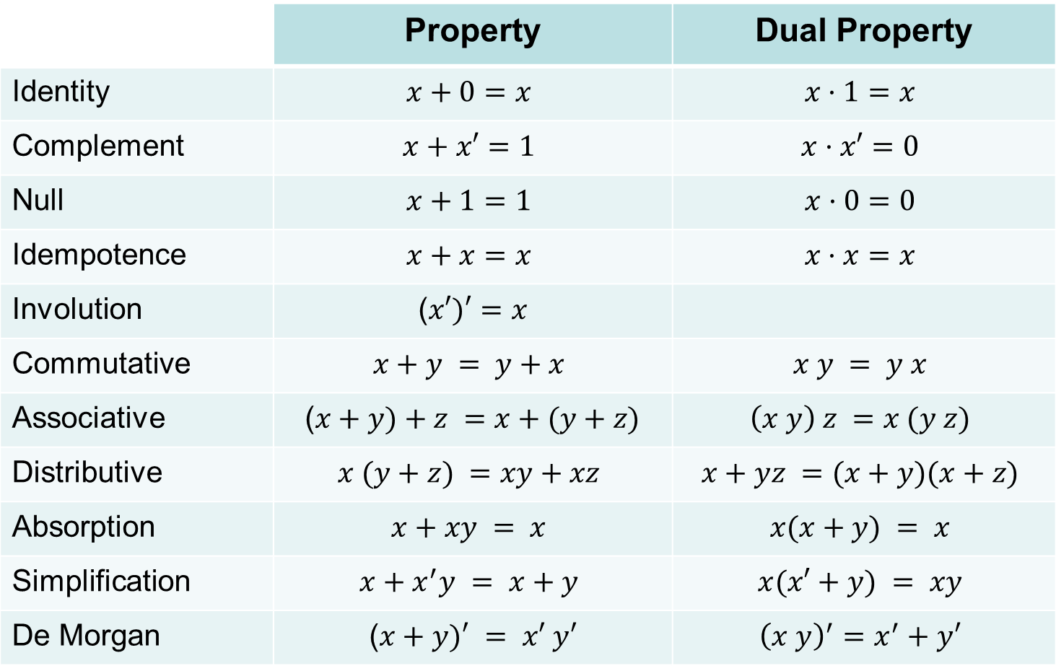
Summary of Boolean Algebra
 | Property | Dual Property
Identity | $$x+0=x$$ | $$x·1=x$$
Complement | $$x+x′=1$$ | $$x·x′=0$$
Null | $$x+1=1$$ | $$x·0=0$$
Idempotence | $$x+x=x$$ | $$x·x=x$$
Involution | ($x′)′=x$
Commutative | $$x+y = y+x$$ | $$x y = y x$$
Associative | ($x+y)+z =x+(y+z)$ | $$\left(x y\right) z =x (y z)$$
Distributive | $$x (y+z) =xy+xz$$ | $$x+yz =(x+y)(x+z)$$
Absorption | $$x+xy = x$$ | $$x(x+y) = x$$
Simplification | $$x+x^{′}y = x+y$$ | $$x(x′+y) = xy$$
De Morgan | ($x+y)′ = x′ y′$ | $${\left(x y\right)}^{′}=x^{′}+y′$$

Slide 13
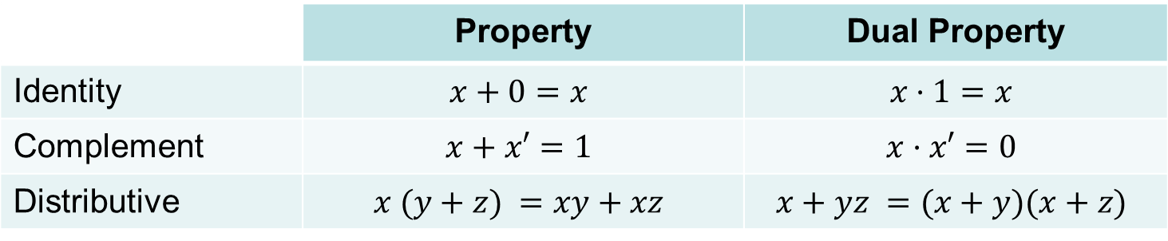
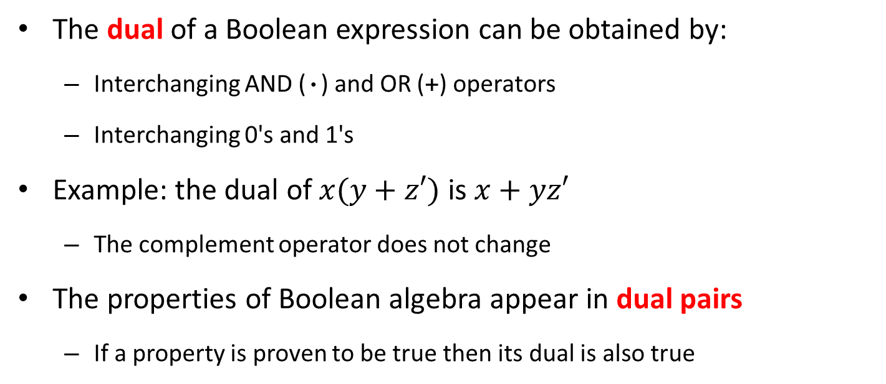
Duality Principle
The dual of a Boolean expression can be obtained by:
Interchanging AND (·) and OR (+) operators
Interchanging 0's and 1's
Example: the dual of $x(y+z′)$ is $x+yz′$
The complement operator does not change
The properties of Boolean algebra appear in dual pairs
If a property is proven to be true then its dual is also true
 | Property | Dual Property
Identity | $$x+0=x$$ | $$x·1=x$$
Complement | $$x+x′=1$$ | $$x·x′=0$$
Distributive | $$x (y+z) =xy+xz$$ | $$x+yz =(x+y)(x+z)$$

Slide 14
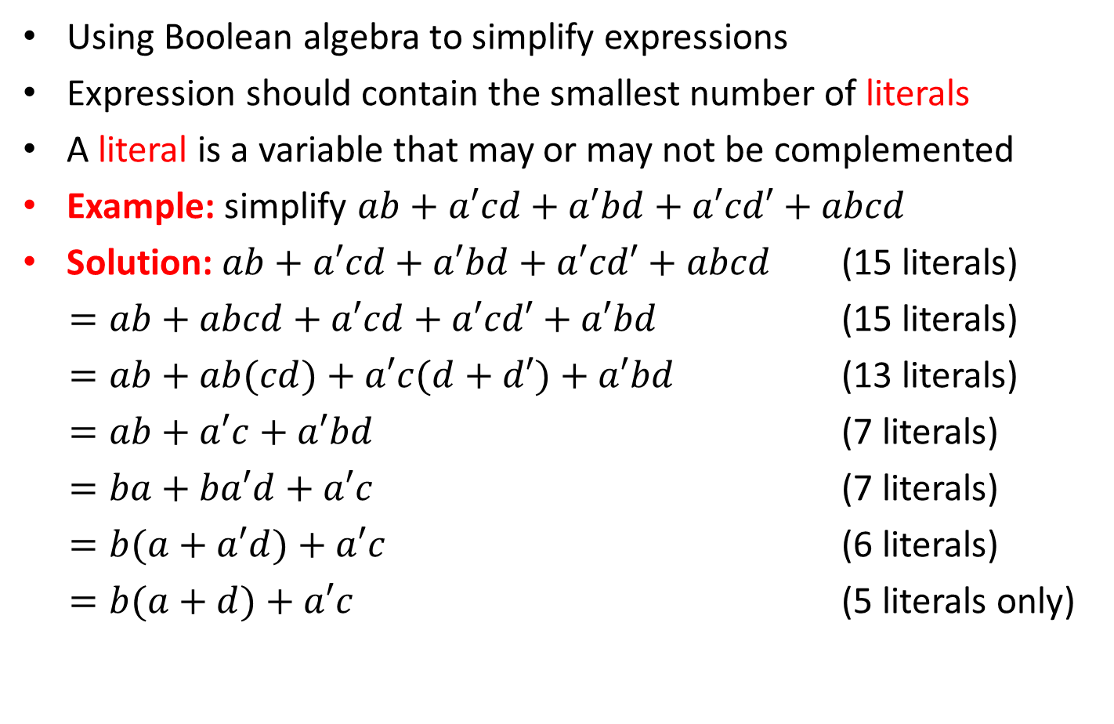
Expression Simplification
Using Boolean algebra to simplify expressions
Expression should contain the smallest number of literals
A literal is a variable that may or may not be complemented
Example: simplify $ab+a′cd+a′bd+a′cd′+abcd$
Solution: $ab+a′cd+a′bd+a′cd′+abcd$ (15 literals)
$=ab+abcd+a′cd+a′cd′+a′bd$ (15 literals)
$=ab+ab(cd)+a′c(d+d′)+a′bd$ (13 literals)
$=ab+a′c+a′bd$ (7 literals)
$=ba+ba′d+a′c$ (7 literals)
$=b(a+a′d)+a′c$ (6 literals)
$=b(a+d)+a′c$ (5 literals only)

Slide 15
Importance of Boolean Algebra
Our objective is to learn how to design digital circuits
These circuits use signals with two possible values
Logic 0 is a low voltage signal (around 0 volts)
Logic 1 is a high voltage signal (e.g. 5 or 3.3 volts)
The physical value of a signal is the actual voltage it carries, while its logic value is either 0 (low) or 1 (high)
Having only two logic values (0 and 1) simplifies the implementation of the digital circuit

Slide 16
Next . . .
Boolean Algebra
Boolean Functions and Truth Tables
DeMorgan's Theorem
Algebraic manipulation and expression simplification
Logic gates and logic diagrams
Minterms and Maxterms
Sum-Of-Products and Product-Of-Sums

Slide 17













Logic Gates and Symbols
$$x$$
$$x$$
$$x·y$$
$$x+y$$
$$x$$
$$x′$$
$$y$$
$$y$$
AND gate
OR gate
NOT gate (inverter)
$$x$$
$$x$$
$$y$$
$$x′$$
$$y$$
AND: Switches in series
logic 0 is open switch
OR: Switches in parallel
logic 0 is open switch
NOT: Switch is normally
closed when x is 0
In the earliest computers, relays were used as mechanical switches controlled by electricity (coils)
Today, tiny transistors are used as electronic switches that implement the logic gates (CMOS technology)

Slide 18
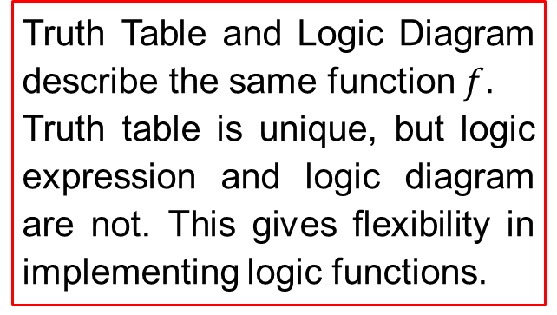





Truth Table and Logic Diagram
Given the following logic function: $f=x(y′+z)$
Draw the corresponding truth table and logic diagram
Truth Table
Logic Diagram
x y z | y'+ z | f = x(y'+ z)
0 0 0 | 1 | 0
0 0 1 | 1 | 0
0 1 0 | 0 | 0
0 1 1 | 1 | 0
1 0 0 | 1 | 1
1 0 1 | 1 | 1
1 1 0 | 0 | 0
1 1 1 | 1 | 1
$$x$$
$$f=x(y^{′}+z)$$
$$y$$
$$z$$
Truth Table and Logic Diagram describe the same function $f$.
Truth table is unique, but logic expression and logic diagram are not. This gives flexibility in implementing logic functions.

Slide 19

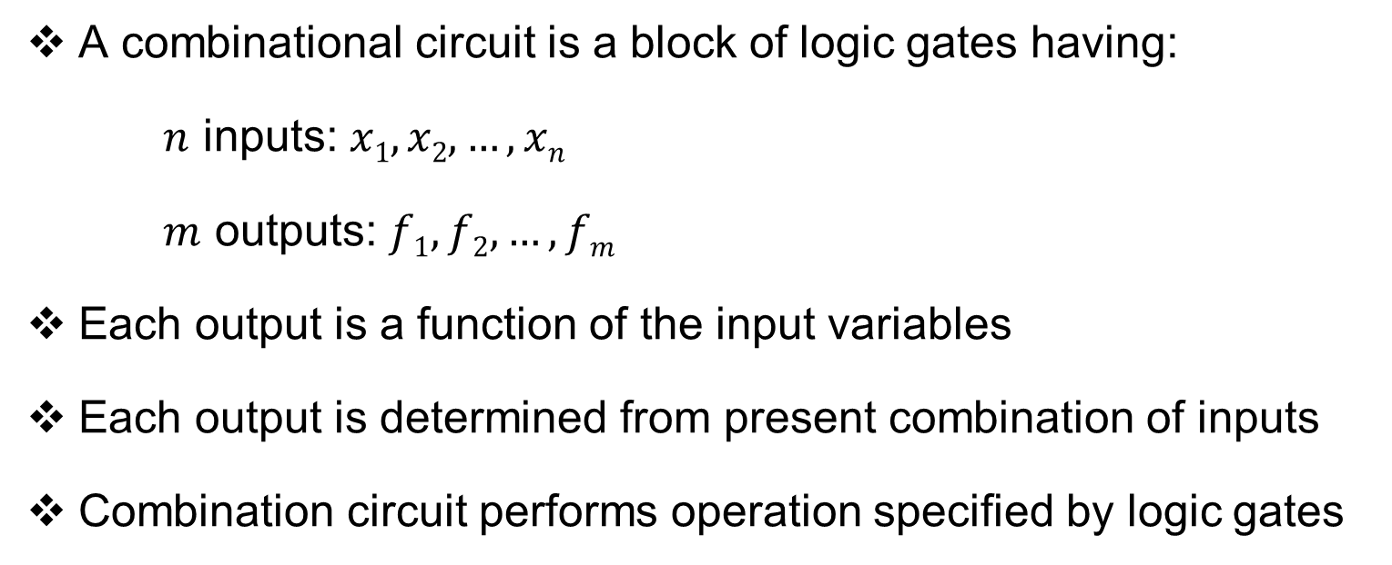

Combinational Circuit
A combinational circuit is a block of logic gates having:
$n$ inputs: $x1, x2, …, xn$
$m$ outputs: $f1, f2, …, fm$
Each output is a function of the input variables
Each output is determined from present combination of inputs
Combination circuit performs operation specified by logic gates
Combinational
Circuit
$n$ inputs
…
…
$m$ outputs

Slide 20


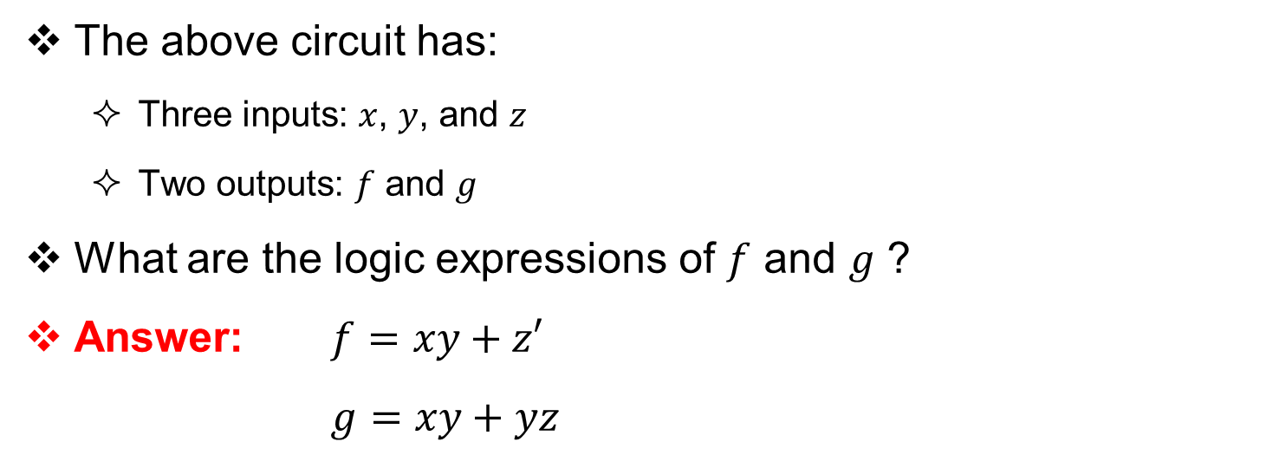



Example of a Simple Combinational Circuit
$$x$$
$$y$$
$$f$$
$$z$$
$$g$$
The above circuit has:
Three inputs: $x$, $y$, and $z$
Two outputs: $f$ and $g$
What are the logic expressions of $f$ and $g$ ?
Answer: $f=xy+z′$
$g=xy+yz$

Slide 21
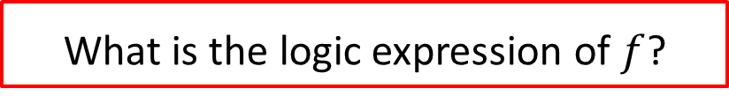
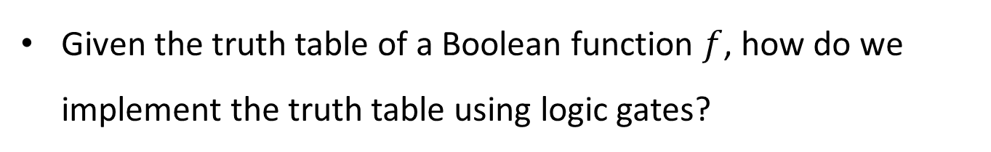
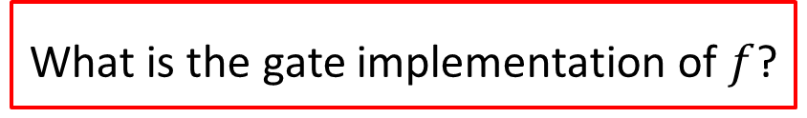
From Truth Tables to Gate Implementation
Given the truth table of a Boolean function $f$, how do we implement the truth table using logic gates?
Truth Table
x y z | f
0 0 0 | 0
0 0 1 | 0
0 1 0 | 1
0 1 1 | 1
1 0 0 | 0
1 0 1 | 1
1 1 0 | 0
1 1 1 | 1
What is the logic expression of $f$?
What is the gate implementation of $f$?
To answer these questions, we need to define Minterms and Maxterms

Slide 22
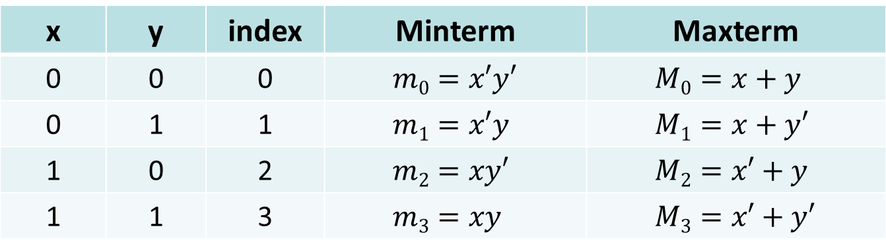

Minterms and Maxterms
Minterms are AND terms with every variable present in either true or complement form
Maxterms are OR terms with every variable present in either true or complement form
Minterms and Maxterms for 2 variables $x$ and $y$
For n variables, there are 2^{n} Minterms and Maxterms
x | y | index | Minterm | Maxterm
0 | 0 | 0 | $$m0=x′y′$$ | $$M0=x+y$$
0 | 1 | 1 | $$m1=x′y$$ | $$M1=x+y′$$
1 | 0 | 2 | $$m2=xy′$$ | $$M2=x′+y$$
1 | 1 | 3 | $$m3=xy$$ | $$M3=x′+y′$$

Slide 23
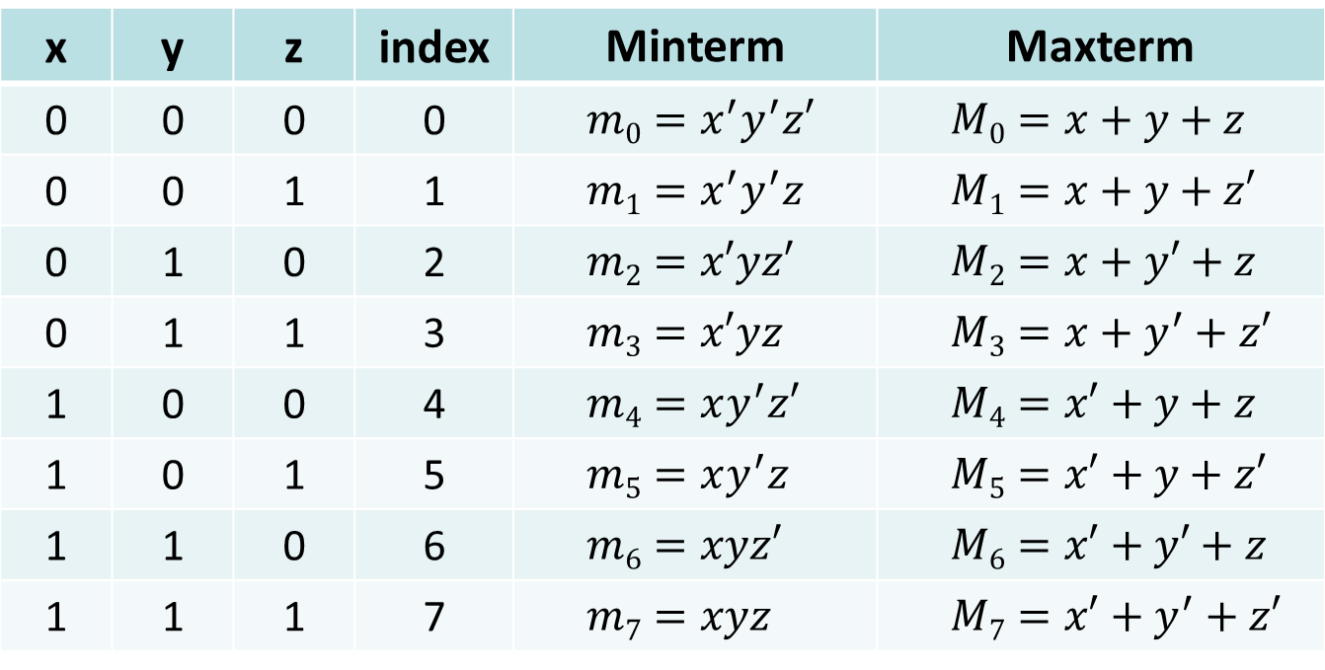
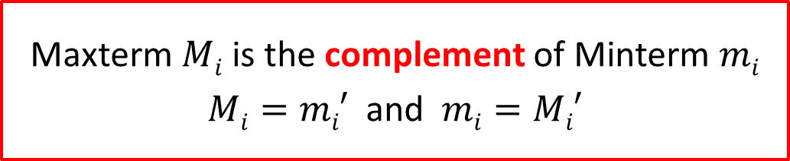
Minterms and Maxterms for 3 Variables
x | y | z | index | Minterm | Maxterm
0 | 0 | 0 | 0 | $$m0=x^{′}y^{′}z′$$ | $$M0=x+y+z$$
0 | 0 | 1 | 1 | $$m1=x^{′}y^{′}z$$ | $$M1=x+y+z′$$
0 | 1 | 0 | 2 | $$m2=x′yz′$$ | $$M2=x+y′+z$$
0 | 1 | 1 | 3 | $$m3=x′yz$$ | $$M3=x+y^{′}+z′$$
1 | 0 | 0 | 4 | $$m4=xy^{′}z′$$ | $$M4=x′+y+z$$
1 | 0 | 1 | 5 | $$m5=xy^{′}z$$ | $$M5=x′+y+z′$$
1 | 1 | 0 | 6 | $$m6=xyz′$$ | $$M6=x′+y′+z$$
1 | 1 | 1 | 7 | $$m7=xyz$$ | $$M7=x′+y^{′}+z′$$
Maxterm $Mi$ is the complement of Minterm $mi$
$Mi=mi′$ and $mi=Mi′$

Slide 24
Purpose of the Index
Minterms and Maxterms are designated with an index
The index for the Minterm or Maxterm, expressed as a binary number, is used to determine whether the variable is shown in the true or complemented form
For Minterms:
‘1’ means the variable is Not Complemented
‘0’ means the variable is Complemented
For Maxterms:
‘0’ means the variable is Not Complemented
‘1’ means the variable is Complemented

Slide 25
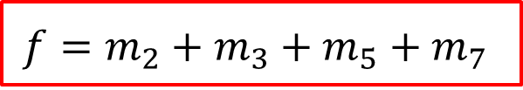
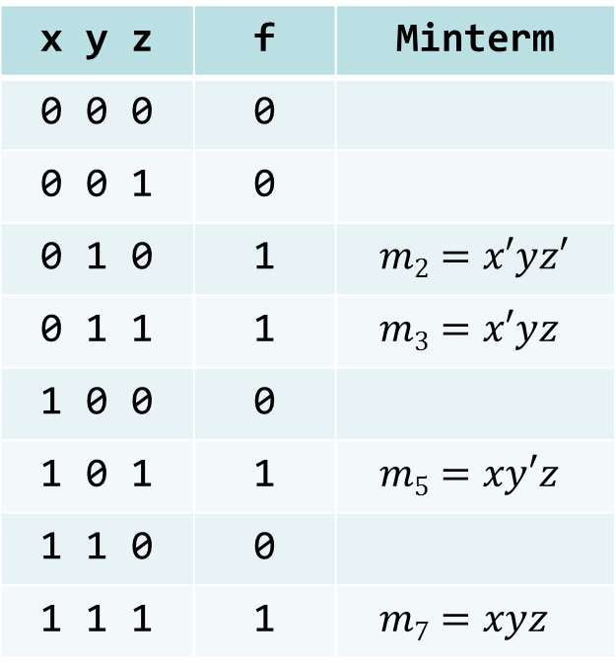
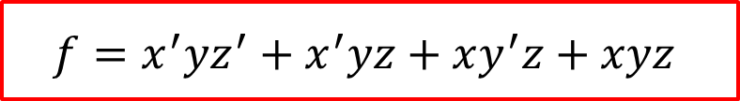
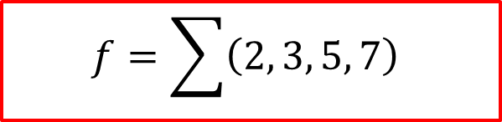
Sum-Of-Minterms (SOM) Canonical Form
Truth Table
x y z | f | Minterm
0 0 0 | 0
0 0 1 | 0
0 1 0 | 1 | $$m2=x′yz′$$
0 1 1 | 1 | $$m3=x′yz$$
1 0 0 | 0
1 0 1 | 1 | $$m5=xy′z$$
1 1 0 | 0
1 1 1 | 1 | $$m7=xyz$$
Sum of Minterm entries that evaluate to ‘1’
Focus on the ‘1’ entries
$$f=m_{2}+m_{3}+m_{5}+m_{7}$$
$$f=\sum{\left(2, 3, 5, 7\right)}$$
$$f=x^{′}yz^{′}+x^{′}yz+xy^{′}z+xyz$$

Slide 26
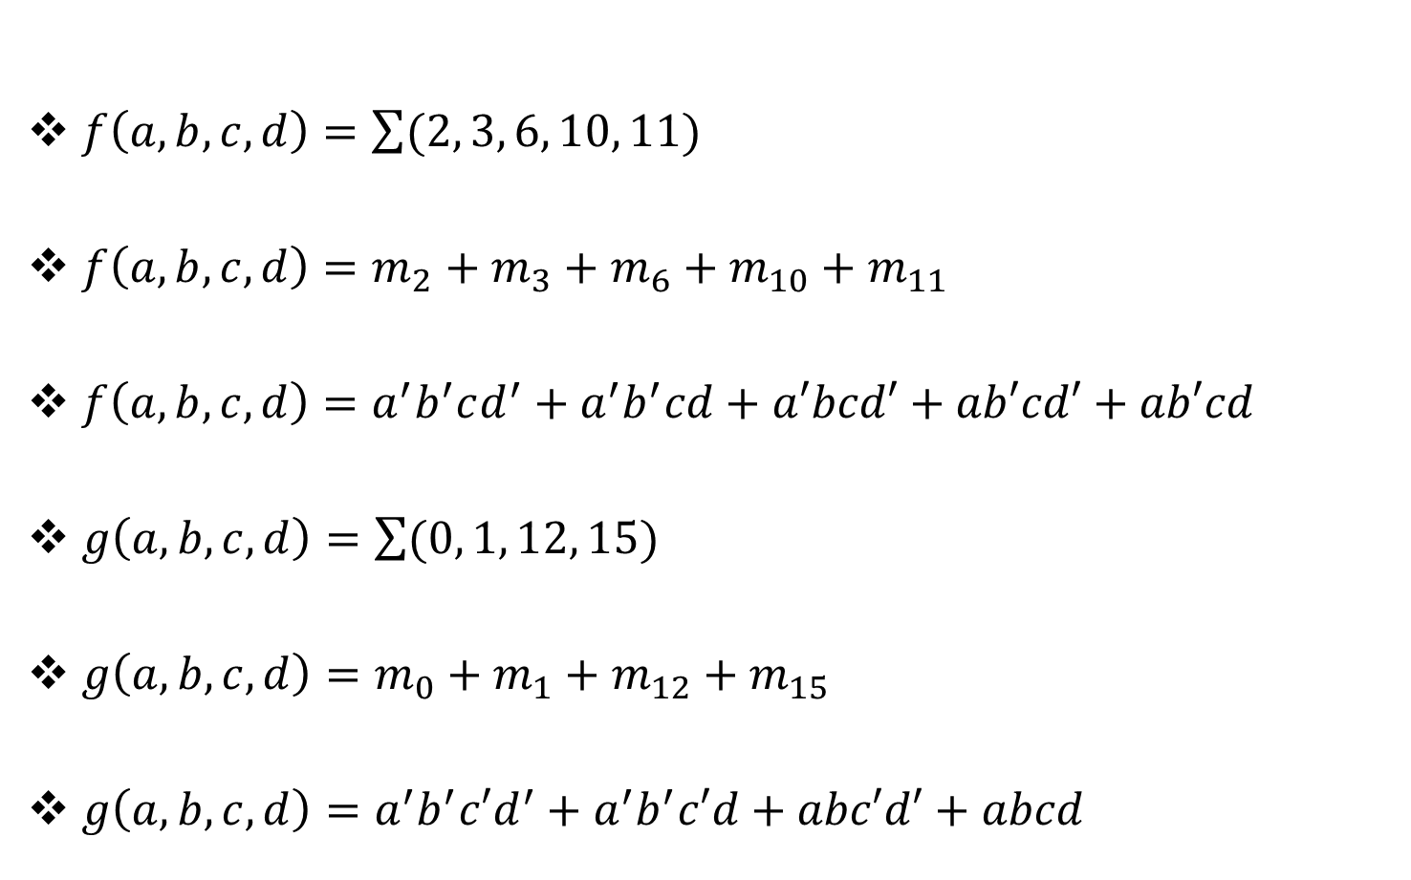
Examples of Sum-Of-Minterms
$f\left(a,b,c,d\right)=\sum{(2, 3, 6, 10, 11)}$
$f\left(a,b,c,d\right)=m_{2}+m_{3}+m_{6}+m_{10}+m_{11}$
$f\left(a,b,c,d\right)=a^{′}b^{′}cd^{′}+a^{′}b^{′}cd+a′bcd′+ab′cd′+ab′cd$
$g\left(a,b,c,d\right)=\sum{(0, 1, 12, 15)}$
$g\left(a,b,c,d\right)=m_{0}+m_{1}+m_{12}+m_{15}$
$g\left(a,b,c,d\right)=a^{′}b^{′}c′d^{′}+a^{′}b^{′}c′d+abc′d′+abcd$

Slide 27
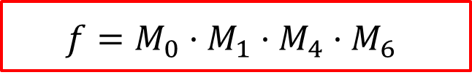
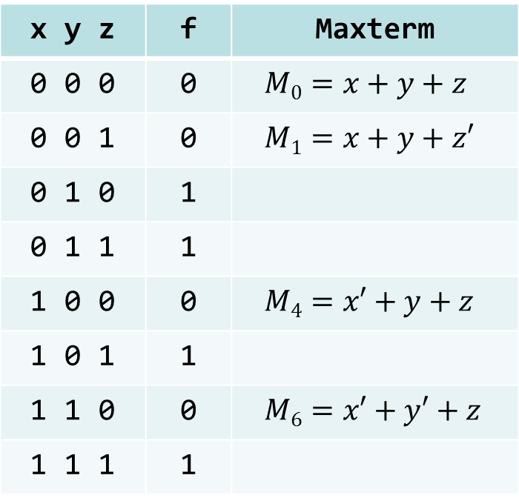
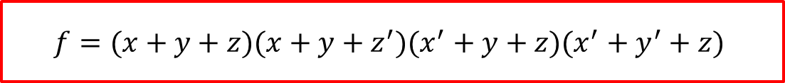

Product-Of-Maxterms (POM) Canonical Form
Truth Table
x y z | f | Maxterm
0 0 0 | 0 | $$M0=x+y+z$$
0 0 1 | 0 | $$M1=x+y+z′$$
0 1 0 | 1
0 1 1 | 1
1 0 0 | 0 | $$M4=x′+y+z$$
1 0 1 | 1
1 1 0 | 0 | $$M6=x′+y′+z$$
1 1 1 | 1
Product of Maxterm entries that evaluate to ‘0’
Focus on the ‘0’ entries
$$f=M_{0}·M_{1}·M_{4}·M_{6}$$
$$f=\prod{\left(0, 1, 4, 6\right)}$$
$$f=(x+y+z)(x+y+z^{′})(x^{′}+y+z)(x^{′}+y^{′}+z)$$

Slide 28
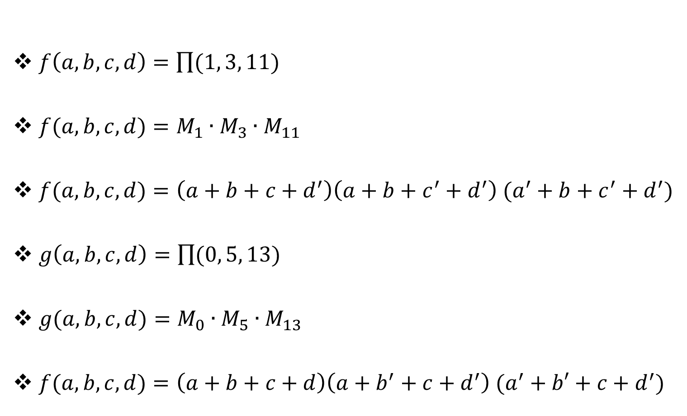
Examples of Product-Of-Maxterms
$f\left(a,b,c,d\right)=\prod{(1, 3, 11)}$
$f(a,b,c,d)=M_{1}∙M_{3}∙M_{11}$
$f(a,b,c,d)=\left(a+b+c+d^{′}\right)\left(a+b+c^{′}+d^{′}\right) (a^{′}+b+c^{′}+d^{′})$
$g\left(a,b,c,d\right)=\prod{(0, 5, 13)}$
$g(a,b,c,d)=M_{0}∙M_{5}∙M_{13}$
$f(a,b,c,d)=\left(a+b+c+d\right)\left(a+b^{′}+c+d^{′}\right) (a^{′}+b′+c+d^{′})$

Slide 29
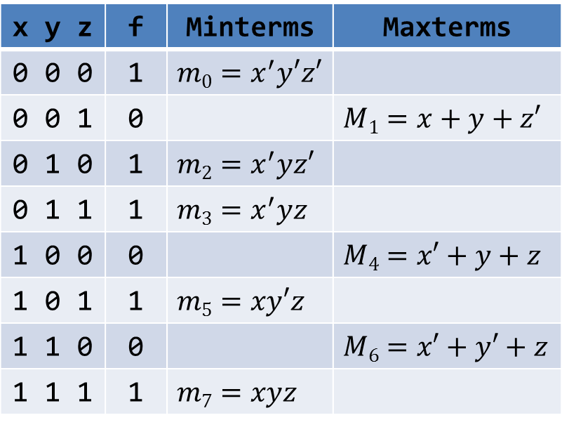
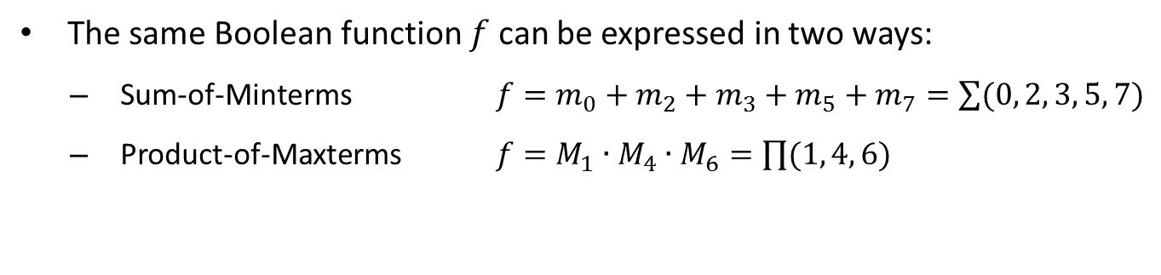
Conversions between Canonical Forms
The same Boolean function $f$ can be expressed in two ways:
Sum-of-Minterms $f=m_{0}+m_{2}+m_{3}+m_{5}+m_{7}=\sum{(0, 2, 3, 5, 7)}$
Product-of-Maxterms $f=M_{1}∙M_{4}∙M_{6}=\prod{(1, 4, 6)}$
Truth Table
x y z | f | Minterms | Maxterms
0 0 0 | 1 | $$m0=x^{′}y′z′$$
0 0 1 | 0 |  | $$M1=x+y+z′$$
0 1 0 | 1 | $$m2=x^{′}yz′$$
0 1 1 | 1 | $$m3=x^{′}yz$$
1 0 0 | 0 |  | $$M4=x′+y+z$$
1 0 1 | 1 | $$m5=xy′z$$
1 1 0 | 0 |  | $$M6=x′+y′+z$$
1 1 1 | 1 | $$m7=xyz$$
To convert from one canonical form to another, interchange the symbols ∑ and ∏ and list those numbers missing from the original form.

Slide 30
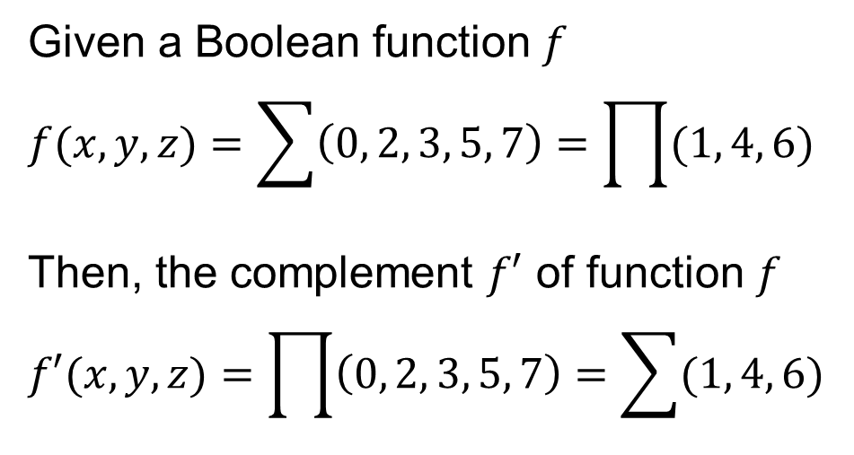
Function Complement
Truth Table
Given a Boolean function $f$
$$f(x,y,z)=\sum{\left(0, 2, 3, 5, 7\right)=\prod{(1, 4, 6)}}$$
Then, the complement $f′$ of function $f$
$$f′(x,y,z)=\prod{\left(0, 2, 3, 5, 7\right)=\sum{(1, 4, 6)}}$$
x y z | f | f'
0 0 0 | 1 | 0
0 0 1 | 0 | 1
0 1 0 | 1 | 0
0 1 1 | 1 | 0
1 0 0 | 0 | 1
1 0 1 | 1 | 0
1 1 0 | 0 | 1
1 1 1 | 1 | 0
The complement of a function expressed by a Sum of Minterms is the Product of Maxterms with the same indices. Interchange the symbols ∑ and ∏, but keep the same list of indices.

Slide 31
Summary of Minterms and Maxterms
There are 2^{n} Minterms and Maxterms for Boolean functions with n variables, indexed from 0 to 2^{n} – 1
Minterms correspond to the 1-entries of the function
Maxterms correspond to the 0-entries of the function
Any Boolean function can be expressed as a Sum-of-Minterms and as a Product-of-Maxterms
For a Boolean function, given the list of Minterm indices one can determine the list of Maxterms indices (and vice versa)
The complement of a Sum-of-Minterms is a Product-of-Maxterms with the same indices (and vice versa)

Slide 32
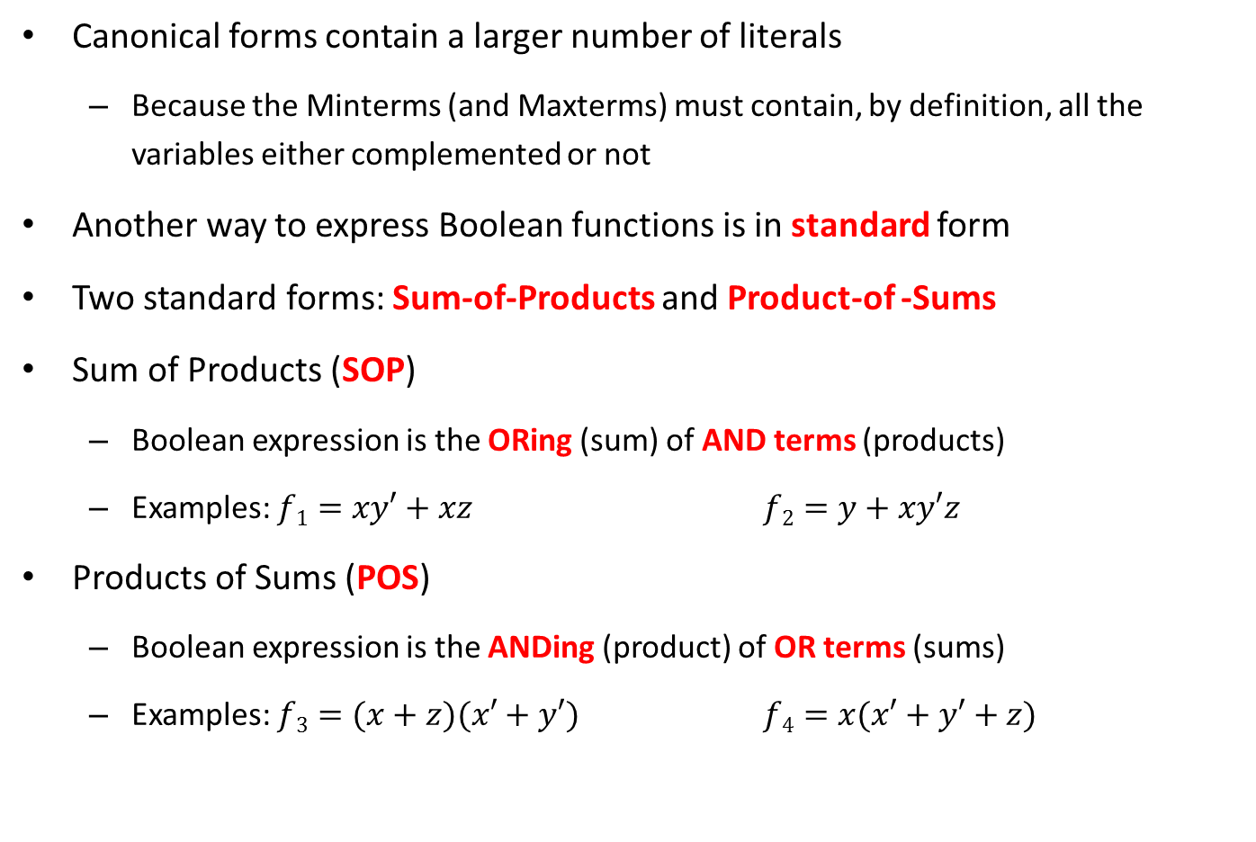
Sum-of-Products and Products-of-Sums
Canonical forms contain a larger number of literals
Because the Minterms (and Maxterms) must contain, by definition, all the variables either complemented or not
Another way to express Boolean functions is in standard form
Two standard forms: Sum-of-Products and Product-of -Sums
Sum of Products (SOP)
Boolean expression is the ORing (sum) of AND terms (products)
Examples: $f1=xy′+xz$ $f2=y+xy′z$
Products of Sums (POS)
Boolean expression is the ANDing (product) of OR terms (sums)
Examples: $f3=(x+z)(x′+y′)$ $f4=x(x′+y′+z)$

Slide 33
























Two-Level Gate Implementation
$$f1=xy′+xz$$
$$f2=y+xy′z$$
$$x$$
$$y$$
$$y′$$
$$f2$$
$$f1$$
$$x$$
$$x$$
$$y′$$
$$z$$
AND-OR
implementations
$$z$$
3-input AND gate
$$f3=(x+z)(x^{′}+y^{′})$$
$$f4=x(x^{′}+y^{′}+z)$$
$$x$$
$$x$$
$$z$$
$$f4$$
$$f3$$
$$x′$$
$$x′$$
$$y′$$
$$y′$$
OR-AND
implementations
$$z$$
3-input OR gate

Slide 34


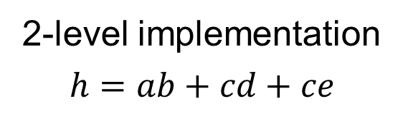



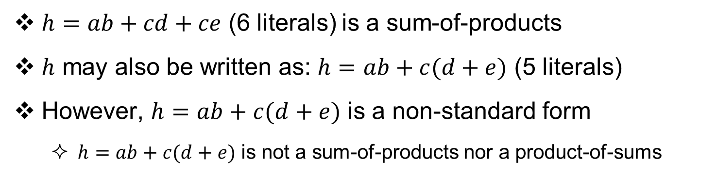






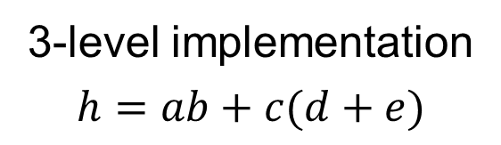


Two-Level vs. Three-Level Implementation
$h=ab+cd+ce$ (6 literals) is a sum-of-products
$h$ may also be written as: $h=ab+c(d+e)$ (5 literals)
However, $h=ab+c(d+e)$ is a non-standard form
$h=ab+c(d+e)$ is not a sum-of-products nor a product-of-sums
2-level implementation
$$h=ab+cd+ce$$
3-level implementation
$$h=ab+c(d+e)$$
$$a$$
$$b$$
$$a$$
$$b$$
$$c$$
$$h$$
$$c$$
$$h$$
$$d$$
$$d$$
$$c$$
$$e$$
$$e$$
3-input OR gate

