Slide 1
Additional Gates
Digital Logic Design

Slide 2
Presentation Outline
Additional Gates and Symbols
Universality of NAND and NOR gates
NAND-NAND and NOR-NOR implementations
Exclusive OR (XOR) and Exclusive NOR (XNOR) gates
Odd and Even functions

Slide 3
























Additional Logic Gates and Symbols
Why?
Low cost implementation
Useful in implementing Boolean functions
$$x$$
$$x$$
$$x·y$$
$$x+y$$
$$x$$
$$x′$$
$$y$$
$$y$$
AND gate
OR gate
NOT gate (inverter)
$$x$$
$$x$$
$$x$$
$$x$$
$${\left(x·y\right)}^{′}$$
$$(x+y)′$$
$$y$$
$$y$$
NAND gate
NOR gate
Buffer
$$c$$
$$x$$
$$x$$
$$x⊕y$$
$$(x⊕y)′$$
$$x$$
$$f$$
$$y$$
$$y$$
XOR gate
XNOR gate
3-state gate

Slide 4






NAND Gate
The NAND gate has the following symbol and truth table
NAND represents NOT AND
The small bubble circle represents the invert function
NAND gate is implemented efficiently in CMOS technology
In terms of chip area and speed
x y | NAND
0 0 | 1
0 1 | 1
1 0 | 1
1 1 | 0
$$x$$
$${\left(x·y\right)}^{′}=x^{′}+y′$$
$$y$$
NAND gate
$$x$$
$$x′+y′$$
$$y$$
Another symbol for NAND

Slide 5






NOR Gate
The NOR gate has the following symbol and truth table
NOR represents NOT OR
The small bubble circle represents the invert function
NOR gate is implemented efficiently in CMOS technology
In terms of chip area and speed
x y | NOR
0 0 | 1
0 1 | 0
1 0 | 0
1 1 | 0
$$x$$
$${\left(x+y\right)}^{′}=x^{′}·y′$$
$$y$$
NOR gate
$$x$$
$$x′·y′$$
$$y$$
Another symbol for NOR

Slide 6



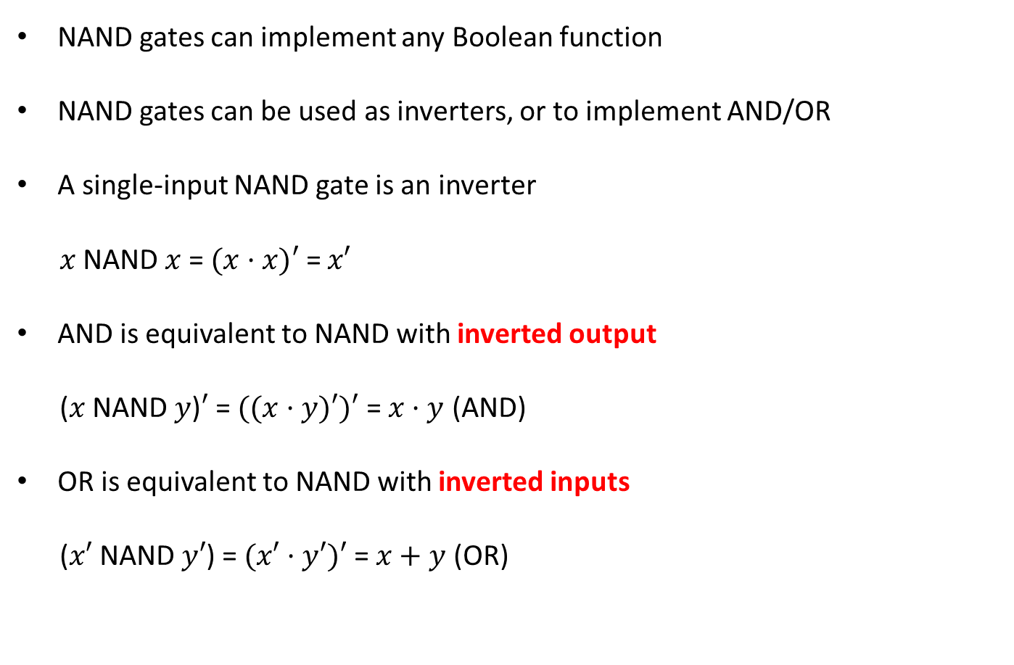





The NAND Gate is Universal
NAND gates can implement any Boolean function
NAND gates can be used as inverters, or to implement AND/OR
A single-input NAND gate is an inverter
$x$ NAND $x$ = $(x·x)′$ = $x′$
AND is equivalent to NAND with inverted output
($x$ NAND $y$)$′$ = $((x·y)′)′$ = $x·y$ (AND)
OR is equivalent to NAND with inverted inputs
($x′$ NAND $y′$) = $(x′·y′)′$ = $x+y$ (OR)
$$x$$
$$x·y$$
$$y$$
$$x′$$
$$x$$
$$x+y$$
$$y$$
$$y′$$

Slide 7

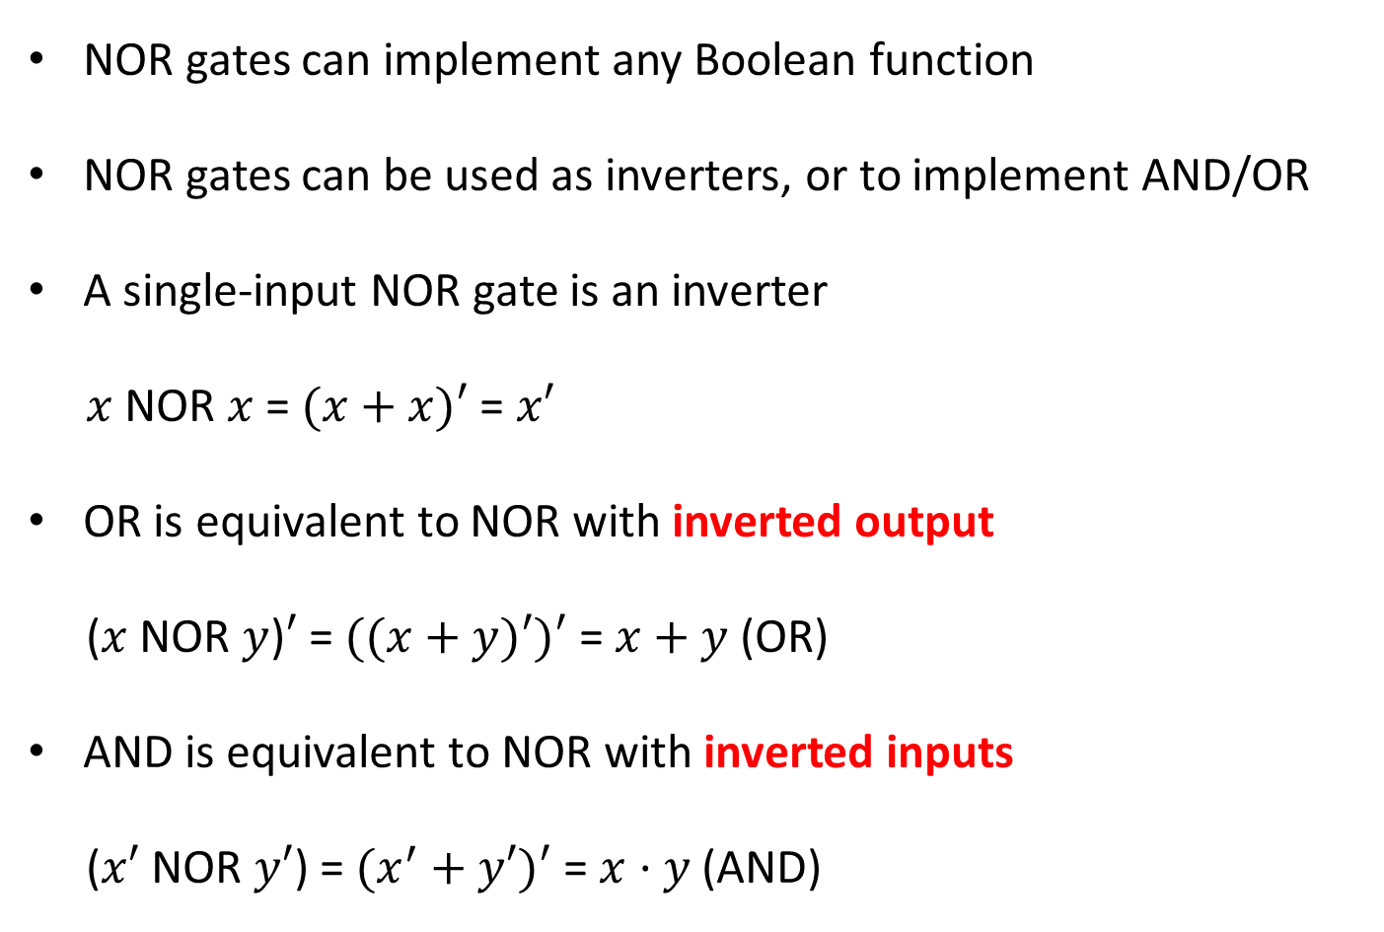

The NOR Gate is also Universal
NOR gates can implement any Boolean function
NOR gates can be used as inverters, or to implement AND/OR
A single-input NOR gate is an inverter
$x$ NOR $x$ = $(x+x)′$ = $x′$
OR is equivalent to NOR with inverted output
($x$ NOR $y$)$′$ = $((x+y)′)′$ = $x+y$ (OR)
AND is equivalent to NOR with inverted inputs
($x′$ NOR $y′$) = $(x^{′}+y′)′$ = $x·y$ (AND)
$$x$$
$$x+y$$
$$y$$
$$x′$$
$$x$$
$$x·y$$
$$y$$
$$y′$$

Slide 8
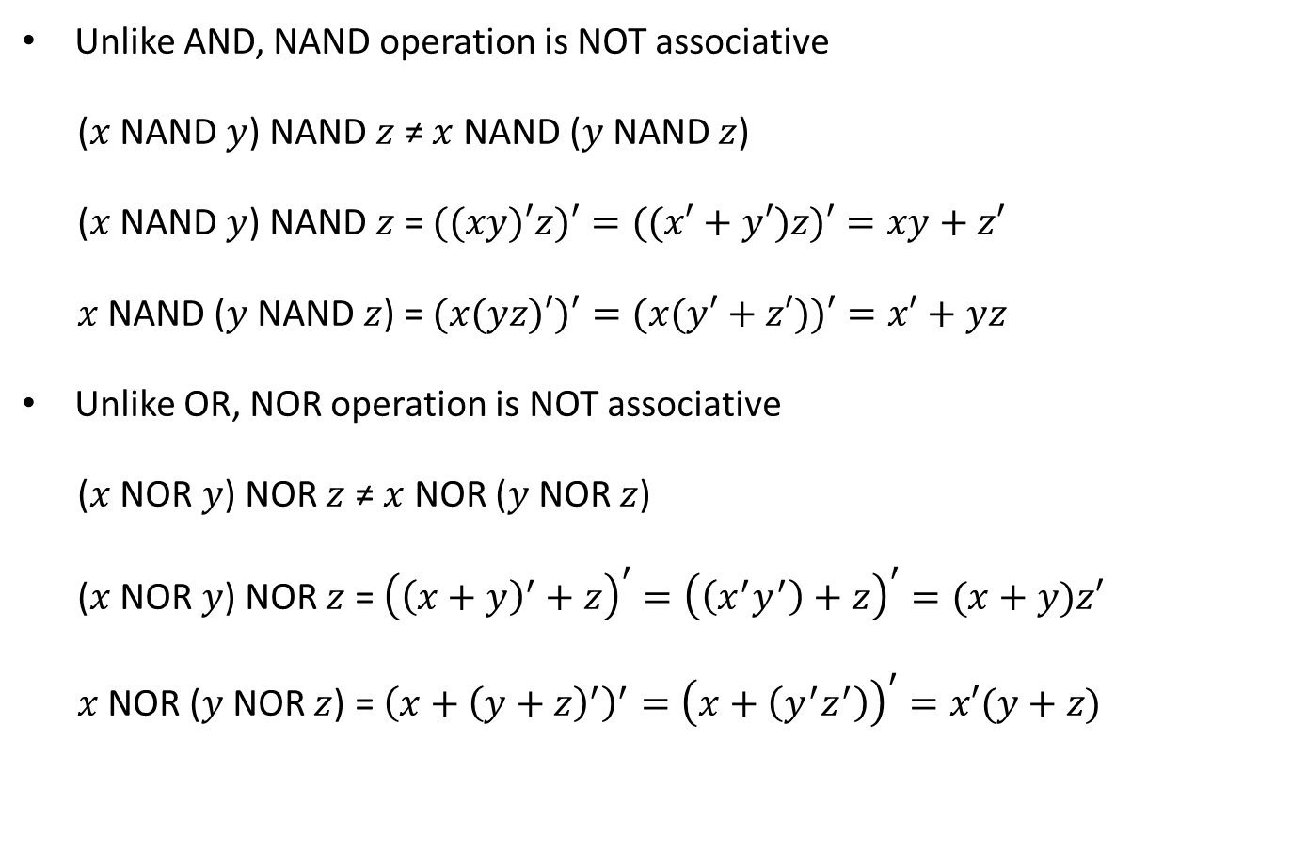
Non-Associative NAND / NOR Operations
Unlike AND, NAND operation is NOT associative
($x$ NAND $y$) NAND $z$ ≠ $x$ NAND ($y$ NAND $z$)
($x$ NAND $y$) NAND $z$ = $((xy)′z)′=((x′+y′)z)′=xy+z′$
$x$ NAND ($y$ NAND $z$) = $(x(yz)′)′=(x(y′+z′))′=x′+yz$
Unlike OR, NOR operation is NOT associative
($x$ NOR $y$) NOR $z$ ≠ $x$ NOR ($y$ NOR $z$)
($x$ NOR $y$) NOR $z$ = ${\left({\left(x+y\right)}^{′}+z\right)}^{′}={\left(\left(x^{′}y^{′}\right)+z\right)}^{′}=(x+y)z′$
$x$ NOR ($y$ NOR $z$) = ${\left(x+{\left(y+z\right)}^{′}\right)}^{′}={\left(x+\left(y^{′}z^{′}\right)\right)}^{′}=x′(y+z)$

Slide 9






















Multiple-Input NAND / NOR Gates
NAND/NOR gates can have multiple inputs, similar to AND/OR gates
$$x$$
$$w$$
$$x$$
$$y$$
$${\left(x·y·z\right)}^{′}$$
$$x$$
$${\left(w·x·y·z\right)}^{′}$$
$${\left(x·y\right)}^{′}$$
$$y$$
$$y$$
$$z$$
$$z$$
2-input NAND gate
3-input NAND gate
4-input NAND gate
$$x$$
$$w$$
$$x$$
$$y$$
$${\left(x+y+z\right)}^{′}$$
$$x$$
$${\left(w+x+y+z\right)}^{′}$$
$${\left(x+y\right)}^{′}$$
$$y$$
$$y$$
$$z$$
$$z$$
2-input NOR gate
3-input NOR gate
4-input NOR gate
Note: a 3-input NAND is a single gate, NOT a combination of two 2-input gates. The same can be said about other multiple-input NAND/NOR gates.

Slide 10







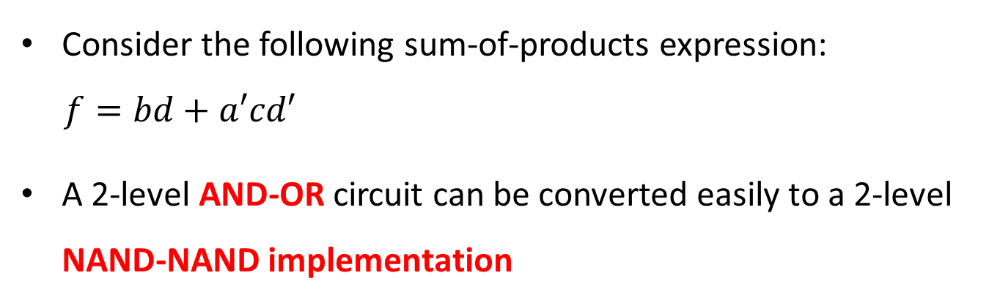











NAND – NAND Implementation
Consider the following sum-of-products expression:
$$f=bd+a′cd′$$
A 2-level AND-OR circuit can be converted easily to a 2-level NAND-NAND implementation
2-Level AND-OR
Inserting Bubbles
2-Level NAND-NAND
$$b$$
$$b$$
$$b$$
$$d$$
$$d$$
$$d$$
$$f$$
$$f$$
$$f$$
$$a′$$
$$a′$$
$$a′$$
$$c$$
$$c$$
$$c$$
$$d′$$
3-input
AND gate
$$d′$$
$$d′$$
3-input
NAND gate
Two successive bubbles on same line cancel each other

Slide 11





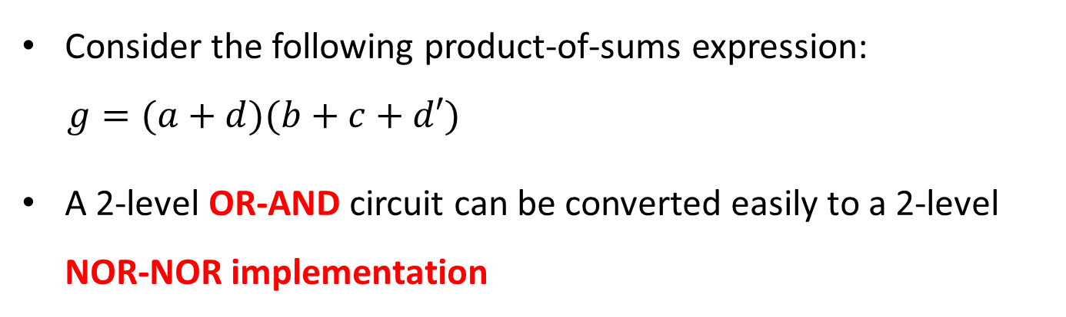










NOR – NOR Implementation
Consider the following product-of-sums expression:
$$g=(a+d)(b+c+d′)$$
A 2-level OR-AND circuit can be converted easily to a 2-level NOR-NOR implementation
2-Level OR-AND
Inserting Bubbles
2-Level NOR-NOR
$$a$$
$$a$$
$$a$$
$$d$$
$$d$$
$$d$$
$$g$$
$$g$$
$$g$$
$$b$$
$$b$$
$$b$$
$$c$$
$$c$$
$$c$$
$$d′$$
3-input
OR gate
$$d′$$
$$d′$$
3-input
NOR gate
Two successive bubbles on same line cancel each other

Slide 12






Exclusive OR / Exclusive NOR
Exclusive OR (XOR) is an important Boolean operation used extensively in logic circuits
Exclusive NOR (XNOR) is the complement of XOR
x y | XOR
0 0 | 0
0 1 | 1
1 0 | 1
1 1 | 0
x y | XNOR
0 0 | 1
0 1 | 0
1 0 | 0
1 1 | 1
XNOR is also known as equivalence
$$x$$
$$x$$
$$x ⨁ y$$
$$(x ⨁ y)′$$
$$y$$
$$y$$
XOR gate
XNOR gate

Slide 13
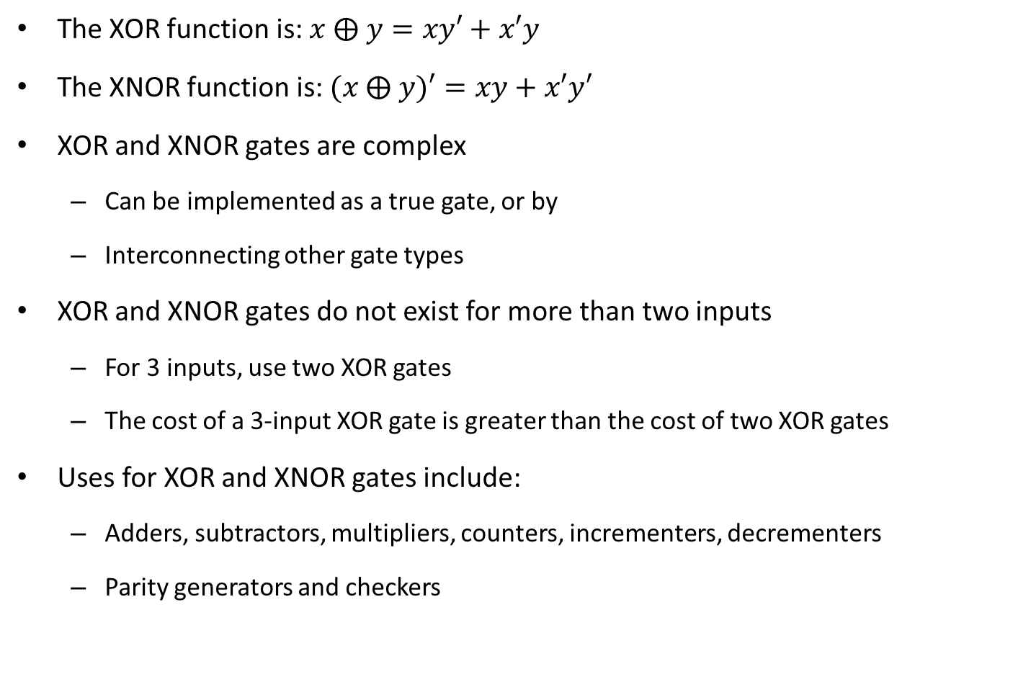
XOR / XNOR Functions
The XOR function is: $x ⨁ y=xy′+x′y$
The XNOR function is: $(x ⨁ y)′=xy+x′y′$
XOR and XNOR gates are complex
Can be implemented as a true gate, or by
Interconnecting other gate types
XOR and XNOR gates do not exist for more than two inputs
For 3 inputs, use two XOR gates
The cost of a 3-input XOR gate is greater than the cost of two XOR gates
Uses for XOR and XNOR gates include:
Adders, subtractors, multipliers, counters, incrementers, decrementers
Parity generators and checkers

Slide 14
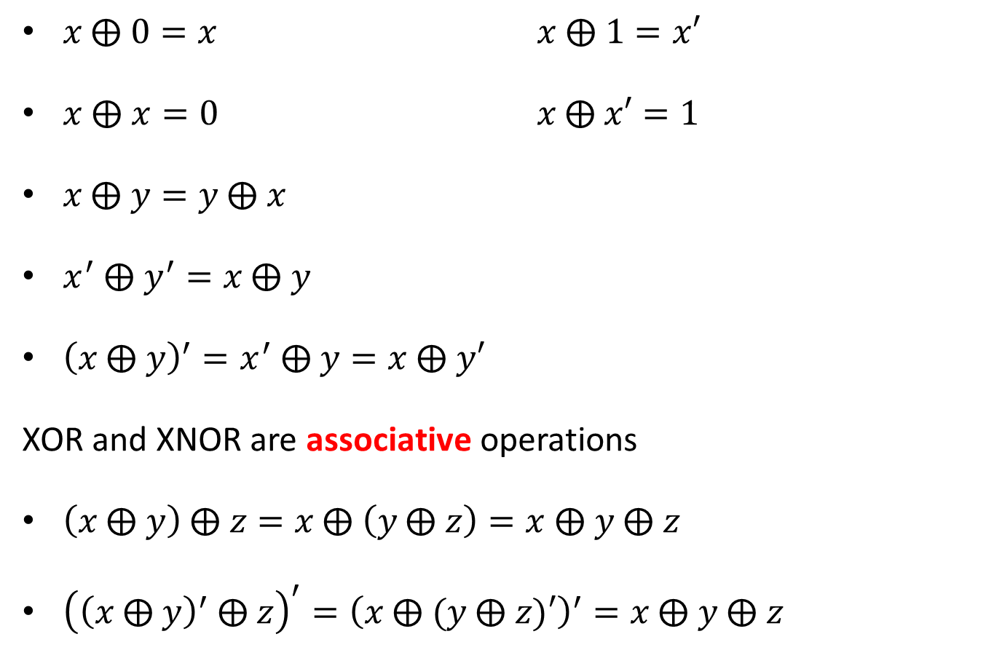
XOR and XNOR Properties
$x \text{⨁} 0=x$ $x \text{⨁} 1=x′$
$x ⨁ x=0$ $x \text{⨁} x′=1$
$x \text{⨁} y=y \text{⨁} x$
$x^{′} \text{⨁} y^{′}=x \text{⨁} y$
${\left(x \text{⨁} y\right)}^{′}=x^{′} \text{⨁} y=x \text{⨁} y′$
XOR and XNOR are associative operations
$\left(x \text{⨁} y\right) \text{⨁} z=x \text{⨁} \left(y \text{⨁} z\right)=x \text{⨁} y \text{⨁} z$
${\left({\left(x \text{⨁} y\right)}^{′} \text{⨁} z\right)}^{′}={\left(x \text{⨁} (y \text{⨁} z)′\right)}^{′}=x \text{⨁} y \text{⨁} z$

Slide 15



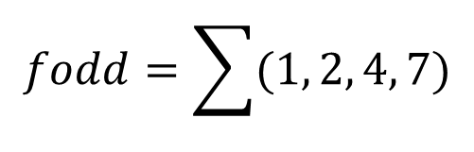



Odd Function
Output is 1 if the number of 1's is odd in the inputs
Output is the XOR operation on all input variables
x y z | fodd
0 0 0 | 0
0 0 1 | 1
0 1 0 | 1
0 1 1 | 0
1 0 0 | 1
1 0 1 | 0
1 1 0 | 0
1 1 1 | 1
$$fodd=\sum{(1, 2, 4, 7)}$$
$$fodd=x^{′}y^{′}z+x^{′}yz^{′}+xy^{′}z^{′}+xyz$$
$$fodd=x ⨁ y ⨁ z$$
Odd Function with 3 inputs
$$x$$
$$y$$
$$fodd$$
$$z$$
Implementation using two XOR gates

Slide 16


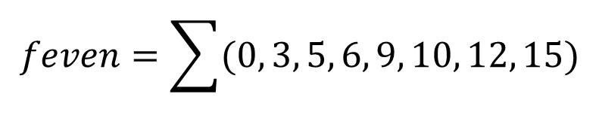




Even Function
w x y z | feven
0 0 0 0 | 1
0 0 0 1 | 0
0 0 1 0 | 0
0 0 1 1 | 1
0 1 0 0 | 0
0 1 0 1 | 1
0 1 1 0 | 1
0 1 1 1 | 0
1 0 0 0 | 0
1 0 0 1 | 1
1 0 1 0 | 1
1 0 1 1 | 0
1 1 0 0 | 1
1 1 0 1 | 0
1 1 1 0 | 0
1 1 1 1 | 1
Output is 1 if the number of 1's is even in the inputs (complement of odd function)
Output is the XNOR operation on all inputs
$$feven=\sum{(0, 3, 5, 6, 9, 10, 12, 15)}$$
Even Function with 4 inputs
$$feven=(w \text{⨁} x \text{⨁} y \text{⨁} z)′$$
$$w$$
$$x$$
$$feven$$
$$y$$
$$z$$
Implementation using two XOR gates and one XNOR

Slide 17
Parity Generators and Checkers
Sender
Receiver
n-bit code
Parity
Generator
Parity
Checker
(n+1)-bit code
Error
A parity bit is added to the n-bit code
Produces (n+1)-bit code with an odd (or even) count of 1's
Odd parity: count of 1's in the (n+1)-bit code is odd
Use an even function to generate the odd parity bit
Use an even function to check the (n+1)-bit code
Even parity: count of 1's in the (n+1)-bit code is even
Use an odd function to generate the even parity bit
Use an odd function to check the (n+1)-bit code

Slide 18



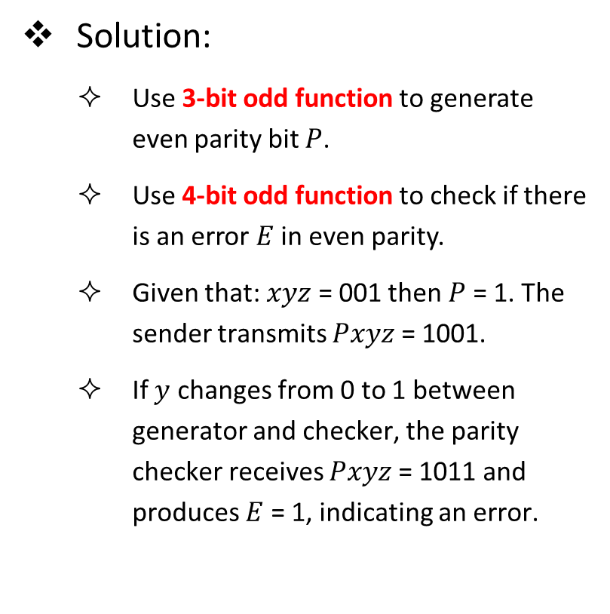






Example of Parity Generator and Checker
Design even parity generator & checker for 3-bit codes
Solution:
Use 3-bit odd function to generate even parity bit $P$.
Use 4-bit odd function to check if there is an error $E$ in even parity.
Given that: $xyz$ = 001 then $P$ = 1. The sender transmits $Pxyz$ = 1001.
If $y$ changes from 0 to 1 between generator and checker, the parity checker receives $Pxyz$ = 1011 and produces $E$ = 1, indicating an error.
Parity Generator
$$x$$
$$y$$
$$P$$
$$z$$
Parity Checker
$$P$$
$$x$$
$$E$$
$$y$$
$$z$$

