Slide 1
Combinational Circuit Design
Digital Logic Design

Slide 2
Presentation Outline
How to Design a Combinational Circuit
Designing a BCD to Excess-3 Code Converter
Designing a BCD to 7-Segment Decoder
Hierarchical Design
Iterative Design

Slide 3

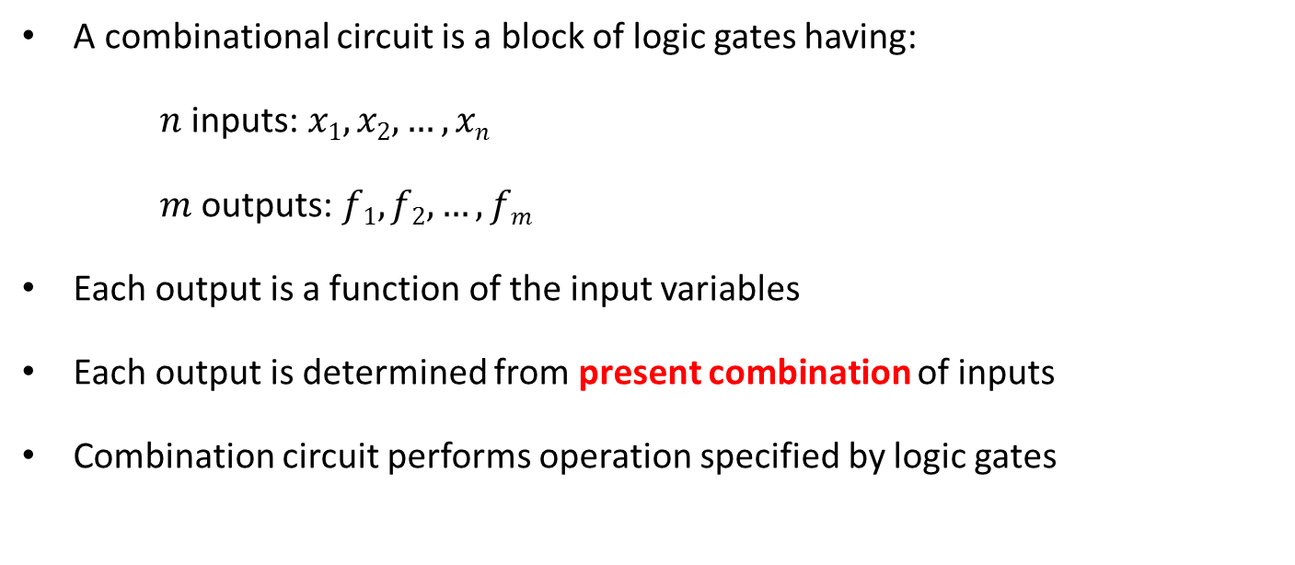

Combinational Circuit
A combinational circuit is a block of logic gates having:
$n$ inputs: $x1, x2, …, xn$
$m$ outputs: $f1, f2, …, fm$
Each output is a function of the input variables
Each output is determined from present combination of inputs
Combination circuit performs operation specified by logic gates
Combinational
Circuit
$n$ inputs
…
…
$m$ outputs

Slide 4
How to Design a Combinational Circuit
Specification
Specify the inputs, outputs, and what the circuit should do
Formulation
Convert the specification into truth tables or logic expressions for outputs
Logic Minimization
Minimize the output functions using K-map or Boolean algebra
Technology Mapping
Draw a logic diagram using ANDs, ORs, and inverters
Map the logic diagram into the selected technology
Considerations: cost, delays, fan-in, fan-out
Verification
Verify the correctness of the design, either manually or using simulation

Slide 5
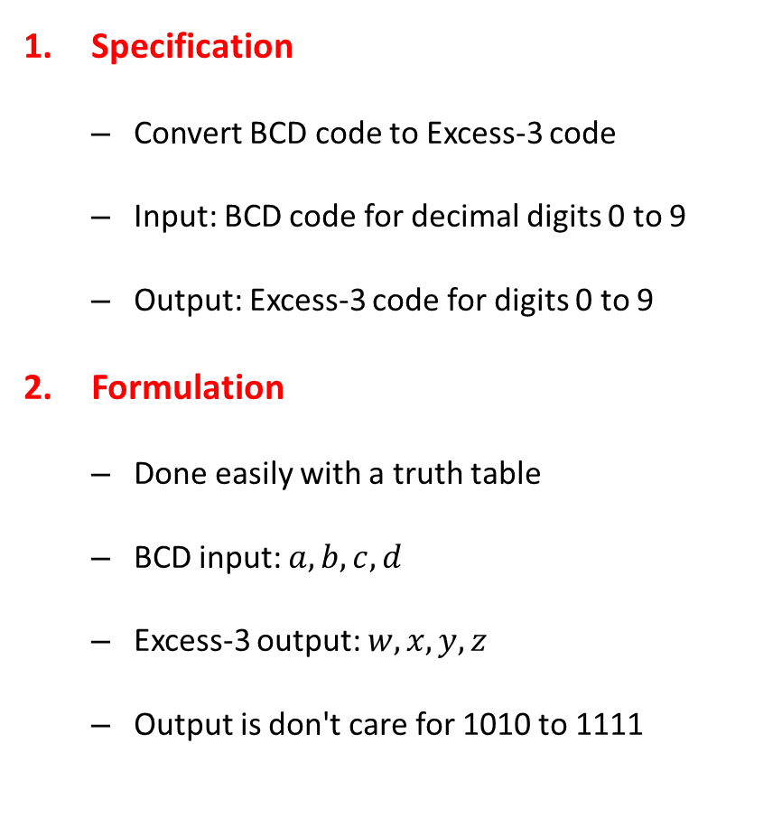
Designing a BCD to Excess-3 Code Converter
Specification
Convert BCD code to Excess-3 code
Input: BCD code for decimal digits 0 to 9
Output: Excess-3 code for digits 0 to 9
Formulation
Done easily with a truth table
BCD input: $a, b, c, d$
Excess-3 output: $w, x, y, z$
Output is don't care for 1010 to 1111
BCD a b c d | Excess-3 w x y z
0 0 0 0 | 0 0 1 1
0 0 0 1 | 0 1 0 0
0 0 1 0 | 0 1 0 1
0 0 1 1 | 0 1 1 0
0 1 0 0 | 0 1 1 1
0 1 0 1 | 1 0 0 0
0 1 1 0 | 1 0 0 1
0 1 1 1 | 1 0 1 0
1 0 0 0 | 1 0 1 1
1 0 0 1 | 1 1 0 0
1010 to 1111 | X X X X

Slide 6






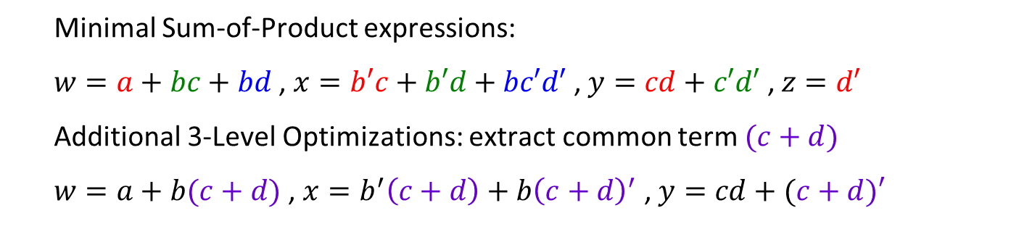
Designing a BCD to Excess-3 Code Converter
Logic Minimization using K-maps
K-map for$w$
K-map for$x$
K-map for$y$
K-map for$z$
$$cd$$
$$ab$$
00
01
11
10
00
01
11
10
00
01
11
10
00
01
11
10
00
1
1
1
1
1
1
1
01
1
1
1
1
1
1
1
1
11
X
X
X
X
X
X
X
X
X
X
X
X
X
X
X
X
10
1
1
X
X
1
X
X
1
X
X
1
X
X
Minimal Sum-of-Product expressions:
$w=a+bc+bd$ , $x=b′c+b′d+bc′d′$ , $y=cd+c′d′$ , $z=d′$
Additional 3-Level Optimizations: extract common term $(c+d)$
$w=a+b(c+d)$ , $x=b^{′}\left(c+d\right)+b{\left(c+d\right)}^{′}$ , $y=cd+(c+d)′$

Slide 7
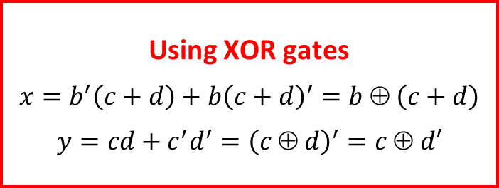
Designing a BCD to Excess-3 Code Converter
Technology Mapping
Draw a logic diagram using ANDs, ORs, and inverters
Other gates can be used, such as NAND, NOR, and XOR
Using XOR gates
$x=b^{′}\left(c+d\right)+b{\left(c+d\right)}^{′}=b ⊕ \left(c+d\right)$
$y=cd+c^{′}d^{′}={\left(c ⊕ d\right)}^{′}=c ⊕ d′$
a
w
x
b
a
w
c
b
x
y
d
c
y
z
d
z

Slide 8
Designing a BCD to Excess-3 Code Converter
Verification
Can be done manually
Extract output functions from circuit diagram
Find the truth table of the circuit diagram
Match it against the specification truth table
Verification process can be automated
Using a simulator for complex designs
Truth Table of the
Circuit Diagram
BCD a b c d | c+d | b(c+d) | Excess-3 w x y z
0 0 0 0 | 0 | 0 | 0 0 1 1
0 0 0 1 | 1 | 0 | 0 1 0 0
0 0 1 0 | 1 | 0 | 0 1 0 1
0 0 1 1 | 1 | 0 | 0 1 1 0
0 1 0 0 | 0 | 0 | 0 1 1 1
0 1 0 1 | 1 | 1 | 1 0 0 0
0 1 1 0 | 1 | 1 | 1 0 0 1
0 1 1 1 | 1 | 1 | 1 0 1 0
1 0 0 0 | 0 | 0 | 1 0 1 1
1 0 0 1 | 1 | 0 | 1 1 0 0
a
w = a + b(c + d)
b
x = b ⊕ (c + d)
c
y = c ⊕ d'
d
z = d'

Slide 9
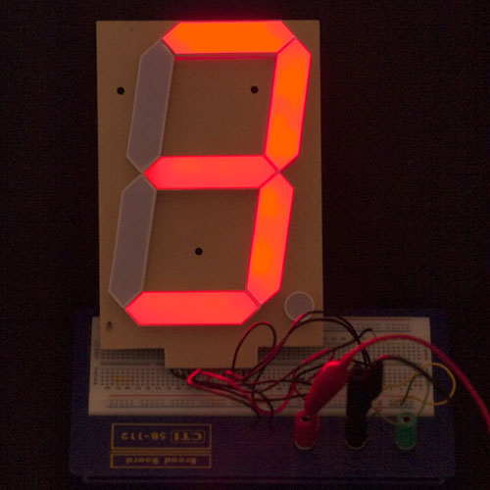
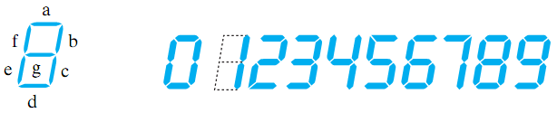
BCD to 7-Segment Decoder
Seven-Segment Display:
Made of Seven segments: light-emitting diodes (LED)
Found in electronic devices: such as clocks, calculators, etc.
BCD to
7-Segment
Decoder
a
A
b
B
c
d
C
e
BCD to 7-Segment Decoder
Accepts as input a BCD decimal digit (0 to 9)
Generates output to the seven LED segments to display the BCD digit
Each segment can be turned on or off separately
D
f
g

Slide 10
Designing a BCD to 7-Segment Decoder
Specification:
Input: 4-bit BCD (A, B, C, D)
Output: 7-bit (a, b, c, d, e, f, g)
Display should be OFF for
Non-BCD input codes
Formulation
Done with a truth table
Output is zero for 1010 to 1111
Truth Table
BCD input A B C D | 7-Segment decoder a b c d e f g
0 0 0 0 | 1 1 1 1 1 1 0
0 0 0 1 | 0 1 1 0 0 0 0
0 0 1 0 | 1 1 0 1 1 0 1
0 0 1 1 | 1 1 1 1 0 0 1
0 1 0 0 | 0 1 1 0 0 1 1
0 1 0 1 | 1 0 1 1 0 1 1
0 1 1 0 | 1 0 1 1 1 1 1
0 1 1 1 | 1 1 1 0 0 0 0
1 0 0 0 | 1 1 1 1 1 1 1
1 0 0 1 | 1 1 1 1 0 1 1
1010 to 1111 | 0 0 0 0 0 0 0

Slide 11

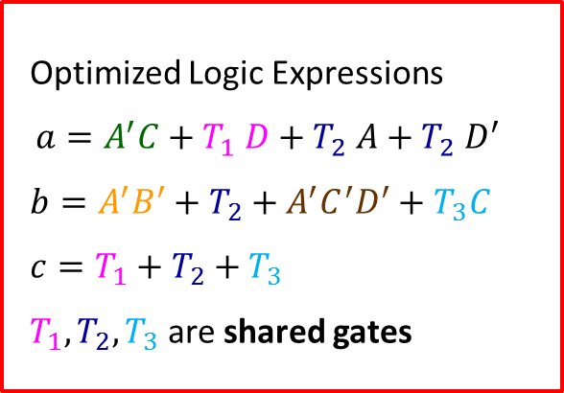


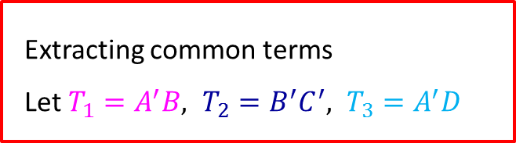


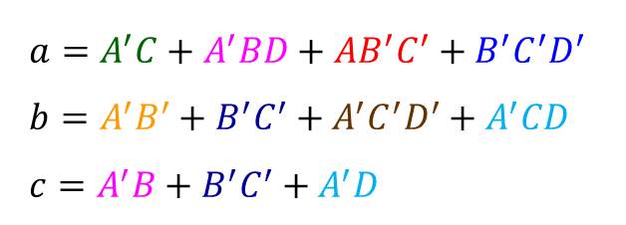




Designing a BCD to 7-Segment Decoder
Logic Minimization Using K-Maps
$$CD$$
K-map for$a$
$$CD$$
K-map for$b$
$$CD$$
K-map for$c$
$$AB$$
00
01
11
10
$$AB$$
00
01
11
10
$$AB$$
00
01
11
10
00
1
1
1
00
1
1
1
1
00
1
1
1
01
1
1
1
01
1
1
01
1
1
1
1
11
11
11
10
1
1
10
1
1
10
1
1
$$a=A^{′}C+A^{′}BD+AB^{′}C^{′}+B^{′}C^{′}D^{′}$$
$b=A^{′}B^{′}+B^{′}C^{′}+A^{′}C^{′}D^{′}+A^{′}CD$
$c=A^{′}B+B^{′}C^{′}+A^{′}D$
Optimized Logic Expressions
$$a=A^{′}C+T_{1} D+T_{2} {A+T_{2} D}^{′}$$
$b=A^{′}B^{′}+T_{2}+A^{′}C^{′}D^{′}+T_{3}C$
$c=T_{1}+T_{2}+T_{3}$
$T_{1}, T_{2}, T_{3}$ are shared gates
Extracting common terms
Let $T_{1}=A^{′}B, T_{2}=B^{′}C^{′}, T_{3}=A^{′}D$

Slide 12









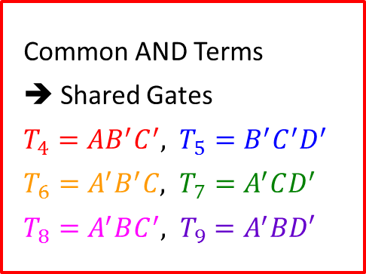



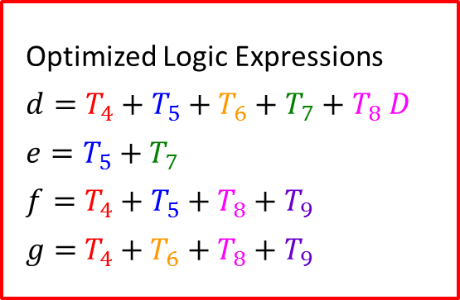
Designing a BCD to 7-Segment Decoder
Logic Minimization Using K-Maps
$$CD$$
K-map for$d$
$$CD$$
K-map for$e$
$$CD$$
K-map for$f$
$$CD$$
K-map for$g$
$$AB$$
00
01
11
10
$$AB$$
00
01
11
10
$$AB$$
00
01
11
10
$$AB$$
00
01
11
10
00
1
1
1
00
1
1
00
1
00
1
1
01
1
1
01
1
01
1
1
1
01
1
1
1
11
11
11
11
10
1
1
10
1
10
1
1
10
1
1
Common AND Terms
➔ Shared Gates
$T_{4}=AB^{′}C^{′}, T_{5}=B^{′}C^{′}D^{′}$
$T_{6}=A^{′}B^{′}C, T_{7}=A^{′}CD^{′}$
$T_{8}=A^{′}BC^{′}, T_{9}=A^{′}BD′$
Optimized Logic Expressions
$d=T_{4}+T_{5}+T_{6}+T_{7}+T_{8} D$
$e=T_{5}+T_{7}$
$$f=T_{4}+T_{5}+T_{8}+T_{9}$$
$g=$ $T_{4}+T_{6}+T_{8}+T_{9}$

Slide 13
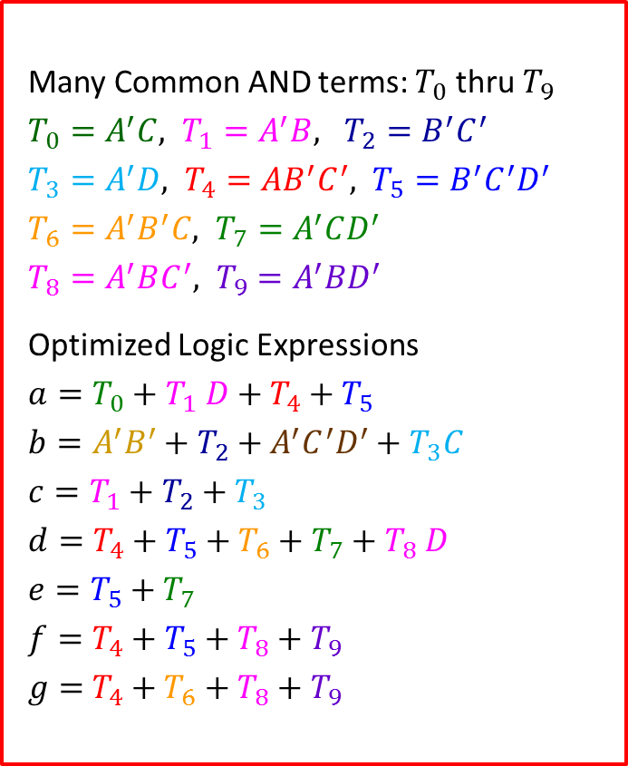
Designing a BCD to 7-Segment Decoder
Technology Mapping
A
T₄
B'
Many Common AND terms: $T_{0}$ thru $T_{9}$
$T_{0}=A^{′}C, T_{1}=A^{′}B, T_{2}=B^{′}C^{′}$
$T_{3}=A^{′}D, T_{4}=AB^{′}C^{′}, T_{5}=B^{′}C^{′}D^{′}$
$T_{6}=A^{′}B^{′}C, T_{7}=A^{′}CD^{′}$
$T_{8}=A^{′}BC^{′}, T_{9}=A^{′}BD^{′}$
Optimized Logic Expressions
$a=T_{0}+T_{1} D+T_{4}+T_{5}$
$b=A^{′}B^{′}+T_{2}+A^{′}C^{′}D^{′}+T_{3}C$
$c=T_{1}+T_{2}+T_{3}$
$d=T_{4}+T_{5}+T_{6}+T_{7}+T_{8} D$
$e=T_{5}+T_{7}$
$$f=T_{4}+T_{5}+T_{8}+T_{9}$$
$g=$ $T_{4}+T_{6}+T_{8}+T_{9}$
C'
T₂
D'
T₅
B'
T₆
A'
C
T₀
D'
T₇
C'
T₈
A'
B
T₁
D'
T₉
Showing only
Outputs e, f, g
e
f
g

Slide 14
Verification Methods
Manual Logic Analysis
Find the logic expressions and truth table of the final circuit
Compare the final circuit truth table against the specified truth table
Compare the circuit output expressions against the specified expressions
Tedious for large designs + Human Errors
Simulation
Simulate the final circuit, possibly written in HDL (such as Verilog)
Write a test bench that automates the verification process
Generate test cases for ALL possible inputs (exhaustive testing)
Verify the output correctness for ALL input test cases
Exhaustive testing can be very time consuming for many inputs

Slide 15
Modeling the 7-Segment Decoder
// Module BCD_to_7Segment: Modeled using continuous assignment
module BCD_to_7Segment (input A,B,C,D, output a,b,c,d,e,f,g);
wire T0, T1, T2, T3, T4, T5, T6, T7, T8, T9;
assign T0=~A&C; assign T1=~A&B; assign T2=~B&~C;
assign T3=~A&D; assign T4=T2&A; assign T5=T2&~D;
assign T6=T0&~B; assign T7=T0&~D; assign T8=T1&~C;
assign T9=T1&~D;
assign a = T0 | T1&D | T4 | T5;
assign b = ~A&~B | T2 | ~A&~C&~D | T3&C;
assign c = T1 | T2 | T3;
assign d = T4 | T5 | T6 | T7 | T8&D;
assign e = T5 | T7;
assign f = T4 | T5 | T8 | T9;
assign g = T4 | T6 | T8 | T9;
endmodule
assign statements can appear in any order

Slide 16
Testing the BCD to 7-Segment Decoder
module Test_BCD_to_7Segment; // No need for Ports
reg A, B, C, D; // variable inputs
wire a, b, c, d, e, f, g; // wire outputs
// Instantiate the module to be tested
BCD_to_7Segment BCD_7Seg (A, B, C, D, a, b, c, d, e, f, g);
initial begin // initial block
A=0; B=0; C=0; D=0; // at t=0
#200 $finish; // at t=200 finish simulation
end // end of initial block
always #10 D=~D; // invert D every 10 time units
always #20 C=~C; // invert C every 20 time units
always #40 B=~B; // invert B every 40 time units
always #80 A=~A; // invert A every 80 time units
endmodule

Slide 17
The initial and always Blocks
There are two types of procedural blocks in Verilog
The initial block
Executes the enclosed statement(s) once
The always block
Executes the enclosed statement(s) repeatedly until simulation terminates
The body of the initial and always blocks is procedural
Can enclose one or more procedural statements
Procedural statements surrounded by begin … end execute sequentially
#delay is used to delay the execution of the procedural statement
Procedural blocks can appear in any order inside a module
Multiple procedural blocks run in parallel inside the simulator

Slide 18
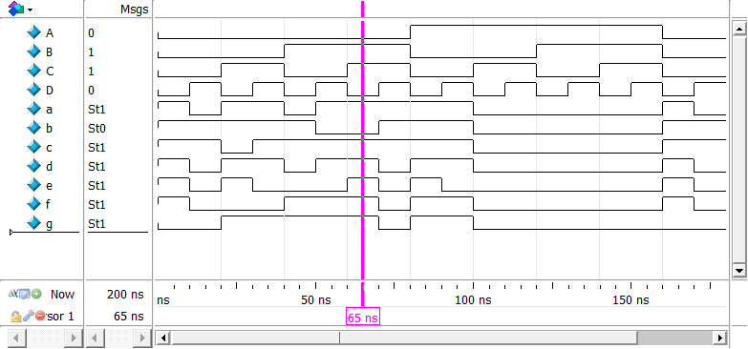
Simulator Waveforms
All sixteen input test cases of A, B, C, D are generated between t=0 and t=160ns. Verify that outputs a to g match the truth table.

Slide 19
Hierarchical Design
Why Hierarchical Design?
To simplify the implementation of a complex circuit
What is Hierarchical Design?
Decompose a complex circuit into smaller pieces called blocks
Decompose each block into even smaller blocks
Repeat as necessary until the blocks are small enough
Any block not decomposed is called a primitive block
The hierarchy is a tree of blocks at different levels
The blocks are verified and well-document
They are placed in a library for future use

Slide 20
Example of Hierarchical Design
Top Level: 16-input odd function: 16 inputs, one output
Implemented using Five 4-input odd functions
Second Level: 4-input odd function that uses three XOR gates
x₀
x₁
x₂
x₃
x₄
x₅
x₆
x₇
x₈
x₉
x₁₀
x₁₁
x₁₂
x₁₃
x₁₄
x₁₅
16-Input
Odd
Function
x₀
x₁
x₂
x₃
4-Input
Odd
Function
x₀
x₀
x₁
x₂
x₃
x₁
z
z
x₂
x₃
x₄
x₅
x₆
x₇
4-Input
Odd
Function
x₀
x₁
x₂
x₃
z
4-Input
Odd
Function
x₀
x₁
x₂
x₃
z
z
z
x₈
x₉
x₁₀
x₁₁
4-Input
Odd
Function
x₀
x₁
x₂
x₃
z
Hierarchical Design typically includes blocks of different functions and sizes
x₁₂
x₁₃
x₁₄
x₁₅
4-Input
Odd
Function
x₀
x₁
x₂
x₃
z

Slide 21
Top-Down versus Bottom-Up Design
A top-down design proceeds from a high-level specification to a more and more detailed design by decomposition and successive refinement
A bottom-up design starts with detailed primitive blocks and combines them into larger and more complex functional blocks
Design usually proceeds top-down to a known set of building blocks, ranging from complete processors to primitive logic gates

Slide 22
Hierarchical Design in Verilog
// Module Odd_4: 4-input Odd function uses three xor gates
module Odd_4 (input [0:3] x, output z);
wire [0:1] w;
xor g1(w[0], x[0], x[1]);
xor g2(w[1], x[2], x[3]);
xor g3(z, w[0], w[1]);
endmodule
// Module Odd_16: 16-input Odd function
module Odd_16 (input [0:15] x, output z);
wire [0:3] w;
Odd_4 block0 (x[0:3], w[0]);
Odd_4 block1 (x[4:7], w[1]);
Odd_4 block2 (x[8:11], w[2]);
Odd_4 block3 (x[12:15], w[3]);
Odd_4 block4 (w[0:3], z);
endmodule
Five instances of the Odd_4 module

Slide 23
Bit Vectors in Verilog
A Bit Vector is multi-bit declaration that uses a single name
A Bit Vector is specified as a Range [msb:lsb]
msb is most-significant bit and lsb is least-significant bit
Examples:
input [0:15] x; // x is a 16-bit input vector
wire [0:3] w; // Bit 0 is most-significant bit
reg [7:0] a; // Bit 7 is most-significant bit
Bit select: w[1] is bit 1 of vector w
Part select: x[8:11] is a 4-bit select of x with range [8:11]
The part select range must be consistent with vector declaration

Slide 24
Testing Hierarchical Design
Exhaustive testing can be very time consuming (or impossible)
For a 16-bit input, there are 2¹⁶ = 65,536 test cases (combinations)
For a 32-bit input, there are 2³² = 4,294,967,296 test cases
For a 64-bit input, there are 2⁶⁴ = 18,446,744,073,709,551,616 test cases!
Testing a hierarchical design requires a different strategy
Test each block in the hierarchy separately
For smaller blocks, exhaustive testing can be done
It is easier to detect errors in smaller blocks before testing complete circuit
Test the top-level design by applying selected test inputs
Make sure that the test inputs exercise all parts of the circuit

Slide 25
Iterative Design
Using identical copies of a smaller circuit to build a large circuit
Example: Building a 4-bit adder using 4 copies of a full-adder
The cell (iterative block) is a full adder
Adds 3 bits: a_{i}, b_{i}, c_{i}, Computes: Sum s_{i} and Carry-out c_{i+1}
Carry-out of cell i becomes carry-in to cell (i +1)
a₃
b₃
a₂
b₂
a₁
b₁
a₀
b₀
a_{i}
b_{i}
c₄
Full
Adder
c₃
Full
Adder
c₂
Full
Adder
c₁
Full
Adder
c₀
c_{i+1}
Full
Adder
c_{i}
s₃
s₂
s₁
s₀
s_{i}

Slide 26
Full Adder
Full adder adds 3 bits: a, b, and c
Two output bits:
Carry bit: cout
Sum bit: sum
Sum bit is 1 if the number of 1's in the input is odd (odd function)
sum = (a ⊕ b) ⊕ c
Carry bit is 1 if the number of 1's in the input is 2 or 3
cout = a·b + (a ⊕ b)·c
Truth Table
a b c | cout | sum
0 0 0 | 0 | 0
0 0 1 | 0 | 1
0 1 0 | 0 | 1
0 1 1 | 1 | 0
1 0 0 | 0 | 1
1 0 1 | 1 | 0
1 1 0 | 1 | 0
1 1 1 | 1 | 1

Slide 27
Full Adder Module (Gate-Level Description)
module Full_Adder(input a, b, c, output cout, sum);
wire w1, w2, w3;
and (w1, a, b);
xor (w2, a, b);
and (w3, w2, c);
xor (sum, w2, c);
or (cout, w1, w3);
endmodule
a
b
c
Full_Adder
w1
w2
w3
cout
sum

Slide 28
16-Bit Adder with Array Instantiation
// Input ports: 16-bit a and b, 1-bit cin (carry input)
// Output ports: 16-bit sum, 1-bit cout (carry output)
module Adder_16 (input [15:0] a, b, input cin,
output [15:0] sum, output cout);
wire [16:0] c; // carry bits
assign c[0] = cin; // carry input
assign cout = c[16]; // carry output
// Instantiate an array of 16 Full Adders
// Each instance [i] is connected to bit select [i]
Full_Adder adder [15:0] (a[15:0], b[15:0], c[15:0],
c[16:1], sum[15:0]);
endmodule
Array Instantiation of identical modules by a single statement

Slide 29
16-Bit Adder with Continuous Assignment
// Input ports: 16-bit a and b, 1-bit cin (carry input)
// Output ports: 16-bit sum, 1-bit cout (carry output)
module Adder_16b (input [15:0] a, b, input cin,
output [15:0] sum, output cout);
wire [16:0] c; // carry bits
assign c[0] = cin; // carry input
assign cout = c[16]; // carry output
// assignment of 16-bit vectors
assign sum[15:0] = (a[15:0] ^ b[15:0]) ^ c[15:0];
assign c[16:1] = (a[15:0] & b[15:0]) |
(a[15:0] ^ b[15:0]) & c[15:0];
endmodule

Slide 30
Testing the 16-bit Adder
Exhaustive testing: 2¹⁶ × 2¹⁶ × 2 = 8,589,934,592 test cases
Let us choose only: 3 × 3 × 2 = 18 test cases
Input test cases for a[15:0] = 'h158A, 'h52AF, 'hB903
Chosen randomly with values shown in hexadecimal
'h158A (hexadecimal) = 'b0001_0101_1000_1010 (binary)
Underscores are ignored (used to enhance readability)
Input test cases for b[15:0] = 'h7095, 'h9A4E, 'hC6BD
Also chosen randomly with values shown in hexadecimal
Radix symbol: 'b (binary), 'o (octal), 'd (decimal), 'h (hex)
Input test cases for cin = 0, 1

Slide 31
Writing a Test bench for the 16-bit Adder
module Test_Adder_16; // Test bench for Adder_16
reg [15:0] A, B; reg Cin; // Data and Carry inputs
wire [15:0] Sum; wire Cout; // Sum and Carry outputs
Adder_16 Test (A, B, Cin, Sum, Cout); // Instantiate 16-bit adder
initial begin
A='h158A; B='h7095; Cin=0; // Initialize A, B, Cin
#10 Cin=1; // t=10, Change Cin
#10 B='h9A4E; Cin=0; // t=20, Change B and Cin
#10 Cin=1; // t=30, Change Cin
#10 B='hC6BD; Cin=0; // t=40, Change B and Cin
#10 Cin=1; // t=50, Change Cin
#10 A='h52AF; B='h7095; Cin=0; // t=60, Change A, B and Cin
#10 Cin=1; // t=70, Change Cin
#10 B='h9A4E; Cin=0; // t=80, Change B and Cin
. . . // more test cases
#10 $finish; // End simulation
end
endmodule

Slide 32
Generating Test Cases in parallel with always
module Test_Adder_16; // Test bench for Adder_16
reg [15:0] A, B; reg Cin; // Data and Carry inputs
wire [15:0] Sum; wire Cout; // Sum and Carry outputs
Adder_16 Test (A, B, Cin, Sum, Cout); // Instantiate 16-bit adder
initial begin
A='h158A; B='h7095; Cin=0; // Initialize A, B, Cin
#200 $finish; // At t=200 end simulation
end
always begin // Change A every 60 ns
#60 A='h52AF; #60 A='hB903; #60 A='h158A;
end
always begin // Change B every 20 ns
#20 B='h9A4E; #20 B='hC6BD; #20 B='h7095;
end
always #10 Cin = ~Cin; // Invert Cin every 10 ns
endmodule

Slide 33
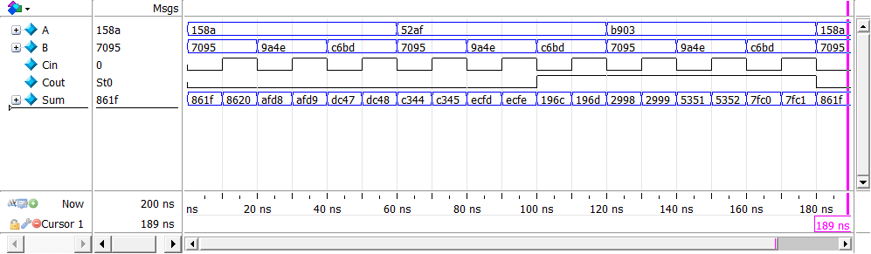
Simulator Waveforms
The values of A, B, and Sum are shown in hexadecimal
Can change the radix to binary, octal, and decimal
The values of Sum and Cout can be verified easily
All 18 test cases of A, B, and Cin are generated (t=0 to 180 ns)

