Slide 1
Network Security
CS 136
Computer Security
Peter Reiher
October 25, 2011

Slide 2
Outline
Basics of network security
Definitions
Sample attacks
Defense mechanisms

Slide 3
Some Important Network Characteristics for Security
Degree of locality
Media used
Protocols used

Slide 4
Degree of Locality
Some networks are very local
  E.g., an Ethernet
  Benefits from:
    Physical locality
    Small number of users and machines
    Common goals and interests
Other networks are very non-local
  E.g., the Internet backbone
  Many users/sites share bandwidth

Slide 5
Network Media
Some networks are wires, cables, or over telephone lines
  Can be physically protected
Other networks are satellite links or other radio links
  Physical protection possibilities more limited

Slide 6
Protocol Types
TCP/IP is the most used
  But it only specifies some common intermediate levels
  Other protocols exist above and below it
In places, other protocols replace TCP/IP
And there are lots of supporting protocols
  Routing protocols, naming and directory protocols, network management protocols
  And security protocols (IPSec, ssh, ssl)

Slide 7
Implications of Protocol Type
The protocol defines a set of rules that will always be followed
  But usually not quite complete
  And they assume everyone is at least trying to play by the rules
  What if they don’t?
Specific attacks exist against specific protocols

Slide 8
Why Are Networks Especially Threatened?
Many “moving parts”
Many different administrative domains
Everyone can get some access
In some cases, trivial for attacker to get a foothold on the network
Networks encourage sharing
Networks often allow anonymity

Slide 9
What Can Attackers Attack?
The media connecting the nodes
Nodes that are connected to them
Routers that control the traffic
The protocols that set the rules for communications

Slide 10
Wiretapping
Passive wiretapping is listening in illicitly on conversations
Active wiretapping is injecting traffic illicitly
Packet sniffers can listen to all traffic on a broadcast medium
  Ethernet or 802.11, e.g.
Wiretapping on wireless often just a matter of putting up an antenna

Slide 11
Impersonation
A packet comes in over the network
  With some source indicated in its header
Often, the action to be taken with the packet depends on the source
But attackers may be able to create packets with false sources

Slide 12
Violations of Message Confidentiality
Other problems can cause messages to be inappropriately divulged
Misdelivery can send a message to the wrong place
  Clever attackers can make it happen
Message can be read at an intermediate gateway or a router
Sometimes an intruder can get useful information just by traffic analysis

Slide 13
Message Integrity
Even if the attacker can’t create the packets he wants, sometimes he can alter proper packets
To change the effect of what they will do
Typically requires access to part of the path message takes

Slide 14
Denial of Service
Attacks that prevent legitimate users from doing their work
By flooding the network
Or corrupting routing tables
Or flooding routers
Or destroying key packets

Slide 15
How Do Denial of Service Attacks Occur?
Basically, the attacker injects some form of traffic
Most current networks aren’t built to throttle uncooperative parties very well
All-inclusive nature of the Internet makes basic access trivial
Universality of IP makes reaching most of the network easy

Slide 16
Example DoS Attack: Smurf Attacks
Attack on vulnerability in IP broadcasting
Send a ping packet to IP broadcast address
  With forged “from” header of your target
Resulting in a flood of replies from the sources to the target
Easy to fix at the intermediary
  Don’t allow IP broadcasts to originate outside your network
No good solutions for victim

Slide 17
Another Example: SYN Flood
Based on vulnerability in TCP
Attacker uses initial request/response to start TCP session to fill a table at the server
Preventing new real TCP sessions
SYN cookies and firewalls with massive tables are possible defenses

Slide 18
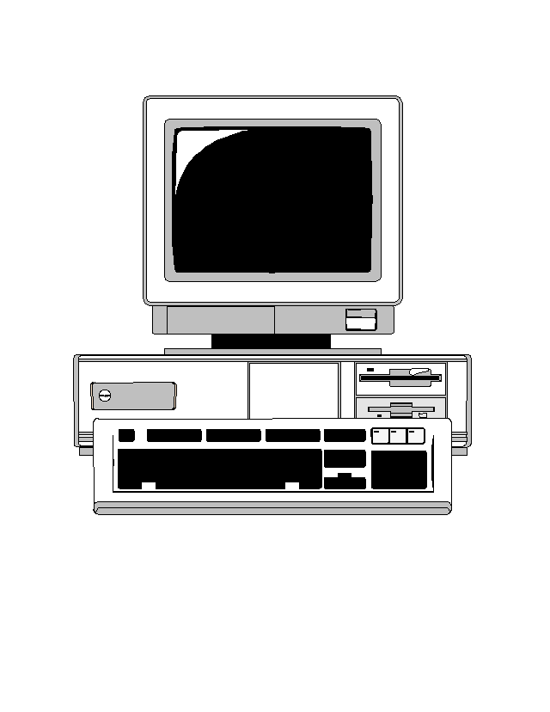

Normal SYN Behavior
SYN
SYN/ACK
ACK
Table of open TCP connections

Slide 19

A SYN Flood
SYN
SYN
SYN
SYN
SYN/ACK
SYN/ACK
SYN/ACK
SYN/ACK
SYN
Server can’t fill request!
Table of open TCP connections

Slide 20

SYN Cookies
And no changes to TCP protocol itself
KEY POINT: Server doesn’t need to save cookie value!
SYN/ACK number is secret function of various information
Client IP address & port, server’s IP address and port, and a timer
SYN
+ 1
SYN/ACK
No room in the table, so send back a SYN cookie, instead
ACK
Server recalculates cookie to determine if proper response

Slide 21
General Network Denial of Service Attacks
Need not tickle any particular vulnerability
Can achieve success by mere volume of packets
If more packets sent than can be handled by target, service is denied
A hard problem to solve

Slide 22
Distributed Denial of Service Attacks
Goal: Prevent a network site from doing its normal business
Method: overwhelm the site with attack traffic
Response: ?

Slide 23

The Problem

Slide 24
Why Are These Attacks Made?
Generally to annoy
Sometimes for extortion
If directed at infrastructure, might cripple parts of Internet

Slide 25
Attack Methods
Pure flooding
  Of network connection
  Or of upstream network
Overwhelm some other resource
  SYN flood
  CPU resources
  Memory resources
  Application level resource
Direct or reflection

Slide 26
Why “Distributed”?
Targets are often highly provisioned servers
A single machine usually cannot overwhelm such a server
So harness multiple machines to do so
Also makes defenses harder

Slide 27
How to Defend?
A vital characteristic:
  Don’t just stop a flood
  ENSURE SERVICE TO LEGITIMATE CLIENTS!!!
If you deliver a manageable amount of garbage, you haven’t solved the problem

Slide 28
Complicating Factors
High availability of compromised machines
  Millions of zombie machines out there
Internet is designed to deliver traffic
  Regardless of its value
IP spoofing allows easy hiding
Distributed nature makes legal approaches hard
Attacker can choose all aspects of his attack packets
  Can be a lot like good ones

Slide 29
Basic Defense Approaches
Overprovisioning
Dynamic increases in provisioning
Hiding
Tracking attackers
Legal approaches
Reducing volume of attack
None of these are totally effective

