Slide 1
Network Security, Continued
CS 136
Computer Security
Peter Reiher
November 1, 2011

Slide 2
Encryption and Network Security
Relies on the kinds of encryption algorithms and protocols discussed previously
Can be applied at different places in the network stack
With different effects and costs

Slide 3
Link Level Encryption
Source
Destination
plaintext
ciphertext
plaintext
ciphertext
ciphertext
plaintext
ciphertext
ciphertext
plaintext
ciphertext
ciphertext
plaintext
ciphertext
Let’s say we want to send a message using encryption
Different keys (maybe even different ciphers) used at each hop

Slide 4
End-to-End Encryption
Source
Destination
plaintext
plaintext
ciphertext
ciphertext
ciphertext
ciphertext
ciphertext
When would link encryption be better?
Cryptography only at the end points
Only the end points see the plaintext
Normal way network cryptography done

Slide 5
Where Are the Endpoints, Anyway?
If you do end-to-end encryption, where are the endpoints?
The network layer end points?
The transport layer end points?
The application layer end points?
Maybe not even end machine to end machine (e.g., VPNs)?
Has serious implications for where you do cryptography
  And keying and trust issues

Slide 6
IPsec
Standard for applying cryptography at the network layer of IP stack
Provides various options for encrypting and authenticating packets
  On end-to-end basis
  Without concern for transport layer (or higher)

Slide 7
What IPsec Covers
Message integrity
Message authentication
Message confidentiality

Slide 8
What Isn’t Covered
Non-repudiation
Digital signatures
Key distribution
Traffic analysis
Handling of security associations
Some of these covered in related standards

Slide 9
Some Important Terms for IPsec
Security Association - “A Security Association (SA) is a simplex ‘connection’ that affords security services to the traffic carried by it.”
  Basically, a secure one-way channel
SPI (Security Parameters Index) – Combined with destination IP address and IPsec protocol type, uniquely identifies an SA

Slide 10
General Structure of IPsec
Really designed for end-to-end encryption
  Though could do link level
Designed to operate with either IPv4 or IPv6
Meant to operate with a variety of different encryption protocols
And to be neutral to key distribution methods
Has sub-protocols
  E.g., Encapsulating Security Payload

Slide 11
Encapsulating Security
Payload (ESP) Protocol
Encrypt the data and place it within the ESP
The ESP has normal IP headers
Can be used to encrypt just the payload of the packet
Or the entire IP packet

Slide 12
ESP Modes
Transport mode
  Encrypt just the transport-level data in the original packet
  No IP headers encrypted
Tunnel mode
  Original IP datagram is encrypted and placed in ESP
  Unencrypted headers wrapped around ESP

Slide 13
ESP in Transport Mode
Extract the transport-layer frame
  E.g., TCP, UDP, etc.
Encapsulate it in an ESP
Encrypt it
The encrypted data is now the last payload of a cleartext IP datagram

Slide 14
ESP Transport Mode
Original
IP header
ESP
Hdr
Normal Packet
Payload
ESP
Trlr
ESP
Auth
Encrypted
Authenticated

Slide 15
Using ESP in Tunnel Mode
Encrypt the IP datagram
  The entire datagram
Encapsulate it in a cleartext IP datagram
Routers not understanding IPsec can still handle it
Receiver reverses the process

Slide 16
ESP Tunnel Mode
Original
Packet
Payload
New
IP hdr
ESP
Hdr
Orig.
IP hdr
ESP
Trlr
ESP
Auth
Encrypted
Authenticated

Slide 17
Uses and Implications of Tunnel Mode
Typically used when there are security gateways between sender and receiver
  And/or sender and receiver don’t speak IPsec
Outer header shows security gateway identities
  Not identities of real parties
Can thus be used to hide some traffic patterns

Slide 18
What IPsec Requires
Protocol standards
  To allow messages to move securely between nodes
Supporting mechanisms at hosts running IPsec
  E.g., a Security Association Database
Lots of plug-in stuff to do the cryptographic heavy lifting

Slide 19
The Protocol Components
Pretty simple
Necessary to interoperate with non-IPsec equipment
So everything important is inside an individual IP packet’s payload
No inter-message components to protocol
  Though some security modes enforce inter-message invariants

Slide 20
The Supporting Mechanisms
Methods of defining security associations
Databases for keeping track of what’s going on with other IPsec nodes
  To know what processing to apply to outgoing packets
  To know what processing to apply to incoming packets

Slide 21
Plug-In Mechanisms
Designed for high degree of generality
So easy to plug in:
  Different crypto algorithms
  Different hashing/signature schemes
  Different key management mechanisms

Slide 22
Status of IPsec
Accepted Internet standard
Widely implemented and used
  Supported in Windows 2000, XP, Vista, Windows 7
  In Linux 2.6 (and later) kernel
The architecture doesn’t require everyone to use it
RFC 3602 on using AES in IPsec still listed as “proposed”
AES will become default for ESP in IPsec

Slide 23
Traffic Control Mechanisms
Filtering
  Source address filtering
  Other forms of filtering
Rate limits
Protection against traffic analysis
  Padding
  Routing control

Slide 24
Source Address Filtering
Filtering out some packets because of their source address value
  Usually because you believe their source address is spoofed
Often called ingress filtering
  Or egress filtering . . .

Slide 25
Source Address Filtering for Address Assurance
Router “knows” what network it sits in front of
  In particular, knows IP addresses of machines there
Filter outgoing packets with source addresses not in that range
Prevents your users from spoofing other nodes’ addresses
  But not from spoofing each other’s

Slide 26
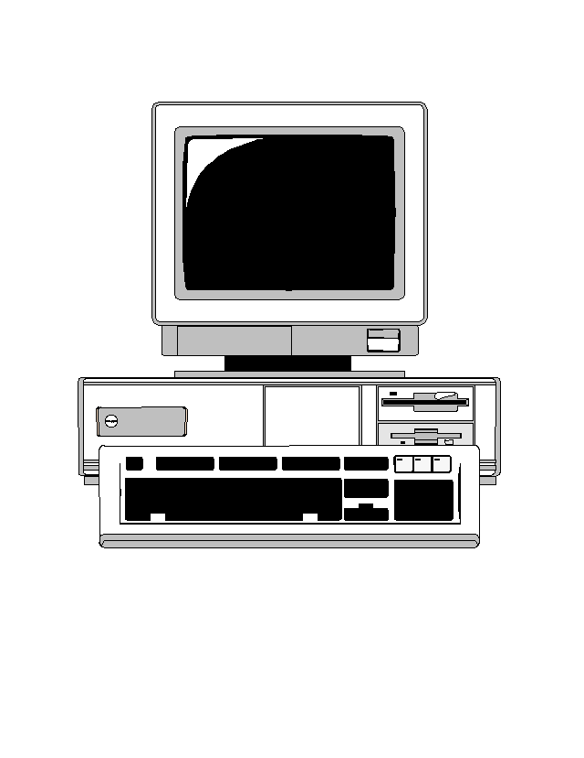

Source Address Filtering Example
95.113.27.12
56.29.138.2
My network shouldn’t be creating packets with this source address
128.171.192.*
So drop the packet

Slide 27
Source Address Filtering in the Other Direction
Often called egress filtering
  Or ingress filtering . . .
Occurs as packets leave the Internet and enter a border router
  On way to that router’s network
What addresses shouldn’t be coming into your local network?

Slide 28
Filtering Incoming Packets
128.171.192.5
128.171.192.7
Packets with this source address should be going out, not coming in
128.171.192.*
So drop the packet

Slide 29
Other Forms of Filtering
One can filter on things other than source address
  Such as worm signatures, unknown protocol identifiers, etc.
Also, there are unallocated IP addresses in IPv4 space
  Can filter for packets going to or coming from those addresses
Some source addresses for local use only
  Internet routers can drop packets to/from them

Slide 30
Realistic Limits on Filtering
Little filtering possible in Internet core
  Packets being handled too fast
  Backbone providers don’t want to filter
  Damage great if you screw it up
Filtering near edges has its own limits
  In what’s possible
  In what’s affordable
  In what the router owners will do

Slide 31
Rate Limits
Many routers can place limits on the traffic they send to a destination
Ensuring that the destination isn’t overloaded
  Popular for denial of service defenses
Limits can be defined somewhat flexibly
But often not enough flexibility to let the good traffic through and stop the bad

Slide 32
Padding
Sometimes you don’t want intruders to know what your traffic characteristics are
Padding adds extra traffic to hide the real stuff
Fake traffic must look like real traffic
  Usually means encrypt it all
Must be done carefully, or clever attackers can tell the good stuff from the noise

Slide 33
Routing Control
Use ability to control message routing to conceal the traffic in the network
Used in onion routing to hide who is sending traffic to whom
  For anonymization purposes
Routing control also used in some network defense
  To hide real location of a machine
  E.g., SOS DDoS defense system

Slide 34
Firewalls
What is a firewall?
A machine to protect a network from malicious external attacks
Typically a machine that sits between a LAN/WAN and the Internet
Running special software to regulate network traffic

Slide 35

Typical Use of a Firewall
???
The
Internet
???
Firewall
Local Network

Slide 36
Firewalls and Perimeter Defense
Firewalls implement a form of security called perimeter defense
Protect the inside of something by defending the outside strongly
  The firewall machine is often called a bastion host
Control the entry and exit points
If nothing bad can get in, I’m safe, right?

Slide 37
Weaknesses of Perimeter Defense Models
Breaching the perimeter compromises all security
Windows passwords are a form of perimeter defense
  If you get past the password, you can do anything
Perimeter defense is part of the solution, not the entire solution

Slide 38

Weaknesses of Perimeter Defense

Slide 39
Defense in Depth
An old principle in warfare
Don’t rely on a single defensive mechanism or defense at a single point
Combine different defenses
Defeating one defense doesn’t defeat your entire plan

Slide 40
So What Should Happen?

Slide 41
Or, Better

Slide 42
Or, Even Better

Slide 43
So Are Firewalls Any Use?
Definitely!
They aren’t the full solution, but they are absolutely part of it
Anyone who cares about security needs to run a decent firewall
They just have to do other stuff, too
94% of respondents in 2008 CSI survey say they use firewalls

Slide 44
The Brass Tacks of Firewalls
What do they really do?
Examine each incoming packet
Decide to let the packet through or drop it
  Criteria could be simple or complex
Perhaps log the decision
Maybe send rejected packets elsewhere
Pretty much all there is to it

Slide 45
Types of Firewalls
Filtering gateways
  AKA screening routers
Application level gateways
  AKA proxy gateways
Reverse firewalls

Slide 46
Filtering Gateways
Based on packet header information
  Primarily, IP addresses, port numbers, and protocol numbers
Based on that information, either let the packet through or reject it

Slide 47
Example Use of
Filtering Gateways
Allow particular external machines to telnet into specific internal machines
  Denying telnet to other machines
Or allow full access to some external machines
And none to others

Slide 48
A Fundamental Problem
IP addresses can be spoofed
If your filtering firewall trusts packet headers, it offers little protection
Situation may be improved by IPsec
  But hasn’t been yet
Firewalls can perform the ingress/egress filtering discussed earlier

Slide 49
Filtering Based on Ports
Most incoming traffic is destined for a particular machine and port
  Which can be derived from the IP and TCP headers
Only let through packets to select machines at specific ports
Makes it impossible to externally exploit flaws in little-used ports
  If you configure the firewall right . . .

Slide 50
Pros and Cons of
Filtering Gateways
Fast
Cheap
Flexible
Transparent
Limited capabilities
Dependent on header authentication
Generally poor logging
May rely on router security

Slide 51
Application Level Gateways
Also known as proxy gateways and stateful firewalls
Firewalls that understand the application-level details of network traffic
  To some degree
Traffic is accepted or rejected based on the probable results of accepting it

Slide 52
How Application Level Gateways Work
The firewall serves as a general framework
Various proxies are plugged into the framework
Incoming packets are examined
  Handed to the appropriate proxy
Proxy typically accepts or rejects

Slide 53
Deep Packet Inspection
Another name for typical activity of application level firewalls
Looking into packets beyond their headers
  Especially the IP header
“Deep” sometimes also means deeper understanding of what’s going on
  Though not always

Slide 54
Firewall Proxies
Programs capable of understanding particular kinds of traffic
  E.g., FTP, HTTP, videoconferencing
Proxies are specialized
A good proxy has deep understanding of the network application

Slide 55
What Are the Limits of Proxies?
Proxies can only test for threats they understand
Either they must permit a very limited set of operations
Or they must have deep understanding of the program they protect
  If too deep, they may share the flaw
Performance limits on how much work they can do on certain types of packets

Slide 56
Pros and Cons of Application Level Gateways
Highly flexible
Good logging
Content-based filtering
Potentially transparent
Slower
More complex and expensive
A good proxy is hard to find

Slide 57
Reverse Firewalls
Normal firewalls keep stuff from the outside from getting inside
Reverse firewalls keep stuff from the insider from getting outside
Often colocated with regular firewalls
Why do we need them?

Slide 58
Possible Uses of Reverse Firewalls
Concealing details of your network from attackers
Preventing compromised machines from sending things out
  E.g., intercepting bot communications or stopping DDoS
  Preventing data exfiltration

Slide 59
Firewall Characteristics
Statefulness
Transparency
Handling authentication
Handling encryption

Slide 60
Stateful Firewalls
Much network traffic is connection-oriented
  E.g., telnet and videoconferencing
Proper handling of that traffic requires the firewall to maintain state
But handling information about connections is more complex

Slide 61
Firewalls and Transparency
Ideally, the firewall should be invisible
  Except when it vetoes access
Users inside should be able to communicate outside without knowing about the firewall
External users should be able to invoke internal services transparently

Slide 62
Firewalls and Authentication
Many systems want to give special privileges to specific sites or users
Firewalls can only support that to the extent that strong authentication is available
  At the granularity required
For general use, may not be possible
  In current systems

Slide 63
Firewalls and Encryption
Firewalls provide no confidentiality
Unless the data is encrypted
But if the data is encrypted, the firewall can’t examine it
So typically the firewall must be able to decrypt
  Or only work on unencrypted parts of packets
Can decrypt, analyze, and re-encrypt

