Slide 1
Network Security: Con’t
CS 136
Computer Security
Peter Reiher
November 3, 2011

Slide 2
Outline
Configuring firewalls
Virtual private networks
Wireless network security
  General issues
  WEP and WPA
Honeypots and honeynets

Slide 3
Firewall Configuration and Administration
Again, the firewall is the point of attack for intruders
Thus, it must be extraordinarily secure
How do you achieve that level of security?

Slide 4
Firewall Location
Clearly, between you and the bad guys
But you may have some different types of machines/functionalities
Sometimes makes sense to divide your network into segments
  Typically, less secure public network and more secure internal network
  Using separate firewalls

Slide 5
Firewalls and DMZs
A standard way to configure multiple firewalls for a single organization
Used when organization runs machines with different openness needs
  And security requirements
Basically, use firewalls to divide your network into segments

Slide 6
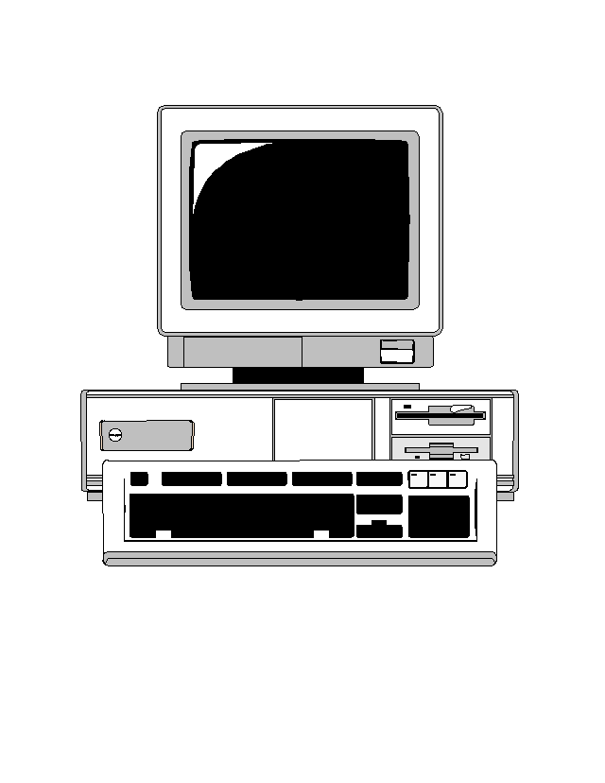

A Typical DMZ Organization
Your web server
The Internet
DMZ
Firewall set up to protect your web server
Firewall set up to protect your LAN
Your production LAN

Slide 7
Advantages of DMZ Approach
Can customize firewalls for different purposes
Can customize traffic analysis in different areas of network
Keeps inherently less safe traffic away from critical resources

Slide 8
Dangers of a DMZ
Things in the DMZ aren’t well protected
  If they’re compromised, provide a foothold into your network
One problem in DMZ might compromise all machines there
Vital that main network doesn’t treat machines in DMZ as trusted
Must avoid back doors from DMZ to network

Slide 9
Firewall Hardening
Devote a special machine only to firewall duties
Alter OS operations on that machine
  To allow only firewall activities
  And to close known vulnerabilities
Strictly limit access to the machine
  Both login and remote execution

Slide 10
Keep Your Firewall Current
New vulnerabilities are discovered all the time
Must update your firewall to fix them
Even more important, sometimes you have to open doors temporarily
  Make sure you shut them again later
Can automate some updates to firewalls
How about getting rid of old stuff?

Slide 11
Closing the Back Doors
Firewall security is based on assumption that all traffic goes through the firewall
So be careful with:
  Wireless connections
  Portable computers
  Sneakernet mechanisms and other entry points
Put a firewall at every entry point to your network
And make sure all your firewalls are up to date

Slide 12


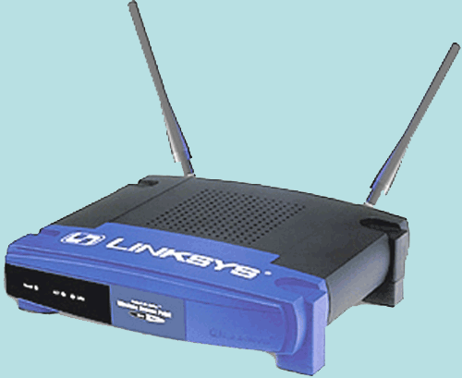

What About Portable Computers?
Bob
Alice
Carol
Xavier
Local Café

Slide 13
Now Bob Goes To Work . . .
Worker
Bob
Worker
Worker
Worker
Bob’s Office

Slide 14
How To Handle This Problem?
Essentially quarantine the portable computer until it’s safe
Don’t permit connection to wireless access point until you’re satisfied that the portable is safe
  Or put them in constrained network
Common in Cisco, Microsoft, and other companies’ products
  Network access control

Slide 15
Single Machine Firewalls
Instead of separate machine protecting network,
A machine puts software between the outside world and the rest of machine
Under its own control
To protect itself
Available on most modern systems

Slide 16
Pros and Cons of Individual Firewalls
Customized to particular machine
  Specific to local software and usage
Under machine owner’s control
Can use in-machine knowledge for its decisions
May be able to do deeper inspection
Provides defense in depth

Slide 17
Cons of Personal Firewalls
Only protects that machine
Less likely to be properly configured
  Since most users don’t understand security well
  And/or don’t view it as their job
On the whole, generally viewed as valuable

Slide 18
Virtual Private Networks
VPNs
What if your company has more than one office?
And they’re far apart?
  Like on opposite coasts of the US
How can you have secure cooperation between them?

Slide 19
Leased Line Solutions
Lease private lines from some telephone company
The phone company ensures that your lines cannot be tapped
  To the extent you trust in phone company security
Can be expensive and limiting

Slide 20
Another Solution
Communicate via the Internet
  Getting full connectivity, bandwidth, reliability, etc.
  At a lower price, too
But how do you keep the traffic secure?
Encrypt everything!

Slide 21
Encryption and Virtual
Private Networks
Use encryption to convert a shared line to a private line
Set up a firewall at each installation’s network
Set up shared encryption keys between the firewalls
Encrypt all traffic using those keys

Slide 22
Actual Use of Encryption in VPNs
VPNs run over the Internet
Internet routers can’t handle fully encrypted packets
Obviously, VPN packets aren’t entirely encrypted
They are encrypted in a tunnel mode

Slide 23
Is This Solution Feasible?
A VPN can be half the cost of leased lines (or less)
And give the owner more direct control over the line’s security
Ease of use improving
  Often based on IPsec

Slide 24
Key Management and VPNs
All security of the VPN relies on key secrecy
How do you communicate the key?
  In early implementations, manually
  Modern VPNs use IKE or proprietary key servers
How often do you change the key?
  IKE allows frequent changes

Slide 25
VPNs and Firewalls
VPN encryption is typically done between firewall machines
  VPN often integrated into firewall product
Do I need the firewall for anything else?
Probably, since I still need to allow non-VPN traffic in and out
Need firewall “inside” VPN
  Since VPN traffic encrypted
  Including stuff like IP addresses and ports
  “Inside” means “later in same box” usually

Slide 26
VPNs and Portable Computing
Increasingly, workers connect to offices remotely
  While on travel
  Or when working from home
VPNs offer secure solution
  Typically as software in the portable computer
Usually needs to be pre-configured

Slide 27
VPN Deployment Issues
Desirable not to have to pre-deploy VPN software
  Clients get access from any machine
Possible by using downloaded code
  Connect to server, download VPN applet, away you go
  Often done via web browser
  Leveraging existing SSL code
  Authentication via user ID/password
  Implies you trust the applet . . .
Issue of compromised user machine

Slide 28
VPN Products
VPNs are big business
Many products are available
Some for basic VPN service
Some for specialized use
  Such as networked meetings
  Or providing remote system administration and debugging

Slide 29
Juniper Secure Access 700
A hardware VPN
Uses SSL
Accessible via web browser
  Which avoids some pre-deployment costs
  Downloads code using browser extensibility
Does various security checks on client machine before allowing access

Slide 30
Citrix GoToMeeting
Service provided through Citrix web servers
  For videoconferencing
Connects many meeting participants via a custom VPN
  Care taken that Citrix doesn’t have VPN key
Basic interface through web browser

Slide 31
Wireless Network Security
Wireless networks are “just like” other networks
Except . . .
  Almost always broadcast
  Generally short range
  Usually supporting mobility
  Often very open

Slide 32
Special Problems For Wireless Networks
Eavesdropping is really easy
  Just put up an antenna in the right place
Traffic injection just as easy
  Encryption/authentication can catch forgeries
  But denial of service possible
Wireless tends to flakiness

Slide 33
Types of Wireless Networks
802.11 networks
  Variants on local area network technologies
Bluetooth networks
  Very short range
Cellular telephone networks
Line-of-sight networks
  Dedicated, for relatively long hauls
Satellite networks

Slide 34
The General Solution For Wireless Security
Wireless networks inherently less secure than wired ones
So we need to add extra security
How to do it?
Link encryption
  Encrypt traffic just as it crosses the wireless network
  Decrypt it before sending it along

Slide 35
Why Not End-to-End Encryption?
Some non-wireless destinations might not be prepared to perform crypto
  What if wireless user wants protection anyway?
Doesn’t help wireless access point provide exclusive access
  Any eavesdropper can use network

Slide 36
Firesheep
Many wireless networks aren’t encrypted
Many web services don’t use end-to-end encryption for entire sessions
Firesheep was a demo of the dangers of those in combination
Simple Firefox plug-in to scan unprotected wireless nets for unencrypted cookies
  Allowing session hijacking attacks
When run in that environment, tended to be highly successful

Slide 37
Why Does Session Hijacking Work?
Web sites try to avoid computation costs of encryption
So they only encrypt login
Subsequent HTTP messages “authenticated” with a cookie
Anyone who has the cookie can authenticate
Cookie is sent in the clear . . .
Why especially a problem for wireless?

Slide 38
802.11 Security
Originally, 802.11 protocols didn’t include security
Once the need became clear, it was sort of too late
  Huge number of units in the field
  Couldn’t change the protocols
So, what to do?

Slide 39
WEP
First solution to the 802.11 security problem
Wired Equivalency Protocol
Intended to provide encryption in 802.11 networks
  Without changing the protocol
  So all existing hardware just worked
The backward compatibility worked
The security didn’t

Slide 40
What Did WEP Do?
Used stream cipher (RC4) for confidentiality
  With 104 bit keys
  Usually stored on the computer using the wireless network
  24 bit IV also used
Used checksum for integrity

Slide 41
What Was the Problem With WEP?
Access point generates session key from its own permanent key plus IV
  Making replays and key deduction attacks a problem
IV was intended to prevent that
But it was too short and used improperly
In 2001, WEP cracking method shown
  Took less than 1 minute to get key

Slide 42
WPA and WPA2
Generates new key for each session
Can use either TKIP or AES mode
Various vulnerabilities in TKIP mode
AES mode hasn’t been cracked yet
  May be available for some WPA
  Definitely in WPA2

Slide 43
Honeypots and Honeynets
A honeypot is a machine set up to attract attackers
Classic use is to learn more about attackers
Ongoing research on using honeypots as part of a system’s defenses

Slide 44
Setting Up A Honeypot
Usually a machine dedicated to this purpose
Probably easier to find and compromise than your real machines
But has lots of software watching what’s happening on it
Providing early warning of attacks

Slide 45
What Have Honeypots Been Used For?
To study attackers’ common practices
There are lengthy traces of what attackers do when they compromise a honeypot machine
Not clear these traces actually provided much we didn’t already know

Slide 46
Can a Honeypot Contribute to Defense?
Perhaps can serve as an early warning system
  Assuming that attacker hits the honeypot first
  And that you know it’s happened
If you can detect it’s happened there, why not everywhere?

Slide 47
Honeynets
A collection of honeypots on a single network
  Maybe on a single machine with multiple addresses
  More often using virtualization
Typically, no other machines are on the network
Since whole network is phony, all incoming traffic is probably attack traffic

Slide 48
What Can You Do With Honeynets?
Similar things to honeypots
  But at the network level
Also good for tracking the spread of worms
  Worm code typically visits them repeatedly
Main tool for detecting and analyzing botnets
Gives evidence on of DDoS attacks
  Through backscatter
  Based on attacker using IP spoofing

Slide 49
Backscatter
Some attacks are based on massive spoofing of IP addresses
  Particularly distributed denial of service attacks
Attack packets are typically reasonably well formed
If target gets them, it will reply to them
This can be helpful

Slide 50

Backscatter In Action
FAKE!
What does the target do with this packet?
95.113.27.12
56.29.138.2
117.15.202.74
56.29.138.2
95.113.27.12
What if this machine is a honeypot?
56.29.138.2
It probably sends a reply
To the forged address!
95.113.27.12

Slide 51
So What?
The honeypot knows it didn’t ask for this response
So it must have resulted from spoofing
Which means the source of the packet is under attack
With sufficient cleverness, you can figure out a lot more

Slide 52
What Can Backscatter Tell Us?
Who’s being attacked
For how long
With what sorts of packets
Even estimates of the volume of attack

Slide 53
How Do We Deduce This Stuff?
Who’s being attacked
  Whoever sends us reply packets
For how long
  How long do we see their replies?
With what sorts of packets
  What kind of reply?
Even estimates of the volume of attack
  This is trickier

Slide 54
Estimating Attack Volumes
Assume the attacker uses random spoofing
  Spoofed addresses chosen randomly
Your honeynet owns some set of addresses
  Perhaps 256 of them
Your addresses will be spoofed proportionally to all others
  Allowing you to calculate how many total packets were sent

Slide 55
Complicating Factors in This Calculation
Not all spoofed packets are delivered
  It’s a denial of service attack, after all
Not all delivered packets get responses
Not all responses are delivered
Attackers don’t always spoof at random

Slide 56
Honeynets and Botnets
Honeynets widely used by security researchers to “capture” bots
Honeynet is reachable from Internet
Intentionally weakly defended
Bots tend to compromise them
Researcher gets a copy of the bot

Slide 57
Issues With Honeynet Research
Don’t want captured bot infecting others
  Or performing other attack activities
So you need to prevent it from attacking out
But you also need to see its control traffic

Slide 58
What To Do With a Bot?
When the bot is captured, what do you do with it?
Typically, analyze it
  Especially for new types of bots
  To find weaknesses
  And to track rest of botnet
Analysis helpful for tracing “ancestry”

Slide 59
Botnet Countermeasures
Bot creators don’t want their bots captured
  If analyzed, they are likely to be stopped
So they try to avoid honeynets
How?

Slide 60
IP Cloaking
Malware creators try to avoid IP addresses run by defenders
  Like honeynets
They assemble lists of such addresses and their malware avoids them
Widely used technique
  Google 2011 study reports 200,000 malware sites using it

Slide 61
Virtualization Battles
Most honeynets built with VMs
  Too expensive to buy and run enough physical machines
  VMs easier to examine
So bots try to avoid VMs
  Which implies detecting them
So honeynet operators try to hide virtualization

Slide 62
Avoiding Virtualization
Basically, try to detect the differences between real and virtual machine
  Or between human and automated responses
E.g., look for actual mouse clicks
Or look for browser emulation, rather than real thing

Slide 63
Do You Need A Honeypot?
Not in the same way you need a firewall
Only useful if your security administrator spending a lot of time watching things
  E.g., very large enterprises
Or if your job is observing hacker activity
Something that someone needs to be doing
  Particularly, security experts watching the overall state of the network world
  But not necessarily you

Slide 64
So, You Want a Honeypot?
If you decide you want to run one, what do you do?
Could buy a commercial product
  E.g., NeuralIQ Event Horizon
Could build your own
Could look for open source stuff

Slide 65
The Honeynet Project
A non-profit organization dedicated to improving Internet security
Many activities related to honeynets
  White papers based on information gained from honeynets
  Tools to run honeypots and honeynets
www.honeynet.org

