Slide 1
Security Principles, Policies, and Tools
CS 136
Computer Security
Peter Reiher
September 27, 2011

Slide 2
Outline
Security design principles
Security policies
  Basic concepts
  Security policies for real systems
Classes of security tools
  Access control

Slide 3
Design Principles for
Secure Systems
Economy
Complete mediation
Open design
Separation of privileges
Least privilege
Least common mechanism
Acceptability
Fail-safe defaults

Slide 4
Economy in Security Design
Economical to develop
  And to use
  And to verify
Should add little or no overhead
Should do only what needs to be done
Generally, try to keep it simple and small

Slide 5
Complete Mediation
Apply security on every access to a protected object
  E.g., each read of a file, not just the open
Also involves checking access on everything that could be attacked

Slide 6
Open Design
Don’t rely on “security through obscurity”
Assume all potential attackers know everything about the design
  And completely understand it
This doesn’t mean publish everything important about your security system
  Though sometimes that’s a good idea
Obscurity can provide some security, but it’s brittle
  When the fog is cleared, the security disappears
  And modern attackers have good fog blowers

Slide 7
Separation of Privileges
Provide mechanisms that separate the privileges used for one purpose from those used for another
To allow flexibility in security systems
E.g., separate access control on each file

Slide 8
Least Privilege
Give bare minimum access rights required to complete a task
Require another request to perform another type of access
E.g., don’t give write permission to a file if the program only asked for read

Slide 9
Least Common Mechanism
Avoid sharing parts of the security mechanism
  among different users
  among different parts of the system
Coupling leads to possible security breaches

Slide 10
Acceptability
Mechanism must be simple to use
Simple enough that people will use it without thinking about it
Must rarely or never prevent permissible accesses

Slide 11
Fail-Safe Designs
Default to lack of access
So if something goes wrong or is forgotten or isn’t done, no security lost
If important mistakes are made, you’ll find out about them
  Without loss of security
  But if it happens too often . . .

Slide 12
Security Policies
Security policies describe how a secure system should behave
Generally, if you don’t have a clear policy, you don’t have a secure system
  Since you don’t really know what you’re trying to do

Slide 13
What Is a Security Policy?
A complete description of the security goals the system should achieve
  Not a description of how to achieve them
Sometimes described informally
Sometimes described very formally
  Using mathematical models

Slide 14
Informal Security Policies
“Users should only be able to access their own files, in most cases.”
“Only authorized users should be able to log in.”
“System executables should only be altered by system administrators.”
The general idea is pretty clear
But it can be hard to determine if a system meets these goals

Slide 15
Formal Security Policies
Typically expressed in a mathematical security policy language
Tending towards precision
  Allowing formal reasoning about the system and policy
Often matched to a particular policy model
  E.g., Bell-La Padula model
Hard to express many sensible policies in formal ways
  And hard to reason about them usefully

Slide 16
Access Control Policies
Describe who can access what resources
Mandatory access control
  The system enforces its own policy
Discretionary access control
  Policy set by individual users
Most systems provide only discretionary access control

Slide 17
Some Important Security Policies
Bell-La Padula
Biba integrity policy

Slide 18
Bell-La Padula Model
Probably best-known computer security model
Corresponds to military classifications
Combines mandatory and discretionary access control
Two parts:
  Clearances
  Classifications

Slide 19
Clearances
Subjects (people, programs, etc.) have a clearance
Clearance describes how trusted the subject is
E.g., unclassified, confidential, secret, top secret

Slide 20
Classifications
Each object (file, database entry, etc.) has a classification
The classification describes how sensitive the object is
Using same categories as clearances
Informally, only people with the same (or higher) clearance should be able to access objects of a particular classification

Slide 21
Goal of Bell-La Padula Model
Prevent any subject from ever getting read access to data at higher classification levels than subject’s clearance
  I.e., don’t let untrusted people see your secrets
Concerned not just with objects
Also concerned with the objects’ contents
Includes discretionary access control
  Which we won’t cover in lecture

Slide 22
Bell-La Padula Simple Security Condition
Subject S can read object O iff l_{O} ≤ l_{S}
Simple enough:
  If S isn’t granted top secret clearance, S can’t read top secret objects
Are we done?

Slide 23
Why Aren’t We Done?
Remember, we really care about the information in an object
A subject with top secret clearance can read a top secret object
If careless, he could write that information to a confidential object
Then someone with confidential clearance can read top secret information

Slide 24
The Bell-La Padula *-Property
S can write O iff l_{S} ≤ l_{O}
Prevents write-down
  Privileged subjects writing high-classification information to low-classification objects
  E.g., a top secret user can’t write to a confidential data file
Can be proven that a system meeting these properties is “secure”

Slide 25
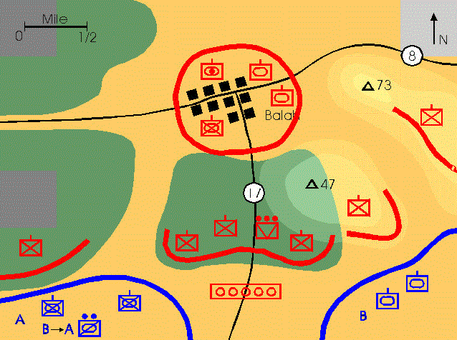

Bell-La Padula Example
TOP SECRET
Classified
read
ORDERS
Write
(attack the red tank)
Top Secret
Bell-La Padula doesn’t allow write-down!
Classified
write
Secret

Slide 26
So How Do You Really Use The System?
There have to be mechanisms for reclassification
  Usually requiring explicit operation
Danger that reclassification process will be done incautiously
Real systems also use classes of information

Slide 27
Integrity Security Policies
Designed to ensure that information is not improperly changed
Often the key issue for commercial systems
Secrecy is nice, but not losing track of your inventory is crucial

Slide 28
Example: Biba Integrity Policy
Subject set S, object set O
Set of ordered integrity levels I
Subjects and objects have integrity levels
Subjects at high integrity levels are less likely to screw up data
  E.g., trusted users or carefully audited programs
Data at a high integrity level is less likely to be screwed up
  Probably because it badly needs not to be screwed up

Slide 29
Biba Integrity Policy Rules
s can write to o iff i(o) ≤ i(s)
s₁ can execute s₂ iff i(s₂) ≤ i(s₁)
A subject s can read object o iff i(s) ≤ i(o)
Why do we need the read rule?

Slide 30
Hybrid Models
Sometimes the issue is keeping things carefully separated
E.g., a brokerage that handles accounts for several competing businesses
Microsoft might not like the same analyst working on their account and IBM’s
There are issues of both confidentiality and integrity here
Example – Chinese Wall model

Slide 31
The Realities of Discretionary Access Control
Most users never change the defaults on anything
  Unless the defaults prevent them from doing something they want to do
Most users don’t think about or understand access control
Probably not wise to rely on it to protect information you care about
  Unless you’re the one setting it
  And you know what you’re doing

Slide 32
The Problems With Security Policies
Hard to define properly
  How do you determine what to allow and disallow?
Hard to go from policy to the mechanisms that actually implement it
Hard to understand implications of policy
Defining and implementing policies is a lot of work

Slide 33
The Result?
Security policies get a lot of lip service
But an awful lot of places haven’t actually got one
  Even some very important places
"If you have a policy, and you don't enforce it, and you don't hold people accountable for violating it, then - do you have a policy?” Marcus Ranum

Slide 34
Tools for Security
Physical security
Access control
Encryption
Authentication
Encapsulation
Intrusion detection
Common sense

Slide 35
Physical Security
Lock up your computer
  Actually, sometimes a good answer
But what about networking?
  Networks poke a hole in the locked door
In any case, lack of physical security often makes other measures pointless

Slide 36
Access Controls
Only let authorized parties access the system
A lot trickier than it sounds
Particularly in a network environment
Once data is outside your system, how can you continue to control it?
  Again, of concern in network environments

Slide 37
Encryption
Algorithms to hide the content of data or communications
Only those knowing a secret can decrypt the protection
One of the most important tools in computer security
  But not a panacea
Covered in more detail later in class

Slide 38
Authentication
Methods of ensuring that someone is who they say they are
Vital for access control
But also vital for many other purposes
Often (but not always) based on encryption

Slide 39
Encapsulation
Methods of allowing outsiders limited access to your resources
Let them use or access some things
  But not everything
Simple, in concept
Extremely challenging, in practice

Slide 40
Intrusion Detection
All security methods sometimes fail
When they do, notice that something is wrong
And take steps to correct the problem
Reactive, not preventative
  But unrealistic to believe any prevention is certain
Must be automatic to be really useful

Slide 41
Common Sense
A lot of problems arise because people don’t like to think
The best security tools generally fail if people use them badly
If the easiest way in is to fool people, that’s what attackers will do

Slide 42
Access Control
Security could be easy
  If we didn’t want anyone to get access to anything
The trick is giving access to only the right people
  And at the right time and circumstances
How do we ensure that a given resource can only be accessed when it should be?

Slide 43
Goals for Access Control
Complete mediation
Least privilege
Useful in a networked environment
Scalability
Acceptable cost and usability

Slide 44
Access Control Mechanisms
Access control lists
Capabilities
Access control matrices
  Theoretical concept we won’t discuss in detail
Role based access control

Slide 45
The Language of Access Control
Subjects are active entities that want to gain access to something
  E.g., users or programs
Objects represent things that can be accessed
  E.g., files, devices, database records
Access is any form of interaction with an object
An entity can be both subject and object

Slide 46
Mandatory vs. Discretionary Access Control
Mandatory access control is dictated by the underlying system
  Individual users can’t override it
  Even for their own data
Discretionary access control is under command of the user
  System enforces what they choose
  More common than mandatory

Slide 47
Access Control Lists
For each protected resource, maintain a single list
Each list entry specifies a user who can access the resource
  And the allowable modes of access
When a user requests access to a resource, check the access control list (ACL)

Slide 48
ACL Objects and Subjects
In ACL terminology, the resources being protected are objects
The entities attempting to access them are subjects
  Allowing finer granularity of control than per-user

Slide 49
ACL Example
An operating system example:
  Using ACLs to protect a file
User (Subject) A is allowed to read and write to the file
User (Subject) B may only read from it
User (Subject) C may not access it

Slide 50
An ACL Protecting a File
Subject A
write
File
X
write
Subject B
read
write
A
ACL for file X
read
B
write
Subject C
C
none
denied

Slide 51
Issues for Access Control Lists
How do you know that the requestor is who he says he is?
How do you protect the access control list from modification?
How do you determine what resources a user can access?
Generally issues for OS design

Slide 52
Pros and Cons of ACLs
Easy to figure out who can access a resource
Easy to revoke or change access permissions
Hard to figure out what a subject can access
Changing access rights requires getting to the object

Slide 53
Capabilities
Each subject keeps a set of data items that specify his allowable accesses
Essentially, a set of tickets
Possession of the capability for an object implies that access is allowed

Slide 54
Properties of Capabilities
Must be unforgeable
  In single machine, keep under control of OS
  What about in a networked system?
In most systems, some capabilities allow creation of other capabilities
  Process can pass restricted set of capabilities to a subprocess

Slide 55
Capabilities Protecting a File
Capabilities
for A
Subject A
Read X
File X
File X
Read, Write
Read, Write
read
OK!
Capabilities
for B
File
X
Subject B
File X
Check validity of capability
Read
File X
Read, Write
Capabilities
for C
Subject C
Capability
Checking

Slide 56
Capabilities Denying Access
Capabilities
for A
User A
File X
Read, Write
No Capability Provided!
Capabilities
for B
File
X
User B
File X
Check validity of capability
Read
Capabilities
for C
denied
User C
write
Capability
Checking
write

Slide 57
How Will This Work in a Network?
How can we tell if it’s a good capability?
Capabilities
for A
Subject A
Subject A
File X
File X
Read, Write
Read, Write
Capabilities
for B
File
X
Subject B
Subject B
File X
File X
Read
Read
Capabilities
for C
File X
Subject C
Read, Write
Subject C
Capability
Checking

Slide 58
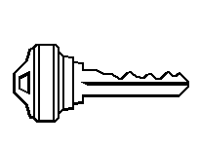
Revoking Capabilities
How do we take away Fred’s capability?
Fred
Accounts receivable
Without taking away Nancy’s?
Nancy

Slide 59
Options for Revoking Capabilities
Destroy the capability
  How do you find it?
Revoke on use
  Requires checking on use
Generation numbers
  Requires updating non-revoked capabilities

Slide 60
Pros and Cons of Capabilities
Easy to determine what a subject can access
Potentially faster than ACLs (in some circumstances)
Easy model for transfer of privileges
Hard to determine who can access an object
Requires extra mechanism to allow revocation
In network environment, need cryptographic methods to prevent forgery

Slide 61
Complete Mediation vs. Performance
Ideally, every data access should have access control independently applied
Practicality of doing so depends on the performance costs
Not doing so raises problems when access permissions change

Slide 62
Distributed Access Control
ACLs still work OK
  Provided you have a global namespace for subjects
  And no one can masquerade
Capabilities are more problematic
  Security relies on unforgeability
  Provided by cryptographic methods
  Prevents forging, not copying

Slide 63
Role Based Access Control
An enhancement to ACLs or capabilities
Each user has certain roles he can take while using the system
At any given time, the user is performing a certain role
Give the user access to only those things that are required to fulfill that role
Available in some form in most modern operating systems

Slide 64
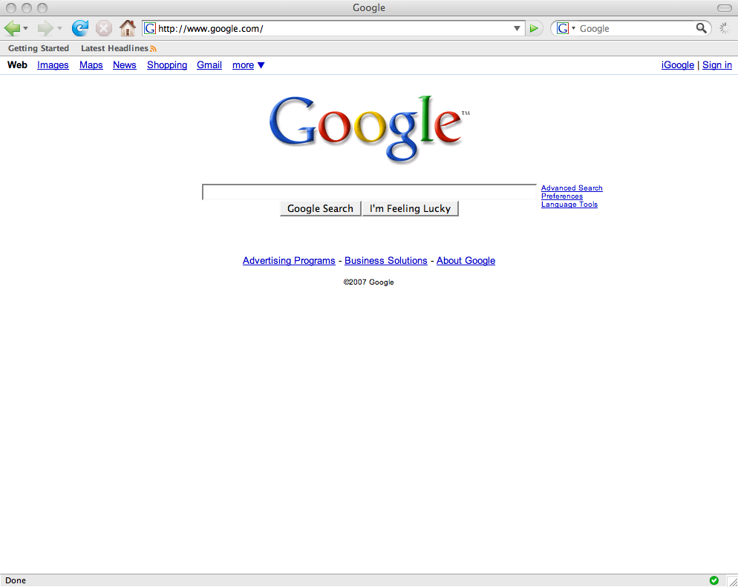

A Simple Example
Fred is a system administrator
But Fred is a also a normal user
To:Fred
From: Dick
Subject: Fun URL
------
Hi, Fred. I found this neat URL
. . .
Fred should operate under one role while doing system administration
And another role while doing normal stuff

Slide 65
Continuing With Our Example
He decides to upgrade the C++ compiler
Fred logs on as “fred”
He reads his email
So he changes his role to “sysadmin”
To:Fred
From: Dick
Subject: Fun URL
------
Hi, Fred. I found this neat URL
. . .
To:Fred
From: Dick
Subject: Fun URL
------
Hi, Fred. I found this neat URL
. . .
To:Fred
From: Dick
Subject: Fun URL
------
Hi, Fred. I found this neat URL
. . .
To:Fred
From: Dick
Subject: Fun URL
------
Hi, Fred. I found this neat URL
. . .
Then he has the privileges to upgrade the compiler

Slide 66
Changing Roles
Role based access control only helps if changing roles isn’t trivial
  Otherwise, the malicious code merely changes roles before doing anything else
Typically requires providing some secure form of authentication
  Which proves you have the right to change roles
  Usually passwords, but other methods possible

Slide 67
Practical Limitations on Role Based Access Control
Number of roles per user
Problems of disjoint role privileges
System administration overheads
Generally, these cause usability and management problems

Slide 68
Android Access Control
Android is a software development environment for mobile devices
  Especially phones
An open platform that allows adding arbitrary applications
  Written by many different parties
What’s the appropriate access control model?

Slide 69
The Android Access Control Model
Linux ACLs at the bottom
  If that were all, apps would run with permissions of user who ran them
Above that, access control specific for Android
Each application runs as its own Linux user
  But how to handle interactions between apps?
Access to other apps’ components handled by Intercomponent Communications (ICC) controls

Slide 70
ICC Access Control
Built into Android stack
  So Android apps use it, but no regular app does
ICC reference monitor provides a form of mandatory access control
Android apps built of components
  Each app component has an access label
Developers assign apps sets of access labels
  Some for components in their own app
  Some for components of other apps
  Set defines an application’s access domain

Slide 71
What Does This Mean?
Application developer limits what his application can do
  Even if compromised, it can’t do more
  Permissions settable only at app installation
Developer can also limit who else can use his components
  Preventing data leakage, for example

Slide 72
Some Advantages of This Approach
Limits power of applications
Allows those installing applications to know what they can access
Centralizes information about access permissions
  Extensions limit that somewhat

Slide 73
Reference Monitors
Whatever form it takes, access control must be instantiated in actual code
  That checks if a given attempt to reference an object should be allowed
That code is called a reference monitor
Obviously, good reference monitors are critical for system security

Slide 74
Desirable Properties of Reference Monitors
Correctness
Proper placement
Efficiency
Simplicity
Flexibility

Slide 75
Conclusion
Much of security relates to allowing some people access to some resources
While preventing the same access to others
Without some method of determining who should access what . . .
You can’t do that

