Slide 1

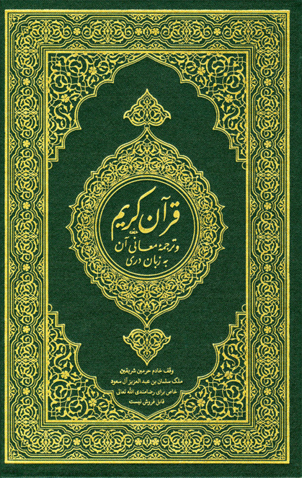
QUR'ANIC PASSAGES RETRIEVAL (DLALAT)
ARTIFCIAL INTELLIGENCE DEPARTMENT, KING ABDULLA II SCHOOL FOR INFORMATION TECHNOLOGY, UNIVERSITY OF JORDAN, AMMAN - JORDAN.
Abdullah Mohammad Abuzeidan - 0201393
Abdulelah Mohd Santrisi - 0205589
Zaid Bassam Al-Surakhi - 2200142
Supervised By:
Dr. Mousa Al-Akhras

Slide 2


Introduction
The Holy Qur'an is a central text in Islam, containing spiritual, moral, and legal guidance for Muslims. With the advancement of technology, web chatbot services have become a popular medium for disseminating information and facilitating discussions. This report explores the development of a web chatbot that offers detailed insights into the Qur'an using the capabilities of the BERT model. The chatbot's primary function is to receive free-text questions in MSA and return a ranked list of passages that potentially contain relevant answers highlighting the answer if found.

Slide 3

Problem Statement
The challenge is to design a system that effectively understands user questions, retrieves relevant Qur'anic passages, and ranks them based on their likelihood of containing pertinent answers, the system then searches these passages for answers.
This involves leveraging the capabilities of the BERT & ELECTRA models to retrieve coherent and informative responses while ensuring that the system remains accurate and respectful of the sacred text.

Slide 4







Project Aim and Objectives
Developing a web chatbot service for Qur'anic analysis.
Implementing a system that interprets free-text questions in MSA.
Creating a collection of Qur'anic passages that cover various aspects of the Holy Qur'an.
Utilizing the BERT model to retrieve detailed responses.
Ranking passages based on their potential to contain relevant answers.
Handling both factoid and non-factoid questions to provide informative responses.

Slide 5
Dataset
Introduction:
The primary dataset for this project consists of the Holy Qur'an translated into text format, it contains 1,266 thematic Qur'anic passages that cover the whole Holy Qur'an. Additionally, a collection of factoid and non-factoid questions related to various aspects of the Qur'an is compiled to assess the system's performance. The system relies on these datasets to provide accurate and informative responses.
Source and Composition:
The primary dataset for this project is sourced from a JSON file named quran-data.json. This dataset includes Quranic verses, detailed with surah number, verse range, and passage text. Additional sources might include external databases for linguistic patterns, semantic databases, and other religious texts for comparative analysis.

Slide 6
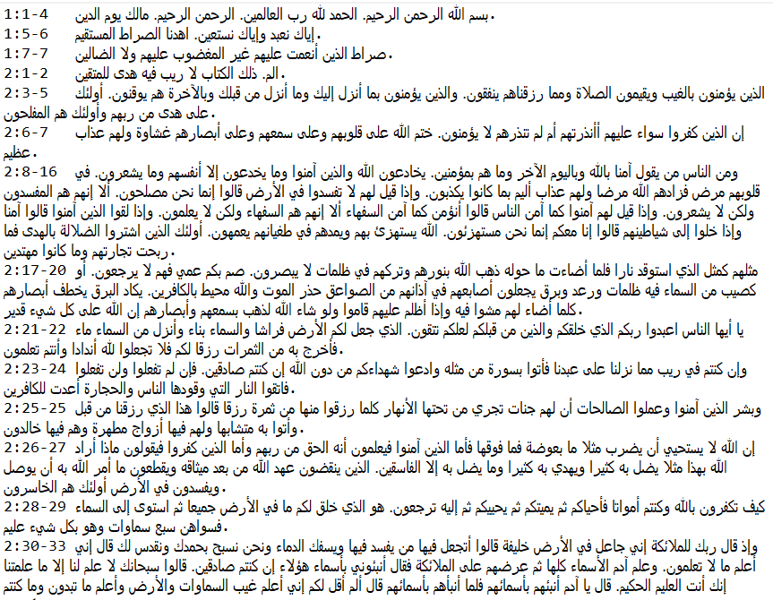
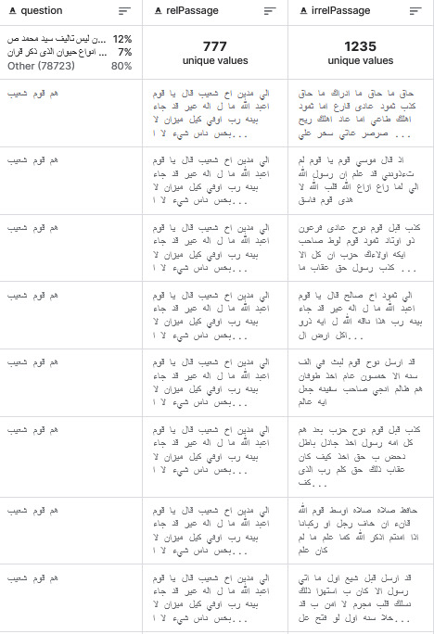
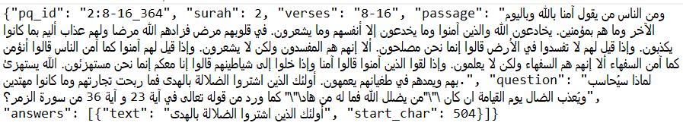
Dataset
Task A: (PA) Passage Retrieval
Task B: (QA) Question Answering
Qur'an Passage Collection (QPC) Task A
Task A Train Dataset
Qur'anic Reading Comprehension Dataset (QRCD) Task B

Slide 7
Data Preprocessing:
Text Cleaning
Stopword Removal
Farasa stemmer
Tokenization
The qur'anic passages where embedded using our trained BERT model, these embeddings where the indexed using FAISS.

Slide 8
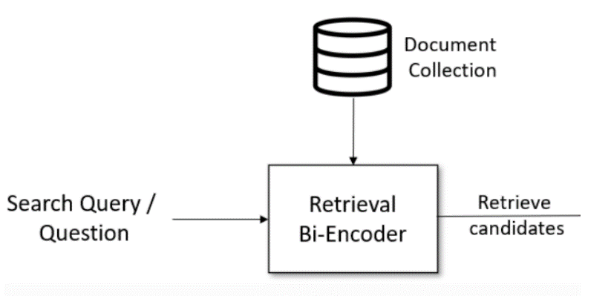
Model Reports
Task A (Passage Retrieval):
Given a free-text question in Modern Standard Arabic (MSA), the task requires retrieving and ranking relevant Quran verses that potentially contain the answer. Pretraining the multiple negative ranking loss was used to pretrain the CL-AraBERT model on our dataset. The triplet loss function was used to finetune the CL-AraBERT model.
Loss=max ((1-cosinesim(anchor, positive)) - (1-cosinesim(anchor, negative)) +margin, where margin is a hyper-parameter that specifies the minimum distance between the similarities between (anchor, positive) and (anchor, negative).
Encoder

Slide 9
Model Reports
Data: The data contains 30 zero-answer questions across splits.
Results:
Dataset | #Questions | #Question-Passage Pairs
Training | 174 | 972
Development | 25 | 160
Epochs | 10
Batch Size | 16
Learning Rate | 2e-5
MAP | 0.40
MRR | 0.60

Slide 10
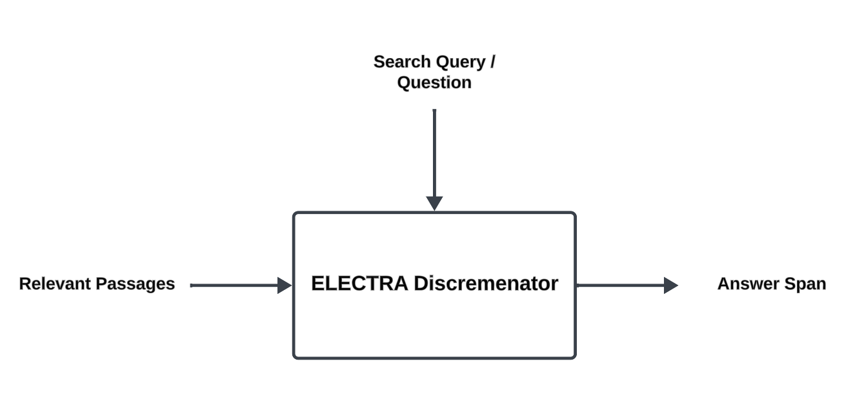
Model Reports
Task B (Question Answering):
The Question Answering task extracts answer spans from retrieved passages by reading and understanding the verses given a question. Model used AraELECTRA.
Total span extraction loss: the sum of a Cross-Entropy for the start and end positions. The model is trained on the preprocessed and augmented dataset with continuous monitoring for performance and potential overfitting.

Slide 11
Model Reports
Data: To simplify the structure of the dataset, each tuple contains one passage, one question and a list that may contain one or more answers to that question.
Results:
Dataset | # Questions | # Question-Passage Pairs | # Question-Passage-Answer Triplets
Training | 174 | 992 | 1179
Development | 25 | 163 | 220
Epochs | 32
Batch Size | 4
Learning Rate | 4e-5
F1-score | 0.70
Exact Match | 0.72

Slide 12
Approach
Methodology:
The project follows a comprehensive NLP methodology, starting from data acquisition, preprocessing, model training, and post-processing of results. Advanced techniques in data augmentation, semantic analysis.
Custom model layers
Indexing Passage Embeddings
Future Scope and Scalability

Slide 13
Approach
Flask:
Lightweight: Flask is a micro-framework, meaning it's minimalistic and doesn't have a lot of built-in features. This makes it efficient for building RESTful APIs or web applications without unnecessary overhead.
Pythonic: Since Flask is based on Python, it integrates seamlessly with Python-based machine learning libraries such as TensorFlow, PyTorch, or Scikit-learn. This allows for smooth integration of machine learning models into Flask applications.
Flexibility: Flask provides the flexibility to design APIs and web applications according to specific project requirements. It allows developers to structure their code in a way that best suits the needs of the machine learning model and the application as a whole.

Slide 14
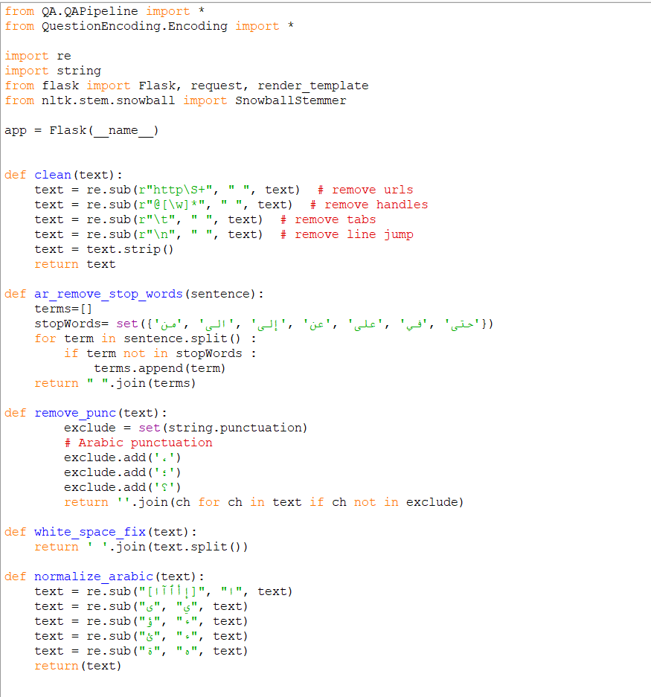
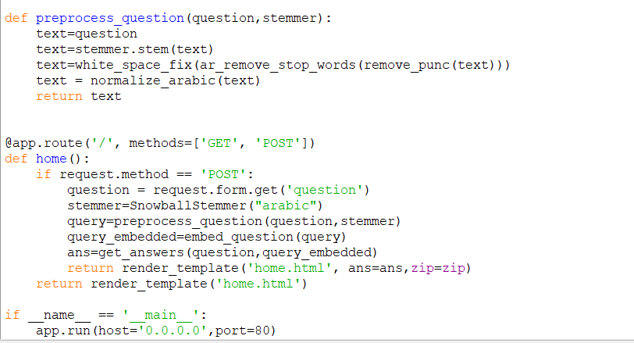
Approach
Flask:

Slide 15
Approach
Docker:
Containerization: Docker allows for packaging applications and their dependencies into containers. This ensures consistency in deployment across different environments, from development to production. Containers encapsulate everything needed to run the application, including libraries, dependencies, and configuration settings.
Portability: Docker containers can run on any platform that supports Docker, making it easy to deploy machine learning models consistently across different cloud providers or on-premises infrastructure. This portability reduces the risk of compatibility issues and streamlines deployment processes.
Scalability: Docker enables horizontal scaling by spinning up multiple containers to handle increased workloads. This makes it well-suited for deploying machine learning models that may experience varying levels of demand or require distributed computing resources.

Slide 16
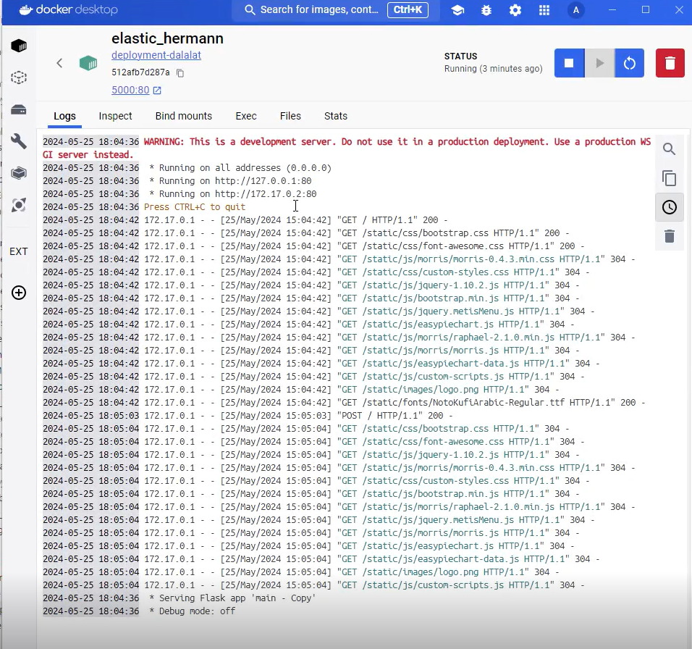
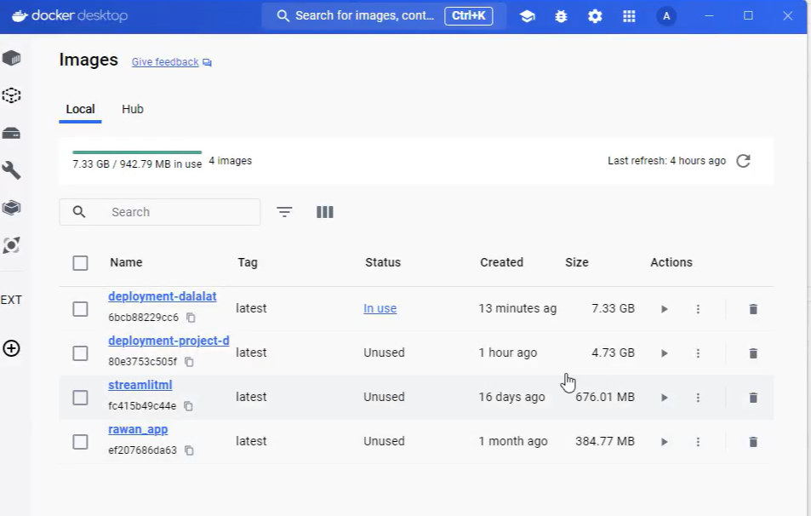
Approach
Docker:

Slide 17
Conclusion
Overall Weaknesses:
While the chatbot represents a significant stride in digital religious studies, it exhibits certain limitations. These include challenges in comprehending the deep contextual and theological nuances of the Qur'anic text, potential biases in the BERT model, and the inherent complexities of translating sacred texts into a format understandable by AI. Moreover, ensuring the respect and reverence due to the sacred text in every interaction remains a delicate balance.
Overall Strengths:
Despite these challenges, the chatbot stands as a testament to technological innovation in the service of religious education. Its strengths lie in its ability to make Qur'anic teachings more accessible to a wider audience, provide quick and relevant responses to users’ queries, and support a diverse range of question types. Additionally, its user-friendly interface and the integration of advanced AI technology make it a pioneering tool in religious studies and digital humanities.

Slide 18
Future Work
Looking ahead, several enhancements are envisioned for the chatbot. These include improving its understanding of complex theological concepts, expanding its database to include more diverse interpretative readings of the Qur'an, and integrating more languages to reach a broader audience. Additionally, continuous updates to the BERT model and user feedback mechanisms will be crucial in evolving the chatbot's accuracy and relevance. Collaborations with Islamic scholars and technologists could further refine its capabilities, ensuring it remains a respectful and informative portal to Qur'anic wisdom.

Slide 19


Thank You For Listening

