Slide 1
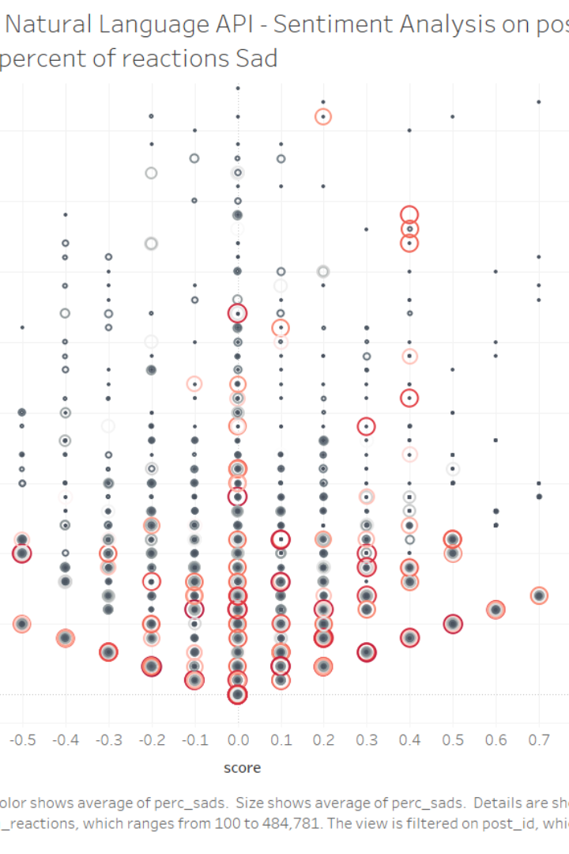
Introduction
The project focuses on sentiment analysis in movie reviews. It introduces an approach for analyzing sentiments in movie reviews by leveraging a dataset rich in movie reviews. The study aims to address the limitations of traditional sentiment analysis methods, which often provide a general view of sentiments but lack depth in capturing the multifaceted nature of movie reviews.

Slide 2
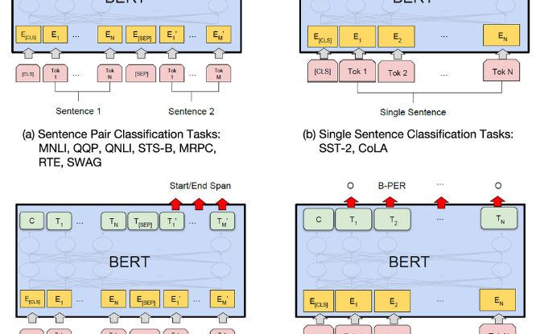
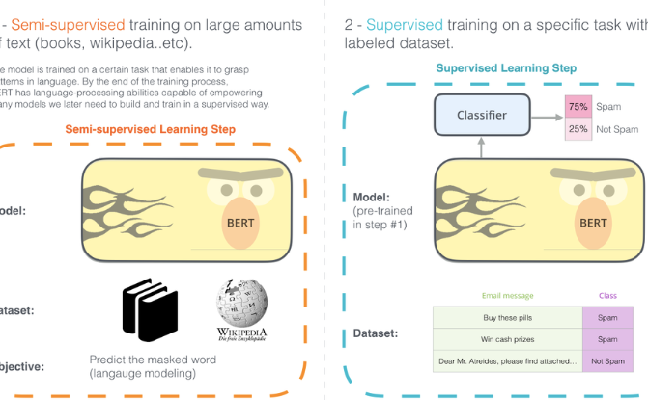
What is BERT and How Does It Work?
BERT Architecture
Key Principles of BERT
BERT (Bidirectional Encoder Representations from Transformers) is a transformer-based model designed to understand the context of words using bidirectional processing, allowing it to capture relationships between words in a sentence.
BERT utilizes attention mechanisms to emphasize relevant words, and its pre-training on large text corpora enables the model to grasp the nuances of language and context.

Slide 3

Datasets:
The Sentiment Labelled Sentences Data Set, introduced by Kotzias et al. in the paper 'From Group to Individual Labels using Deep Features' (KDD 2015) , has a size of 334 KB. This dataset comprises sentences annotated with either a positive or negative sentiment, extracted from three distinct websites/fields: imdb.com, amazon.com, and yelp.com. Each of these websites contributes 500 positively labeled and 500 negatively labeled sentences, randomly selected from larger review datasets.

Slide 4
Preprocessing Text Data
removeStopWords: Removes common English stop words from the text.
stem: Applies stemming using the Snowball Stemmer to reduce words to their root form.
removeURL: Removes URLs from the text using a regular expression.
removeTags: Removes HTML tags from the text using a regular expression.
removeEmoji: Removes emojis from the text using a regular expression.
removeBetweenBrackets: Removes text between square brackets from the text using a regular expression.
encodeTarget: Encodes categorical target columns using label encoding.
augmentText: Augments text data with labels using the specified augmentation technique (nlpaug).

Slide 5
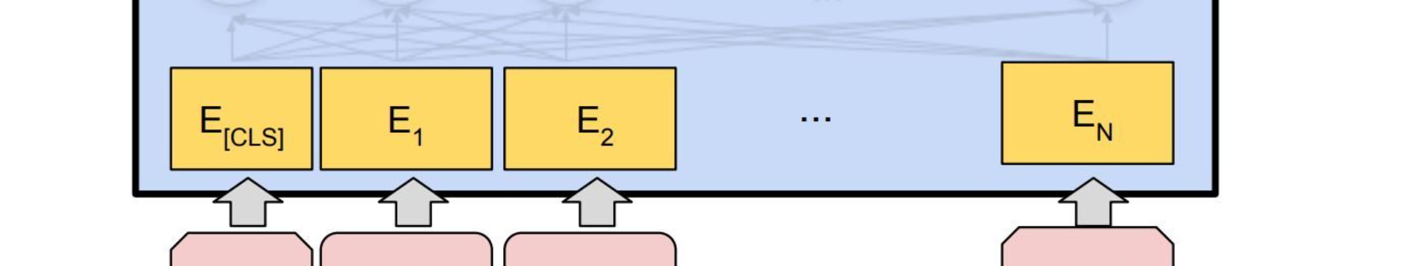
Fine-Tuning BERT for Sentiment Analysis
1
Objective Definition
2
Training Strategy
3
Validation and Iteration
Clearly defining the sentiment analysis task and the specific emotions or sentiments to be classified.
Choosing appropriate hyperparameters, optimization algorithms, and learning rates for fine-tuning BERT on the sentiment analysis dataset.
Performing iterative validation and fine-tuning to enhance BERT's performance for sentiment analysis tasks.

Slide 6
Evaluating the Performance of BERT
We ran the code 48 times to gain multiple results and extract the best out. In Run 23, where the model was exclusively trained on the raw dataset over 9 epochs with a learning rate of 5e-05, commendable results were achieved. The validation phase displayed a loss of 0.49 and an accuracy of 92.5%, with the testing phase echoing these figures at 0.29 for loss and 95% for accuracy. This highlights the model's ability to generalize effectively to new data while relying solely on the original, unaltered dataset.

Slide 7
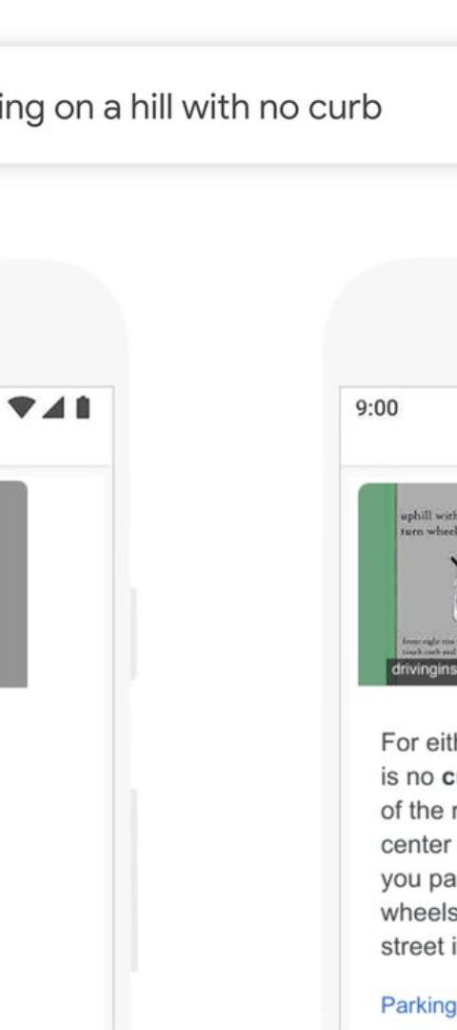
Limitations and Challenges of Using BERT for Sentiment Analysis
Data Dependency
Model Complexity
BERT's performance heavily relies on the quality and diversity of the training dataset, making it susceptible to biases and imbalances.
The computational resources required for training and inference with BERT can be significant, posing challenges for resource-constrained environments.
Domain Adaptation
Adapting BERT to specific domains or jargons may require extensive fine-tuning to ensure accurate sentiment analysis results.

Slide 8
SWOT Analysis for Sentence-Level Sentiment Analysis
Strengths
Weaknesses
Accurate identification of sentiment in individual sentences
Challenges with Rare and Uncommon Words
Ability to handle large volumes of text data
Difficulty in handling negations and double negatives
Useful for analyzing customer feedback and social media sentiment
Dependent on the quality and diversity of training data
Opportunities
Threats
Integration with other natural language processing techniques
Emergence of new sentiment analysis techniques
Improvement in handling complex sentence structures
Influence of External Events
Subjectivity and Differing Opinions
Expansion to different languages and domains

