Slide 1
EECE 350 Computer Networks
Spring 2015

Slide 2

















Transport services and protocols
application
transport
network
data link
physical
provide logical communication between app processes running on different hosts
transport protocols run in end systems
more than one transport protocol available to apps
Internet: TCP and UDP
logical end-end transport
application
transport
network
data link
physical

Slide 3
Transport vs. network layer
network layer: logical communication between hosts
transport layer: logical communication between processes
relies on, and can enhance, network layer services

Slide 4
Internet transport-layer protocols
reliable, in-order delivery (TCP)
congestion control
flow control
connection setup
unreliable, unordered delivery: UDP
no-frills extension of “best-effort” IP
services not available:
delay guarantees
bandwidth guarantees
application
transport
network
data link
physical
network
data link
physical
network
data link
physical
network
data link
physical
logical end-end transport
network
data link
physical
network
data link
physical
network
data link
physical
network
data link
physical
application
transport
network
data link
physical

Slide 5

Multiplexing/demultiplexing
multiplexing at sender:
handle data from multiple
sockets, add transport header (later used for demultiplexing)
demultiplexing at receiver:
use header info to deliver
received messages to correct
socket
application
application
P1
P2
application
socket
P3
transport
P4
process
transport
network
transport
network
link
network
link
physical
link
physical
physical

Slide 6
How de/multiplexing works
host receives IP datagrams
each datagram has source IP address, destination IP address
datagram may carry a transport-layer “segment”
each segment has source, destination port number
host uses IP addresses & port numbers to direct segment to appropriate socket
32 bits
source port #
dest port #
other header fields
application
data
(payload)
segment format

Slide 7
UDP: User Datagram Protocol [RFC 768]
“no frills,” “bare bones” Internet transport protocol
“best effort” service, UDP messages may be:
lost
delivered out-of-order to app
connectionless:
no handshaking between UDP sender, receiver
each UDP message handled independently of others
UDP use:
streaming multimedia apps (loss tolerant, rate sensitive)
DNS (domain name)
SNMP (network management)
reliable transfer over UDP:
add reliability at application layer
application-specific error recovery!

Slide 8
UDP header
length, in bytes of UDP message, including header
32 bits
source port #
dest port #
length
checksum
why is there a UDP?
no connection establishment (which can add delay)
simple: no connection state at sender, receiver
small header size
no congestion control: UDP can blast away as fast as desired
application
data
(payload)
UDP message format

Slide 9
UDP Header
source port (16 bits) - could be zero if not used
destination port (16 bits)
UDP message length (16 bits) - header and data
UDP checksum (16 bits)
optional for low overhead
check that data arrives correctly
uses a pseudo-header in computation

Slide 10
UDP Pseudo-Header
Verifies that UDP datagram reaches its correct destination
specific machine and specific protocol port
UDP on the sending machine computes a checksum that covers the IP addresses and the UDP datagram
Since the IP is a layer “below” this, we must copy the IP addresses into a pseudo-header

Slide 11
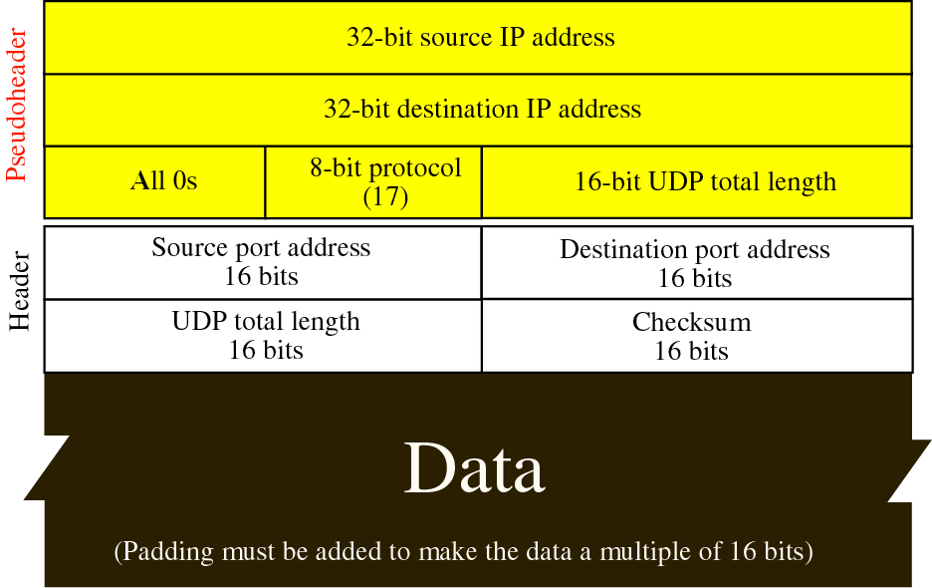
UDP Pseudo-Header

Slide 12
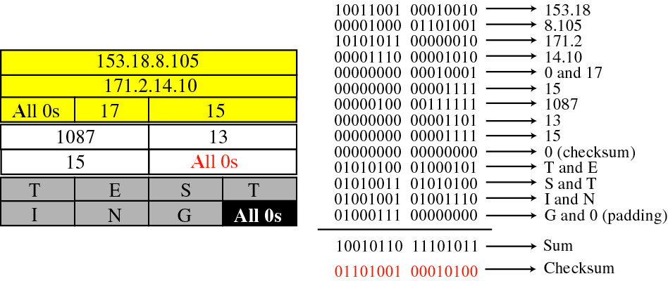
Example Checksum Calculation
UDP datagram going from IP address 153.18.8.105, port 1087 to IP address 171.2.14.10, port 13. The UDP message is “TESTING”

Slide 13
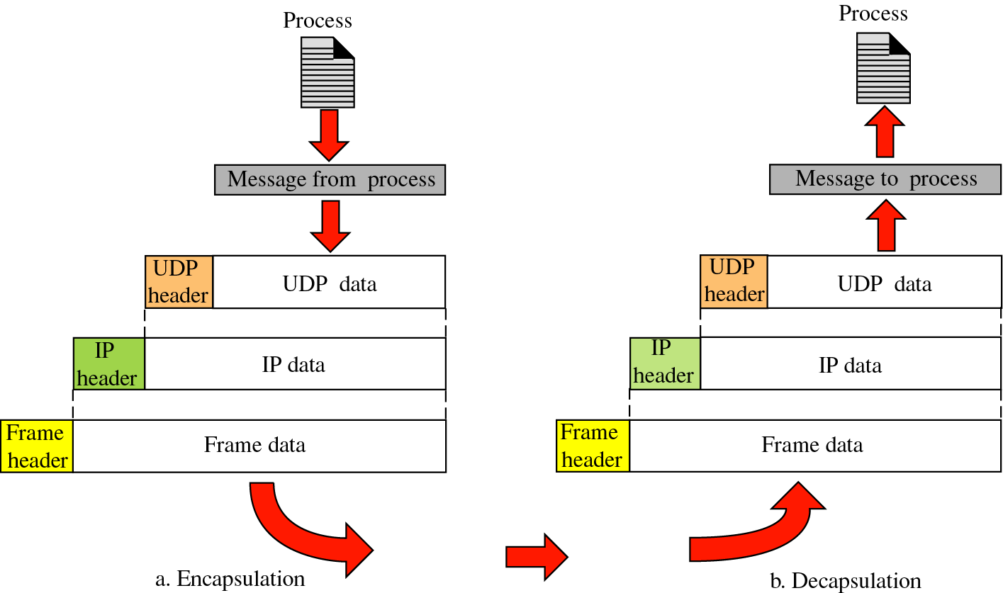
Encapsulation and Decapsulation two hosts on the same subnet

Slide 14
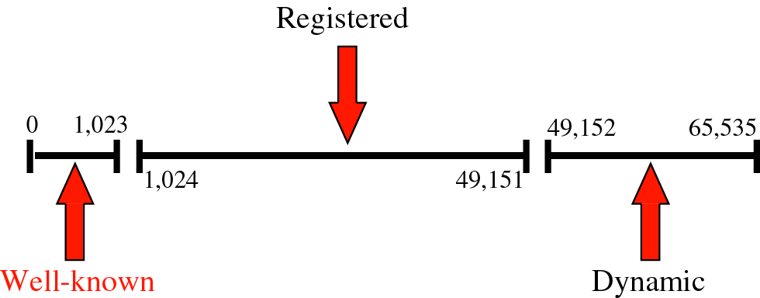
UDP Port Numbers
Computers need to agree on port numbers and their meaning
Well-known ports are permanently assigned for specific applications
Dynamic binding
assigned by the network software when a program needs a port

Slide 15
Well-Known UDP Port Numbers
Port Number | Service
7 | Echo
9 | Discard
13 | Daytime
37 | Time
53 | Domain
69 | TFTP
161 | SNMP
514 | Syslog
520 | Routed (RIP)

Slide 16
NAT: network address translation
rest of
Internet
local network
(e.g., home network)
10.0.0/24
10.0.0.1
10.0.0.4
10.0.0.2
138.76.29.7
10.0.0.3
all datagrams leaving local
network have same single source NAT IP address: 138.76.29.7,different source port numbers
datagrams with source or
destination in this network
have 10.0.0/24 address for
source, destination (as usual)

Slide 17
NAT: network address translation
motivation: local network uses just one IP address as far as outside world is concerned:
range of addresses not needed from ISP: just one IP address for all devices
can change addresses of devices in local network without notifying outside world
can change ISP without changing addresses of devices in local network
devices inside local net not explicitly addressable, visible by outside world (a security plus)

Slide 18
NAT: network address translation
implementation: NAT “router” must:
outgoing datagrams: replace (source IP address, port #) of every outgoing datagram to (NAT IP address, new port #)
. . . remote clients/servers will respond using (NAT IP address, new port #) as destination address
remember (in NAT translation table) every (source IP address, port #) to (NAT IP address, new port #) translation pair
incoming datagrams: replace (NAT IP address, new port #) in destination fields of every incoming datagram with corresponding (source IP address, port #) stored in NAT table

Slide 19
NAT: network address translation
NAT translation table
WAN side addr LAN side addr
2: NAT router
changes datagram
source addr from
10.0.0.1, 3345 to
138.76.29.7, 5001,
updates table
1: host 10.0.0.1
sends datagram to
128.119.40.186, 80
138.76.29.7, 5001 10.0.0.1, 3345
…… ……
S: 10.0.0.1, 3345
D: 128.119.40.186, 80
10.0.0.1
1
2
S: 138.76.29.7, 5001
D: 128.119.40.186, 80
10.0.0.4
10.0.0.2
138.76.29.7
S: 128.119.40.186, 80
D: 10.0.0.1, 3345
4
S: 128.119.40.186, 80
D: 138.76.29.7, 5001
3
10.0.0.3
4: NAT router
changes datagram
dest addr from
138.76.29.7, 5001 to 10.0.0.1, 3345
3: reply arrives
dest. address:
138.76.29.7, 5001

Slide 20
DNS: domain name system
people: many identifiers:
ID number, name, passport #
Internet hosts, routers:
IP address (32 bit or 128 bit)
“name”, e.g., www.yahoo.com - used by humans
Q: how to map between IP address and name, and vice versa ?
Domain Name System:
distributed database implemented in hierarchy of many name servers
application-layer protocol: hosts, name servers communicate to resolve names (address/name translation)
note: core Internet function, implemented as application-layer protocol
complexity at network’s “edge”

Slide 21
DNS: services, structure
DNS services
hostname to IP address translation
host aliasing
canonical, alias names
mail server aliasing
load distribution
replicated Web servers: many IP addresses correspond to one name
why not centralize DNS?
single point of failure
traffic volume
distant centralized database
maintenance
A: doesn’t scale!

Slide 22
DNS: a distributed, hierarchical database
Root DNS Servers
…
…
com DNS servers
org DNS servers
edu DNS servers
yahoo.com
DNS servers
ieee.org
DNS servers
aub.edu
DNS servers
mit.edu
DNS servers
amazon.com
DNS servers
client wants IP for www.amazon.com; 1st approx:
client queries root server to find com DNS server
client queries com DNS server to get amazon.com DNS server
client queries amazon.com DNS server to get IP address for www.amazon.com

Slide 23
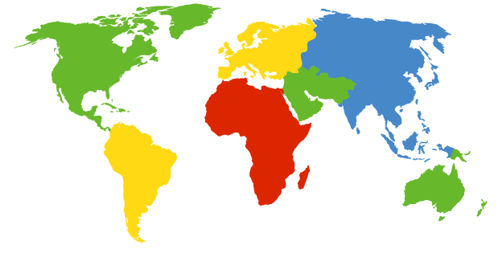
DNS: root name servers
contacted by local name server that can not resolve name
root name server:
contacts authoritative name server if name mapping not known
gets mapping
returns mapping to local name server
c. Cogent, Herndon, VA (5 other sites)
d. U Maryland College Park, MD
h. ARL Aberdeen, MD
j. Verisign, Dulles VA (69 other sites )
k. RIPE London (17 other sites)
i. Netnod, Stockholm (37 other sites)
e. NASA Mt View, CA
f. Internet Software C.
Palo Alto, CA (and 48 other sites)
m. WIDE Tokyo
(5 other sites)
13 root name “servers” worldwide
a. Verisign, Los Angeles CA
(5 other sites)
b. USC-ISI Marina del Rey, CA
l. ICANN Los Angeles, CA
(41 other sites)
g. US DoD Columbus, OH (5 other sites)

Slide 24
TLD, authoritative servers
top-level domain (TLD) servers:
responsible for com, org, net, edu, …, and all top-level country domains, e.g.: uk, fr, ca, jp, lb
authoritative DNS servers:
organization’s own DNS server(s), providing authoritative hostname to IP mappings for organization’s named hosts
can be maintained by organization or service provider

Slide 25
Local DNS name server
does not strictly belong to hierarchy
each ISP (residential ISP, company, university) has one
also called “default name server”
when host makes DNS query, query is sent to its local DNS server
has local cache of recent name-to-address translation pairs (but may be out of date!)
acts as proxy, forwards query into hierarchy

Slide 26
DNS name resolution example
root DNS server
2
host at cis.poly.edu wants IP address for gaia.cs.umass.edu
3
TLD DNS server
4
5
iterated query:
contacted server replies with name of server to contact
“I don’t know this name, but ask this server”
local DNS server
dns.poly.edu
7
6
1
8
authoritative DNS server
dns.cs.umass.edu
requesting host
cis.poly.edu
gaia.cs.umass.edu

Slide 27
DNS name resolution example
root DNS server
2
3
recursive query:
puts burden of name resolution on contacted name server
heavy load at upper levels of hierarchy?
7
6
TLD DNS
server
local DNS server
dns.poly.edu
5
4
1
8
authoritative DNS server
dns.cs.umass.edu
requesting host
cis.poly.edu
gaia.cs.umass.edu

Slide 28
DNS: caching, updating records
once (any) name server learns mapping, it caches mapping
cache entries timeout (disappear) after some time
TLD servers typically cached in local name servers
thus root name servers not often visited
cached entries may be out-of-date
if host changes IP address, may not be known Internet-wide until all cached entries expire

