Slide 1
DeepMutation: Improving Mutation Testing of Deep Neural Networks
Master Thesis
Abdulhayyu H. Lawal
Universität Passau
Chair of Software Engineering II
Prof. Dr. Gordon Fraser
Supervisor: Dr. Alessio Gambi
04 December 2019
DeepMutation
1
Notes:
1

Slide 2
Introduction
Deep Learning
Important concept in many application domains such as self-driving vehicles, image recognition, speech recognition…
Network learns more when there is more training examples. Hence, improving accuracy
Prof. Dr. Ralf Krestal, Uni-Passau
DeepMutation
2
Notes:
2

Slide 3
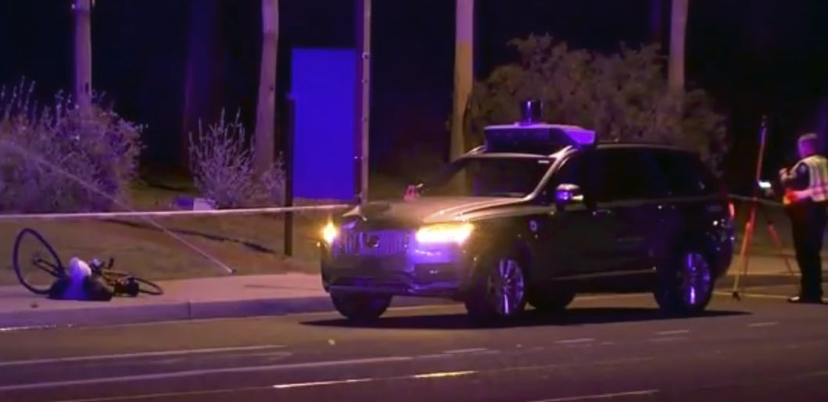
The Problem
Tremendous success, but
Robustness and quality remain a major concern
Present a big challenge more especially in safety-critical systems
Defective DL may lead to catastrophic accidents, consequences
Can easily be fooled with adversarial samples
Uber autonomous car accident in March 2018
Led to a pedestrian death
https://www.theguardian.com/technology/2018/mar/19/uber-self-driving-car-kills-woman-arizona-tempe#img-2
DeepMutation
3
Notes:
3

Slide 4
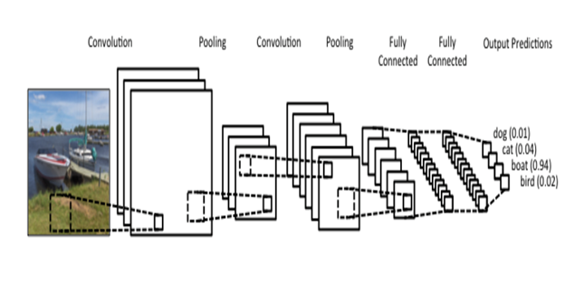
Deep Neural Networks (DNNs)
Convolutional Neural Networks (CNNs)
Multi-hidden layer neural network architecture, well-adapted to classify images
Uses examples to automatically infer rules for recognizing handwritten digits
Fully connected-layers, each trains on a distinct set of features based on previous layer’s output
The deeper the layer, the more accuracy
LeNet 5 architecture is considered to be used,
Suitable for handwritten and machine-printed character recognition
http://deeplearning.net/tutorial/lenet.html
DeepMutation
4
Notes:
4

Slide 5

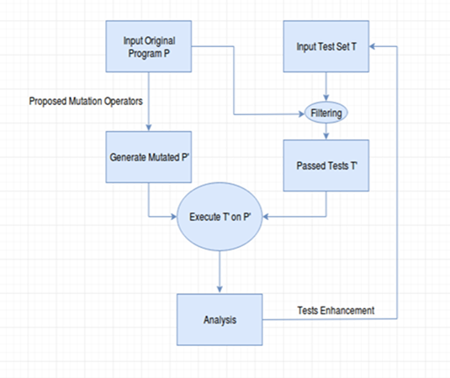
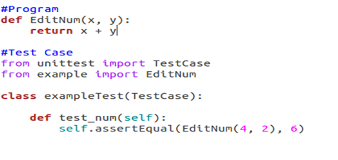

Why Mutation Testing of DL?
Why Testing in general?
Point out defects, errors (Reliable functioning), robustness & accuracy
DNNs are known to be vulnerable to adversarial sample
Can be improved through mutation testing by examining their performance on test dataset
a fault-based technique for quality evaluation of test suites
mutation operators to create mutated copy of original
execute test suites to catch and kill introduced mutants
mutation score =
ratio of #killed_mutants against total #all_generated_mutants
evaluate test suites and determine test dataset quality
examine test dataset to gain confidence of the trained model
- Running the same test case, the T` will fail
DeepMutation
5
Notes:
5

Slide 6
Start-of-the for testing NN
Multiple approaches to improve robustness of the DNN models
Many research to turn MT into practice
But, very few research specifically and directly apply MT to DL systems
Lei Ma et.al 2018, first well-known approach
Training cost and equivalent mutants problem are major limitations
Though, MT improves the DNN robustness to some extent by examining performance on test data quality
More adequate MT on the dataset is required to increase robustness to max
Test to cover more aspects and their impact analyzed (Thesis focus)
DeepMutation
6
Notes:
6

Slide 7
Motivation
Deep high-performing DNNs can be fooled by intentionally constructed samples
Adversarial samples or mutants, exposing DNNs lack of robustness
Improvement of DL models need to be increased
A test like MT can be very useful
This thesis will apply MT on CNN adapting Lei et.al approach to improve the testing of DNNs
Proposing versatile mutation operators to cover more diverse aspects
Investigating the relations of the operators and their impacts
Further demonstrating the usefulness of the technique
More diverse mutant and test coverage will enhance the evaluation
DeepMutation
7
Notes:
7

Slide 8
Why Lei et.al 2018 Approach?
Due to DL architectural designs, traditional testing technique cannot be applied directly
Lei Ma et. al 2018 proposed a framework suitable for DL
One of very few approach to inject mutants to NN
Designed source and model-level mutation operators directly
Repeating the approach will provide;
an efficient way to apply MT on DL systems
a path to investigate further more on mutation operators coverage and their impact
Double check findings of the authors
DeepMutation
8
Notes:
8

Slide 9
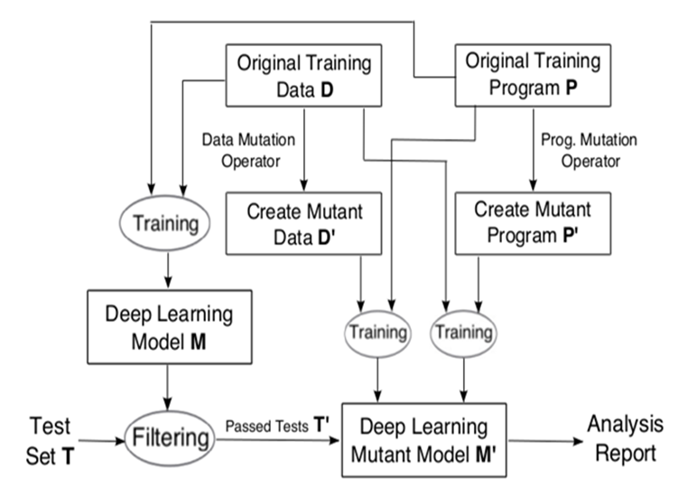
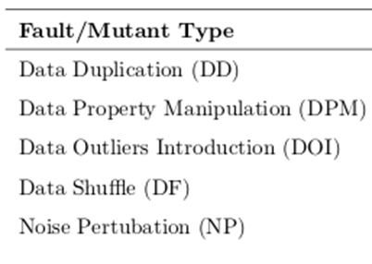
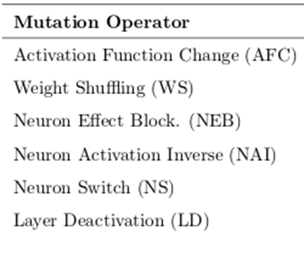
Implementation
Dataset:
Either MNIST, – 10% as test data
Proposed mutation operators:
Manuel and automatic generation using mutants using DeepMutation++ framework tool. Mutpy
Setup:
Based on Keras 2.3.2 with Tensorflow 2.0.0 backend
Python 3
Lei et.al 2018
f(x) = f(y)', T’ is executed to catch OPactfuncw
If f(y) != f(y)', OPactfuncw is feasible and is killed
DeepMutation
9
Notes:
9

Slide 10
How good are the tests?
Improving the tests:
Extend coverage in the program
covering diverse aspects of the target parameters, area and relations
mutants impact by analyzing their coverage and class
killed, stubborn or alive
Strong mutation operators for both levels
Enhance test coverage to cover more parts in the program and evaluate test
Test coverage = test_covered_program / all_mutated_program *100%
Covering methods may include;
Sign-Sign , Value-Sign, Sign-Value, and Value-Value coverage
DeepMutation
10
Notes:
10

Slide 11
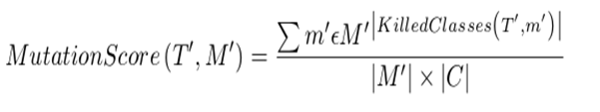


Evaluation Analysis
Qualitative:
Interpret general MT evaluation with statistical inference
Address precision problem when T’ size is large enough
Enhance metric to focus on the classification problem
Solve large behavioral difference between original and mutated data/program
Average error rate
Other evaluation metric (Test accuracy)
F1 Score
Qualitative:
Elaborate MT understanding and usefulness
Report analysis indicating improvement of the test data quality and model’s robustness after examining
Precision: Correct positive (killed) / total predicted positive observations (all introduced mutant)
Recall: Correct positive (killed) / total actual positive (total introduced mutant)
DeepMutation
11
Notes:
11

Slide 12
Conclusion/Contribution
Close implementation similar to Lei Ma et.al 2018 approach
But, different test subject
Different mutation operators (Faults)
Mutation operators to cover more diverse aspects
More mutants and test coverage
Evaluate
Test cases and examine model performance on test dataset to gain confidence
Demonstrate MT usefulness for DL systems
Other contributions of the thesis
A study on cost of mutation testing and equivalent mutant problem (May not be part)
DeepMutation
12
Notes:
12

Slide 13

Thank you for your Attention!
Feedback,
Recommendations,
DeepMutation
13
Notes:
13

