Slide 1
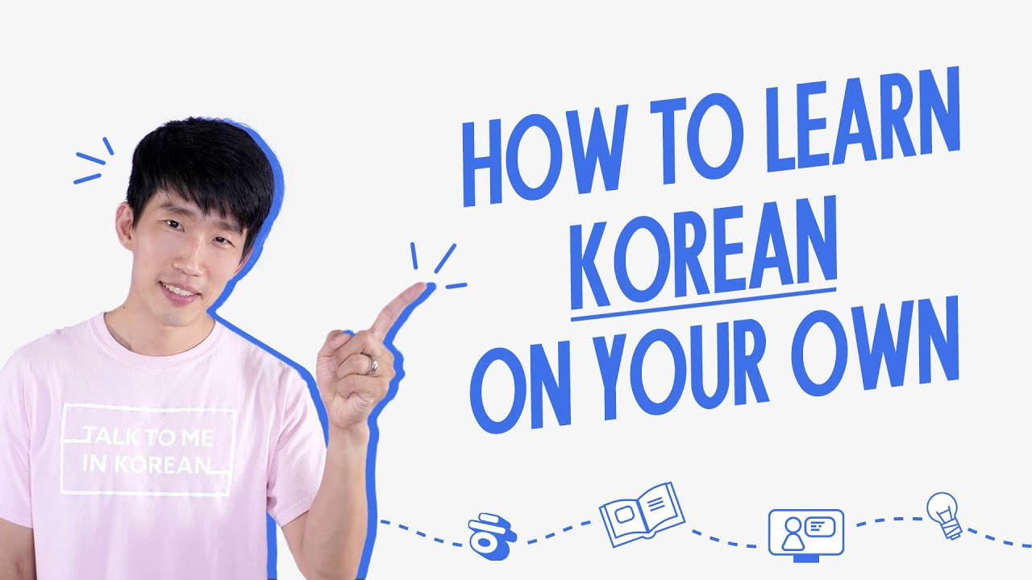
Talk To Me In Korean
YouTube Channel
What if you could learn Korean
without sitting in a classroom?
A Korean-learning system/resource
System Analysis and Design
01
Notes:
[50 seconds]
What if you could learn Korean without sitting in a classroom? TTMIK makes this possible through online educational content. Our task is to analyze the YouTube channel as a learning resource. We look at the learner, the actions available, and the gaps between watching a lesson and being able to use Korean. The system boundary includes TTMIK videos and their organization, together with YouTube playback, discovery, and community features. The wider TTMIK course platform is a separate service. This boundary matters because we should not claim that every feature of the paid platform belongs to the YouTube channel. Our question is how this resource can support effective learning.
Sources (accessed 5 October 2026):
https://www.youtube.com/watch?v=TLgAJgYqIZk
Image: https://img.youtube.com/vi/0KnUyy6pH-U/maxresdefault.jpg

Slide 2
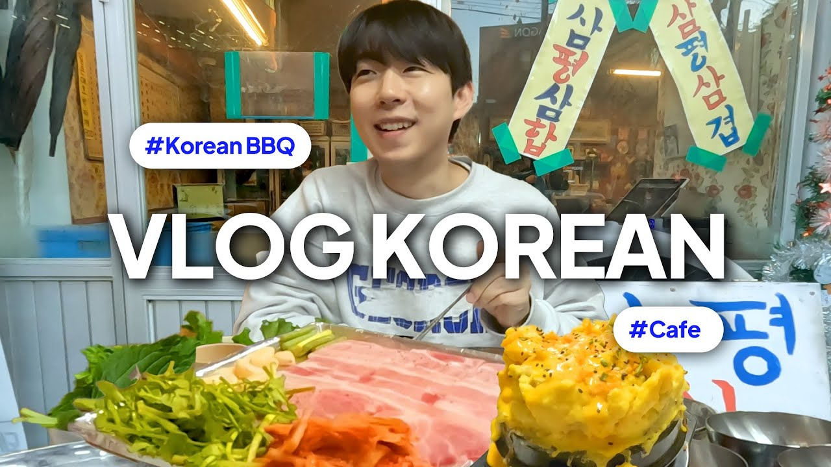
What is TTMIK?
Beginners
Clear grammar and vocabulary
Intermediate learners
Natural speech and listening
Travelers / culture learners
Useful phrases and context
TOPIK learners*
Everyday Korean in context
Supplementary exam practice
Example: a TTMIK restaurant and cafe lesson
*Potential users. A complete TOPIK syllabus needs additional resources.
02
Notes:
[55 seconds]
Talk To Me In Korean provides Korean teaching materials across several services. On YouTube, learners can watch explanations and listen to Korean in real situations. For requirements analysis, we group users by their goals. Beginners need clear explanations and a starting point. Intermediate learners need more natural speech and enough context to understand it. Travelers may want a phrase for ordering food immediately, while culture learners want context for expressions. TOPIK learners are a possible stakeholder group, but the channel should support their wider exam preparation rather than promise a complete syllabus. These groups are analytical assumptions based on the content, not results from a user survey. We would validate them through interviews.
Sources (accessed 5 October 2026):
https://www.youtube.com/watch?v=TLgAJgYqIZk
https://www.youtube.com/watch?v=5n7HFxyE4ZI
https://courses.talktomeinkorean.com/course-curriculum

Slide 3
How does the system help users learn?
1 Find a lesson
2 Watch / listen
3 Learn
Search a topic or playlist
Follow examples and captions
Note vocabulary and grammar
6 Advance
5 Review
4 Practice
Choose harder content
Revisit saved lessons
Repeat aloud and listen again
Learning gap: the learner must create a practice routine and decide what comes next.
03
Notes:
[60 seconds]
This flow describes an intended learner journey, rather than a process that YouTube enforces. First the learner finds a relevant lesson. Then they watch and listen, using captions when available. They identify vocabulary or a grammar pattern and practice by pausing, repeating aloud, and listening again. Saving a lesson makes later review easier. Finally, they move to harder content. The gap is that a viewer can skip practice and review entirely. A video player can record that someone watched a lesson without showing whether they understood it. This suggests requirements for clearer sequencing and evidence of learning. In a proposed companion platform, a short quiz could determine whether to review the same topic or recommend a next lesson.
Sources (accessed 5 October 2026):
https://www.youtube.com/watch?v=TLgAJgYqIZk
Flow and learning-gap assessment: group analysis.

Slide 4
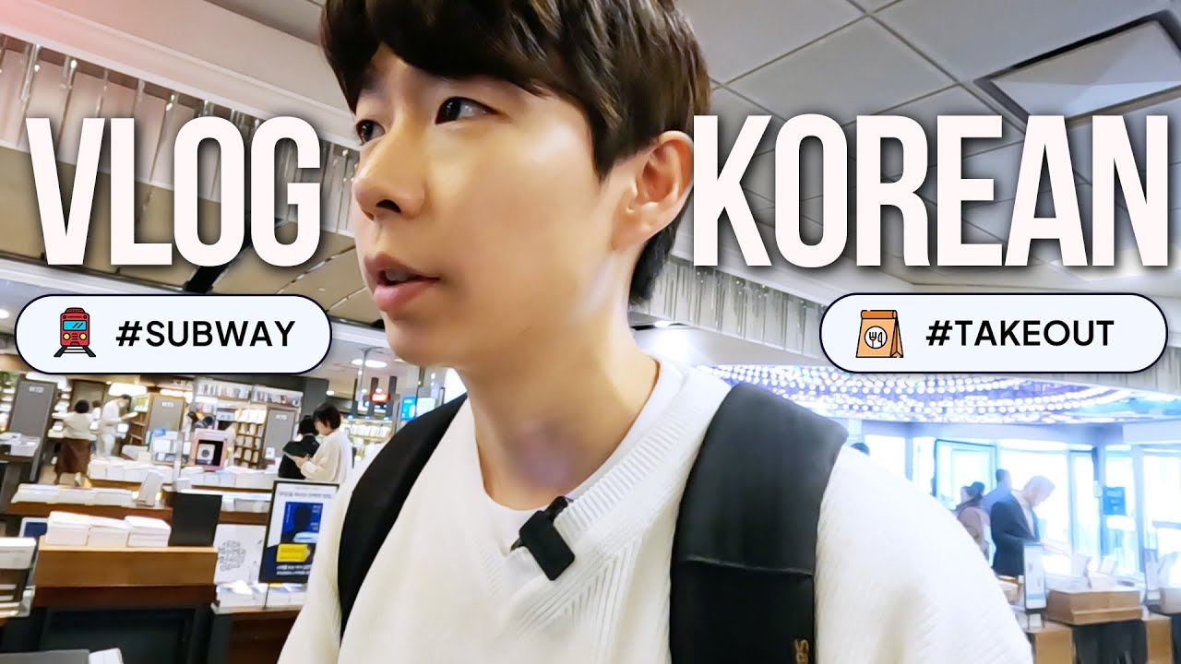
What should the system do?
ID | Learner need | Required function
FR1 | Understand Korean | Lessons, vocabulary and grammar
FR2 | Find a lesson | Search, topic and level organization
FR3 | Use spoken Korean | Listening and pronunciation practice
FR4 | Follow speech | Subtitles / translations when available
FR5 | Review and continue | Save, revisit and recommend lessons
FR6 | Ask questions | Comments and community interaction
Learning content
TTMIK supplies lessons.
YouTube supplies discovery,
playback and interaction.
Requirements trace each platform function to a learner need.
04
Notes:
[65 seconds]
Functional requirements describe the actions that the system should support. Each requirement here traces back to a need. A learner who struggles with a grammar pattern needs an explanation and examples, which becomes FR1. Someone who cannot find the right lesson needs search and clear organization, FR2. Listening and pronunciation practice address the need to use spoken Korean. Captions can help learners follow unfamiliar speech, although their availability differs by video. Saving and recommendations support review and continued study. Comments give learners a way to ask questions, but do not guarantee a teacher reply. Responsibility is shared: TTMIK supplies the educational content and organizes it, while YouTube supplies many platform functions. Difficulty organization is a requirement to evaluate, not a claim that every existing video has a consistent level label.
Sources (accessed 5 October 2026):
https://www.youtube.com/watch?v=TLgAJgYqIZk
Requirements and responsibility mapping: group analysis. Image: https://img.youtube.com/vi/TLgAJgYqIZk/maxresdefault.jpg

Slide 5
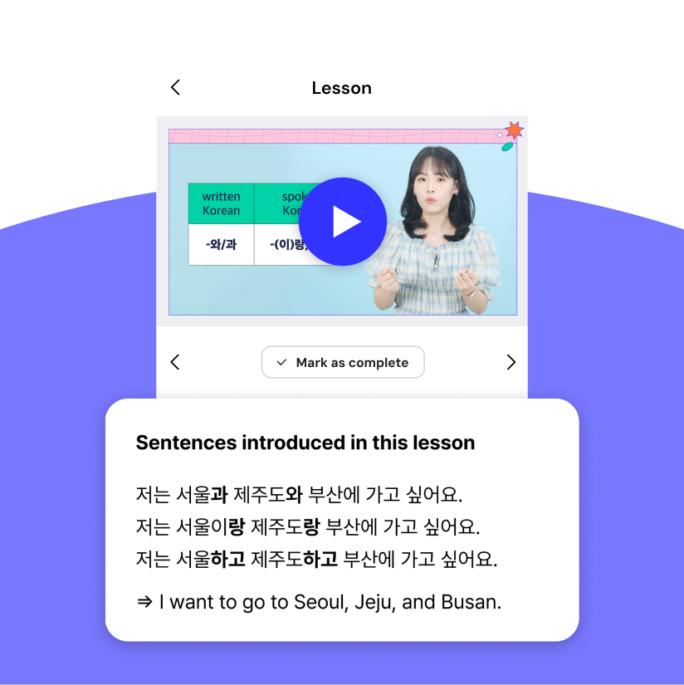
How should the system work?
Usability + learnability
Find a suitable first lesson within 1 minute
Accessibility
Checked captions and playback speed controls
Performance
Start playback within 3 seconds in a defined test
Reliability
Check lesson links every week
Compatibility
Test phone, tablet and laptop access
Visual clarity
Readable titles and captions on mobile
Mobile learning example
TTMIK Courses, separate service
Proposed acceptance targets, not measured performance results.
05
Notes:
[65 seconds]
Non-functional requirements describe the quality of the experience. Saying easy to use is vague, so we need a test: can a new learner find an appropriate starting lesson in one minute? Accessibility includes checked captions and playback speed controls. Speed controls do not replace accurate captions. For performance, we propose a three-second playback start under a defined connection and device test. We are not claiming that TTMIK currently achieves this. Reliability includes checking links and maintaining an organized catalogue. Compatibility means testing core tasks on phones, tablets, and laptops. Visual clarity requires checking text at actual mobile size. Some qualities depend heavily on YouTube and network conditions, so the team should record those dependencies before assigning responsibility for a failure.
Sources (accessed 5 October 2026):
Proposed acceptance criteria: group analysis, not measured service guarantees. Image: https://15th-anniversary.talktomeinkorean.com/image/ttmik-courses_pc.png (separate TTMIK Courses interface).

Slide 6
Strengths and weaknesses
CONTENT ACCESS
LEARNING EVIDENCE
Easy to watch
Harder to verify
+
Free, convenient video access
?
Learners must choose the next lesson
+
Clear explanations for beginners
?
Watching does not show understanding
+
A broad learning catalogue
?
Limited assessment inside the channel
+
Korean instructors and natural speech
?
Watch history does not show mastery
Design opportunity: connect each lesson to practice and a short understanding check.
06
Notes:
[60 seconds]
The channel has several strengths as a resource. Free videos lower the access barrier, and YouTube is convenient for learners who already use it. Explanations can help beginners, while conversations expose learners to natural speech. The weaknesses concern the learning process. A large catalogue can make choosing the next lesson harder. Watching a video does not demonstrate that a student can use a new expression independently. Comments allow interaction but do not provide systematic feedback. Watch history records activity rather than mastery. These are our analytical observations about the channel format, not evidence that TTMIK as a whole lacks educational tools. Its separate course service already offers structured lessons and review quizzes. The design opportunity is to make the route between open videos and active practice clearer.
Sources (accessed 5 October 2026):
https://www.youtube.com/watch?v=TLgAJgYqIZk
https://courses.talktomeinkorean.com/
Strengths and limitations: group analysis.

Slide 7
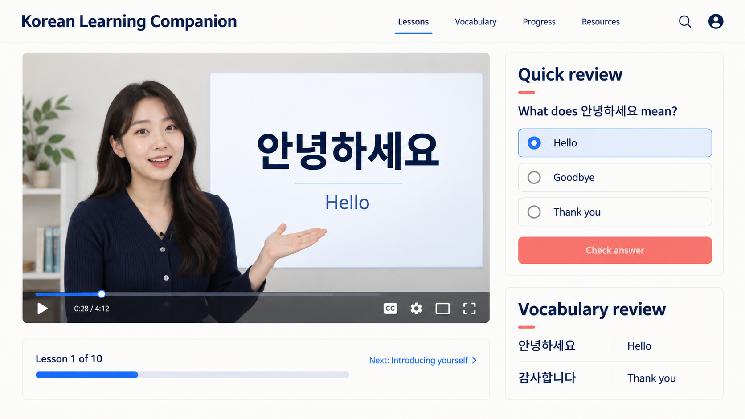
How could the system be better?
Proposed learning companion
FIRST
Level labels + guided paths
FIRST
Quizzes + progress tracking
NEXT
Flashcards + pronunciation
LATER
TOPIK paths + recommendations
LATER
Assessed achievements / certificates
Illustrative concept, not an existing TTMIK interface
07
Notes:
[70 seconds]
We propose a companion layer that links each YouTube lesson to a guided learning activity. Start with consistent level labels and paths, followed by quizzes and progress tracking. For example, after a lesson the learner answers a short check. The system records the result and offers review or an appropriate next lesson. Flashcards support later recall. Speaking tasks can begin with recording and self-comparison before introducing automated feedback. Later features could include an exam-focused path, personalized recommendations, and achievement records. Certificates should reflect assessed completion rather than viewing alone. The illustration shows our proposed companion interface with a quiz, vocabulary review, and progress indicator. The separate TTMIK course service already offers structured lessons and review quizzes. We should reuse or link to existing tools where possible instead of duplicating them. Account integration, permissions, and learner data privacy would need investigation before implementation.
Sources (accessed 5 October 2026):
https://courses.talktomeinkorean.com/
https://15th-anniversary.talktomeinkorean.com/
Visual: AI-generated illustrative companion concept, not an existing product screenshot.
Priorities and integration proposal: group analysis.

Slide 8
Thank You
Valuable content becomes more effective
with structure, practice and feedback.
Is watching a lesson enough
to learn a language?
08
Notes:
[35 seconds]
Our conclusion is that TTMIK YouTube provides valuable Korean-learning content within a familiar digital platform. Requirements analysis helps us connect what learners need with the functions and qualities that support those needs. The most useful improvements are clearer learning paths and checks that show what a student has understood. A connected practice and progress layer could support the learning process while continuing to use the existing videos and TTMIK tools. Thank you. To finish, consider this question: is watching a lesson enough to learn a language? What extra activity would prove that you can actually use what you learned?
Sources (accessed 5 October 2026):
Conclusion: group analysis based on the sources in slides 2, 6 and 7.

